Slide 1
CSCE 190
Computing in the Modern World
Introduction
Fall 2019
Marco Valtorta
mgv@cse.sc.edu
www.cse.sc.edu/~mgv/csce190f19

Slide 2
iClicker
A physical iClicker is required for this course.
The answers you provide will be used to check attendance.
Please turn on your clicker now and enter AA as base station code; AA should be the default, so it is likely that you do not have to change the code.

Slide 3
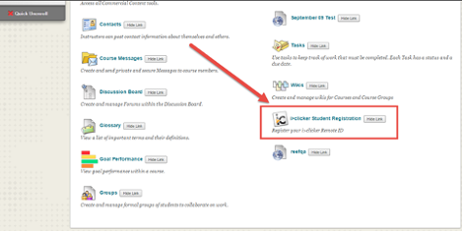
iClicker
This is how the iClicker registration link will appear on the Tools Page.
Notes:
A physical iClicker is required for this course.
The answers you provide will be used to check attendance.
Locate the iClicker Student Registration option on the Tools page. This is how the iClicker registration link will appear for students in your course

Slide 4
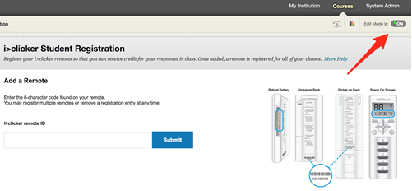
iClicker
If you do not see the iClicker link, it is likely being hidden. Turn on Edit Mode, click the Show Link button to make the link visible, then turn Edit Mode off.
Notes:
A physical iClicker is required for this course.
The answers you provide will be used to check attendance.
Locate the iClicker Student Registration option on the Tools page. This is how the iClicker registration link will appear for students in your course.
If you do not see the iClicker link, it is likely being hidden. Turn on Edit Mode, click the Show Link button to make the link visible, then turn Edit Mode off.

Slide 5
iClicker
Answer the following multiple-choice question.
My major is:
  A. Computer Science
  B. Computer Information System
  C. Computer Engineering
  D. Integrated Information Technology
  E. Other.

Slide 6
iClicker
Answer the following multiple-choice question.
My year is:
  A. First
  B. Second
  C. Third
  D. Fourth
  E. Other.

Slide 7
iClicker
Answer the following multiple-choice question.
I am a transfer student:
  A. Yes
  B. No

Slide 8
iClicker
Answer the following multiple-choice question.
I live in the Rhodos Living and Learning Community
  A. Yes
  B. No

Slide 9
iClicker
Answer the following multiple-choice question.
I belong to the student chapter of a professional organization in Computing
  A. ACM
  B. IEEE
  C. Both
  D. Neither

Slide 10
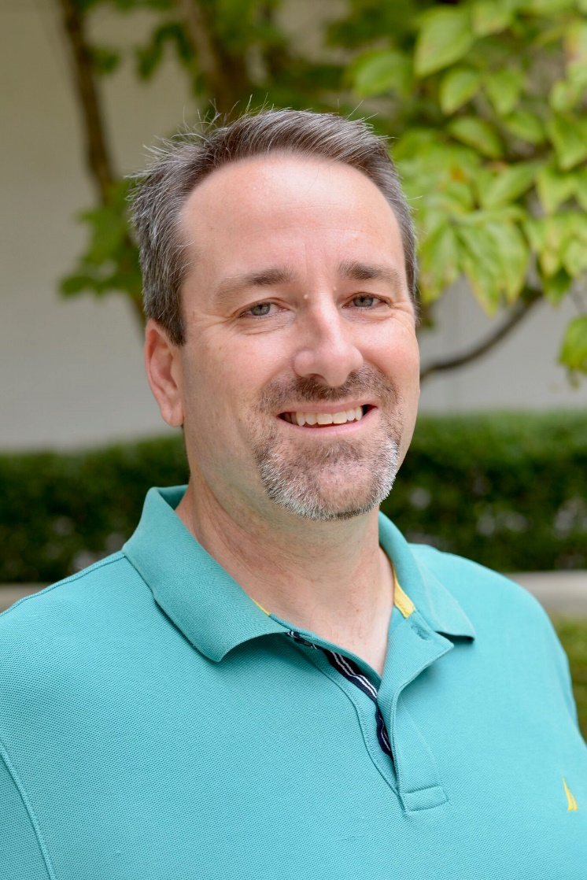
Chair’s Welcome
Prof. Matt Thatcher
Chair, Department of Computer Science and Engineering
College of Engineering and Computing
thatche1@cec.sc.edu

Slide 11
Student Groups
ACM Students
Women in Computing
Minorities in Computing
Cybersecurity @USC
Code-a-Thon (Software Engineering) Group
Carolina Gamers Club
Upsilon Pi Epsilon
IEEE Student Chapter
Most links at https://cse.sc.edu/undergraduate

Slide 12
ACM@USC
Association for Computing Machinery

Slide 13

Weekly meetings featuring graduate and undergraduate lecturers (and pizza).
Monthly meetings with guest lectures including professors and representatives from companies like Apple (and pizza).
Semester Code-A-Thons with prizes.
Fix-It Day!
Trips to competitive CS tournaments (ICPC).
Great network of supportive computer science students currently at the USC and beyond.
Association for Computing Machinery
Interest Meetings this Week:
Wednesday, August 30 @ 7PM in SWGN 2A14
Thursday, August 31 @ 7PM in SWGN 2A14
Questions? Email vmcquinn@email.sc.edu

Slide 14
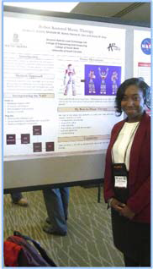
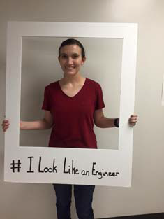
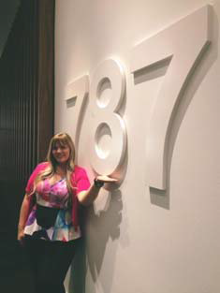
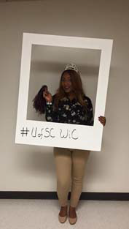
Women in Computing at USC
facebook.com/uofsc.wic
Samyuktha (“Samyu”) Comandur, Co-president

Slide 15
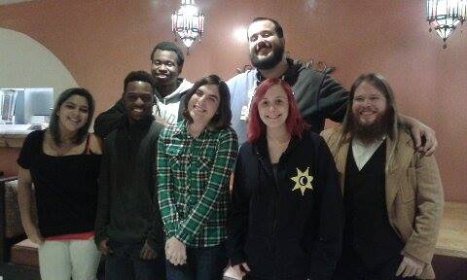
Carolina Gamers Club
Judson James, Treasurer (not in the picture)
web.sa.sc.edu/cgc
Notes:
http://web.sa.sc.edu/cgc/people/
Left To Right Back: Lorenzo Dyckes, Spencer Powell
Left To Right Front: Danielle Talley, Elijah Gabriel, Ruka Brooks, Haley Sandersfeld, Dr. Shepherd
Not Pictured: William Hoskins & Judson James

Slide 16
First-Year Academic Advisors
Mr. Blake Brown
  Your primary academic contact for your first year at Carolina
  BAB2@cec.sc.edu
Ms. Amanda Torrence
AMANDAT2@cec.sc.edu

Slide 17
Computing Disciplines and Majors
http://computingcareers.acm.org/
Notes:
http://computingcareers.acm.org/

Slide 18
Computing Disciplines (ACM defns.)
Computer Engineering
Typically involves software and hardware and the development of systems that involve software, hardware, and communications.
Computer Science
Currently the most popular of the computing disciplines; tends to be relatively broad and with an emphasis on the underlying science aspects.
(Computer) Information Systems
Computing in an organizational context, typically in businesses.
Notes:
http://computingcareers.acm.org/?page_id=6
These three disciplines correspond to the three undergraduate majors offered in the CSE department

Slide 19
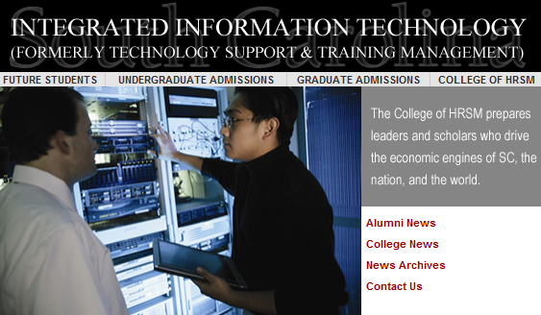
Computing Disciplines (ctd.)
Information Technology
Focuses on computing infrastructure and needs of individual users; tends to involve a study of systems (perhaps just software systems, but perhaps also systems in support of learning, of information dissemination, etc.).
Software Engineering
Focuses on large-scale software systems; employs certain ideas from the world of engineering in building reliable software systems.
Notes:
http://computingcareers.acm.org/?page_id=6
The Information Technology discipline is closer to the TSTM (Technology Support and Technology Management) major, which is offered in the school of Hospitality, Retail, and Sports Management:
The Integrated Information Technology Program (iIT). Students in the iIT program receive an in-depth background in information technologies in four major areas. These areas include computer networking, database systems, corporate training and development, and end-user support. In the computer networking area, students learn about networking theory, hardware, configuration, design, installation, and network operating system administration. In the database systems area, students learn to create and maintain databases through courses in Access, Visual Basic (for database integration), Oracle, and Systems Analysis and Design. The training area covers both the human side of corporate training, as well as the technical side of training materials development. The final area emphasizes end-user support which includes help desk
To maximize the learning experience, all iIT students must complete a capstone course that incorporates all four core areas. In this course, student teams work with a real business, solve an actual system issue, and design the needed system. Additionally, they must complete an internship as a final requirement for the program. Students graduating from this program have a very diverse IT background and have obtained positions in a wide range of organizations ranging from Network Administrator to Database Administrator to Director of Information Technologies. The program places emphasis on technology-based decision making and information management skills in dynamic business environments.
Technology Support and Training Management Program gets new name
Technology Support and Training Management Program at the University of South Carolina has changed its name to Integrated Information Technology (iIT). The name change is effective immediately.
“The new name expresses what we do much better than the old name,” said Dr. Bob Brookshire, the Program’s Director. “Our curriculum and our faculty’s research integrate the disciplines of database management, network management, web development, and information technology training. The old name really reflected only part of what our program is about.”
Information technology industry executives support the name change. “I strongly endorse the name change,” said Andy Bernardin, Client Director with IBM. “I have found the faculty and staff to be in tune with the day-to-day information technology needs business have in South Carolina. They have been proactive in helping to meet those needs by producing quality students and programs.”
Steve Wiggins, chief information officer for BlueCross BlueShield of South Carolina, agrees. “We have witnessed the transformation of this program to one of the leading university programs in producing the type of candidates that are most needed by IT businesses,” he said. “This will bring the appropriate level of attention to this program through the clarity established between the name and the focus of the program.”
The name change was approved by the State of South Carolina’s Commission on Higher Education at its March 24 meeting.
For more information on the Integrated Information Technology Program, contact Bob Brookshire at brookshire@sc.edu or visit the website at http://iit.sc.ed

Slide 23
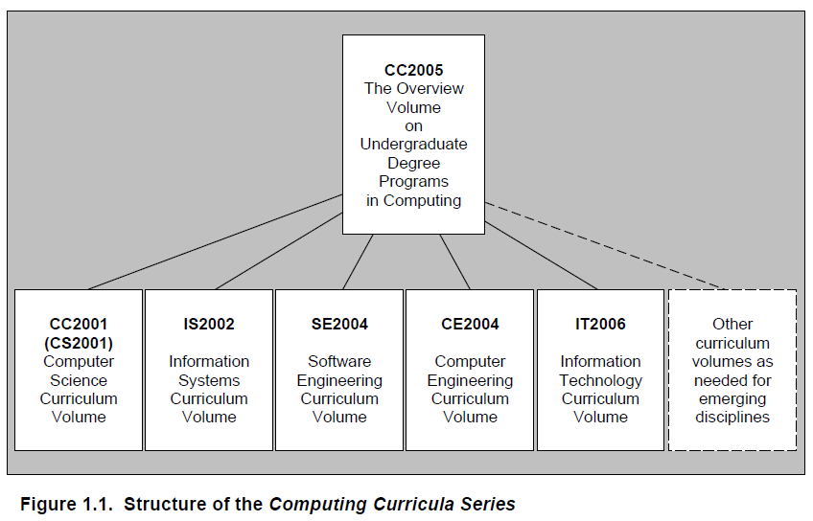
Summary: Five Curricula
Notes:
CC2020 is under development. See https://www.cc2020.net/.

Slide 24
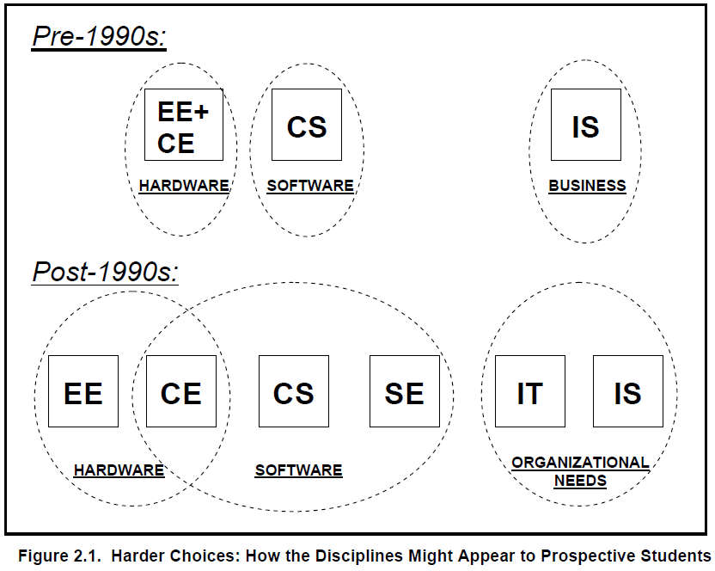
Many Curricular Choices!

Slide 25
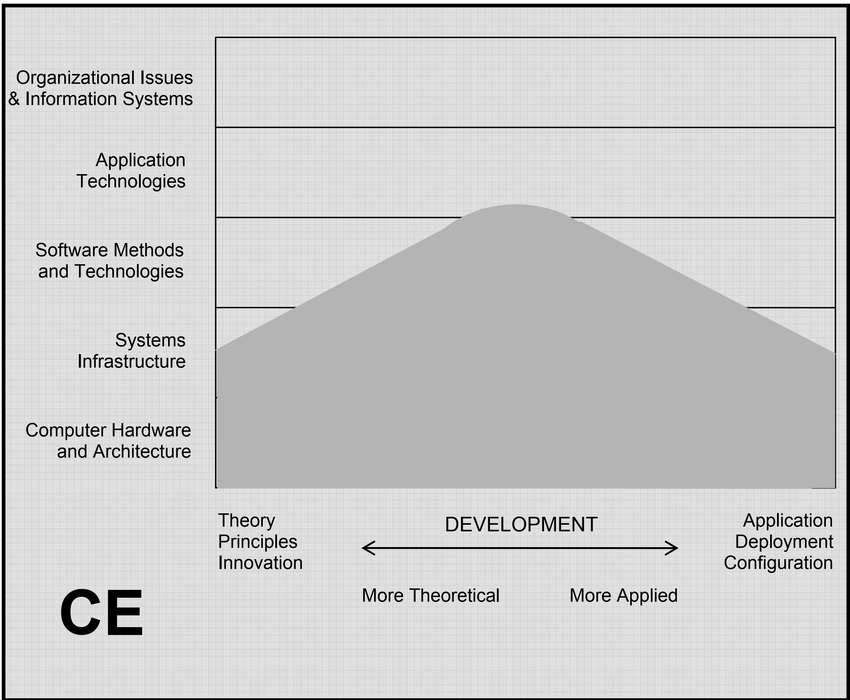
Computer Engineering
Notes:
2005 report. The shaded portion in Figure 2.3 represents the computer engineering discipline. It is broad across the
bottom because computer engineering covers the range from theory and principles to the practical
application of designing and implementing products using hardware and software. It narrows towards the
center as we move upwards because a computer engineer’s interests narrow as we move away from the
hardware. By the time we get up to the level of software development, we see that the computer
engineer’s interest has narrowed to the horizontal center because they care about software only inasmuch
as they need it to develop integrated devices.

Slide 26
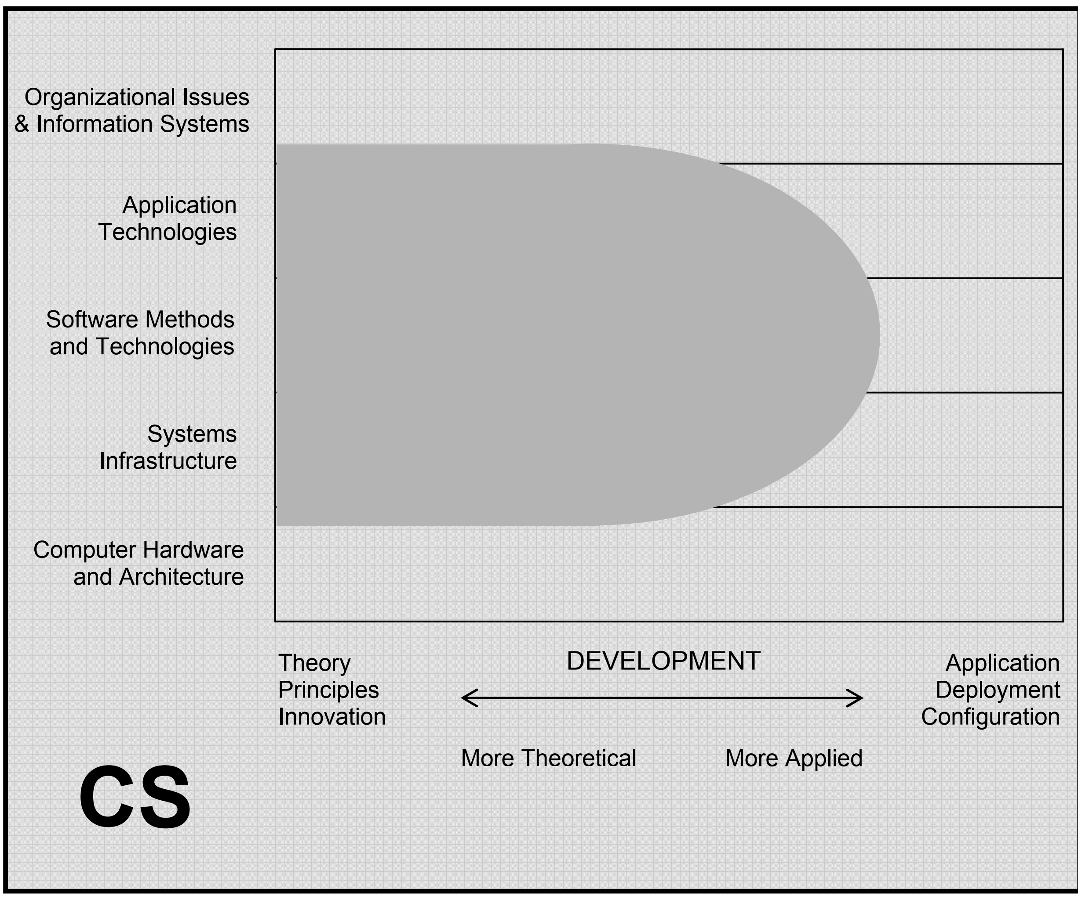
Computer Science
Notes:
2005 report The shaded portion in Figure 2.4 represents the computer science discipline. Computer science covers
most of the vertical space between the extreme top and extreme bottom because computer scientists
generally do not deal with just the hardware that runs software, or just the organization that makes use of
the information that computing can provide. As a group, computer scientists care about almost
everything in between those areas (down as far as the software that enables devices to work and up as far
as the information systems that help organizations to operate). They design and develop all types of
software from systems infrastructure (operating systems, communications programs, etc.) to application
technologies (web browsers, databases, search engines, etc.) Computer scientists create these capabilities,
but they do not manage the deployment of them. Therefore, the shaded area for computer science
narrows and then stops as we move to the right. This is because computer scientists do not help people to
select computing products, or tailor products to organizational needs, or learn to use such products.

Slide 27
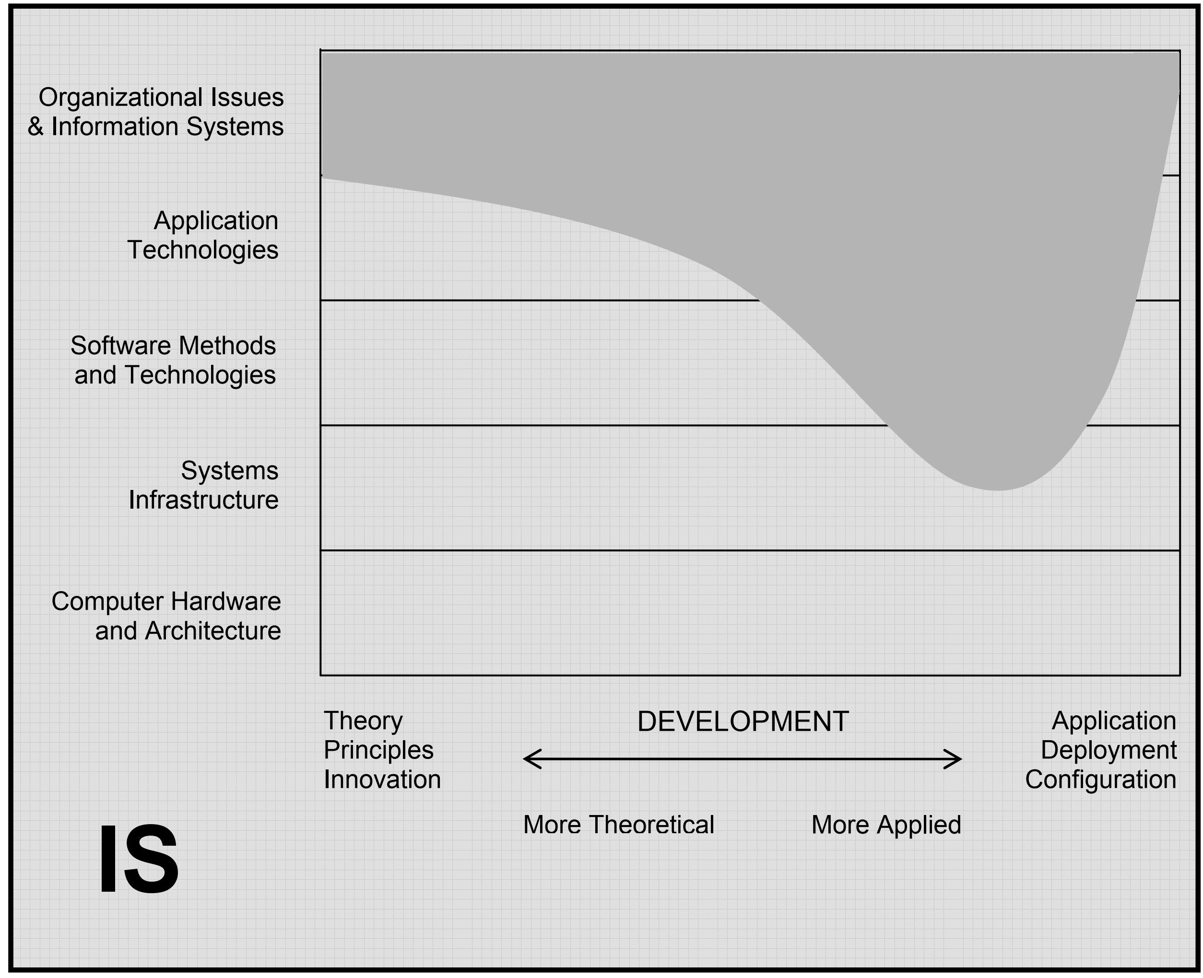
(Computer) Information Systems
Notes:
2005 report The shaded portion in Figure 2.5 represents the information systems discipline. The shaded area extends
across most of the top-most level because IS people are concerned with the relationship between
information systems and the organizations that they serve, extending from theory and principles to
application and development. Many IS professionals are also involved in system deployment and
configuration and the training of users. The area covered by IS dips downward, all the way through
software development and systems infrastructure in the right half of the graph. This is because IS
specialists often tailor application technologies (especially databases) to the needs of the enterprise, and
they often develop systems that utilize other software products to suit their organizations’ needs for
information. (This figure does not reflect the attention that information systems programs devote to core
business topics. See Chapter 3 for tables that summarize both computing and non-computing topics.)

Slide 28
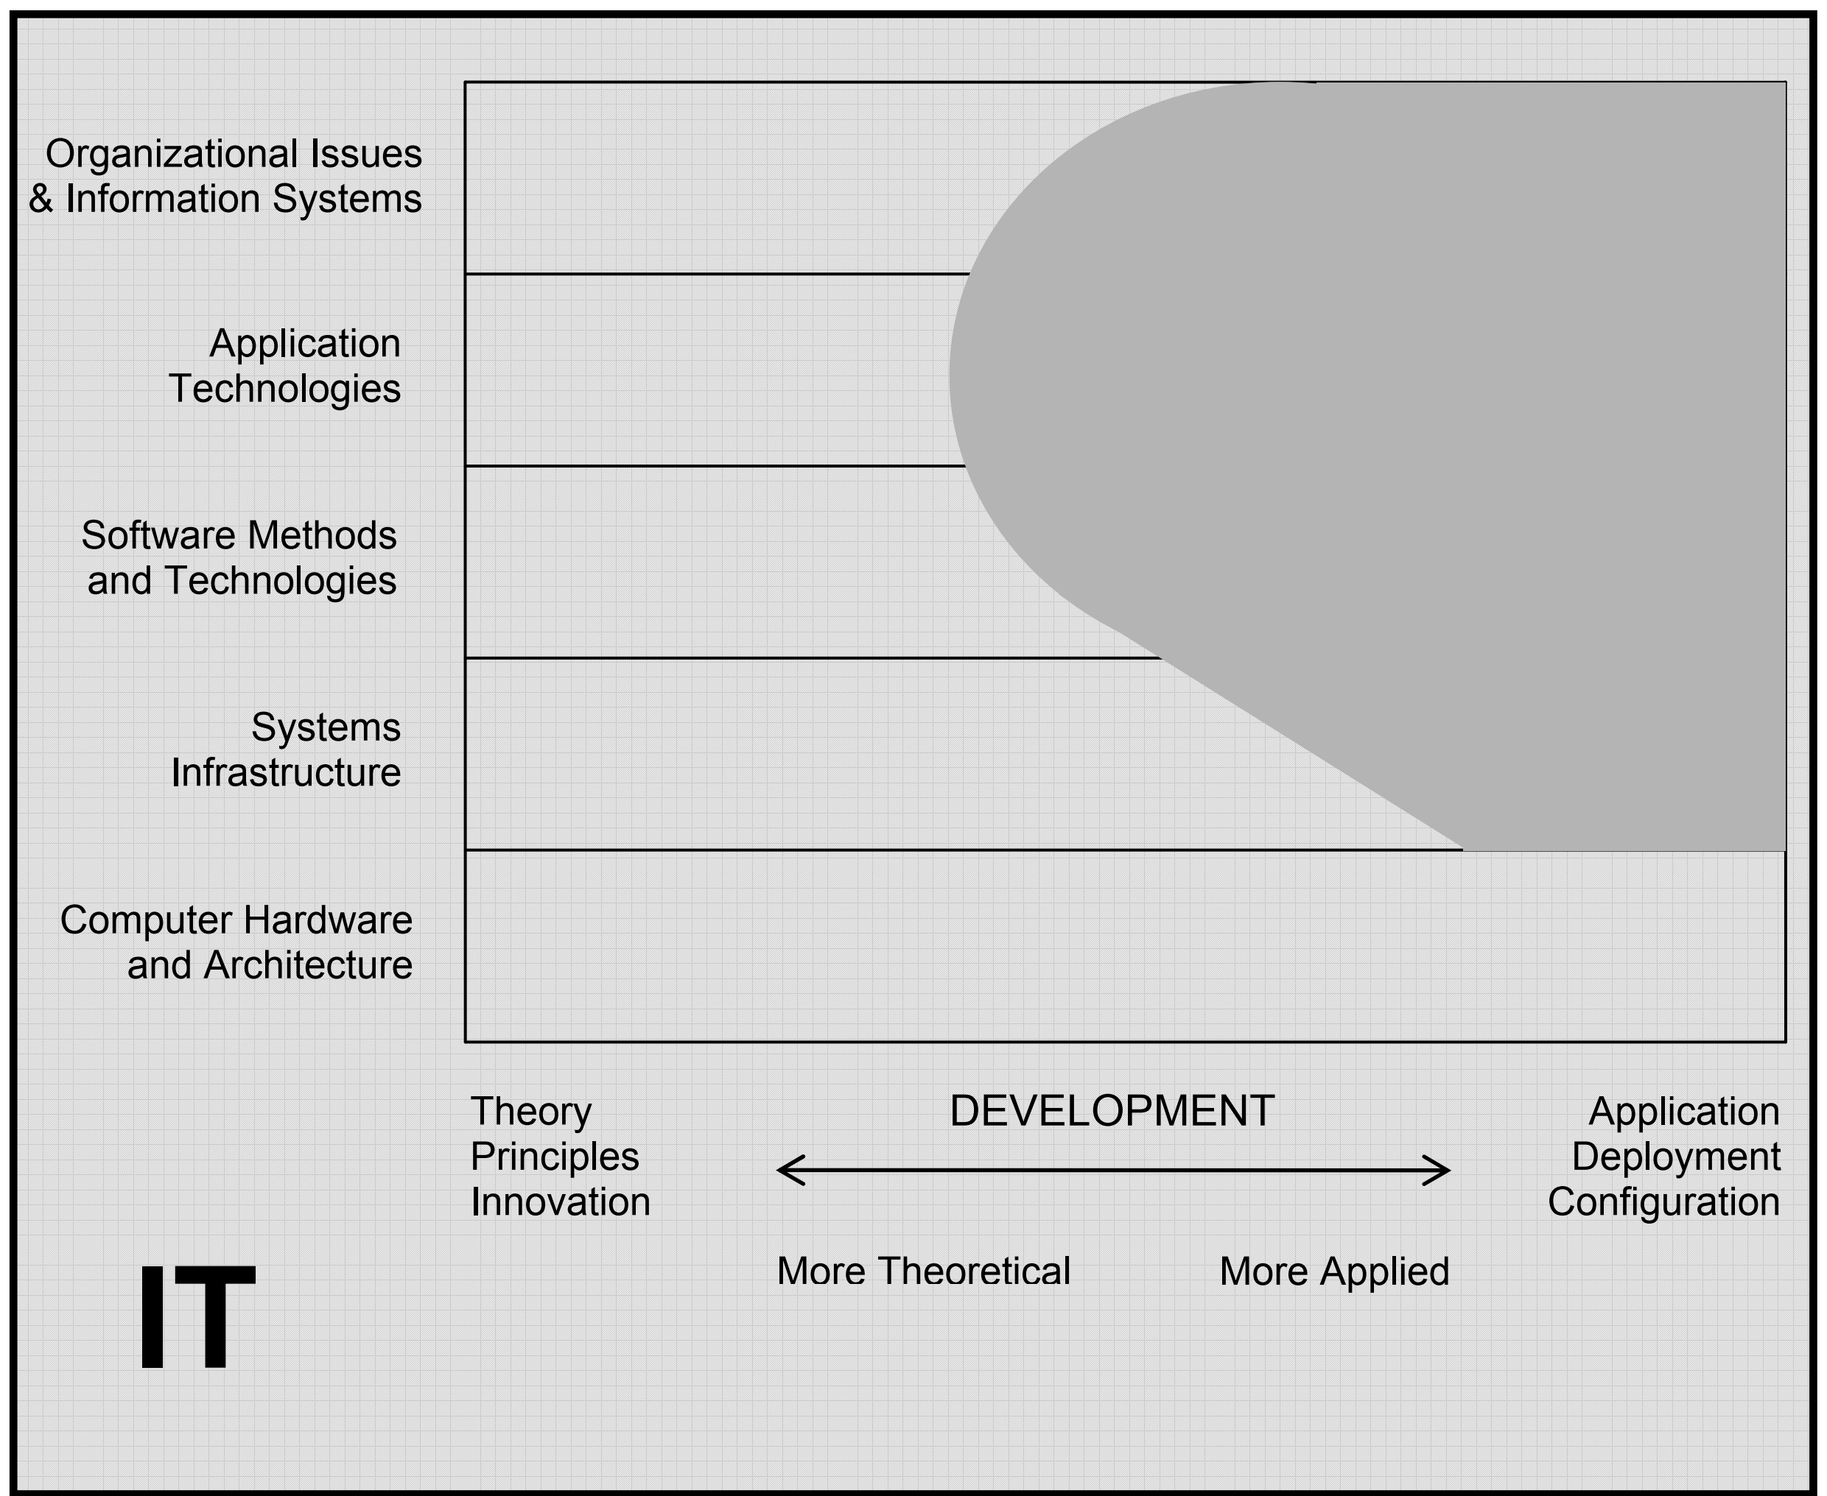
(Computer) Information Systems
Notes:
2005 report The shaded portion in Figure 2.6 represents the information technology discipline. Its shaded area
extends down most of the right edge as it focuses on the application, deployment, and configuration needs
of organizations and people over a wide spectrum. Across this range (from organizational information
systems, to application technologies and down to systems infrastructure), their role has some overlap with
IS, but IT people have a special focus on satisfying human needs that arise from computing technology.
In addition, the IT shaded area goes leftwards from application towards theory and innovation, especially
in the area of application technologies. This is because IT people often develop the web-enabled digital
technologies that organizations use for a broad mix of informational purposes, and this implies an
appropriate conceptual foundation in relevant principles and theory.
Because IT is a very new discipline, its focus has been on developing educational programs that give
students a foundation in existing concepts and skills. Many in the community of IT faculty assert that
research in their field will grow to create and develop new knowledge in relevant areas. When that
happens, an appropriate snapshot would feature a shaded area that extends significantly further to the left.
However, this is an ambition and not yet an achievement. This figure reflects the current status of IT.

Slide 29
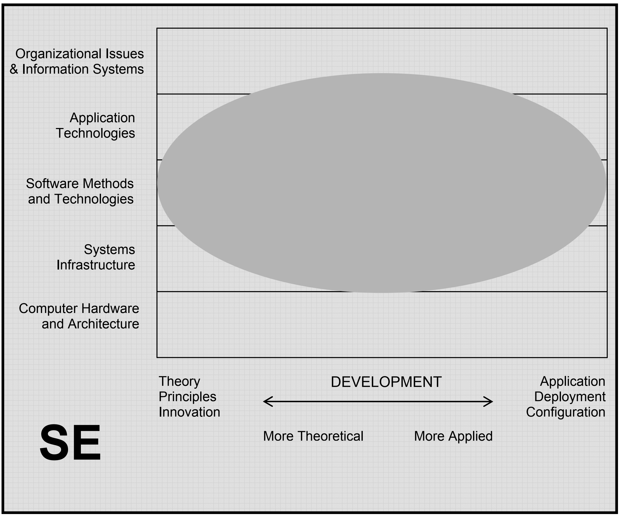
Software Engineering
Notes:
2005 report The shaded portion in Figure 2.7 represents the software engineering discipline. Just as we have seen that
computer engineering’s area spans the entire horizontal dimension at the lower hardware-related level,
and IS spans most of that dimension at the higher organization-related level, software engineering covers
a wide range with respect to the systematic development of software. This is because SE people fill a
wide range of needs in large-project software expertise. SE’s main goal is to develop systematic models
and reliable techniques for producing high-quality software on time and within budget, and these
concerns extend all the way from theory and principles to daily practice. The domain of SE also extends
downward through systems infrastructure since SE people develop software infrastructure that is robust in
operation. Its domain also extends upward into organizational issues because SE people are interested in
designing and developing information systems that are appropriate to the client organization.

Slide 30
The Job Market
https://cs.calvin.edu/documents/computing_careers

Slide 31
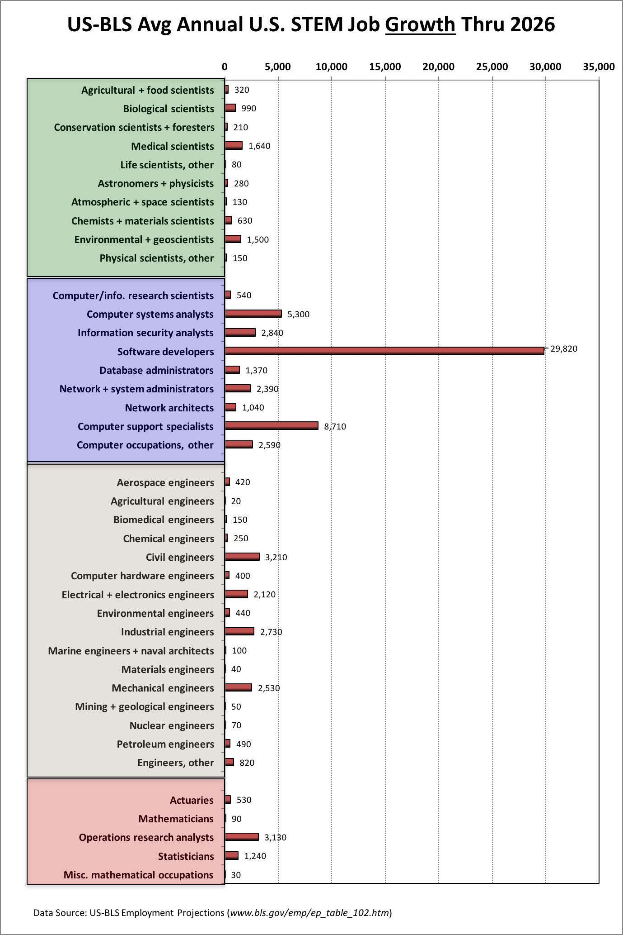
US Bureau of Labor Statistics:
New US STEM Jobs per Year, through 2026
Notes:
Source: Joel Adams, Calvin College, http://cs.calvin.edu/p/ComputingCareersMarket There are lots of myths about computing careers. One of the most ridiculous is the myth that all the computing jobs are going overseas. By contrast, the U.S. Bureau of Labor Statistics (US-BLS) predicts that computing will be one of the fastest-growing U.S. job markets in science, technology, engineering, and mathematics (STEM) for the foreseeable future, as indicated on the following chart (on powerPoint chart).
As you can see from the chart on the left, the US government predicts that the four top STEM jobs with the most growth will all be in computing. No other area is expected to generate even 4000 new jobs per year.
By contrast, the US-BLS predicts there will be nearly 20,000 new software development jobs, nearly 12,000 new systems analysts jobs, over 8,000 new computing support jobs, and over 4,000 network/system administration jobs.

Slide 32
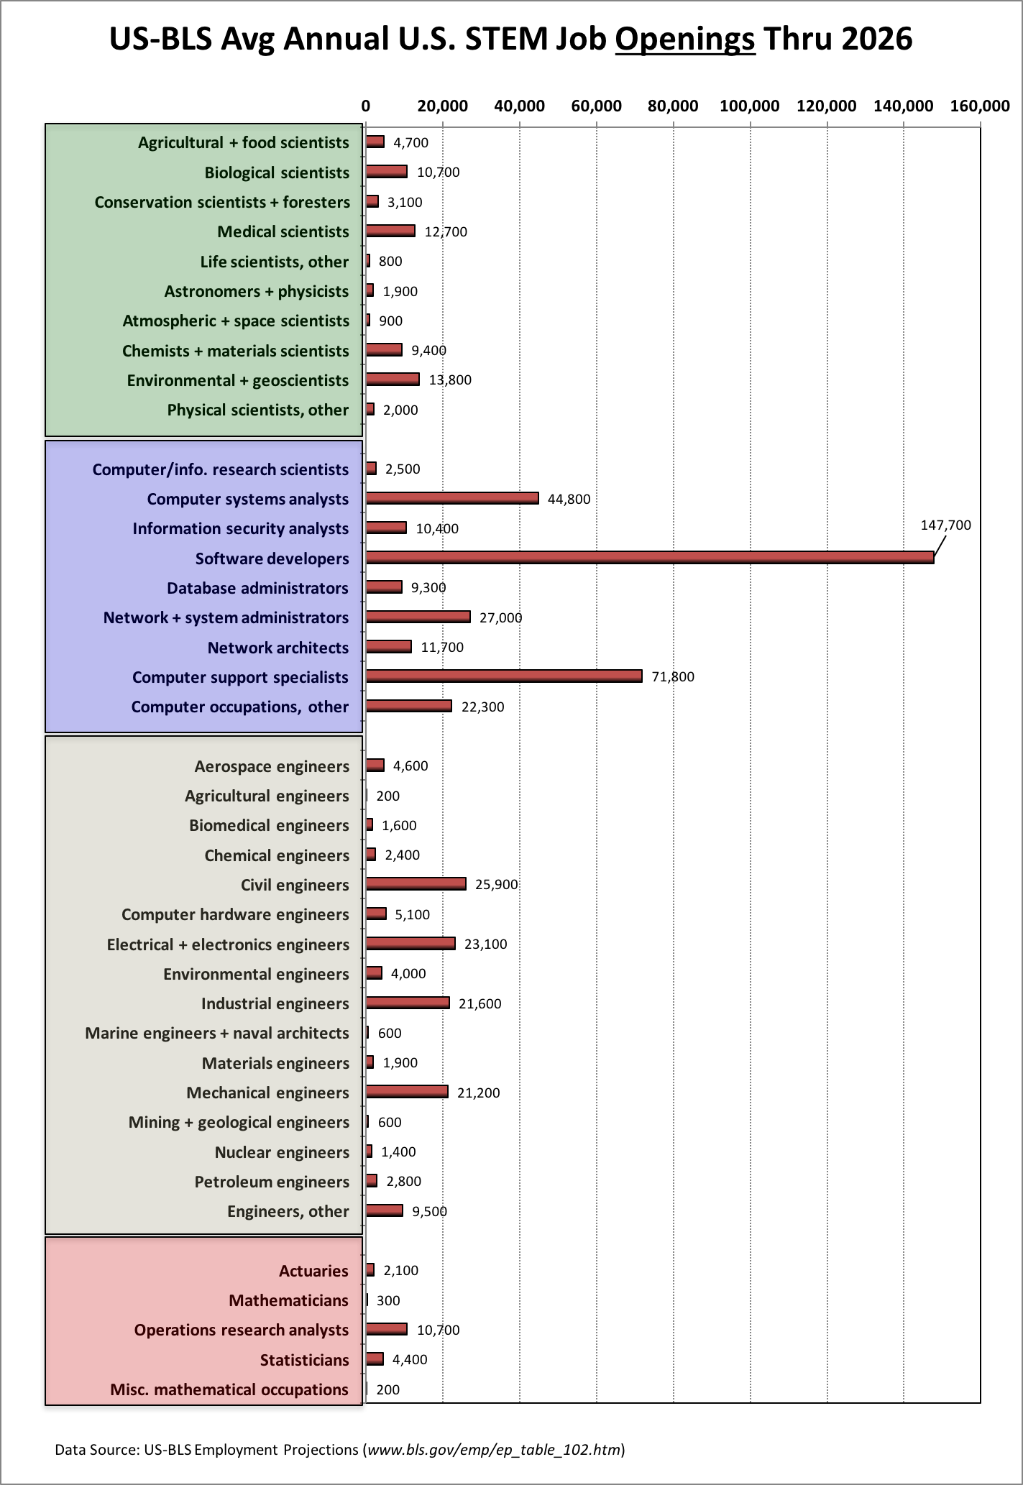
US Bureau of Labor Statistics:
Total US STEM Jobs per Year, through 2026
Notes:
Source: Joel Adams, Calvin College, https://computing.calvin.edu/careers-outcomes/ The chart above [on the right] shows that even when retiree replacements are considered, the top four careers with the most job opportunities remain the same: software development, systems analysts, computing support, and network/systems administration. The chart on the right does indicate that there will be some jobs in non-computing STEM areas; most of those jobs will be replacing retiring baby boomers, not new jobs created by economic growth.

Slide 33
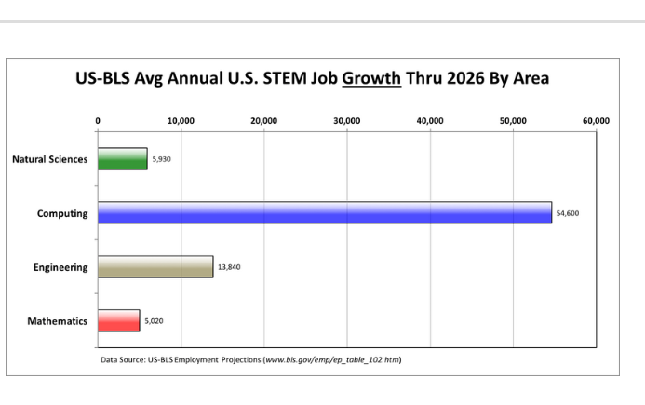
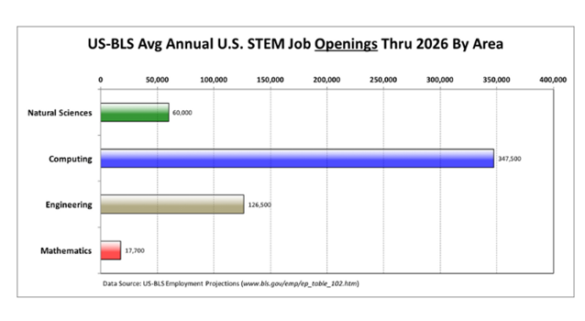
A Summary
Notes:
If we aggregate these US-BLS projections to see the number of jobs per year in each STEM area, we get the following charts [above].

Slide 34
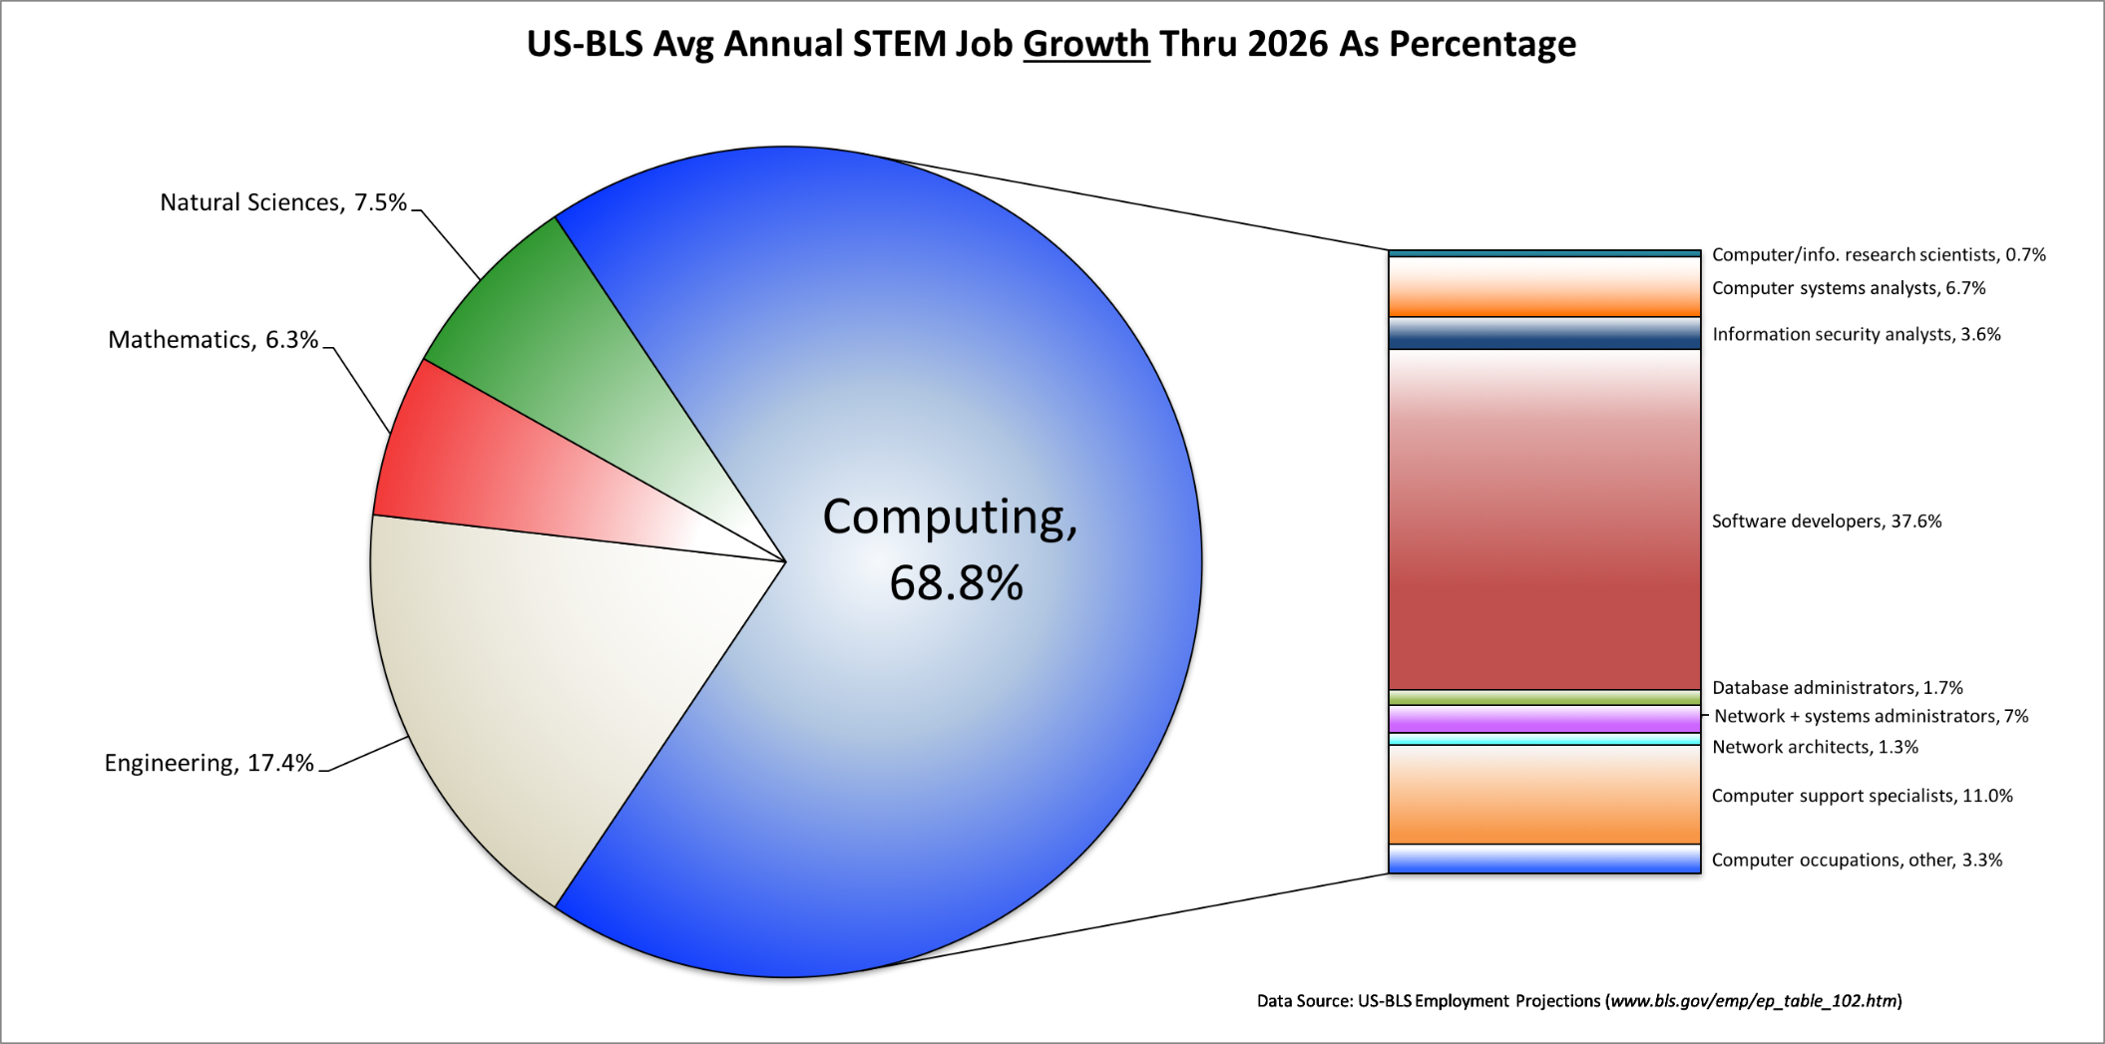
Percentage of New STEM Jobs by Area through 2026
Notes:
For the foreseeable future, nearly 3 out of 4 new science or engineering jobs in the U.S. are going to be in computing! By contrast, just 16% will be traditional engineering jobs, and even fewer will be in the sciences or mathematics.
What kind of “computing” jobs are these? The pie-chart on the right (PowerPoint chart) breaks the “computing” jobs down in the different career categories, and shows that the US-BLS is predicting:
27% (295,200 jobs) of the new STEM jobs will be in software engineering alone as compared to 16% (178,400 jobs) in the rest of engineering combined!
There will be far more new jobs in network analysis and administration (235,700) than in traditional engineering.
Note that basic computer literacy (i.e., knowing Microsoft Word, Excel, or Powerpoint) or CAD-design will not qualify you for one of these jobs. These jobs require skills that you will only gain by studying computer science, information systems, and/or software engineering.

Slide 35
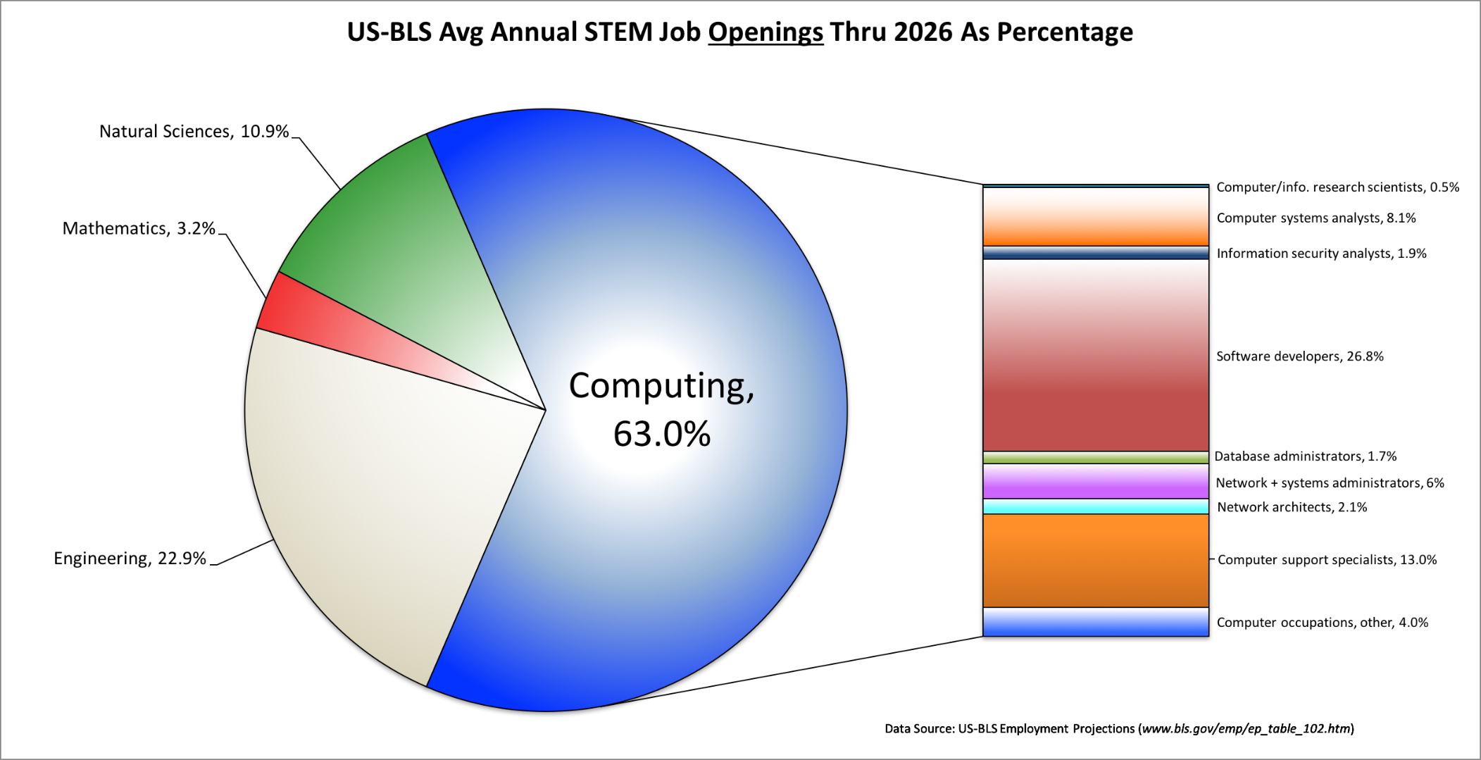
Percentage of Total STEM Jobs by Area through 2026
Notes:
For the foreseeable future, nearly 3 out of 4 new science or engineering jobs in the U.S. are going to be in computing! By contrast, just 16% will be traditional engineering jobs, and even fewer will be in the sciences or mathematics.
What kind of “computing” jobs are these? The pie-chart on the right (PowerPoint chart) breaks the “computing” jobs down in the different career categories, and shows that the US-BLS is predicting:
27% (295,200 jobs) of the new STEM jobs will be in software engineering alone as compared to 16% (178,400 jobs) in the rest of engineering combined!
There will be far more new jobs in network analysis and administration (235,700) than in traditional engineering.
Note that basic computer literacy (i.e., knowing Microsoft Word, Excel, or Powerpoint) or CAD-design will not qualify you for one of these jobs. These jobs require skills that you will only gain by studying computer science, information systems, and/or software engineering.

Slide 36
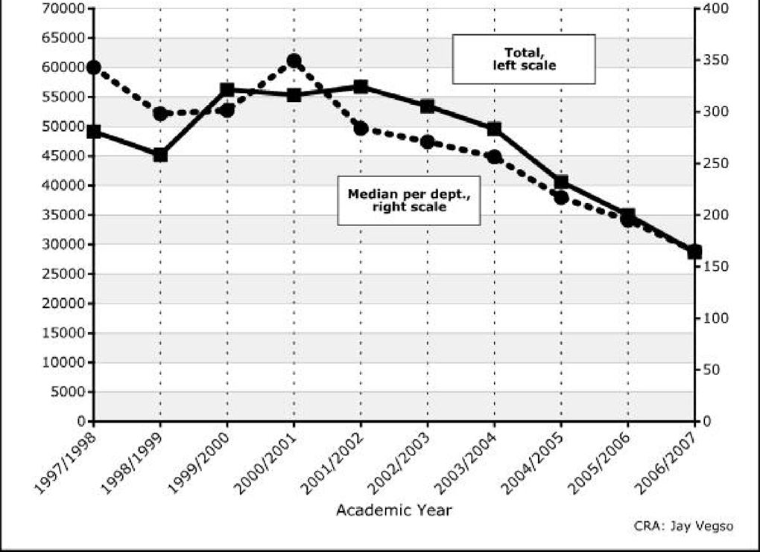
Undergraduate CS Degree Enrollment
Notes:
(Source: CRA Taulbee Survey)
With all of these jobs out there, you’d expect students to be flocking to computing. Unfortunately, the opposite is true, as the following chart shows (chart on PowerPoint slide).
So demand for software engineers, network administrators, systems analysts, and other computing-related professionals is exploding, but fewer and fewer students are choosing to study what is needed to get these jobs. As a result, salaries for these professionals are climbing.

Slide 37
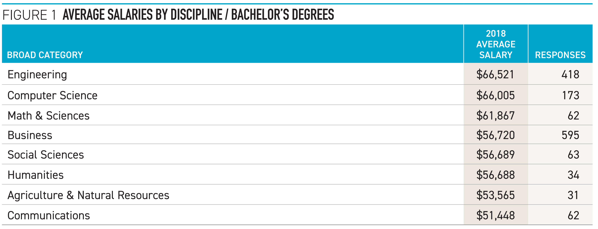
Starting Salaries
Winter 2018 yearly salary survey by the National Association of Colleges and Employers (NACE)
Notes:
NACE salary survey, found at https://www.mcgill.ca/caps/files/caps/db_salary_summary.pdf. The salary and increase projections for the two highestpaid majors—engineering and computer science—
are nearly identical. With an overall average salary
projection of $66,521, engineering graduates are once
again expected to be the highest paid. However, with
a gain of less than 1 percent over last year’s average
projection of $66,097 for Class of 2017 graduates,
their average remains essentially flat.
Similarly, the average salary for Class of 2018
computer science graduates is expected to be
$66,005, which also is an increase of less than 1
percent over last year’s average salary projection of
$65,540

Slide 38
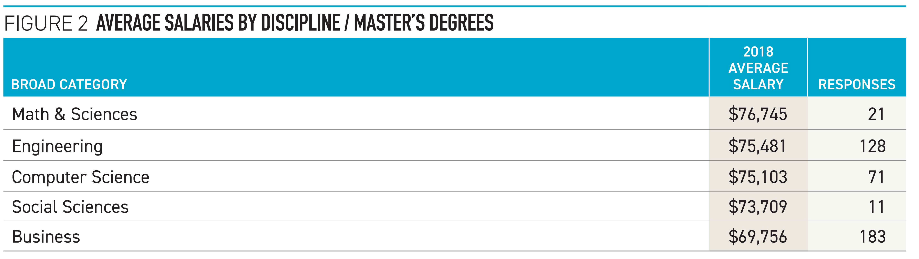
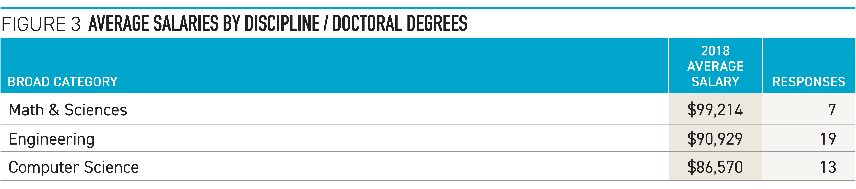
Starting Salaries: Master’s and PhDs
Winter 2018 yearly salary survey by the National Association of Colleges and Employers (NACE)
Notes:
NACE salary survey, found at https://www.mcgill.ca/caps/files/caps/db_salary_summary.pdf. Computer science graduates at this degree level are
showing greatly reduced average salary projections;
their overall average projection has dropped more
than 21 percent, from $110,841 last year to just
$86,570 this year. The average salary projections
by individual major tell the story, with drops for
computer science (from $110,850 to $94,877),
information sciences (from $110,000 to $76,046),
and software applications ($110,000 to $77,713)
majors. Again, however, the data are extremely
limited and highly dependent upon the respondents
to the survey, so any trend analysis among this group
is not possible.

Slide 39
Curricula in the Department of Computer Science and Engineering
https://cse.sc.edu/undergraduate

Slide 40
Curricula in the Computer Science and Engineering Department
Major references are the University Undergraduate Studies Bulletin (http://www.sc.edu/bulletin/), the departmental website (http://www.cse.sc.edu/), and the College of Engineering and Computing Website (especially Student Services: http://www.cec.sc.edu/studsvcs/stud_svcs.html)
The objectives of the Undergraduate Program of Computer Science and Engineering are to provide the student with a thorough grounding in mathematics, science, and computational subjects and to prepare the student for a professional career or graduate studies in computer science, computer engineering and other fields.

Slide 41
Three Degrees: CS, CE, CIS
The Department of Computer Science and Engineering offers baccalaureate degrees with majors in computer engineering, computer information systems, and computer science.
All three degrees provide students with the knowledge and skills needed to work as practitioners in all aspects of the computing and information processing industries. All majors include a common core of fundamental courses in computing.
  The major in computer engineering includes courses in electronics and computer hardware as well as software;
  the major in computer information systems includes courses in business and is designed for students who are primarily interested in business applications;
  the major in computer science allows students to focus primarily on the software aspects of computing and requires selection of an appropriate application area.

