Slide 1
Applied Analytics and ML in Healthcare and Benefits Management
Seth Gregorie
Sr. Director, Engineering and Data Science
Seth.Gregorie@benefitfocus.com

Slide 2
Everything discussed today has one thing in common. It is enabled by computing.

Slide 3
Takeaways:
Outlook is positive.
Distinguish yourself by combining with skills that complement computing.
Find your passion.

Slide 4
Agenda (let’s keep this conversation casual)
My journey
Industry and career thoughts
Analytics/ML in Healthcare
Questions

Slide 5
My journey
Mathematics background
Worked in university fundraising
Statistician for MUSC
Embarked with Benefitfocus

Slide 6
A few things I wish I knew in college
Learning never stops
Practice building professional relationships
Experience is important (internships, capstones)
Take care of yourself (mental and physical health)
Focus on positivity and celebrate success
Try to intersect personal and career values (work culture is important)

Slide 7
Industry Outlook is Great
Applied computing and mathematics roles are everywhere
Academia
Pharmaceuticals
Media
Technology
Two areas within industry highlighted today
Internal business intelligence (data science)
Helping businesses translate data into important information to gain competitive advantage.
Decision support products and AI ( data science and product development)
Developing advanced analytical techniques into products to improve customer lives.

Slide 8
About Benefitfocus

Slide 9
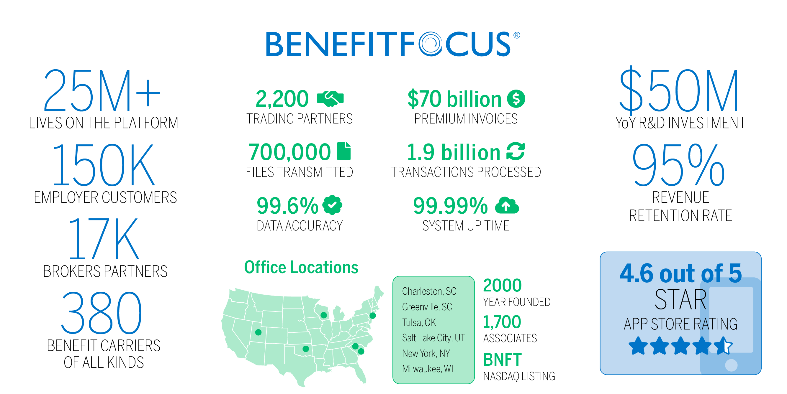

Slide 10
Why are benefits so important to consumers?
44%
of employees would not be able to cover unexpected medical costs of $1,000+
58%
of employees could not go more than three weeks without a paycheck
34%
say a better benefits package would help keep them in their current jobs
Notes:
We’ve seen the unpredictability of life. These moments that matter can surface at any point. From moments like a child’s 16th birthday, to an unforeseen circumstance like an injury these critical points can leave consumers feeling vulnerable or in disarray.
44% of employees could not go more than three weeks without a paycheck.
58% of employees would not be able to cover unexpected medical costs of $1,000 or more
34% say a better benefits package would help keep them in their current jobs
source

Slide 11
Benefitfocus Exists To Improve Lives
We are transforming how consumers acquire and use products to protect their health, wealth and lifestyle.

Slide 12
Notes:
Katie: Examples of how AI is changing the game – BenefitSAIGE “Connects the dots"
Ben Admins- we have empathy for the challenge you have to serve a changing work force that is often distributed, a growing network of partners yet your resources are finite or shirking.
Accuracy- connecting you to focus on areas of concern, anomalies etc.
Data: We can’t dig through files of data to find that one deduction or paycheck that seems out of the ordinary. We can use AI to point out an anomaly that needs a 2nd look.
Timing of communication: it can learn which employees option which emails at what time
Efficiency- who to contact when about about
AI can help automate what was once manual. AI can help automate emails and communication with your employees and your partners.
Decision Making- you have the ultimate decision, but suggestions with data
The power of AI can also take on the impossible of matching millions of data points to suggest choices for us, but it is important to remember that the human in the equation has the decision making power. Data can give suggestions but humans make the choices.
Your workforce is changing.
Data can show you how and when to adjust your benefit strategy.
It can save you time.
But we must keep at the heart of all of it that it is is still about building trust.

Slide 13
iClicker
Answer the following multiple-choice question.
How many lives are on the Benefitfocus platform?
A. 5M
B. 10M
C. 25M+
Notes:
C correct.

Slide 14
Specific Applied Mathematics and computing at Benefitfocus

Slide 15
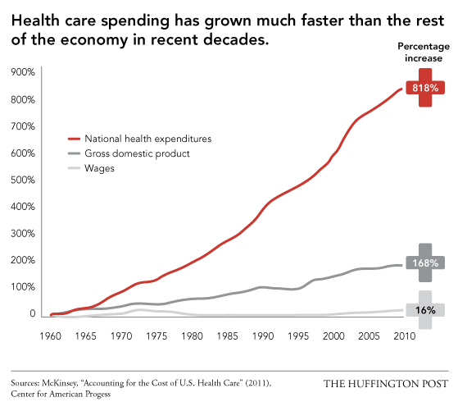
Rising healthcare costs are the problem of our lifetime

Slide 16
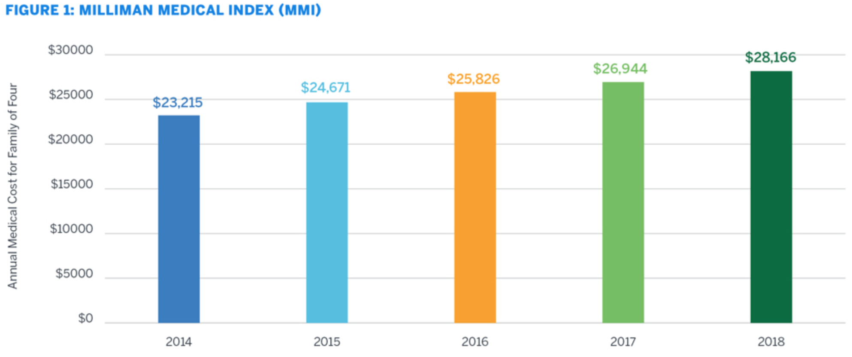
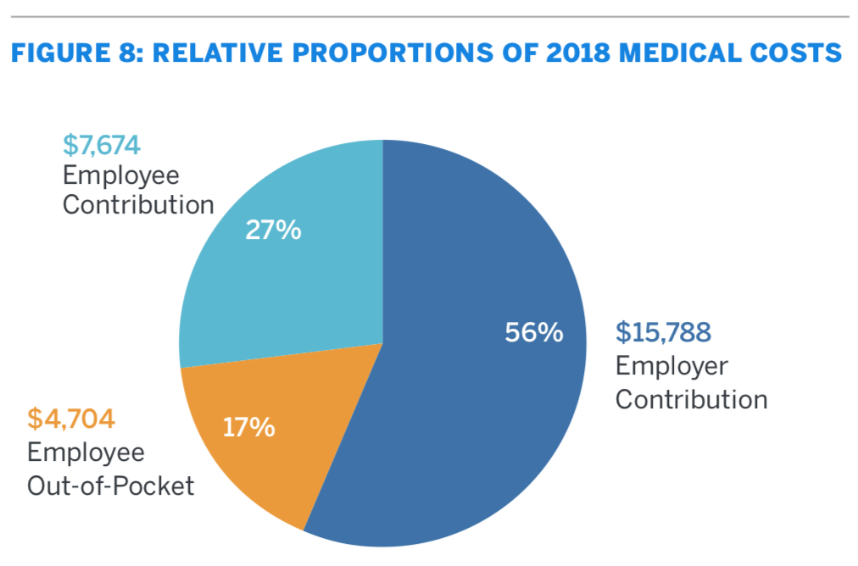
Rising healthcare costs are the problem of our lifetime
In 2018, the cost of healthcare for a typical American family of four covered by employer sponsored PPO plan is $28,166
Of this annual amount, Employers subsidize 56% of the costs or $15,788
Employees pay the remaining $12,378, which is a combination of $7,674 premium and $4,704 in OOP costs when using healthcare services.

Slide 17
Intersection of computing, mathematics, and humans

Slide 18
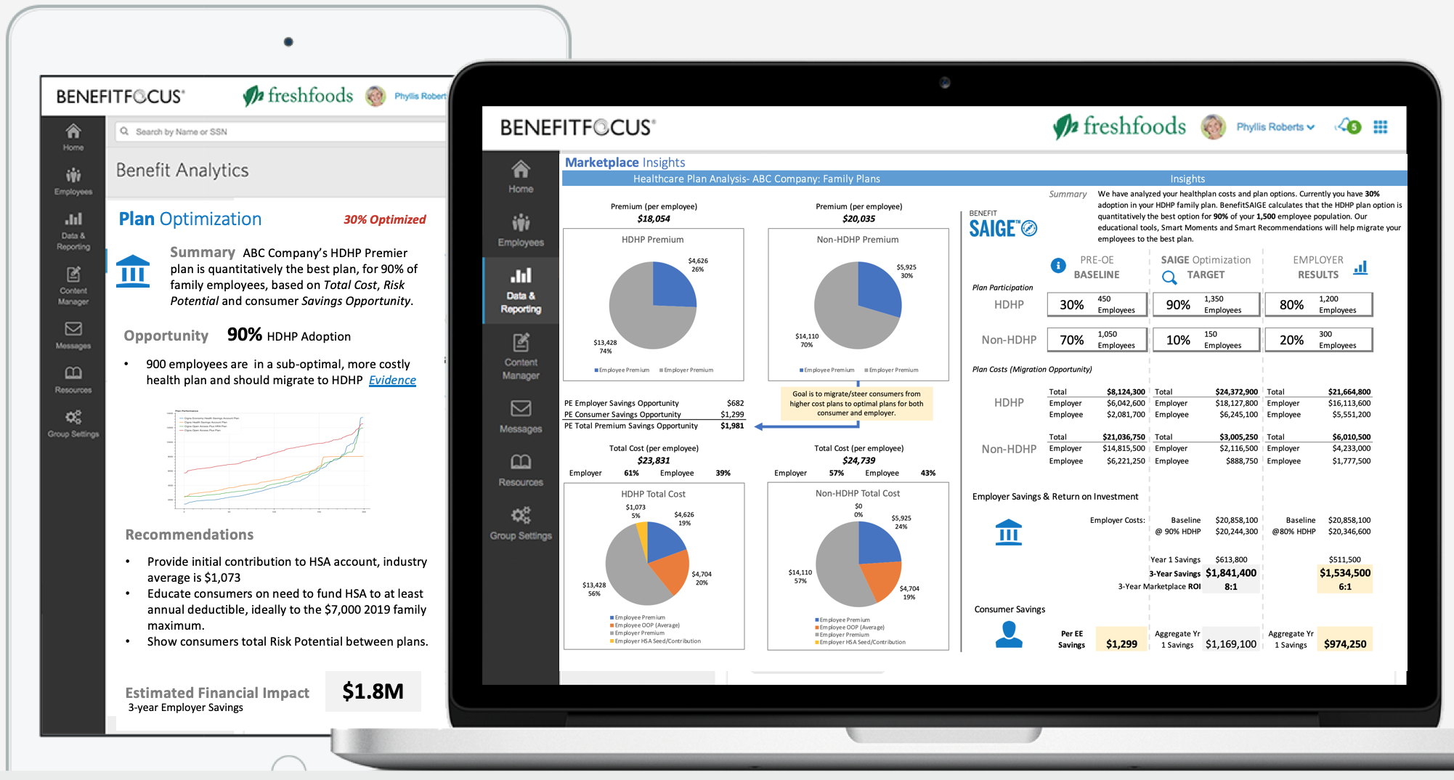
Analytics and ML Opportunity - Reporting
Benefitfocus strives to Make Lives easier through Benefits by providing education and decision support.
High computing and mathematics help make this possible.

Slide 19
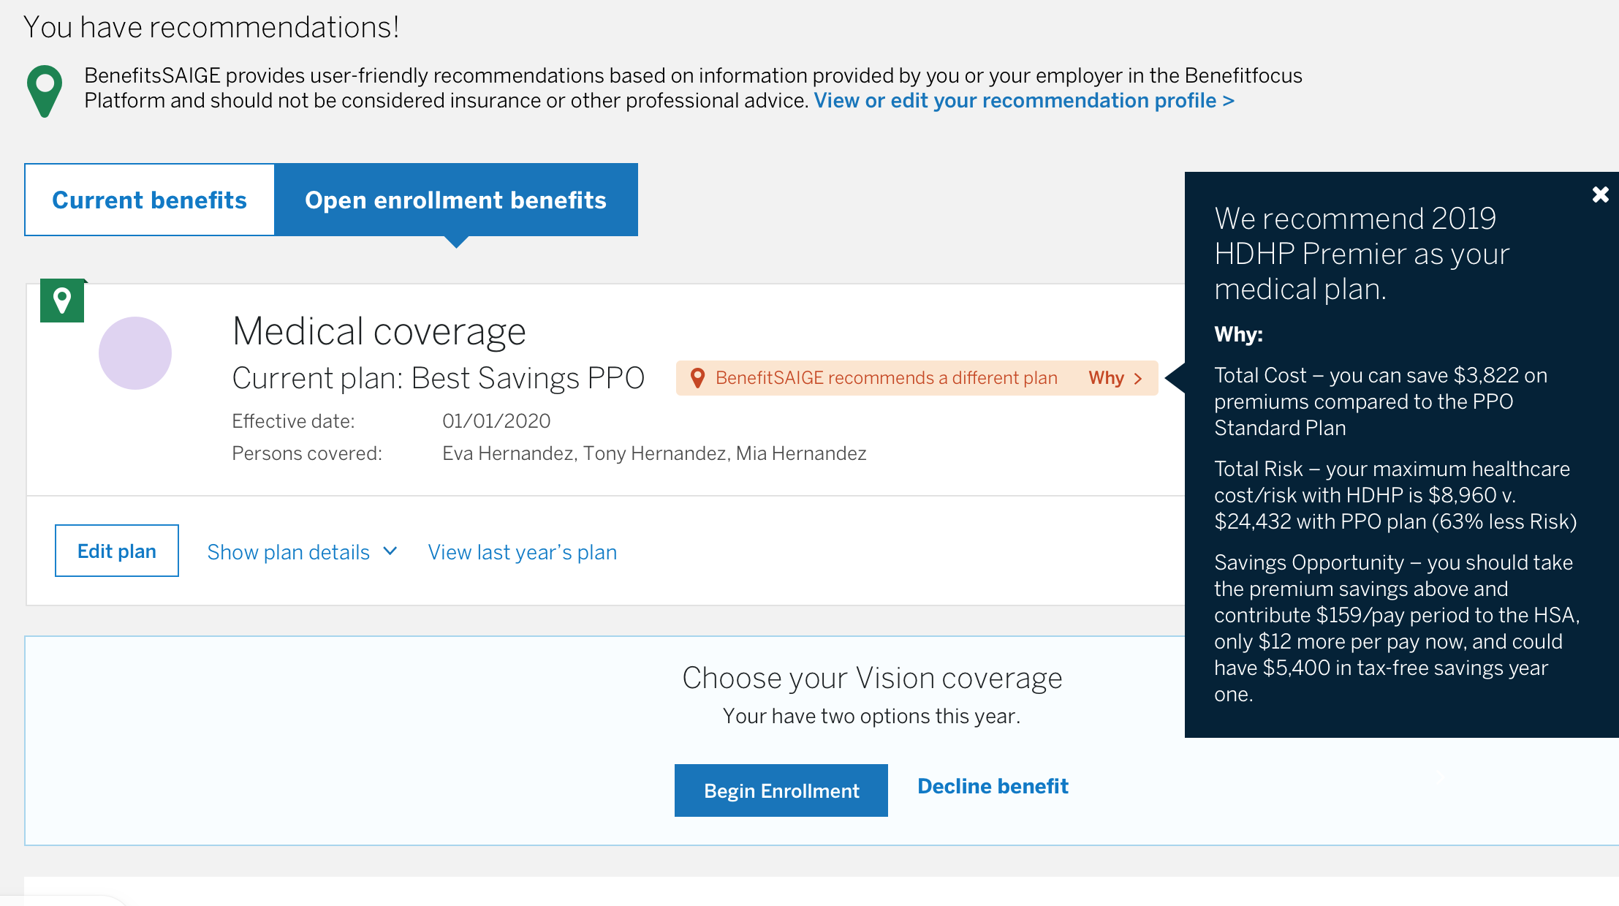
Analytics and ML Opportunity – AI/Recommendations
Benefits Recommendations

Slide 20
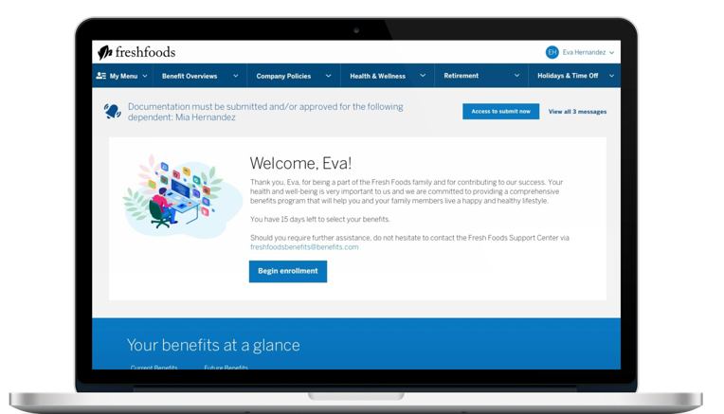
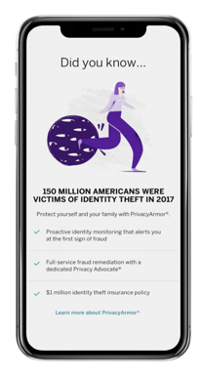
Analytics and ML Opportunity – AI/Messaging
AI driven content
Push notifications, email, text
Close the loop!

Slide 21
iClicker
Answer the following multiple-choice question.
How much does an employee with a family of 4 pay on average, annually in healthcare services?
A. $3,928
B. $7,654
C. $12,378 (correct)

Slide 22
Computing at Benefitfocus – What we learn
UI
Application Code
*If only it were this easy for platform solutions.
How do you make solutions repeatable?
How do you keep component decoupled?
How do you scale to millions of users?
Database

Slide 23
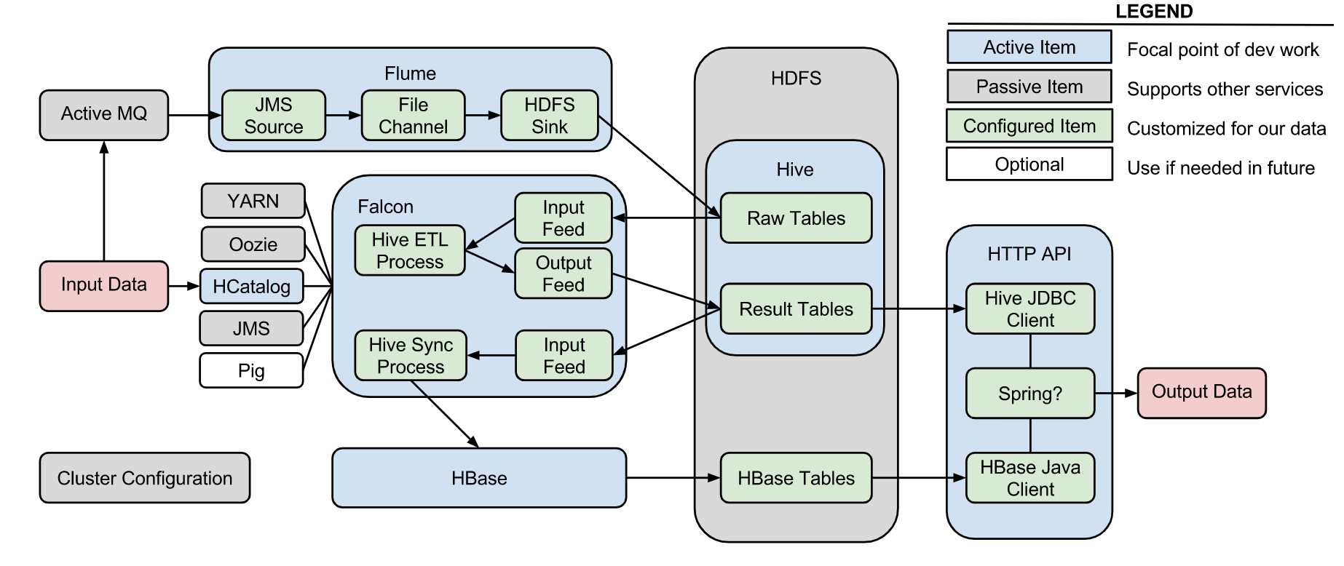
Computing at Benefitfocus - Reporting

Slide 24
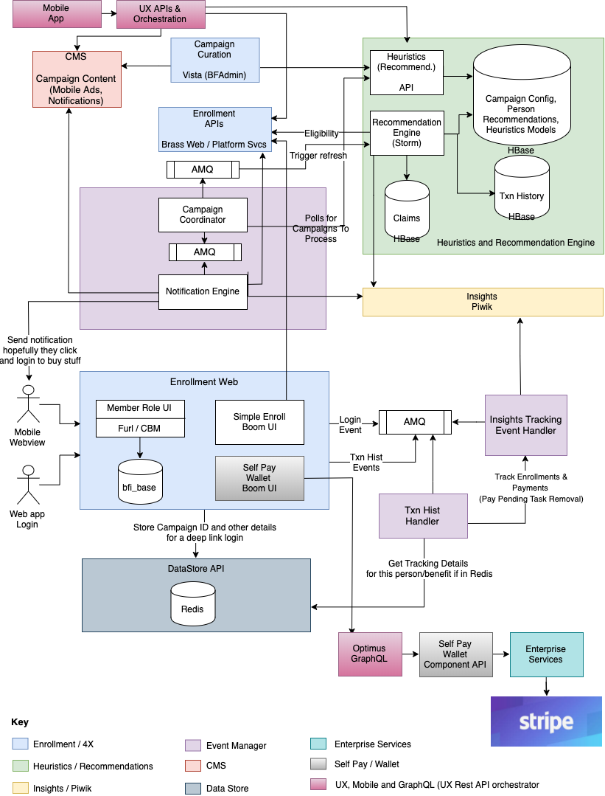
Computing at Benefitfocus – AI/Recommendations
*Governance is important.
Learn source control.
Learn deployments.
Learn automated testing.

Slide 25
Computing at Benefitfocus – Delivery
Engineers write code
DevOps configures and deploys code
Hosting operates the systems
Product Managers create requirements
Architecture proposes technical designs
security

Slide 26
Takeaways:
Outlook is positive.
Distinguish yourself by combining with skills that complement computing.
Find your passion.

Slide 27
Questions? Or email me - Seth.Gregorie@benefitfocus.com

