Slide 1
Academic Advising
College of Engineering and Computing
Fall 2016

Slide 2

Why is Advising Important?
Advising is a shared partnership
As an advisee, you are responsible for knowing where to find the information & policies you need to make important academic decisions.
Your advisor will help you navigate all of this information and assist you with developing your academic, career, and personal goals.
Notes:
Advising is very different than High School. In High School, you were given information and the responsibility wasn’t solely on you. In College, it is your responsibility to keep up with Academic Policies and Procedures, along with information and requirements that is affiliated with your Major. Remember that you are your “best” advocate.
Your advisor will assist in helping you navigate between information online and in person. They will also help answer any questions you have and make effective referrals for you, if needed.

Slide 3
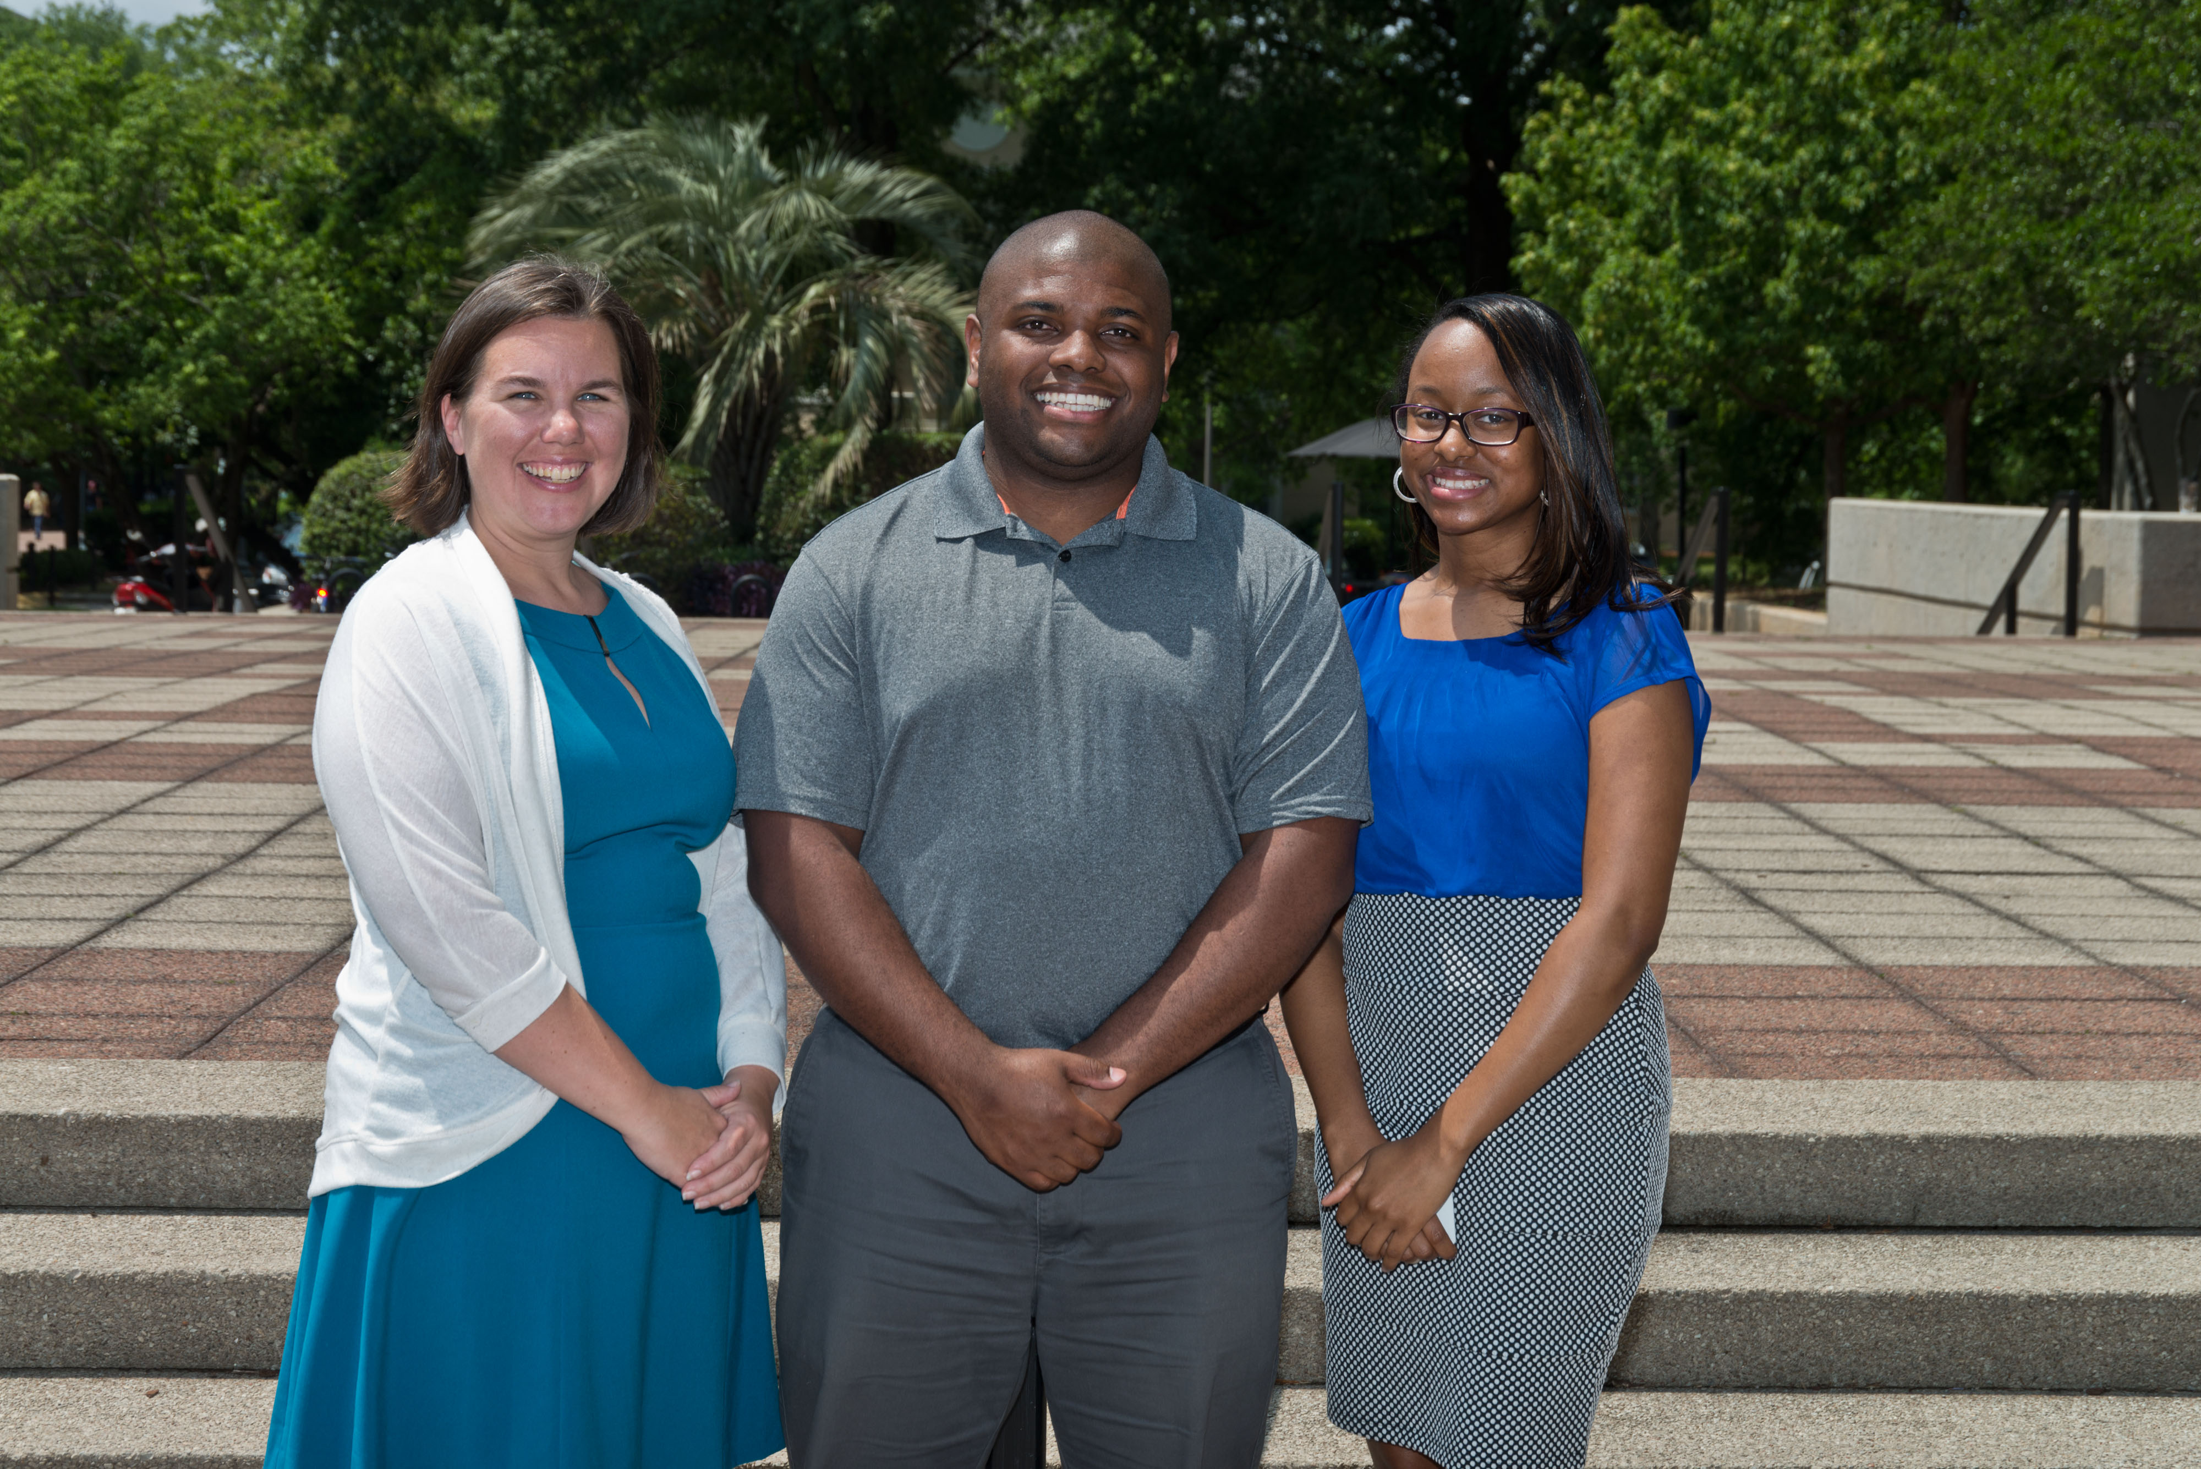
Who is my Advisor?
Incoming Freshman students in the College of Engineering and Computing will be assigned to a First Year Advisor. This advisor specializes in comprehensive academic advisement and issues unique to freshman students. First Year Advisors are available during normal business hours and be reached in person, by phone, or email. At the end of the freshman year, students will be assigned a faculty advisor.
Ms. Sarah Jusiewicz
Mr. Brian McCaster
Ms. Tiffany Lide
Notes:
New freshmen students will receive advisement appointment information by email from their First Year Academic Advisor. New freshmen advising will begin earlier than for other students. Regularly view your University email!

Slide 4
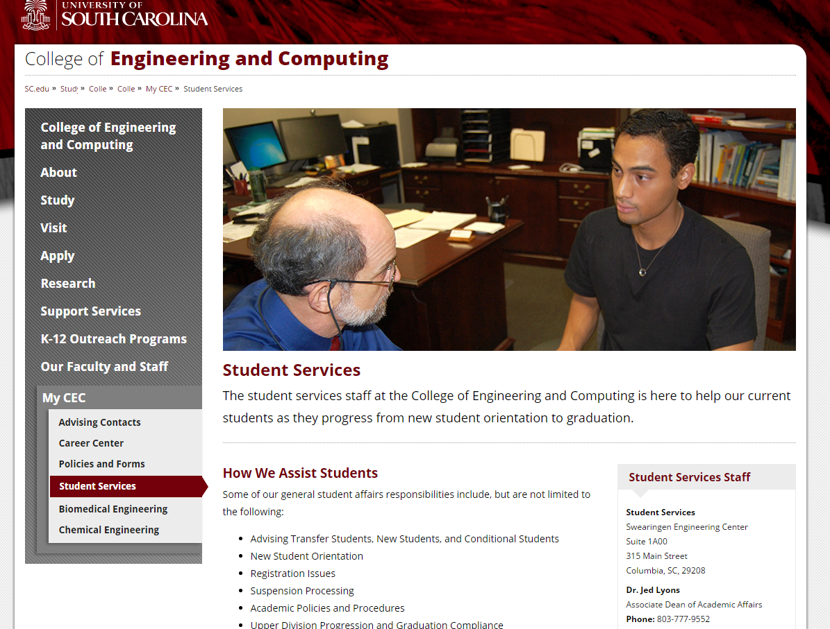
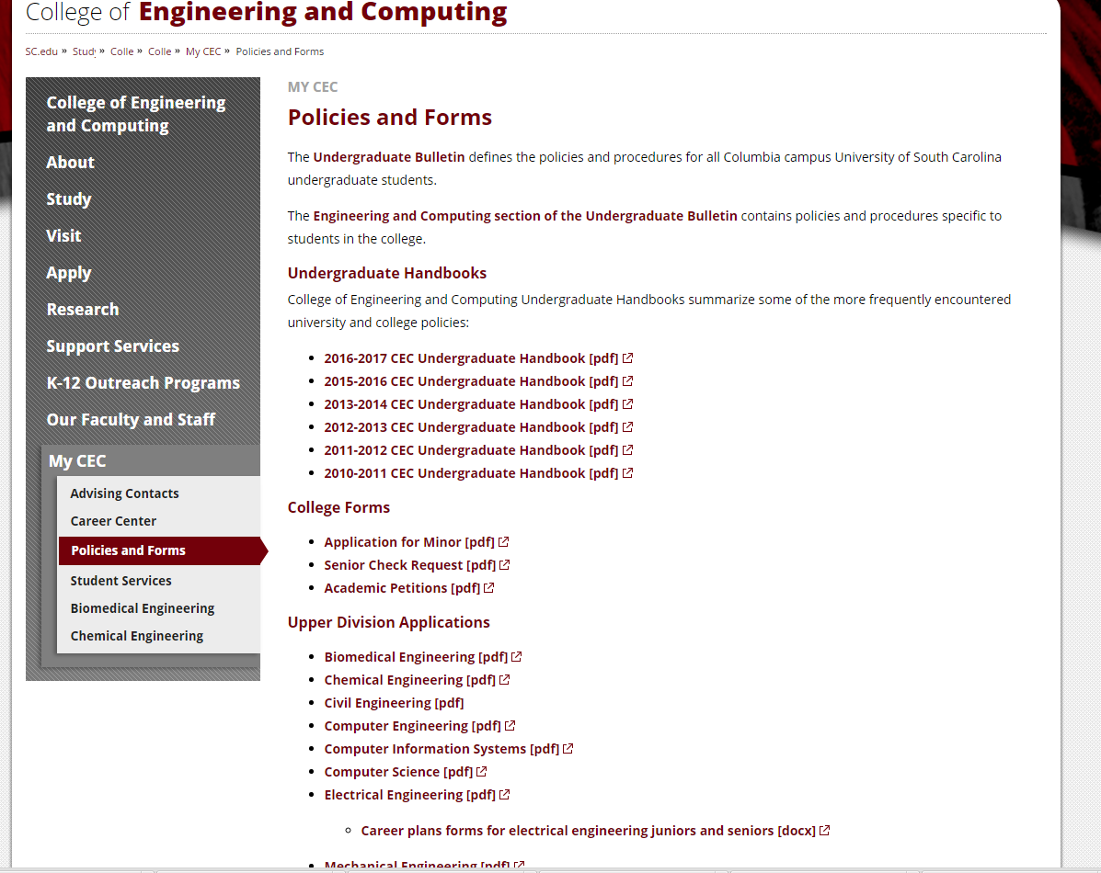
Advising Resources
www.cec.sc.edu
Notes:
This website will provide general information for all of the Majors in the College of Engineering and Computing. Here you will find contact information from staff in the Student Support Service Office, along with general information on Policies and various forms.

Slide 5
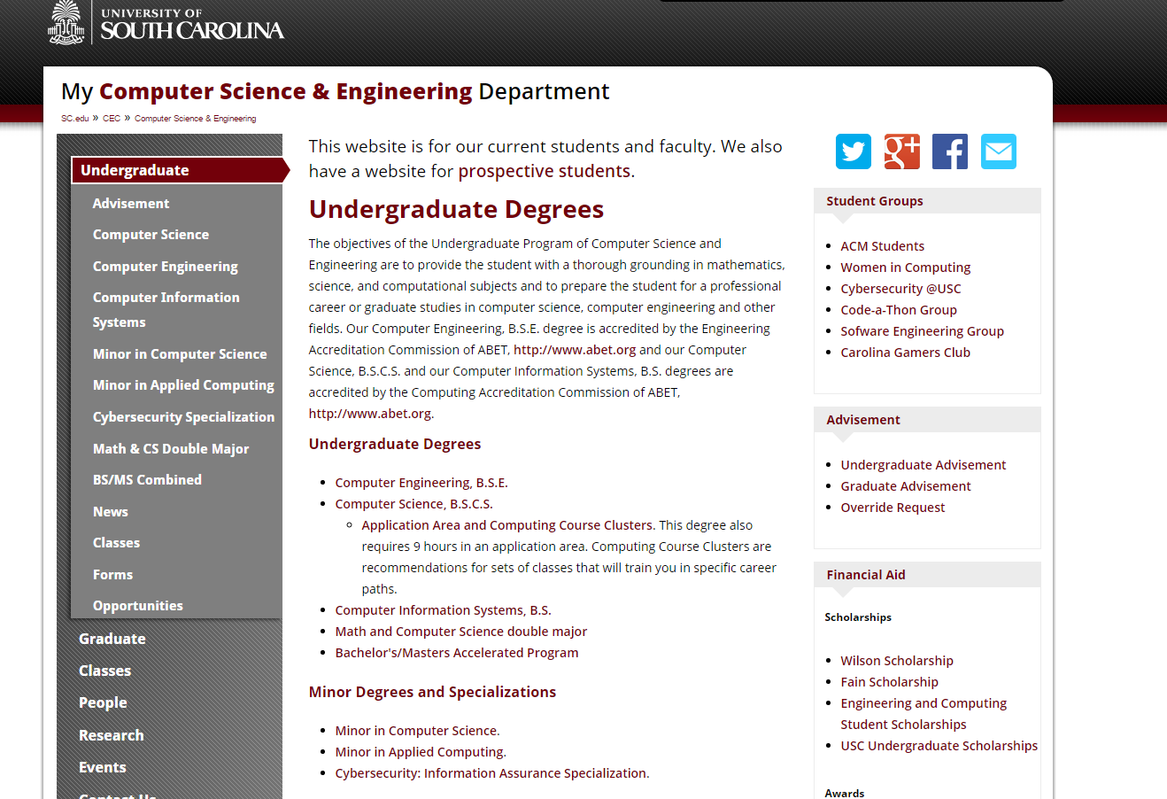
Advising Resources(Computing)
https://cse.sc.edu/undergraduate
Notes:
The computing website is very informative. It will include guidesheets, curriculum sheets, upcoming events, current advisement information, and so much more.

Slide 6
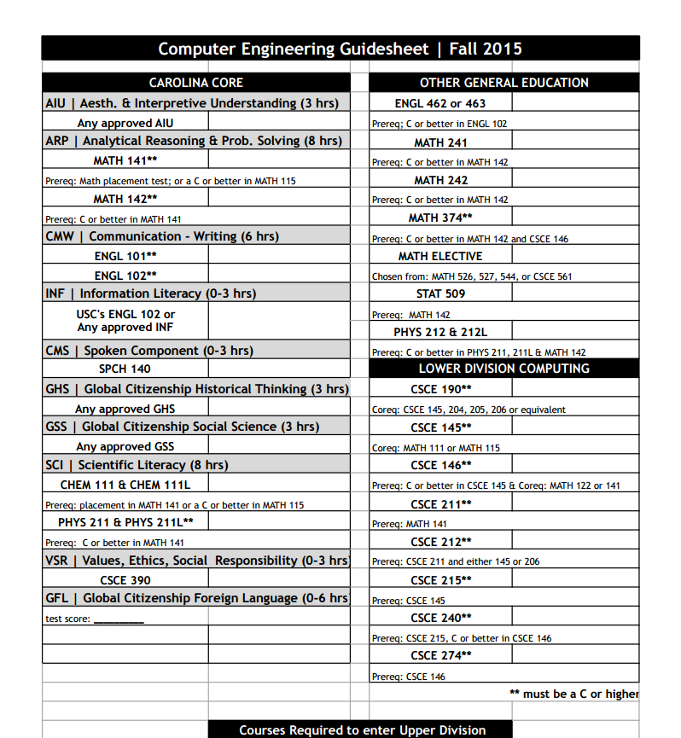
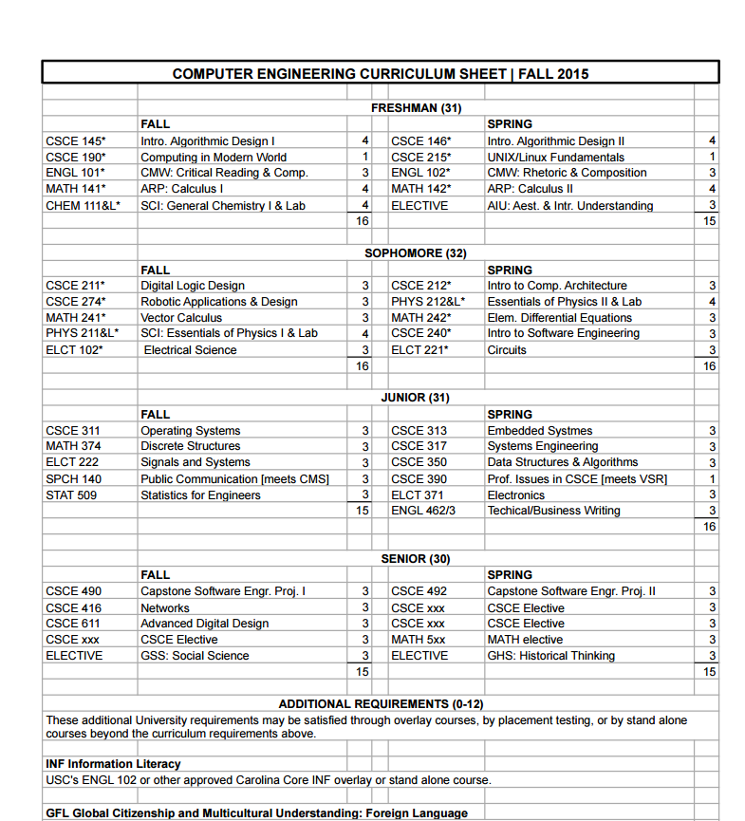
Example of a Guide sheet & Curriculum Sheet
Notes:
Although you will review this during Advisement, it is important for you (as students) to ensure that you have a copy of your guide sheet and Curriculum sheet. Your guidesheet will illustrate the prerequisites of courses needed for your Major as well as if the course must be passed with a “C” or better. Be sure that both the guidesheet and curriculum sheet has the year entered and use it to fill in as you go. Both sheets are equally important and will reflect the accurate record of the requirements of your Major.

Slide 7
Carolina Core
The Carolina Core curriculum provides the common core of knowledge, skill, and academic experience for all Carolina undergraduates. Every student at the University must fulfill all of the requirements. (Located on pg. 94). Your Advisor will discuss this in further detail.

Slide 8
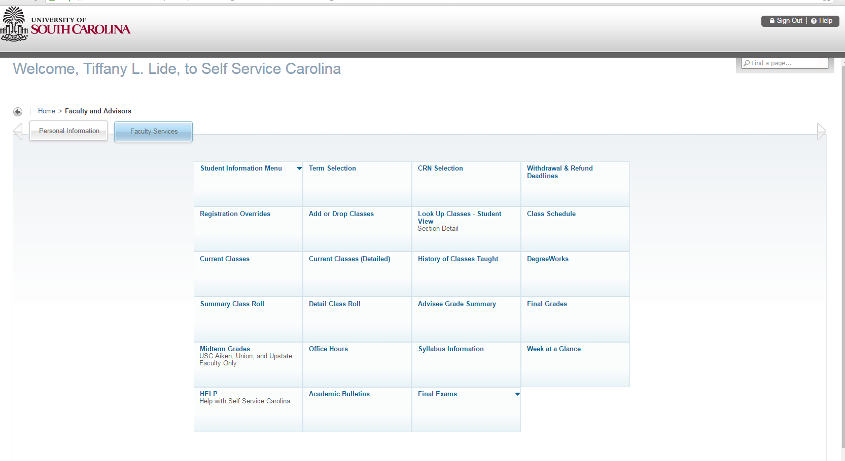
Self Service Carolina

Slide 9
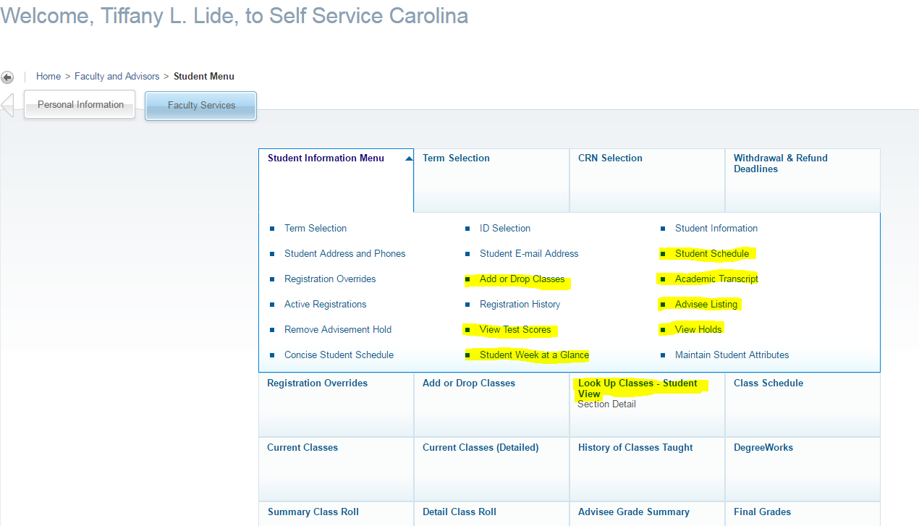
Self Service Carolina
Notes:
The Highlighted Material are links that you might want to become familiar with. It is important for you to know where to look for important academic information.

Slide 10
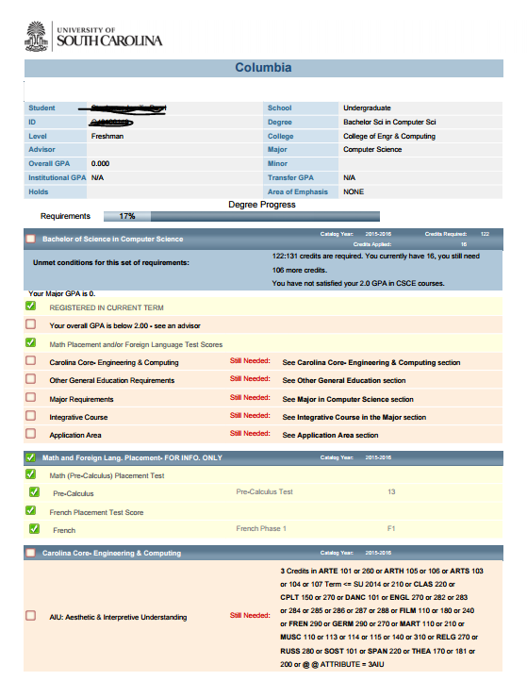
Degree Audit
Notes:
You will find your Degree Audit by logging into my.sc.edu. Click on the Degree works tile and read the important notices and select “Columbia.” Degree Works is a web-based auditing and academic advising tool that aids both the students and advisors in reviewing progress toward the completion of a degree program’s requirement. It will allow students to view their progress towards degree completion, allow advisors/students to plan for future courses, and allow students to hypothetically change their major or degree program.

Slide 11
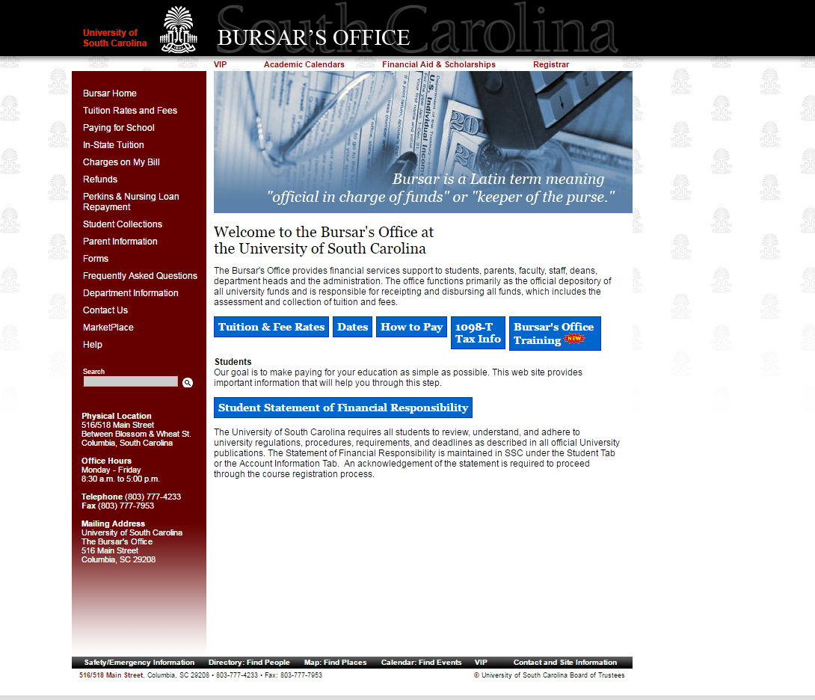

Slide 12
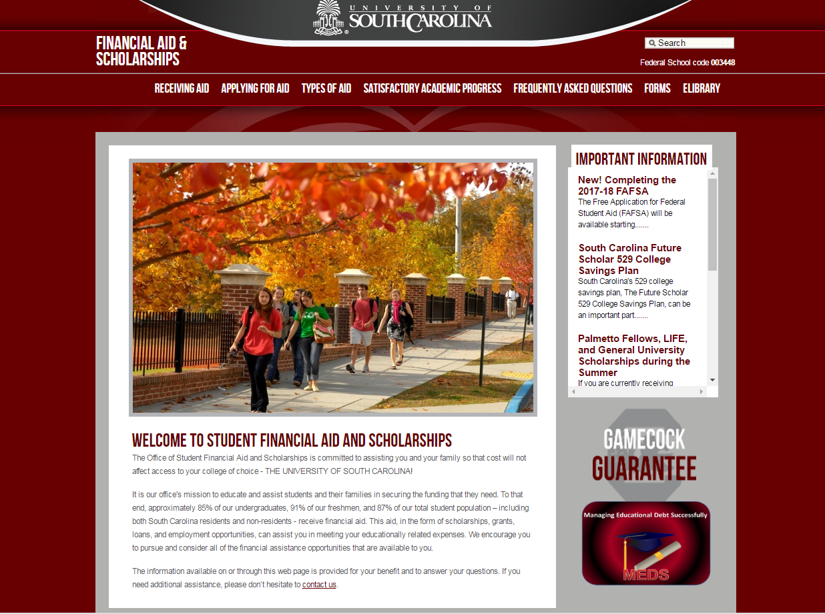

Slide 13
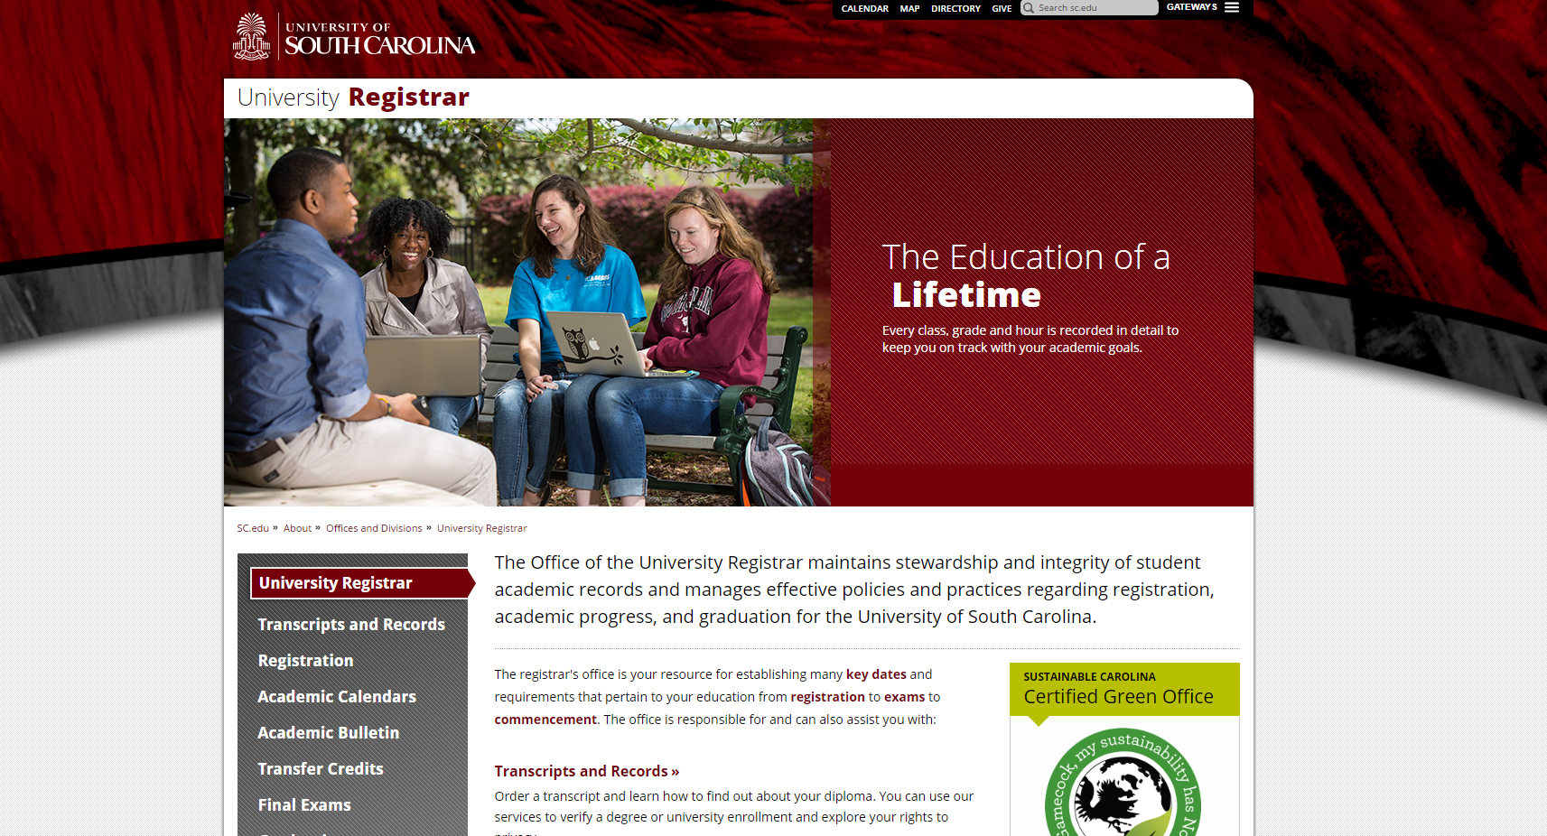
Registrar’s Office

Slide 14
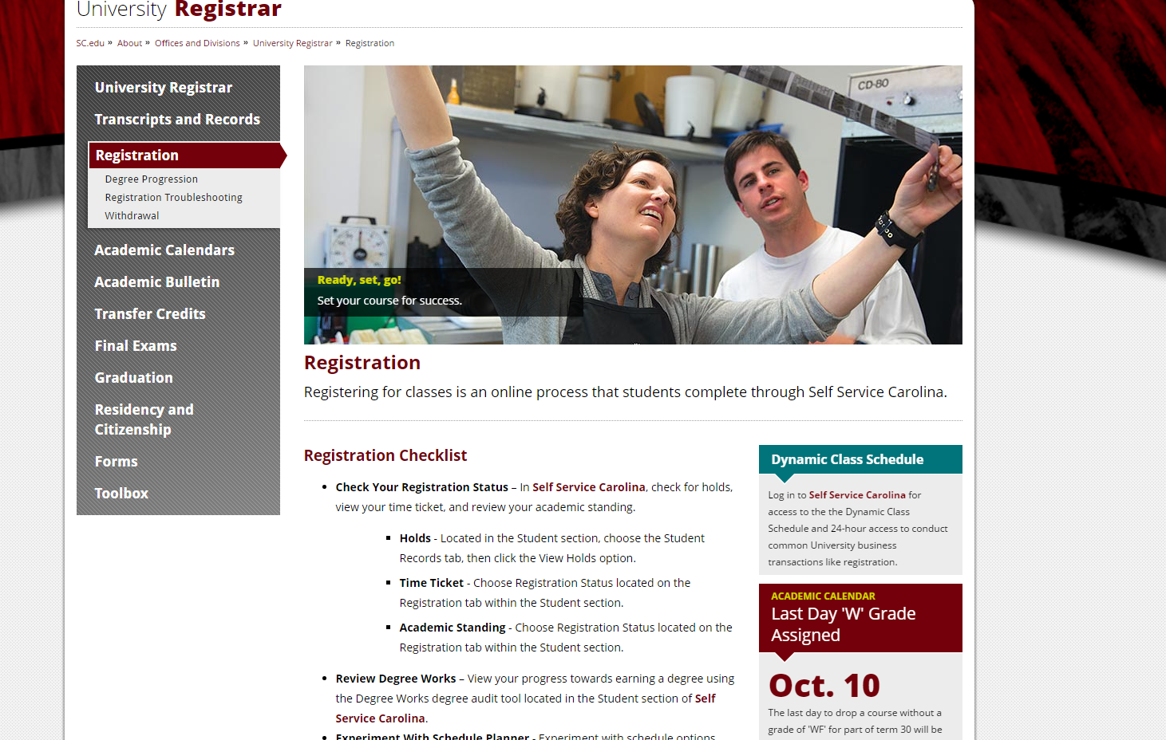

Slide 15
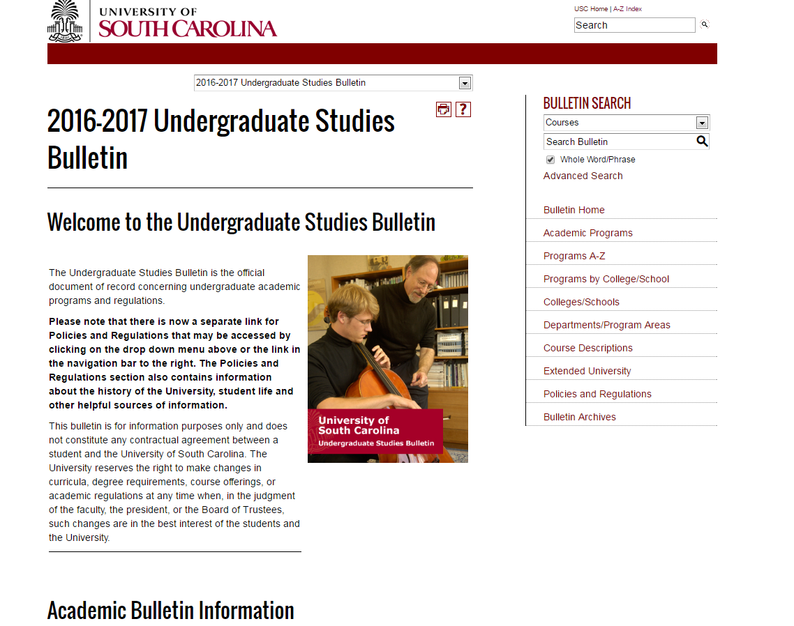
2016-2017 Bulletin
http://bulletin.sc.edu/
Notes:
It is important for you to know that your Bulletin is your “contract” for Academic requirements and Policies, the year you entered the University of South Carolina. It contains information for other Majors and Minors in the entire college.

Slide 16

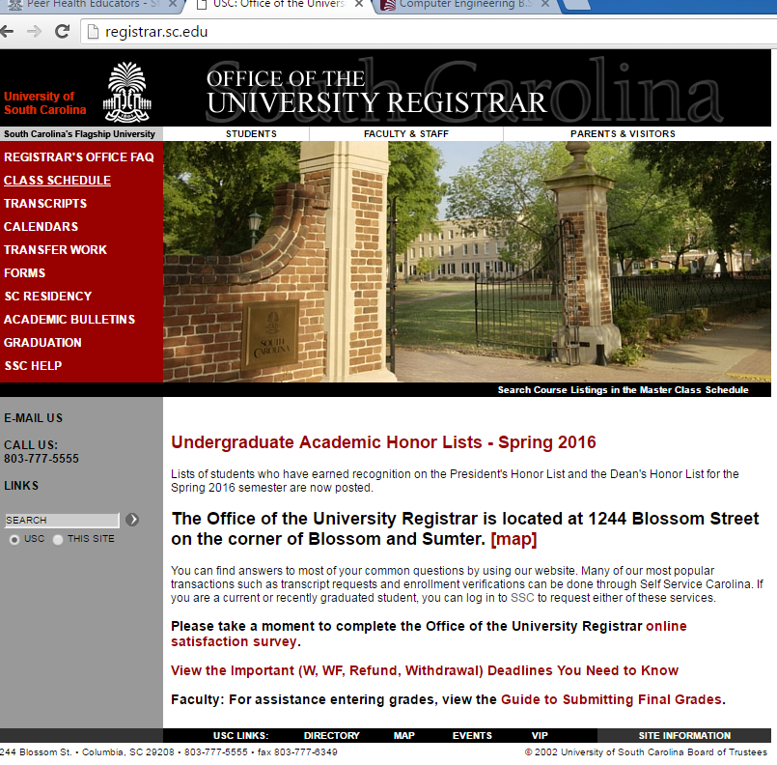
Important Dates to Remember
August 24- Last day to change/drop a course with a grade of “W” being recorded.
September 26- Advising Starts
September 27- S.E.T Fair
October 10- Last day to drop a course or withdraw without a grade of “WF” being recorded.
October 13-14- No classes (Fall Break)
Nov. 23-27- Thanksgiving Recess (no classes)
December 2- Last day of classes
December 3- Reading Day
December 5-15- Final Examinations (includes exams on Saturday)
http://registrar.sc.edu/
Notes:
Be sure to write the following dates in your calendar.

Slide 17
Things you need to understand
University
College
Department
Related issues: Repeat Policy, Override into a College of Engineering and Computing course, Curriculum related issues, Transfer credit issue

Slide 18
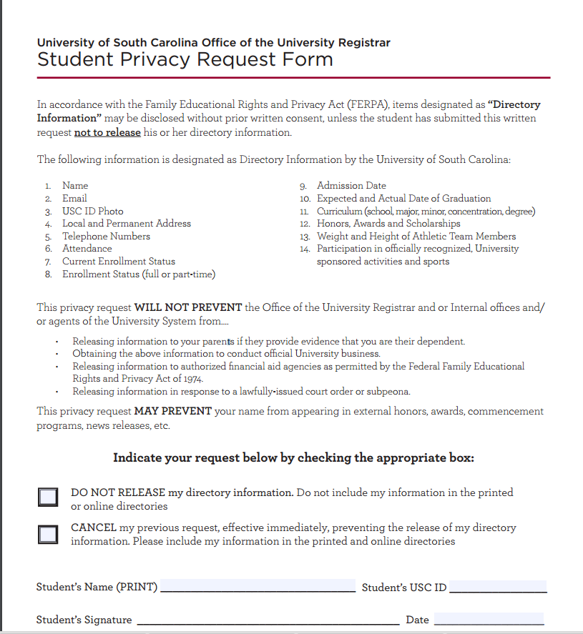
FERPA
Family Educational Rights and Privacy Act
The University will not release Information about students to most people, except for directory information.
A Student may file a Student Privacy Request form to prevent the release of directory information.
A student may file a FERPA Release form to allow parents or others access to grades and academic progress.
Additional details are on the forms and elsewhere on the Registrar’s Office website.
http://registrar.sc.edu/pdf/PrivacyRequest.pdf
Notes:
Advisors/Instructors can only speak to your parents if you both signed the FERPA release form, which is located on the Registrar’s Website.

Slide 19
Interested in a Minor, Internships, etc…
Students can declare or apply for this, after having a USC GPA and 30 credits in their Major.

Slide 20
Other Important Policies
Repetition of Course work-
-CEC allows a max of four repeated Engineering & Computing courses. Regardless of other satisfactory work a course may not be taken a third time (2 chances to pass!).
-If you exceed four repeated Engineering & Computing courses or do not pass a course after two attempts, you must change majors or transfer out of the College of Engineering & Computing.

Slide 21
Dropping of a Course-
-If you drop before the scheduled add/drop, a grade of a “W” will not be recorded.
-Throughout the next six weeks of the semester, any dropped course will reflect a “W” on your transcript.
-The “W” is grade-neutral; it is not calculated into your GPA.
-If you decide to drop after the Withdrawal deadline, you will receive a “WF” which is treated as an “F.”

Slide 22

Other Important Policies
Grade Forgiveness- You are allowed to take up to (2) undergraduate courses for a second time for the purpose of grade forgiveness. The grade must be a D+. D, F, or WF. Once grade forgiveness is applied to a repeated course, the action may not be revoked. The form is found on the Registrar’s webpage.
University Suspension-
1st suspension: Students unable to meet the standards shown on the chart (next slide) are suspended from USC for one Fall or Spring semester and contiguous summer (approximately 8 months). Students have the right to appeal to the petition committee.
Returning after First suspension : After the suspension has been served, a student will be considered for readmission by the college or school to which the student is seeking admission. A student readmitted following suspension continues on probation & is reviewed for suspension at the end of each Fall or Spring semester. A semester GPA of a 2.5 or higher must be achieved each semester.
Notes:
Students returning from a first suspension who fails to meet academic standards will be permanently suspended from the University. The duration of the second suspension is indefinite, and the student can be considered for readmission only after being approved for reinstatement by a successful petition from the college or school to which the student is seeking admission. A favorable decision by college petitions committee is unlikely within two years of the suspension. Credits earned while a student is on academic suspsension from the University cannot be applied toward a degree or used in improving grade point average.

Slide 23
Probation and Suspension
Cumulative Grade Hours attempted (GH) | Placed on Probation | Continue on probation(avoid suspension) | Removed from probation
12-35 | Below 2.0 cumulative GPA | 1.500 or higher cumulative GPA | 2.0 or higher
36-71 | Below 2.0 cumulative GPA | 1.800 or higher cumulative GPA | 2.0 or higher
71+ | Below 2.0 cumulative GPA | Only with semester reprieve (see below) or by college petition | 2.0 or higher
Semester Reprieve: Regardless of the USC GPA, a student may continue on probation and avoid suspension if the semester grade point average is a 2.5 or greater.
Notes:
When a student’s cumulative gpa at the end of any semester is a 2.0 or above, he or she is removed from academic probation.

Slide 24

Dean’s List
In order for Dean’s List recognition, you must have a 3.25 GPA and must be listed as a Full time student.
Sophomore students or above must have a 3.5 GPA.
The President’s List consist of a 4.0 GPA.

Slide 25

Senior Check
A Senior Check is a final review to ensure requirements are being met for the Major. It is typically done in the student’s junior year and before registering for Senior year classes. This is simply a courtesy that is done by the representatives in Student Services.

Slide 26
Taking Courses from Another School (Transient Status)
Students can take up to 18 semester hours of courses in transient status provided:
  the student is in good standing by USC (2.0 GPA or higher)
  the courses are approved in advance by the Office of Student Services or First-Year Advisor
  USC grades of (D, WF, F) retaken at USC
  the transient institution is fully accredited
  the student is not in the last 30 degree hours
  transient grades must be a C or higher to be applied to degree program.
**Remember: The last 30 semester hours must be earned in residence at the University, and at least half of the credit hours in the student’s major courses and in the student’s minor courses (if applicable) must be taken at the University.

Slide 27
Typical Course load
Full-time Minimum | 12 Hours
Full-time Maximum | 18 Hours
Typical Class Load | 12-17 Hours
Notes:
Full-time enrollment is a minimum of 12 semester hours. Most students must complete 15 semester hours each semester to graduate in four years or to meet LIFE or Palmetto Scholarship requirements. Full-time fees are calculated on 12 to 16 semester hours. An additional fee per credit hour will apply to any course loads above 16 semester hours. It your responsibility to mindful of this. Also, first semester freshman students are not allowed to register for more than 18 hours. After the first semester, students may register for more than 18 hours if they have a USC gpa of a 3.) or better.

Slide 28
Class Standing
Hours Passed | Status
<29 | Freshman
30-59 | Sophomore
60-89 | Junior
>90 | Senior

Slide 29
How does Advising Work?
Advisement Appointment- September/October
Advising Hold lifted
Mid-October- Find out Registration time
November- Registration

Slide 30
When is Advising?
September 26- November 1-First-Year Freshman
October 3- November 1-First-Year Transfer

Slide 31

How can I find my Advisor in the future?
All students can find their advisor by logging into Self Service Carolina and click on the Student Tab → Student Records → View Student Information. It is the student’s responsibility to contact his/her advisor to set up an advisement appointment.

Slide 32
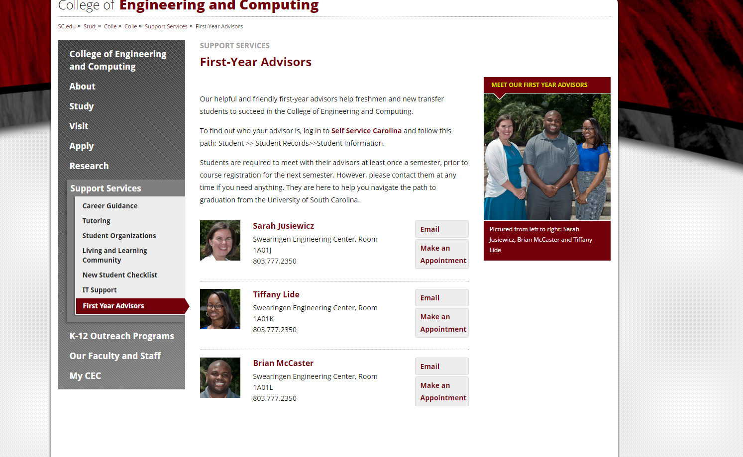
How to set up an Appointment…
https://sc.edu/study/colleges_schools/engineering_and_computing/supportservices/firstyearadvising.php

Slide 33
Any Questions?

