Slide 1
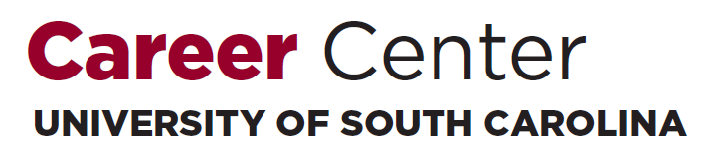
Prepare for the Fair:
Gamecocks Get Hired! STEM Majors Fair
Fall 2018
Katie Kinniburgh
Career Development Coach
College of Engineering & Computing Career Center

Slide 2
Our Agenda for this Evening:
What is the Career Center?
What is Handshake?
How Do I Write A Professional Resume?
How Do I Prepare for the Gamecocks Get Hired: STEM Majors Fair?
Notes:
Learning Outcomes:
Explain the purpose of a professional resume.
Identify the Career Center’s career management platform, Handshake.
Explain the importance of networking.

Slide 3
Our Mission
The mission of the University of South Carolina Career Center is to educate and empower students in their development of lifelong career management skills.

Slide 4

How does the Career Center help?
Resume Reviews
Major & Career
Exploration
Handshake
Internship & Co-op
Search
Mock Interviews
Company Research
Salary Negotiation
Professional Development

Slide 5

Pop Quiz!

Slide 6
Today’s college students will have 12 to 15 jobs over the span of their career.
iClicker:
A for Fact
B for Crap

Slide 7
FACT

Slide 8
Employers don’t expect students to have any career-related experience before they graduate.
iClicker:
A for Fact
B for Crap

Slide 9
CRAP

Slide 10
Computing majors who graduated in 2017 reported starting salaries that averaged
$66K.
iClicker:
A for Fact
B for Crap

Slide 11
FACT

Slide 12
Students who participated in an internship/co-op had starting salaries that were $7K higher than their peers.
iClicker:
A for Fact
B for Crap

Slide 13
FACT

Slide 14
Experiential Education
Any type of hands-on experience in which you can apply ideas and theory from the classroom to real world situations. Experiential education also engages students in deliberate reflection through learning objectives.

Slide 15
What does Experiential Education look like?
Experience it.
Internships
Job Shadowing
Research
Student Organizations
Peer Leadership
Volunteerism
Part-Time Work
Study Abroad
Co-ops
Externships

Slide 16

What is a resume?

Slide 17

What is a resume?
A summary of your qualifications:
  Education
  Experiences
  Skills
To connect your skills, knowledge, and relevant experience to the employer’s needs.
Notes:
A concise summary of your education, experiences, and skills. Not much of a surprise, right? But that definition doesn’t really address the bigger question: why do we write a resume? What’s the point? The answer: to connect your skills, knowledge, and relevant experience to the employer’s needs. This is the crucial thing that I want you to keep in mind as you edit your document today, and for years to come. In essence, the resume is the bridge that connects you to the position – how well-constructed is your bridge?

Slide 18
Pop Quiz!
What is the initial amount of time an employer takes to review an applicant’s resume?
Answer:
  6 seconds minimum
  30 seconds maximum
YOUR RESUME | YOU
Neat Organized Error-free | Neat Organized Detail-Oriented

Slide 19
Resume Appearance
Page length: 1 page
Margins: 0.5-1 inch
Font Style: Times New Roman, Arial, Calibri
Font Size: 10-12 pt
Spacing:
  Single-spacing between bullets
  Double-spacing between headings
Emphasis: Bold, italics, UPPER CASE, underline
Notes:
How long do you think employers tend to spend on their initial review of a candidate’s resume?
*Pause for responses*
The answer: Between 6 and 30 seconds! That’s a quick review, right?! So what does that mean for you as the author of your resume? Essentially, you have a lot of information to convey about yourself very, very quickly. We therefore need to make sure we’re making our documents as clean and easy to read as possible.
So how do we do that? Well, we start by cleaning up the format and appearance. This - not the content- is what’s going to give the employer the very first impression of your resume.
For current undergraduate students, your resume really shouldn’t exceed 1 page. This might require cutting some sections, condensing, and being as concise as possible. For graduate students, 2-3 pages is fine. For those with relevant experience prior to pursuing their degree: the “rule of thumb” is that you can add 1 page for every 10 years of relevant experience you have. Regardless of the number of pages you’re working with, each page on your resume needs to be a full page – no half- or quarter-pages, please!
Margins should be between half an inch and one inch.
Keep the font style clean and professional. We recommend Times New Roman, Arial, or Calibri – you can use something else, but, again, be sure it’s clean, professional, and easy to read.
Keep your font between size 10 and 12. Whatever size you choose, everything on the resume should be that size. The only exception to this is your name, which can be between size 14 and 18. This creates visual consistency.
Keep to single-spacing for your content, except for double-spaces between section headers.
Rather than use color, instead rely on the consistent use of bolding, italics, underlining, and/or using all caps.
And please avoid templates. Build your document from scratch – it will look much cleaner, employers will be able to find the information they need faster, and it will be much easier for you to edit and update.

Slide 20

Resume Components
Header (Your identifying information)
Education
Experience
Skills
Notes:
Once we have the visual stuff taken care of, we can move into the content. The header, education, experience, and skills sections are all necessary components of the resume, particularly for students in STEM majors. There are a few other optional sections that we’ll touch on in just a moment. For now, we’ll start with the header…

Slide 21
Header
Cap the top of your resume with…
  Full name
  Phone numbers
  Email address
Optional:
  Your address (home or local)
  Personal website (if appropriate)
Anita Job
Columbia, SC 29206
(803) 555-1212
Anita.job@sc.edu
Anita Job
Columbia, SC 29206 | (803) 555-1212 | Anita.job@sc.edu
Notes:
Your resume needs to be capped with your full name, your phone number, and a professional email address. You can include your address if you’d like, but it’s no longer mandatory. Often, people will simply include their city, state, and zip code. You can also include the link to your LinkedIn, your Github, etc. Just remember to shorten the link, and to remove the hyperlink (the blue font and underlining).

Slide 22
Education
University of South Carolina: Columbia, SC May 2019
Bachelor of Science: Integrated Information Technology
GPA: 3.72; Dean’s List: 2 semesters
MUST INCLUDE:
Name of the school or university where you earned a degree
City and state in which the school is located
Expected graduate date (Month Year)
Degree (Bachelor of…)
Major, minor, or cognate
GPA if above a 3.0 (cumulative or major)
MAY ALSO INCLUDE:
Awards/Honors/Scholarships (consider a separate section if ≥3)
  Dean’s List, President’s List, Scholarship Programs, Honors College, Capstone Scholars
Study abroad experiences
Relevant coursework

Slide 23

Skills
Optional (but valuable!)
Focus on “hard skills”
Possible categories include:
List product names and numbers if possible
* Students seeking positions in technology should break this list down
Computers | Technology | Language
Programming languages Hardware Software | Operating systems Databases Web Technologies

Slide 24
SKILLS
Computer
Languages: C++, Java, HTML, CSS
Applications: Eclipse, Putty, Matlab
Machines: Unix, Linux, Solaris
Languages
French (Fluent), Spanish (Fluent), German (Written)

Slide 25
Experience
Can be labeled as…
Always include:
  Employer Name
  Employer Location (City, State OR School)
  Your position title
  Dates of employment
  Bulleted list of accomplishments/contributions beginning with an ACTION VERB
Work Experience | Relevant Experience | Leadership Experience | Course Projects

Slide 26
Building Your Bullet Points
Describe your accomplishments*
Use short, concise sentences
Describe “soft” (transferrable) skills you utilized
  Communication
  Teamwork
  Customer service
Quantify: Use numbers, percentages, dollar amounts
TASK | + | SKILL | + | SCOPE

Slide 27
YMCA, Columbia, SC
Childcare Coordinator/Volunteer Counselor May 2017 – August 2017
Facilitated bi-weekly meetings with five counselors to plan weeklong summer camps for community children
Provided educational activities for approximately 60 fifth-grade students to increase skills in reading and math
Supported childcare function for families in need of daycare assistance
Identified caretakers and matched them with families
Successfully coordinated over 75 placements for the summer program

Slide 28
What about…
An Objective?
  Optional - when in doubt, leave it out!
An Interests/Activities Section?
  Format like an experience OR include as a list
A Course Projects Section?
  Include if relevant work experience is limited
  Even if relevant work experience is not limited, it’s usually good to include your Capstone project!
Notes:
At this point, you might have a few other sections on your resume that we haven’t talked about. Or, you might have a few other experiences you’re proud of that you don’t know how to include. Here are a few other considerations you might want to be thinking about:
An activities section can be a great way to demonstrate your involvement in the community, OR if your activities include professional associations, to demonstrate your involvement in the field. You can format these in a few ways: some people include these as a list (particularly if they’re not very actively involved) and others format their activities as they would a work or research experience. Whichever format you choose, just make sure you maintain consistency throughout the section. Also, avoid including very personal activities like knitting or rockclimbing – those won’t carry much weight unless you’re applying for very specific industries.
A course projects section can be a great section to include if you’re sitting here thinking “wait a minute…I don’t have relevant experience in the field yet…” A course projects section is your opportunity to demonstrate that you know how to put theory to practice. Pick 1 or 2 of the projects that are most relevant to the positions you’re applying to and format them as you would a work or research experience. For those of you that do have relevant experience in the field, I (and your professors) still encourage you to include your Capstone Design project on your resume once you’re able.

Slide 29
What about…
An Honors and Awards Section?
  Include in the Education section (<3)
  Include in a separate Honors & Awards section (>3)
References?
  Do not include on your resume!
  Create a separate reference page of 3-5 references (who you have asked!) and only provide it if requested
Notes:
An honors and awards section can also be a great section to include if you have more than 3 awards that you think will help you stand out from other candidates in a meaningful way. If you have less than 3, I recommend incorporating them into the education section.
And finally, if you have a references section on your resume, please remove it. I recommend making a separate reference page (there’s an example of how to do this in the resume packet) and only providing it if/when requested.

Slide 30
Let’s Review…
Resume DO’s | Resume DON’Ts
Use action verbs | Use pronouns (I, me, my, etc.)
Use concise sentences | Include references
Keep resume to 1 page | Include personal information (age, marital status, gender identity)
PROOFREAD! | Include nonessential information

Slide 31

What is
?
Every job starts with a handshake.
The USC Handshake database allows students to search for jobs, internships, and co-ops.
To activate your account:
- Go to https://sc.joinhandshake.com
- Enter your @mailbox or @email.sc.edu email address, then click U of SC Student Log-In
- On the next screen, type in your network name and university password

Slide 32
Handshake Resume Approval
Approved
Not Approved
Can look at posted positions
Can be searched for by employers
Can apply for any position posted
Can look at posted positions
Can be searched for by employers
Cannot apply for ANYTHING
* To obtain Approved access to Handshake, you will need to upload your resume to your Handshake profile. Please do this early!

Slide 33

The Importance of Networking
80% of job vacancies: never advertised
The overall time needed to
find a job can be drastically
reduced.
  4-6 months if networking
  6-9 months if not networking
Learn about occupations, employers, and industries of interest
START EARLY!
Notes:
Therefore, it’s important to follow up appropriately!

Slide 34
Researching Employers
Review the list of employers attending the fair
  Handshake
  Fairs app
Visit employer web sites
Narrow your focus and prioritize the number of employers you want to connect with
Before the Fair

Slide 35

Prepare your Pitch
Elevator Pitch:
Marketing message for
your professional self
Your qualifications
+ Your interests/goals
= Your Pitch
30-60 seconds
Practice, practice, practice!
Before the Fair
Notes:
Articulate who you are, where you’ve been, and where you want to go
*The image is hyperlinked to an elevator pitch video.

Slide 36
Prepare to Make a Good Impression
Bring 20+ copies of well-written, critiqued resume
Practice your elevator pitch until it sounds natural
Develop a list of questions for employers based on your research
Prepare a “Career Fair Employer Log” to use for note-taking during the fair
Before the Fair
Notes:
Know how to relate your past work, academic and out-of-class experiences, to the career field.
Prepare a career log in advance to document career fair information (i.e., To whom have you given a resume?, Are they scheduled to return to USC ?, etc.)

Slide 37
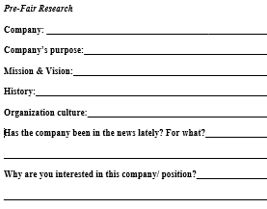
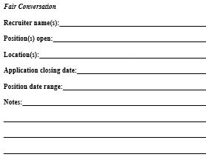
Career Fair Employer Log
Before the Fair
Notes:
Know how to relate your past work, academic and out-of-class experiences, to the career field.
Prepare a career log in advance to document career fair information (i.e., To whom have you given a resume?, Are they scheduled to return to USC ?, etc.)

Slide 38

Think Ahead!
Be prepared for potential bad
weather
Consider time for travel/parking
  Allow ample time for delays!
Talk to professors about class
conflicts
Before the Fair

Slide 39

Make a Good Impression
Arrive early
Behave professionally
Establish rapport with the
recruiters
Remember your body
language
LISTEN to the recruiter
Don’t ramble
Ask at least TWO intelligent questions of each organization
During the Fair
Notes:
Smile, make eye contact, and shake hands confidently and firmly. Introduce yourself with your full name, major, and graduation date.
Remember your body language…don’t fidget or look around. Act interested, focused, and enthusiastic. Be friendly, assertive, mature, and sincere.
Ask at least 2 intelligent questions of each organization, about such topics as: organizational statistics, company mission, client base, internship or co-op opportunities, summer or part-time employment, full-time career paths, trainee programs, benefits, hiring procedures, etc.

Slide 40

Suit Up!
Before the Fair

Slide 41


Slide 42
Always Follow Up
If conducting Day-After Interviews, submit your application materials well before the deadline!
Mail or email thank-you note (and resume) to selected employers as soon as possible
Follow up with a phone call approximately 2 weeks later
After the Fair

Slide 43
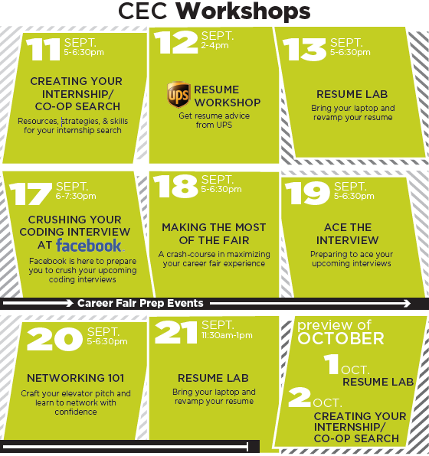

Slide 44
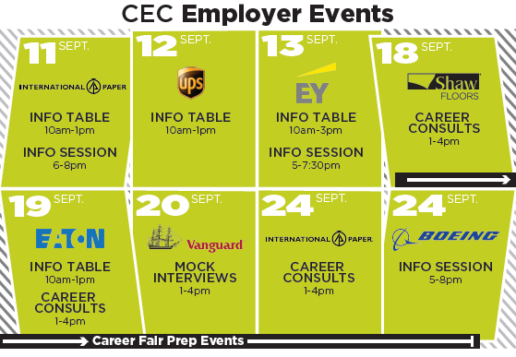

Slide 45

Ready to Show What You Know?
In your web browser, go to
kahoot.it

Slide 46
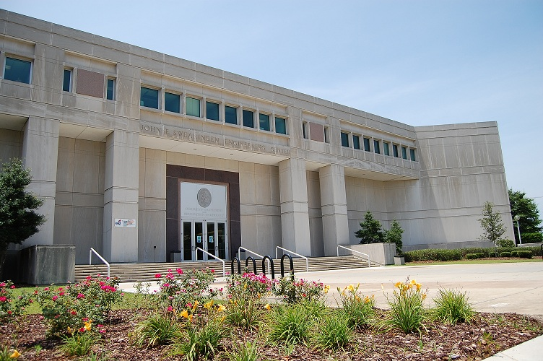
Come visit us!
College of Engineering & Computing Career Center
Swearingen 3A57 | 803-777-1949
Drop-Ins: Monday-Friday, 1-4pm, SWGN 3D19
Appointments: Sign up on Handshake, SWGN 3A57

Slide 47

Thank you!
Questions?

