Slide 1
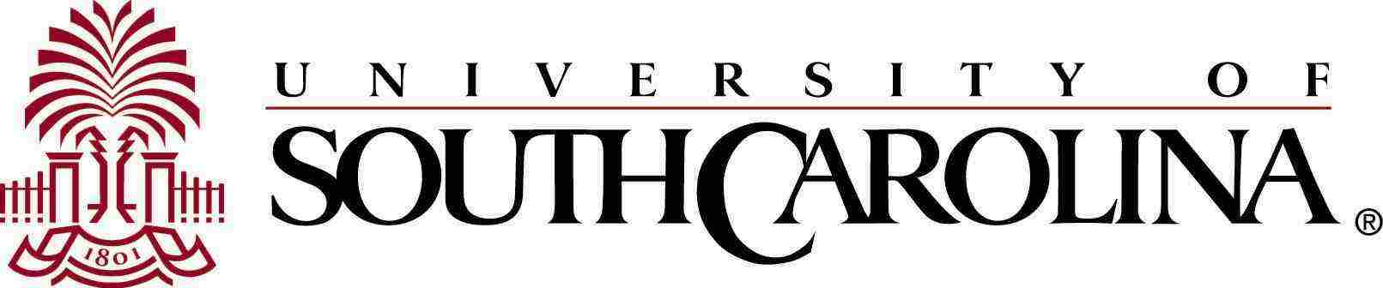


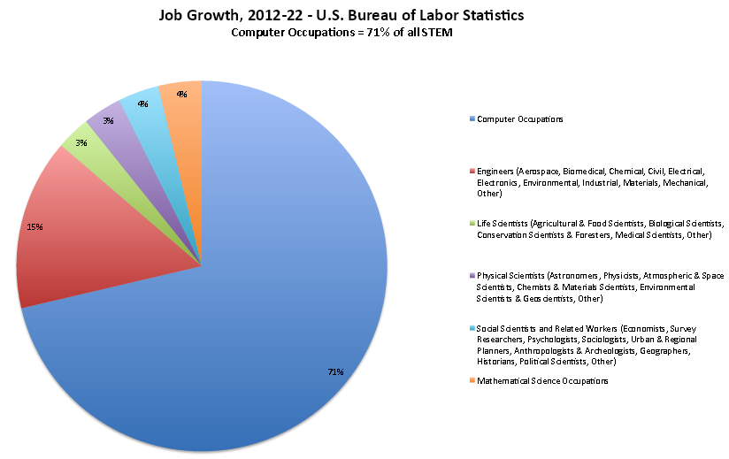
Department of Computer Science and Engineering
Undergraduate Programs
US News Best 100 Jobs 2014
Student Organizations
Computer Engineering
Computer Engineering (CE)
Robotics, embedded systems, VLSI
CE > Computing Courses + Electrical Engineering
Great jobs: Starting Salary of May 2014 graduates $65,578
ACM (Association for Computing Machinery)
  Student Member Lounge 2A17
  Regular Meetings with Pizza
  Lock Picking tutorial ➔ Computer Security
  Duke Energy Information Sessions
  Code-A-Thon sponsored by Boeing
  Fix-IT Day
  First Meeting September 3 @ 7:00PM, 2A17
Women in Computing
  Trip to Hopper Celebration, Phoenix AZ
  Networking with local industry
  First Meeting September 16 @ 7:00PM, 2A17
Cyber Defense Team
  Competitions
  First Meeting September 4 @ 6:00PM, Amoco Hall
Society of Women Engineers (SWE)
  http://web.sa.sc.edu/swe/
Society of Black Engineers
IEEE
Computer Information Systems
All jobs aren’t created equal. In fact, some are simply better than the rest. U.S. News 100 Best Jobs of 2014 offer a mosaic of employment opportunity, good salary, manageable work-life balance and job security. … .
Read the full article for all the details at
http://money.usnews.com/careers/best-jobs/rankings/the-100-best-jobs
# 1 Software Developer (8.4 out of 10)
These professionals are the brains behind your Candy Crush obsession and Android phone dependency.
They might be applications developers, who design computer software, databases and games, or they could be systems-focused developers, who are responsible for building operating systems.
Growth for both types of IT professionals should balloon: The Bureau of Labor Statistics predicts there will be nearly 140,000 brand new positions created before 2022.
#2 Computer Systems Analyst (8.2 out of 10)
To excel in this job, you need to be both goal-focused and process-oriented.
Computer systems analysts must understand computer hardware, software and networks and how they work together, so they can make recommendations to organizations for the best operations systems to use.
The Bureau of Labor Statistics predicts 24.5 percent employment growth for this job by 2022.
#9 Web Developer (7.8 out of 10)
Web developers are responsible for the sleek fonts and clean layout you love on your favorite websites. …
Computer Information Systems (CIS) is the intersection of people, technology and organizations.
Computers are used in every aspect of business in every industry! Great Jobs!
Business oriented mathematics and statistics courses
CIS > Computing Courses + Business Information Management Minor
Computer Science
Software and computers have become ubiquitous in business, education and research settings
Small team projects required in many courses
CS > Computing Courses + focused application area
Example areas: game design, data science, bioinformatics
Great Jobs!
Undergraduate Opportunities
Research on Magellan projects – paid to do research
Co-op opportunities with local industry
Summer internships
Support for NSF REU summer opportunities
Job Fairs - http://www.sc.edu/career/ Part-time fair tomorrow!!!
Assistance
Job Growth in STEM - Bureau of Labor Statistics
CSCE 145/146 Tutors, Calculus tutors
Your Advisor on the CSE Faculty
Student Services – Swearingen 1A00
Computing Help Desk – Swearingen 1D35
Computer Science Office Swearingen 3A01
Dr. Jose Vidal – Undergraduate Director Swearingen 3A51
Dr. Matt Thatcher – Associate Chair Swearingen 3A53
Dr. Manton Matthews – Chair Swearingen 3A01
Important Dates
August 21 first day of class
August 27 end of Drop Add (your schedule is fixed at this point)
October 9 WF–Day – withdrawal on or before this date does not hurt your GPA
December 5 – Last Day of Classes
December 15 – Last Day of Exams
Computer occupations 71% of STEM growth

