Slide 1

Computing from an Electric and Gas Utility Perspective
CSCE Students
November 6 2018
Chris Pierson, IT Manager

Slide 2
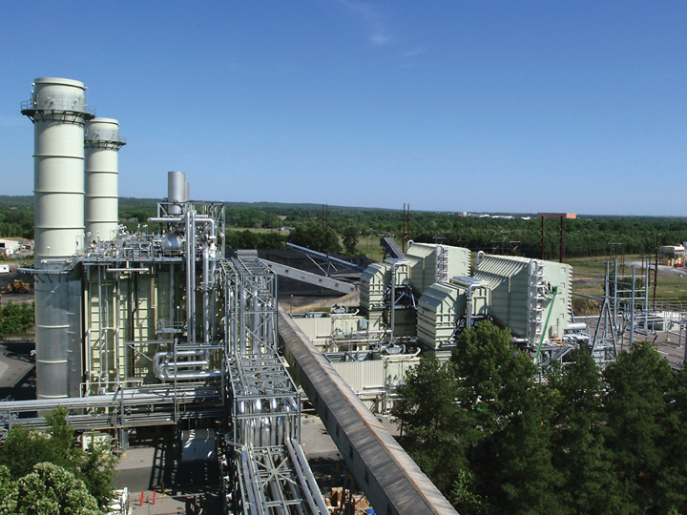
Agenda
SCANA Brief
Why CSE Degree?
My Career Highlights
Industry Outlook
What you can do
Questions

Slide 3
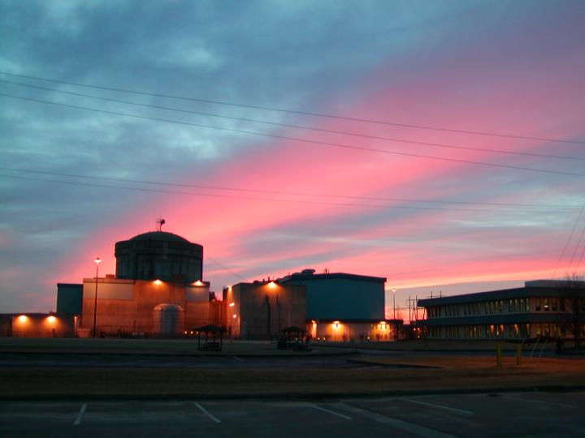
SCANA Basics
Headquartered in Cayce, SC
SCANA Corporation is an energy-based holding company
Utility operations in regulated electric and natural gas and other energy-related businesses
Subsidiaries serve more than half a million electric customers in South Carolina and more than 1.2 million natural gas customers in South Carolina, North Carolina and Georgia.
Over 5,000 employees in three states

Slide 4

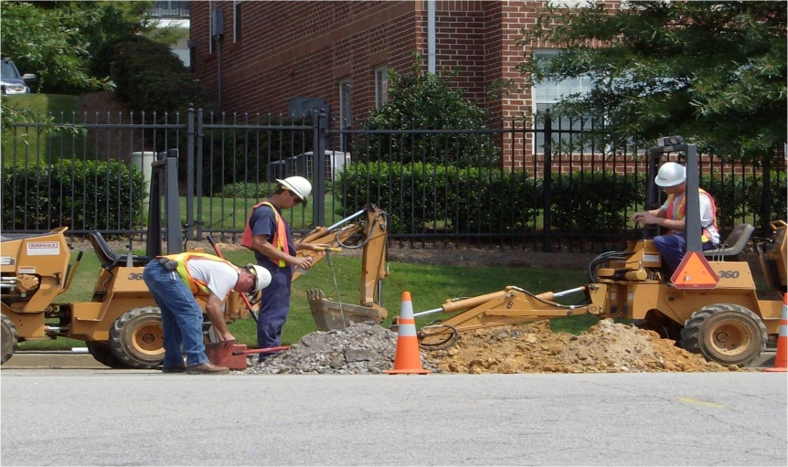
Our Mission and Vision
Provide energy-related products to retail markets in the Southeast.
A company of committed people working together professionally to serve our customers.

Slide 5
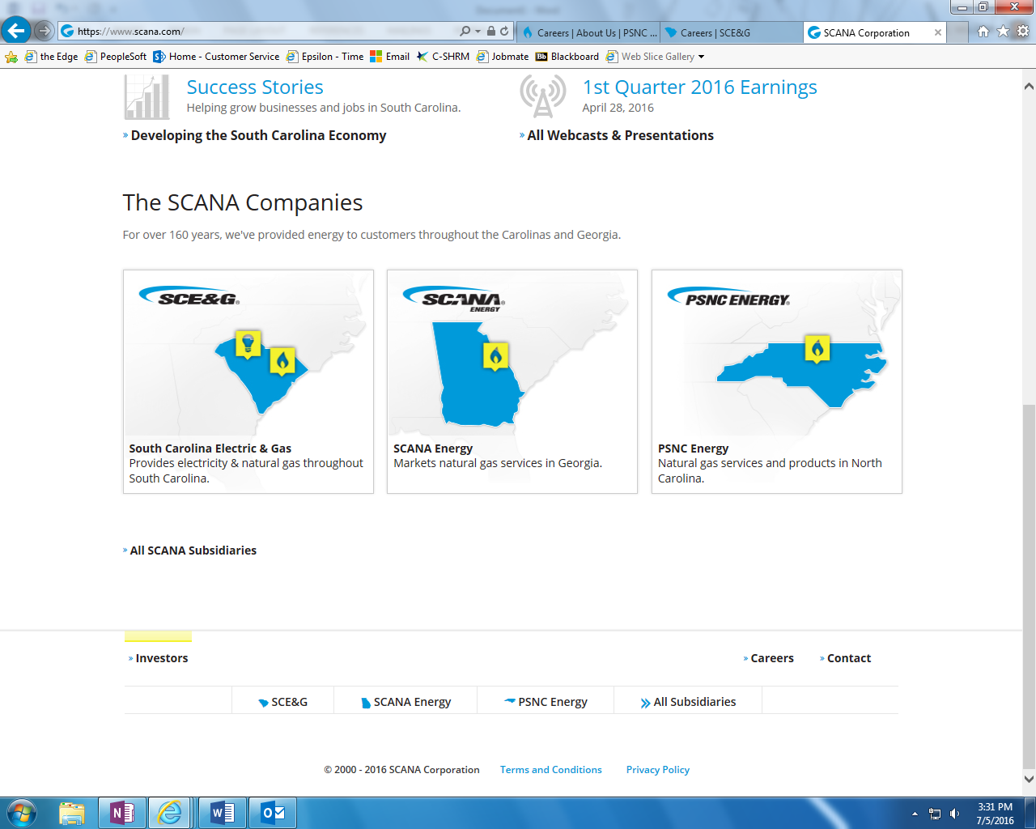
Family of Companies

Slide 6





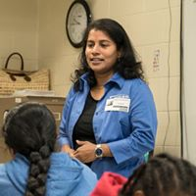

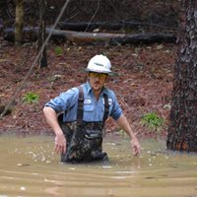



SCANA Introductory Video
October 22, 2018

Slide 7
Where can a computer related degree take you?
Examples of job titles/opportunities just within SCANA:
Software Engineer
Cyber Security Analyst
Database Administration
Infrastructure Analyst
Infrastructure Tech
IT Analyst
IT Project Management
IT Training
Network Planning & Engineering
Technical Writing
Technology Consultant
Telecommunications Tech
Leadership

Slide 8

Employee Makeup
400+ IST employees
Most have BS in Computer Science, Computer Engineering, Management Information Science,
or related field
44% female; 22% minority
30% Gen X, 12% Gen Y
Student Internships and Co-op programs

Slide 9
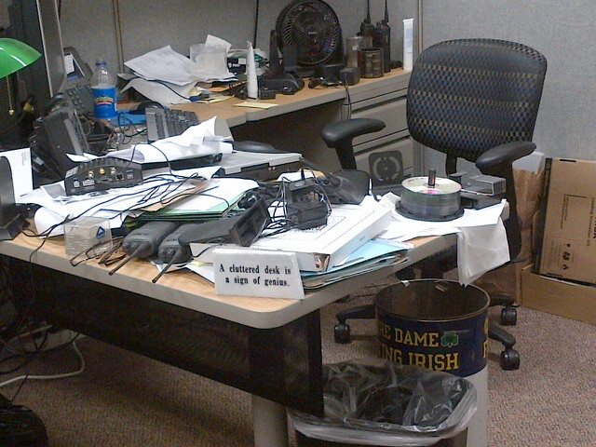
We aren’t always at our desks

Slide 10
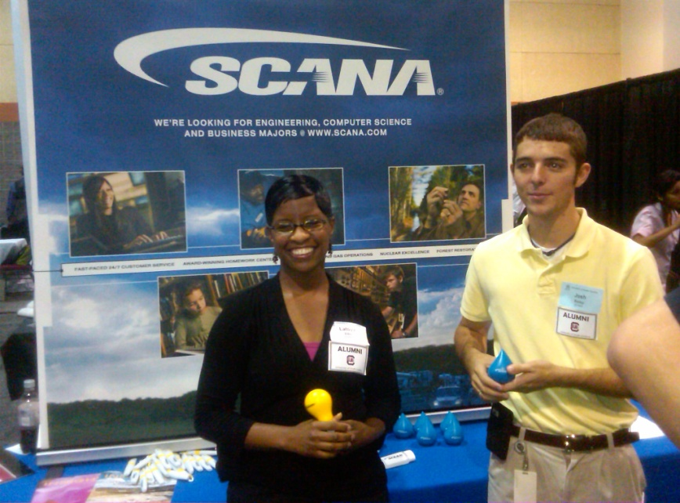
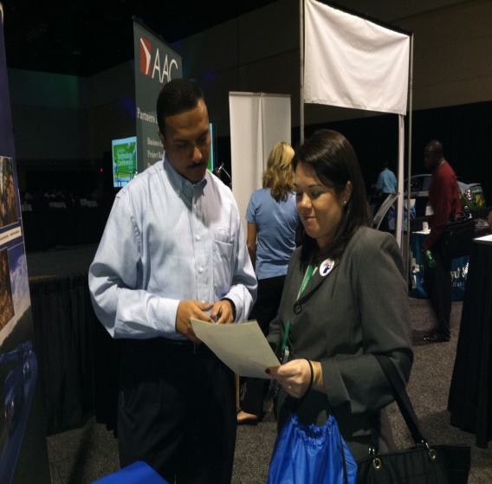
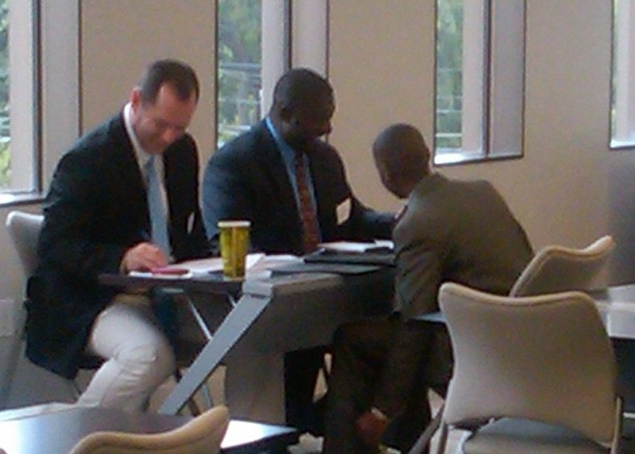
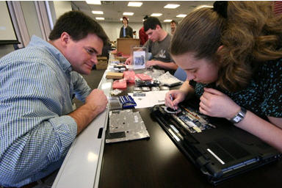
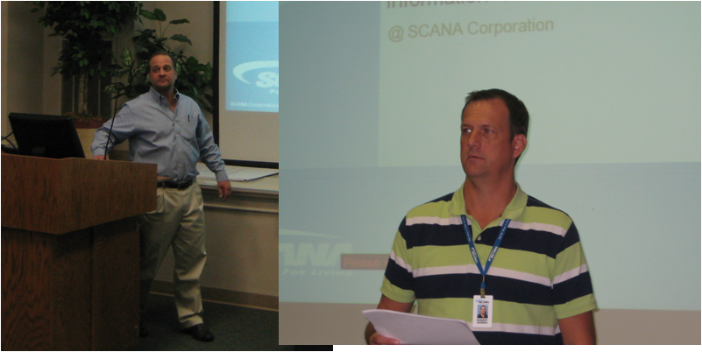
We do outreach

Slide 11
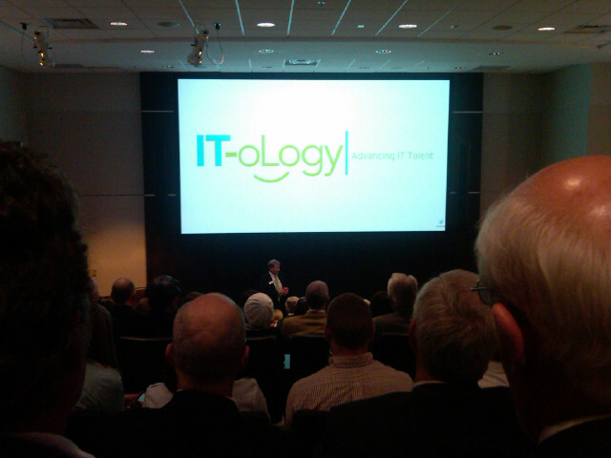
We support community education

Slide 12
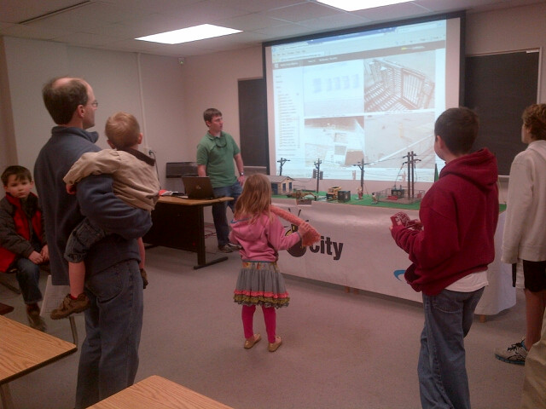
We support universities

Slide 13

We support local charities

Slide 14
My career-26+ years, never bored
ROLES:
Student Co-op
Applications developer
Systems analyst
Project manager
Applications specialist
IT Supervisor
Client manager
Program manager
IT manager
OPPORTUNITIES:
Electric Operations
Client/server (internet start)
Fossil/Hydro plant IT + OT
SCANA Energy startup
PSNC merger
Marketing/Sales systems
Data analytics
Demand Side Management
Customer Service Eng.
IT Operations

Slide 15

Projects at Lake Murray Dam

Slide 16

Cope Station Construction

Slide 17

Fuel Delivery Management System

Slide 18
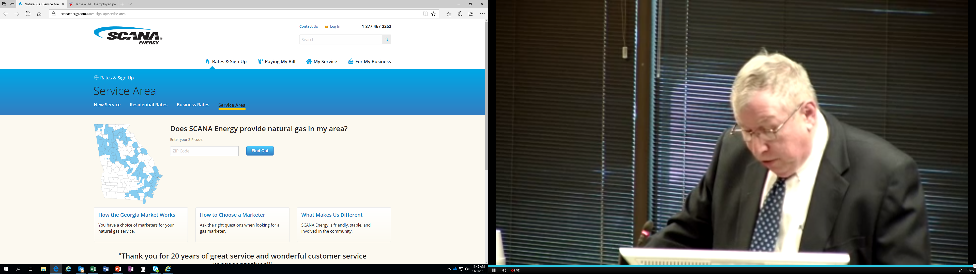
SCANA Energy Startup in GA

Slide 19
Industry Outlook

Slide 20
Bureau of Labor and Statistics Projection
Computer and Information Technology Occupations
Employment of computer and information technology occupations is projected to grow 13 percent from 2016 to 2026, faster than the average for all occupations…projected to add about 557,100 new jobs.
The median annual wage for computer and information technology occupations was $84,580 in May 2017, which was higher than the median annual wage for all occupations of $37,690.

Slide 21
iClicker!
Computer and Information Technology occupations are projected to grow by 13% from 2016 to 2026, which is faster than the average for all occupations.
A. True
B. False

Slide 22
Jobs Are Out There!
Even during poor economic times
Unemployment Rate
National, June 2012: 8.4%
2015 = 5.5%
2016 = 4.9%
2017 = 4.4%
‘Balanced’ Unemployment:
Technology: May 2012:
Technology, June 2012: 3.1%
2015 = 3.0%
2016 = 2.1%
2017 = 2.3%
April 2018 = 1.9%
8.4%
5-6%
3.5%
3.1%
Notes:
And there are lots of jobs out there!

Slide 23
What you can do
Complete STEM BS degree
STEM degree is extremely valuable
  CEC had highest starting salaries, averaging $20,000 more than USC total average starting salaries*
Get real world experience typically via internship or co-op
  Education relevant sooner
  Build resume and references
  Potential job offer before graduation
  Team and corporate environment
  Starting salary $7,000 more with intern/co-op experience*
  * USC career center May ‘17 survey

Slide 24
iClicker!
What can you do, in addition to completing your degree, to improve your chances of getting hired upon graduation, make your education relevant sooner, build your resume’, and have a potential job offer before graduation?
A. Wait until your senior year to start looking for jobs
B. Hang out in five points
C. Nothing in addition to degree as a degree entitles me to a job
D. Gain industry experience if time permits while attending college
E. None of the above

Slide 25
Internships and Co-ops
  Hear directly from students about internship experiences

Slide 26

Student Opportunities
Internships
  Summer
  Extended
Co-ops
Externships (Field Study/Tour)
Job Shadowing
Partnerships

Slide 27


Slide 28
In closing…
Completing your education should be top priority
A degree may get you in the hiring process, but it does not automatically qualify you
Gain work experience in your field
Learn as much as you can about computer technology regardless of your major
Good luck in your journey!

