Slide 1
How Does Watson Work?
CSCE 190
September 25, 2017
Marco Valtorta
mgv@cse.sc.edu

Slide 2
What is Watson?
A computer system that can compete in real-time at the human champion level on the American TV quiz show Jeopardy.
  Adapted from: David Ferrucci, Eric Brown, Jennifer Chu-Carroll, James Fan, David Gondek, Aditya A. Kalyanpur, Adam Lally, J. William Murdock, Eric Nyberg, John Prager, Nico Schlafer, and Chris Welty. “Building Watson: An Overview of the DeepQA Project.” AI Magazine, 31, 3 (Fall 2010), 59-79.
    This is the reference for much of this presentation.

Slide 3
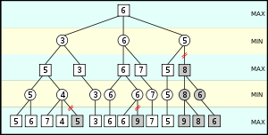
Game Playing
Computer programs usually do not play games like people:
They use a variation of the min-max algorithm.
A Min-Max tree of moves:
(from wikipedia)

Slide 4
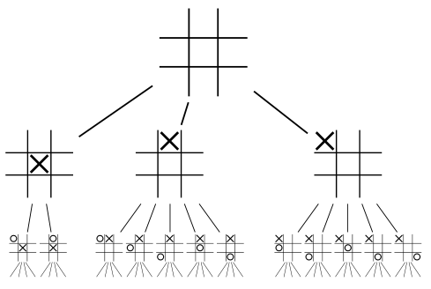
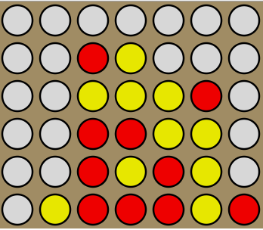
Computers Play Games Very Well
Tic-tac toe is a forced draw
Connect-4 is a forced win for the first player
Notes:
The tic-tac-toe search tree is from Wikipedia.

Slide 5
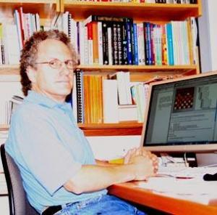
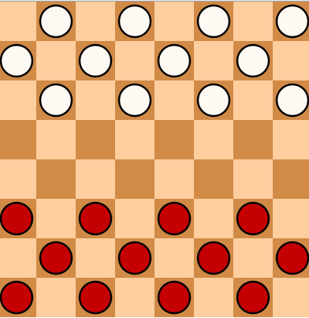
Checkers: a Forced Draw
“After 18-and-a-half years and sifting through 500 billion billion (a five followed by 20 zeroes) checkers positions, Dr. Jonathan Schaeffer and colleagues at the University of Alberta have built a checkers-playing computer program that cannot be beaten. Completed in late April [2007], the program, Chinook, may be played to a draw but will never be defeated.” (http://www.sciencedaily.com/releases/2007/07/070719143517.htm, accessed 2011-02-15)
Jonathan Schaeffer
Notes:
The tic-tac-toe search tree is from Wikipedia.
(http://www.sciencedaily.com/releases/2007/07/070719143517.htm, accessed 2011-02-15)
The checkers board is from Wikipedia.

Slide 6
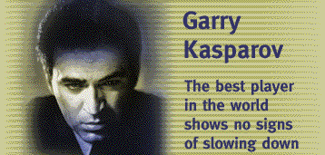
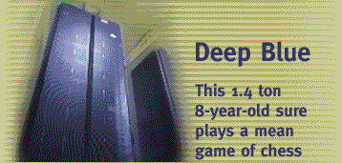
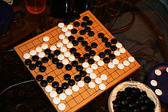
Chess and Go
Chess is not a solved game, but the best computer program are at least as good as the best human players
Human players are better than the best computer programs at the game of Go
Notes:
http://www.research.ibm.com/deepblue/meet/html/d.3.shtml,
http://en.wikipedia.org/wiki/Go_%28game%29,
both accessed 2011-02-15

Slide 7

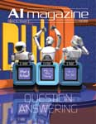
Notes:
The IBM JR&D special issue (at http://brenocon.com/watson_special_issue/) has many technical details. The slides that follow are based on the AI Magazine Issue

Slide 8
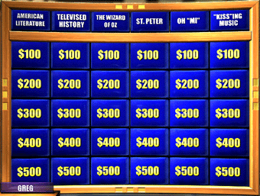
Jeopardy Requires a Broad Knowledge Base
Factual knowledge
  History, science, politics
Commonsense knowledge
  E.g., naïve physics and gender
Vagueness, obfuscation, uncertainty
  E.g., “KISS”ing music

Slide 9

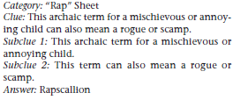

The Questions: Solution Methods
Factoid questions
Decomposition
Puzzles

Slide 10
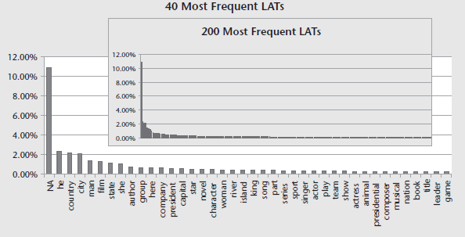
The Domain: Lexical Answer Types
Example: castling is a maneuver in chess

Slide 11
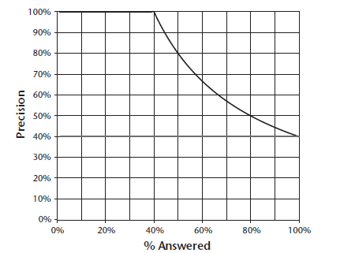
Precision vs. Percentage Attempted
Upper line: perfect confidence estimation
Notes:
There is a thick horizontal line at 40% corresponding to no confidence estimation.

Slide 12
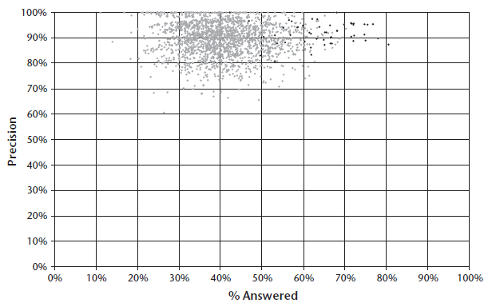
Champion Human Performance
Dark dots correspond to Ken Jenning’s games

Slide 13
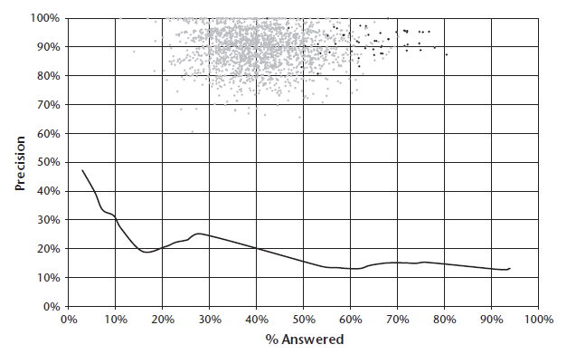
Baseline Performance
(IBM) PIQUANT system

Slide 14
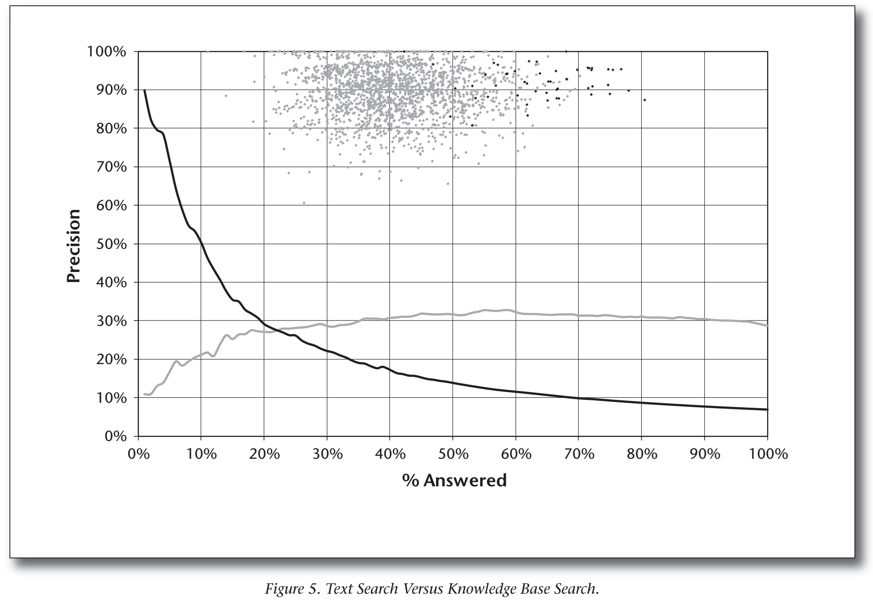
Text Search vs. KB Search
Notes:
Text: light; KB (Structured search: thick). Note lack of accurate confidence estimation for the text-based system, which, however, has better coverage.

Slide 15
The DeepQA Approach
A massively parallel probabilistic evidence-based architecture.
“For the Jeopardy Challenge, we use more than 100 different techniques for analyzing natural language, identifying sources, finding and generating hypotheses, finding and scoring evidence, and merging and ranking hypotheses.”
“What is far more important than any particular technique we use is how we combine them in DeepQA such that overlapping approaches can bring their strengths to bear and contribute to improvements in accuracy, confidence, or speed.”

Slide 16
Overarching Principles
Massive parallelism
  Exploit massive parallelism in the consideration of multiple interpretations and hypotheses
Many experts
  Facilitate the integration, application, and contextual evaluation of a wide range of loosely coupled probabilistic question and content analytics.
Pervasive confidence estimation
  No component commits to an answer
Integrate shallow and deep knowledge

Slide 17
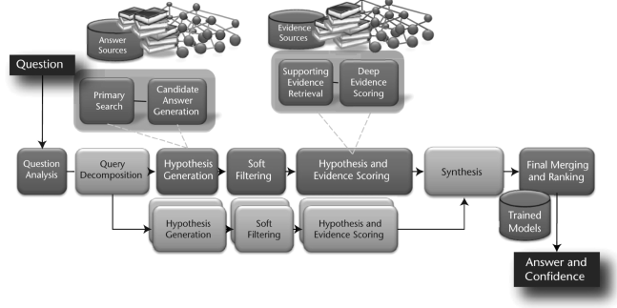
High-Level Architecture

Slide 18
Content Acquisition
Content
Acquisition:
identify
and gather content for the answer and evidence sources.
Answer sources are used to describe the kinds of answers that occur in the game; they are mainly old games.
Evidence sources include encyclopedias, dictionaries, thesauri, newswire articles, literary works, etc.
Seed documents are used to search the web for related text nuggets. Novel text nuggets are retained.
Notes:
Something should be added on this slide.

Slide 19
Question Analysis
Question classification, e.g.: puzzle question, math question, definition question
Discovery of the Lexical Answer Type (LAT) of the answer, e.g.: country, president, novel
Discovery of the focus of the question, e.g., “This title character” in: “This title character was the crusty and tough city editor of the Los Angeles Tribune.”
Relation detection, e.g., borders(Florida, x, North)
Decomposition, i.e., breaking up a question into subquestions

Slide 20
Hypothesis Generation
Candidate answers are considered hypotheses.
“The operative goal for primary search eventually
stabilized at about 85 percent binary recall for
the top 250 candidates; that is, the system generates the correct answer as a candidate answer for 85 percent of the questions somewhere within the top 250 ranked candidates.”
“If the correct answer(s) are not generated at this stage as a candidate, the system has no hope of answering the question. [The candidate answer generation] step therefore significantly favors recall over precision, with the expectation that the rest of the processing pipeline will tease out the correct answer, even if the set of candidates is quite large.”

Slide 21
Soft Filtering
Soft filtering reduces the set of candidate answers, using a superficial analysis embedded in a classifier produced using a machine learning algorithm.
The number of candidates is reduced from about 250 to about 100.
The candidates that survive the soft filtering threshold proceed to hypothesis and evidence scoring; the other ones are not simply discarded, but may be reconsidered at the final merging stage.

Slide 22
Hypothesis and Evidence Scoring
Evidence retrieval includes passage search, where the candidate answer is added to the question. E.g.:
Question: He was presidentially pardoned on September 8, 1974.
Candidate answer: Nixon.
Candidate passage: Nixon was presidentially pardoned on September 8, 1974.
Retrieved passage: Ford pardoned Nixon on September 8, 1974.
Notes:
Example is in the _AI Magazine_ paper.

Slide 23
Hypothesis and Evidence Scoring
Scoring determines the confidence that the retrieved evidence supports the candidate answers.
He was presidentially pardoned on September 8, 1974.
Ford pardoned Nixon on September 8, 1974.
Many techniques are used, e.g.:
term frequency-inverse document frequency (IDF) weights
edit distance
logical form alignment (Ford or Nixon?)
geospatial reasoning (e.g., relative location)
temporal reasoning (e.g., alive at the time?)
popularity (as in web search engines)
Notes:
Example is in the _AI Magazine_ paper.

Slide 24
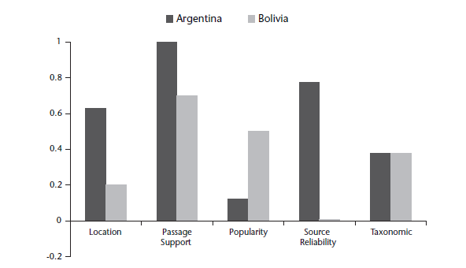
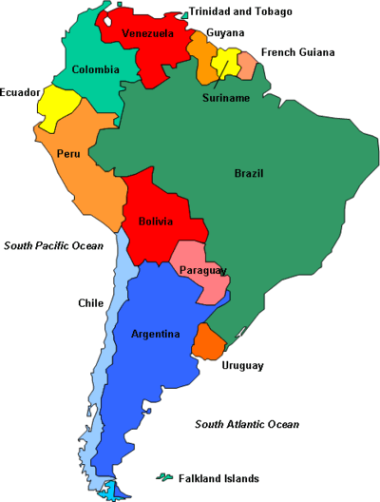
Search Engines Are Not Enough
Evidence profiles aggregate evidence by combining related feature scores.
Example: Chile shares its longest land border with this country.

Slide 25
Final Merging and Ranking
To win at Jeopardy, Watson must
not only return documents related to
the question, but also identify the
precise answer and determine an
accurate confidence in it, so that it can bet on it.
Answer merging combines answers that are superficially different.
Ranking and confidence estimation are two separate phases and use several task-specific models that are assemble from examples using machine learning techniques.
Notes:
Something should be added on this slide.

Slide 26
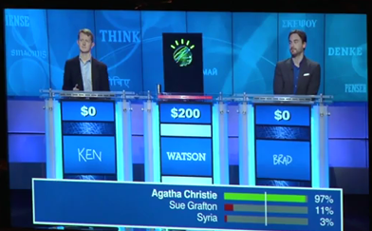
Strategy
Watson must
decide whether to
buzz in and attempt
to answer a question
select questions from
the board
wager on Daily Doubles
wager on Final Jeopardy
Notes:
Something should be added on this slide.

Slide 27
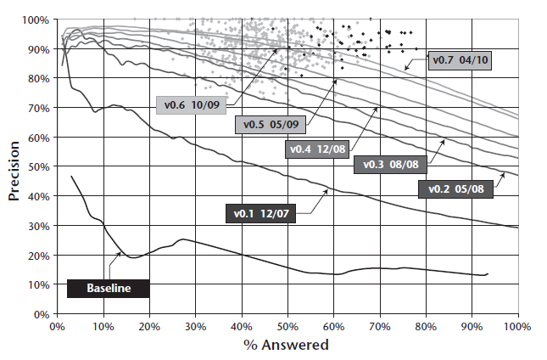
Progress
Notes:
A conclusion slide should be added after this. Maybe one could summarize the TV Jeopardy shows of February 14-16, after they have taken place.

Slide 28

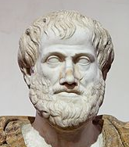
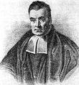
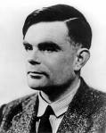
Artificial Intelligence: How Does Watson Fit In?
Systems that think like humans “The exciting new effort to make computers think… machines with minds, in the full and literal sense.” (Haugeland, 1985) “[The automation of] activities that we associate with human thinking, activities such as decision-making, problem solving, learning…” (Bellman, 1978) | Systems that think rationally “The study of mental faculties through the use of computational models.” (Charniak and McDermott, 1985) “The study of the computations that make it possible to perceive, reason, and act.” (Winston, 1972)
Systems that act like humans “The art of creating machines that perform functions that require intelligence when performed by people” (Kurzweil, 1990) “The study of how to make computers do things at which, at the moment, people are better (Rich and Knight, 1991) | Systems that act rationally “The branch of computer science that is concerned with the automation of intelligent behavior.” (Luger and Stubblefield, 1993) “Computational intelligence is the study of the design of intelligent agents.” (Poole et al., 1998) “AI… is concerned with intelligent behavior in artifacts.” (Nilsson, 1998)
Richard Bellman (1920-84)
Aristotle (384BC -322BC)
Thomas Bayes (1702-1761)
Alan Turing (1912-1954)
Notes:
Adapted from: Stuart J. Russell and Peter Norvig. _Artificial Intelligence: A Modern Approach_, 2nd ed. Prentice Hall, 2003.

Slide 29
Watson is Designed to Act Humanly
Watson is supposed to act like a human on the general question answering task
Watson needs to act as well as think
  It needs to push the answer button at the right time
    This is a Jeopardy requirement. The IBM design team wanted to avoid having to use a physical button
The Jeopardy game is a kind of limited Turing test

Slide 30
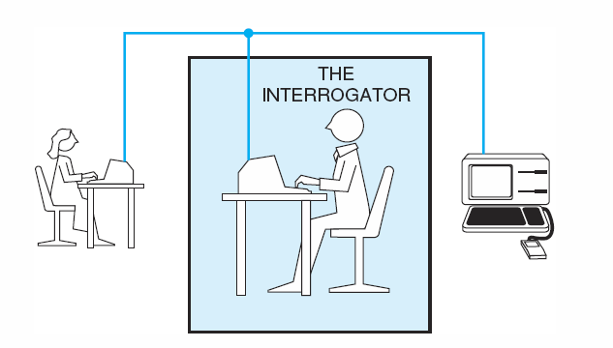
Acting Humanly: the Turing Test
Operational test for intelligent behavior: the Imitation Game
In 1950, Turing
  predicted that by 2000, a machine might have a 30% chance of fooling a lay person for 5 minutes
  Anticipated all major arguments against AI in following 50 years
  Suggested major components of AI: knowledge, reasoning, language understanding, learning
Problem: Turing test is not reproducible, constructive, or amenable to mathematical analysis
Notes:
Adapted from: Stuart J. Russell and Peter Norvig. _Artificial Intelligence: A Modern Approach_, 2nd ed. Prentice Hall, 2003.
Alan Turing. “Computing machinery and Intelligence.“ _Mind_, 59 (1950), 433-460.
The original version involved determining the sex of a correspondent; exchanging the man with a computer; comparing the performance of the interrogator in the two different situations. “We now ask the question: “What will happen when a machine takes the part of A [the man] in this game?’ Will the interrogator decide wrongly as often when the game is played like this as he does when the game is played between a man and a woman? These questions replace our original, ‘Can machines think?’”

Slide 31
Watson is Designed to Act Rationally
Watson needs to act rationally by choosing a strategy that maximizes its expected payoff
Some human players are known to choose strategies that do not maximize their expected payoff.

Slide 32
Acting Rationally
Rational behavior: doing the right thing
The right thing: that which is expected to maximize goal achievement, given the available information
Doesn't necessarily involve thinking (e.g., blinking reflex) but
  thinking should be in the service of rational action
Aristotle (Nicomachean Ethics):
  Every art and every inquiry, and similarly every action and pursuit, is thought to aim at some good

Slide 33
Questions?

