Slide 1
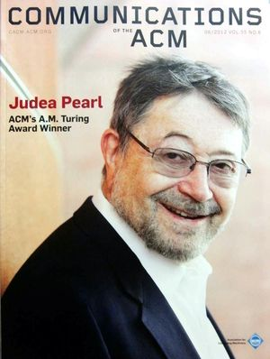
CSCE 190
Computing in the Modern World
Judea Pearl
2011 ACM A.M. Turing Award Winner
November 27, 2018
Marco Valtorta
mgv@cse.sc.edu
Notes:
June 2012 CACM Cover Page

Slide 2
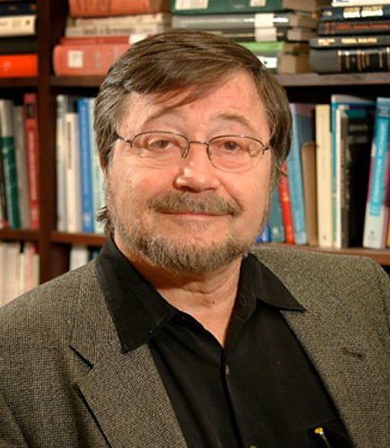
Professor Judea Pearl
March 15, 2012.
ACM today named Judea Pearl the winner of the 2011 ACM A.M. Turing Award for pioneering developments in probabilistic and causal reasoning and their application to a broad range of problems and challenges.
Notes:
http://www.acm.org/press-room/news-releases/2012/turing-award-11/

Slide 3
Biography
Judea Pearl is a professor of computer science at UCLA, where he was director of the Cognitive Systems Laboratory. Before joining UCLA in 1970, he was at RCA Research Laboratories, working on superconductive parametric and storage devices. Previously, he was engaged in advanced memory systems at Electronic Memories, Inc. Pearl is a graduate of the Technion, the Israel Institute of Technology, with a Bachelor of Science degree in Electrical Engineering. In 1965, he received a Master's degree in Physics from Rutgers University, and in the same year was awarded a Ph.D. degree in Electrical Engineering from the Polytechnic Institute of Brooklyn.
Among his many awards, Pearl is the recipient of the 2003 Allen Newell Award from ACM and the AAAI (Association for the Advancement of Artificial Intelligence). His groundbreaking book on causality won the 2001 Lakatos Award from the London School of Economics and Political Science "for an outstanding significant contribution to the philosophy of science."
Pearl is a member of the National Academy of Engineering and a Fellow of the American Association for the Advancement of Artificial Intelligence (AAAI) and the Institute for Electrical and Electronic Engineers (IEEE). He is President of the Daniel Pearl Foundation, named after his son.
Notes:
http://www.acm.org/press-room/news-releases/2012/turing-award-11/
Also: http://bayes.cs.ucla.edu/stat_bio.html

Slide 4
iClicker
Judea Pearl is a computer scientist whose research area is:
Mobile Networks
Artificial Intelligence
Programming Languages
Operating Systems
Databases

Slide 5
Four Books
Heuristics, Addison-Wesley, 1984
Probabilistic Reasoning in Intelligent Systems, Morgan-Kaufmann, 1988
Causality: Models, Reasoning, and Inference, Cambridge University Press, 2000 (2nd edition, 2009)
The Book of Why: The New Science of Cause and Effect, Basic Books, 2018.

Slide 6
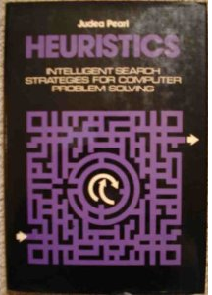
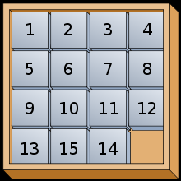
Heuristics
Pearl's early work on heuristic search—a trial-and-error method of problem-solving— propelled the evolution of AI into a mature field with sound scientific foundations. He challenged and ultimately overturned the prevailing approach to reasoning embodied in expert systems and other technologies developed in AI. In his 1984 book Heuristics: Intelligent Search Strategies for Computer Problem Solving, he set a new standard where algorithms, even heuristic ones, had to be analyzed rigorously in terms of their correctness and performance. He subsequently devised ways of programming machines to discover their own heuristics.
Notes:
http://www.acm.org/press-room/news-releases/2012/turing-award-11/

Slide 7
Bayesian Networks
Pearl went on to develop the theoretical foundations for reasoning under uncertainty using a "Bayesian network," a term he coined in 1985, named for the 18th century British mathematician Thomas Bayes. An extremely general and flexible modeling tool, a Bayesian network mimics the neural activities of the human brain, constantly exchanging messages without benefit of a supervisor. These networks revolutionized AI by providing a compact way of representing probability distributions and reasoning about them. Pearl showed how Bayesian networks and their belief updating algorithms provide an intuitive, elegant characterization of complex probability distributions, and the way they track new evidence. This development was a critical step toward achieving human-level AI that can interact with the physical world.

Slide 8
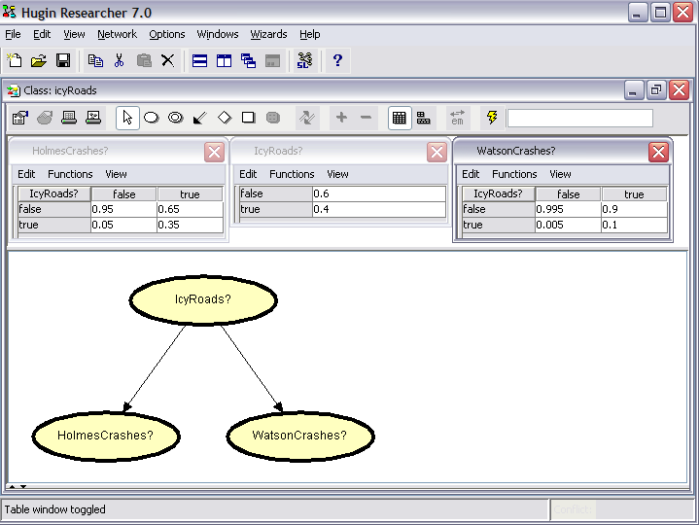
Icy Roads, Model
Source: Judea Pearl via Finn V. Jensen; Hugin Screen Shot

Slide 9
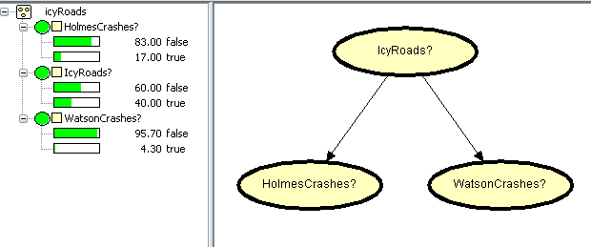
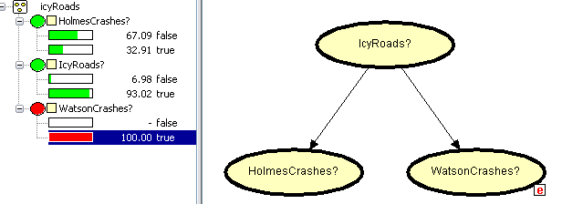
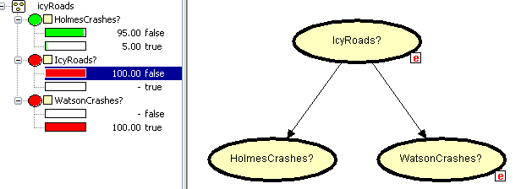
Icy Roads, Example of Use
Source: Judea Pearl via Finn V. Jensen; Hugin Screen Shots

Slide 10
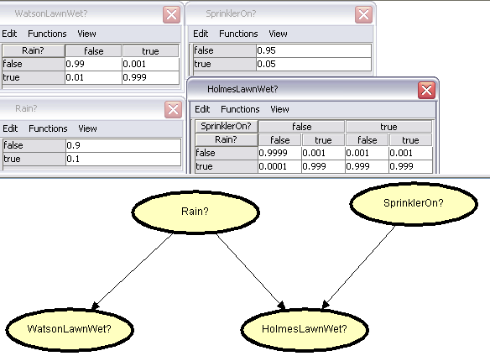
Wet Lawn, Model
Judea Pearl via Finn V. Jensen; Hugin Screen Shot

Slide 11
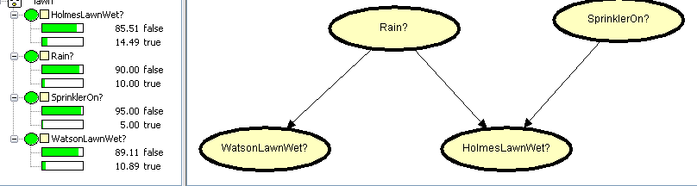
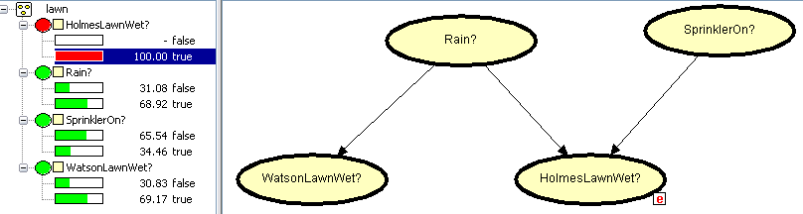
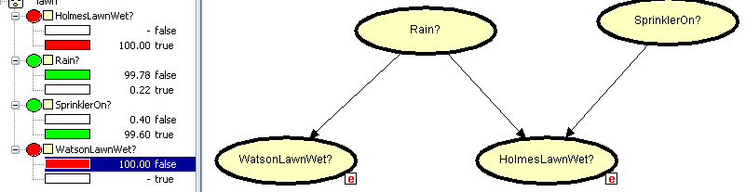
Wet Lawn, Example of Use
Judea Pearl via Finn V. Jensen; Hugin Screen Shot

Slide 12
Causality
In addition to their impact on probabilistic reasoning, Bayesian networks completely changed the way causality is treated in the empirical sciences, which are based on experiment and observation. Pearl's work on causality is crucial to the understanding of both daily activity and scientific discovery. It has enabled scientists across many disciplines to articulate causal statements formally, combine them with data, and evaluate them rigorously. His 2000 book Causality: Models, Reasoning, and Inference is among the single most influential works in shaping the theory and practice of knowledge-based systems. His contributions to causal reasoning have had a major impact on the way causality is understood and measured in many scientific disciplines, most notably philosophy, psychology, statistics, econometrics, epidemiology and social science.
Notes:
http://www.acm.org/press-room/news-releases/2012/turing-award-11/

Slide 13
Causal Bayesian Networks
Causal Bayesian networks
are Bayesian networks
  Each variable in the graph is
  independent of all its non-
  descendants given its parents
Causal Bayesian networks
are causal
  The directed edges in the
  graph represent causal influences between the corresponding variables
Notes:
Explain the graph: variables in one-one correspondence with nodes, conditional independences encoded by the graph, factoring, chain rule for Bayesian networks. Genotype is hidden (unmeasured). Can we still recover the sufficient statistics? Can we recover the causal effect of SerumSelenium on KeshanDisease?
Read the First Paragraph of the JCI Paper.
A directed acyclic graph (DAG) can represent the factorization of a joint distribution of a set of random
variables. To be more precise, a Bayesian network is a pair (G; P), where G is a DAG and P is a joint
probability distribution of variables in one-to-one correspondence with the nodes of G, with the property
that each variable is conditionally independent of its non-descendants given its parents. It follows from this
definition that the joint probability P factors according to G, as the product of the conditional probabilities
of each node given its parents. Thus a discrete Bayesian network is fully specified by a DAG and a set of
conditional probability tables, one for each node given its parents [1, 2].

Slide 14
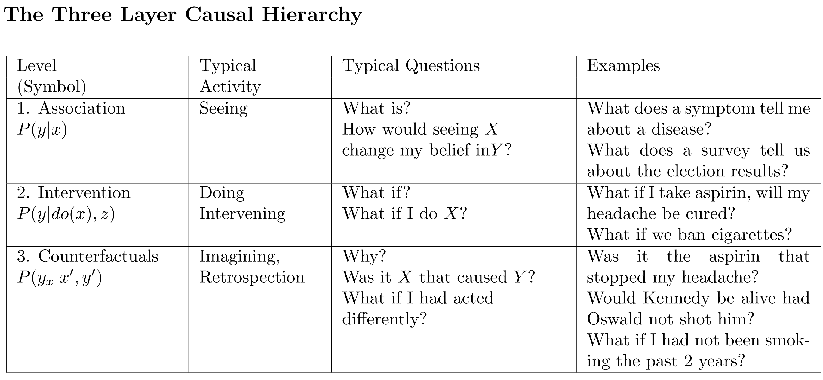
The Ladder of Causation
From: Judea Pearl and Dana Mackenzie. The Book of Why: The New Science of Cause and Effect. Basic Books, 2018. This figure was removed for copyright reasons and replaced with a table from UCLA CSL Technical Report R-475 (July 2018): Judea Pearl. “Theoretical Impediments to Machine Learning with Seven Sparks from the Causal Revolution.”
Notes:
Read example with floss.

Slide 15
iClicker
According to Pearl, the ladder of causation has this many rungs:
1
2
3
4
5

Slide 16
What is Identifiability?
The sufficient parameters for discrete Bayesian network with hidden and observable nodes are the conditional probability tables (CPTs) for each family of nodes
Unidentifiability_1: The ability to determine whether the CPTs can be computed from observable data alone and, if so, to compute them
Unidentifiability_2: The ability to determine whether the causal effect of a set of observable variables on another observable variable in a causal Bayesian network with hidden nodes can be computed from observable data alone, and, if so, to compute it
An Example of case 2 follows

Slide 17
Unidentifiability_2 Example(1)
All the variables are binary.
P(U=0) = 0.5,
P(X=0|U) = (0.6,0.4),
P(Y=0|X,U) =
U
X
Y
Y=0 | X =0 | X= 1
U =0 | 0.7 | 0.2
U=1 | 0.2 | 0.7
Notes:
Fisher, Nature, 1958.

Slide 18
Unidentifiability_2 Example(2)
Note that
We get:
Because of the excision semantics, the link from U to X is removed, and we have:
So, P_{X=0} (Y=0) = (0.7x0.5) + (0.2x0.5) = 0.45
 | X =0 | X= 1
Y =0 | 0.25 (=0.7x0.6x0.5+0.2x0.4x0.5) | 0.25
Y=1 | 0.25 | 0.25

Slide 19
Unidentifiability_2 Example(3)
All the variables are still binary.
P(U=0) = 0.5
P(X=0|U) = (0.7,0.3)
P(Y=0|X,U) =
U
X
Y
Y=0 | X =0 | X= 1
U =0 | 0.65 | 0.15
U=1 | 0.15 | 0.65

Slide 20
Unidentifiability_2 Example(4)
Using
We still get:
From
We have P_{X=0} (Y=0) = (0.65x0.5) + (0.35x 0.5) = 0.4 <> 0.45
So, P_{X}(Y) is unidentifiable in this model
 | X =0 | X= 1
Y =0 | 0.25 | 0.25
Y=1 | 0.25 | 0.25

Slide 21
The Identifiability_2 Problem
For a given causal Bayesian network, decide whether P_{t}(s) (i.e., P(S | do(T)) is identifiable or not
If P_{t}(s) is identifiable, give a closed-form expression for the value of P_{t}(s) in term of distributions derived from the joint distribution of all observed quantities, P(n)

