Slide 1
Digital Humanities
What in the world is that?
Why should I care?

Slide 2
Your Presenter:
W. Matthew J. Simmons, PhD
Interim Director, Center for Digital Humanities
simmonwm@mailbox.sc.edu
https://cdh.sc.edu

Slide 3
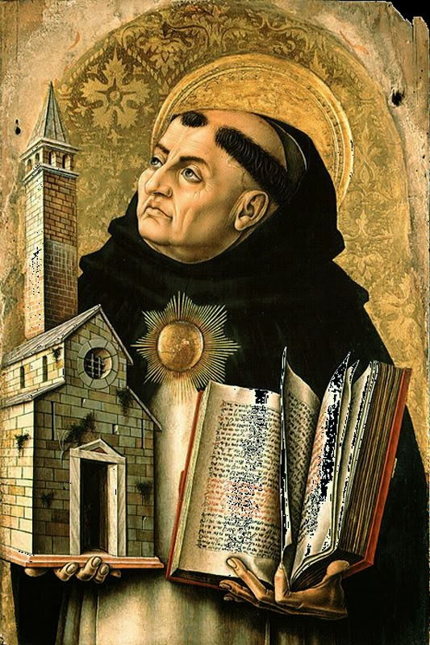
Digital Humanities: The Beginning
Blame St. Thomas Aquinas
What in the world does a 13th-century Italian monk have to do with the ‘digital’?

Slide 4
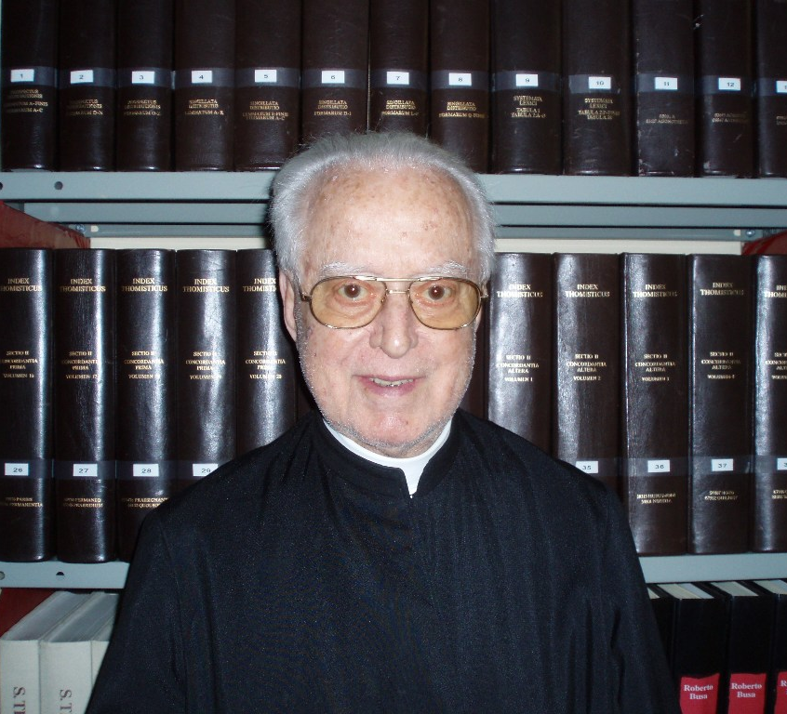
Digital Humanities: The Beginning
Blame another Italian cleric, Fr. Roberto Busa
Index Thomisticus
Worked with IBM’s Thomas Watson
30 Year Project
56 Printed Volumes
CD-ROM Version (‘89)
Web-Version (2005):
http://www.corpusthomisticum.org/it/index.age

Slide 5
Digital Humanities: Recent History
Gradual—but steady!—movements up until the 1990s
Recognition that computing could have implications for humanistic scholarship—especially in processing massive amounts of text
1994—Text Encoding Initiative (TEI) Standards Released
Standardized XML markup for text
Allows for analyzing text via programming/scripting languages parsing standardized XML
Late ‘90s—Several large digital archives of texts launched
‘HUMANITIES COMPUTING’

Slide 6
Digital Humanities: Birth of a Scholarly Field
2004 Publication of A Companion to Digital Humanities
First use of ‘digital humanities’ rather than ‘humanities computing’
Argued that DH was more than simply digitizing materials and displaying them on the (still young) web
Rest of the decade saw the birth of DH as a scholarly discipline
Two main thrusts:
Digitizing/Displaying Materials
Analytical/Interpretive Work, Normally using Large Datasets

Slide 7
Digital Humanities at USC: Center for Digital Humanities
Launched in 2009
Works with partners throughout the US and Globally
Digitization Projects Include:
Carlyle Letters Online
Plants and Planter
Analytical Projects Include:
Dirty History Crawler
Paragon
AR/Cultural Heritage:
Ward One

Slide 8
Center for Digital Humanities: What We Do
Conceptualize projects with faculty partners (‘clients’)
Work with non-programmer/developer partners to digitize materials/do data entry
We establish metadata standards, with client goals in mind
Build, test, publish, and maintain public-facing projects used by scholars, students, and the general public
All of our work is done by STUDENTS!!
Professionalizing students is one of our chief priorities

Slide 9
Center for Digital Humanities: Technologies We Use
CMSes (Wordpress, Drupal, etc)
The MEAN Stack
MongoDB (non-relational noSQL database)
ExpressJS
Angular
Node.js
Git
Google Cloud Platform
Docker/Kubernetes
Our Student Staff Gets Real-Life Training in these Technologies

Slide 10
QUESTIONS?
simmonwm@mailbox.sc.edu
Come Stop By CDH!
Innovation Center Room 1213 First Floor

