Slide 1
CSCE 190
Computing in the Modern World
Blockchain: the Basics
Fall 2018
Marco Valtorta
mgv@cse.sc.edu
www.cse.sc.edu/~mgv/csce190f18

Slide 2
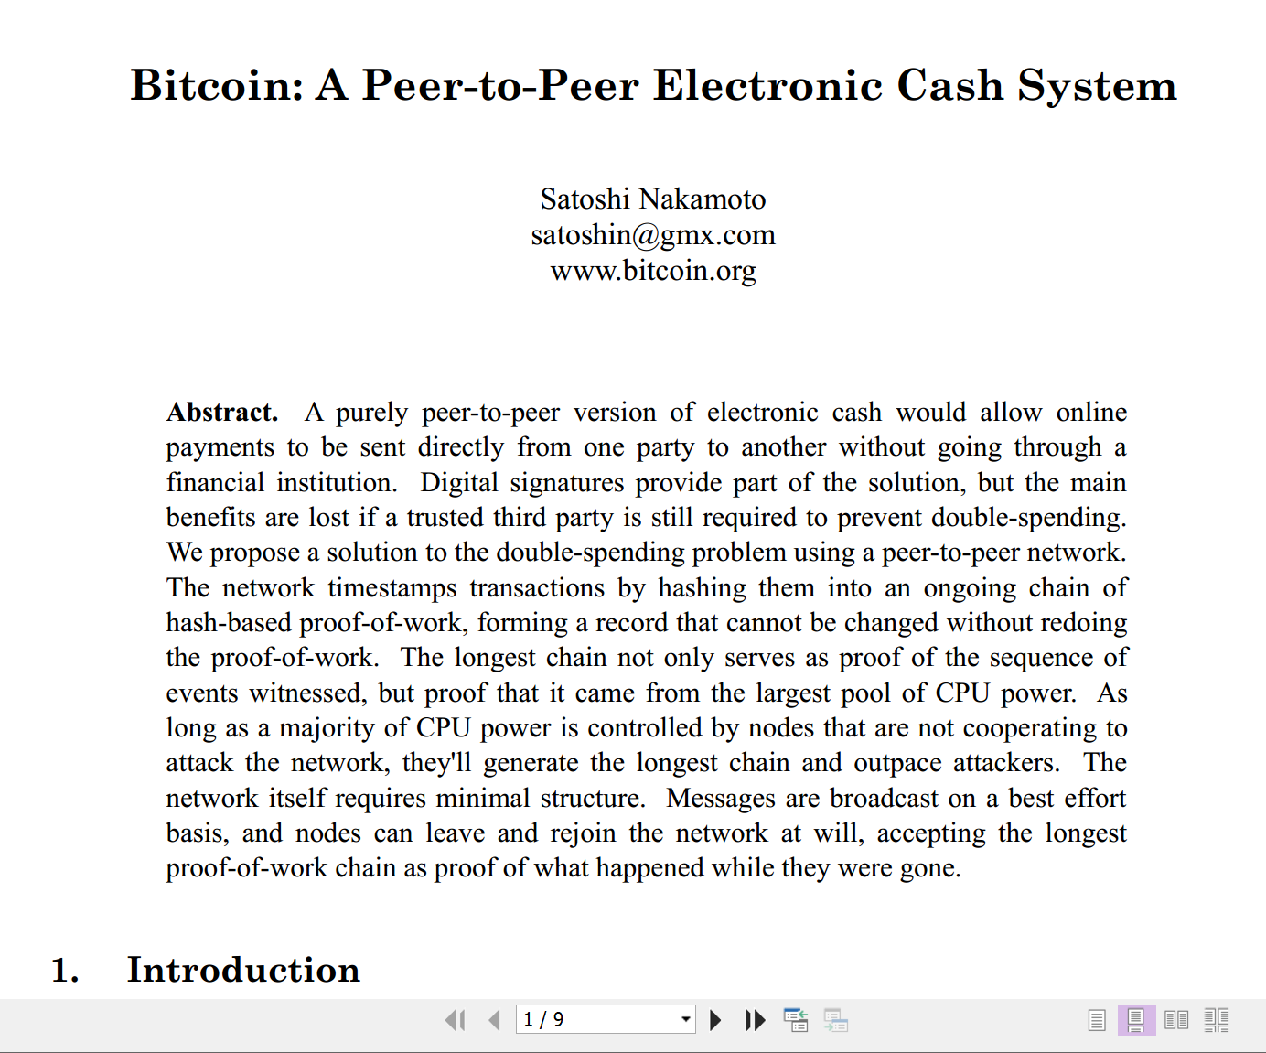
The Original Paper
This presentation is based on:
Massimo Di Pierro.
“What is the Blockchain?”
IEEE Computing Edge, 4, 4 (April 2018), pp.22-25.
Notes:
This paper is not peer reviewed.

Slide 3
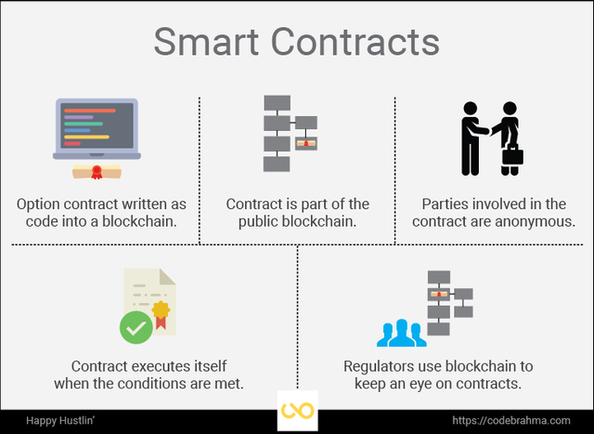
Blockchain vs. Bitcoin
Blockchain is a technique at the foundation of Bitcoin and all other cryptocurrencies
Blockchain has other uses, such as smart contracts
Notes:
Source: https://blogdesantiagonadal.wordpress.com/2018/02/05/e-commerce-y-smart-contracts-1-3/

Slide 4
Trust
Nakamoto’s system creates a distributed storage of timestamped documents where no party can tamper with the content of the data or the timestamps without detection
This is different from the problems of authentication (who created a document?), integrity (was the document surreptitiously modified after being created?), and nonrepudiation (can the true author of a document deny its creation?), which are solved by digital signatures
A digital signature guarantees a link between a document and its creator, but says nothing about when the document was signed

Slide 5
Example: House Sales
Transactions need to be recorded in a secure ledger, to establish ownership
A single trusted centralized ledger is the usual solution (cf: registry of deeds)
Centralized ledgers do not scale and are prone to tampering
The blockchain provides a distributed mechanism with multiple copies, and “every party can verify that the order and timestamp of the transactions have not been tampered with.”

Slide 6
iClicker
Answer the following multiple-choice question.
A blockchain solves the problem of
A. Authentication
B. Establishing trust in a distributed system of transactions
C. The same problem solved by digital signature D. Nonrepudiation
E. All of the above

Slide 7
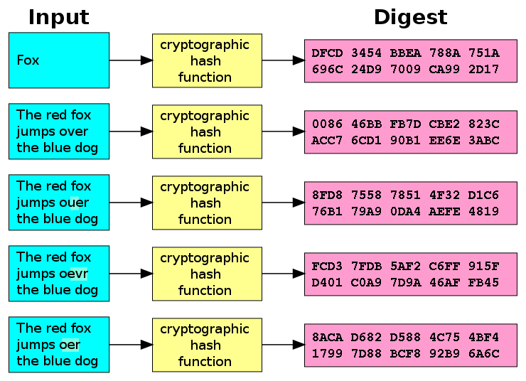
Cryptographic Hash Functions
Notes:
Wikipedia, accessed 2018-10-16.
The ideal cryptographic hash function has five main properties:
it is deterministic so the same message always results in the same hash
it is quick to compute the hash value for any given message
it is infeasible to generate a message from its hash value except by trying all possible messages
a small change to a message should change the hash value so extensively that the new hash value appears uncorrelated with the old hash value
it is infeasible to find two different messages with the same hash value

Slide 8
Cryptographic Hash Functions
The ideal cryptographic hash function has five main properties:
it is deterministic so the same message always results in the same hash
it is quick to compute the hash value for any given message
it is infeasible to generate a message from its hash value except by trying all possible messages
a small change to a message should change the hash value so extensively that the new hash value appears uncorrelated with the old hash value
it is infeasible to find two different messages with the same hash value
Notes:
Wikipedia, accessed 2018-10-16

Slide 9
Transaction Representation
A transaction is a triple of three strings:
  timestamp (the time of the transaction)
  details (the description of the transaction)
  hash of the concatenation of the timestamp and details of the current transaction and the hash of the previous transaction
It is convenient to think of a blockchain as a table, with each transaction in a row and three columns (timestamp, detail, and hash)

Slide 10
Transaction Examples
A transaction is a triple of three strings:
  timestamp (the time of the transaction)
  details (the description of the transaction)
  hash of the concatenation of the timestamp and details of the current transaction and the hash of the previous transaction
Example (four consecutive transactions; the first one is special):
(1539718609.131, 'A found $1', '')
(1539718698.678, 'A gives $1 to B‘ 'a0bffae472cc26e89318185afe1b04e3f0c79fcf')
(1539718717.25, 'B gives $1 to C', 'ca911be27eaeaf54549ae9f29c32e6417549bdcc')
(1539718734.571, 'C gives $1 to D', 'ab7ebcf29c9fe59ef53993791e2f5a8fe586d3f5')
Notes:
Triples are in parenthesis: (a,b,c). Hash is computed using the sha1 algorithm

Slide 11
Python Implementation
import hashlib, json, time
print hashlib.sha1('hello,world').hexdigest()
def bhash (timestamp, details, prev_hash):
token = json.dumps([timestamp, details, prev_hash])
return hashlib.sha1(details).hexdigest()
Notes:
This is a basic implementation by Di Pierro (see ref. on slide 2)

Slide 12
Python Implementation
class Blockchain(object):
def __init__(self, details='new-chain'):
self.blocks = [(time.time(), details, '')]
def record(self, details, timestamp = None):
timestamp = timestamp or time.time()
prev_hash = self.blocks[-1][2]
new_hash = bhash(timestamp, details, prev_hash)
self.blocks.append((timestamp, details, new_hash))
Notes:
This is a basic implementation by Di Pierro (see ref. on slide 2)
Init is a constructor; the initial transaction has no hash of the previous one
Method record stores a new transaction; by default, the current time is used as timestamp
Self.blocks[-1] is the previous transaction; self.blocks[-1][2] is the third (we count from zero) field in the previous transaction

Slide 13
iClicker
Answer the following multiple-choice question.
The blockchain code is written in
  A. C
  B. Java
  C. Python
  D. Prolog
  E. Haskell

Slide 14
Running the Code: Creating a Chain
>>> bc = Blockchain('A found $1')
>>> bc.record('A gives $1 to B')
>>> bc.record('B gives $1 to C')
>>> bc.record('C gives $1 to D')
Notes:
This is a basic implementation by Di Pierro (see ref. on slide 2)
The fist line uses the constructor to build an instance of the Blockchain
The next three lines add transactions

Slide 15
Running the Code: Printing a Chain
>>> print bc.blocks
[(1495941516.704196, 'A found $1', ”),
(1495941516.704201, 'A gives $1 to B', 'a75a9227f...'),
(1495941516.704277, 'B gives $1 to C', 'ca911be27...'),
(1495941516.704290, 'C gives $1 to D', 'cb462885e...')]
Notes:
This is a basic implementation by Di Pierro (see ref. on slide 2)
The fist line uses the constructor to build an instance of the Blockchain
The next three lines add transactions

Slide 16
Verifying a Chain’s Integrity
def verify(blockchain):
prev = blockchain.blocks[0]
for block in blockchain.blocks[1:]:
new_hash = bhash(block[0], block[1], prev[2])
if block[2] != new_hash: return False
prev = block
return True
Notes:
Loop over the transactions (blocks) starting with the second one, checking that the hash computed from the timestamp, details, and hash of the previous block matches the hash in the current bloc.
Call by: # Example
##>>> print verify(bc)
##True

