Slide 1

Computing from an Electric and Gas Utility Perspective
CSCE 190 April 15, 2013
Chris Pierson, IT Manager
Latoya Ellis, Infrastructure Analyst
Chris Broom, Applications Developer

Slide 2

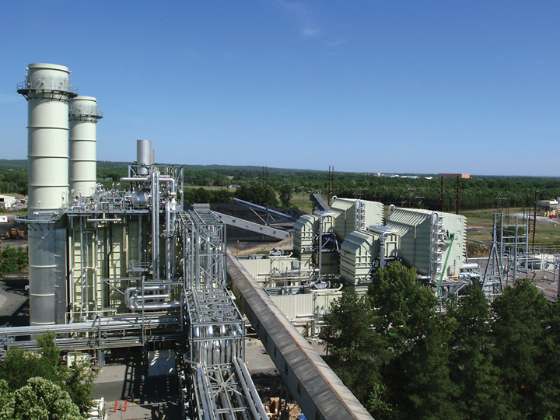


SCANA Corporation
$11 billion energy-based holding company headquartered in Cayce, South Carolina
SCANA’s stock is included in the S&P 500 index
Generate and sell electricity
Purchase, sell and transport natural gas

Slide 3

IT at SCANA
50% Applications Development, 50% Infrastructure
2 Data Centers
High Availability Capabilities
Redundant 10 GB core network
Secure Wireless Campus & Service Trucks
1,000+ Software Applications

Slide 4

Technology
A little bit of everything
Microsoft .NET, Business Objects, HP & IBM UNIX, Linux, EMC Storage, CISCO Network, PeopleSoft, Filenet
We Support most Microsoft Products
DB2, Oracle, Teradata, MS SQL Server
Mainframe critical for core processing
Remote computing capabilities

Slide 5

SCANA IST Job Families
Applications Development
Database Administration
Infrastructure Analyst
Infrastructure Tech
IST Project Management
IST Training
Security Analyst
IT Analyst
Network Planning and Engineering
Systems Programming
Technical Writing
Technology Consultant
Telecommunications Tech
Leadership

Slide 6

Employee Makeup
400+ IST employees
Many have BS in Computer Science, Management Information Science,
or related field
44% female; 22% minority
Historically low turnover, but high potential due to boomer retirement
30% Gen X, 12% Gen Y
6-10 positions in Co-op programs

Slide 7
How IST fits into the business
Everything we do depends IT:
Functional Systems
Cross-Functional Systems
Underlying Technologies

Slide 8
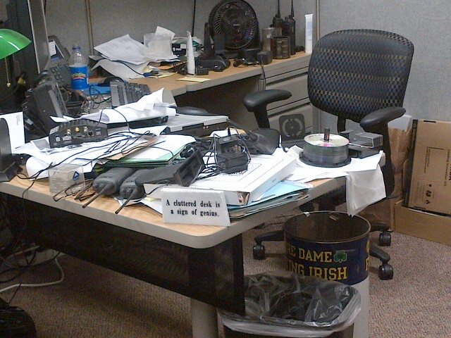
We aren’t always at our desks
Notes:
Bill Lamprey’s desk – he spends most of his time out in the field during the day

Slide 9
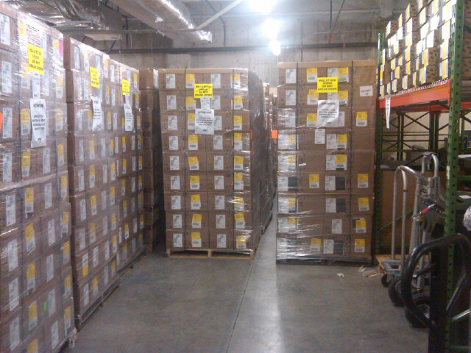
We work hard
Notes:
Workstations at the CHQ ready for mass deployment during our desktop modernization effort

Slide 10

We do outreach

Slide 11
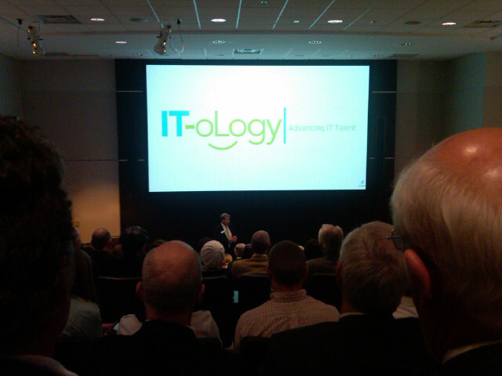
We support education

Slide 12
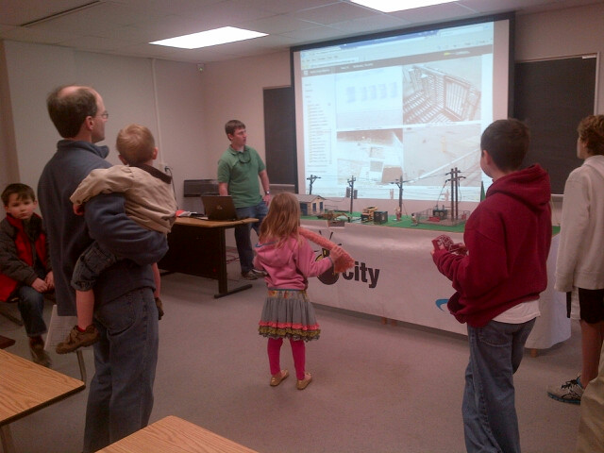
We support universities
Notes:
Engineering week at USC 2012

Slide 13

We support the community

Slide 14
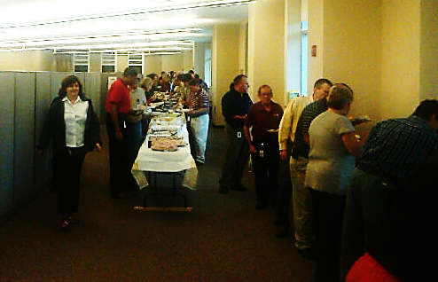
We eat and have fun

Slide 15
My career-22 years, never bored
ROLES:
Student assistant
Applications developer
Systems analyst
Project manager
Applications specialist
IT Supervisor
Client manager
Program manager
IT manager
OPPORTUNITIES:
Electric Operations
Client/server (internet start)
Fossil/Hydro plant IT
SCANA Energy startup
PSNC merger
Marketing/Sales
Data analytics
Demand Side Management
Customer Service Eng.
IT Customer Support

Slide 16

Electric Operations
Notes:
Electric meters track individual premise usage for billing purposes - customer payments - how we get paid

Slide 17

Lake Murray Dam

Slide 18
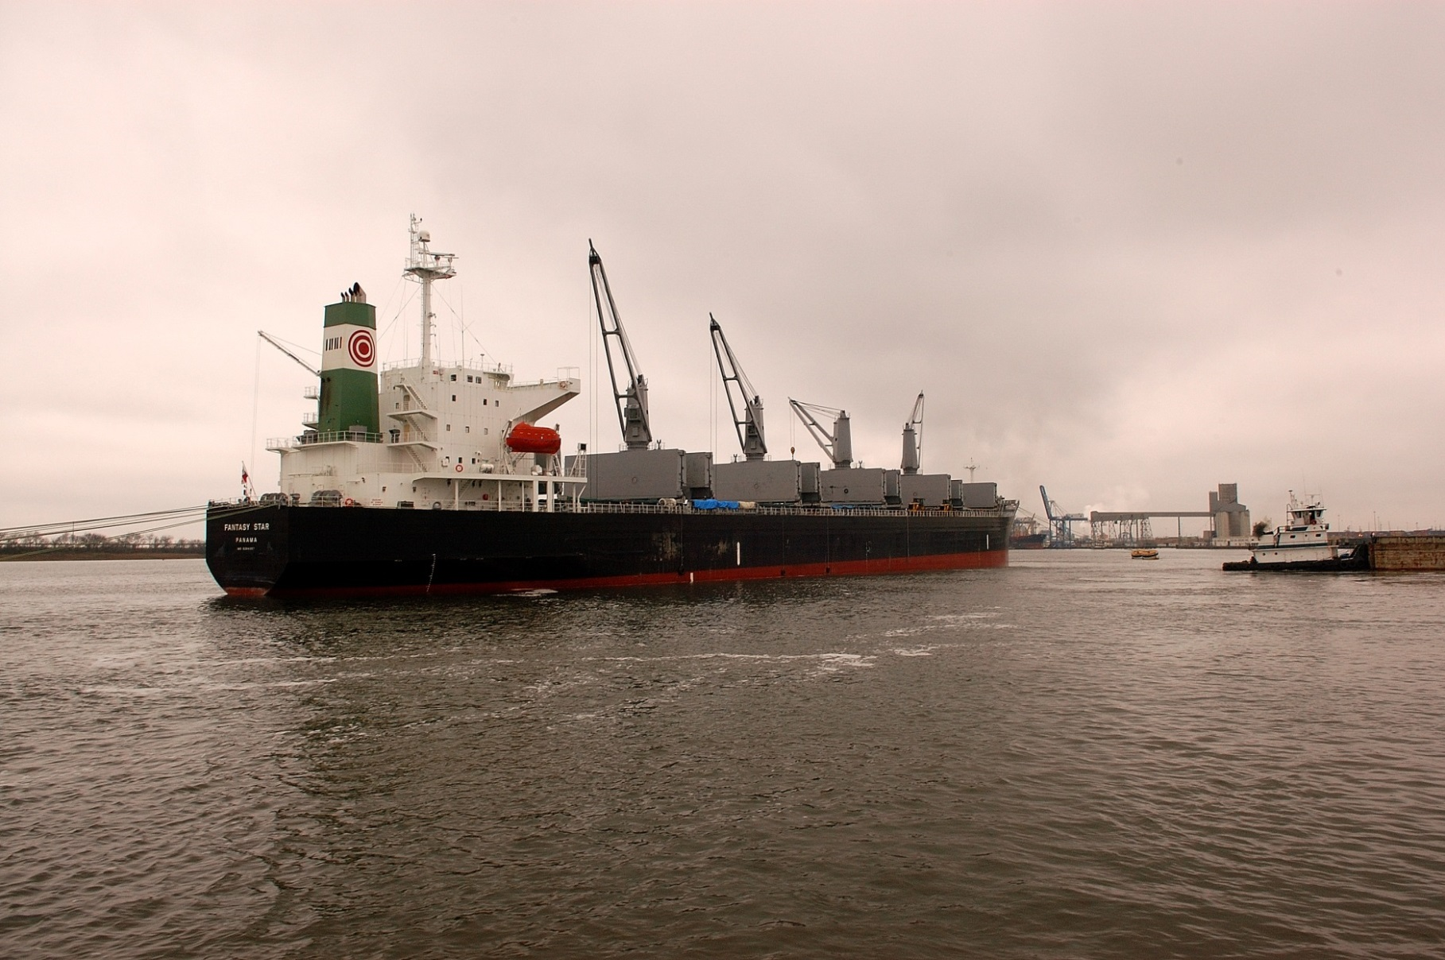
Fuel Delivery

Slide 19

Transmission/Distribution
Notes:
How the power gets from a plant to consumers

Slide 20
Why computing?
  Computer technology impacts everyone
  Everybody should know something about computer technology
http://www.code.org/

Slide 21
Jobs Are Out There!
Unemployment Rate
National, June 2012:
‘Balanced’ Unemployment:
Technology: May 2012:
Technology, June 2012:
8.4%
5-6%
3.5%
3.1%
Notes:
And there are lots of jobs out there!

Slide 22
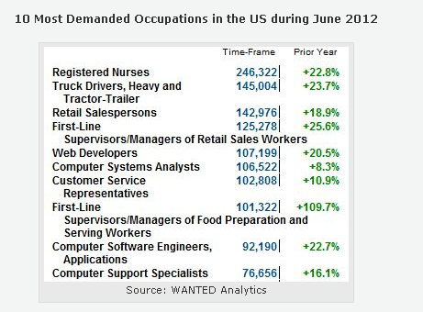
What Unemployment?
382,567 Postings in June
Notes:
Together IT job postings total 382,567… and this is just the top 10!

Slide 23
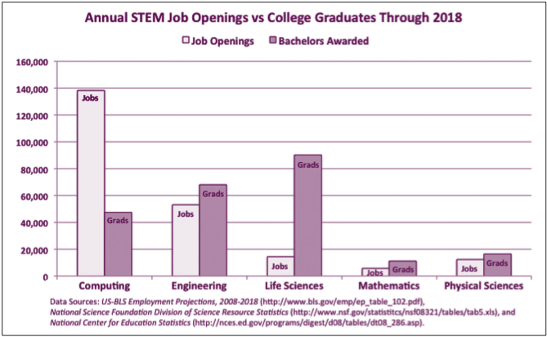
Computing is not expected to produce sufficient graduates to cover needs

Slide 24
We’re not Just Techno-Geeks
IT plus Business experience is extremely valuable
Analysts translate ‘tech talk’ into business terms
Customer Service is a key, along with a desire and aptitude for technology
Business knowledge helps us produce solid systems
Financial Analysis is big business in IST!

Slide 25
Q/A with employees
Latoya Ellis, Infrastructure Analyst
Chris Broom, Applications Developer

Slide 26
In closing…
Completing your education should be top priority
A degree may get you in the hiring process, but it does not automatically qualify you
Gain work experience in your field
Learn as much as you can about computer technology regardless of your major
Notes:
Degree is valuable, experience is valuable, soft skills are valuable, combining all is most valuable.
Finish your degree and get some experience along the way if possible. It is harder to get degree after entering working world and some progressions are limited without degree.

