Slide 1
Trends in the Infrastructure of Computing
CSCE 190: Computing in the Modern World
Jason D. Bakos
Heterogeneous and Reconfigurable Computing Group

Slide 2
Apollo 11 vs iPhone 10
Apollo 11
Cost: ~$200 billion
(whole program, adjusted)
Guidance Computer (1966):
2.048 MHz clock
33,600 transistors
85,000 instructions per second
iPhone 10
Cost: ~$999
Apple A11 Bionic CPU (2017):
2390 MHz clock (~1000X faster)
4.3 billion transistors (125,000X more)
57 billion instructions per second (671,000X faster)
+ Performs 600 billion neural network operations per second
+ Processes 12 million pixels per second from still image camera
+ Processes 2 million image tiles per second from record video (feature extraction, classification, and motion analysis)
+ Encodes 240 frames per second at 1920x1080 (500 million pixels per second)

Slide 3
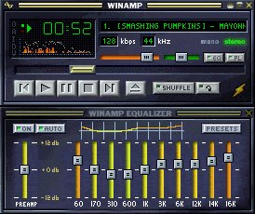
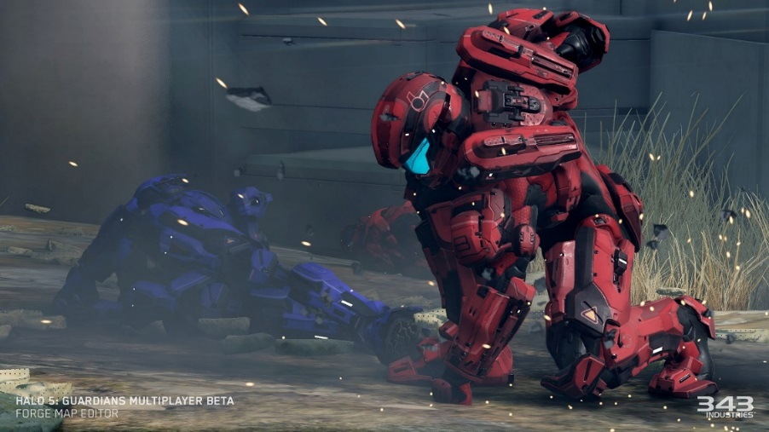
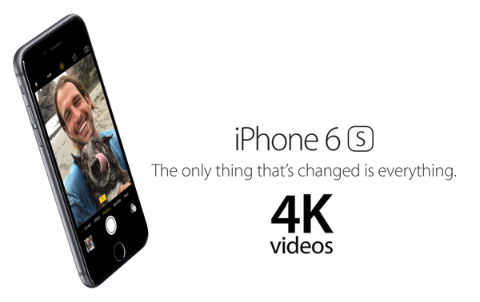
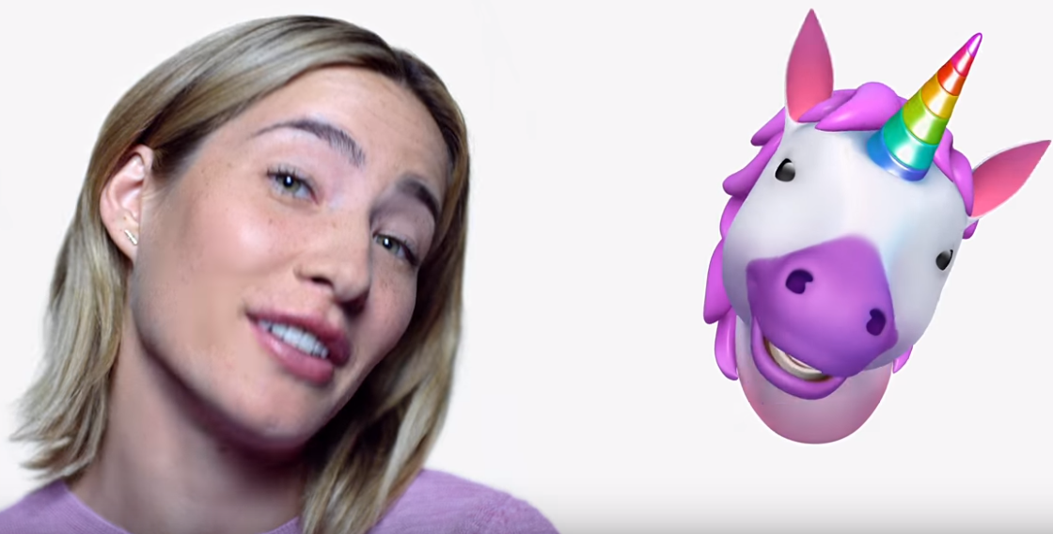
New Capabilities
Play MP3s (but at nearly 100% CPU load) (~1996)
Xbox One (2013)
4K video on a phone (2015)
Animojis (2017)

Slide 4
New Capabilities
Networking (Ethernet)
10 Megabit/s (1.25 MB/s) (1980)
100 Megabits/s (12.5 MB/s) (1995)
1 Gigabits/s (125 MB/s) (1999)
10 Gigabit/s (over twisted-pair) (1.25 GB/s) (2006)
Computer memory (DRAM)
DDR (2000): 1.6 GB/s
DDR2 (2003): 8.5 GB/s
DDR3 dual channel (2007): 25.6 GB/s
DDR4 quad channel (2014): 42.7 GB/s

Slide 5
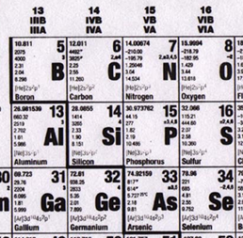
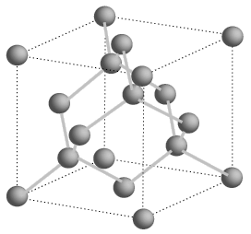
Semiconductors
Silicon is a group IV element
Forms covalent bonds with four neighbor atoms (3D cubic crystal lattice)
Si is a poor conductor, but conduction characteristics may be altered
Add impurities/dopants replaces silicon atom in lattice
Adds two different types of charge carriers: holes and electrons
Adds electrons
Creates n-type Si
Adds holes
Creates p-type Si
Spacing = .543 nm
Notes:
4 valence electrons: bonds with 4 neighboring atoms No charge carriers without dopants. Dopants are from group 3 (hole; p-type) or group 5 (electron; n-type) Hole and electrons are charge carriers.

Slide 6
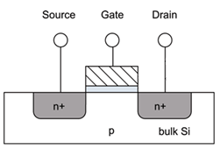
MOSFETs
Cut away side view
VDD
+ + + + + + +
- - - - - - -
+ + + + + + + + + + + + + +
GND
Notes:
If p is grounded, no electricity from diffusion area to substrate.
Works like a switch. The gate is a capacitor (there is a glass insulator under the gate---blue in the figure); charging it draws electrons and opens a channel, opening the connection.

Slide 7
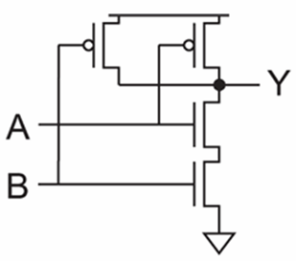
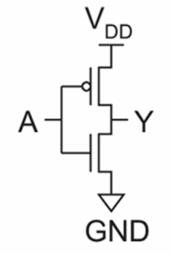
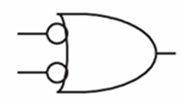
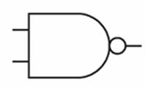
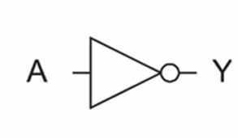
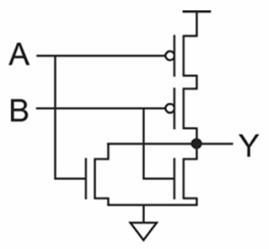
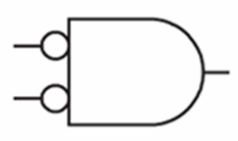
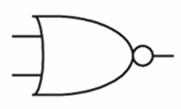
Logic Gates
inv
NAND2
NOR2
Notes:
Gates.

Slide 8
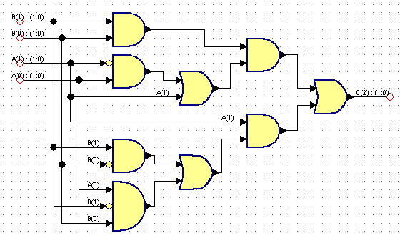
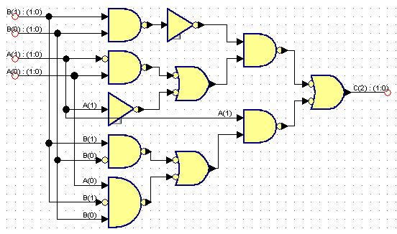
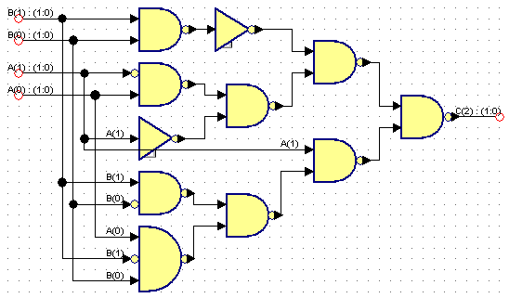
Logic Synthesis
Behavior:
S = A + B
Assume A is 2 bits, B is 2 bits, C is 3 bits
A | B | C
00 (0) | 00 (0) | 000 (0)
00 (0) | 01 (1) | 001 (1)
00 (0) | 10 (2) | 010 (2)
00 (0) | 11 (3) | 011 (3)
01 (1) | 00 (0) | 001 (1)
01 (1) | 01 (1) | 010 (2)
01 (1) | 10 (2) | 011 (3)
01 (1) | 11 (3) | 100 (4)
10 (2) | 00 (0) | 010 (2)
10 (2) | 01 (1) | 011 (3)
10 (2) | 10 (2) | 100 (4)
10 (2) | 11 (3) | 101 (5)
11 (3) | 00 (0) | 011 (3)
11 (3) | 01 (1) | 100 (4)
11 (3) | 10 (2) | 101 (5)
11 (3) | 11 (3) | 110 (6)

Slide 9
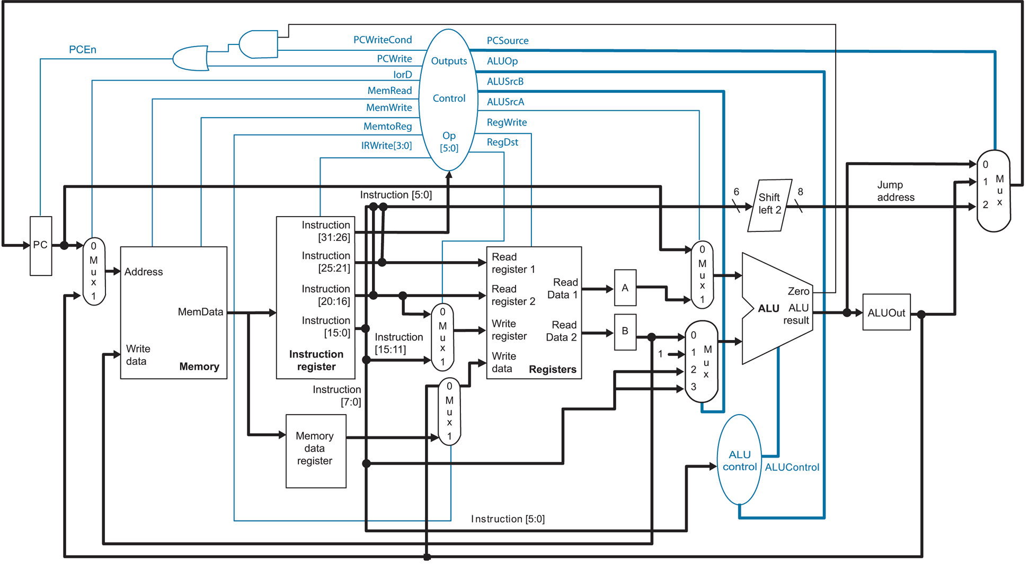
Microarchitecture
Notes:
A MIPS CPU (as used in Hennessy and Patterson; in 212).

Slide 10
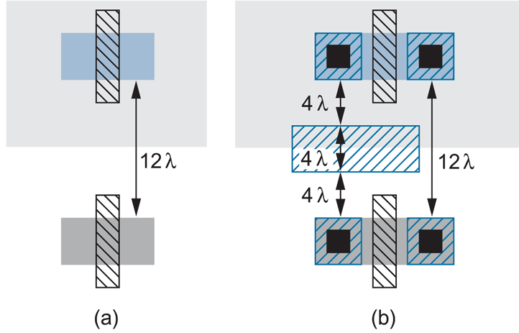
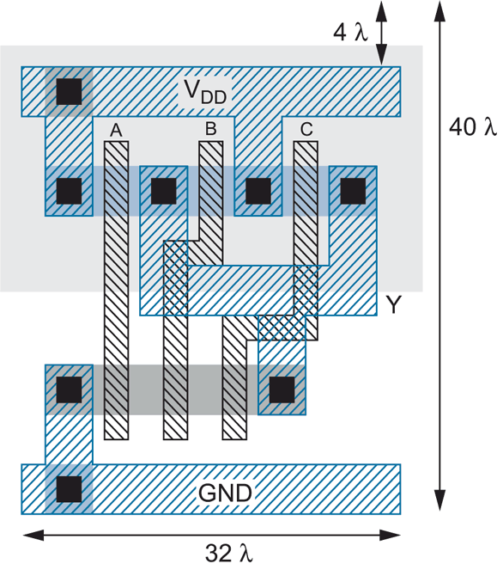
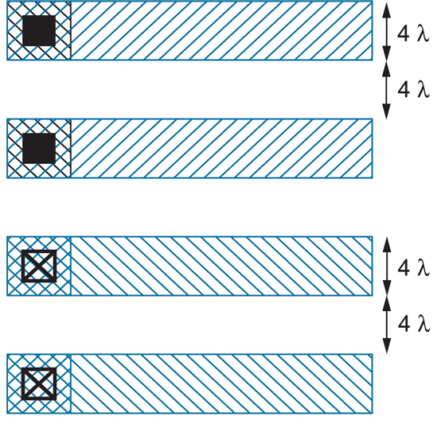
Layout
3-input NAND
Notes:
Polygons represent transistors (looking from the top down). Blue are wires (copper), the black (vias, vertical) connect metal to substrate; otherwise, glass in between. Grey shaded are gates. Around 180 nanometers (around 2000), the rules no longer are parametrized by lambda, because of the complicated physics at very small scale. Free MOSIS is 180 nanometers now.

Slide 11
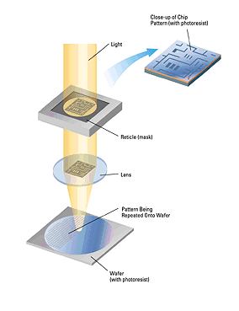
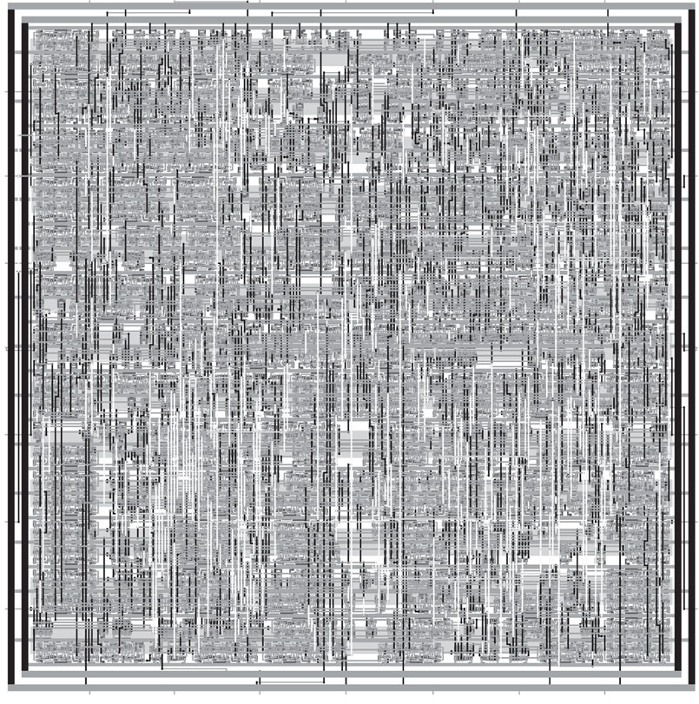
Synthesized and P&R’ed MIPS Architecture
Notes:
P&R’ed means: Placed and Routed. MOSIS (fabrication facility at ISI at USC) would receive something like this. (core of a tiny chip here.)

Slide 12
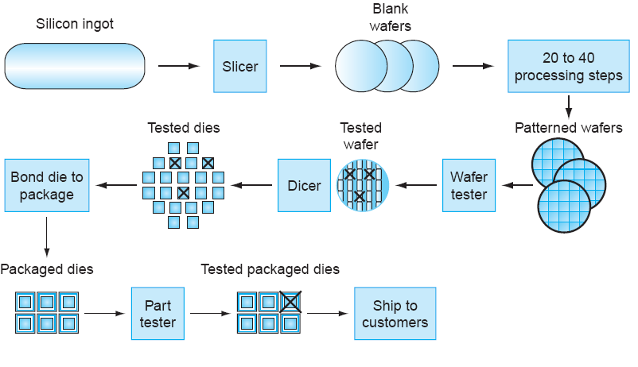
IC Fabrication

Slide 13
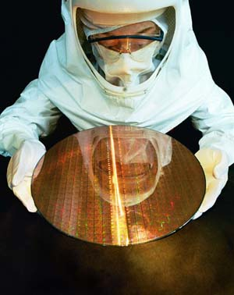
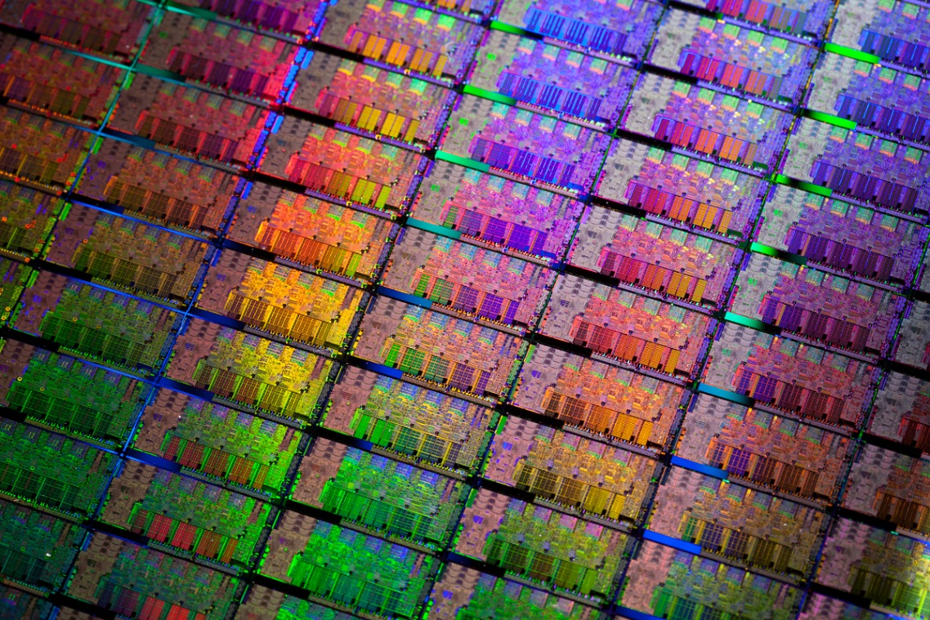
Si Wafer
Notes:
Most chips are rectangular.

Slide 14
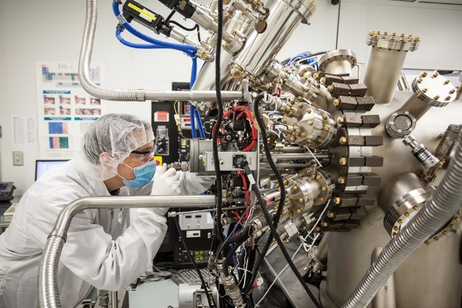
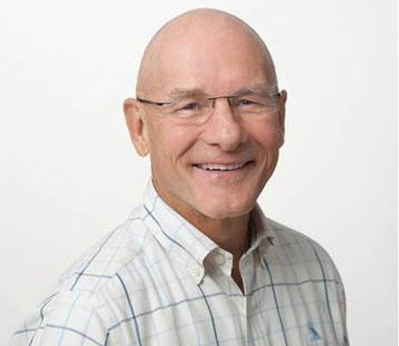
Improvement: Fab + Architects
90 nm
200 million transistors/chip
(2005)
65 nm
400 million transistors/chip
(2006)
Execute 2 instructions per cycle
Execute 4 instructions per cycle

Slide 15
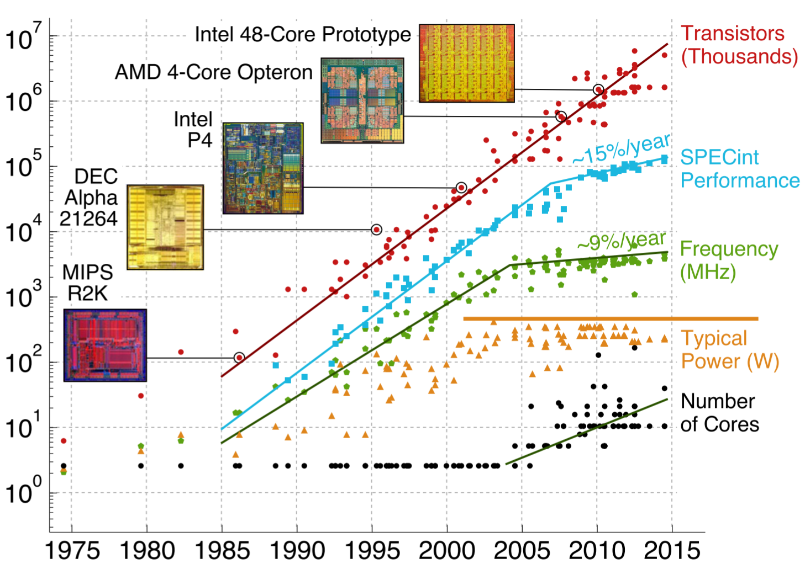
Moore’s Law
source: Christopher Batten, Cornell

Slide 16
Intel Desktop Technology
Year | Processor | Transistors | Transistor Size | Performance
1982 | i286 | ~134,000 | 1.5 μm | 6 - 25 MHz
1986 | i386 | ~270,000 | 1 μm | 16 – 40 MHz
1989 | i486 | ~1 million | .8 μm | 16 - 133 MHz
1993 | Pentium | ~3 million | .6 μm | 60 - 300 MHz
1995 | Pentium Pro | ~4 million | .5 μm | 150 - 200 MHz
1997 | Pentium II | ~5 million | .35 μm | 233 - 450 MHz
1999 | Pentium III | ~10 million | .25 μm | 450 – 1400 MHz
2000 | Pentium 4 | ~50 million | 180 nm | 1.3 – 3.8 GHz
2005 | Pentium D | ~200 million | 90 nm | 2 cores/package
2006 | Core 2 | ~300 million | 65 nm | 2 cores/chip
2008 | “Nehalem” | ~800 million | 45 nm | 4 cores/chip
2010-11 | “Westmere” / “Sandy Bridge” | ~1.2 billion | 32 nm | 6 cores/chip
2012-13 | “Ivy Bridge” / ”Haswell” | ~1.4 billion | 22 nm | 8 cores/chip
2014-15 | “Broadwell” / ”Skylake” | ~2.8 billion | 14 nm | 8 cores/chip
2016-18 | “Kaby Lake” / “Coffee Lake” / “Whiskey Lake” | ~5.6 billion | 14 nm (!!!) | 8 cores/chip
2018? | “Cannon Lake” | ? | ??? | ?
End of frequency scaling
End of core scaling
End of technology scaling?

Slide 17
Performance: Intel Desktop Peak Performance
Desktop Processor Generation | Max. Clock Speed (GHz) | Peak Integer IPC | Max. Number of Cores | Max. DRAM Bandwidth (GB/s) | Peak Floating Point (Gflop/s) | L3 cache (MB)
Core (2006) | 3.33 | 4 | 4 | 25.6 | 107 | 8
Penryn (2007) | 3.33 | 4 | 4 | 25.6 | 107 | 8
Westmere (2010) | 3.60 | 4 | 6 | 25.6 | 173 | 12
Ivy Bridge (2013) | 3.70 | 6 | 6 | 25.6 | 355 | 15
Broadwell (2015) | 3.80 | 8 | 6 | 25.6 | 365 | 30
Kaby Lake (2017) | 4.00 | 8 | 6 | 42.7 | 768 | 32

Slide 18
Intel Desktop: Moore’s Law
Processor Generation | Transistor size (nm) | Number of transistors (millions)
Core (2006) | 65 | 105
Penryn (2007) | 45 | 228
Westmere (2010) | 32 | 800
Ivy Bridge (2013) | 22 | 1400
Broadwell (2015) | 14 | 2800
Cannon Lake (2018) | 10 | 5200
?? (2022) | 7 | 10400
?? (2025) | 5 | 20800
?? (2027) | 3 | 41600
Si atom spacing = 0.5 nm

Slide 19
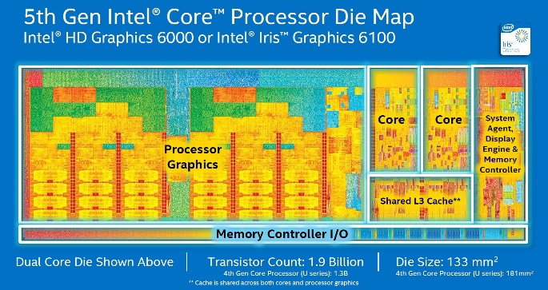
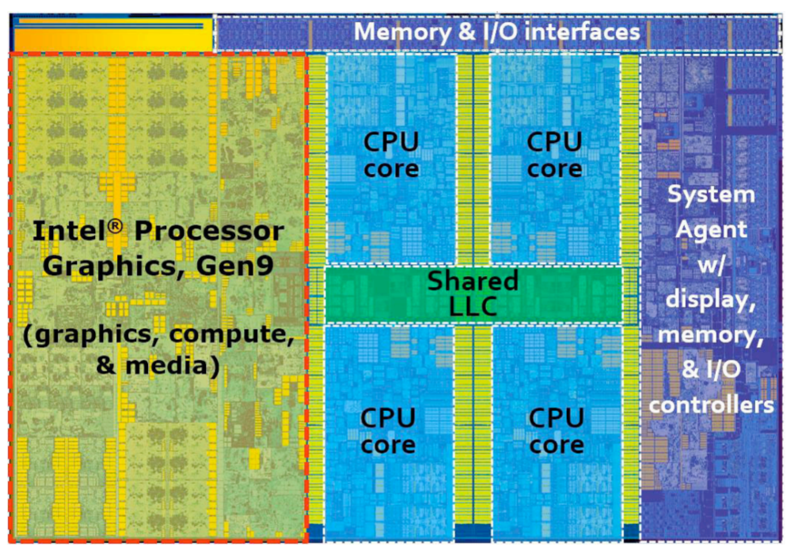
Why Learn Hardware Design?
7th gen Skylake

Slide 20
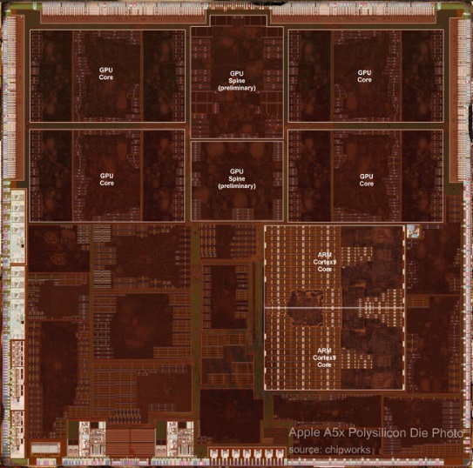
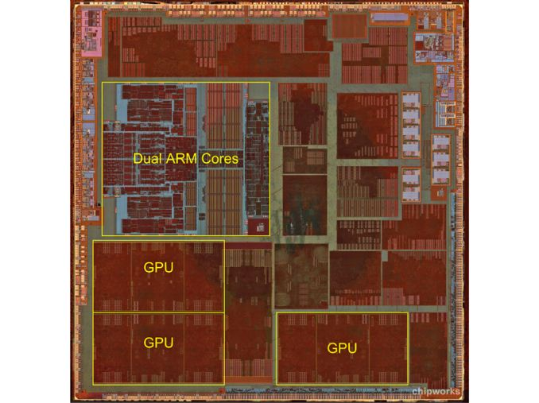
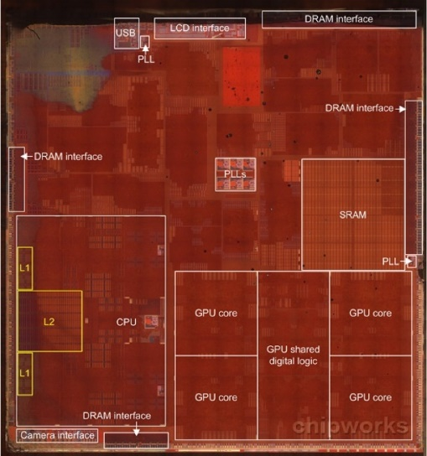
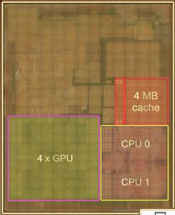
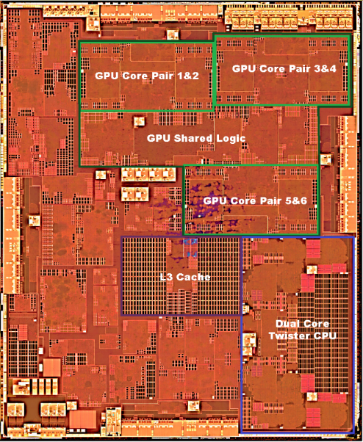
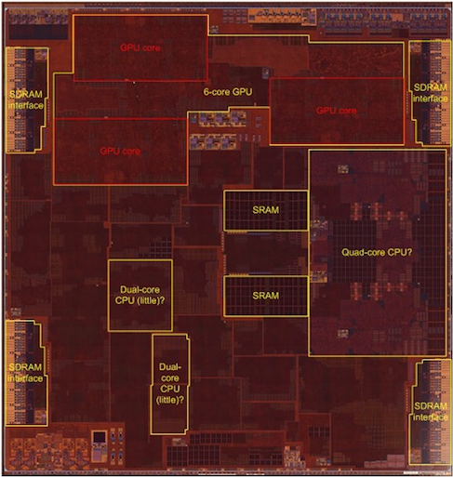
Why Learn Hardware Design?
Apple A5x
Apple A6
Apple A7
Apple A8
Apple A9
Apple A10

Slide 21
CPU Performance “Walls”
Power Wall
Must maintain thermal density of ~ 1 Watt per square mm
~200 Watts for 200 mm² area
Dennard Scaling no longer in effect
Power density increases with transistor density
P_{dynamic} = ½CV_{DD}²f

Slide 22
Logic Levels
NM_{H} = V_{OH} – V_{IH}
NM_{L} = V_{IL} – V_{OL}

Slide 23
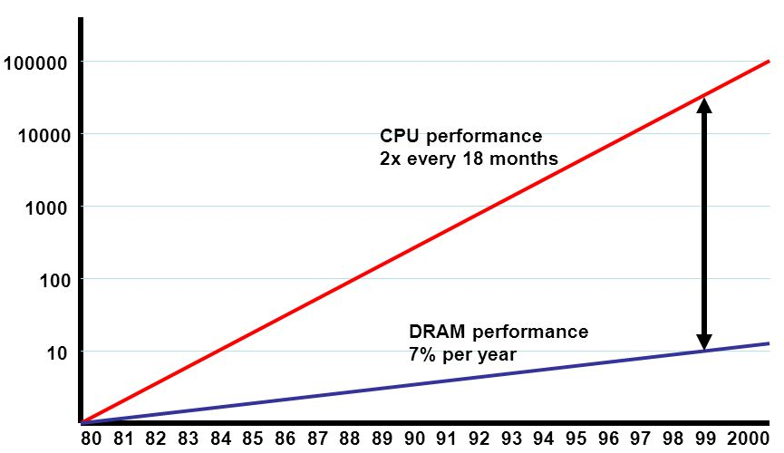
CPU Performance “Walls”
Memory Wall
Memory usually cannot supply data to CPU fast enough
GPUs use soldered memory for higher speed

Slide 24
CPU Performance “Walls”
Solution: Domain-specific architecture
Use dedicated memories to minimize data movement
Invest resources into more arithmetic units or bigger memories
Use the easiest form of parallelism that matches the domain
Reduce data size and type to the simplest needed for the domain

Slide 25
Domain-Specific Architectures
Qualcomm Snapdragon 835
Wireless:
Snapdragon LTE modem
Wi-Fi module
Processors:
Hexagon DSP Processor
Qualcomm Aqstic Audio Processor
Qualcomm IZat Location Processor
Adreno 540 GPU (DPU + VPU) Processor
Qualcomm Spectra 180 Camera Processor
Kryo 280 CPU (8 core ARM BigLittle)
Qualcomm Haven Security Processor
Raspberry Pi gen1: ARM11 + 3 types of GPUs

Slide 26
Co-Processor (GPU) Design
FOR i = 1 to 1000
C[i] = A[i] + B[i]
GPU
cache
ALU
ALU
ALU
ALU
ALU
ALU
ALU
ALU
Core 1
threads
cache
ALU
ALU
ALU
ALU
ALU
ALU
ALU
ALU
Core 2
cache
ALU
ALU
ALU
ALU
ALU
ALU
ALU
ALU
Core 3
cache
ALU
ALU
ALU
ALU
ALU
ALU
ALU
ALU
Core 4
cache
ALU
ALU
ALU
ALU
ALU
ALU
ALU
ALU
Core 5
cache
ALU
ALU
ALU
ALU
ALU
ALU
ALU
ALU
Core 6
cache
ALU
ALU
ALU
ALU
ALU
ALU
ALU
ALU
Core 7
cache
ALU
ALU
ALU
ALU
ALU
ALU
ALU
ALU
Core 8
Thread
Thread
Thread
Thread
Thread
Thread
Thread
Thread
Thread
Thread
Thread
Thread
Thread
Thread
Thread
Thread
Notes:
Many threads! Even 1000 in some GPUs. Each outermost loop iteration becomes a thread.

Slide 27
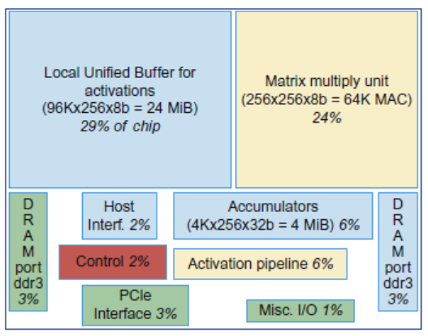
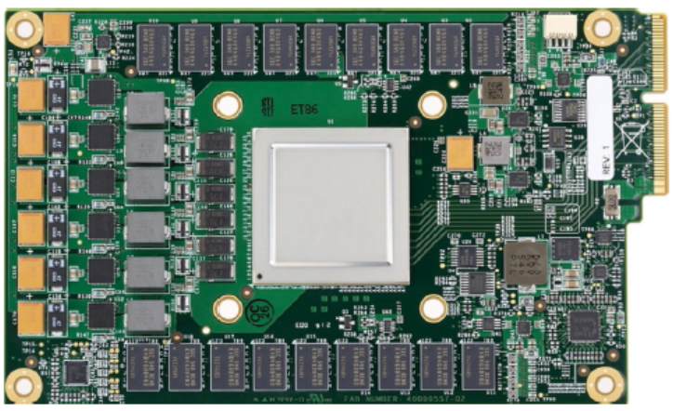
Google Tensor Processing Unit

Slide 28
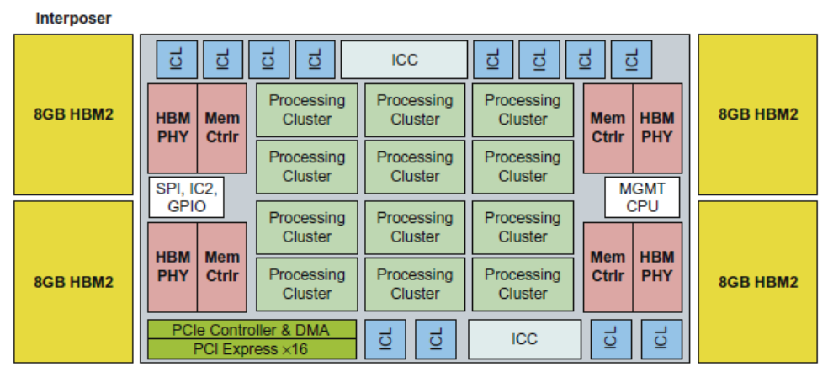
Intel Crest
DNN training
16-bit fixed point
Operates on blocks of 32x32 matrices
SRAM + HBM2

Slide 29
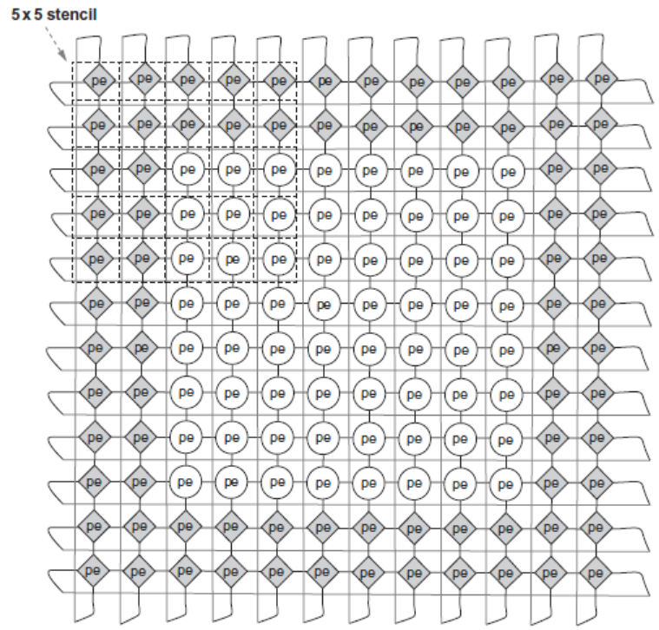
Pixel Visual Core
Pixel Visual Core
Image Processing Unit
Performs stencil operations

Slide 30
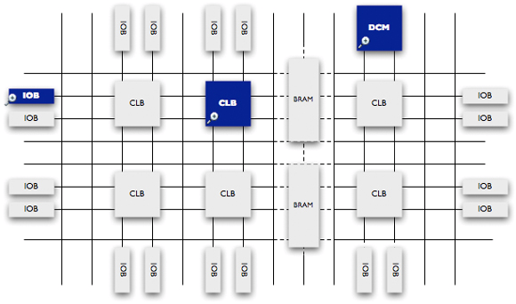
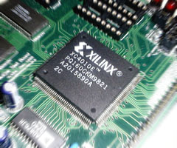
Field Programmable Gate Arrays
FPGAs are blank slates that can be electronically reconfigured
Allows for totally customized architectures
Drawbacks:
More difficult to program than GPUs
10X less logic density and clock speed
Notes:
Huge flexibility, must use hardware description language: very lower level, RTL, timing. In principle, much higher utilization of the hardware. Electronically (“in the field”) reconfigurable. CE students will use FPGAs in 611 and 313.

Slide 31
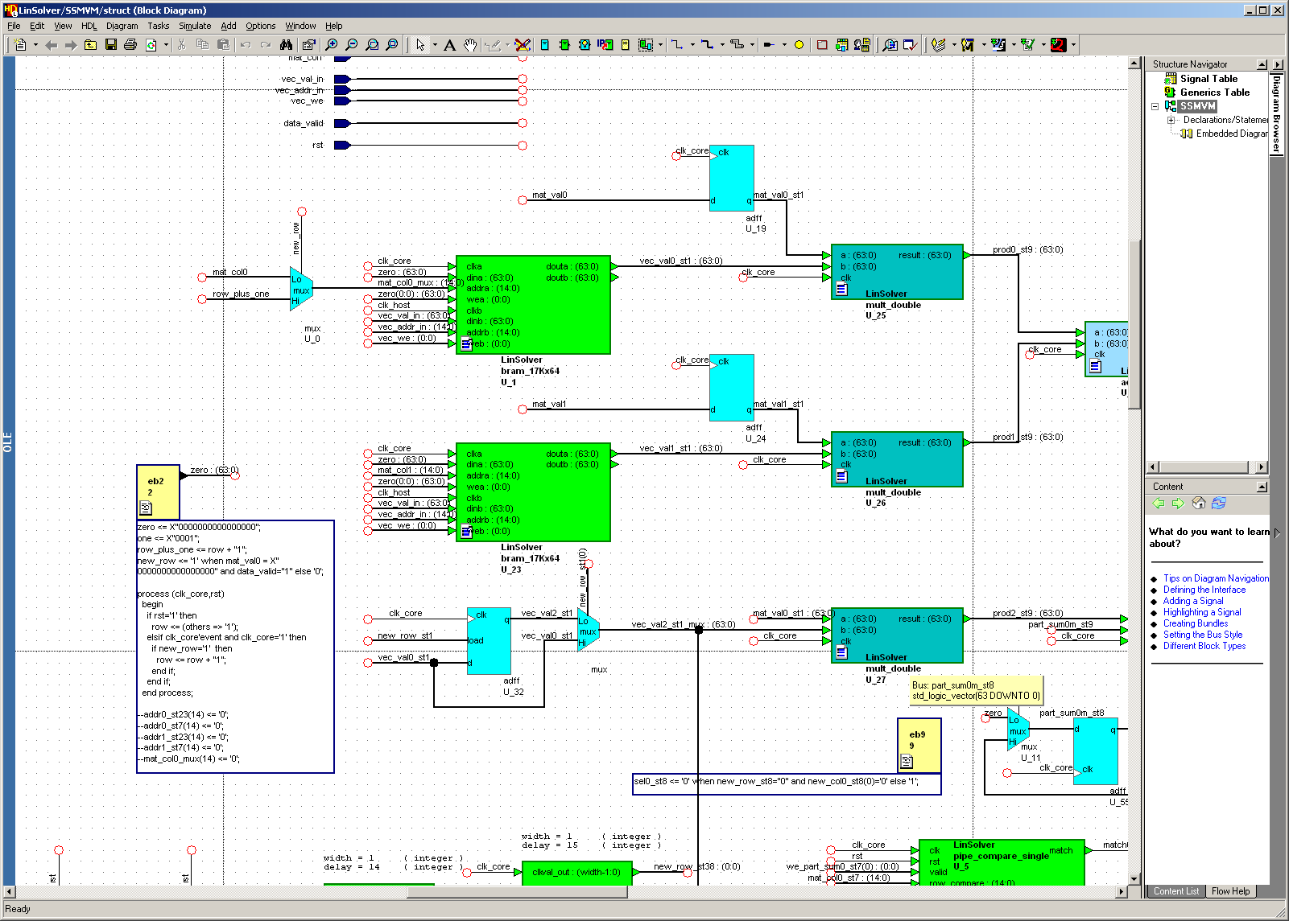
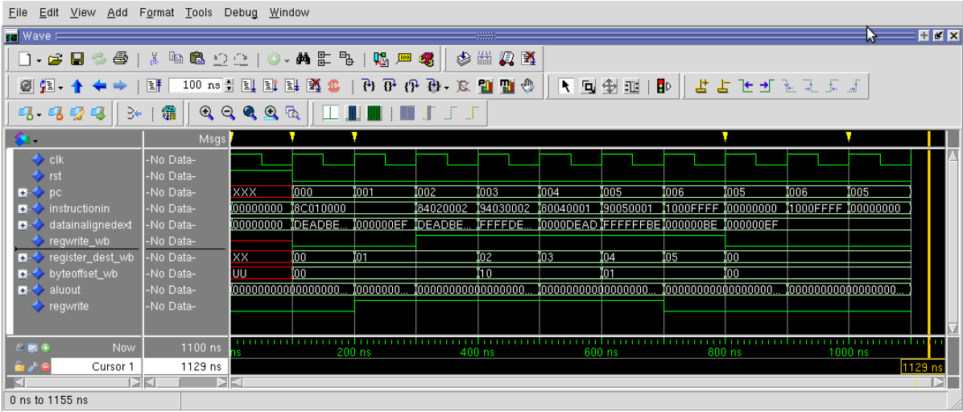
Programming FPGAs
Notes:
FPGA have worked very hard on compiler from C to HDL. They call it high-level synthesis. Also, used for debugging before (re-)configuring the chip.

Slide 32
HeRC Group: Heterogeneous Computing
Combine CPUs and coprocs
Example:
Application requires a week of CPU time
Offload computation consumes 99% of execution time
49% of code
initialization
0.5% of run time
“hot” loop
99% of run time
2% of code
Kernel speedup | Application speedup | Execution time
50 | 34 | 5.0 hours
100 | 50 | 3.3 hours
200 | 67 | 2.5 hours
500 | 83 | 2.0 hours
1000 | 91 | 1.8 hours
49% of code
clean up
0.5% of run time
co-processor

Slide 33
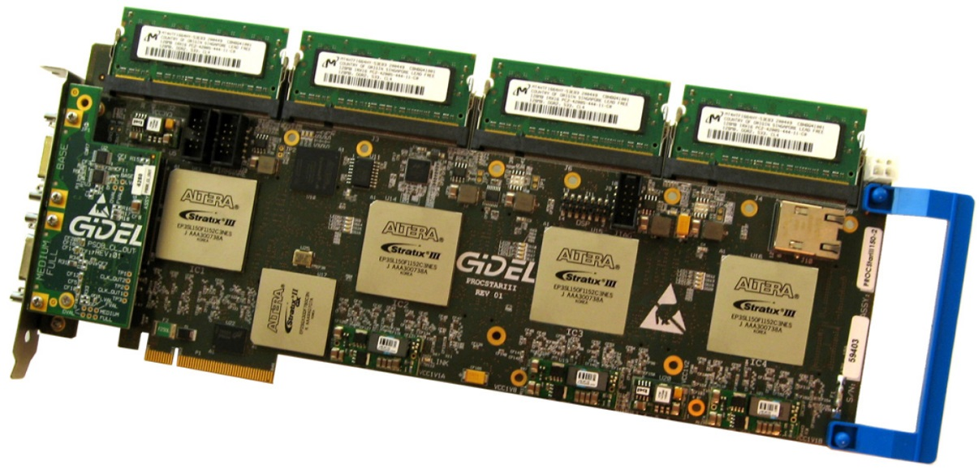
Heterogeneous Computing with FPGAs
Developed custom FPGA coprocessor architectures for:
Computational biology
Sparse linear algebra
Data mining
Generally achieve 50X – 100X speedup over CPUs
Notes:
Jason used these. No longer. The ones used now are very similar (2018).

Slide 34
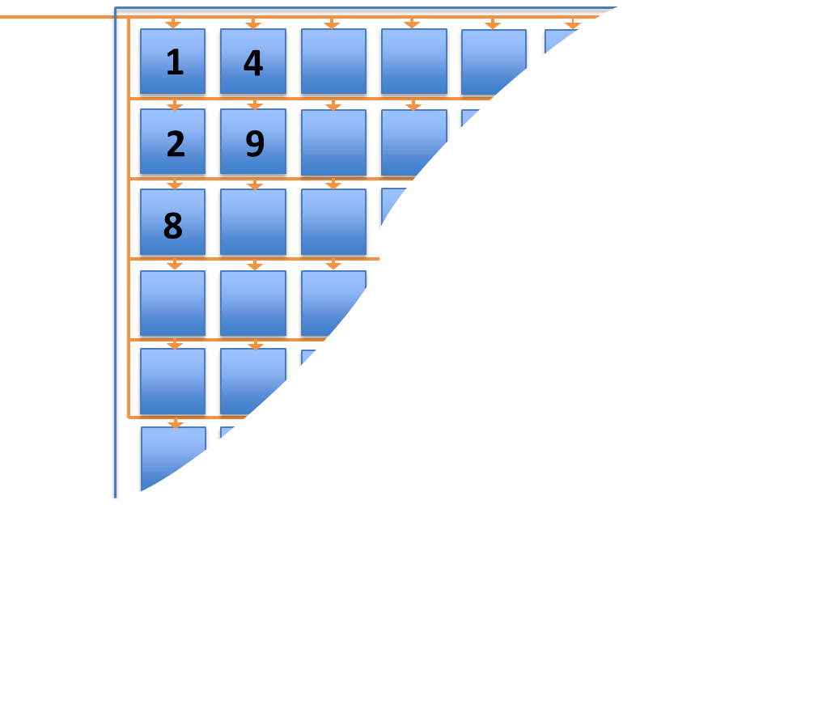
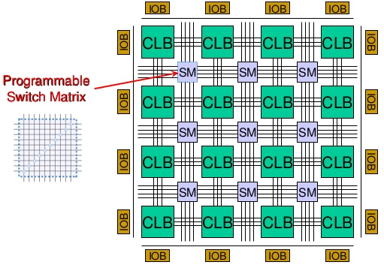
Heterogeneous Computing with FPGAs
Application
Design tools (compilers)
Overlay
(Processing Elements)
Hardware engineering
FPGA
(Logic Gates)

Slide 35
Conclusions
Moore’s Law continues, but CPUs are benefitting from an increasingly lessor degree
Power Wall
Memory Wall
The future is in domain-specific architectures
Hardware designers will play increasing role in introducing new capabilities
FPGA-based computing allows for fast development of new domain specific architectures

