Slide 1
CSCE 190
Computing in the Modern World
Introduction
Fall 2016
Marco Valtorta
mgv@cse.sc.edu
www.cse.sc.edu/~mgv/csce190f16

Slide 2
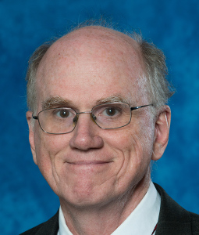
Chair’s Welcome
Prof. Manton M. Matthews
Chair, Department of Computer Science and Engineering
College of Engineering and Computing
mmm@cec.sc.edu

Slide 3
Student Groups
ACM Students
Women in Computing
Cybersecurity @USC
Code-a-Thon Group
Software Engineering Group
Carolina Gamers Club
Links at https://cse.sc.edu/undergraduate

Slide 4
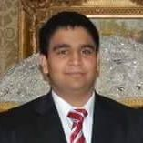
ACM@USC
Viraj Patel, ACM student chapter president
Association for Computing Machinery

Slide 5
ACM@USC
Association for Computing Machinery

Slide 6
Why join ACM
It is the oldest computing organization (1947)
Help for CSCE classes
Mentorship
Software engineering meeting (weekly)
Code-A-Thons
Workshops

Slide 7
Interest Meeting
Come let’s do this!!
Aug-24
In B103 300 Main 5:30
Aug-25
In B103 300 Main at 5:30
IF YOU CAN NOT MAKE THE MEETING FOR SOME REASON,
send me an email at vkpatel@email.sc.edu

Slide 8
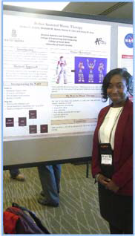
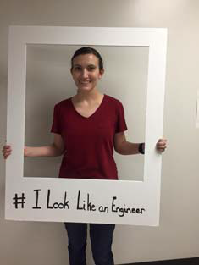

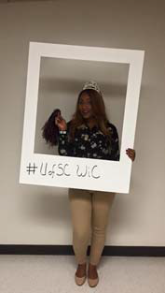
Women in Computing at USC
facebook.com/uofsc.wic
uofsc.wic@gmail.com
Alyssa Shofner

Slide 9
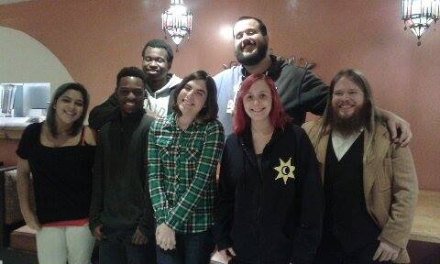
Carolina Gamers Club
Judson James, Treasurer (not in the picture)
web.sa.sc.edu/cgc
Notes:
http://web.sa.sc.edu/cgc/people/
Left To Right Back: Lorenzo Dyckes, Spencer Powell
Left To Right Front: Danielle Talley, Elijah Gabriel, Ruka Brooks, Haley Sandersfeld, Dr. Shepherd
Not Pictured: William Hoskins & Judson James

Slide 10
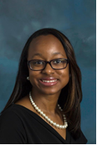
First-Year Academic Advisor
Ms. Tiffany Lide
Your primary academic contact for your first year at Carolina
tlide@sc.edu

Slide 11
Computing Disciplines and Majors
http://computingcareers.acm.org/
Notes:
http://computingcareers.acm.org/

Slide 12
Computing Disciplines (ACM defns.)
Computer Engineering
Typically involves software and hardware and the development of systems that involve software, hardware, and communications.
Computer Science
Currently the most popular of the computing disciplines; tends to be relatively broad and with an emphasis on the underlying science aspects.
(Computer) Information Systems
Computing in an organizational context, typically in businesses.
Notes:
http://computingcareers.acm.org/?page_id=6
These three disciplines correspond to the three undergraduate majors offered in the CSE department

Slide 13
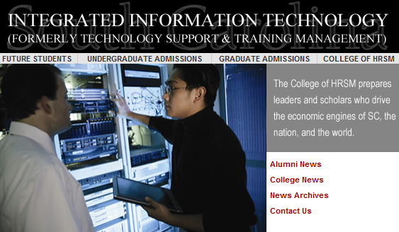
Computing Disciplines (ctd.)
Information Technology
Focuses on computing infrastructure and needs of individual users; tends to involve a study of systems (perhaps just software systems, but perhaps also systems in support of learning, of information dissemination, etc.).
Software Engineering
Focuses on large-scale software systems; employs certain ideas from the world of engineering in building reliable software systems.
Notes:
http://computingcareers.acm.org/?page_id=6
The Information Technology discipline is closer to the TSTM (Technology Support and Technology Management) major, which is offered in the school of Hospitality, Retail, and Sports Management:
The Integrated Information Technology Program (iIT)—formerly Technology Support and Training Management—is part of USC‘s College of Hospitality, Retail, and Sport Management. Students in the iIT program receive an in-depth background in information technologies in four major areas. These areas include computer networking, database systems, corporate training and development, and end-user support. In the computer networking area, students learn about networking theory, hardware, configuration, design, installation, and network operating system administration. In the database systems area, students learn to create and maintain databases through courses in Access, Visual Basic (for database integration), Oracle, and Systems Analysis and Design. The training area covers both the human side of corporate training, as well as the technical side of training materials development. The final area emphasizes end-user support which includes help desk
To maximize the learning experience, all iIT students must complete a capstone course that incorporates all four core areas. In this course, student teams work with a real business, solve an actual system issue, and design the needed system. Additionally, they must complete an internship as a final requirement for the program. Students graduating from this program have a very diverse IT background and have obtained positions in a wide range of organizations ranging from Network Administrator to Database Administrator to Director of Information Technologies. The program places emphasis on technology-based decision making and information management skills in dynamic business environments.
Technology Support and Training Management Program gets new name
Technology Support and Training Management Program at the University of South Carolina has changed its name to Integrated Information Technology (iIT). The name change is effective immediately.
“The new name expresses what we do much better than the old name,” said Dr. Bob Brookshire, the Program’s Director. “Our curriculum and our faculty’s research integrate the disciplines of database management, network management, web development, and information technology training. The old name really reflected only part of what our program is about.”
Information technology industry executives support the name change. “I strongly endorse the name change,” said Andy Bernardin, Client Director with IBM. “I have found the faculty and staff to be in tune with the day-to-day information technology needs business have in South Carolina. They have been proactive in helping to meet those needs by producing quality students and programs.”
Steve Wiggins, chief information officer for BlueCross BlueShield of South Carolina, agrees. “We have witnessed the transformation of this program to one of the leading university programs in producing the type of candidates that are most needed by IT businesses,” he said. “This will bring the appropriate level of attention to this program through the clarity established between the name and the focus of the program.”
The name change was approved by the State of South Carolina’s Commission on Higher Education at its March 24 meeting.
For more information on the Integrated Information Technology Program, contact Bob Brookshire at brookshire@sc.edu or visit the website at http://iit.sc.ed

Slide 17
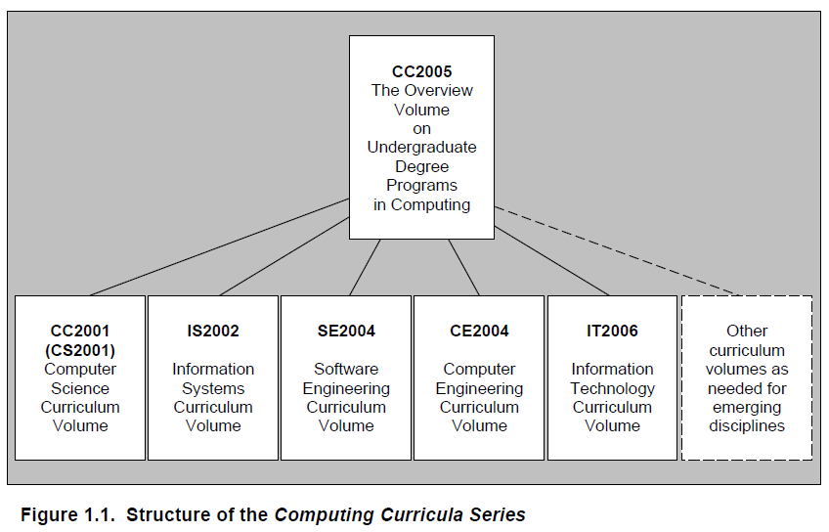
Summary: Five Curricula

Slide 18
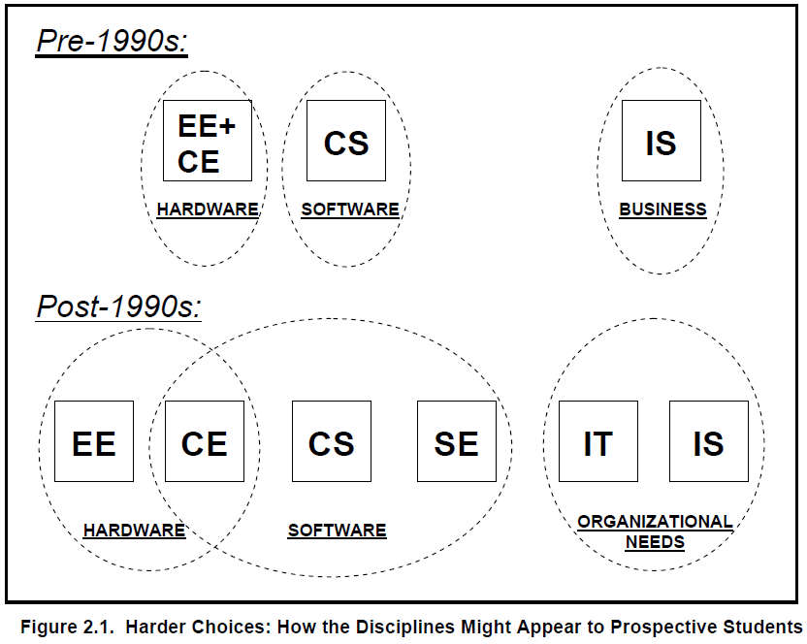
Many Curricular Choices!

Slide 19
The Job Market
https://cs.calvin.edu/documents/computing_careers

Slide 20
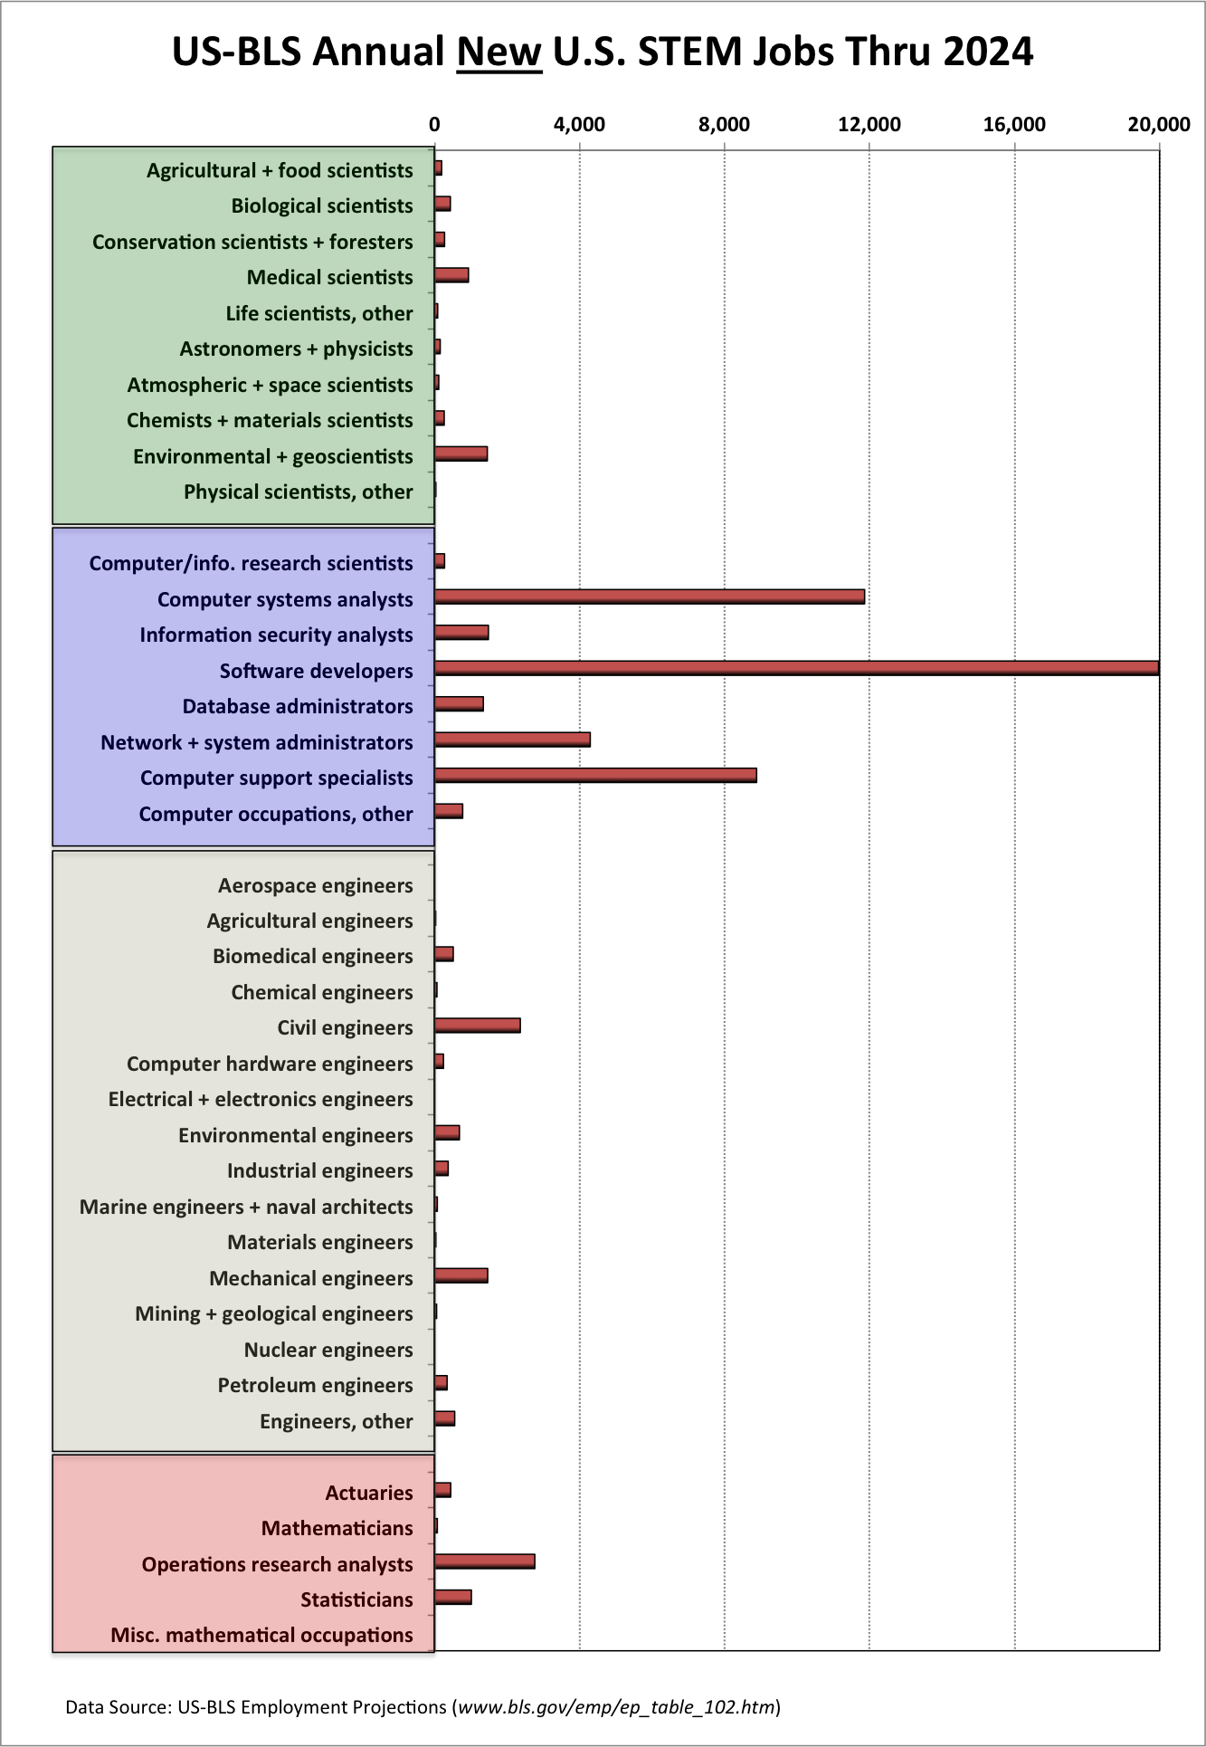
US Bureau of Labor Statistics:
New US STEM Jobs per Year, through 2024
Notes:
Source: Joel Adams, Calvin College, http://cs.calvin.edu/p/ComputingCareersMarket, via CSTA web site (http://blog.acm.org/archives/csta/points_of_interest/)
There are lots of myths about computing careers. One of the most ridiculous is the myth that all the computing jobs are going overseas. By contrast, the U.S. Bureau of Labor Statistics (US-BLS) predicts that computing will be one of the fastest-growing U.S. job markets in science, technology, engineering, and mathematics (STEM) for the foreseeable future, as indicated on the following chart (on powerPoint chart).
As you can see, the US government is predicting that the vast majority of the new STEM jobs will be in computing; only one other area (civil engineering) is expected to generate more than 5000 new jobs per year. By contrast, the US-BLS predicts there will be over 25,000 software engineering jobs each year, over 20,000 network specialist jobs each year, and over 10,000 systems analysts jobs each year.

Slide 21
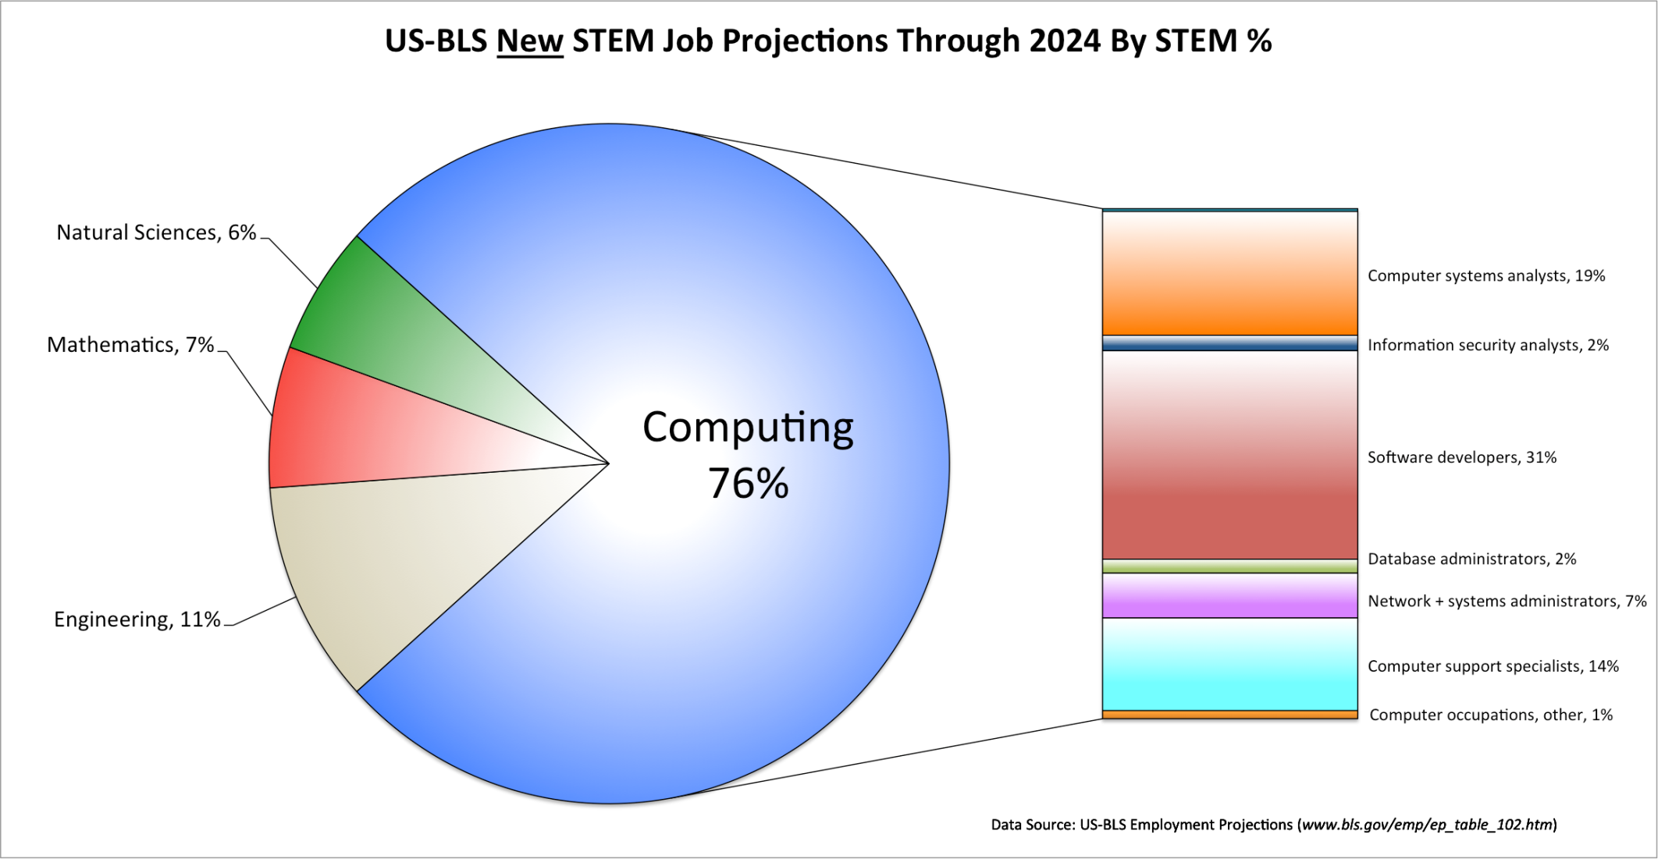
Percentage of New STEM Jobs by Area through 2024
Notes:
For the foreseeable future, nearly 3 out of 4 new science or engineering jobs in the U.S. are going to be in computing! By contrast, just 16% will be traditional engineering jobs, and even fewer will be in the sciences or mathematics.
What kind of “computing” jobs are these? The pie-chart on the right (PowerPoint chart) breaks the “computing” jobs down in the different career categories, and shows that the US-BLS is predicting:
27% (295,200 jobs) of the new STEM jobs will be in software engineering alone as compared to 16% (178,400 jobs) in the rest of engineering combined!
There will be far more new jobs in network analysis and administration (235,700) than in traditional engineering.
Note that basic computer literacy (i.e., knowing Microsoft Word, Excel, or Powerpoint) or CAD-design will not qualify you for one of these jobs. These jobs require skills that you will only gain by studying computer science, information systems, and/or software engineering.

Slide 22
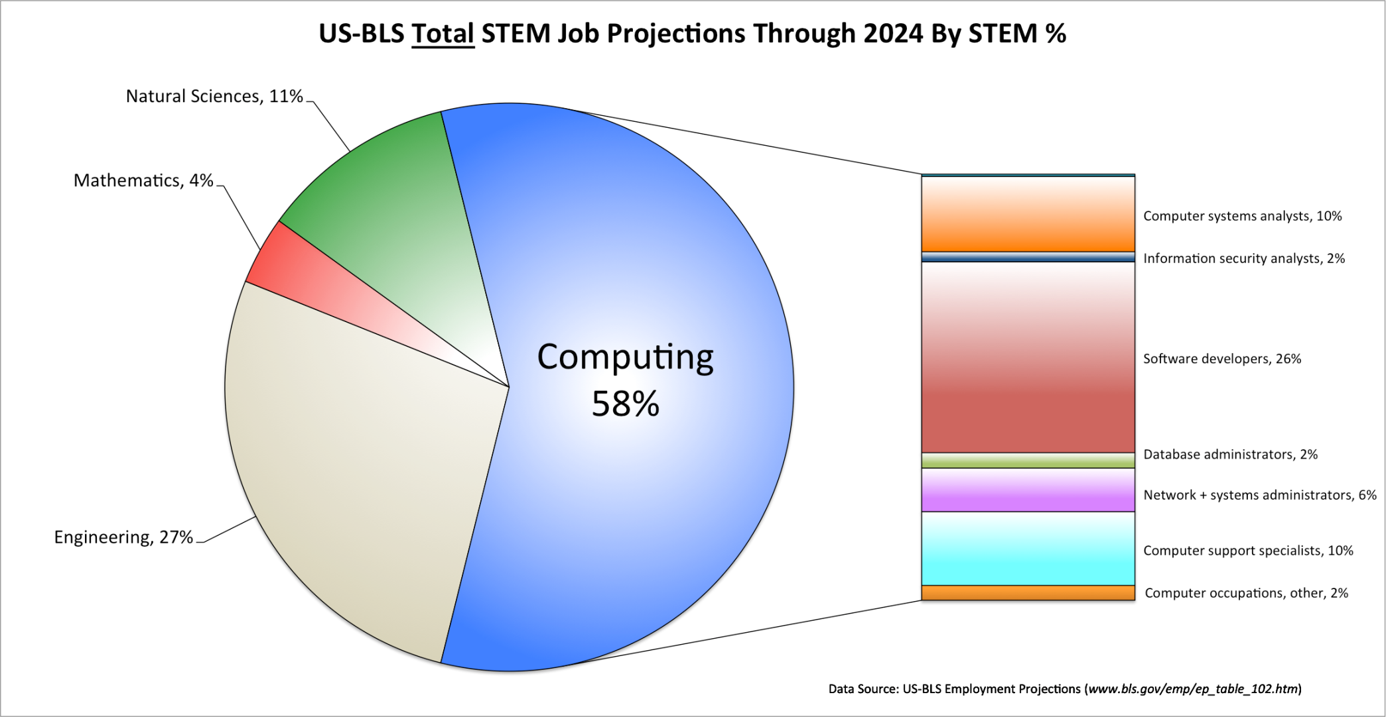
Percentage of Total STEM Jobs by Area through 2024
Notes:
For the foreseeable future, nearly 3 out of 4 new science or engineering jobs in the U.S. are going to be in computing! By contrast, just 16% will be traditional engineering jobs, and even fewer will be in the sciences or mathematics.
What kind of “computing” jobs are these? The pie-chart on the right (PowerPoint chart) breaks the “computing” jobs down in the different career categories, and shows that the US-BLS is predicting:
27% (295,200 jobs) of the new STEM jobs will be in software engineering alone as compared to 16% (178,400 jobs) in the rest of engineering combined!
There will be far more new jobs in network analysis and administration (235,700) than in traditional engineering.
Note that basic computer literacy (i.e., knowing Microsoft Word, Excel, or Powerpoint) or CAD-design will not qualify you for one of these jobs. These jobs require skills that you will only gain by studying computer science, information systems, and/or software engineering.

Slide 23
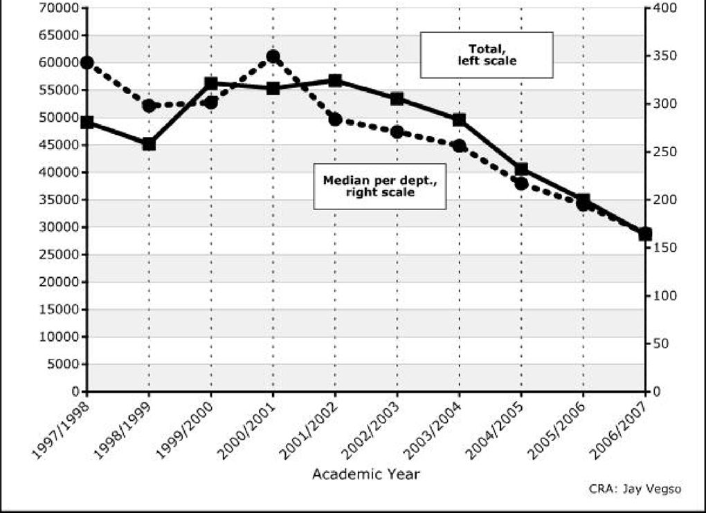
Undergraduate CS Degree Enrollment
Notes:
(Source: CRA Taulbee Survey)
With all of these jobs out there, you’d expect students to be flocking to computing. Unfortunately, the opposite is true, as the following chart shows (chart on PowerPoint slide).
So demand for software engineers, network administrators, systems analysts, and other computing-related professionals is exploding, but fewer and fewer students are choosing to study what is needed to get these jobs. As a result, salaries for these professionals are climbing.

Slide 24
Starting Salaries
The Spring 2016 yearly salary survey by the National Association of Colleges and Employers (NACE) reported that the average salary offer made to the class of 2015 graduates in computer engineering, information systems, and computer science increased to $69,241 (from $65,849 in the previous survey). The starting salary for computer science graduates were the highest, at 75,191.
Notes:
NACE salary survey, found at https://www.mcgill.ca/caps/files/caps/db_salary_summary.pdf

Slide 25
Curricula in the Department of Computer Science and Engineering
https://cse.sc.edu/undergraduate

Slide 26
Curricula in the Computer Science and Engineering Department
Major references are the University Undergraduate Studies Bulletin (http://www.sc.edu/bulletin/), the departmental website (http://www.cse.sc.edu/), and the College of Engineering and Computing Website (especially Student Services: http://www.cec.sc.edu/studsvcs/stud_svcs.html)
The objectives of the Undergraduate Program of Computer Science and Engineering are to provide the student with a thorough grounding in mathematics, science, and computational subjects and to prepare the student for a professional career or graduate studies in computer science, computer engineering and other fields.

Slide 27
Three Degrees: CS, CE, CIS
The Department of Computer Science and Engineering offers baccalaureate degrees with majors in computer engineering, computer information systems, and computer science.
All three degrees provide students with the knowledge and skills needed to work as practitioners in all aspects of the computing and information processing industries. All majors include a common core of fundamental courses in computing.
  The major in computer engineering includes courses in electronics and computer hardware as well as software;
  the major in computer information systems includes courses in business and is designed for students who are primarily interested in business applications;
  the major in computer science allows students to focus primarily on the software aspects of computing and requires selection of an appropriate application area.

