Slide 1
LIFE AS A WEB DEVELOPER
Richard Baldwin
Manager of Digital Services at Palmetto Health
Email: richardkbaldwin@gmail.com
Twitter: @richardkbaldwin

Slide 3
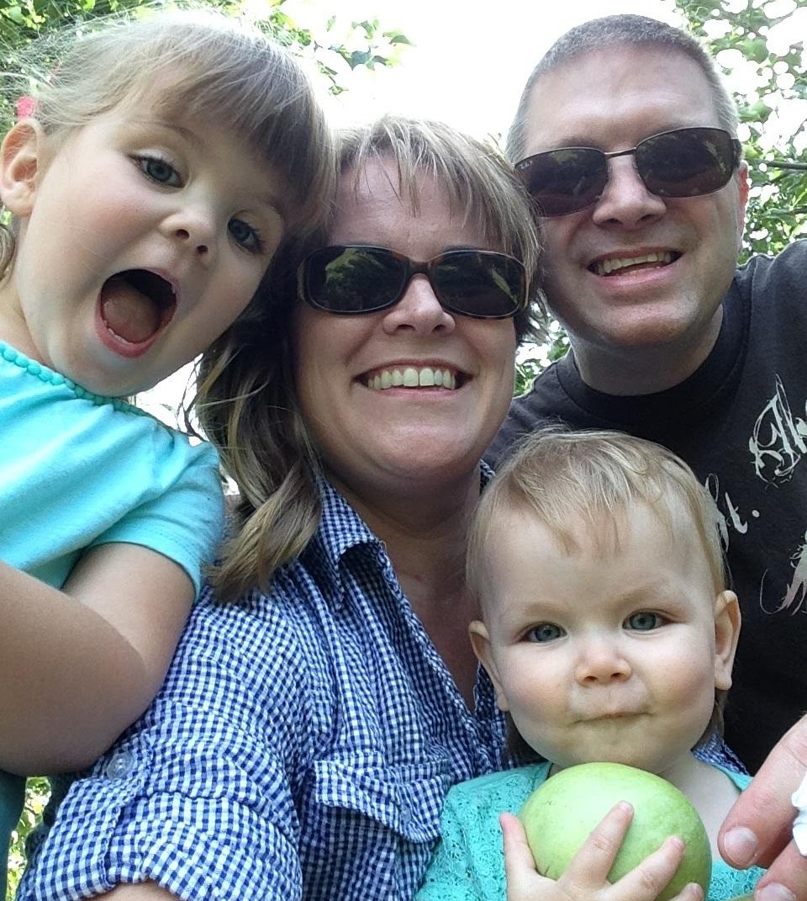

Slide 4
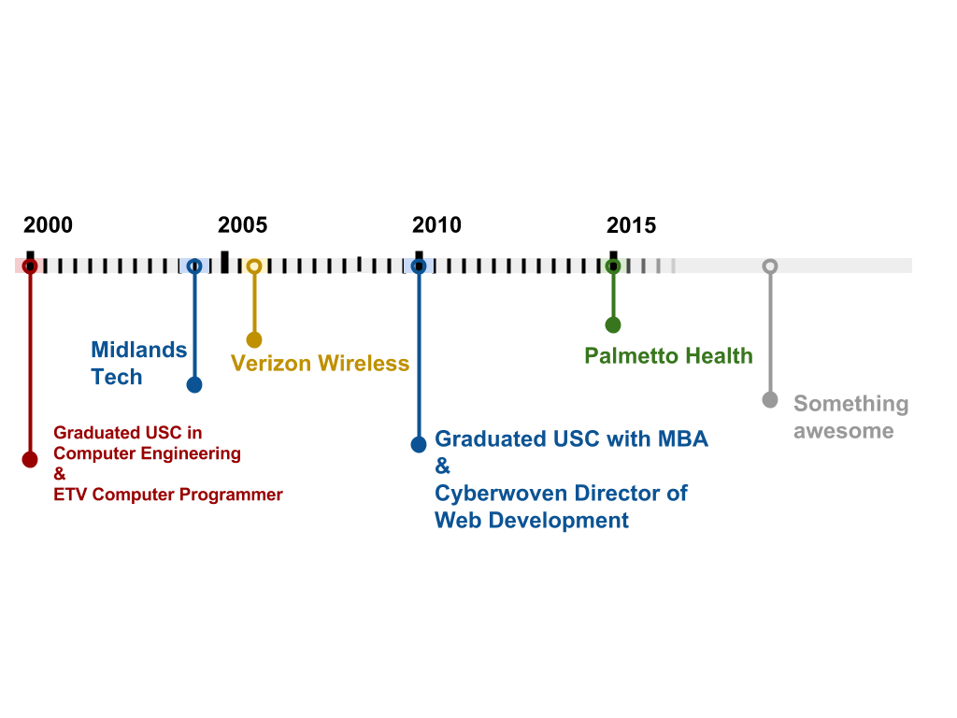
ABOUT ME
Richard Baldwin
Manager of Digital Services at Palmetto Health

Slide 5
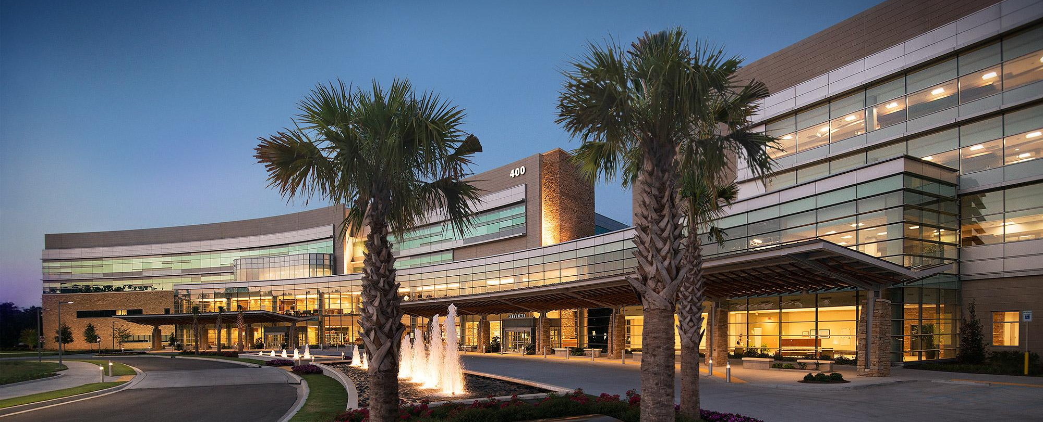
ABOUT
PALMETTO HEALTH
Five hospitals in the midlands area
48 physician practices
Nearly 11,000 team members
About 1 million patient encounters per year
Vision: To be remembered by each patient as providing the care and compassion we would want for our families and ourselves

Slide 6
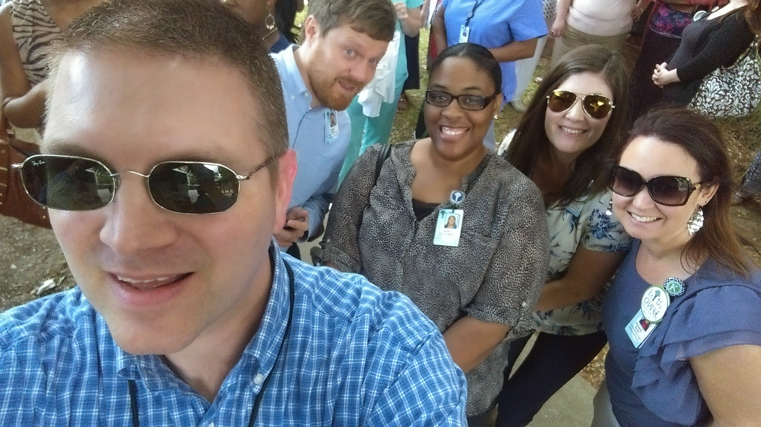

Slide 7
TERMINOLOGY
Programming/Development
Writing code in any computer language to accomplish any task
Software Development
Writing code to create applications, tools or services on computers, servers or devices
Web Development
Writing code to create web sites, web applications, web tools that are typically consumed in a browser

Slide 8
SOFTWARE DEVELOPMENT VS WEB DEVELOPMENT
$90,060 – median salary
139,900 – US jobs
2.8% – unemployment
#1 – 2013 best jobs ranking
$62,500 – median salary
28,500 – US jobs
4.2% – unemployment
#9 – 2013 best jobs ranking
Computer Programming
$74,280 – median salary
28,400 – US jobs
4.5% – unemployment
#30 – 2013 best jobs ranking
http://money.usnews.com/careers/best-jobs/rankings/the-100-best-jobs

Slide 9
SOFTWARE DEVELOPMENT VS WEB DEVELOPMENT II
Non-glamorous jobs
Slow changing field
Large and long projects
Less ownership
Specific skills
More competitive
Public facing work
Ever changing field
Smaller and shorter
More ownership
Transferable skills
Less competitive

Slide 10
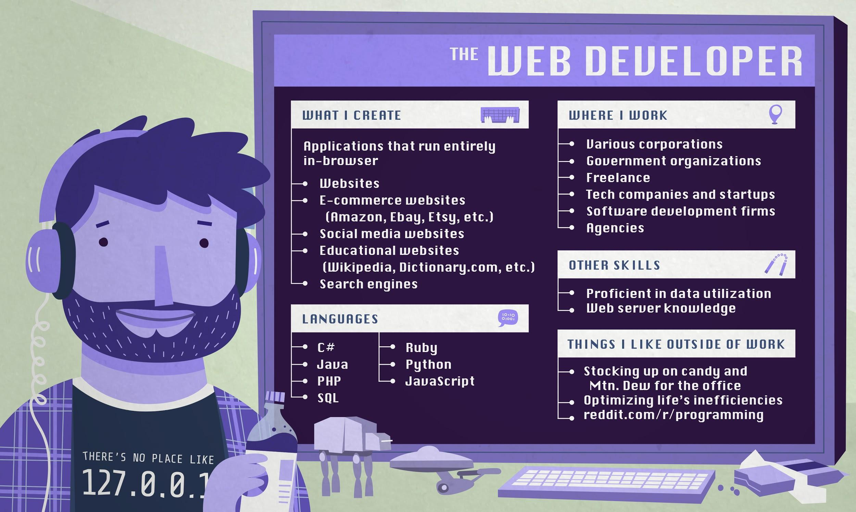

Slide 11
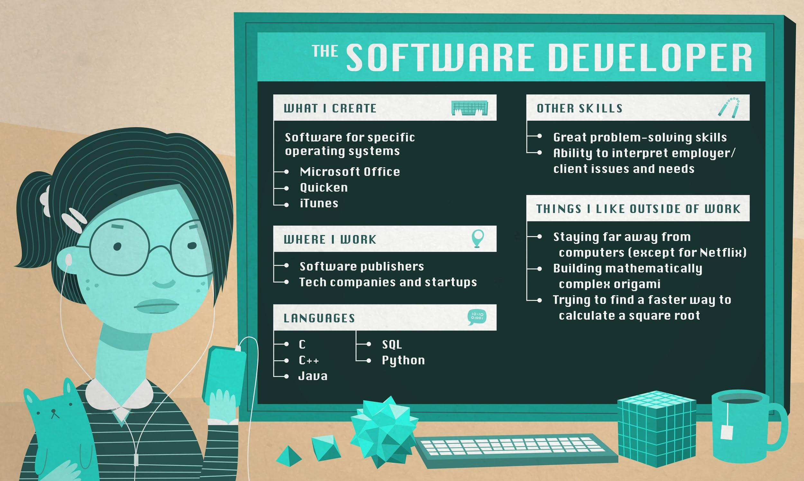

Slide 12
THE WEB WORLD
Designer
Photoshop, Illustrator
Layout, fonts, colors, logos
Front-end Developer
Sublime, SASS
HTML, CSS, JavaScript
Web Developer
Visual Studio or Text Editor
C#, SQL, PHP, JavaScript
UX Designer
Workflow tools
Site flow, application flow, layout
Notes:
Funny images

Slide 13
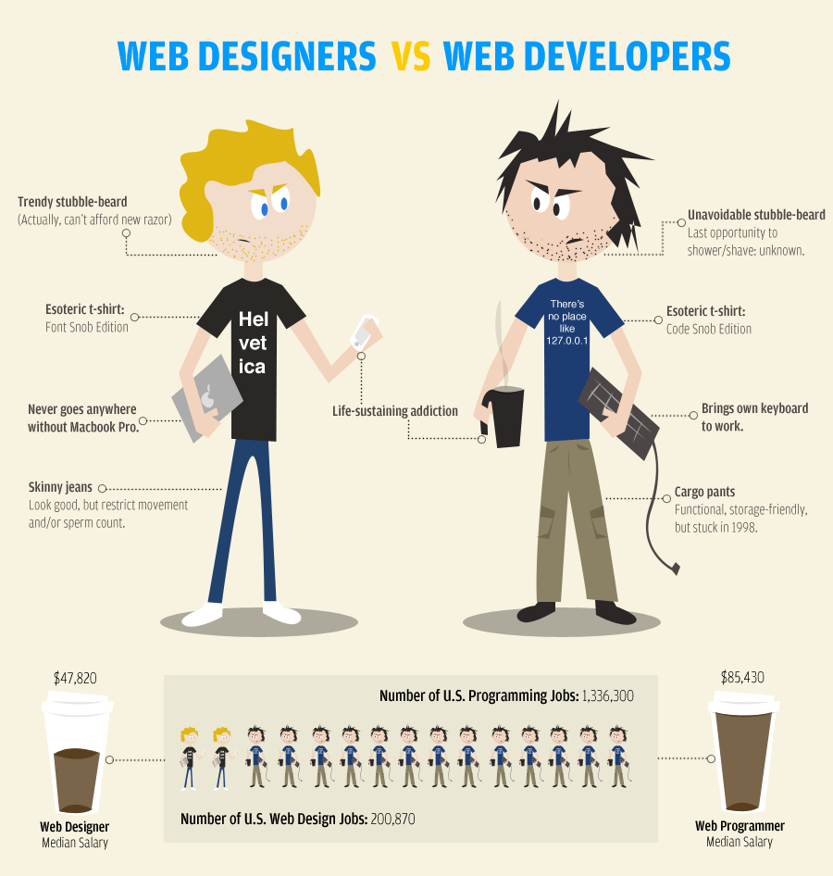

Slide 14
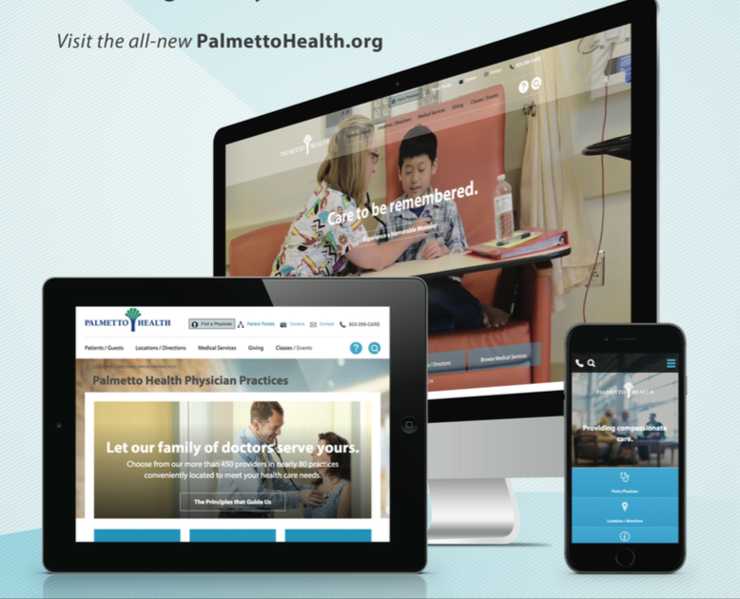

Slide 15
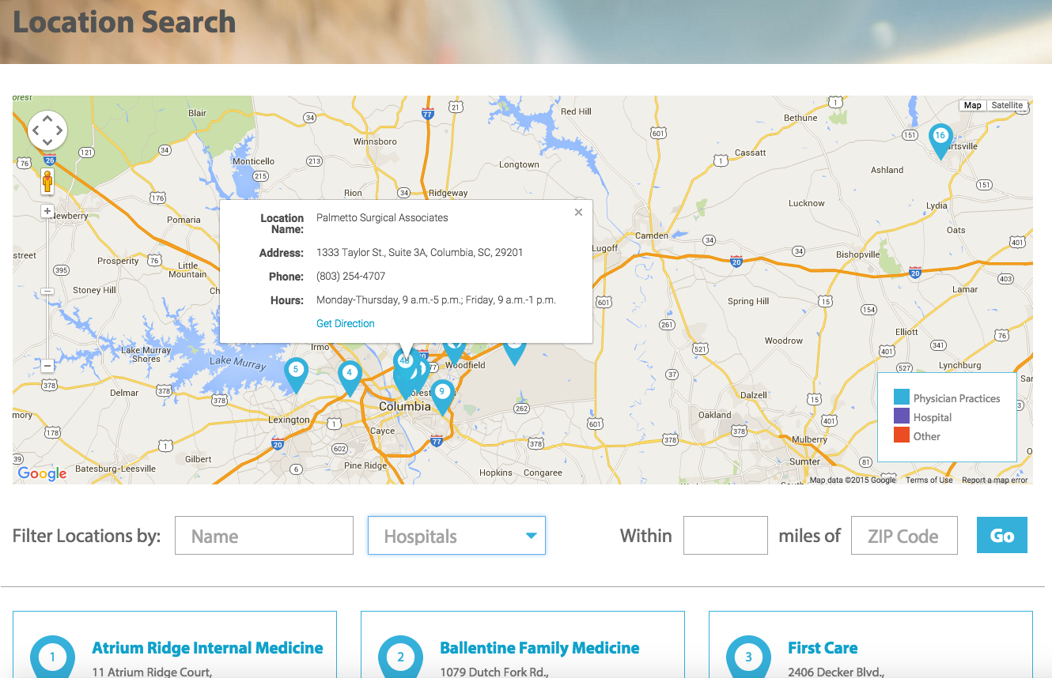

Slide 16
FIND A JOB AS A WEB DEVELOPER
Create Stuff
Side projects
Non-profits
Clubs
Personal
Example code
Github
Develop skills
Languages
Software
Databases
Content management systems
Network, community, conferences, etc.
Specific training

Slide 17
LIFE LESSONS
Keep living like a student
Pay down debt/loans
Don’t be afraid to take risks
Look for a team you want to be a part of
Find something you can be passionate about
Notes:
Code examples

Slide 18
Thank You!
Any Questions?
richardkbaldwin@gmail.com
@richardkbaldwin

Slide 20
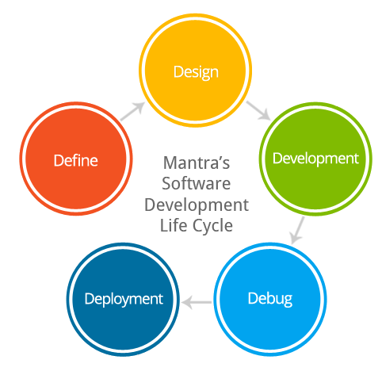

Slide 22
