Slide 1

Trends in the Infrastructure of Computing
CSCE 190: Computing in the Modern World
Dr. Jason D. Bakos

Slide 2
My Questions
How do computer processors work?
Why do computer processors get faster over time?
  How much faster do they get?
What makes one processor faster than another?
  What type of tradeoffs are involved in processor design?
  Why is my cell phone so much slower than my laptop?
What is the relationship between processor performance and how programs are written?
  Is this relationship dependent on the processor?
Notes:
Bottom up---how do things work.

Slide 3
Talk Outline
Quick introduction to how computer processors work
The role of computer architects
CPU design philosophy and survey of state-of-the art CPU technology
Coprocessor design philosophy and survey of state-of-art coprocessor technology
Reconfigurable computing
Heterogeneous computing
Brief overview of my research

Slide 4
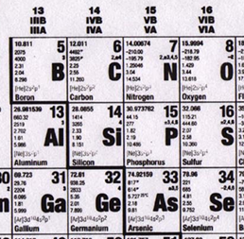
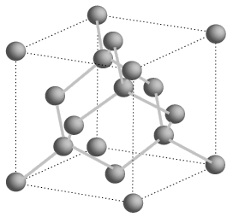
Semiconductors
Silicon is a group IV element
Forms covalent bonds with four neighbor atoms (3D cubic crystal lattice)
Si is a poor conductor, but conduction characteristics may be altered
Add impurities/dopants replaces silicon atom in lattice
  Adds two different types of charge carriers
Spacing = .543 nm
Notes:
4 valence electrons: bonds with 4 neighboring atoms No charge carriers without dopants. Dopants are from group 3 (hole; p-type) or group 5 (electron; n-type) Hole and electrons are charge carriers.

Slide 5
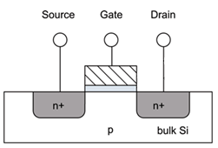
MOSFETs
Cut away side view
Metal-poly-Oxide-Semiconductor structures built onto substrate
  Diffusion: Inject dopants into substrate
  Oxidation: Form layer of SiO2 (glass)
  Deposition and etching: Add aluminum/copper wires
Notes:
If p is grounded, no electricity from diffusion area to substrate.
Works like a switch. The gate is a capacitor (there is a glass insulator under the gate---blue in the figure); charging it draws electrons and opens a channel, opening the connection.

Slide 6
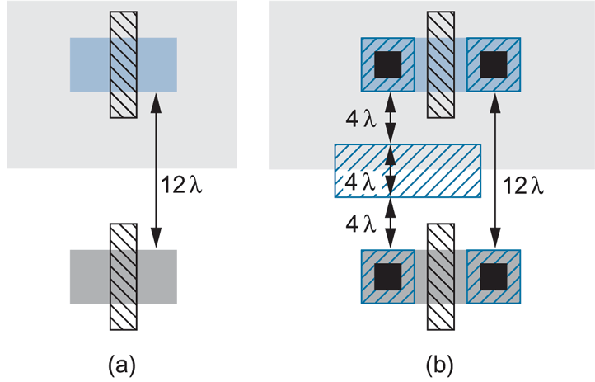
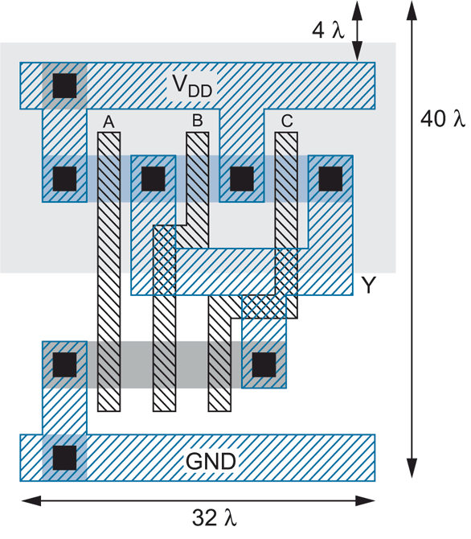
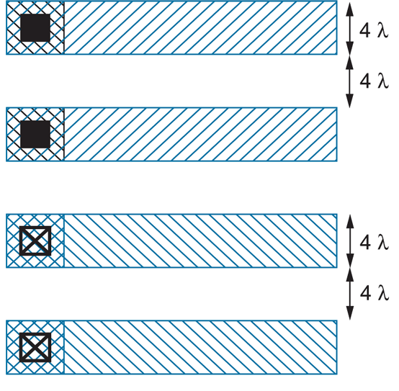
Layout
3-input NAND
Notes:
Polygons represent transistors (looking from the top down). Blue are wires (copper), the black (vias, vertical) connect metal to substrate; otherwise, glass in between. Grey shaded are gates. Around 180 nanometers (around 2000), the rules no longer are parametrized by lambda, because of the complicated physics at very small scale. Free MOSIS is 180 nanometers now.

Slide 7
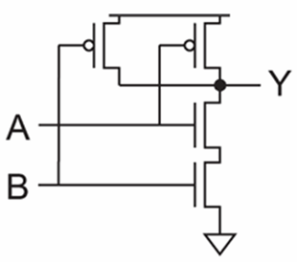
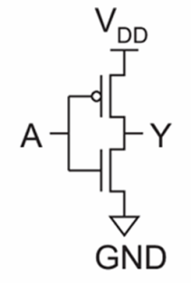
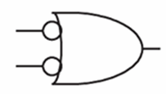
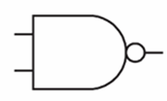
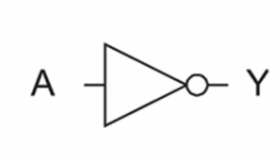
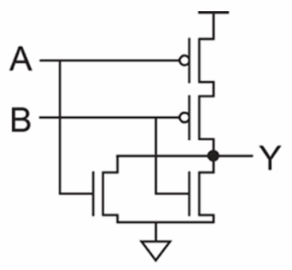
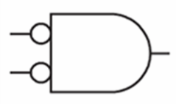
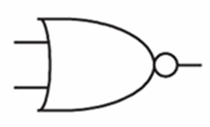
Logic Gates
inv
NAND2
NOR2
Notes:
Gates.

Slide 8
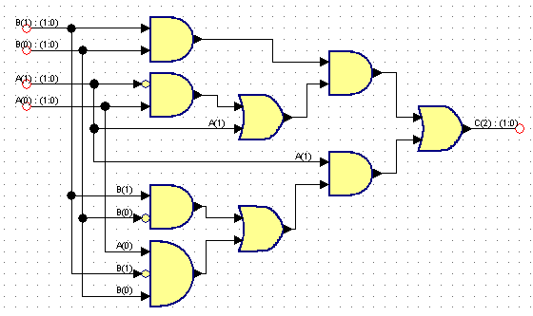
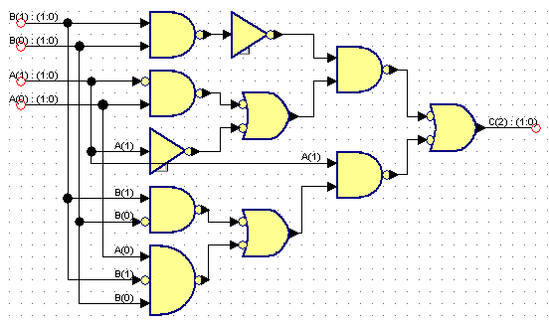
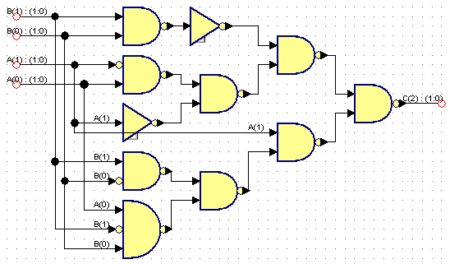
Logic Synthesis
Behavior:
  S = A + B
  Assume A is 2 bits, B is 2 bits, C is 3 bits
A | B | C
00 (0) | 00 (0) | 000 (0)
00 (0) | 01 (1) | 001 (1)
00 (0) | 10 (2) | 010 (2)
00 (0) | 11 (3) | 011 (3)
01 (1) | 00 (0) | 001 (1)
01 (1) | 01 (1) | 010 (2)
01 (1) | 10 (2) | 011 (3)
01 (1) | 11 (3) | 100 (4)
10 (2) | 00 (0) | 010 (2)
10 (2) | 01 (1) | 011 (3)
10 (2) | 10 (2) | 100 (4)
10 (2) | 11 (3) | 101 (5)
11 (3) | 00 (0) | 011 (3)
11 (3) | 01 (1) | 100 (4)
11 (3) | 10 (2) | 101 (5)
11 (3) | 11 (3) | 110 (6)

Slide 9
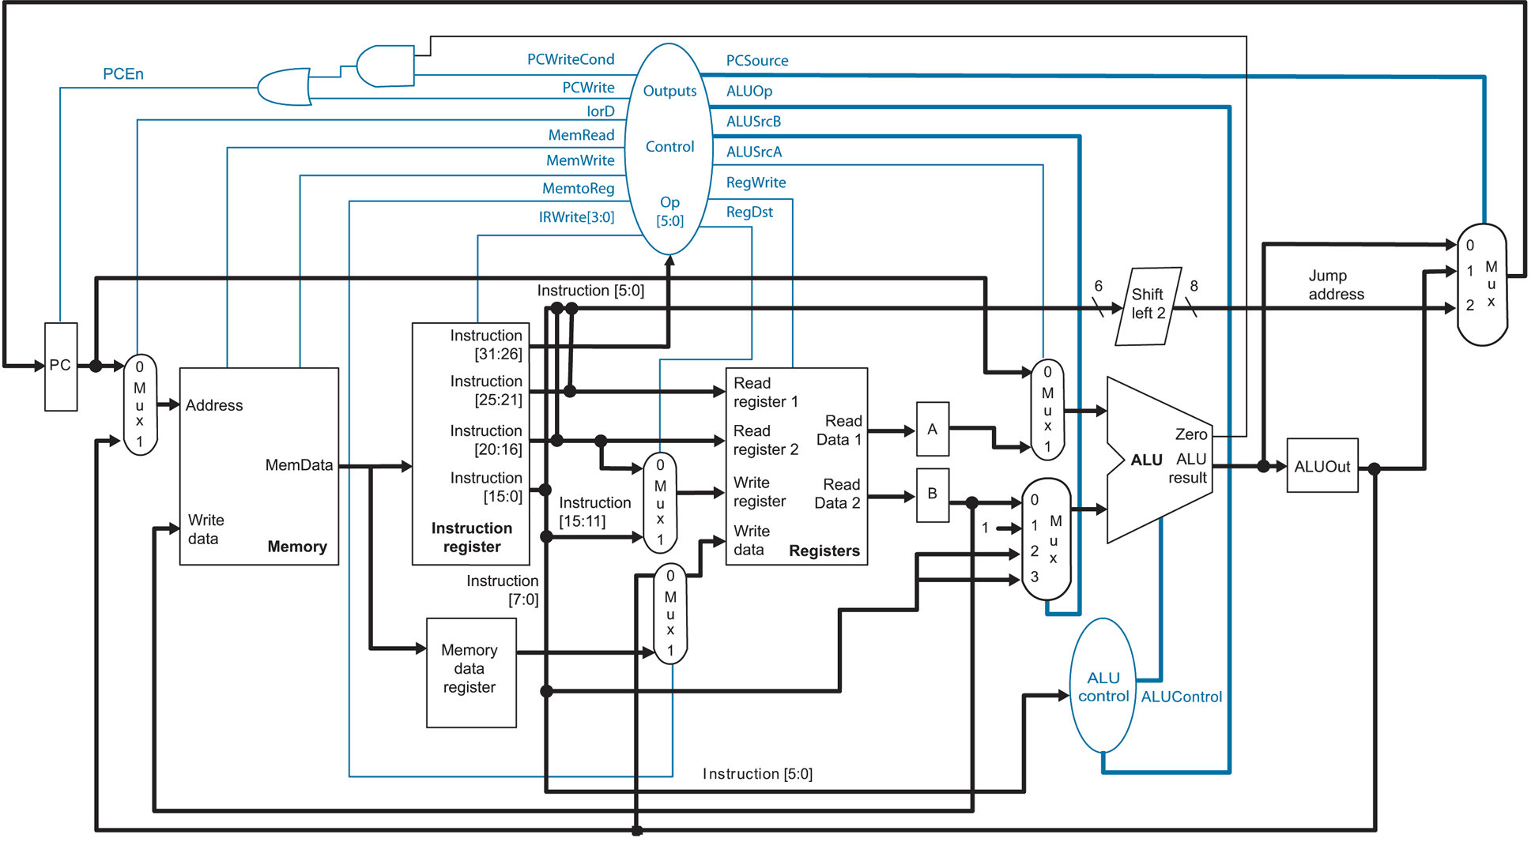
Microarchitecture
Notes:
A MIPS CPU (as used in Hennessy and Patterson; in 212).

Slide 10
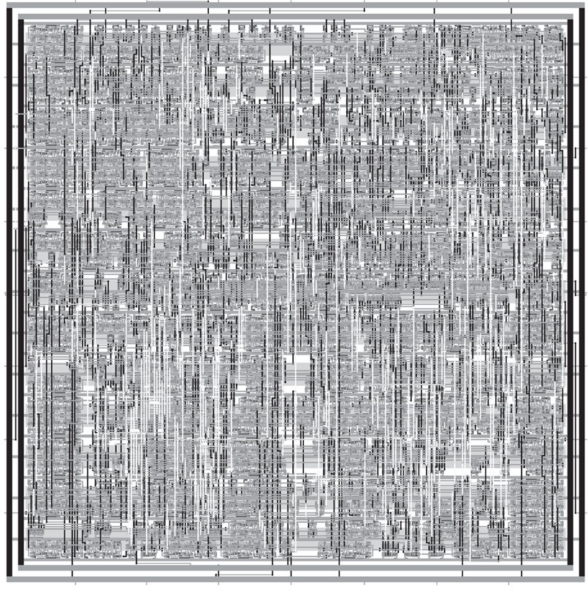
Synthesized and P&R’ed MIPS Architecture
Notes:
P&R’ed means: Placed and Routed. MOSIS (fabrication facility at ISI at USC) would receive something like this. (core of a tiny chip here.)

Slide 11
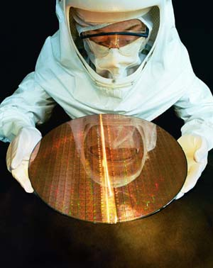
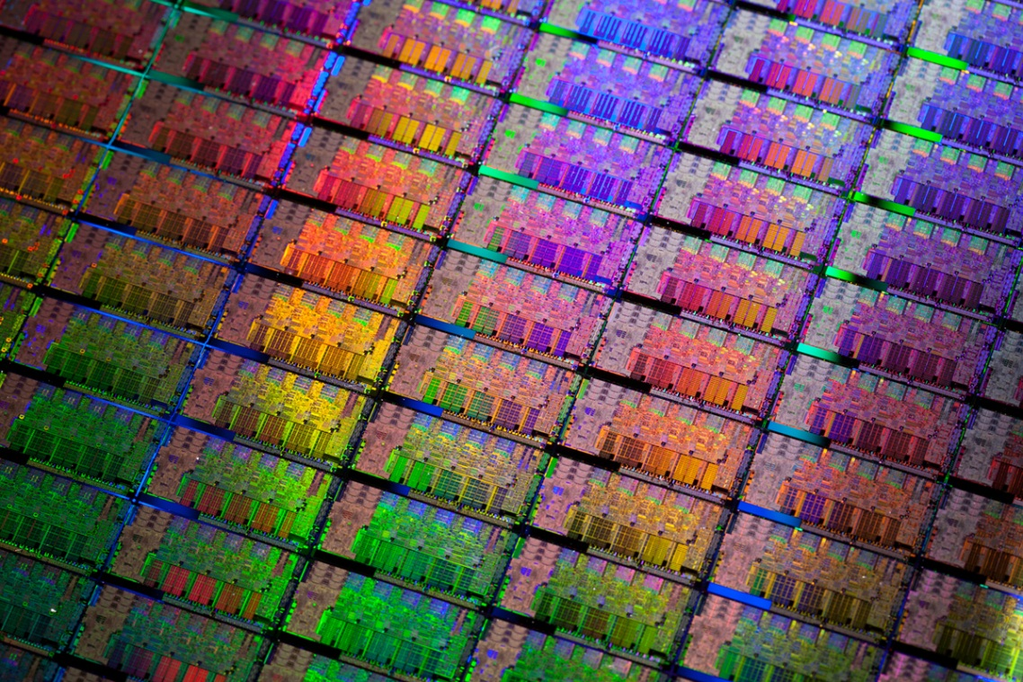
Si Wafer
Notes:
Most chips are rectangular.

Slide 12
Feature Size
Shrink minimum feature size…
  Smaller L decreases carrier time and increases current
  Therefore, W may also be reduced for fixed current
  C_{g}, C_{s}, and C_{d} are reduced
  Transistor switches faster (~linear relationship)
Notes:
Lambda is the gate length (the length of the channel from source to drain) Clock delays (due to wire capacitance) now add more delay that switching. Clock rate has remained 4 Ghz for the past 15 years or so.

Slide 13
Minimum Feature Size
Year | Processor | Performance | Transistor Size | Transistors
1982 | i286 | 6 - 25 MHz | 1.5 μm | ~134,000
1986 | i386 | 16 – 40 MHz | 1 μm | ~270,000
1989 | i486 | 16 - 133 MHz | .8 μm | ~1 million
1993 | Pentium | 60 - 300 MHz | .6 μm | ~3 million
1995 | Pentium Pro | 150 - 200 MHz | .5 μm | ~4 million
1997 | Pentium II | 233 - 450 MHz | .35 μm | ~5 million
1999 | Pentium III | 450 – 1400 MHz | .25 μm | ~10 million
2000 | Pentium 4 | 1.3 – 3.8 GHz | .18 μm | ~50 million
2005 | Pentium D | 2 threads/package | .09 μm | ~200 million
2006 | Core 2 | 2 threads/die | .065 μm | ~300 million
2008 | “Nehalem” | 8 threads/die | .045 μm | ~800 million
2009 | “Westmere” | 8 threads/die | .045 μm | ~1 billion
2011 | “Sandy Bridge” | 12 threads/die | .032 μm | ~1.2 billion
2012 | “Ivy Bridge” | 16 threads/die | .022 μm | ~1.4 billion
Year | Processor | Speed | Transistor Size | Transistors
2008 | NVIDIA Tesla (GT200) | 240 threads/die | .065 μm | 1.4 billion
2010 | NVIDIA Fermi (GF110) | 512 threads/die | .040 μm | 3.0 billion
2012 | NVNDIA Kepler (GK104) | 1536 threads/die | .028 μm | 3.5 billion
Notes:
Moore’s law: the number of transistors doubles every 18 months or two years. This is continuing.
The number of cores is no longer increasing. Most of the new transistors are used for graphics (GPU). This is because of gaming and (4K) video. For scientific computing, speeds are not higher; in reality, the bottleneck is the “memory wall” (von Neumann bottleneck).
JASON WILL EMAIL ME A NEW SLIDE WITH CHIPS OF DIFFERENT GENERATIONS!

Slide 14
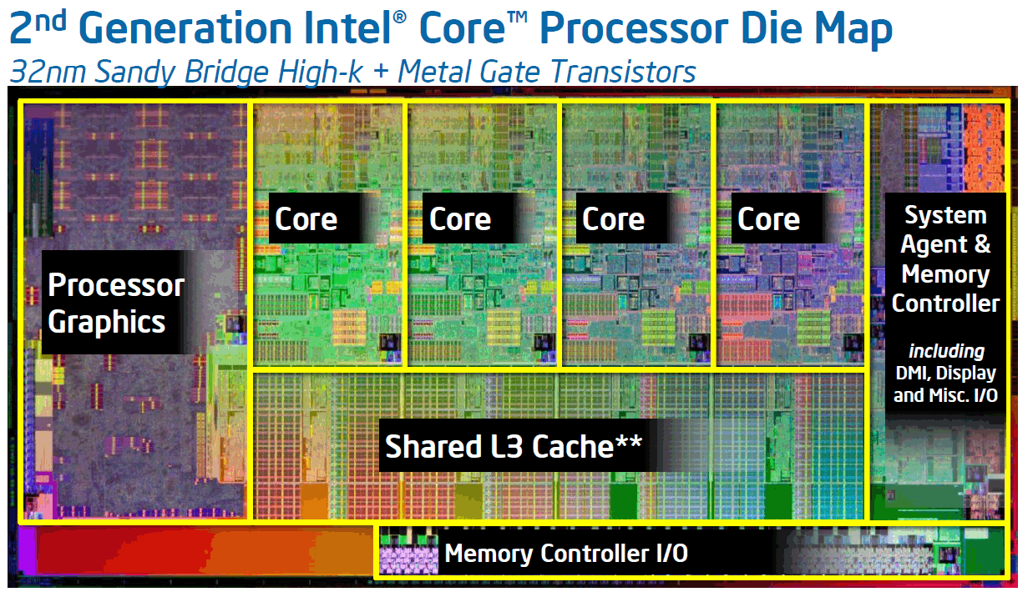
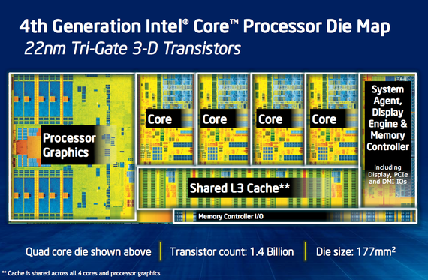
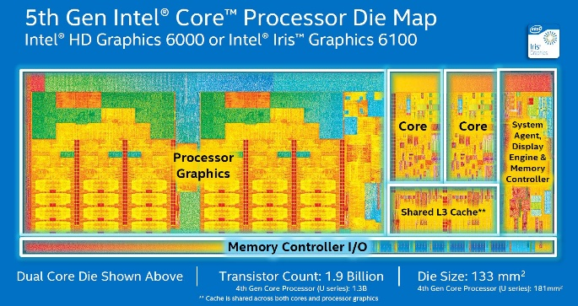
Where are the New Transistors Allocated?

Slide 15
The Role of Computer Architects
Given a blank slate (silicon substrate)
Budget: 2 billion transistors:
  Transistors ⬄ Area
Choose your components:
Component | Cost
Control Logic and Cache
Cache | 50K transistors/1KB + 10K transistors/port
Out-of-order instruction scheduler and dispatch | 200K transistors/core
Speculative execution | 400K transistors/core
Branch predictor | 200K transistors/core
Functional Units
Integer and load/store units | 100K transistors/unit/core
Floating-point unit | 1M transistors/unit/core
Vector/SIMD floating-point unit | 100M transistors/64b width/unit/core
2 cm
2 cm
multiplier
adder

Slide 16
The Role of Computer Architects
Problem:
  Cost of fabricating one chip: Hundreds of millions of dollars
  Additional cost of fabricating hundreds of thousands of copies of same chip: FREE
Strategy for staying in business:
  Sell LOTS of chips
How to sell many chips:
  Make sure it works well for a wide range of applications (e.g. CPUs)
    Maximize performance of each thread, target small number of threads
  Works well for one application, but has a large market (e.g. GPUs, DSPs, smart phone processors, controllers for manufacturing)
Notes:
The cost of building masks is increasing. So, chips need to be general purpose or for a huge marking (e.g., TI; phones; Nvidia, AMD (which bought ATI): discrete GPUs)

Slide 17
CPU Design Philosophy
Processors consist of three main componets:
  Control logic
  Cache
  Functional units
Premise:
  Most code (non scientific) isn’t written to take advantage of multiple cores
  Devote real estate budget to maximizing performance of each thread
    Control logic: reorders operations within a thread, speculatively execution
    Cache: reduces memory delays for different access patterns
CPUs do achieve higher performance when code is written to be multi-threaded
  But CPUs quickly run out of functional units
Notes:
A lot of space is taken for cache and ALUs, so they support naively written code. GPUs are faster but require specially written code.

Slide 18
CPU Design
FOR i = 1 to 1000
C[i] = A[i] + B[i]
Core 1
Core 2
CPU
Control
ALU
ALU
Control
ALU
ALU
ALU
ALU
ALU
ALU
Thread 1
Thread 2
time
L1 cache
L1 cache
Copy part of A onto CPU
L2 cache
L2 cache
Copy part of B onto CPU
ADD
ADD
ADD
ADD
L3 cache
Copy part of C into Mem
Copy part of A onto CPU
Copy part of B onto CPU
ADD
ADD
ADD
ADD
Copy part of C into Mem
…
Notes:
Intel CPUs are able to extract much instruction-level parallelism automatically (out of order, speculative, move order of instructions); GPUs cannot.

Slide 19
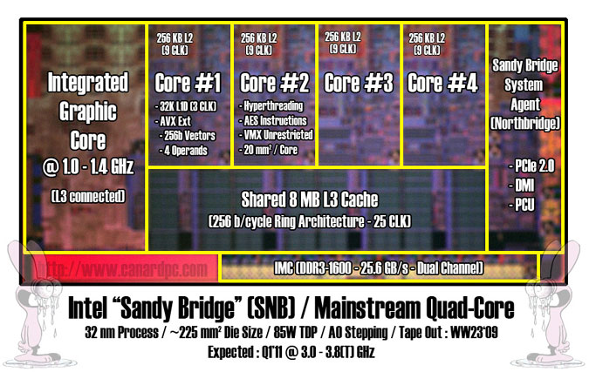
Intel Sandy Bridge Architecture
Four cores, each core has 256-bit SIMD unit
Integrated GPU (IGU) with 12 execution units
Notes:
Single Instruction Multiple Data; sometimes compilers can use these automatically. 2009 tape out (i.e., sent to fabrication) -> 2011 release. 256=bit data path.

Slide 20
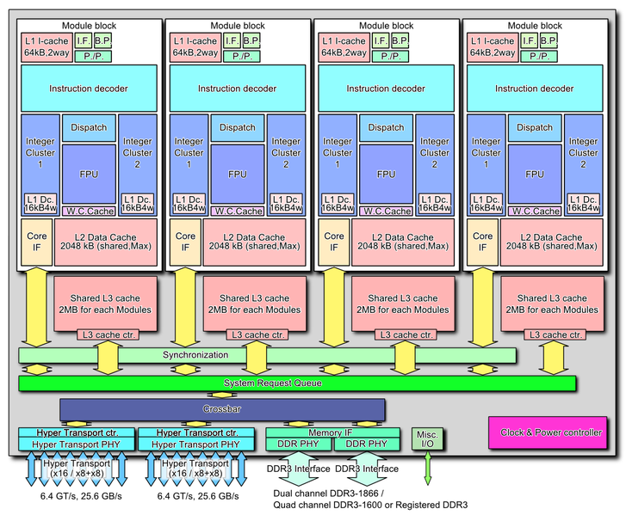
AMD Bulldozer Architecture
Next generation AMD architecture
Designed from scratch
Four cores, each core:
  Executes 2 threads with dedicated logic
  Contains two 128-bit FP multiply-add units
Decoupled L3 caches
Notes:
Intel and AMD make processors that can run the same programs, but make different choices about allocation of real estate. In particular, the Bulldozer splits the level-3 cache (“decoupled cache”) and uses two FP multiplier; 128-bit wide.

Slide 21
Graphical Processor Units (GPUs)
Basic idea:
  Originally designed for 3D graphics rendering
  Success in gaming market
  Devote real estate to computational resources
    As opposed to control and caches to make naïve and general-purpose code run fast
  Achieves very high performance but:
    Extremely difficult to program
      Program must be split into 1000s of threads
    Only works well for specific types of programs
    Lacks functionality to manage computer system resources
  Now widely used for High Performance Computing (HPC)
Notes:
Almost all space devoted to ALU, very little to cache and control: need to explicitly parallelize your code. GPUs are used in XBOX and Playstation 4.
If you are interested in this, go for the scientific computing cluster!

Slide 22
Co-Processor (GPU) Design
FOR i = 1 to 1000
C[i] = A[i] + B[i]
GPU
cache
ALU
ALU
ALU
ALU
ALU
ALU
ALU
ALU
Core 1
threads
cache
ALU
ALU
ALU
ALU
ALU
ALU
ALU
ALU
Core 2
cache
ALU
ALU
ALU
ALU
ALU
ALU
ALU
ALU
Core 3
cache
ALU
ALU
ALU
ALU
ALU
ALU
ALU
ALU
Core 4
cache
ALU
ALU
ALU
ALU
ALU
ALU
ALU
ALU
Core 5
cache
ALU
ALU
ALU
ALU
ALU
ALU
ALU
ALU
Core 6
cache
ALU
ALU
ALU
ALU
ALU
ALU
ALU
ALU
Core 7
cache
ALU
ALU
ALU
ALU
ALU
ALU
ALU
ALU
Core 8
Thread
Thread
Thread
Thread
Thread
Thread
Thread
Thread
Thread
Thread
Thread
Thread
Thread
Thread
Thread
Thread
Notes:
Many threads! Even 1000 in some GPUs. Each outermost loop iteration becomes a thread.

Slide 23
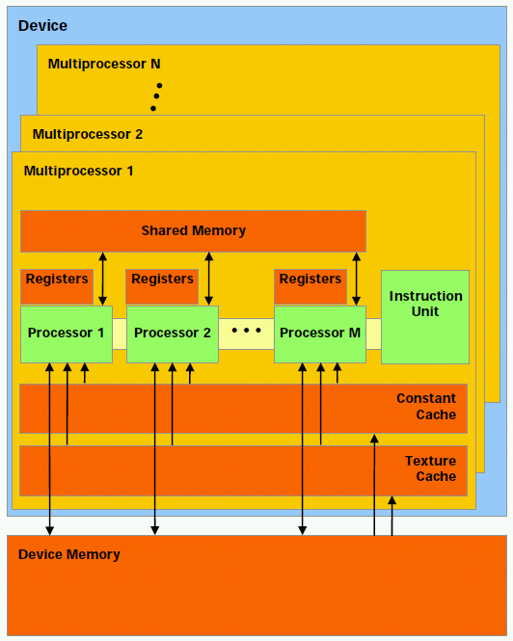
NVIDIA GPU Architecture
Hundreds of simple processor cores
Core design:
  Executes each individual thread very slowly
  Each thread can only perform one operation at a time
  No operating system support
  Able to execute 32 threads (per core per clock cycle)
  Has 8 cores
Notes:
A closer view of each core

Slide 24
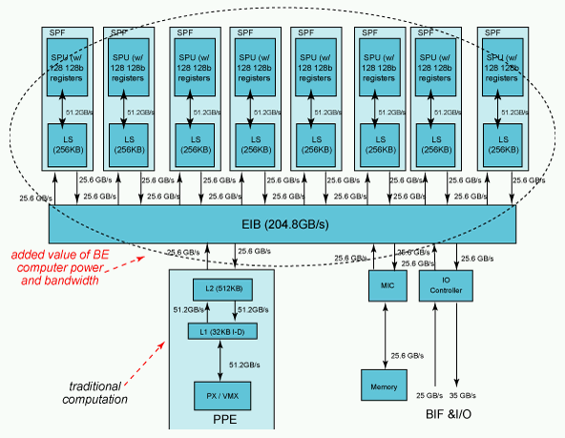
IBM Cell/B.E. Architecture
1 PPE, 8 SPEs
Programmer must manually manage 256K memory and threads invocation on each SPE
Each SPE includes a vector unit like the one on current Intel processors
  128 bits wide (4 ops)
Notes:
Power PCS + 8 DSP cores; certain parts of the code must be downloaded directly to the Dsp cores. Was used for Playstation 3. Broadband Engine (B.E.). This architecture is no longer built.

Slide 25
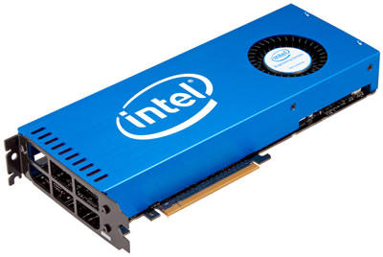
Intel Phi Coprocessor
PCIe coprocessor card
Used like a GPU
“Many Integrated Core”
  32 x86 cores, 128 threads
  512 bit SIMD units
  Coherent cache among cores
  2 GB onboard memory
  Uses Intel ISA
Notes:
New ones are up to 80 (Pentium---older and smaller) cores. The Phi co-processor card was just (Aug. 2017) discontinued. It has been replaced with an in-socket version, which reduces the bus bottleneck.

Slide 26
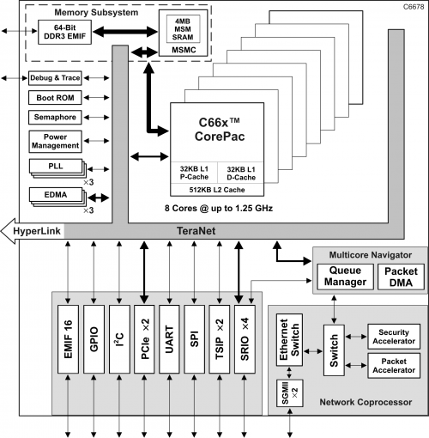
Texas Instruments C66x Architecture
Originally designed for signal processing
8 decoupled cores
  No shared cache
Can do floating-point or fixed-point
  Can do fixed-point much faster
Possible coprocessor for HPC
  Less watts per FLOP
Notes:
Used for cellphone base stations (Voice over IP encoding); Jason Bakos and his group (HRC, Heterogeneous and Reconfigurable Computing group) did a three-year project developing specific applications for this architecture. Now (2018), extension for two years for driver assistance. (Keystone architecture.)

Slide 27
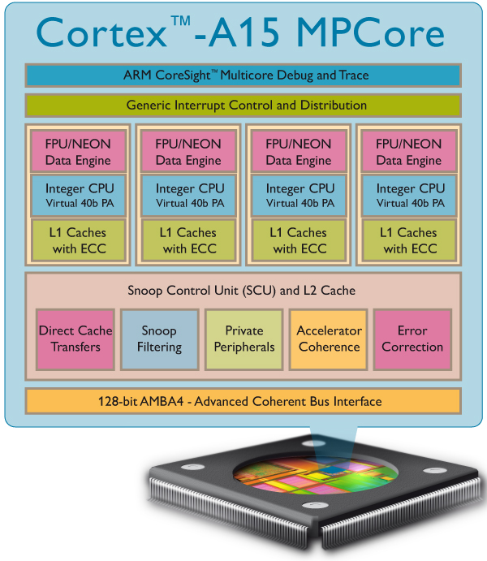
ARM Cortex-A15 Architecture
Originally designed for embedded (cell phone) computing
Out-of-order superscalar pipelines
4 cores per cluster, up to 2 clusters per chip
Possible coprocessor for HPC?
  LOW POWER
    FLOPS/watt
Notes:
ARM makes chips for phones, embedded mobile and consumer devices; tried to get into data center (transaction, data base) computing. These are power-efficient.

Slide 28
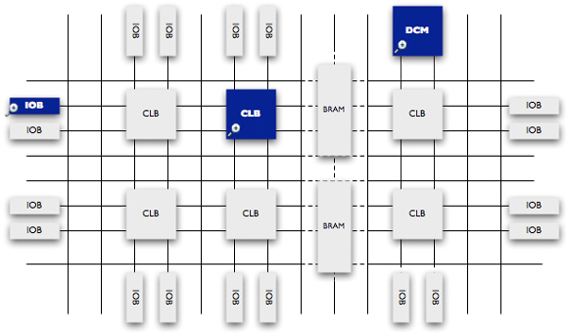
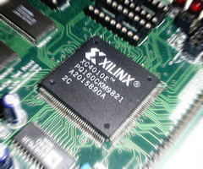
Field Programmable Gate Arrays
FPGAs are blank slates that can be electronically reconfigured
Allows for totally customized architectures
Drawbacks:
  More difficult to program than GPUs
  10X less logic density and clock speed
Notes:
Huge flexibility, must use hardware description language: very lower level, RTL, timing. In principle, much higher utilization of the hardware. Electronically (“in the field”) reconfigurable. CE students will use FPGAs in 611 and 313.

Slide 29
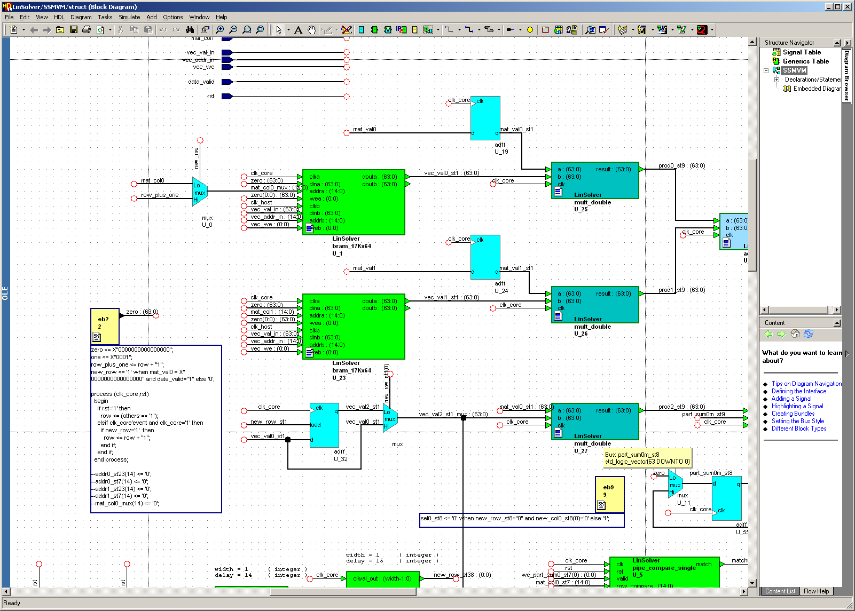
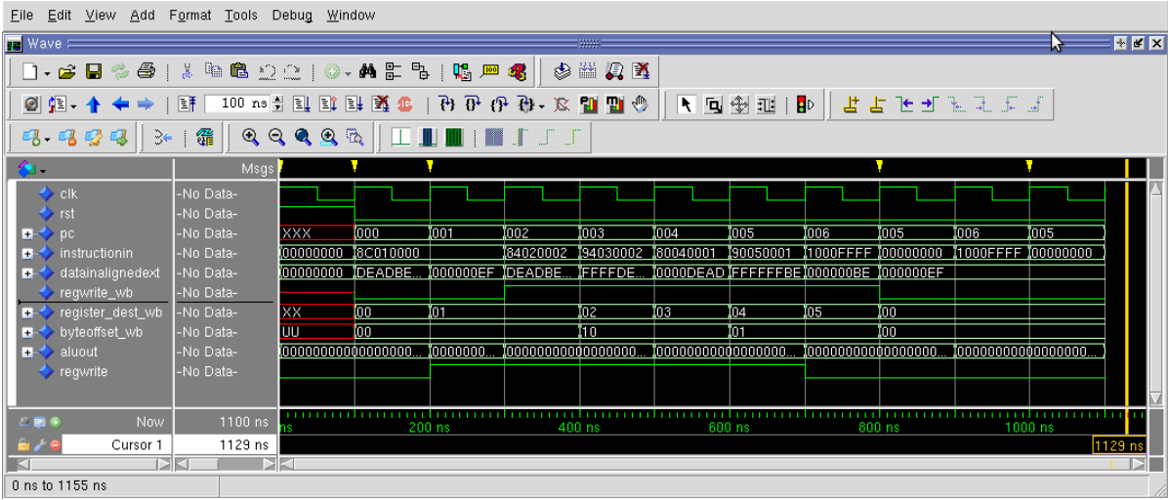
Programming FPGAs
Notes:
FPGA have worked very hard on compiler from C to HDL. They call it high-level synthesis. Also, used for debugging before (re-)configuring the chip.

Slide 30
Heterogeneous Computing
Combine CPUs and coprocs
Example:
  Application requires a week of CPU time
  Offload computation consumes 99% of execution time
49% of code
initialization
0.5% of run time
“hot” loop
99% of run time
2% of code
Kernel speedup | Application speedup | Execution time
50 | 34 | 5.0 hours
100 | 50 | 3.3 hours
200 | 67 | 2.5 hours
500 | 83 | 2.0 hours
1000 | 91 | 1.8 hours
49% of code
clean up
0.5% of run time
co-processor

Slide 31
Heterogeneous Computing
General purpose CPU + special-purpose processors in one system
Use coprocessors to execute code that they can execute fast!
  Allow coprocessor to have its own high speed memory
Possible bottleneck!
Host Memory
CPU
QPI
PCIe
On board
Memory
X58
Co-processor
25 GB/s
25 GB/s
8 GB/s (x16)
150 GB/s
host
add-in card
Notes:
General-purpose coprocessing on one die has not (yet) been successful.

Slide 32
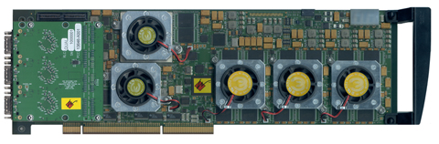
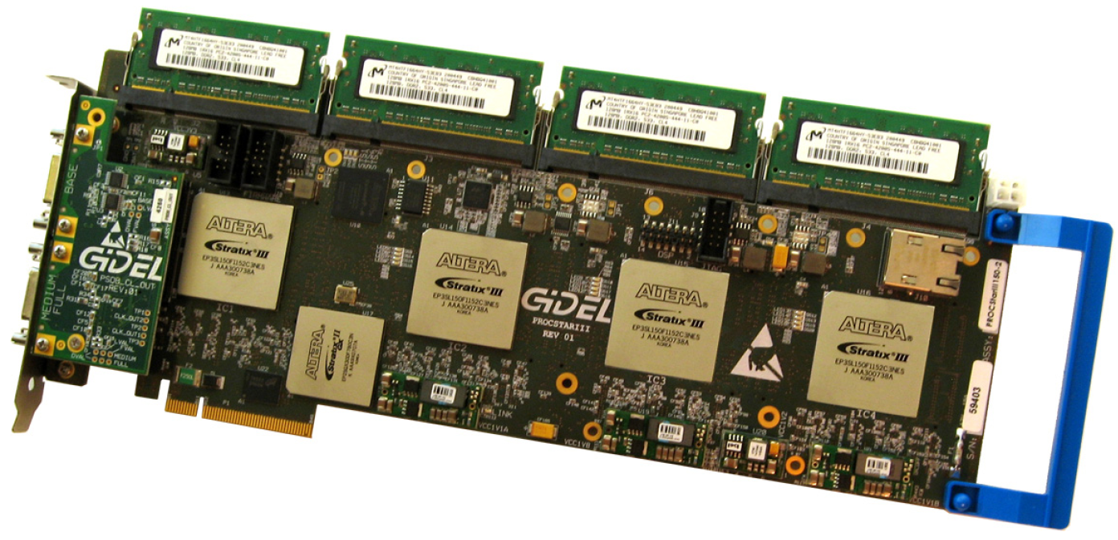
Heterogeneous Computing with FPGAs
Annapolis Micro Systems
WILDSTAR 2 PRO
GiDEL PROCSTAR III
Notes:
Jason used these. No longer. The ones used now are very similar (2018).

Slide 33
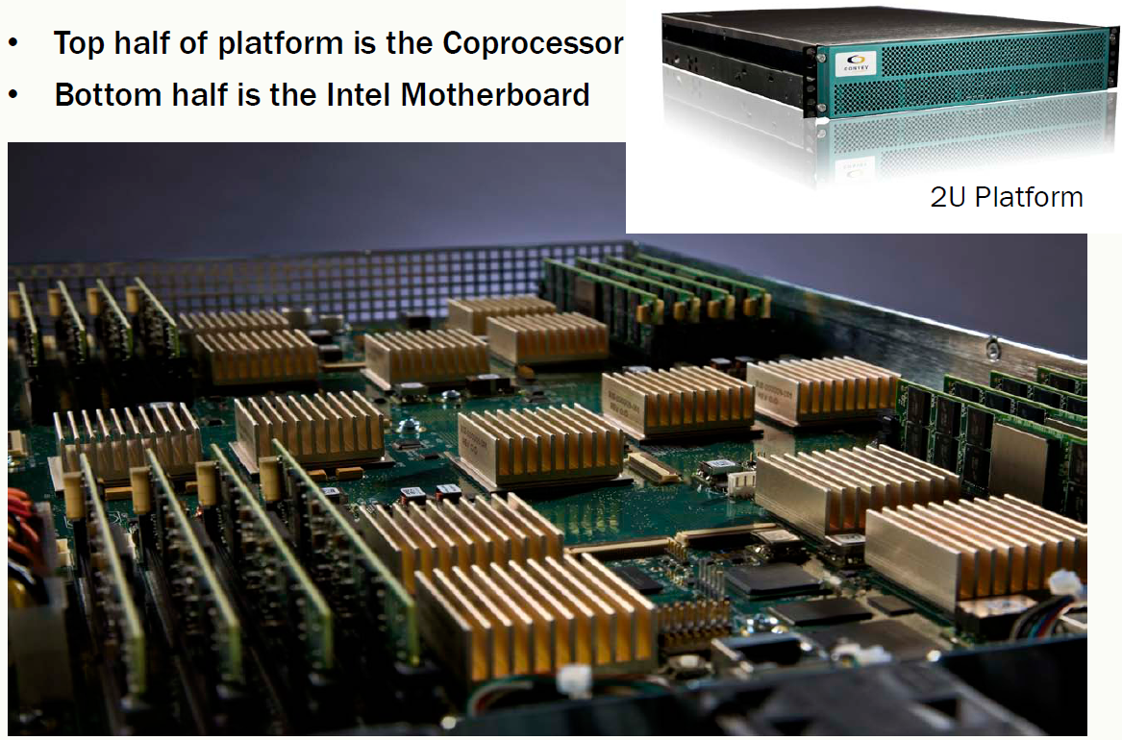
Heterogeneous Computing with FPGAs
Convey HC-1
Notes:
Cache coherency protocols can be used. No need to use DMA: there is a coherent shared memory space. This is a little dated; it is very expensive, and Convey may have returned to the traditional plug-in card form factor. Co-processor with 40 FPGA boards. Jason still has it, but it is not used any more: steep learning curve, very loud, and uses an older Linux OS, so UTS does not like it.

Slide 34
AMD Fusion Architecture
Integrate GPU-type coprocessor onto CPU
  Put a small RADEON GPU onto the CPU
Allows to accelerate smaller programs than PCIe-connected coprocessor
Targeted for embedded but AMD hopes to scale to servers
Notes:
Did not scale---did not work out.

Slide 35
My Research
Developed custom FPGA coprocessor architectures for:
  Computational biology
  Sparse linear algebra
  Data mining
Written GPU optimized implementations for:
  Computational biology
  Logic synthesis
  Data mining
  General purpose graph traversals
Optimized computer vision implementations for DSP chips
Generally achieve 50X – 100X speedup over general-purpose CPUs
Notes:
CPU have gotten really fast! Hard to achieve these speedups.

Slide 36
Current Research Goals
Develop high level synthesis (compilers) for specific types of FPGA-based computers
  Based on:
    Custom pipeline-based architectures
    Multiprocessor soft-core systems on reconfigurable chips (MPSoC)
Develop code tuning tools for GPU code based on runtime profiling analysis
Automata processors in a grid architecture. Uses an intermediate level of abstraction called overlay.
Notes:
Pipeline scheduling (Jemin Zheng): not in a while.
Code Tuning: Jordan Bradshaw, but them moved to string matching.
4 PhD, 1 MS, 3 UGs.
1: developing apps for the automata processor (NDA).
2: using FPGA to control medium-voltage power converters, with minimum latency.
Some UGs are working on spiking neural networks with the IBM True North processor, which work on the basis of rate of signals (impulses), closer to biological NNs, working in parallel more easily, and using very little power. Jason and students are trying to bypass the proprietary IBM ASIC, by writing a compiler from these to FPGAs. Also, learning.

