Slide 1
CSCE 190
Programming Language Paradigms
Fall 2015
mgv@cse.sc.edu

Slide 2
Language Families
Imperative (or Procedural, or Assignment-Based)
Functional (or Applicative)
Logic (or Declarative)

Slide 3
Imperative Languages
Mostly influenced by the von Neumann computer architecture
Variables model memory cells, can be assigned to, and act differently from mathematical variables
Destructive assignment, which mimics the movement of data from memory to CPU and back
Iteration as a means of repetition is faster than the more natural recursion, because instructions to be repeated are stored in adjacent memory cells

Slide 4
GCD (Euclid’s Algorithm) in C
To compute the gcd of a and b, check to see if a and b are equal. If so, print one of them and stop. Otherwise, replace the larger one by their difference and repeat.
#include <stdio.h>
int gcd(int a, int b) {
while (a != b) {
if (a > b) a = a - b;
else b = b - a;
}
return a;
}
Notes:
[S] Also:
int main()
{
int i, j;
scanf("%d %d", &i, &j);
printf("%d\n", gcd(i, j));
}

Slide 5
Functional Languages
Model of computation is the lambda calculus (of function application)
No variables or write-once variables
No destructive assignment
Program computes by applying a functional form to an argument
Program are built by composing simple functions into progressively more complicated ones
Recursion is the preferred means of repetition

Slide 6
GCD (Euclid’s Algorithm) in Scheme
The gcd of a and b is defined to be (1) a when a and b are equal, (2) the gcd of b and a-b when a > b and (3) the gcd of a and b-a when b > a. To compute the gcd of a given pair of numbers, expand and simplify this definition until it terminates
(define gcd2 ; 'gcd' is built-in to R5RS
(lambda (a b)
(cond ((= a b) a)
((> a b) (gcd2 (- a b) b))
(else (gcd2 (- b a) a)))))
Notes:
Show the algorithm in Haskell too (20151124_190.hs in csce330f09/hutton/chapterPrograms)

Slide 7
Logic Languages
Model of computation is the Post production system
Write-once variables
Rule-based programming
Related to Horn logic, a subset of first-order logic
AND and OR non-determinism can be exploited in parallel execution
Almost unbelievably simple semantics
Prolog is a compromise language: not a pure logic language

Slide 8
GCD (Euclid’s Algorithm) in Prolog
The proposition gcd(a,b,g) is true if (a) a,b, and g are equal; (2) a is greater than b and there exists a number c such that c is a-b and gcd(c,g,b) is true; or (3) a is less than b and there exists a number c such that c is b-a and gcd(c,a,g) is true. To compute the gcd of a given pair of numbers, search for a number g (and various numbers c) for which these rules allow one to prove that gcd(a,b,g) is true
gcd(A,B,G) :- A = B, G = A.
gcd(A,B,G) :- A > B, C is A-B, gcd(C,B,G).
gcd(A,B,G) :- B > A, C is B-A, gcd(C,A,G).
Notes:
Show gcd program in Prolog (gcd_190_20151124.pl in csce330f12/levesque/TCFiles)

Slide 9
Some Historical Perspective
“Every programmer knows there is one true programming language. A new one every week.”
  Brian Hayes, “The Semicolon Wars.” American Scientist, July-August 2006, pp.299-303
  http://www.americanscientist.org/template/AssetDetail/assetid/51982#52116
Language families
Evolution and Design

Slide 10
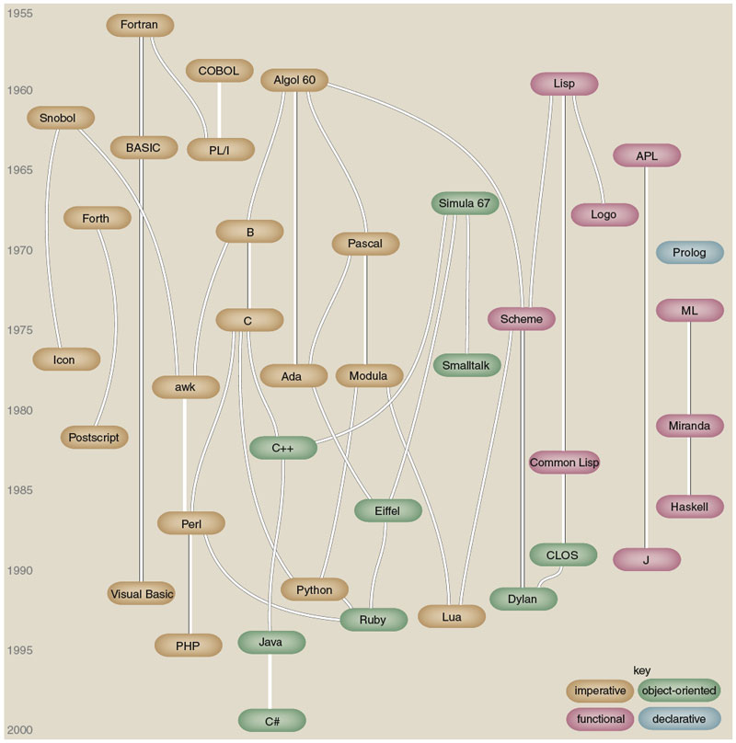
Figure by Brian Hayes
(who credits, in part, Éric Lévénez and Pascal Rigaux):
Brian Hayes, “The Semicolon Wars.” American Scientist, July-August 2006, pp.299-303
Notes:
Also see figure A.1 in [S], p.820.

Slide 11
Some Historical Perspective
Plankalkül (Konrad Zuse, 1943-1945)
FORTRAN (John Backus, 1956)
LISP (John McCarthy, 1960)
ALGOL 60 (Transatlantic Committee, 1960)
COBOL (US DoD Committee, 1960)
APL (Iverson, 1962)
BASIC (Kemeny and Kurz, 1964)
PL/I (IBM, 1964)
SIMULA 67 (Nygaard and Dahl, 1967)
ALGOL 68 (Committee, 1968)
Pascal (Niklaus Wirth, 1971)
C (Dennis Ritchie, 1972)
Prolog (Alain Colmerauer, 1972)
Smalltalk (Alan Kay, 1972)
FP (Backus, 1978)
Ada (UD DoD and Jean Ichbiah, 1983)
C++ (Stroustrup, 1983)
Modula-2 (Wirth, 1985)
Delphi (Borland, 1988?)
Modula-3 (Cardelli, 1989)
ML (Robin Milner, 1978)
Haskell (Committee, 1990)
Eiffel (Bertrand Meyer, 1992)
Java (Sun and James Gosling, 1993?)
C# (Microsoft, 2001?)
Scripting languages such as Perl, etc.
Etc.

Slide 12
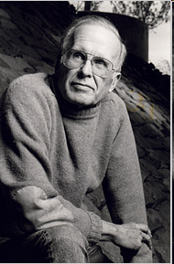

Alain Colmerauer and John Backus
Alain Colmerauer (1941-), the creator of Prolog
John Backus (1924-2007), the creator of FP
Notes:
http://alain.colmerauer.free.fr/, accessed 2010-08-17
http://en.wikipedia.org/wiki/John_Backus and http://www.nytimes.com/2007/03/20/business/20backus.html?_r=2&hp&oref=slogin accessed 2010-08017, accessed 2010-08-17

Slide 13
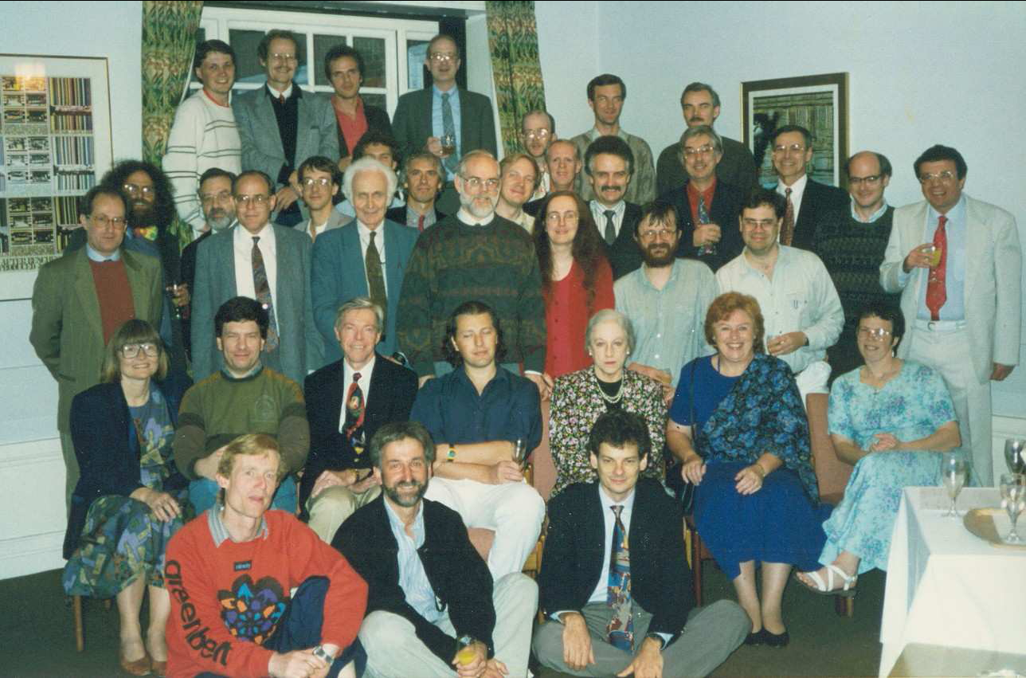
Haskell committee, 1992---history from www.haskell.org
Notes:
From the History of Haskell paper in the csce330f15 folder (p.6).

Slide 14
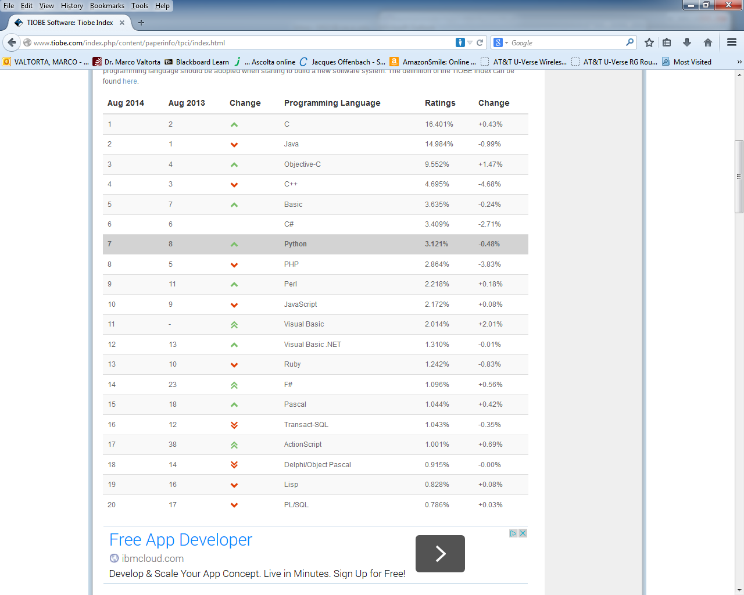
August 2014 Tiobe PL Index
Notes:
Accessed 2014-08-21. Haskell is #40 (was #34 in August 2013 and 2012), Prolog is #46 (was #36 in August 2013, #31 in August 2012), Fortran is #34, and ML is #25.

Slide 15
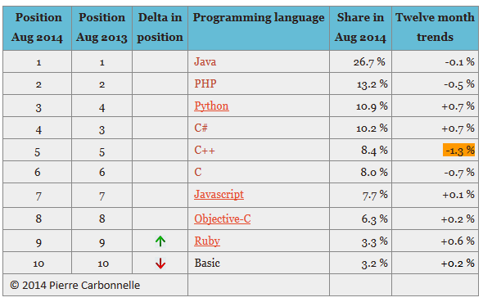
August 2014 PYPL Index
Notes:
PYPL is a competing (with respect to Tiobe) PL popularity index. This chart and the commentary below were downloaded on 2014-08-19 from https://sites.google.com/site/pydatalog/pypl/PyPL-PopularitY-of-Programming-Language.
The PYPL PopularitY of Programming Language index is created by analyzing how often language tutorials are searched on Google : the more a specific language tutorial is searched, the more popular the language is assumed to be. It is a leading indicator. The raw data comes from Google Trends, so that anyone can verify it, or make the analysis for his own country.

Slide 16
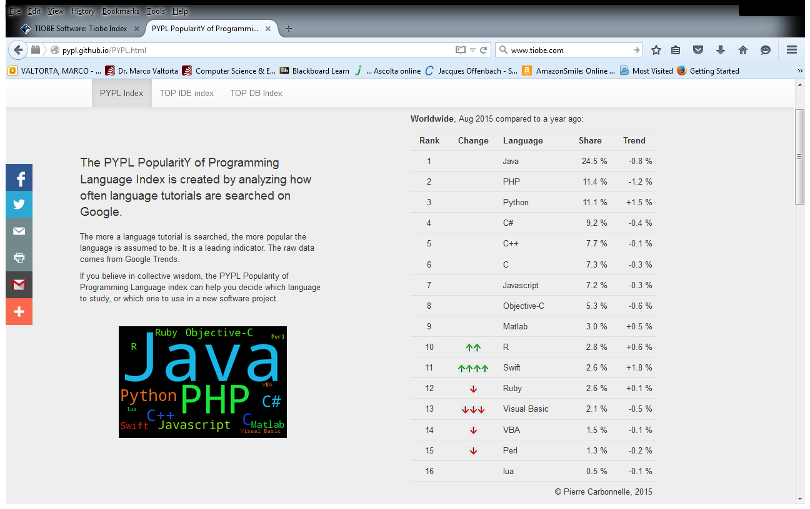
August 2015 PYPL Index
Notes:
PYPL is a competing (with respect to Tiobe) PL popularity index. This chart and the commentary below were downloaded on 2015-08-18 from http://pypl.github.io/PYPL.html. The site includes a custom search engine to construct charts and graphs for specific languages and geographic regions. The PYPL PopularitY of Programming Language index is created by analyzing how often language tutorials are searched on Google : the more a specific language tutorial is searched, the more popular the language is assumed to be. It is a leading indicator. The raw data comes from Google Trends, so that anyone can verify it, or make the analysis for his own country.

Slide 17
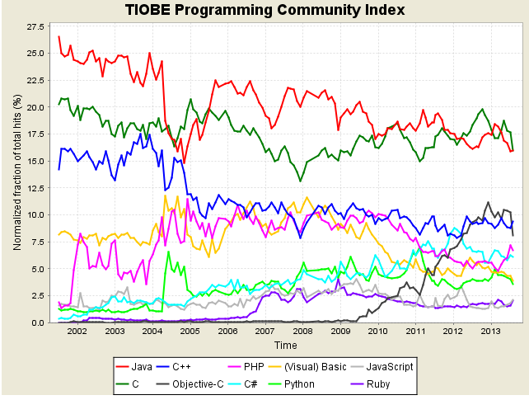
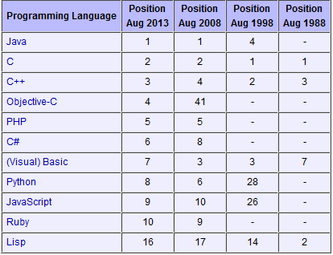
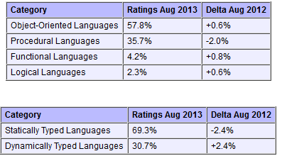
Tiobe Index Long Term Trends, August 2013
Notes:
http://www.tiobe.com/index.php/content/paperinfo/tpci/index.html, accessed 2013-08-20. The end of 2004 drop for Java is due to a change in Google. See http://www.tiobe.com/index.htm?tiobe_index, accessed on 2007-08-23.
Static vs. Dynamic Typing will be explained in a later lecture.

Slide 18
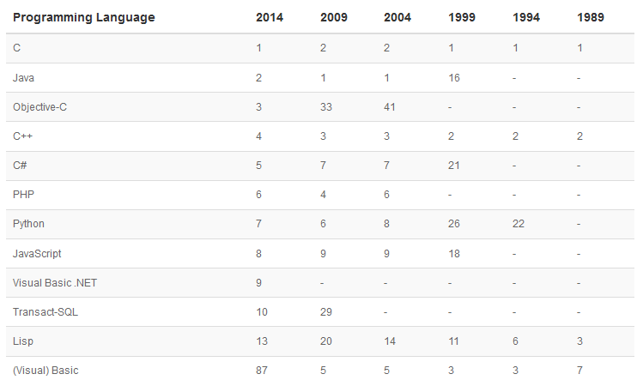
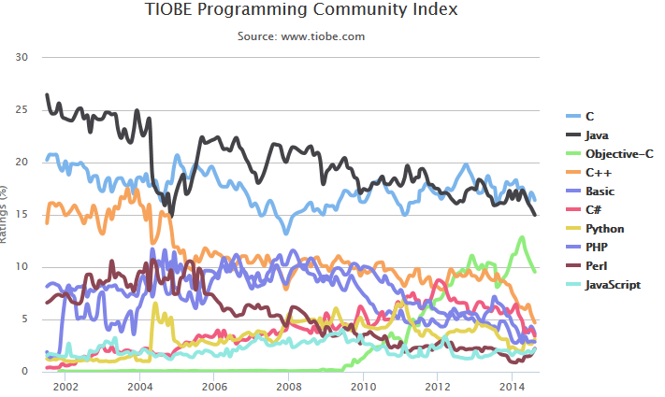
Tiobe Index Long Term Trends, August 2014
Notes:
http://www.tiobe.com/index.php/content/paperinfo/tpci/index.html, accessed 2014-08-19. The end of 2004 drop for Java is due to a change in Google. See http://www.tiobe.com/index.htm?tiobe_index, accessed on 2007-08-23. Apparently, Tiobe no longer provides “category” tables.
Static vs. Dynamic Typing will be explained in a later lecture.

Slide 19
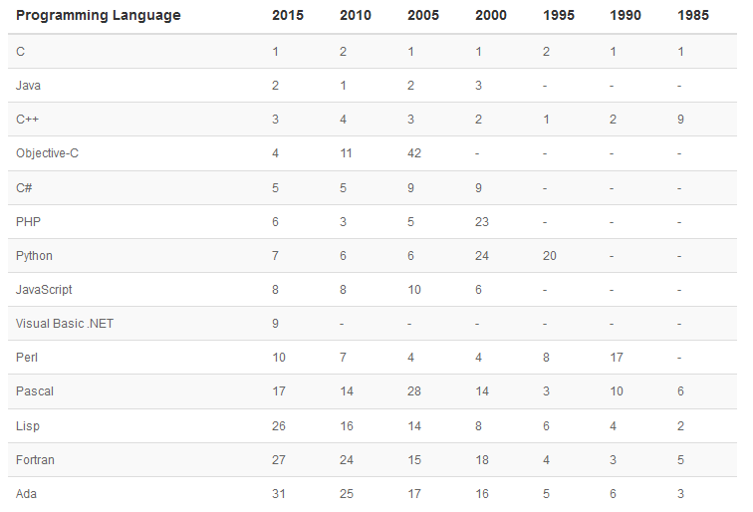
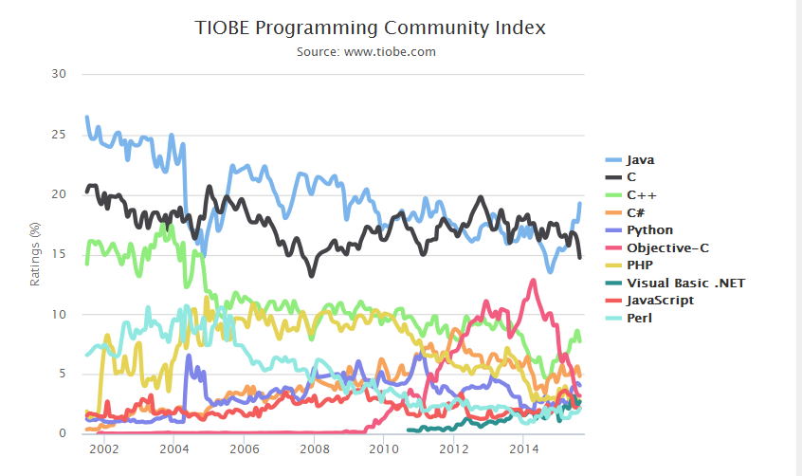
Tiobe Index Long Term Trends, August 2015
Notes:
http://www.tiobe.com/index.php/content/paperinfo/tpci/index.html, accessed 2015-08-18. The end of 2004 drop for Java is due to a change in Google. See http://www.tiobe.com/index.htm?tiobe_index, accessed on 2007-08-23. Apparently, Tiobe no longer provides “category” tables.
Static vs. Dynamic Typing will be explained in a later lecture.

