Slide 1
Computing from an Electric and Gas Utility Perspective
CSCE Students
November 3 2015
Chris Pierson, IT Manager

Slide 2
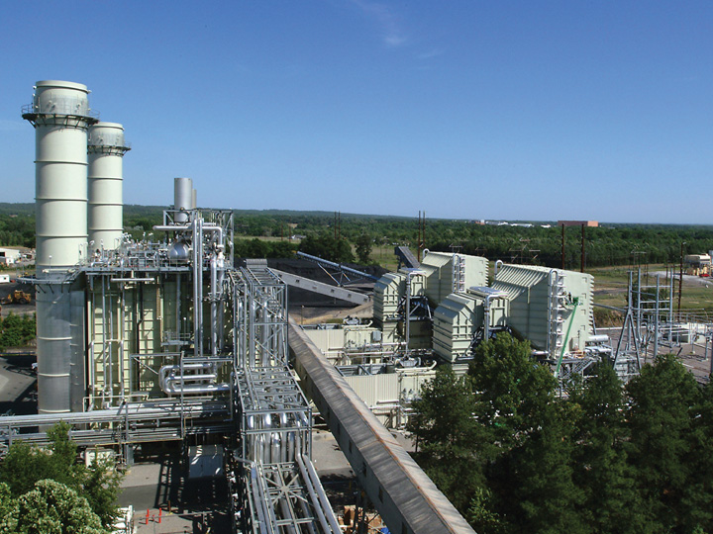
SCANA Corporation
$11 billion energy-based holding company headquartered in Cayce, South Carolina
SCANA’s stock is included in the S&P 500 index
Generate and sell electricity
Purchase, sell and transport natural gas

Slide 3
IT at SCANA
50% Applications Development, 50% Infrastructure
Multiple Data Centers
High Availability Capabilities
Redundant 10 GB core network
Secure Wireless Campus & Service Trucks
1,000+ Software Applications

Slide 4
Technology
A little bit of everything
Microsoft .NET, Business Objects, HP & IBM UNIX, Linux, EMC Storage, CISCO Network, PeopleSoft, Filenet
We Support most Microsoft Products
DB2, Oracle, Teradata, MS SQL Server
Mobile and remote computing capabilities

Slide 5
Cyber Security
Heavy and growing emphasis on security
ISOC
Everyone involved or impacted by security
Cutting edge methods and tools

Slide 6
SCANA IST Job Families
Applications Development
Cyber Security Analyst
Database Administration
Infrastructure Analyst
Infrastructure Tech
IT Analyst
IT Project Management
IT Training
Network Planning and Engineering
Systems Programming
Technical Writing
Technology Consultant
Telecommunications Tech
Leadership

Slide 7
Employee Makeup
400+ IST employees
Most have BS in Computer Science, Management Information Science, or related field
44% female; 22% minority
Historically low turnover, but high potential due to retirements
30% Gen X, 12% Gen Y
6-10 positions in Co-op programs

Slide 8
How IST fits into the business
Everything we do depends on IT:
Functional Systems
Cross-Functional Systems
Underlying Technologies

Slide 9
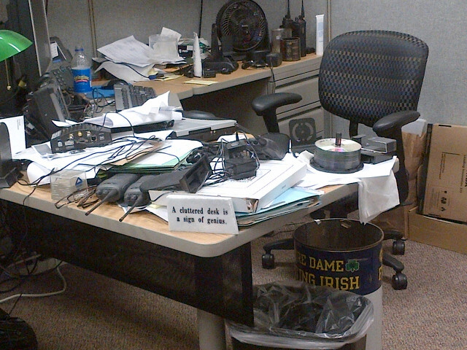
We aren’t always at our desks
Notes:
Bill Lamprey’s desk – he spends most of his time out in the field during the day

Slide 10
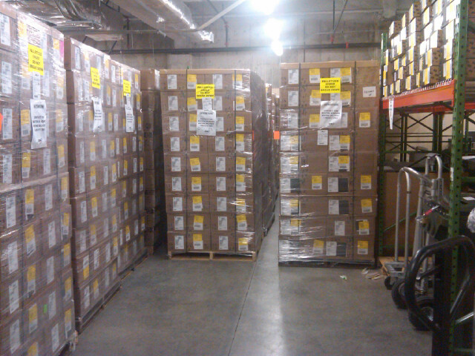
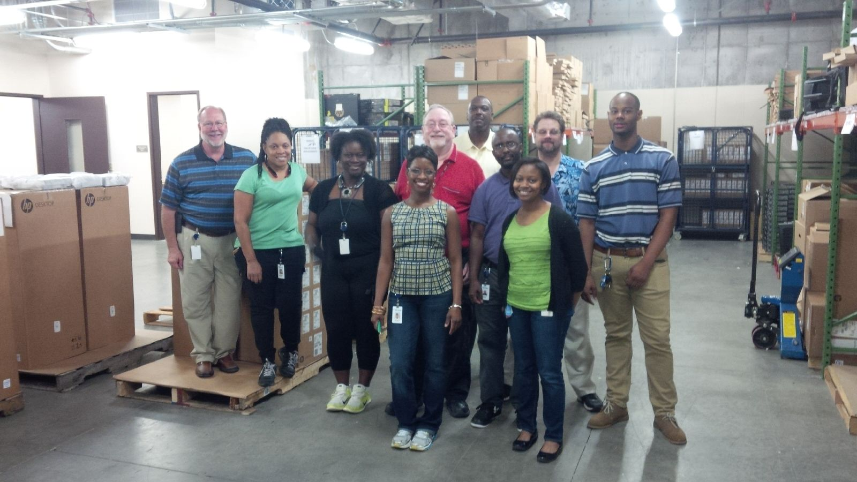
We work hard
Notes:
Workstations at the CHQ ready for mass deployment during our desktop modernization effort

Slide 11
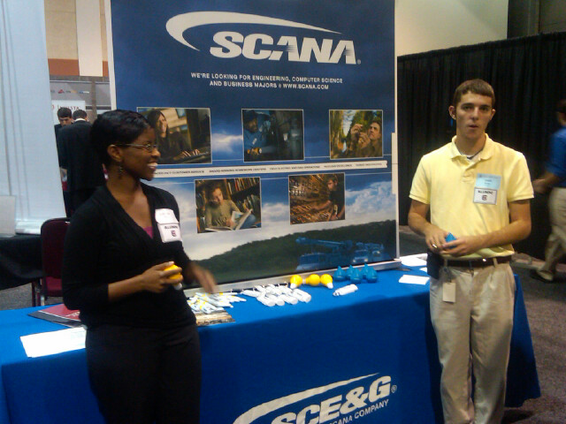
We do outreach

Slide 12
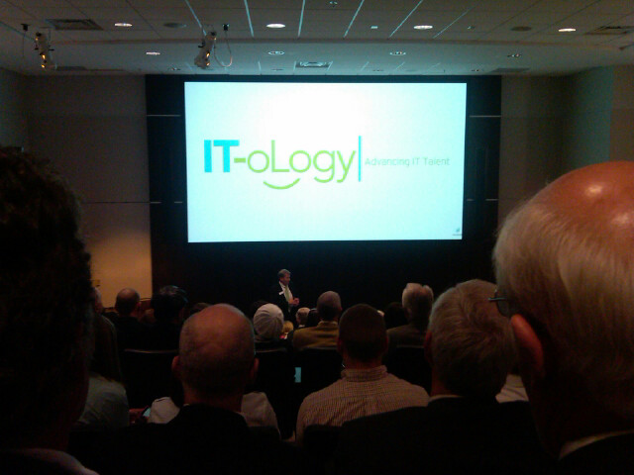
We support community education

Slide 13
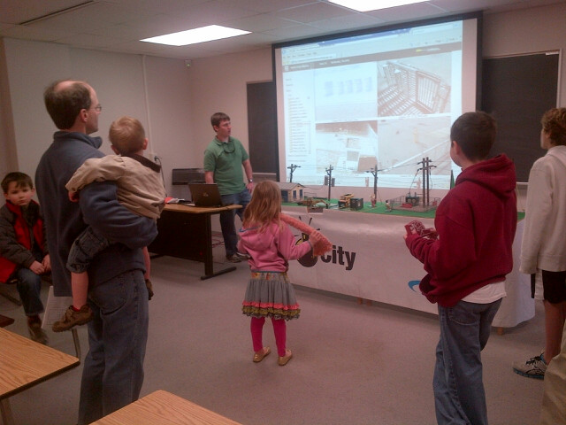
We support universities
Notes:
Engineering week at USC 2012

Slide 14
We support charities

Slide 15
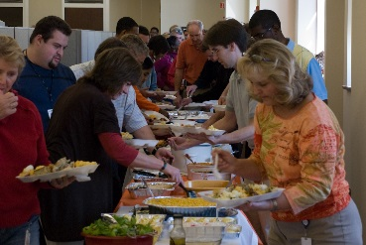
We eat and have fun

Slide 16
My career-23 years, never bored
ROLES:
Student/Co-op
Applications developer
Systems analyst
Project manager
Applications specialist
IT Supervisor
Client manager
Program manager
IT manager
OPPORTUNITIES:
Electric Operations
Client/server (internet start)
Fossil/Hydro plant IT
SCANA Energy startup
PSNC merger
Marketing/Sales systems
Data analytics
Demand Side Management
Customer Service Eng.
IT Operations

Slide 17
Electric Operations
Notes:
Electric meters track individual premise usage for billing purposes - customer payments - how we get paid

Slide 18
Lake Murray Dam

Slide 19
Cope Station
Notes:
Fossil/Hydro Business Unit - Electricity generation power by Coal and Natural Gas

Slide 20
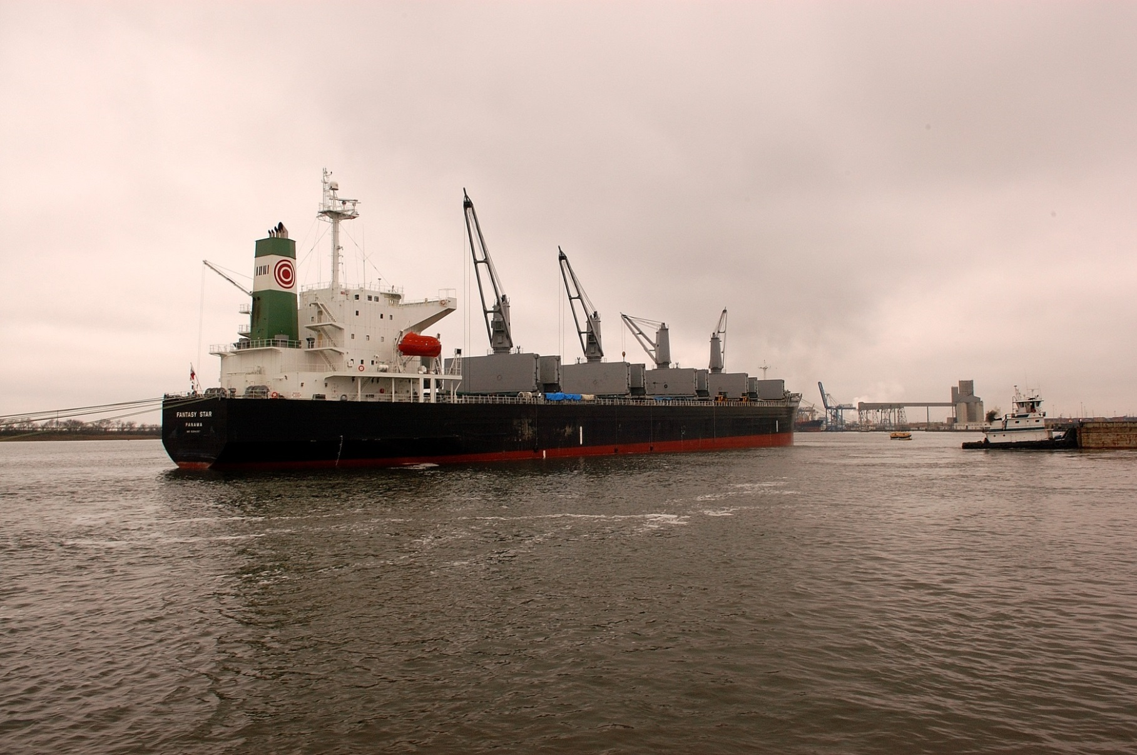
Fuel Delivery

Slide 21
SCE&G Nuclear - Unit 1
Notes:
Nuclear Business Unit - Electricity generation powered by Nuclear fuel

Slide 22
Jobs Are Out There! Even during poor economic times
Unemployment Rate
National, June 2012:
(2015 = 5.5%)
‘Balanced’ Unemployment:
Technology: May 2012:
Technology, June 2012:
(2015 = 3.0)
8.4%
5-6%
3.5%
3.1%
Notes:
And there are lots of jobs out there!

Slide 23
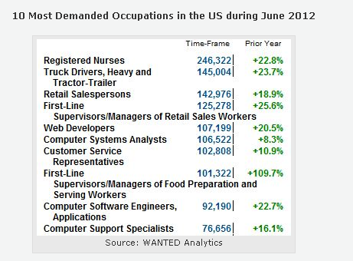
Top 10 most demanded in 2012
382,567 Postings in June 2012
Notes:
Together IT job postings total 382,567… and this is just the top 10!

Slide 24
Top 10 Jobs In High Demand That Require A College Degree - Forbes 2015

Slide 25
Computing is not expected to produce sufficient graduates to cover needs

Slide 26
What you can do
Complete STEM BS degree
CEC had highest avg: $59, 855; USC avg: $42,753 *
STEM degree is extremely valuable
Get real world experience typically via co-op
Education relevant sooner
Build resume and references
Potential job offer before graduation
Team and corporate environment
11k differential *
* USC career center May ‘14 survey

Slide 27
In closing…
Completing your education should be top priority
A degree may get you in the hiring process, but it does not automatically qualify you
Gain work experience in your field
Learn as much as you can about computer technology regardless of your major
Good luck in your journey!
Notes:
Degree is valuable, experience is valuable, soft skills are valuable, combining all is most valuable.
Finish your degree and get some experience along the way if possible. It is harder to get degree after entering working world and some progressions are limited without degree.

