Slide 1
Research Roadmap Driven by Network Benchmarking Lab (NBL):
Deep Packet Inspection, Traffic Forensics, Embedded Benchmarking, WLAN/LTE, and Beyond
Ying-Dar Lin 林盈達 (IEEE Fellow, 2013)
Dept of Computer Science & Network Benchmarking Lab
National Chiao Tung Univeristy, Hsinchu, Taiwan
ydlin@cs.nctu.edu.tw
www.cs.nctu.edu.tw/~ydlin
www.nbl.org.tw
12-4-2013

Slide 2
B.S., NTU-CSIE, 1988; Ph.D., UCLA-CS, 1993
Professor (1999~)/Associate Professor (1993~1999), NCTU-CS; IEEE Fellow (2013)
Founder and Director, III-NCTU Embedded Benchmarking Lab (EBL; www.ebl.org.tw), 2011~
Founder and Director, NCTU Network Benchmarking Lab (NBL; www.nbl.org.tw), 2002~
Editorial Boards: IEEE Wireless Comm. (2013~), IEEE Transactions on Computers (2011~), IEEE Computer (2012~), IEEE Network (2011~), IEEE Communications Magazine – Network Testing Series (2010~), IEEE Communications Letters (2010~), Computer Communications (2010~), Computer Networks (2010~) , IEEE Communications Surveys and Tutorials (2008~), IEICE Transactions on Information and Systems (11/2011~)
Special Issues: Open Source for Networking, IEEE Network, Mar 2014; Mobile Application Security, IEEE Computer, Mar 2014; Multi-Hop Cellular, IEEE Wireless Communications, Oct 2014; Deep Packet Inspection, IEEE JSAC, Q4 2014; Traffic Forensics, IEEE Systems Journal, early 2015.
CEO, Telecom Technology Center (www.ttc.org.tw), 7/2010~5/2011
Director, Computer and Network Center, NCTU, 2007~2010
Consultant, ICL/ITRI, 2002~2010
Visiting Scholar, Cisco, San Jose, 7/2007-7/2008
Director, Institute of Network Engineering, NCTU, 2005~2007
Co-Founder, L7 Networks Inc. (www.L7.com.tw), 2002
Areas of research interests
  Deep Packet Inspection
    Attack, virus, spam, porno, P2P
    Software, algorithm, hardware, SoC
    Real traffic, beta site, botnet
  Internet security and QoS
  Wireless communications
  Test technologies of switch, router, WLAN, security, VoIP, 4G/LTE and embedded systems
Publications
  International journal: 95
  International conference: 50
  IETF Internet Draft: 1
  Industrial articles: 153
  Textbooks: 3 (Ying-Dar Lin, Ren-Hung Hwang, Fred Baker, Computer Networks: An Open Source Approach, McGraw-Hill, Feb 2011)
  Patents: 26
  Tech transfers: 8
Well-cited paper: Multihop Cellular: A New Architecture for Wireless Communications, INFOCOM 2000, YD Lin and YC Hsu; #citations: 600; standardized into IEEE 802.11s, Bluetooth, WiMAX, and LTE

Slide 3
Agenda
From development to research
System research with three side products
  NBL, L7 Networks Inc., textbook
The blue track – product development
  Development plane: L7 Networks Inc., textbook
  Research plane: QoS, DPI (deep packet inspection)
The green track – product testing
  Development plane: NBL, EBL, BML
  Research plane: traffic forensics, embedded benchmarking
Lessons

Slide 4
From Development to Research
Sources of research topics
  Literature repository: minor improvement on existing or pseudo problems
  Development projects: feasible solutions on real problems
  Industrial discussions: real problems but not necessarily feasible solutions
D(development) → R(research)
  Enabling resource: Linux
  Research is the non-trivial part within the development process.
  If I don’t know how to develop it, I would not research on it.
Roadmap and footprints: cable TV networks (1996-1999) → multi-hop cellular (1998-2000) → QoS (1998~2003) → deep packet inspection (2004~2009) → traffic forensics (2008~) → embedded benchmarking (2011~)

Slide 5
System Research with Three Side Products
7-in-1
Security
Gateway
Linux QoS Router
Development
L7 Inc.
Startup
Computer Networks:
An Open Source Approach
Public Testing
with a Magazine
Network Benchmarking Lab (NBL)
RealFlow
Embedded Benchmarking Lab (EBL)
4G LTE
Development Plane
1996 1998 2000 2002 2004 2008 2011 2012 2014
QoS
Deep Packet Inspection
Cable TV
Networks
Multi-hop
Cellular
Traffic Forensics
Research Plane
Embedded
Benchmarking
& 4G LTE

Slide 6
The blue Track
Development Plane:
L7 Networks Inc.
Computer Networks: An Open Source Approach
Research Plane:
QoS
Deep Packet Inspection (DPI)

Slide 7
7-in-1 System Prototyping and Benchmarking
7-in-1: VPN, Firewall, NAT, Routing, Content Filtering, Intrusion Detection, Bandwidth Management
Launched a startup in 2002: L7 Networks Inc.
Appeared in IEEE Communications Surveys & Tutorials, 3rd quarter 2002, http://speed.cis.nctu.edu.tw/~ydlin/wei.pdf
LAN/DMZ
WAN
LAN/DMZ to WAN Outbound Traffic
MAC
Filter
Redirect
In-LAN
Filter
Policy
Route
Route
Out-WAN
Filter
NAT
IPsec
VPN
Bandwidth
Mgt.
Y
Y
Y
FTP/POP3/SMTP/
Web/URL Filter with
Many-to-One NAT
Alerting
System
Intrusion
Detection
sniff
Y
Y
Bandwidth
Mgt.
Out-LAN
Filter
Route
In-WAN
Filter
Redirect
deNAT
IPsec
deVPN
WAN to DMZ/LAN Inbound Traffic

Slide 8
4-in-1 Proxy Architecture
Reducing IPC and Restructuring Modules
Boosted Web throughput by 200% and mail throughput by 500%
Appeared in IEEE Computer, Nov 2006; http://speed.cis.nctu.edu.tw/~ydlin/LIN06.pdf
Original Web Traffic Flow
USER LAYER
New 4-in-1 Proxy Architecture
Packet Sniffing
Snort
child
ps 1
child
ps 2
Squid
USER LAYER
DansGuardian
Static Link
Shared Lib
Snort
(Detect Engine)
Web
User 1
SpamAssiassian
ClamAV
Web
Server
DansGuardian
(IP/URL/Text check)
Web
User 2
KERNEL LAYER
Text
File
User/Kernel Interaction
Decompressor/ Decoder
File type Recognition
Original Mail Traffic Flow
Webfd
MIME Handler
USER LAYER
AMaViS
Snort
child
ps 1
child
ps 2
child
ps 1
child
ps 2
User/Kernel Interaction
ClamAV
Port 80
Port 25
KERNEL LAYER
MTA
AMaVis
Multi-Thread
Spam
Assassian
TCP/IP stack
Mail
User 1
Network Interface
Mail
User 2
Mail
Server
KERNEL LAYER
Inter-Process Communication

Slide 9
Profiling String Matching Algorithms on Large Problem Size
First profiled result for string matching algorithms on large problem size
Appeared in IEEE Comm. Surveys & Tutorials, 2nd quarter, 2006; http://speed.cis.nctu.edu.tw/~ydlin/profile06.pdf
# of patterns
C=256
3-gram BG+
100k
Anti-Virus
Anti-Spam
50k
20k
FNPw2
10k
5k
CF
2k
2-gram BG+
1k
ModifiedWM
500
Aho-Corasick
200
IDS
100
pattern length
1
2
3
4
5
6
7
8
9
10

Slide 10
Revisiting String Matching with Recent Developments on DPI
Comprehensive review of string matching algorithms and realizations for DPI
Appeared in IEEE Computer, Apr 2008; http://speed.cis.nctu.edu.tw/~ydlin/string%20matching.pdf
Summary of string matching methods for DPI (underlines mean hardware-based)
Automaton-based
rewrite and group regular expressions
reduce number of transitions (D²FA)
hardwire regular expressions on FPGA
track a DFA that accepts the patterns (Aho-Corasick)
reduce sparse transition table (Bitmap-AC, BNFA in Snort)
reduce fan-out from the states (split automata)
track multiple characters at a time in an NFA (JACK-NFA)
Heuristic-based
get shift distance using heuristics based on the automaton that recognizes the reverse prefixes of a regular expression (RegularBNDM)
get shift distance from a fixed block in the suffix of search window (Wu-Manber)
get shift distance from the longest suffix of search window (BG)
Filtering-based
extract necessary substrings from regular expressions and filter the text with them (MultiFactRE)
filter with a set of Bloom filters for different pattern lengths
filter with a set of hash functions sequentially in a Bloom filter (Hash-AV)

Slide 11
Traversing Aho Corasic State Machine:
Hardware Acceleration on Root and Non-Root States
New Parallel Architecture with Pre-Hashing and Root-Indexing
10Gbps on large pattern set with Xilinx ML310 SoC platform
Appeared in ACM Transactions on Embedded Computing Systems, Apr 2009

Slide 12
BFAST: Bloom Filter Accelerated Sub-linear Time architecture
Sub-linear with bounded worst-case performance
Appeared in IEEE Transactions on VLSI Systems, Aug 2009
Patterns:
P₁ = abcdefgh
P₂ = ijklmnop
P₃ = zyxwvuts
Grouping:
  G₀ = {efgh,mnop,vuts} G₁ = {defg,lmno,wvut}
  G₂ = {cdef,klmn,xwvu} G₃ = {bcde,jklm,yxwv}
  G₄ = {abcd,ijkl,zyxw} G₅ = {abc,ijk,zyx}
  G₆ = {ab,ij,zy} G₇ = {a,i,z}
BF(G₀)
PE
cdef
BF(G₁)
BF(G₂)
hit
text
uvwxyzabcdef
…
…
m=8
BF(G₇)
search window
The search window can be shifted by 2 characters.

Slide 13
Multi-core Design of a Scalable String Matching Algorithm
Appeared in IEEE Transactions on Computers, Apr 2011
Search window shifted by lmin - k
Heuristic in BH
(Backward Hashing)
New position of the search window
lmin
lmin
Γ₁
Γ₂
k
lmin-k
k
Γ₃
B
text
k
Best shift distance
(1) B is not a factor of any Γ_{i}∈Γ.
- No suffix of B is a prefix of any Γ_{i}∈Γ,
SHIFT[h(B)] = lmin.
  - One suffix of B is a prefix of some Γ_{i}∈Γ.
  Let k be the maximum length of such
  a suffix. SHIFT[h(B)] = lmin – k.
(2) B is a factor of some Γ_{i}∈Γ.
- Let l be the rightmost occurrence of B.
SHIFT[h(B)] = lmin – l.
Verify if SHIFT[h(B)] = 0
|B| = 2 or 3
Suffix(B) of length k
Observation in virus signature set:
A large number of long signatures plus
a small number of short signatures
Either curbing long shift (if BH only) or needing a huge data structure (if AC only)
Solutions:
Long signatures for BH
The shift window can skip fast
Short signatures for AC
→ A small data structure
Running in a multi-core design

Slide 14
Hardware Software Co-design for DPI
Experimenting (1) pure Linux software, (2) Linux + HW, (3) Linux + HW
/w less copy, (4) pure HW
Appeared in IEEE Micro, Sept 2009.
Time of writing data into TextRAM occupies about 90% of matcher-bfast*.

Slide 15

Ying-Dar Lin, Ren-Hung Hwang, Fred Baker, Computer Networks: An Open Source Approach, McGraw-Hill, Feb 2011.
www.mhhe.com/lin; available now at amazon.com
Facebook Q&A Communit: www.facebook.com/CNFBs
ISBN: 0-07-337624-8 / 978-007-337624-0
Computer Networks: An Open Source Approach considers why a protocol, designed a specific way, is more important than how a protocol works. Key concepts and underlying principles are conveyed while explaining protocol behaviors. To further bridge the long-existing gap between design and implementation, it illustrates where and how protocol designs are implemented in Linux-based systems. A comprehensive set of fifty-six live open source implementations spanning across hardware (8B/10B, OFDM, CRC32, CSMA/CD, and crypto), driver (Ethernet and PPP), kernel (longest prefix matching,
checksum, NAT, TCP traffic control, socket, shaper, scheduler, firewall, and VPN), and daemon (RIP/OSPF/BGP, DNS, FTP, SMTP/POP3/IMAP4, HTTP, SNMP, SIP, streaming, and P2P) are interleaved with the text.
15

Slide 16
Key Features of the Book
Logically reasoned why, where, and how of protocol designs and implementations.
Fifty-six explicitly numbered open source implementations for key protocols and mechanisms.
Four appendices on Internet and open source communities, Linux kernel overview, development tools, and network utilities.
“A Packet’s Life” to illustrate the book roadmap and packet flows.
Sixty-nine sidebars of Historical Evolution (33), Principle in Action (26), and Performance Matters (10).
End-of-chapter FAQs and “Common Pitfalls.”
Class support materials including PowerPoint lecture slides and solutions manual available via the textbook website www.mhhe.com/lin.

Slide 17
Quotes from Reviewers:
“The exposure to real life implementation details in this book is phenomenal... Definitely one of the better books written in the area of Computer Networks.” – Mahasweta Sarkar, San Diego State University
“I have never seen a book giving such details on explaining the design and implementation of such practical systems...Those open source implementations are excellent demonstrations for practical networking systems.” – Fang Liu, University of Texas-Pan American
“This is a solid textbook with strong emphasis on technical (implementation) details of computer network protocols.” – Oge Marques, Florida Atlantic University
“Written by RFC and open source contributors, this book definitely is an authentic guide for network engineers.” – Wen Chen, Cisco Fellow
“Interleaving designs and implementations into the same book bridges the long-existing gap and makes this an ideal text to teach from.” – Mario Gerla, University of California, Los Angeles
“The sidebars of Historical Evolution and Principle in Action make the reading more enjoyable, while Performance Matters treat computer networking quantitatively.” – H. T. Kung, Harvard University

Slide 18
Final Comments on the Book
The first attempt
  Interleaved vs. separated
  Live running codes in daily usage
Follow-up on other courses?
  Algorithms
  Operating systems
  Computer organizations

Slide 19
The Green track
Development Plane:
Network Benchmarking Lab (NBL)
Embedded Benchmarking Lab (EBL)
Broadband Mobile Lab (BML): 4G LTE
Research Plane:
Traffic Forensics
Embedded Benchmarking & 4G LTE

Slide 20
Pre-NBL: Public Benchmarking
Benchmarking, Workshop, and Publishing
2005
VoIP Plugfest
Network/Content Security
2004
Wireless LAN SOHO Router
VoIP
2006
Intrusion Detection Systems
10GbE Ethernet Switch
VoWLAN
2009
SOHO under RealFlow
2003
Network Security
IPv6 Router
LAN L2/L3 Switch
Backbone Switch/Router
2007
P2P Friendly Properties of NAT
Wireless SIP Residential Gateways
2002
E-Commerce
WLAN
Security Gateway
Content Delivery Network
2001
Security Gateway
Bandwidth Management
Web Switch
QoS

Slide 21
NBL Funding and Features
Founded in May 2002
Funding sources
  Industry for test services and tools
  Government seed money
Features
  A real-world traffic test lab (from 2007)
  A developer for test tools
  Providing SPEC Verification & RealFlow Certification
  Experienced in benchmarking products

Slide 22
NBL Staff
Advisory Committee
Director + 20 full-time + 15 students
Operation model: 3-line
Type | Analog | Who | Mission
Test Service (1st line) | Infantry | Mostly full-time Some students | 1. Conducting tests 2. Writing test plans
Test Tool (2nd line) | Artillery | Some full-time Mostly students | 1. Developing test tools 2. Licensing tools to vendors
Test Research (3rd line) | Supply | Professors and students | Researching test methodologies on test beds Researching product bottlenecks

Slide 23
Initial NBL Test Coverage and Tools
Area | DUT/FUT | Test Coverage
Security | UTM, Anti-Virus, IPS, SSL VPN, IPSec VPN, P2P/IM Management | Functionality, Interoperability, Session Capacity and Rate, Accuracy
VoIP And WLAN | SOHO Router, DSL Router, IAD Gateway, SIP Phone, SIP Gateway, SIP Proxy, Access Point | Voice Quality, Mobility, Functionality, Interoperability, Session Capacity and Rate
Bridging and Routing | Ethernet L2/L3 Switch | Functionality, Conformance, RFC 2544/2889
Type Area | Commercial Test Platforms | Commercial Test Tools
Switch/Router | Smartbits 2000 | ANVL
 | Smartbits 6000B | SmartFlow、SmartWindow
 | Smartbits 6000C | SmartMulticastIP
 | SmartMetrics XD 3324A*4, totally 16 * Giga ports | TeraDot1x、TeraRouting
WLAN | Azimuth 800W-platform | Azimuth Director
 | IxWLAN | IxChariot
VoIP | Abacus 5000
 | Emutel Edge Bulk call generator
NCSec | Smartbits 600 | Avalanche、TeraVPN、WebSuite
 | TeraMetrics 3301A*2, totally 4 * Giga ports | Traffic IQ Professional

Slide 24





































NBL Industrial Customers
Over 100 vendors served, over 600 products tested

Slide 25
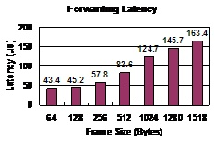
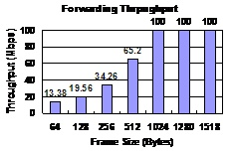
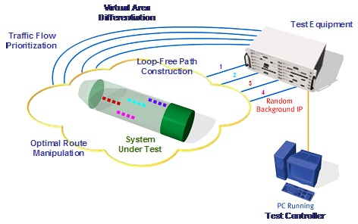
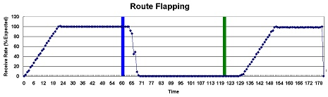
Switch and Router
Performance | Conformance | Functionality & Interoperability
Forwarding Rate Forwarding Latency Congestion Control Broadcast Control Address Learning Address Caching IP Forwarding IP Multicasting Routing: RIP/OSPF Redundancy: VRRP Quality of Service | Spanning Tree (STP) Multi/Rapid STP Virtual LAN GVRP/GMRP IP v4/v6 Gateway ICMP/IGMP Routing: RIP/OSPF, DVMRP, and PIM SNMP, RMON | Management Firmware Upgrade Spanning Tree (STP) Virtual LAN GVRP/GMRP Link Aggregation Authentication (.1X) IP Configuration Routing: RIP/OSPF, DVMRP, and PIM DHCP, NAT, etc.
Notes:
RFC 2544: Benchmarking Methodology for Network Interconnect Devices
In a network where a Link-state routing protocol is run, route flapping will force frequent recalculation of the topology by all participating routers. In networks with Distance vector routing protocols flapping routes can trigger routing updates with every state change. In both cases, they prevent the network from converging.
Conformance tests for STP(802.1D), MSTP(802.1w), IPv6
Router Withdraw Time = (timestamp of the last packet received on the best path) - (timestamp of withdrawing the routes)
Router Switch Time = (timestamp of the first data packet received on the alternate path) - (timestamp of withdrawing the routes)
Total Convergence Time = (timestamp when the traffic level on the alternate path has reached the same level as it was on the best path) - (timestamp of withdrawing the routes)

Slide 26
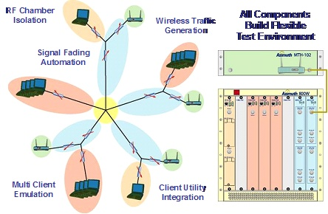
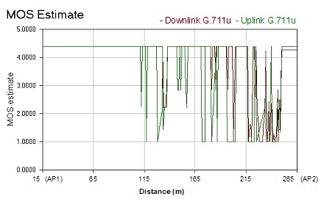
WLAN
Performance | Functionality & Interoperability
Forwarding Rate Association Capacity Association Latency Rate vs. Range Rate vs. Channel Failover Roaming Smooth Roaming WDS Forwarding Rate Rate vs. WDS Range Rate vs. WDS Channel Roaming with WDS MixedBG Throughput Secure Throughput PowerSaved Throughput Interfered Throughout App/VoIP Distance App/VoIP Switch Roam App/VoIP Motion Adapt App/VoIP Motion Roam | SSID/Channel WEP/WPA-PSK/TLS Power Saving Mode Roaming Ability Site Survey/Profile WDS Bridge Mode TX Rates/Beacon Int. MixedBG/PureG Mode RTS/Fragment Threshold Firmware Upgrade Event Log/Traffic Stat. User Interfaces, etc.

Slide 27
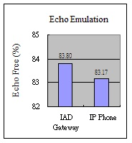
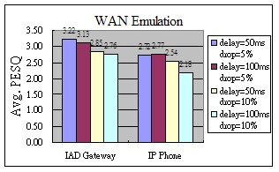
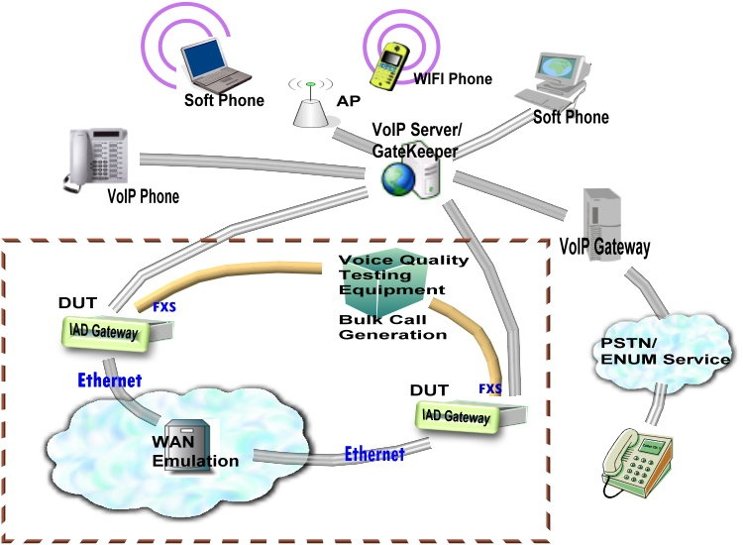
VoIP
Performance | Functionality | Interoperability | Conformance
Voice Quality (PESQ, PSQM+, PAMS, MOS), Echo Doubletalk, Signal Loss, VAD, Call Processing (Bulk Call Generation), Security, Vulnerability Scanning, etc. | Management, Firmware Update, Voice Message, DTMF, Authentication, Three-Way Conference, Call Features (Call Hold, Call Transfer, etc.), NAT Traversal, Networking (DHCP, DNS, PPPoE, etc.), Phone Book, etc. | Signaling, Conversation, CODEC, Call Features (Call Hold, Call Transfer, etc.), NAT Traversal, ENUM trial, etc. (Communicate with Different CPE and CO Devices) | SIP Signaling (Testing in Normal and Abnormal Call Flows)
Hours | DUT | Abacus Attempts | DUT Answers | Errors | Completion Ratio | Call Rate
12 | IAD Gateway | 1,370 | 1,370 | 0 | 100.00 | 114
24 | IAD Gateway | 2,578 | 2,576 | 2 | 99.92 | 107
36 | IAD Gateway | 3,669 | 3,659 | 10 | 99.73 | 101
48 | IAD Gateway | 4,577 | 4,565 | 12 | 99.74 | 95

Slide 28
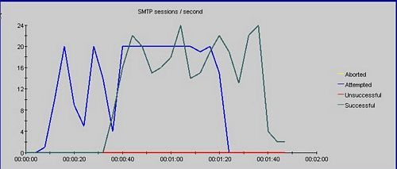

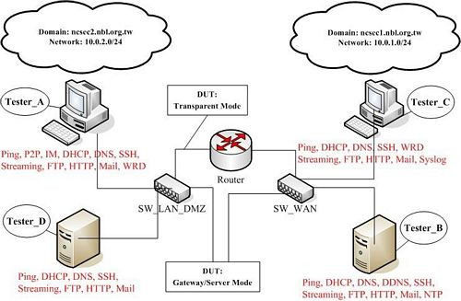
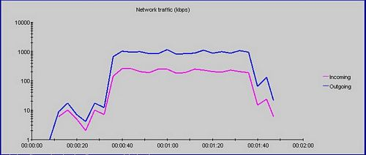
Security
Functionality | Performance | Interoperability & Conformance
Packet Filter IPSEC, SSL VPN Application Firewall IPS/IDP Content Filter Anti-Virus Anti-Spyware Anti-Spam IM Management Endpoint Security | Capacity&Rate : TCP Connection IPSec Session SMTP/POP3 Session FTP Session Telnet Session HTTP(S) Session Streaming Session DNS Session Utilities : WebSuite, TeraVPN, Avalanche, In-Lab Live Testing, URL Filtering Analyzer | IPSEC Interop Time for purging SA Initiator/Responder Phase 1Phase 2 ID Key Group and PFS IPSec Keep Alive NAT-Traversal Dead Peer Detection Conformance : IKE, ESP, AH, PPTP, and L2TP Utility : 10+ VPN Devices ANVL

Slide 29
Where the Traditional Didn’t Touch – Stability
Traditional test
  Functionality
  Performance
  Conformance
  Interoperability
Lab test vs. field test
  Traffic: artificial vs. real
  Executed program space: limited vs. exhaustive
Stability test!!
  Customer Found Defect (CFD)
  Triggered by real traffic

Slide 30
Test Coverage: An Example
Test Cases
Functions
Test Cases | Cost | Functions
A | 10 | 1, 2, 3
B | 5 | 2, 4
C | 2 | 3
D | 5 | 5, 6
E | 4 | 3, 4, 6
F | 3 | 5, 7
G | 2 | 7
A
B
C
D
E
F
G
1
2
3
4
5
6
7
Modified
Functions: 2, 3, 7
Methods | Selected Test Cases | Cost | Reached Functions
Traditional selection | A, B, C, D, E, F, G | 31 | 7
Safe selection | A, B, C, E, F, G | 26 | 7
Minimize Numbers | A, F | 13 | 5
Minimize Cost | B, C, G | 9 | 4
Balance Cost and Coverage (1:1) | E, F, A | 17 | 7
Maximize Coverage with Given Cost (10 minutes) | E, F | 7 | 5
Minimize Cost with Given Coverage (Cover 6 functions) | E, F, A | 17 | 7
Notes:
2300*20000 = 46,000,000
Explain each method
Test intensity of functions: function 7: 2/7=> 30%
Infrastructure function: threshold: 40% => function 3
Function reachability: Test case A=> 42%

Slide 31
Relationship Between Test Technologies
Notes:
測試階段: Lab Test → Field Test
自動化: 提高Lab Test及Field Lab效率 (效率)
真實流量：提高Filed Test測試重製率 (reproducibility), 找出產品問題 (品質與效率); vs. Cisco Alpha Networks: 無法重播重製
涵蓋率: 提高Lab Test與Field Test測試安全信心與保證性 (品質與效率)

Slide 32
NBL Technologies
From test service provider to test solution provider
Automation: ACTS (Auto-Control Test System)
Real Traffic: RealFlow
Test Coverage: TestCov

Slide 33
NBL Technology Applications
From network devices to handhelds
Switch and Router
Network Security
WLAN
4G LTE
Handhelds

Slide 34
NBL Solutions
編號 | 技術名稱
1 | 自動控制測試系統 - ACTS (Automatically Controlled Test System)
2 | 真實流量錄製與重播工具 – ILLT (In-Lab Live Testing)
3 | 真實流量資料庫 – PCAP Lib
4 | 測試涵蓋率分析與最佳化之技術 – Test Coverage Analysis and Optimization
5 | 惡意程式收集分析之工具與資料庫 – Malware Tool-chain and Malware Lib
6 | 無線區域網路流量與訊號之錄製與重播工具 – WLAN Capture and Replay of Traffic and Environment
7 | 第四代無線行動通訊之協定測試環境 – LTE Conformance and Interoperability Testing
8 | 第四代無線行動通訊之多重輸入出之測試環境與工具 – LTE MIMO OTA (Over-the-Air)
9 | 手持裝置耗時耗電與穩定度之自動測試工具 – Android AKL (Automatic Key Logger)

Slide 35
Auto-Control Test System(ACTS) 1/2
#1

Slide 36
Auto-Control Test System(ACTS) 2/2
Display
or
Debug
User Interface
Report
Customization
GUI
CLI
Runner
Customization
General
Modules
GLOBAL
CONSOLE
WEB
DOSAPP
GUIAPP
IMAGEAPP

Slide 37
ACTS Application Case
Control Commands (API)
NBL has developed over 3000 test scripts, for 7 functionality tests.
Control Interface | Control Commands | 功能
RS232 | 22 | Issue commands to DUTs through RS232
Web GUI | 31 | Configure Web modules on DUTs
iOS | 5 | Configure iPhone or iPad
Win APP | 18 | Control Windows Application, e.g. Filezilla
DOS APP | 22 | Control DOS Application, e.g. Ping
Others | Extensible | TCL Scripting

Slide 38
Comparing Automatic Testing Platforms
 | AutoMate | QTP | Rational | ACTS
Capture | No | Yes | Yes | Partial(Web)
Ease of use | Easy | Difficult | Difficult | Medium
Script language | Self-defined | Self-defined +VB | Self-defined +Java | TCL
Self-defined functions | No | Yes | Yes | Yes
Debug mode | No | Yes (break point) | Yes (break point) | Yes (debug tag)
  Parameterized test scripts
  Supporting the control of commercial platforms (Smartbits、Android)
  Supporting Web control (Ajax、Javascript、.NET)
  Increased test productivity by 100%
  Shortened test script deployment by 50%
  Hosting over 3000 test scripts

Slide 39
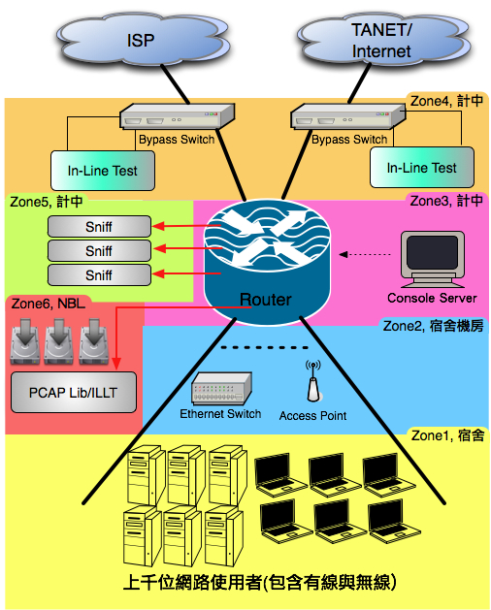
Beta Site with 6 DUT Zones
A world-wide unique model of applying campus traffic to testing
Appeared in IEEE Communications Magazine, Dec 2010
Zone 1
  End-user software
Zone 2
  Ethernet L2/L3 Switch
  Wireless AP
Zone 3
  Core Router
Zone 4 (Inline, one-in-one-out)
  UTM, IPS, Anti-Virus, QoS Firewall
Zone 5 (Sniff)
  Network Forensic
  Anti-Malware/Botnet
Zone 6 (ILLT)
  SOHO Router, Home Gateway
  Broadband Gateway
  DSL Router, IAD Gateway

Slide 40
Time to Fail (TTF)
TTF: Time to trigger a defect during product testing
  TTF >= 4 weeks → convergence!
  convergence ratio: percentage of SUTs that could converge in a period of time
Among 100 SUTs
  TTF ↑ as test duration↑, which means improved product quality
  Under a test duration of 1 month and 1 year, we have a convergence ratio of 7% and 20%, respectively.
  Only a few SUTs could survive well under real traffic.
Accumulative SUT vs. TTF
TTF vs. Testing Duration
Notes:
Fig.6b中Testing Duration以4周為單位的原因在於較可觀察出產品修正後品質改善的效果，因為從Fig.6a中了解到目前大部份的產品會在4周內出現defect然後進行修正。

Slide 41

RealFlow Certification
RealFlow Test
  Applying real traffic, live or replayed, to test products
RealFlow Certification
  Converged under RealFlow Test, i.e., TTF >= 4 weeks
  Iterative testing for 6 months to 1 year, with a pass ratio of …. 5%
Notes:
這些拿到RealFlow Certification的產品都是測試超過半年以上、日趨穩定

Slide 42
PCAP Lib
#2

Slide 43
PCAP Lib: Classifying, Extracting, and Anonymizing Packet Traces
PCAP Lib: classified, extracted, and anynymized
In revision at IEEE Systems Journal, 2013

Slide 44
PCAP Lib for Scholars 1.0
 | Web | Email | File Transfer | Remote Access | Encryption | Chat | File Sharing | Streaming | VoIP | Net work
Healthy General | 53 | 8 | 36 | 8 | 6 | 15 | 21 | 6 | 2 | 32
Healthy Special | 21 | 4 | 0 | 2 | 0 | 1 | 0 | 0 | 0 | 0
Attack | 49 | 6 | 15 | 5 | 6 | 5 | 0 | 0 | 2 | 13
Virus | 0 | 0 | 0 | 1 | 1 | 0 | 0 | 0 | 0 | 0
Spam | 2 | 3 | 0 | 0 | 0 | 0 | 0 | 0 | 0 | 0
Total | 125 | 21 | 51 | 16 | 13 | 21 | 21 | 6 | 4 | 45
Attribute | T1 | T2 | T3 | T4 | T5 | T6 | T7
Web | HTTP (125)
Email | POP3 (5) | SMTP (11) | IMAP (5)
File Transfer | FTP (28) | SMB (22) | TFTP (1)
Remote Access | Telnet (6) | SSH (4) | RDP (4) | VNC (2)
Encryption | SSL (11) | FTPs (1) | HTTPs (1)
Chat | IRC (7) | ICQ (4) | Yahoo Messenger (4) | MSN (1) | AIM (1) | Skype (1) | Google talk (1)
File Sharing | Bittorrent (2) | eDonkey (1) | Gnutella (1) | Pando (1) | SoulSeek (1) | Winny (1) | Xunlei (1)
Streaming | PPLive (2) | QuickTime (1) | Octoshape (1) | Orb (1) | Slingbox (1)
VoIP | SIP (4)
Network | NetBIOS (21) | DNS (19) | SNMP (3) | Socks (1) | STUN (1)

Slide 45
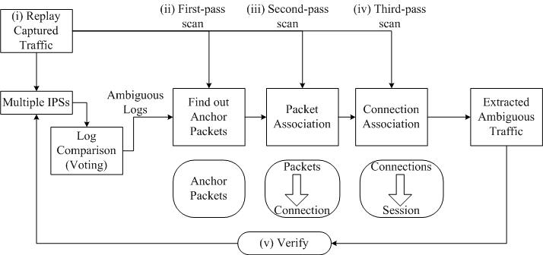
Extracting Attack Sessions from Real Traffic with Intrusion Prevention Systems
Leveraging product signature databases to classify and extract attack sessions
Appeared in Intl Journal of Network Security, Sept 2012

Slide 46
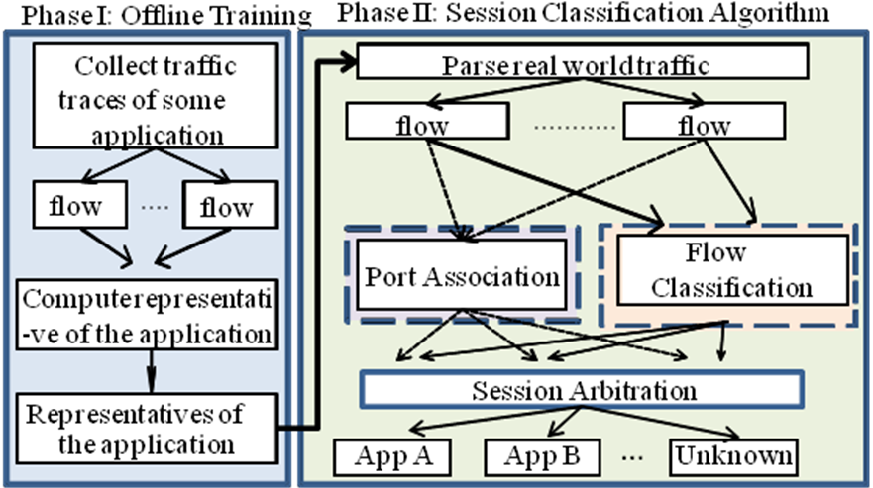
Session Classification Based on Flow Classification, Association and Arbitration
Classifying with packet size distribution as signatures
Appeared in Computer Networks, Jan 2012

Slide 47
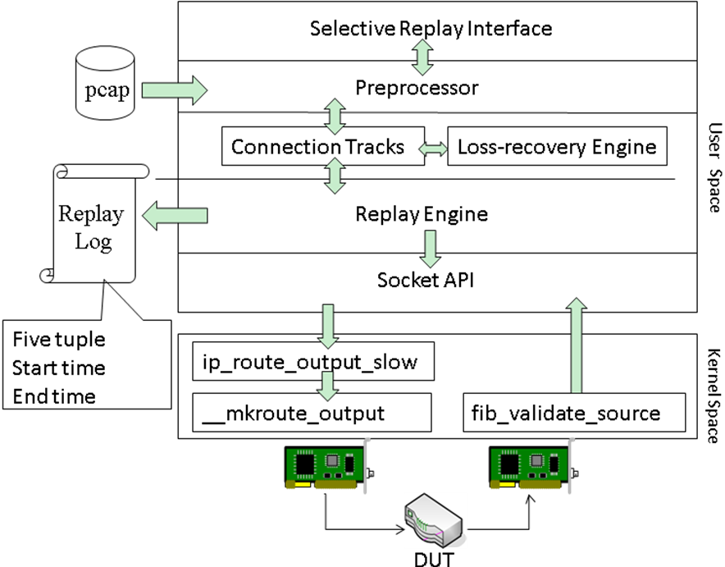
SocketReplay: Low-Storage Packet Capture and Loss-Recovery Stateful Replay of Real Flows
Socket Replay: a stateful replay tool that tolerates capture loss
Appeared in IEEE Communications Magazine, Apr 2012

Slide 48
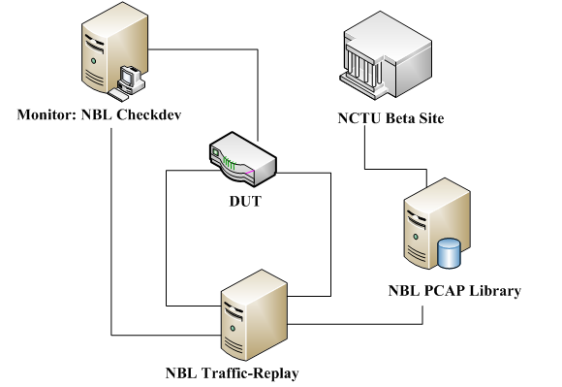
Replay Test – In-Lab Live Test (ILLT)
#3
DUT
  Device Under Test
NBL PCAP Library
  Packet trace repository in PCAP format
NBL Checkdev
  Probing the DUT status
  Collecting statistics of replayed traffic
NBL Traffic-Replay
  Replaying PCAP packet traces
Notes:
ILLT: 利用錄製與重播網路流量的技術，完整呈現真實網路環境，將錄製到的網路流量重播至待測物中
Checkdev 跟 Traffic-Replay 會互相溝通統計資訊：如PCAPs, 連線量, 頻寬使用量, 連線埠分布狀況
1) 檢查DUT各層protocol是否正常運作, 一般是使用http, tcp, icmp, arp來檢查

Slide 49

Live SOHO
Public Testing

Slide 50
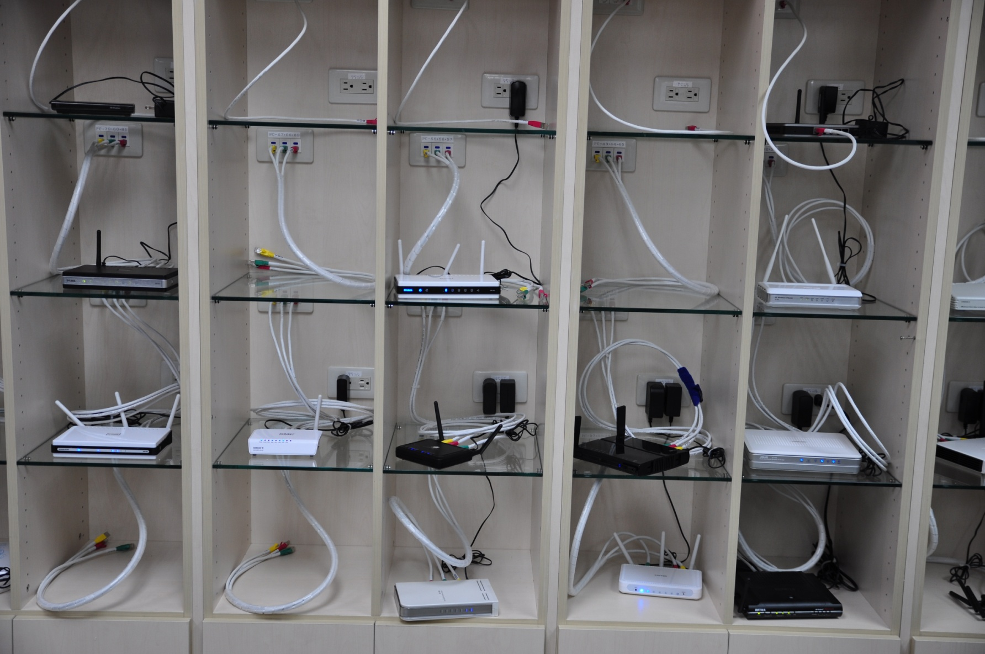
SOHO Routers “Wall”

Slide 51
ILLT Test Results
Replayed traffic volume > 4 TB
Notes:
把上頁的 “total failure”再拆開成 “L1” && “L2”;
一片單層藍光光碟: 25 GB; total 約為 12841 片藍光
一片單層DVD光碟: 4.7 GB, 135分長度 ; total 約為 68301 片 DVD,
一首 三分半 左右的歌曲, 換成 128 kbps 的 mp3, 約為 3.5 MB

Slide 52
Market Impact
Forums and blogs
  Mobile01, Xfastest, 巴哈姆特, PCZone, 滄者極限, 中國無線論壇, PALMisLife, FAME中隊, 香港高登, HKEPC, Plus….
  Blog
  Plurk
  PTT (BBS)
Well recognized models
  Buffalo WZR-HP-G300NH, WCR-G54
  PCI MZK-WNH
  SMC WBR14S-NL
  ASUS RT-N16
  Apple Airport Extreme

Slide 53
TestCov: Coverage Analysis and Optimization
#4
Notes:
三項專利標地圖示: NBL-Fuzzer, TestCov, TestSel
The entire test case selection system with optimal test coverage includes three subsystems.
First, traffic diversification system including a fuzzing system --- NBL-Fuzzer
Second, test coverage analyzer and visualization system --- TestCov
Third, test case selection system by coverage mapping database, product specifications, and customer requirements --- TestSel

Slide 54
Test Coverage Analysis and Optimization
for Large Code Problems
Function reachability of test cases: how many functions a test case can reach
Test intensity of functions: how often a function is reached
Formulated and solved 6 optimization problems
Appeared in Journal of Systems and Software, Jan 2012

Slide 55
Redefining Security Criteria
Best-of-breed from Common Criteria, ICSA, NSS, and RealFlow
NCC Security Criteria: switch, router, WLAN, firewall, IDS, WAF, anti-virus, anti-spam, application control
To appear in IEEE Security & Privacy, 2014

Slide 56
Malware Tool-Chain: Collection, Detection, Analysis
Malware collection: active vs. passive
Malware propagation: passive vs. active
To appear in IEEE Computer, 2014
#5
PMC&D: Proactive Malware
Capture & Detection
HBA: Host Behavior Analysis
NBA: Network Behavior Analysis

Slide 57
EAR: Real Traffic Replay over WLAN with Environment Emulation
Appeared in IEEE WCNC, Apr 2012
#6
EAR: Event-driven Automata-synchronized Replay
EAR Evaluation Testbed

Slide 58
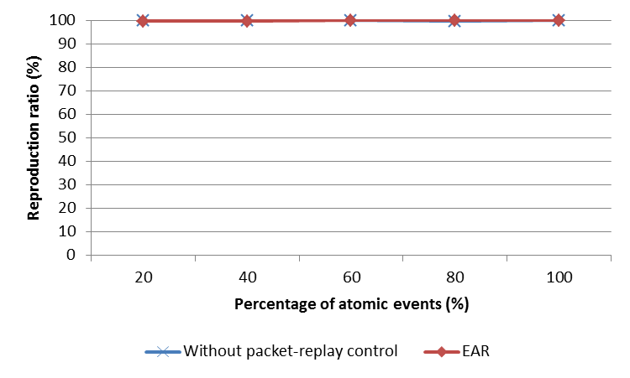
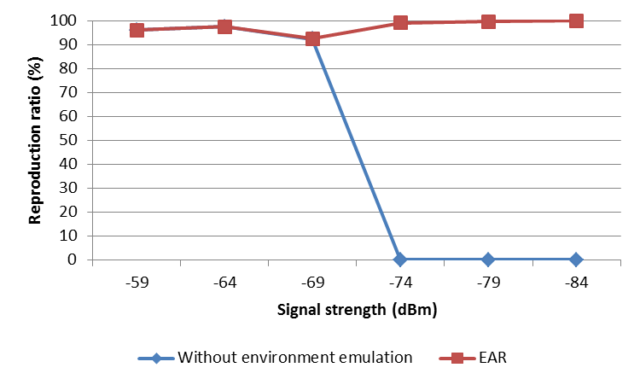
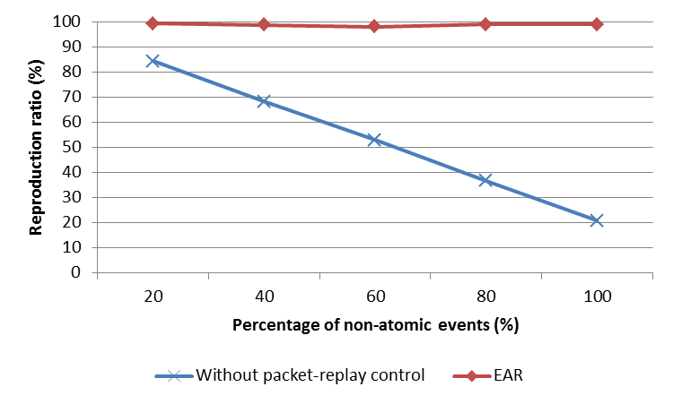
Event Reproduction Ratio of EAR

Slide 59
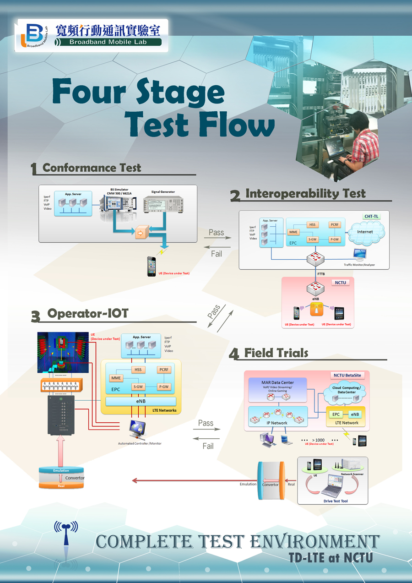
LTE 4-stage Testbeds
Stage 1
  eNB emulator
  Test purposes
    Conformance Test
    Design verification
Stage 2
  eNB/EPC of diff. vendors
  Test purposes
    Interoperability Test
    Capacity verification
Stage 3
  OTA chamber/channel emulator
  Test purposes
    Operator-IOT
    Performance test for mobile devices (CTIA)
Stage 4
  Experimental band in NCTU campus
  Test purposes
    Field Trials
    BetaSite
#7
#8
Notes:
Summary all stages, including stage 1 and 2 by table
改成先三後四

Slide 60
Throughput vs. Channel Power and Angle (DUT2)

Slide 61
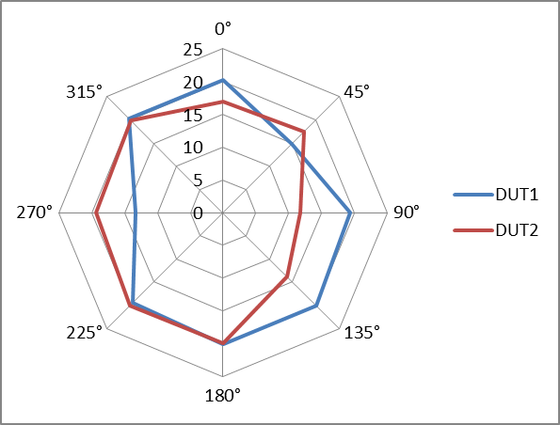
Effect of Attitude Angle to Throughput (-74.4dBm)

Slide 62
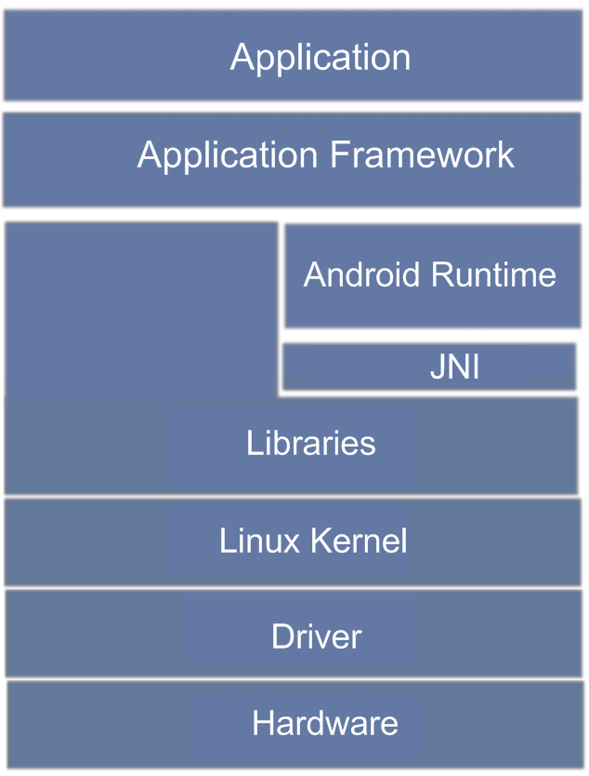
A Spin-Off: EBL (Embedded Benchmarking Lab)
AKL (stand-alone)
Dynamic Multi-Level Profiler
Cross Layer Bottleneck Detector
Bottleneck Analyzer
H-Profile
Power Measurer (System Level)
Battery Use Extension (App Level)
Power Memo (Function Level)
Android System

Slide 63
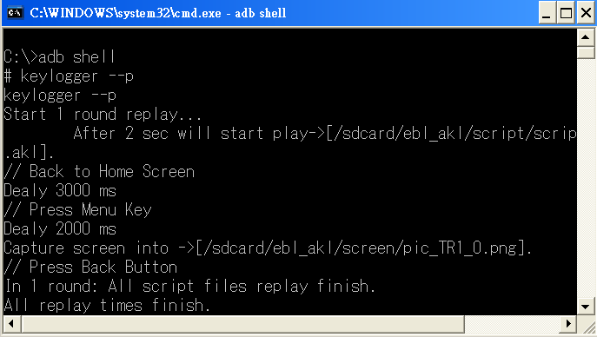
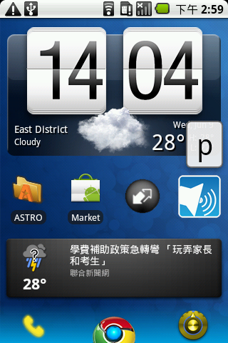
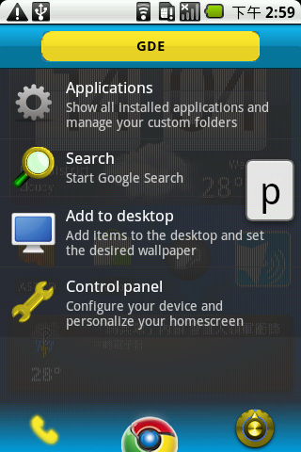
Android Key Logger (AKL)
#9
The AKL can record, then replay user events.

Slide 64
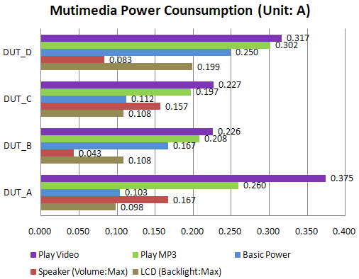
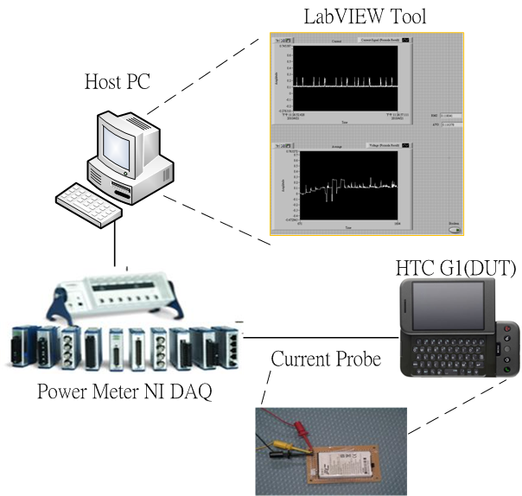
Application Power Measurer
Purpose
  To measure power consumption for android Apps automatically
Test tools
  Power meter
  Android Key Logger

Slide 65
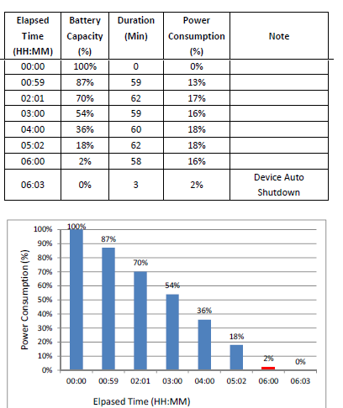
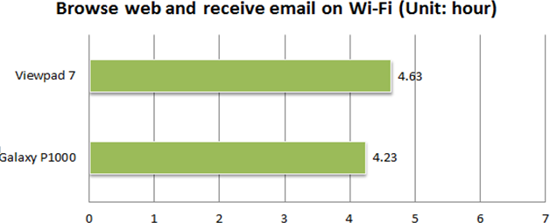
Battery Rundown Test
Decide user scenario
Set execution loop
Get battery life time

Slide 66
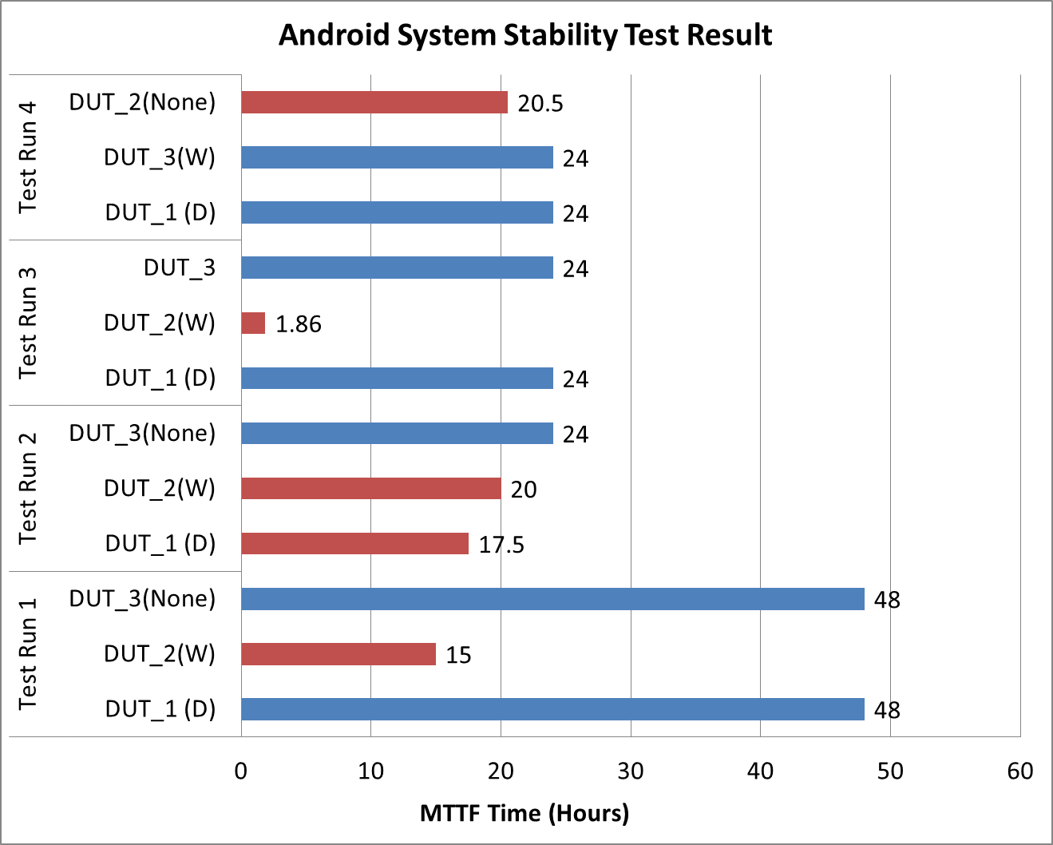
System Stability Test
DUT Issue

Slide 67
Automated GUI Testing for Embedded Systems
SPAG (Smart Phone Automatic GUI)
Record and replay user behaviors with accuracy improvement
To appear in IEEE Software, 2014

Slide 68
Lessons (1/2)
Development vs. research
  R only, R→D, D→R, or parallel R&D?
  Front line (D) → back line (R), D first then R
  Industry: D&r, academia: R&d
  → grow r in industry & d in academia!
  Good balance between D & R: but not in ComSoc
NBL experiences
  Duplicating others (e.g. UNH/IOL) has no value.
  Real traffic testing is indeed unique.
  3rd-party lab only for 2nd-tier vendors?
    Large/small projects with large/small vendors
Research roadmap vs. random picks
  A series of works with deeper understanding
  But random picks have their chances
Publication strategy: conferences vs. journals/magazines
  Conference-driven vs. journal-driven: travel budget
  Time-to-publish

Slide 69
Lessons (2/2)
Academic services vs. academic cooperation
  Editorial boards, program committees, technical committees
  Extra effort for new thoughts and resources
  Research: collaboration > work alone
Impacts
  A work with high impact on the industry might not have high impact on the academia, and vice versa.
  A high-impact paper might be rejected in its early version.
  Many papers in top journals or conferences have low impact eventually. The review process can screen regarding quality but usually not impact.
  Keep a few of your favorite problems in your mind and review them with new inputs.

