Slide 1
Building
Sustainable e-Infrastructures for Research and Education
HPC Clusters, Grids, and Clouds
University of South Carolina, Columbia, February 25, 2011
  Wolfgang Gentzsch
  The DEISA Project

Slide 2
Content
  Infrastructure => e-Infrastructure
  Why are we building e-Infrastructures ?
  Paradigms: Cluster, Grid, & Clouds Computing
  The DEISA Ecosystem for HPC Applications
  HPC in the Cloud
  Killer Application: e-School / e-University
  Conclusions

Slide 3
Infrastructures e-Infrastructure
University of South Carolina, Columbia, February 25, 2011

Slide 4
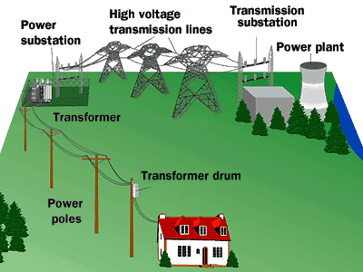
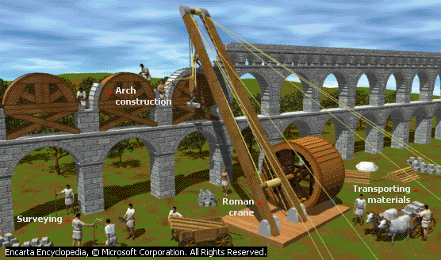
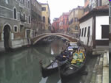
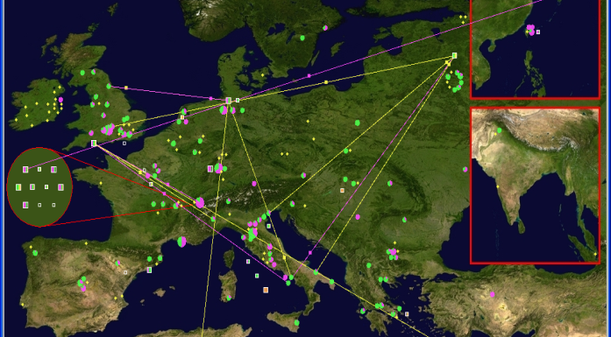
We always built Service Infrastructures
Ancient Rome: 10 aqueducts
150,000 m³ of water each day
Electrical Power Grid
Infrastructure
Transportation
Land, water, air
Internet
WWW, Grids, Clouds

Slide 5
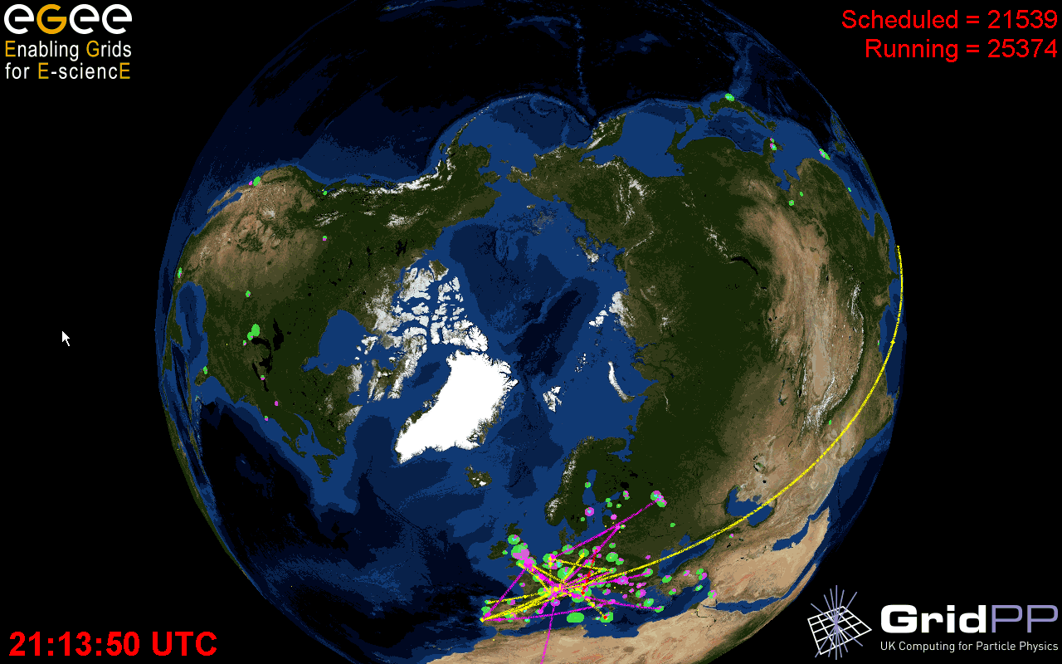
Service Infrastructure for Collaboration in Science
Scientific Communities:
  High Energy Physics
  Astrophysics
  Comp Chemistry
  Fusion
  Life Sciences
  Biomedicine
  Earth Sciences
  Finance
  Geophysics
  Multimedia
  ...and more
~ 280 sites in 54 countries
> 200 Virtual Organizations
~ 120 000 CPUs (March 2010)
20 PB storage
16000 users
> 250K jobs/day
Acknowledgements:
Julia Andreeva, Ian Bird, David Colling, David Foster, Jürgen Knobloch,
Faïrouz Malek, the LCG Collaboration, EGEE, OSG, the LHC experiments

Slide 6
Why are we building e-Infrastructures ?
University of South Carolina, Columbia, February 25, 2011

Slide 7
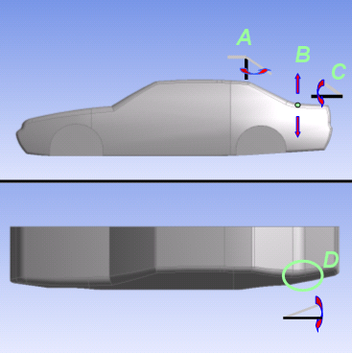
Aerodynamic Shape Optimization
Design plan
Geometry modification
Volume meshing
Optimizer
CFD simulation
4 parameters to be optimized
cubic face centered design
25 cases+16 extra cases for error estim.
70 hours wall clock time on 64 cpus
Result analysis
Optimal
solution
Each of these steps need to be fully automated and controlled by the optimizer

Slide 8
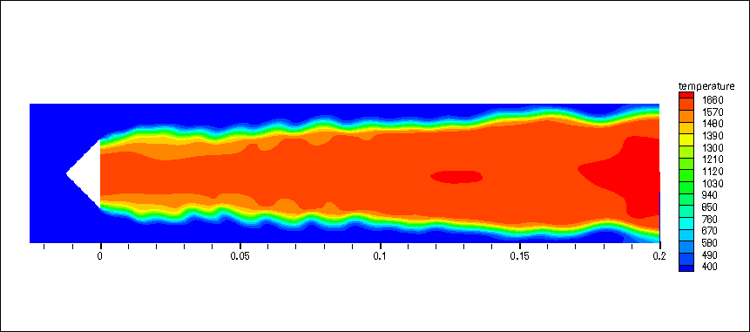
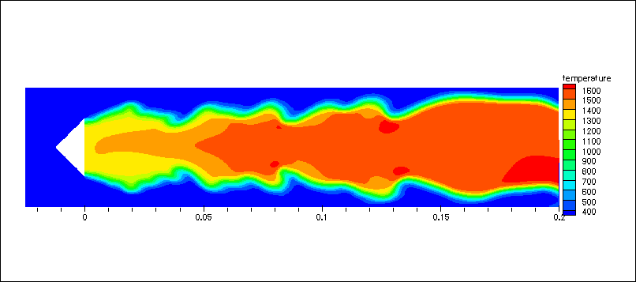
Combustion / Radiation
  Study the impact of radiative heat transfer (RHT) on the combustion process (2D)
  Couple combustion (AVBP), the RHT (Rayon) codes and the pollutant formation (AVBP)
  Parallelization of the Rayon code and improvement of the coupling part
  Load balancing issue
  3D extension proposed to DECI and accepted
N processes MPI
t + m.dt
Pthreads (OpenMP)
AVBP
(combustion)
Species, T
RAYON
(RHT)
Radiative E
t + n.dt
Yi, T, V
AVBP
(pollutant)
N processes MPI
Temperature field
WITHOUT
Radiative heat transfer
WITH

Slide 9
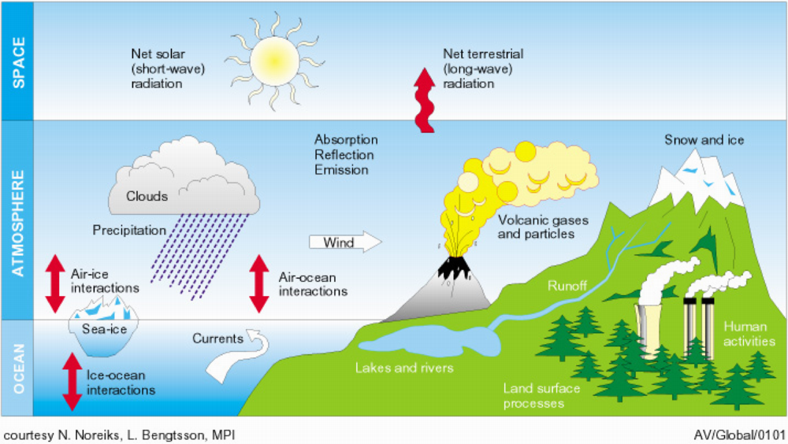

Climate Modelling
Climate research moves towards new levels of complexity:
Stepping from Climate (=Atmosphere+Ocean) to Earth System Modelling
Earth system model wishlist:
Higher spatial and temporal resolution
Quality: Improved subsystem models
Atmospheric chemistry (ozone, sulfates,..)
Bio-geochemistry (Carbon cycle, ecosystem dynamics,..)
Increased computational demand factor: O(1000 -10000)

Slide 10
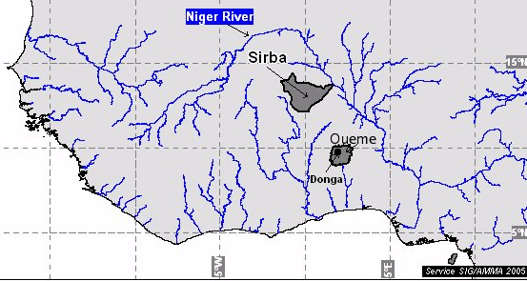
Environmental Application
  Study the impact of water cycles of the hydrological and vegetation models on climate models
  Coupling area in West Africa
  Best performances with a vector and scalar platform
  Improve extensibility of the architecture and the coupling part
  AMMA project, PhD thesis, 2 publ. and 2 comms.
Atmosphere
Vegetation
Hydrological
Meteorological
Mesh
MAR
SVAT_M
Sirba
Sirba
SVAT_H_1
ABC
Hydrological Mesh
Ouémé
Ouémé
SVAT_H_2
TopModel

Slide 11
Why are we building e-Infrastructures
for research & education?
Transparent secure on-demand access to resources
Enabling computation and collaboration
Increasing flexibility: capability versus capacity
Making innovation real for research & education
Increasing productivity of the users
Raising the ROI of IT – maximizing value/cost
Expanding impact of IT on the organization

Slide 12
Components of e-Infrastructures
Networks, Clusters, Grids, Clouds
University of South Carolina, Columbia, February 25, 2011

Slide 13













Dedicated high speed network (10 Gb/s)
Daresbury
Edinburgh
UKERNA
FUNET
RENATER
GARR
RedIris
SURFnet
Frankfurt
Dedicated
10 Gb/s
Wavelength
10 Gb/s Ethernet / IP
1 Gb/s
GRE Tunnel
DFN
13
Notes:
13

Slide 14
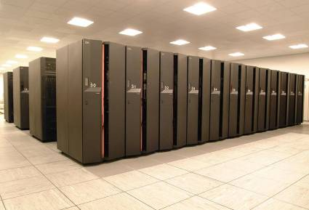
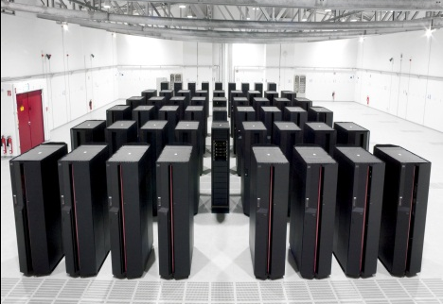
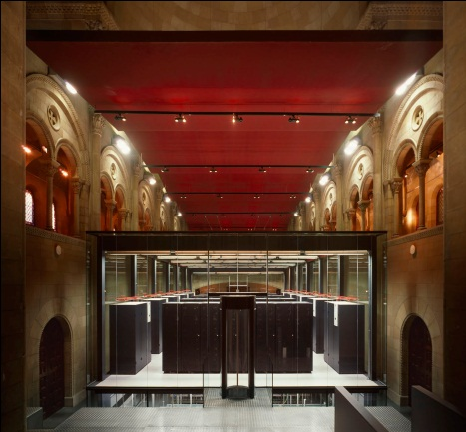
HPC Centers and Clusters
- still our bread & butter -
HPC Centers are service providers, for the past 40 years
IT Services: Computing, storage, applications, data, etc
Professional: to end-users, they look (almost) like Cloud services.
Amazon Cloud definition: … easy, secure, flexible, on demand, self serve,…
Challenges: peta/exa, software, scalability, multicore, GPUs, Green Computing, connected to Grids & Clouds,...

Slide 15
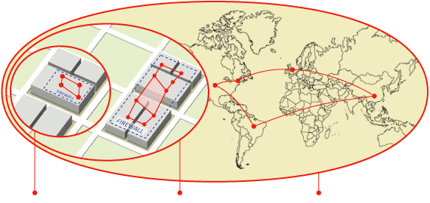
Remember Grids
Departmental Enterprise Global
Grids Grids Grids
1998:
“Dependable, consistent, pervasive, inexpensive
access to high-end computational capabilities.”
2002:
”Coordinated resource sharing and problem solving in
dynamic, multi-institutional virtual organizations.”
Ian Foster et al.

Slide 16

Example :
The DEISA Ecosystem for
HPC Grand-Challenge Applications
HPC Centers in the Grid
DEISA:
Distributed European Infrastructure
for Supercomputing Applications

Slide 17
DEISA: Vision and Mission
Vision:
Persistent European HPC ecosystem integrating European Tier-1 (Tflop/s) and Tier-0 (Pflop/s) centers.
Mission:
By integrating the most powerful supercomputers into a European HPC e-infrastructure.
On top of existing national services, deployment and operation of a persistent, production quality, distributed supercomputing environment with continental scope.

Slide 18
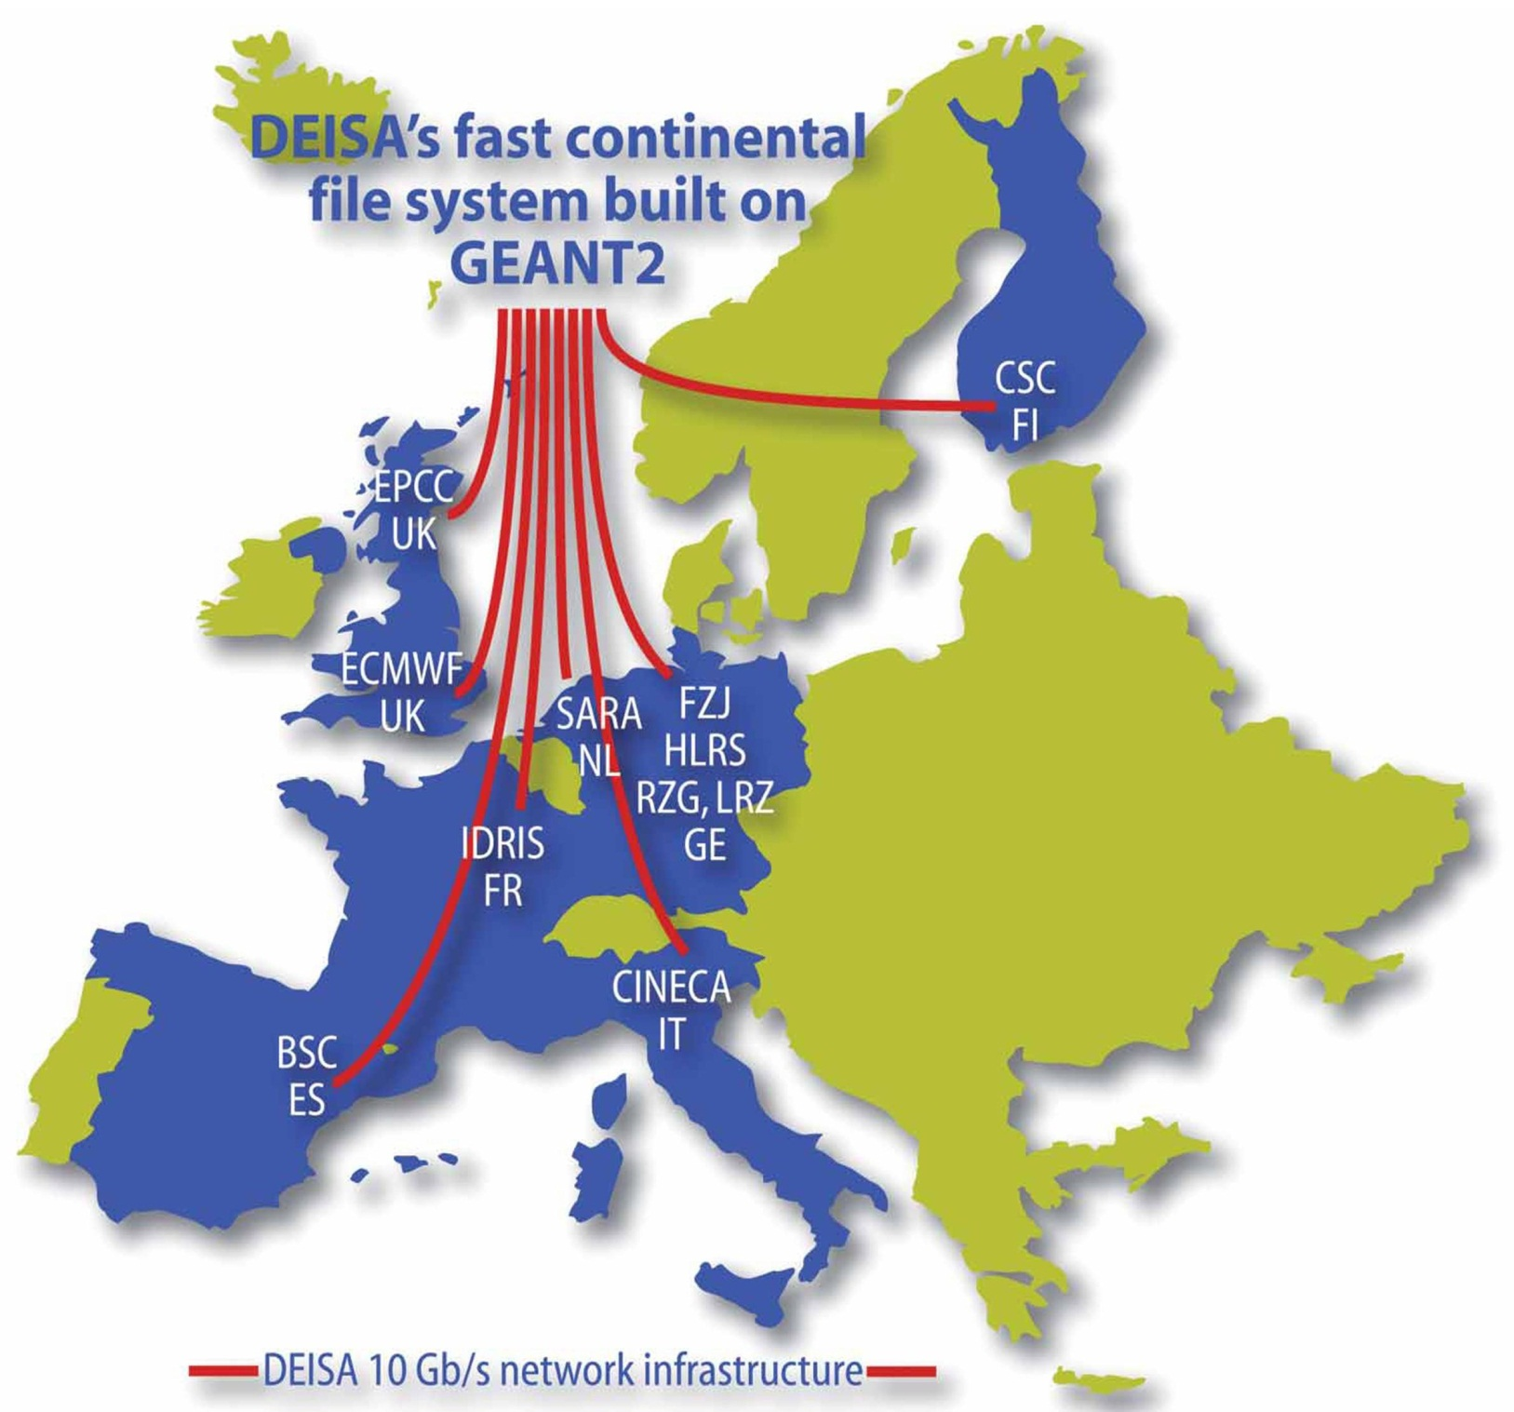
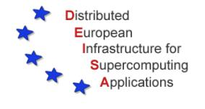
DEISA Evolution
DEISA
2005 – 2011
six years of operation
Most powerful
European Supercomputers
for most challenging projects
Grand Challenge
projects performed
on a regular basis
Top-level Europe-wide application enabling
Virtual Science Community Support

Slide 19
Categories of DEISA services
Operations
requests support
requests configuration
offers product
offers service
Technologies
requests development
Applications
offers technology

Slide 20
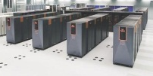
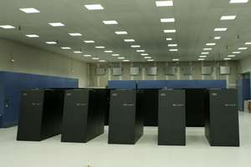
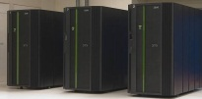

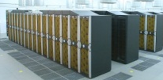
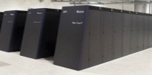
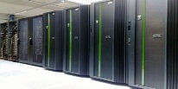
Unified Access and Use of HPC Resources
Access via Internet
single sign-on (based on X.509 ‘Grid‘ certificates)
gsi-ssh -> D-ssh
Unicore, gridFTP
DEISA Common Production Environment
Different Software Environments
SE A1
SE B1
SE C1
SE D1
SE E1
SE B2
SE C2
SC A
SC B
SC A
SC B
Different SuperComputers - Compute elements and interconnect
Dedicated 10 Gb/s network – via GEANT2
DEISA highly performant continental global file system

Slide 21

DEISA Service Layers
Multiple
ways to
access
Workflow
managemnt
Common
production
environmnt
Presen-tation
layer
Single
monitor
system
Job
rerouting
Co-reservation
and co-allocation
Job manag.
layer and
monitor.
Data staging
tools
Data
transfer tools
WAN
shared
File system
Data manag.
layer
Unified
AAA
DEISA
Sites
Network
connectivity
Network
and
AAA
layers

Slide 22

HIAST HPC Workshop, Damascus, December 14 - 17, 2010
HPC in the Clouds
  Wolfgang Gentzsch
  EU DEISA Project, Board of Directors of OGF, IDC Analyst, and STE Advisor to Governments
  Gentzsch at rzg.mpg.de

Slide 23

Cloud... IT as a Service
Cloud: dynamically scalable and virtualized resources
provided as a service over the Internet
Accessible online, anytime, anywhere
Pay for what you use
Available on demand
Service Level Agreements
Automated:
  Scalability
  Failover
  Private, hybrid, public
Infrastructure (IaaS)
Platform (PaaS)
Software (SaaS)
Notes:
23

Slide 24
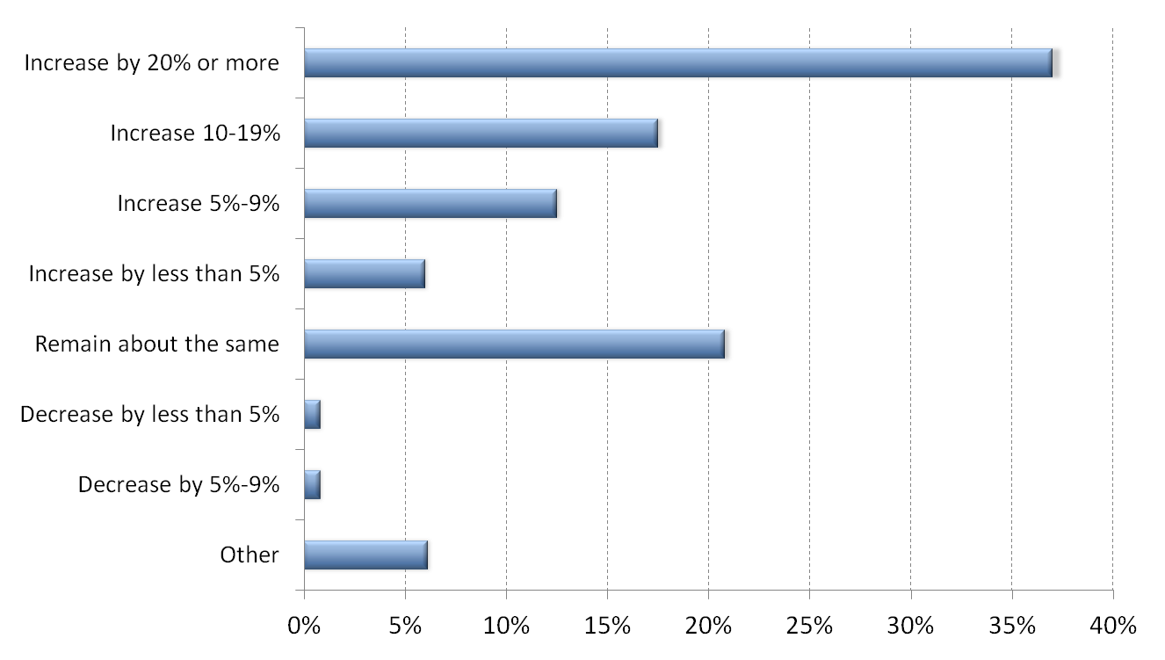
How will your budget for cloud computing change in 2011 compared with 2010 ?
75 %
Source: John Barr, The 451 Group Cloud Adoption Survey 2010
Notes:
24

Slide 25
Challenges in the Cloud
Sustainable
Competitive
Advantage
TECHNICAL
CULTURAL
LEGAL &
REGULATORY

Slide 26
Challenges in the Cloud
Sensitive data, sensitive applications (med. patient records)
PERFORMANCE – latency and bandwidth
Security – end to end
Interoperability of Clouds
Current IT culture is not predisposed to loosing control
Not all applications are cloud-ready or cloud-enabled
Moving data to application OR application to data
SLAs
“Static” licensing model don’t embrace cloud
Protection of intellectual property
Legal issues (FDA, HIPAA, location of cloud
resources, multi-country clouds, etc)

Slide 27
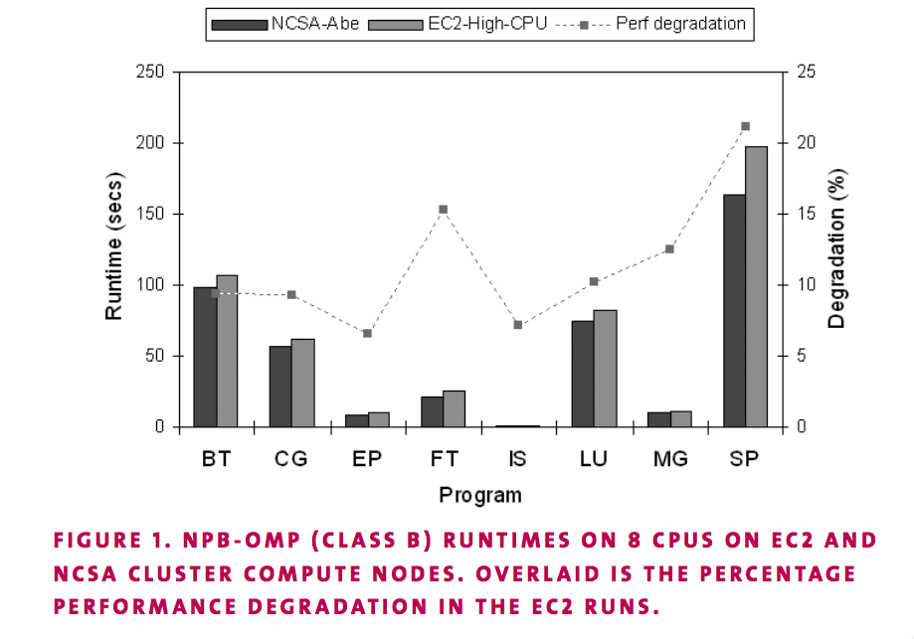
Potential overhead in Cloud performance
Ed Walker, Benchmarking Amazon EC2 for high-performance scientific computing, ;Login, October 2008.
Notes:
Performance studies might seem to confirm some part of the conventional wisdom.
Running 8 of the NAS parallel benchmarks on multiprocessor nodes—Amazon is slightly slower when running on single nodes, with OpenMP.
27

Slide 28
Breakthrough July 2010: Amazon
Introducing CCI Cluster Compute Instances
Amazon EC2 instance type
Optimized for network intensive computing
  Low latency
  High bandwidth
  New EC2 API: Placement groups
Instance Configuration
  2 * Xeon 5570 (Intel “Nehalem” quad-core architecture)
  23 GB 1333MHz DDR3 Registered ECC RAM
  1690 GB of local instance storage
  10 Gbps Ethernet interconnects CCI‘s

Slide 29
Some EC2 CCI Results
Some applications can expect 10x better performance
LNBL NERSC saw 8.5x compared to similar clusters on standard EC2 instances
Linpack benchmark
  880-instance CC1 cluster
  Performance: 41.82 Tflops
  ➔EC2 at #146 in the June 2010 Top 500 rankings

Slide 30
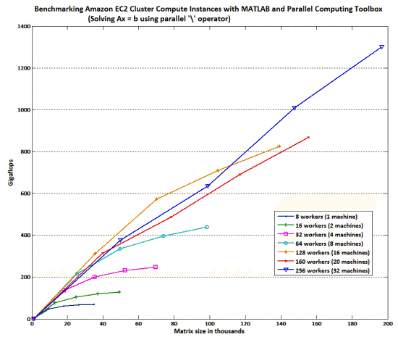
MATLAB Ax = b Benchmark, Sept 2010

Slide 31
Grid versus Cloud
Why should my App run in the Grid ?
Closer collaboration with colleagues (VCs)
Mapping workflows to resources (plumbing)
Suitable resources => faster/more/accurate
Different architectures serve different apps
Failover: move jobs to another system
. . . and why in the Cloud ?
No upfront cost for additional resources
CapEx => OpEx, pay-per-use
Elasticity, scaling up and down
Hybrid solution (private and public cloud)

Slide 32
One Killer Application for e-Infrastructures: e-School & e-University an e-Infrastructure for interactive science simulations
University of South Carolina, Columbia, February 25, 2011

Slide 33
e-Learning on e-Infrastructures
The Challenges:
World-wide data and knowledge explosion
We need more scientists and engineers, but not enough students are interested in science
Schools and teachers are not prepared
The Solution:
New ways of teaching and learning for our digital natives
e-Infrastructures for enriched learning
Working with didactic and pedagogic experts
The Prototype:
e-School, interactive science laboratory, the digital sand-box for life-long learning in the sciences

Slide 34
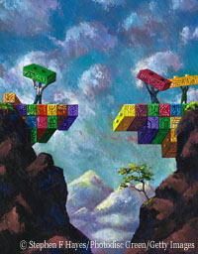
e-School Prototype
A Virtual Laboratory based on an e-Infrastructure and a distributed
digital repository for science and engineering applications
for students and educators
Bridging the Chasm between
Education and Science

Slide 35

Vision: e-School Science Collaboratory
for a better learning experience
Inter-active learning tools for creative students (edutainment)…
…same tools engineers & scientists are using in the 21st century
Edu portal provides seamless access to virtual laboratory
100s of real-world computer simulations available for all ages
On dynamic, shared, remote resources, at your finger tip
e-School: empowering education
- Learning by doing -

Slide 36
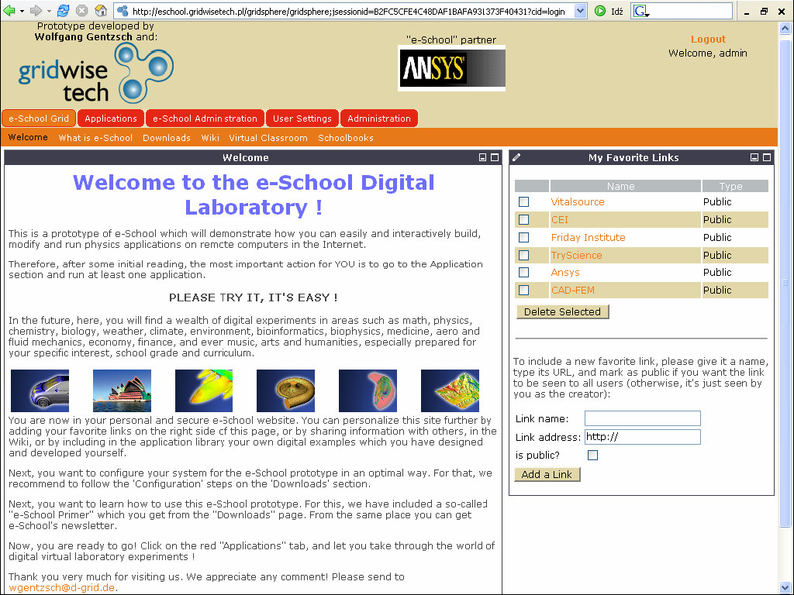
e-School Prototype Website http://eschool.gridwisetech.pl

Slide 37
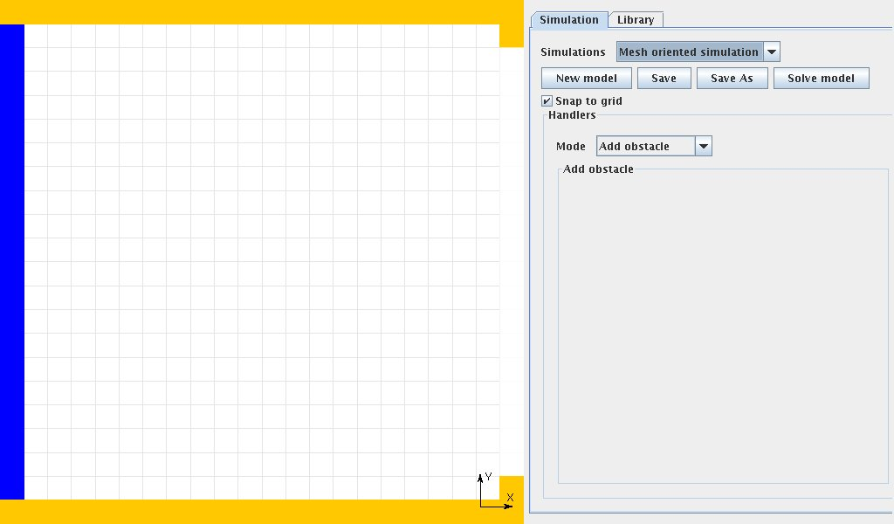
e-School: Your personal workspace

Slide 38
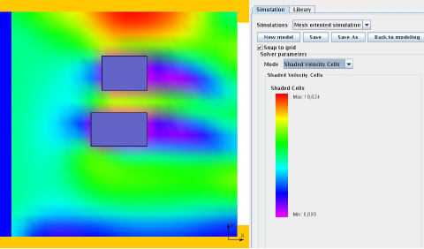
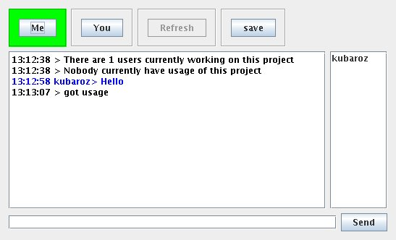
Example: interactive real-time fluid flow
Collaboratorium

Slide 39

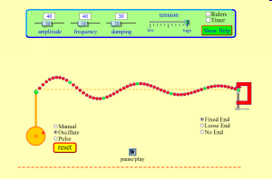
e-School: Physics, Waves

Slide 40
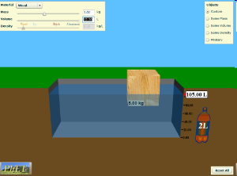
e-School: Physics, Density

Slide 41
University of South Carolina, Columbia, February 25, 2011
Thank You
for your attention
gentzsch @ rzg.mpg.de
Notes:
Scientists will work one year to fully analyse the result data

