Slide 1
Lecture 9
SLR Parse Table Construction
CSCE 531 Compiler Construction
Topics
  SLR Parse Table Construction
  Sets of Items
  Closure(I)
Readings: 4.7
Homework: Test 1 – Feb 27
February 15, 2018

Slide 2
Last Time
  Panic mode error recovery in Predictive parsing
  Overview Bottom-Up Parsing
  Handles
  Shift-reduce parsing
Today’s Lecture
  Sets of Items / Closure / GOTO (J, X)
  LR(0) sets of items construction
  SLR parser table construction
Homework:
  LL(1) table for core (pdf email handout) grammar
  Test 1 Feb 27 !!!
  Reference: ξ is the greek letter Xi
    http://www.mathacademy.com/pr/prime/articles/greek/index.asp

Slide 3
Slides in Lecture
Review
Model of an LR parser
LR Parse table (Expressions)
Constructing SLR Parse Tables
Sets of Items / Closure
Example
Goto Operation and example
Canonical LR(0) sets-of-items (fig 4.35)
Valid Items/Viable prefixes
SLR table construction
Example
Example 4.38
Example 4.39
Bison/Flex Overview picture
Bison specification files

Slide 4
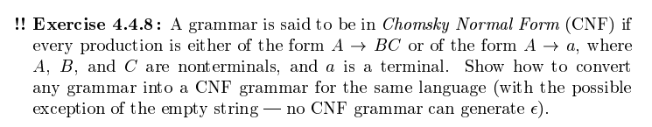
Chomsky Normal form CNF
.

Slide 5
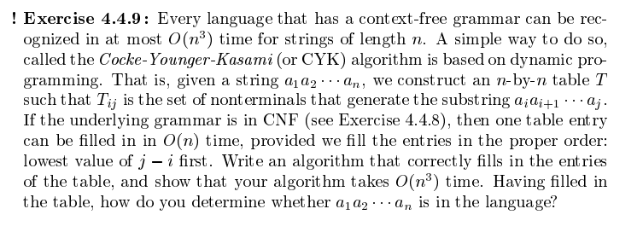

Slide 6
Recall - Model of an LR Parser
input
a₁ | … | a_{i} | … | a_{n}$
Stack
s_{m}
X_{m}
s_{m-1}
X_{m-1}
…
s₀
LR Parsing
Program
output
Parsing Table
Action goto

Slide 7
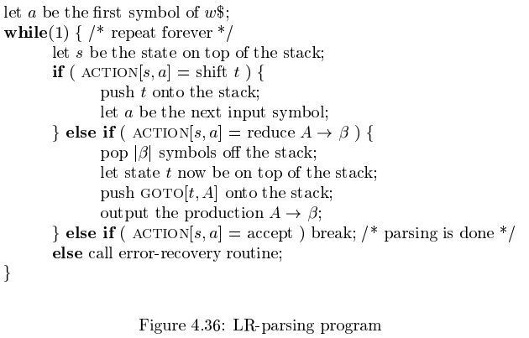
Fig 4.36 LR Parsing Algorithm

Slide 8
Expression LR-Parsing Table fig 4.31
State | Action | goto
 | Id | + | * | ( | ) | $ | E | T | F
0 | S5 |  |  | S4 |  |  | 1 | 2 | 3
1 |  | S6 |  |  |  | accept
2 |  | R2 | S7 |  |  | R2
3 |  | R4 | R4 |  |  | R4
4 | S5 |  |  | S4 |  |  | 8 | 2 | 3
5 |  | R6 | R6 |  |  | R6
6 | S5 |  |  | S4 |  |  |  | 9 | 3
7 | S5 |  |  | S4 |  |  |  |  | 10
8 |  | S6 |  |  | S11
9 |  | R1 | S7 |  | R1 | R1
10 |  | R3 | R3 |  | R3 | R3
11 |  | R5 | R5 |  | R5 | R5

Slide 9
Constructing SLR Parse Tables
As with LL(1) or Predictive Parsing table construction we will use FIRST and FOLLOW.
We will construct an automata for recognizing handles.
This will be similar to subset construction, NFA ➔DFA
We use “items” to represent partially matched productions.
The sets of items are sort of the collection of productions we are working on matching.
Grammars
  For top-down we avoid left recursion and left factor
  For LR we avoid right recursion (in some cases we will ignore)

Slide 10
Items
An item is a production with a “dot” somewhere on the right hand side.
Examples:
A → B C D E
Yields the following items
A → . B C D E
A → B . C D E
A → B C . D E
A → B C D . E
A → B C D E .
Also N → ε generates the item N → .

Slide 11
Sets of Items: Closure fig 4.33
If J is a set of items for a grammar G, then closure(J) is the set of items constructed from J by the two rules:
Initially, every item in J is added to closure(J)
If A → α . Bβ is in closure(J) and B → η is a production then add B → . η
Apply this rule until no new items can be added to the set.
Example:
Assume D→ xyF | Bc and B→aB | Dd are the productions then
Closure(A→BC.DE) = {A→BC.DE, D→.xyF, D→ . Bc, B→.aB, B→.Dd }

Slide 12
Sets-of-items GOTO(J, X)
If J is a set of items and X is a grammar symbol then
GOTO(J, X) is the closure of the set of all items of the form [A→αX .β] such that [A→α . Xβ] is an item in J.
GOTO(J, X) = closure ({A→αX .β | A→α . Xβ is in J} )
Example given E → E + E | E * E | id
If J = { [E → E . + E ], [E → . id] } then
GOTO (J, +) = closure({[E → E + . E ] } )
= {[E → E + . E ], …

Slide 13
Augmentation and Kernel Items
To facilitate recognition of the sucessful end of a parse we will “augment the grammar” adding
a new start symbol S’, and
a new production S’ → S
Items with the dot not at the left end and the initial item S’→.S are called kernel items.
All others will be referred to as non-kernel.
Note non-kernel items will have the dot on the left.

Slide 14
LR(0) Sets-of-Items Construction
Figure 4.34
Procedure items(G’)
Begin
C = { closure({ S’→ . S} ) }
repeat
for each set of items J in C and each grammar symbol X
such that GOT(J, X) is nonempty and not in C
add GOT(J, X) to C
until no more sets of items can be added to C
end

Slide 15
Examples LR(0) sets-of-items
Grammar 4.35 generates LR(0) items in fig 4.35 (p 225).
Example 4.39 (p229)
Example
D → T ; | T R ; D
T → int | float | char
R → id | id [ const ] | * id
First augment the grammar with S’ → D
Then …

Slide 16
Valid Items/Viable prefixes
The set of prefixes of right sentential forms that can appear on the stack are called viable prefixes.
Alternately it is one that is capable of being extended to a handle.
Alternately it is a prefix of a right sentential form that does not extend beyond the right end of the rightmost handle.
An item [ A→β₁ . β₂ ] is valid for a viable prefix αβ if there is a derivation
S’ ➔ α A w ➔ α β₁ β₂ w
An item may be valid for many viable prefixes

Slide 17
Valid Items ➔ Parsing Actions
Valid items indicate possible parsing actions
If A → β . Is valid ➔ the action is reduce by A→ β
If [ A→β₁ . β₂ ] is valid ➔ the action is shift.
Contradictory actions yield conflicts.

Slide 18
SLR table construction Alg 4.8
Augment G to obtain G’.
Construct C = {I₀, I₁, …I_{n}} the LR(0) items for G’.
State i corresponds to I_{i}. The parsing actions for state i are determined as follows:
  If [ A→α . a β ] is in I_{i} and GOTO(I_{i}, a) = I_{j} then set action[i, a] = “shift and goto state j” or just “shift j”
  If [ A→α . ] is in I_{i} then set action[i, a] = “reduce A→α” for all a in FOLLOW(A). (here A !=S’)
  If [ S’→S . ] is in I_{i} then set action[i, $] = “accept.”

Slide 19
Examples of SLR Parse Table Construction
Grammar | Sets-of-Items | Parse Table
Example 4.39, pp 229 | Fig 4.37, pp 229 | Conflict bottom pp229
Example 4.38, pp 228 | Fig 4.35, pp 225 | Fig 4.31, pp 219
Example Grammar 4.42
S’ → S
S → C C
C → c C | d

Slide 21
LR(1) Parsers
source
code
Scanner
Table-driven
Parser
IR
ACTION &
GOTO
Tables
grammar
Parser
Generator
A table-driven LR(1) parser looks like
Tables can be built by hand
However, this is a perfect task to automate

Slide 22
YACC/Bison
Yet Another Compiler Compiler Stephen Johnson 1976
Takes grammar specification and generates the Action and GOTO tables

Slide 23
YACC Format and Usage
First Bison = new and improved YACC
YACC Format
Definitions section
%%
productions / semantic actions section
%%
routines

Slide 24
Example (grammar & sets)
Simplified, right recursive expression grammar
Is this what we want?
Goal → Expr
Expr → Term – Expr
Expr → Term
Term → Factor * Term
Term → Factor
Factor → ident

Slide 25
Simple0.y in web/Examples/SimpleYacc
%token DIGIT
%%
line : expr '\n'
;
expr : expr '+' term
| term
;
term : term '*' factor
| factor
;
factor : '(' expr ')'
| DIGIT
;
%%

Slide 26
bison simple0.y
deneb>
deneb> ls -lrt
…
-rw-r--r-- 1 matthews faculty 28499 Jun 30 12:04 simple0.tab.c
deneb> wc simple0.tab.c
1084 4111 28499 simple0.tab.c

Slide 27
gcc simple0.tab.c -ly
Undefined first referenced
symbol in file
yylex /var/tmp//ccW88jE5.o
ld: fatal: Symbol referencing errors. No output written to a.out
collect2: ld returned 1 exit status

Slide 28
deneb> more simple1.y
%token DIGIT
%%
expr : expr '+' expr
| expr '*' expr
| '(' expr ')'
| DIGIT
;
%%

Slide 29
deneb> bison simple1.y
simple1.y contains 4 shift/reduce conflicts.
bison -v simple1.y
simple1.y contains 4 shift/reduce conflicts.
deneb> ls -lrt
…
-rw-r--r-- 1 matthews faculty 2311 Jun 30 12:10 simple1.output

Slide 30
.output
deneb> more simple1.output
State 8 contains 2 shift/reduce conflicts.
State 9 contains 2 shift/reduce conflicts.
Grammar
Number, Line, Rule
1 5 expr -> expr '+' expr
2 6 expr -> expr '*' expr
3 7 expr -> '(' expr ')'
4 8 expr -> DIGIT

Slide 31
Terminals, with rules where they appear
$ (-1)
'(' (40) 3
')' (41) 3
'*' (42) 2
'+' (43) 1
error (256)
DIGIT (257) 4
Nonterminals, with rules where they appear
expr (8)
on left: 1 2 3 4, on right: 1 2 3

Slide 32
state 0
DIGIT shift, and go to state 1
'(' shift, and go to state 2
expr go to state 3
state 1
expr -> DIGIT . (rule 4)
$default reduce using rule 4 (expr)
4

Slide 33
state 2
expr -> '(' . expr ')' (rule 3)
DIGIT shift, and go to state 1
'(' shift, and go to state 2
expr go to state

Slide 34
state 3
expr -> expr . '+' expr (rule 1)
expr -> expr . '*' expr (rule 2)
$ go to state 10
'+' shift, and go to state 5
'*' shift, and go to state 6
… for states 4 through 7

Slide 35
Conflicts
state 8
expr -> expr . '+' expr (rule 1)
expr -> expr '+' expr . (rule 1)
expr -> expr . '*' expr (rule 2)
'+' shift, and go to state 5
'*' shift, and go to state 6
'+' [reduce using rule 1 (expr)]
'*' [reduce using rule 1 (expr)]
$default reduce using rule 1 (expr)

Slide 36
state 9
expr -> expr . '+' expr (rule 1)
expr -> expr . '*' expr (rule 2)
expr -> expr '*' expr . (rule 2)
'+' shift, and go to state 5
'*' shift, and go to state 6
'+' [reduce using rule 2 (expr)]
'*' [reduce using rule 2 (expr)]
$default reduce using rule 2 (expr)

Slide 37
state 10
$ go to state 11
state 11
$default accept

