Slide 1
Lecture 8
Bottom Up Parsing
CSCE 531 Compiler Construction
Topics
  Nullable, First, Follow
  LL (1) Table construction
  Bottom-up parsing
  handles
Readings:
February 13, 2018

Slide 2
Overview
Last Time
  Regroup
    A little bit of lex -- finish off Lecture 4
    Review of Derivations
    Recursive descent parsers
  First and Follow
  LL(1) property
Today’s Lecture
  Test 1
  First and Follow
  LL(1) property
References: Sections 4.5-4.6
Homework: p 730 #1, #4,

Slide 3
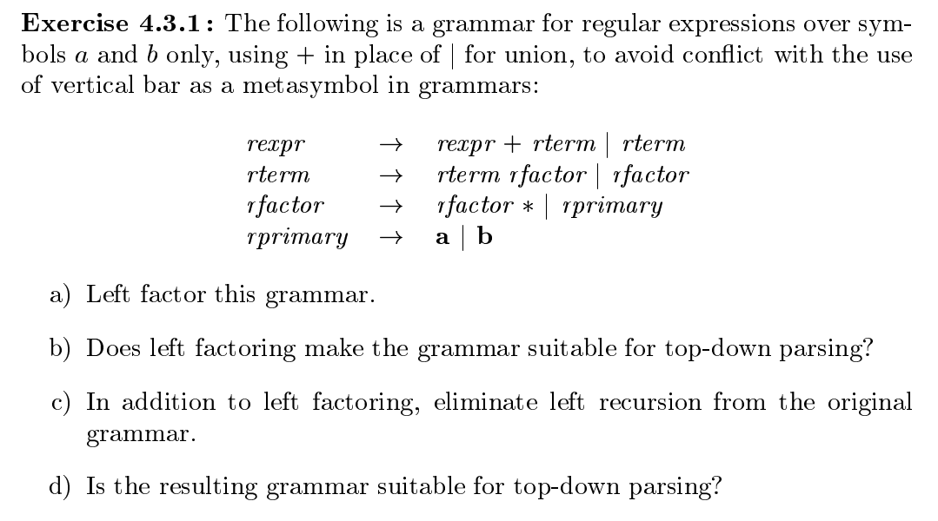

Slide 4
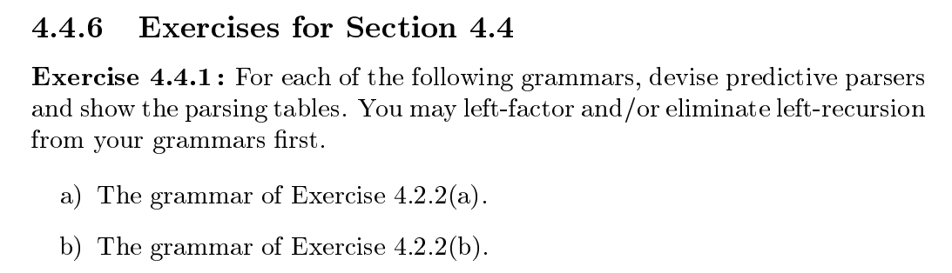
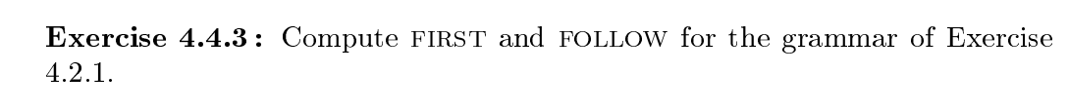

Slide 5
FIRST and FOLLOW Sets
FIRST(α)
  For some α ∈T ∪ NT, define FIRST(α) as the set of tokens that appear as the first symbol in some string that derives from α
  That is, x ∈ FIRST(α) iff α ⇒* x γ, for some γ
FOLLOW(α)
  For some α ∈ NT, define FOLLOW(α) as the set of symbols that can occur immediately after α in a valid sentence.
  FOLLOW(S) = {EOF}, where S is the start symbol
To build FIRST sets, we need FOLLOW sets …

Slide 6
First, Follow and Nullable Notes
A non-terminal X is called nullable if X ➔ ε . (note derives)
First(a) = { a } for all terminals a
If X→ Y₁Y₂…Y_{n} and each Yi is nullable (Yi ➔ ε) then X is nullable. (X➔ ε)
If X→ Y₁Y₂…Y_{k}…Y_{n} and Y_{i} is nullable for i < k then anything in First(Y_{k}) is also in First(X)
If X→ Y₁Y₂…Y_{k}…Y_{n} and Y_{i} is nullable for i > k then anything in Follow(X) is also in First(Y_{k})

Slide 7
First, Follow and Nullable Calculation
For each terminal symbol a
First(a) = { a }
Repeat
for each production X→ Y₁Y₂…Y_{k}…Y_{n}
if all Y_{k} are nullable for 1 <= k <=n then X is nullable.
for each k from 1 to n
if Y₁Y₂…Y_{k-1} are nullable (or n=0)
then First[X] ⬅ First[X] U First[Y_{k}]
if Y_{k+1}Y_{k+2}…Y_{n} are nullable (or k=n)
then Follow[Y_{k}] ⬅ Follow[Y_{k}] U Follow[X]
if Y_{k+1}…Y_{j-1} are nullable (or k+1=j)
then Follow[Y_{k}] ⬅ Follow[Y_{k}] U First[Y_{j}]
Until First Follow and Nullable all do not change in current iteration.

Slide 8
Example
Z → d | X Y Z
Y → c | ε
X → Y | a

Slide 9
Building Top Down Parsers
Building the complete table
Need a row for every NT & a column for every T
Need an algorithm to build the table
Filling in TABLE[X,y], X ∈ NT, y ∈ T
  entry is the rule X→ β, if y ∈ FIRST(β )
  entry is the rule X → ε if y ∈ FOLLOW(X ) and X → ε ∈ G
  entry is error if neither 1 nor 2 define it
If any entry is defined multiple times, G is not LL(1)
This is the LL(1) table construction algorithm

Slide 10
Example LL(1) Table

Slide 11
LL(1) Skeleton Parser
token ← next_token()
push EOF onto Stack
push the start symbol, S, onto Stack
TOS ← top of Stack
loop forever
if TOS = EOF and token = EOF then
break & report success
else if TOS is a terminal then
if TOS matches token then
pop Stack // recognized TOS
token ← next_token()
else report error looking for TOS
else // TOS is a non-terminal
if TABLE[TOS,token] is A→ B₁B₂…B_{k} then
pop Stack // get rid of A
push B_{k}, B_{k-1}, …, B₁ // in that order
else report error expanding TOS
TOS ← top of Stack
exit on success

Slide 12
Example Parse Trace

Slide 15
Recall Two Classes of Parsing Techniques
Top-down parsers (LL(1), recursive descent)
Start at the root of the parse tree and grow toward leaves
Pick a production & try to match the input
Bad “pick” ⇒ may need to backtrack
Some grammars are backtrack-free (predictive parsing)
Bottom-up parsers (LR(1), operator precedence)
Start at the leaves and grow toward root
As input is consumed, encode possibilities in an internal state
Start in a state valid for legal first tokens
Bottom-up parsers handle a large class of grammars

Slide 16
Bottom-up Parsing (definitions)
The point of parsing is to construct a derivation
A derivation consists of a series of rewrite steps
S ⇒ γ₀ ⇒ γ₁ ⇒ γ₂ ⇒ … ⇒ γ_{n–1} ⇒ γ_{n} ⇒ sentence
Each γ_{i} is a sentential form
  If γ contains only terminal symbols, γ is a sentence in L(G)
  If γ contains ≥ 1 non-terminals, γ is a sentential form
To get γ_{i} from γ_{i–1}, expand some NT A ∈ γ_{i–1} by using A →β
  Replace the occurrence of A ∈ γ_{i–1} with β to get γ_{i}
  In a leftmost derivation, it would be the first NT A ∈ γ_{i–1}
A left-sentential form occurs in a leftmost derivation
A right-sentential form occurs in a rightmost derivation

Slide 17
Bottom-up Parsing
A bottom-up parser builds a derivation by working from
the input sentence back toward the start symbol S
S ⇒ γ₀ ⇒ γ₁ ⇒ γ₂ ⇒ … ⇒ γ_{n–1} ⇒ γ_{n} ⇒ sentence
To reduce γ_{i} to γ_{i–1} match some rhs β against γ_{i} then replace β with its corresponding lhs, A. (assuming the production A→β)
In terms of the parse tree, this is working from leaves to root
Nodes with no parent in a partial tree form its upper fringe
Since each replacement of β with A shrinks the upper fringe,
we call it a reduction.
The parse tree need not be built, it can be simulated
|parse tree nodes| = |words| + |reductions|

Slide 18
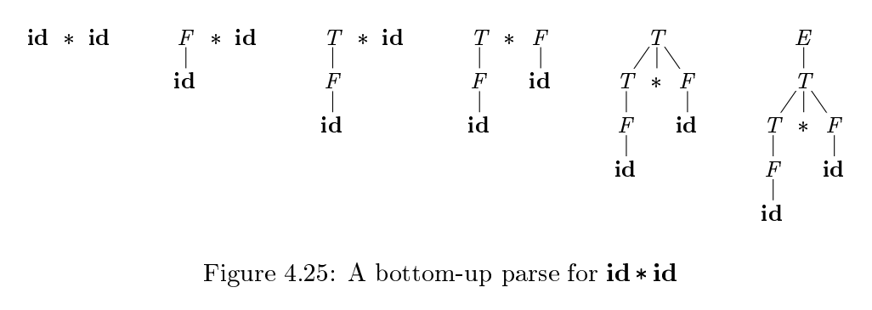
Figure 4.25

Slide 19
Finding Reductions
Consider the simple grammar
And the input string abbcde
The trick is scanning the input and finding the next reduction
The mechanism for doing this must be efficient

Slide 20
Formally, if S ➔*_{rm} αAω ➔_{rm} α βω, as in Fig. 4.27,
then production A→ β
in the position following α is a handle of α βω.
Alternatively, a handle of a right-sentential form is a production A→ β and a position of where the string may be found, such that replacing at that position by A produces the previous right-sentential form in a rightmost derivation of γ.

Slide 21
Finding Reductions (Handles)
Critical Insight
  If G is unambiguous, then every right-sentential form has a
  unique handle.
If we can find those handles, we can build a derivation !
Sketch of Proof:
G is unambiguous ⇒ rightmost derivation is unique
⇒ a unique production A → β applied to derive γ_{i} from γ_{i–1}
⇒ a unique position k at which A→β is applied
⇒ a unique handle <A→β,k>
This all follows from the definitions

Slide 22
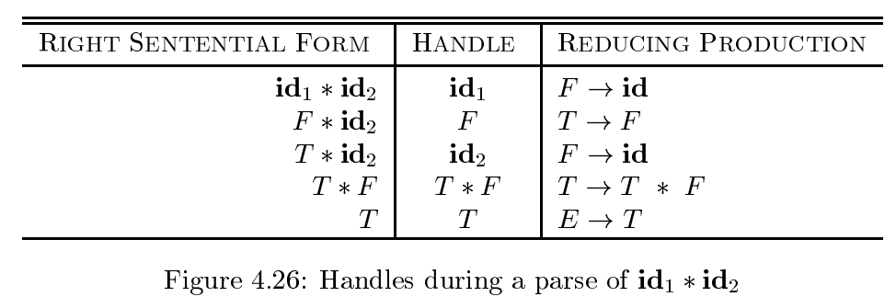
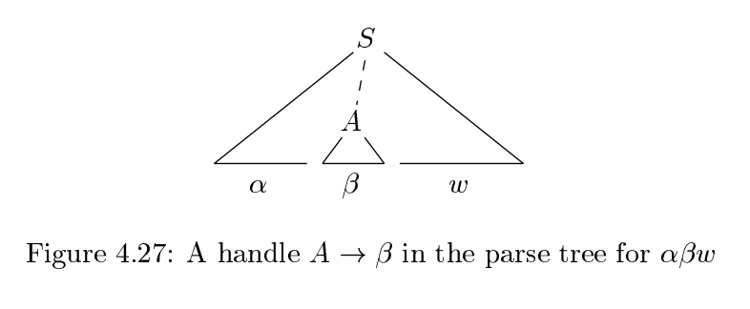
Figure 4.26 Handles example

Slide 23
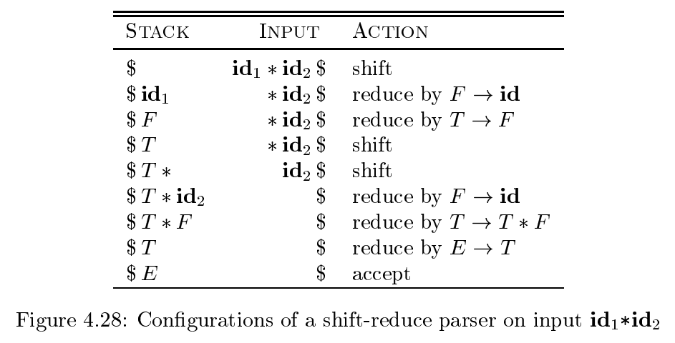

Slide 24
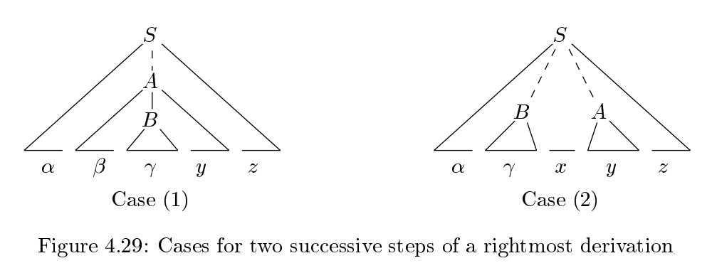

Slide 25
Shift-reduce Parsing
Shift reduce parsers are easily built and easily understood
A shift-reduce parser has just four actions
Shift — next word is shifted onto the stack
Reduce — right end of handle is at top of stack
  Locate left end of handle within the stack
  Pop handle off stack & push appropriate lhs
Accept — stop parsing & report success
Error — call an error reporting/recovery routine
Accept & Error are simple
Shift is just a push and a call to the scanner
Reduce takes |rhs| pops & 1 push
If handle-finding requires state, put it in the stack ⇒ 2x work

Slide 26
An Important Lesson about Handles
To be a handle, a substring of a sentential form γ must have two properties:
  It must match the right hand side β of some rule A → β
  There must be some rightmost derivation from the goal symbol that produces the sentential form γ with A → β as the last production applied
Simply looking for right hand sides that match strings is not good enough
Critical Question: How can we know when we have found a handle without generating lots of different derivations?
  Answer: we use look ahead in the grammar along with tables produced as the result of analyzing the grammar.
  LR(1) parsers build a DFA that runs over the stack & finds them

Slide 28
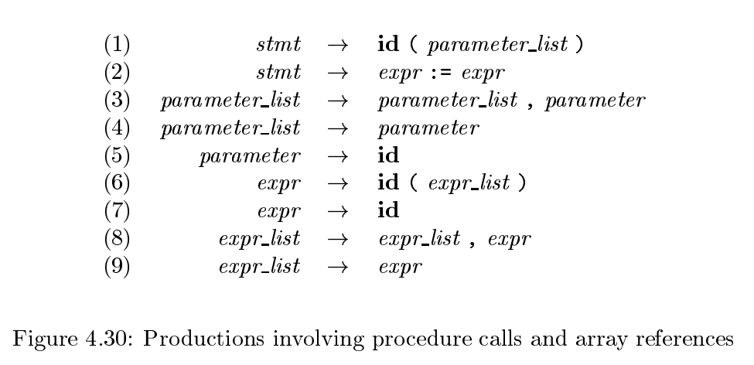

Slide 29
Introduction to LR Parsing
LL parsing
LL(k) parsing
Top-down, recursive descent, LL(1)
LR parsing
LR(k) parsing
Bottom-up, Shift reduce parsing

Slide 30
The LR-parsing method is the most general nonbacktracking shift-reduce parsing method known, yet it can be implemented as effciently as other, more primitive shift-reduce methods
An LR parser can detect a syntactic error as soon as it is possible to do so on a left-to-right scan of the input.
The class of grammars that can be parsed using LR methods is a proper superset of the class of grammars that can be parsed with predictive or LL methods.
For a grammar to be LR(k ), we must be able to recognize the occurrence of the right side of a production in a right-sentential form, with k input symbols of lookahead.

Slide 31
LR(0) items
An item is a production with a dot somewhere on the RHS
Example: A → XYZ gives rise to items:
A → . XYZ
A → X.YZ
A → XY.Z
A → XYZ.
Also, A → ε gives rise to the item A → .

Slide 32
Meaning of A → X . YZ
Just seen in the input a string derivable from X, and
Hope to see something derivable from YZ

Slide 33
Closure of Item Sets
Closure of Item Sets
If I is a set of items for a grammar G , then CLOSURE(I ) is the set of items constructed from I by the two rules:
Initially, add every item in I to CLOSURE( I ).
If A → α .B β is in CLOSURE(I ) and B → γ is a production, then add the item B →. γ to CLOSURE( I ), if it is not already there.
Apply this rule until no more new items can be added to CLOSURE( I ).

Slide 34
Computing sets of items
Augment the grammar with new production S’ → S.
Then I₀ = closure (S’ → .S)
Consider the F grammar for expressions
E→ E + T | T
T → T * F | F
F → id | ( E )

Slide 35
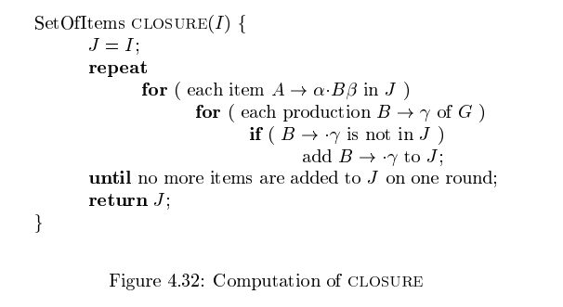

Slide 36
GoTo’s: GoTo (I_{0,} X)
GoTo (I, X) = closure ({ A → α X . β} such that ({ A → α . X β}

Slide 37
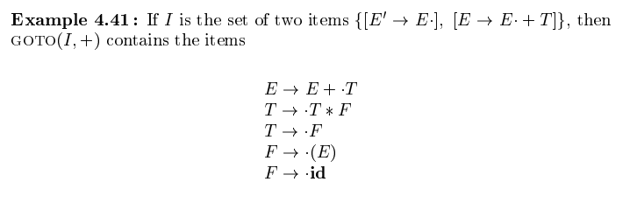

Slide 38
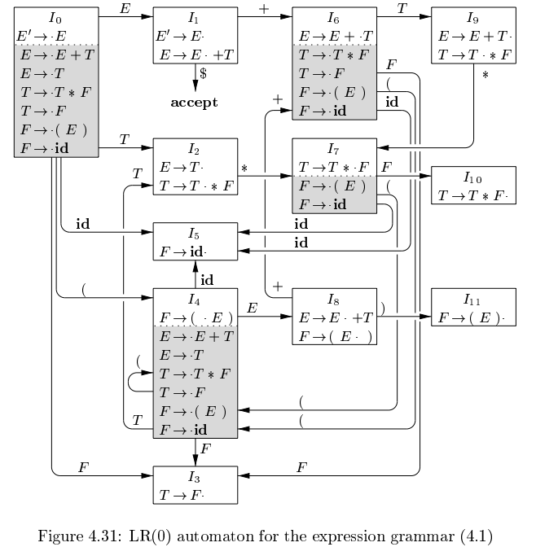

Slide 39
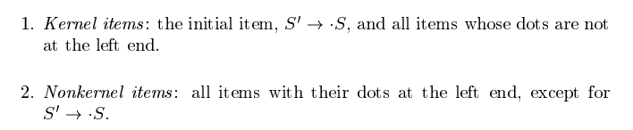
Kernel items

Slide 40
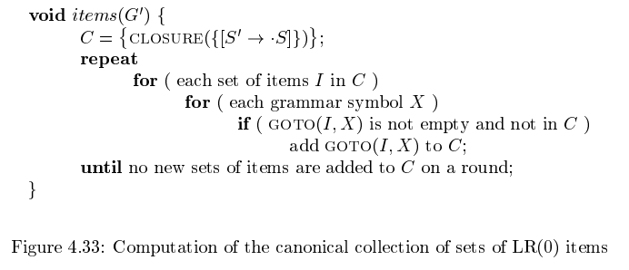
Figure 4.33

Slide 41
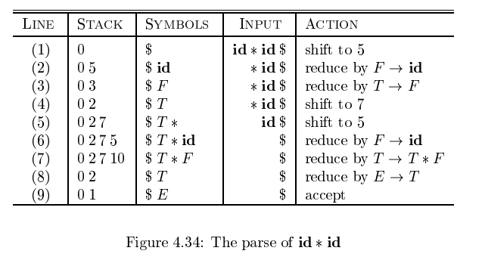

Slide 42
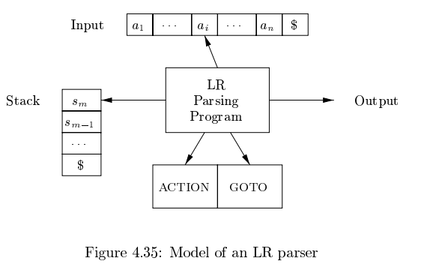
Figure 4.35 LR parser

Slide 43
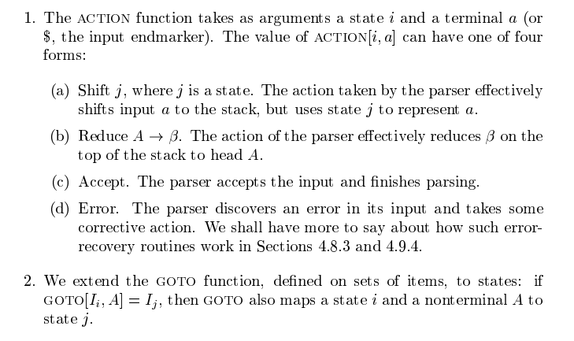
Action and GOTO sections of the table

