Slide 1
Lecture 4 (new improved)
Subset construction
NFA ➔ DFA
CSCE 531 Compiler Construction
Topics
  FLEX
  Subset Construction
    Equivalence relations, partitions …
Readings:
January 30, 2018

Slide 2
Overview
Last Time
  Thompson Construction: Regular Expression ➔ NFA
Today’s Lecture
  Rubular – regular expressions online
  Subset Construction: NFA ➔ DFA
  Minimization of DFA well: distinguished states
  Lex/Flex
References
  Chapter 2
  http://www.gnu.org/software/flex/manual/html_mono/flex.html
  C introduction Examples

Slide 3
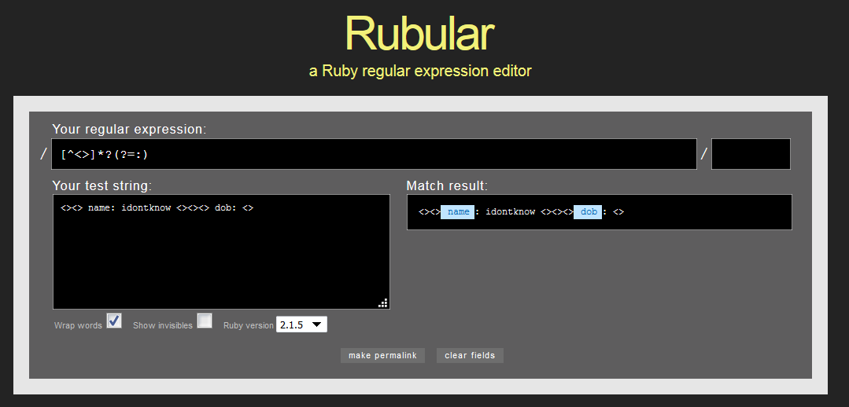
Rubular.com

Slide 4
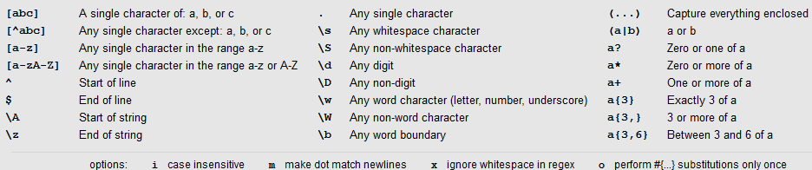
RegEx Quick Reference
http://rubular.com/r/11Z1trB1JI

Slide 5
Python Regular Expressions
  https://docs.python.org/3.4/library/re.html
Pythex: a Python regular expression editor
  https://pythex.org/
POSIX:
  https://www.regular-expressions.info/posix.html

Slide 6
Python Regular Expressions
import re
import time
filename="../../513/513F16.txt"
f = open(filename, "r")
regexp=re.compile(r'Degree:\s*([A-Z].*)|[1-9][0-9]?.*([A-Z][a-zA-Z-]*)') #,\s*([A-Z][a-z]*)')
degreeRE=re.compile(r'Degree:\s*([A-Za-z].*)')
nameRE=re.compile(r'[1-9][0-9]?\s*([A-Z][a-zA-Z-]*\,\s*[A-Za-z-]+)')
https://docs.python.org/3.4/library/re.html

Slide 7
Python Example Continued
name="unassigned"
for line in f:
m=regexp.match(line)
if m != None:
m2 = nameRE.match(line)
if m2 != None:
name=m2.group(1)
m3 = degreeRE.match(line)
if m3 != None:
print (name, "\t", m3.group(1))
f.close()

Slide 8
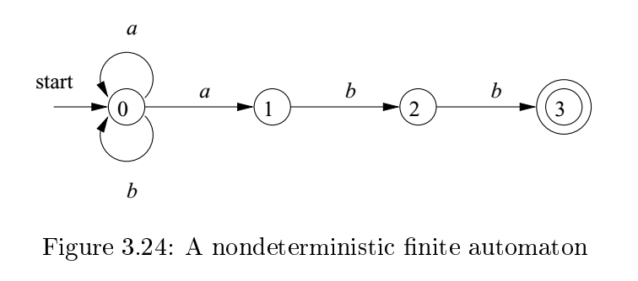
Example 3.14 (a | b)*abb

Slide 9
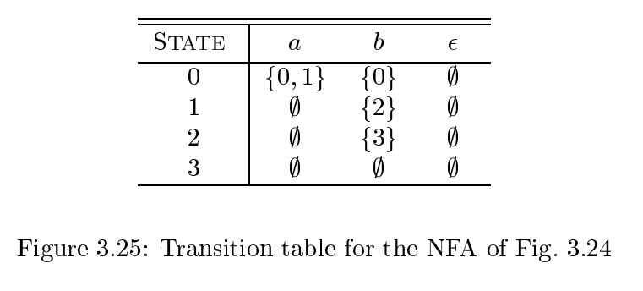
Transition Table

Slide 10
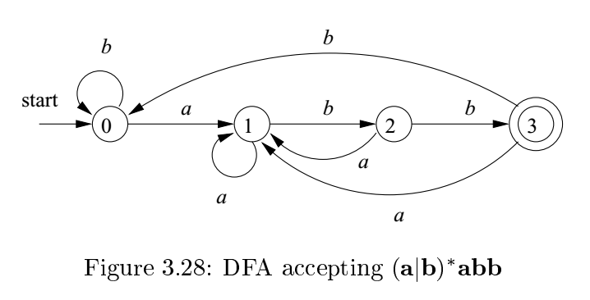
Deterministic Finite Automata (DFA)
A deterministic finite automata (DFA) is an NFA such that:
There are no moves on input ε, and
For each state s and input symbol a , there is exactly one edge out of s labeled a .

Slide 11
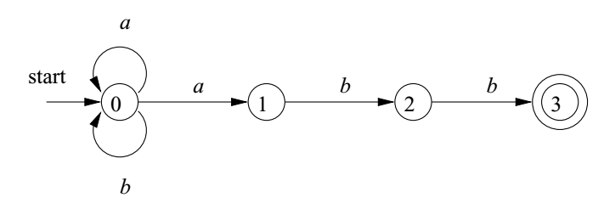
NFA transitions versus DFA
Not every state an input has a transition
  δ(s, a) might be empty
  δ(1, a) = ϕ
For a given state and input there can be more than one transition
  δ(0, a) = { 0, 1}
Epsilon transitions allowed in NFAs
  None in this diagram

Slide 12
Every DFA is an NFA
A DFA is just an NFA that satisfies:
No epsilon moves; formally δ(s, ε) = ϕ
For each state s and input symbol a, δ(s, a) is a single state; formally | δ(s, a) | = 1
So, every language accepted by an DFA is also accepted by an NFA.
Earlier we showed every language denoted by a regular expression has an NFA that accepts it.
Today we show every language recognized by an NFA has a DFA that recognizes it also.

Slide 13
So why use an NFA and why use a DFA?
NFA more expressive power
DFA more efficient recognizer

Slide 14
Algorithm 3.18 : Simulating a DFA.
INPUT: An input string x terminated by an end-of-file character eof. A DFA D with start state s₀ , accepting states F , and transition function move.
OUTPUT: Answer “yes” if D accepts x ; “no” otherwise.
METHOD: Apply the algorithm in Fig. 3.27 to the input string x . The function move( s; c) gives the state to which there is an edge from state s on input c . The function nextChar returns the next character of the input string x .

Slide 15
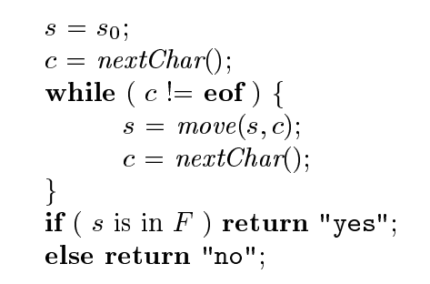
Simulating DFA = recognizing L(DFA)

Slide 16
Algorithm 3.20 : The subset construction
Algorithm 3.20 : The subset construction of a DFA from an NFA.
INPUT: An NFA N .
OUTPUT: A DFA D accepting the same language as N .
METHOD:
  Our algorithm constructs a transition table Dtran for D .
  Each state of D is a set of NFA states, and we construct Dtran so D will simulate “in parallel” all possible moves N can make on a given input string.

Slide 17
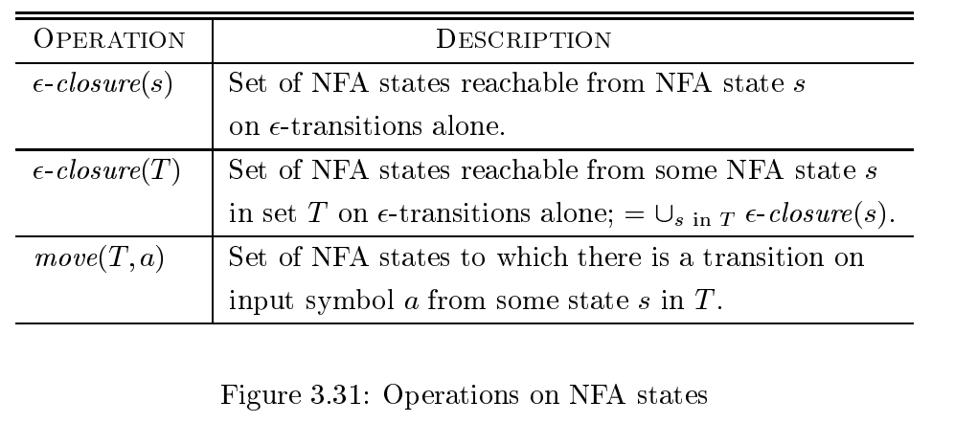
Fig 3.31 Operations on NFA states

Slide 18
Fig. 3.32 the Subset Contruction
initially, - closure ( s 0 ) is the only state in Dstates, and it is unmarked;
while ( there is an unmarked state T in Dstates ) {
mark T ;
for ( each input symbol a ) {
U = - closure (move( T;a) );
if ( U is not in Dstates )
add U as an unmarked state to Dstates; Dtran[T;a] = U ;
}
}
Aho, Alfred V.; Monica S. Lam; Jeffrey D. Ullman; Ravi Sethi. Compilers: Principles, Techniques, and Tools (Page 154). Pearson Education. Kindle Edition.

Slide 19
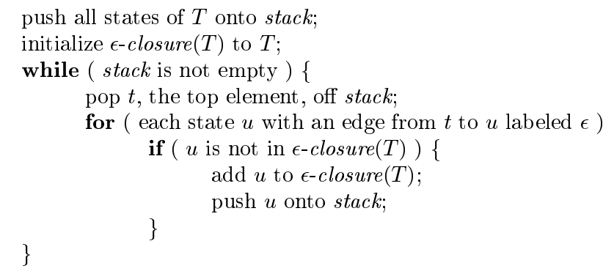
Fig 3.33 Computing ε-closure of a set

Slide 20
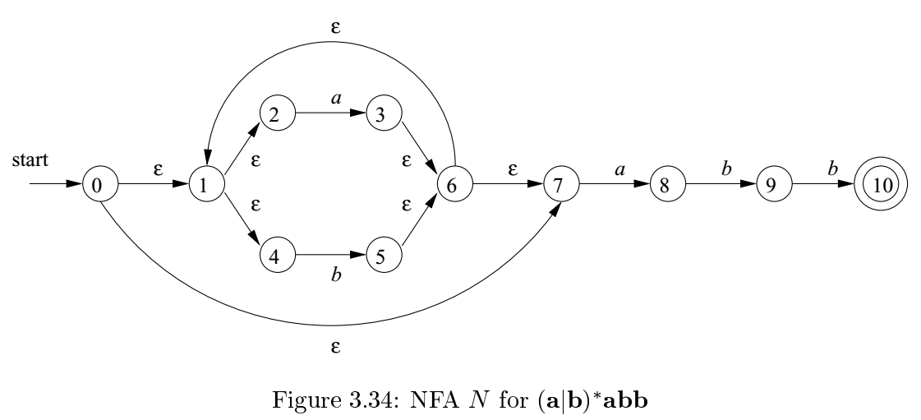
NFA ➔ DFA via Subset Construction
d₀ = ε-closure(0) = {0, 1, 2, 4, 7}

Slide 21
State of DFA | a | b
d₀ = ε-closure(0) = {0, 1, 2, 4, 7} | d₁ = ε-closure(move(d₀, a)) =ε-closure( 3, 8} ={3, 8, 6, 7, 1, 2, 4} | d₂ = ε-closure(move(d₀, b)) =ε-closure( 5 } ={5, 6, 1, 7, 2, 4}
d₁={3, 8, 6, 7, 1, 2, 4} | ε-closure(move(d₁, a)) =ε-closure( 3, 8} ={3, 8, 6, 7, 1, 2, 4}
d₂={5, 6, 1, 2, 4}

Slide 22
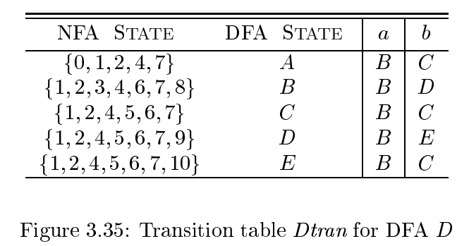

Slide 23
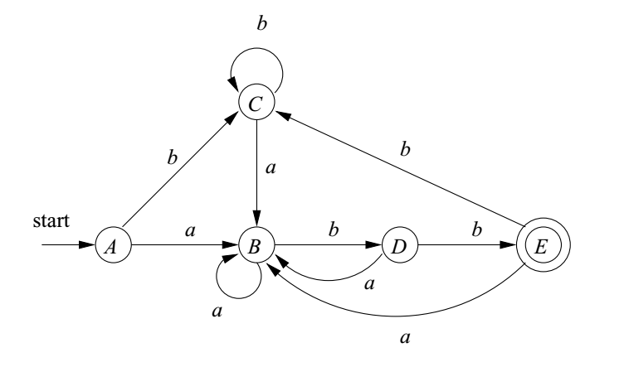

Slide 24
Algorithm 3.22 : Simulating an NFA
INPUT: An input string x terminated by an end-of- le character eof. An NFA N with start state s₀ , accepting states F , and transition function move.
OUTPUT: Answer “yes” if N accepts x ; “no” otherwise.
METHOD:
The algorithm keeps a set of current states S, those that are reached from s₀ following a path labeled by the inputs read so far.
If c is the next input character, read by the function nextChar(), then we first compute move( S; c) and then close that set using ε - closure ().

Slide 25
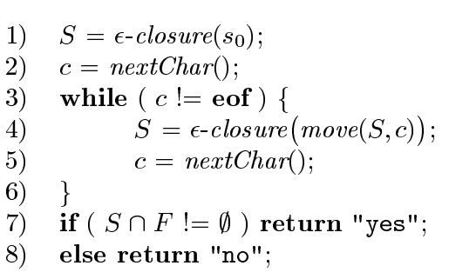
Simulating an NFA

Slide 26
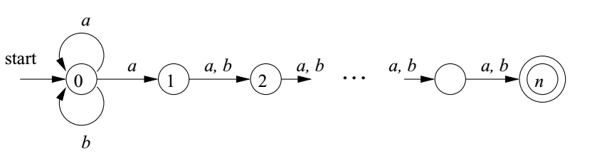

Slide 27
DFA Minimization Algorithm (Author’s Slide)
Discover sets of equivalent states
Represent each such set with just one state
Two states are equivalent (indistinguishable)if and only if:
The set of paths leading to them are equivalent
∀ α ∈ Σ, transitions on α lead to equivalent states (DFA)
α-transitions to distinct sets ⇒ states must be in distinct sets
A partition P of S
Each s ∈ S is in exactly one set p_{i} ∈ P
The algorithm iteratively partitions the DFA’s states

Slide 28
Details of the algorithm (Author’s Slide)
Details of the algorithm
Group states into maximal size sets, optimistically
Iteratively subdivide those sets, as needed
States that remain grouped together are equivalent
Initial partition, P₀ , has two sets: {F} & {Q-F} (D =(Q,Σ,δ,q₀,F))
Splitting a set (“partitioning a set by a”)
Assume q_{a}, & q_{b} ∈ s, and δ(q_{a},a) = q_{x}, & δ(q_{b},a) = q_{y}
If q_{x} & q_{y} are not in the same set, then s must be split
  q_{a} has transition on a, q_{b} does not ⇒ a splits s
One state in the final DFA cannot have two transitions on a

Slide 29
Minimization Algorithm
P ← { F, {Q-F}}
while ( P is still changing)
T ← { }
for each set S ∈ P
for each a ∈ Σ
partition S by a
into S1, and S2
Add S1 and S2 to T
if T ≠ P then
P ← T
The partitioning step is:
If δ(S) contains states in 2 equivalent sets of states.
S

Slide 30
Building Faster Scanners from the DFA
(Author’s slide)
Table-driven recognizers waste a lot of effort
Read (& classify) the next character
Find the next state
Assign to the state variable
Trip through case logic in action()
Branch back to the top
We can do better
Encode state & actions in the code
Do transition tests locally
Generate ugly, spaghetti-like code
Takes (many) fewer operations per input character

Slide 31
Symbol Tables
#define ENDSTR 0
#define MAXSTR 100
#include <stdio.h>
struct nlist { /* basic table entry */
char *name;
struct nlist *next; /*next entry in chain */
int val;
};
#define HASHSIZE 100
static struct nlist *hashtab[HASHSIZE]; /* pointer table */

Slide 32
The Hash Function
/* PURPOSE: Hash determines hash value based on the sum of the
character values in the string.
USAGE: n = hash(s);
DESCRIPTION OF PARAMETERS: s(array of char) string to be hashed
AUTHOR: Kernighan and Ritchie
LAST REVISION: 12/11/83
*/
hash(char *s) /* form hash value for string s */
{
int hashval;
for (hashval = 0; *s != '\0'; )
hashval += *s++;
return (hashval % HASHSIZE);
}

Slide 33
The lookup Function
/*PURPOSE: Lookup searches for entry in symbol table and returns a pointer
USAGE: np= lookup(s);
DESCRIPTION OF PARAMETERS: s(array of char) string searched for
AUTHOR: Kernighan and Ritchie
LAST REVISION: 12/11/83*/
struct nlist *lookup(char *s) /* look for s in hashtab */
{
struct nlist *np;
for (np = hashtab[hash(s)]; np != NULL; np = np->next)
if (strcmp(s, np->name) == 0)
return(np); /* found it */
return(NULL); /* not found */
}

Slide 34
The install Function
PURPOSE: Install checks hash table using lookup and if entry not found,
it "installs" the entry.
USAGE: np = install(name);
DESCRIPTION OF PARAMETERS: name(array of char) name to install in
symbol table
AUTHOR: Kernighan and Ritchie, modified by Ron Sobczak
LAST REVISION: 12/11/83
*/

Slide 35
struct nlist *install(char *name) /* put (name) in hashtab */
{
struct nlist *np, *lookup();
char *strdup(), *malloc();
int hashval;
if ((np = lookup(name)) == NULL) { /* not found */
np = (struct nlist *) malloc(sizeof(*np));
if (np == NULL)
return(NULL);
if ((np->name = strdup(name)) == NULL)
return(NULL);
hashval = hash(np->name);
np->next = hashtab[hashval];
hashtab[hashval] = np;
}
return(np);
}

