Slide 1
Lecture 16
Boolean Expressions and Control Flow
CSCE 531 Compiler Construction
Topics
  Numeric Implementation of Booleans
  Positional Encoding of Booleans
  Short Circuit Evaluation
  Debugging
Readings: 5.7, 6.3, 7.4
March 27, 2018

Slide 2
Overview
Last Time
  Attribute Grammars
  Type Systems
  ILOC
  Symbol Table
Last Time Didn’t Finish
  Pascal like declarations
  Hierarchical Symbol Tables
Today’s Lecture
  Numeric Implementation of Booleans
  Positional Encoding of Booleans
  Short Circuit Evaluation
  Debugging YACC generated parsers
References: Sections 7.4
Homework:

Slide 3
Pascal like declarations
What if the language gets it wrong?
Pascal
x,y,z : integer;
Grammar?

Slide 4
Syntax-Directed Definitions (SDD)
A syntax-directed definition (SDD) is a context-free grammar together with attributes and rules.
Attributes are associated with grammar symbols and rules are associated with productions.
If X is a symbol and a is one of its attributes, then we write X:a to denote the value of a at a particular parse-tree node labeled X .

Slide 5
Synthesized an Inherited attributes
W e shall deal with two kinds of attributes for nonterminals:
A synthesized attribute for a nonterminal A at a parse-tree node N is defined b y a semantic rule associated with the production at N . Note that the production must have A as its head. A synthesized attribute at node N is defined only in terms of attribute values at the children of N and at N itself.
An inherited attribute for a nonterminal B at a parse-tree node N is defined by a semantic rule associated with the production at the parent of N . Note that the production must have B as a symbol in its body. An inherited attribute at node N is defined only in terms of attribute values at N 's parent, N itself, and N 's siblings.

Slide 6
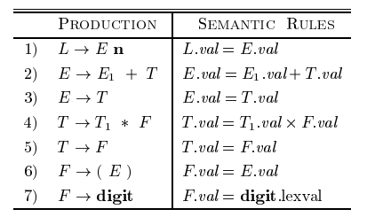
Synthesized Attributes Example 5.1
n = end marker, why not ‘;’ or … I don’t know

Slide 7
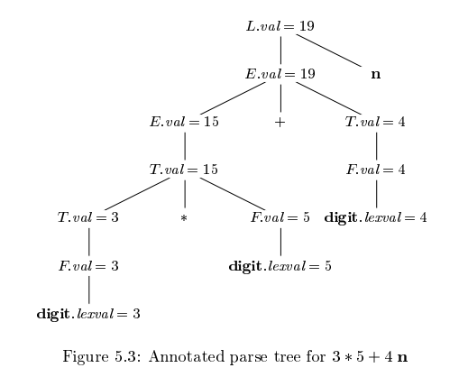
Figure 5.3

Slide 8
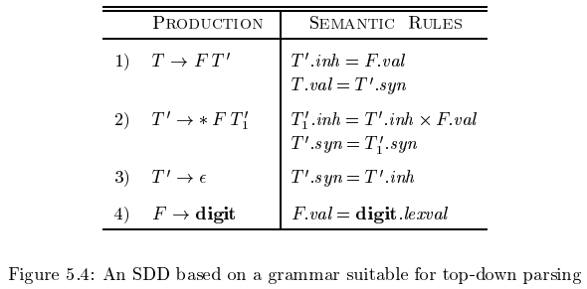
Example 5.3, Figure 5.4
val – a synthesized attribute of T, F; the value
inh – an inherited attribute
T’ → * F T₁’ -- inherits the left operand of *

Slide 9
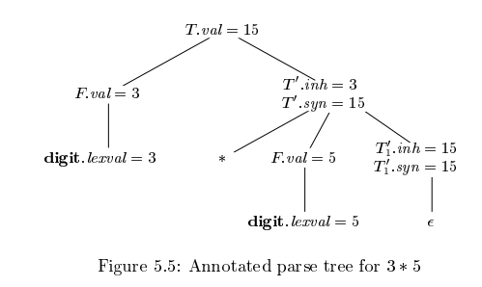
Fig 5.5 Inherited Attribute
T’→ * F T’

Slide 10
Hierarchical Symbol Tables
From last time figure 5.12 page 246

Slide 11
Test 2

Slide 12
History of Compilers
The first compiler was written by Corrado Böhm, in 1951, for his PhD thesis.
The term compiler was coined by Grace Hopper.^{[1][2]}, referring to her A-0 system which functioned as a loader or linker, not the modern notion of a compiler.
The FORTRAN team led by John W. Backus at IBM introduced the first commercially available compiler, in 1957, which took 18 person-years to create.^{[3]}
The first ALGOL 58 compiler was completed by the end of 1958 by Friedrich L. Bauer, Hermann Bottenbruch, Heinz Rutishauser, and Klaus Samelsonfor the Z22 computer.

