Slide 1
Lecture 11
LR Parse Table Construction
CSCE 531 Compiler Construction
Topics
  Review of Shift-Reduce Parsing
  LR parsing; handles
  Sample Test Overview
Readings:
June 23, 2004

Slide 2
Building the Canonical Collection
Start from s₀ = closure( [S’→S,EOF ] )
Repeatedly construct new states, until all are found
The algorithm
s₀ ← closure ( [S’→S,EOF] )
S ← { s₀ }
k ← 1
while ( S is still changing )
∀ s_{j} ∈ S and ∀ x ∈ ( T ∪ NT )
s_{k} ← goto(s_{j},x)
record s_{j} → s_{k} on x
if s_{k} ∉ S then
S ← S ∪ s_{k}
k ← k + 1
Fixed-point computation
Loop adds to S
S ⊆ 2^{ITEMS}, so S is finite
Worklist version is faster

Slide 3
Example (grammar & sets)
Goal → Expr
Expr → Term – Expr
Expr → Term
Term → Factor * Term
Term → Factor
Factor → ident
Simplified, right recursive expression grammar

Slide 4
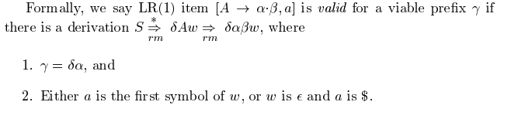
Valid LR(1) items

Slide 5
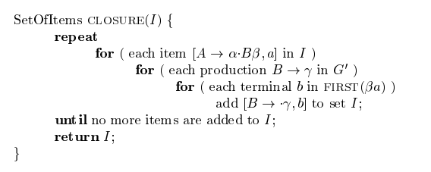
Figure 4.40 -- LR(1) closure(I)

Slide 6
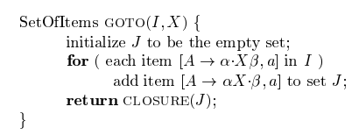
LR(1) -- GOTO(I, X)

Slide 7
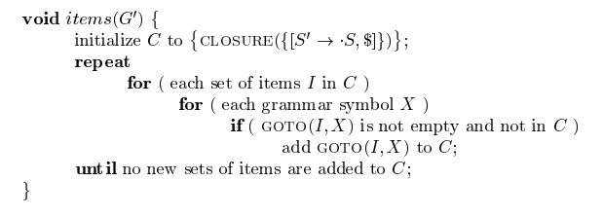
Algorithm 4.53 -- LR(1) Sets of Items
Input Augmented Grammar G’

Slide 8
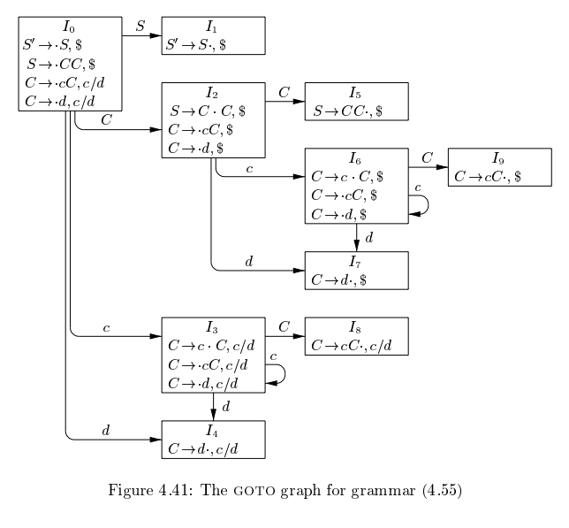
Fig 4.41

Slide 9
Example (building the collection)
Engineering: A Compiler 2nd Edition by Cooper & Torczon
Initialization Step
s₀ ← closure( { [Goal → •Expr , EOF] } )
  { [Goal → • Expr , EOF], [Expr → • Term – Expr , EOF], [Expr → • Term , EOF],
  [Term → • Factor * Term , EOF], [Term → • Factor * Term , –],
  [Term → • Factor , EOF], [Term → • Factor , –],
  [Factor → • ident , EOF], [Factor → • ident , –], [Factor → • ident , *] }
S ← {s₀ }

Slide 10
Example (building the collection)
Engineering: A Compiler 2nd Edition by Cooper & Torczon
Iteration 1
  s₁ ← goto(s₀ , Expr)
  s₂ ← goto(s₀ , Term)
  s₃ ← goto(s₀ , Factor)
  s₄ ← goto(s₀ , ident )
Iteration 2
  s₅ ← goto(s₂ , – )
  s₆ ← goto(s₃ , * )
Iteration 3
  s₇ ← goto(s₅ , Expr )
  s₈ ← goto(s₆ , Term )

Slide 11
Example: LR(1) Sets of Items
S₀ : { [Goal → • Expr , EOF], [Expr → • Term – Expr , EOF], [Expr → • Term , EOF],
  [Term → • Factor * Term , EOF], [Term → • Factor * Term , –],
  [Term → • Factor , EOF], [Term → • Factor , –],
  [Factor → • ident , EOF], [Factor → • ident , –], [Factor→ • ident, *] }
S₁ : { [Goal → Expr •, EOF] }
S₂ : { [Expr → Term • – Expr , EOF], [Expr → Term •, EOF] }
S₃ : { [Term → Factor • * Term , EOF],[Term → Factor • * Term , –], [Term → Factor •, EOF],
[Term → Factor •, –] }
S₄ : { [Factor → ident •, EOF],[Factor → ident •, –], [Factor → ident •, *] }
S₅ : { [Expr → Term – • Expr , EOF], [Expr → • Term – Expr , EOF], [Expr → • Term , EOF],
  [Term → • Factor * Term , –], [Term → • Factor , –],
  [Term → • Factor * Term , EOF], [Term → • Factor , EOF],
  [Factor → • ident , *], [Factor → • ident , –], [Factor → • ident , EOF] }
Engineering: A Compiler 2nd Edition by Cooper & Torczon

Slide 12
S₆ : { [Term → Factor * • Term , EOF], [Term → Factor * • Term , –],
[Term → • Factor * Term , EOF], [Term → • Factor * Term , –],
[Term → • Factor , EOF], [Term → • Factor , –],
[Factor → • ident , EOF], [Factor → • ident , –], [Factor → • ident , *] }
S₇: { [Expr → Term – Expr •, EOF] }
S₈ : { [Term → Factor * Term •, EOF], [Term → Factor * Term •, –] }
Engineering: A Compiler 2nd Edition by Cooper & Torczon

Slide 13
Example
The Goto Relationship (from the construction)
Engineering: A Compiler 2nd Edition by Cooper & Torczon

Slide 14
ACTION and GOTO Tables
∀ set s_{x} ∈ S
∀ item i ∈ s_{x}
if i is [A→β •aδ,b] and goto(s_{x},a) = s_{k} , a ∈ T
then ACTION[x,a] ← “shift k”
else if i is [S’→S •,EOF]
then ACTION[x ,a] ← “accept”
else if i is [A→β •,a]
then ACTION[x,a] ← “reduce A→β”
∀ n ∈ NT
if goto(s_{x} ,n) = s_{k}
then GOTO[x,n] ← k
x is the state number
Engineering: A Compiler 2nd Edition by Cooper & Torczon

Slide 15
Expr Grammar: Filling in the tables
The algorithm produces the following table
Engineering: A Compiler 2nd Edition by Cooper & Torczon

Slide 16
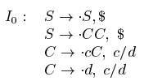









Example 4.54 G➔LR(1) sets of items
Consider the following augmented grammar.
S’→ S
S → C C
C → c C | d
S
d
C
c
d
C
c
C
c
d
C
d

Slide 17
Algorithm 4.56 : Construction of canonical-LR parsing tables.
INPUT: An augmented grammar G’ .
OUTPUT: The canonical-LR parsing table ACTION and GOTO for G’.
Construct C = {I₀, I₁, … I_{i}, … I_{n} }, the sets of LR(1) items
If state i = I_{i} the parsing action for state i is determined as follows
  If [A →a ; b] is in I_{i} and GOTO(I_{i} ; a) = I_{j} , then set ACTION[i; a] = “shift j”
  If [A →α; a] is in I_{i} and A != S’ , then set ACTION[i; a] to “reduce A → α"
  If [S’→S. ; $] is in I_{i} , then set ACTION[i; $] to “accept.”
  If any conflicting actions result from the above rules, we say the grammar is not LR(1). The algorithm fails to produce a parser in this case.
goto transitions for state i are read from the diagram
All other entries are “error.”
The initial state of the parser is closure([S’→.S; $])

Slide 18
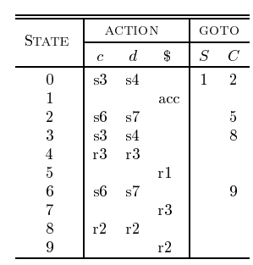
Example 4.54 and Figure 4.42
Sets of Items
LR(1) parse table

Slide 19
Shift / Reduce Conflicts
What if set s contains [A→β•aγ,b] and [B→β•,a] ?
First item generates “shift”,
second generates “reduce”
Both define ACTION[s,a] ➔ cannot do both actions
This is a shift/reduce error or conflict
Example if-then-else, expression grammar
Solution
Modify the grammar to eliminate it
Let Shifting have priority will often resolve it correctly
Yacc defaults to “shift”
Engineering: A Compiler 2nd Edition by Cooper & Torczon

Slide 20
Reduce / Reduce Conflicts
What is set s contains [A→γ•, a] and [B→γ•, a] ?
[A→γ•, a] ➔ reduce by
[B→γ•, a] ➔ reduce by
Each generates “reduce”, but with a different production
Both define ACTION[s,a] — cannot do both reductions
This is called a reduce/reduce conflict
Solutions
Modify the grammar to eliminate it
In either case shift/reduce or reduce/reduce, the grammar is not LR(1)

Slide 21
Shrinking the Tables
Three options:
Combine terminals such as number & identifier, + & -, * & /
  Directly removes a column, may remove a row
  For expression grammar, 198 (vs. 384) table entries
Combine rows or columns
  Implement identical rows once & remap states
  Requires extra indirection on each lookup
  Use separate mapping for ACTION & for GOTO
Use another construction algorithm
  Both LALR(1) and SLR(1) produce smaller tables
  Implementations are readily available

Slide 22
LR(k) versus LL(k)(Top-down Rec. Desc.)
Finding Reductions
LR(k) ⇒ Each reduction in the parse is detectable with
  the complete left context,
  the reducible phrase, itself, and
  the k terminal symbols to its right
LL(k) ⇒ Parser must select the reduction based on
  The complete left context
  The next k terminals
  Thus, LR(k) examines more context
“… in practice, programming languages do not actually seem to fall in the gap between LL(1) languages and deterministic languages” J.J. Horning, “LR Grammars and Analysers”, in Compiler Construction, An Advanced Course, Springer-Verlag, 1976

Slide 23
Summary
Advantages
Fast
Good locality
Simplicity
Good error detection
Fast
Deterministic langs.
Automatable
Left associativity
Disadvantages
Hand-coded
High maintenance
Right associativity
Large working sets
Poor error messages
Large table sizes
Top-down
recursive
descent
LR(1)

