Slide 1
Lec07
Memory Hierarchy II
CSCE 513 Computer Architecture
Topics
  Pipelining Review
    Load-Use Hazard
  Memory Hierarchy Review
    Terminology review
    Basic Equations
    6 Basic Optimizations
  Memory Hierarchy – Chapter 2
Readings: Appendix B, Chapter 2
September 27, 2017

Slide 2
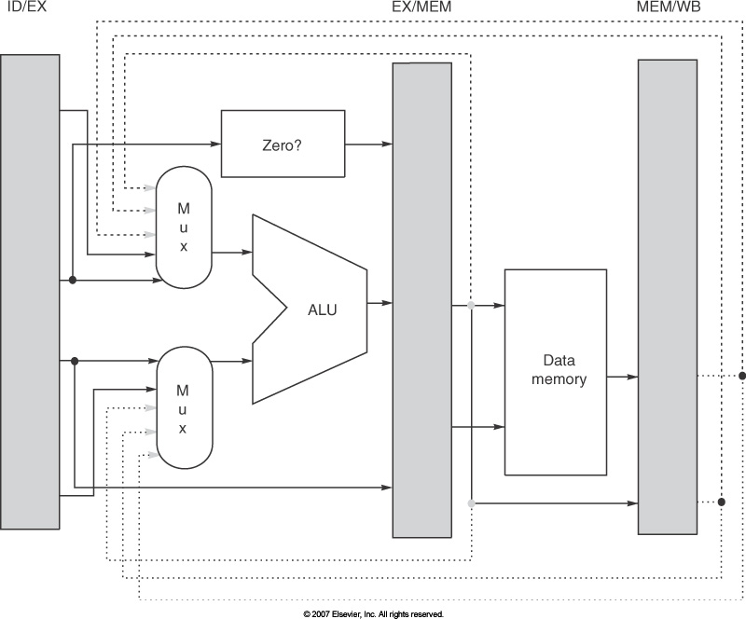
Figure C.23 Forwarding Pop-Quiz
What is the name (register name) of the value to forward as shown in the diagram?
Give an instruction sequence that would cause this type of forwarding.
Is an Immediate instruction in the ID/EX.IR[opcode]?

Slide 3
Overview
Last Time
  Memory Hierarchy
  Block placement
    Fully associative
    Direct Mapped
    Set Associative
  Block replacement
  Write strategies
  Lecture 6 no slides
New
  Cache addressing
  Average Memory Access Time (AMAT)
References: Appendix B

Slide 4

Block address == Block Identifier
Block offset = Byte within the block
Figure B.3 The three portions of an address in a set associative or direct-mapped cache. The tag is used to check all the blocks in the set, and the index is used to select the set. The block offset is the address of the desired data within the block. Fully associative caches have no index field.

Slide 5
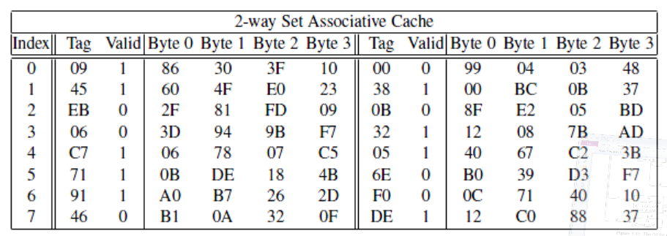
Cache Example
Physical addresses are 13 bits wide.
The cache is 2-way set associative, with a 4 byte line size and 16 total lines.
Physical address: 0E34

Slide 6
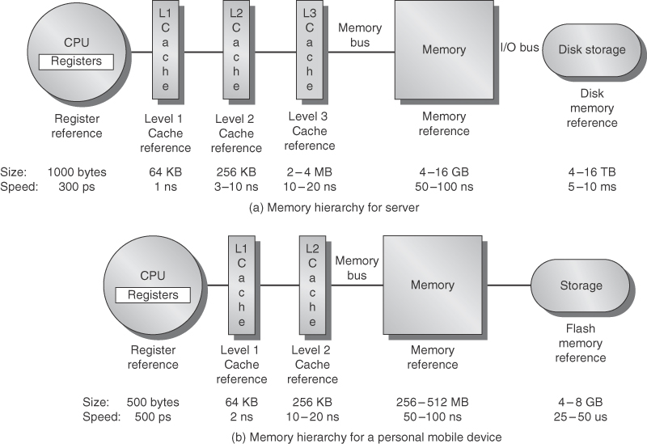
Figure 2.1 typical memory hierarchy

Slide 7
Intel Core i7 Cache Hierarchy (Repeat)
Processor package
Core 0
Core 3
L1 i-cache and d-cache:
  32 KB, 8-way,
  Access: 4 cycles
L2 unified cache:
  256 KB, 8-way,
  Access: 10 cycles
L3 unified cache:
  8 MB, 16-way,
  Access: 40-75 cycles
Block size: 64 bytes for all caches.
Regs
Regs
L1
d-cache
L1
i-cache
L1
d-cache
L1
i-cache
…
L2 unified cache
L2 unified cache
L3 unified cache
(shared by all cores)
Main memory
CSAPP – Computer Systems: a Programmer’s Perspective 3rd ed. Bryant and O’Hallaron

Slide 8
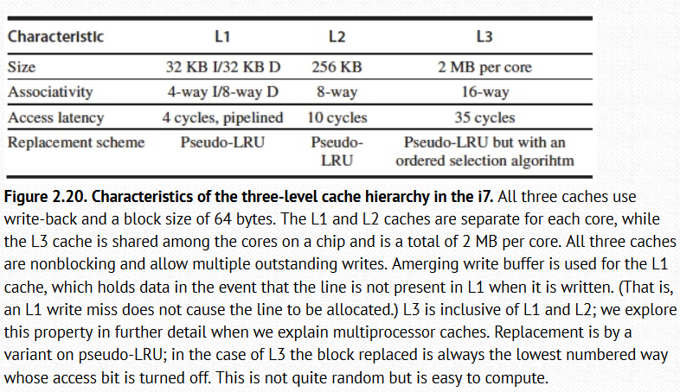
Intel I-7 Memory Hierarchy

Slide 9
Partitioning Address Example
L1-Data
32KB
64B blocks
4-way associative
Lines = Total Cache Size/BlockSize
Sets = Lines/associativity
b = log₂ Blocksize
s = log₂ NumSets
t = address size – s – b
What set and what is the tag for address 0xFFFF3344?

Slide 10
Cache Review – Appendix B Terminology
fully associative
write allocate
virtual memory
dirty bit
unified cache
memory stall cycles
block offset
misses per instruction
direct mapped
write-back
valid bit
locality allocate page
least recently used
write buffer
miss penalty
block address
hit time
address trace
write-through
cache miss
set
instruction cache
page fault
random replacement
average memory access time
miss rate
index field
cache hit
n-way set associative
tag field
write stall

Slide 11
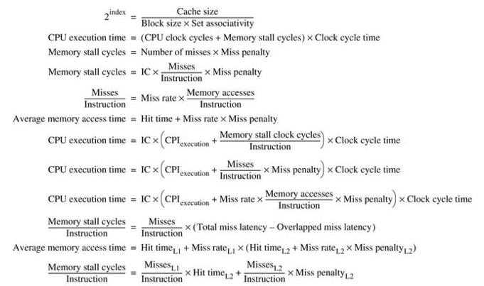
Summary of performance equations
Fig B.7

Slide 12
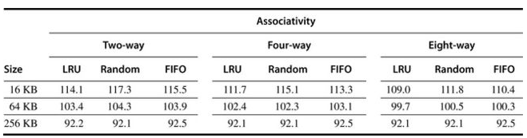
Figure B-4 data cache misses per 1000 instructions
.

Slide 13
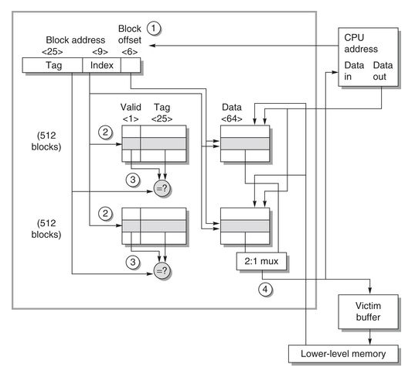
Figure B. 5 Opteron data cache
64KB cache
Two-way assoc.
64 byte blocks
#lines?
#sets?

Slide 14
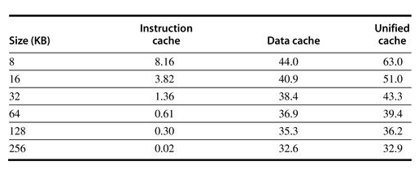
Figure B.6 Misses per 1000 instructions

Slide 15
Average Memory Access Time (AMAT)
AMAT = HitTime + MissRate * MissPenalty
For two level cache
AMAT = HT + MR_{L1}*[HT_{L2} + MR_{L2}* MissPenalty_{L2}]

Slide 16
Example
CPI=1.0 always when we hit cache
Loads/stores 50% of instructions
MissPenalty=200 cycles
MissRate = 2%
What is the AMAT?

Slide 17
Pop Quiz
Given L1-data cache 256KB, direct mapped, 64B blocks, hit_rate=.9, miss_penalty = 10 cycles
What is size of block offset field?
What is the size of the set_index field?
If the Virtual address is 32 bits what is the size of the tag field?
Given the address 0x00FF03b4 what is the
  Block offset field
  Set-index field
  Tag field
AMAT = ? In cycles

Slide 18
Virtual memory review
Cache analogy
Software versus Hardware

Slide 19
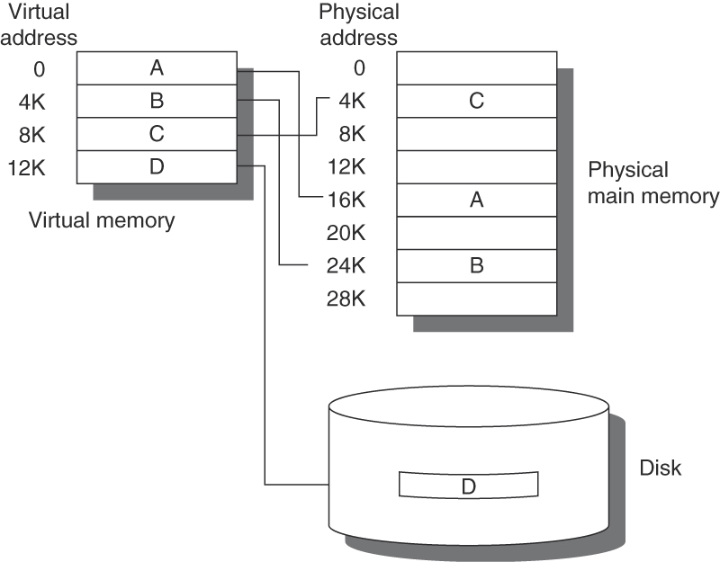
Figure B.19 The logical program in its contiguous virtual address space is shown on the left. It consists of four pages, A, B, C, and D. The actual location of three of the blocks is in physical main memory and the other is located on the disk.

Slide 20
Translation Lookaside Buffers

Slide 21
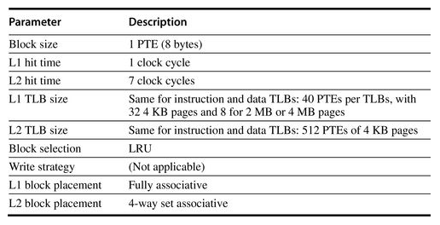
Opteron L1 and L2 Data
Fig B-28

Slide 22
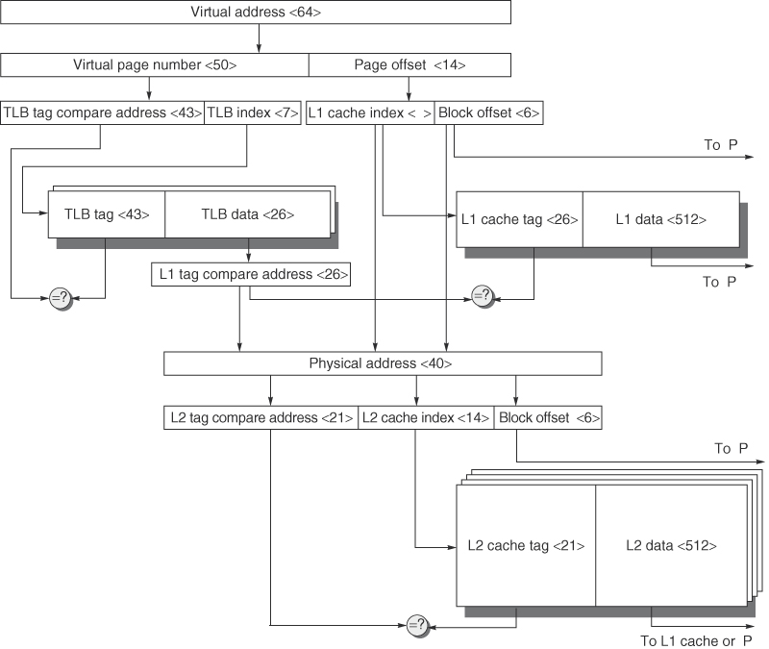
Figure B.17 The overall picture of a hypothetical memory hierarchy going from virtual address to L2 cache access. The page size is 16 KB. The TLB is two-way set associative with 256 entries. The L1 cache is a direct-mapped 16 KB, and the L2 cache is a four-way set associative with a total of 4 MB. Both use 64-byte blocks. The virtual address is 64 bits and the physical address is 40 bits.

Slide 23
B.3 Six Basic Cache Optimizations
Categories
Reducing the miss rate— larger block size, larger cache size, and higher associativity
Reducing the miss penalty— multilevel caches and giving reads priority over writes
Reducing the time to hit in the cache— avoiding address translation when indexing the cache

Slide 24
Optimization 1 – Larger Block Size to Reduce Miss Rate

Slide 25
Optimization 2 - Larger Caches to Reduce Miss Rate

Slide 26
Optimization 3 – Higher Associativity to reduce Miss Rate

Slide 27
Optimization 4 - Multilevel Caches to Reduce Miss Penalty

Slide 28
Optimization 5 – Giving Priority to Read Misses over Write misses to reduce Miss Penalty

Slide 29
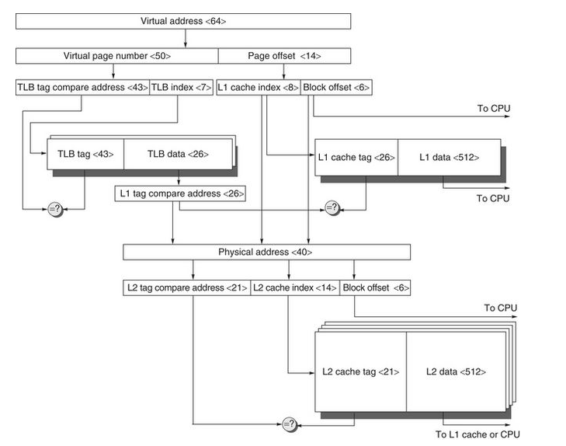
Optimization 6 - Avoiding Address Translation during indexing of the Cache to reduce Hit time
Fig B.17

Slide 30
CAAQA 5th revisted
http://booksite.mkp.com/9780123838728/
Reference Appendices.
Appendix D: Storage Systems
Appendix E: Embedded Systems by Thomas M. Conte
Appendix F: Interconnection Networks updated by Timothy M. Pinkston and José Duato
Appendix G: Vector Processors by Krste Asanovic
Appendix H: Hardware and Software for VLIW and EPIC
Appendix I: Large-Scale Multiprocessors and Scientific Applications
Appendix J: Computer Arithmetic by David Goldberg
Appendix K: Survey of Instruction Set Architectures
Historical Perspectives with References. Appendix L
Lecture Slides. Lecture slides in PowerPoint (PPT) format are provided. These slides, developed by Jason Bakos of the University of South Carolina, …
http://booksite.mkp.com/9780123838728/

Slide 31
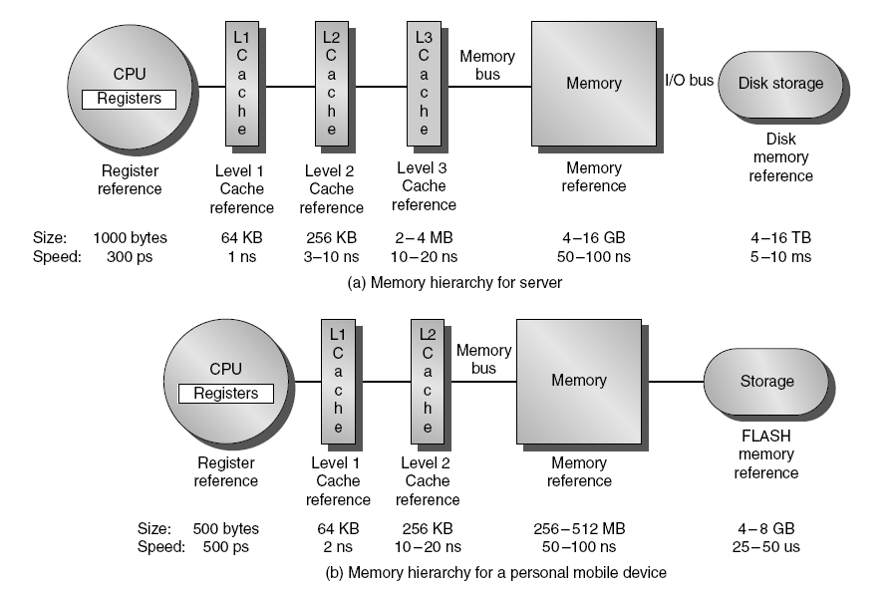
Memory Hierarchy
Introduction

Slide 32
Memory Hierarchy Basics
Introduction
When a word is not found in the cache, a miss occurs:
  Fetch word from lower level in hierarchy, requiring a higher latency reference
  Lower level may be another cache or the main memory
  Also fetch the other words contained within the block
    Takes advantage of spatial locality
  Place block into cache in any location within its set, determined by address
    block address MOD number of sets

Slide 33
Memory Hierarchy Basics
Introduction
n blocks per set => n-way set associative
  one block per set ➔Direct-mapped cache
  Fully associative => one set
Writing to cache: two strategies
  Write-through
    Immediately update lower levels of hierarchy
  Write-back
    Only update lower levels of hierarchy when an updated block is replaced
  Both strategies use write buffer to make writes asynchronous

Slide 34
Memory Hierarchy Basics
Introduction
Miss rate
  Fraction of cache access that result in a miss
Causes of misses
  Compulsory
    First reference to a block
  Capacity
    Blocks discarded and later retrieved
  Conflict
    Program makes repeated references to multiple addresses from different blocks that map to the same location in the cache

Slide 35
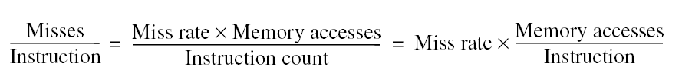
Memory Hierarchy Basics
Introduction
Note that speculative and multithreaded processors may execute other instructions during a miss
  Reduces performance impact of misses

Slide 36
Memory Hierarchy Basics (Appendix B)
Introduction
Six basic cache optimizations:
  Larger block size
    Reduces compulsory misses
    Increases capacity and conflict misses, increases miss penalty
  Larger total cache capacity to reduce miss rate
    Increases hit time, increases power consumption
  Higher associativity
    Reduces conflict misses
    Increases hit time, increases power consumption
  Higher number of cache levels
    Reduces overall memory access time
  Giving priority to read misses over writes
    Reduces miss penalty
  Avoiding address translation in cache indexing
    Reduces hit time

Slide 37
2.2 - 10 Advanced Cache Optimizations
Five Categories
Reducing Hit Time-Small and simple first-level caches and way-prediction. Both techniques also generally decrease power consumption.
Increasing cache bandwidth— Pipelined caches, multibanked caches, and nonblocking caches. These techniques have varying impacts on power consumption.
Reducing the miss penalty— Critical word first and merging write buffers. These optimizations have little impact on power.
Reducing the miss rate— Compiler optimizations
Reducing the miss penalty or miss rate via parallelism— Hardware prefetching and compiler prefetching.

Slide 38
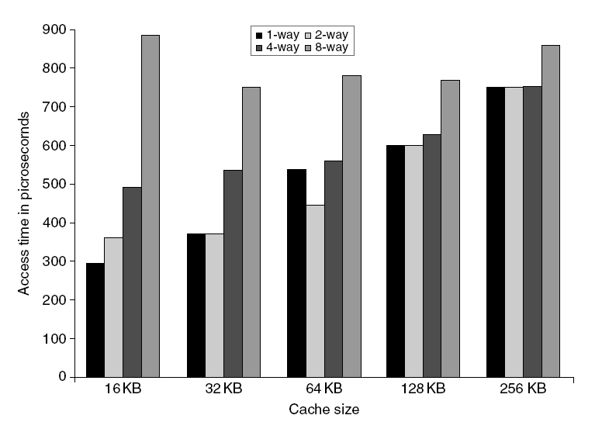
L1 Size and Associativity
Advanced Optimizations
Access time vs. size and associativity

Slide 39
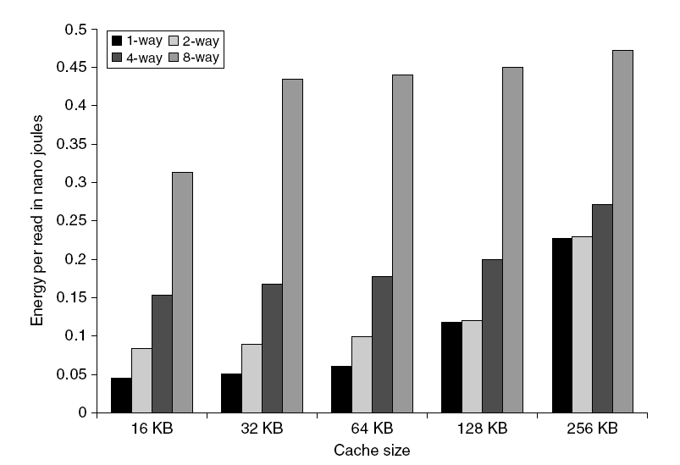
L1 Size and Associativity
Advanced Optimizations
Energy per read vs. size and associativity

Slide 40
Way Prediction
To improve hit time, predict the way to pre-set mux
  Mis-prediction gives longer hit time
  Prediction accuracy
    > 90% for two-way
    > 80% for four-way
    I-cache has better accuracy than D-cache
  First used on MIPS R10000 in mid-90s
  Used on ARM Cortex-A8
Extend to predict block as well
  “Way selection”
  Increases mis-prediction penalty
Advanced Optimizations

Slide 41
Pipelining Cache
Pipeline cache access to improve bandwidth
  Examples:
    Pentium: 1 cycle
    Pentium Pro – Pentium III: 2 cycles
    Pentium 4 – Core i7: 4 cycles
Increases branch mis-prediction penalty
Makes it easier to increase associativity
Advanced Optimizations

Slide 42
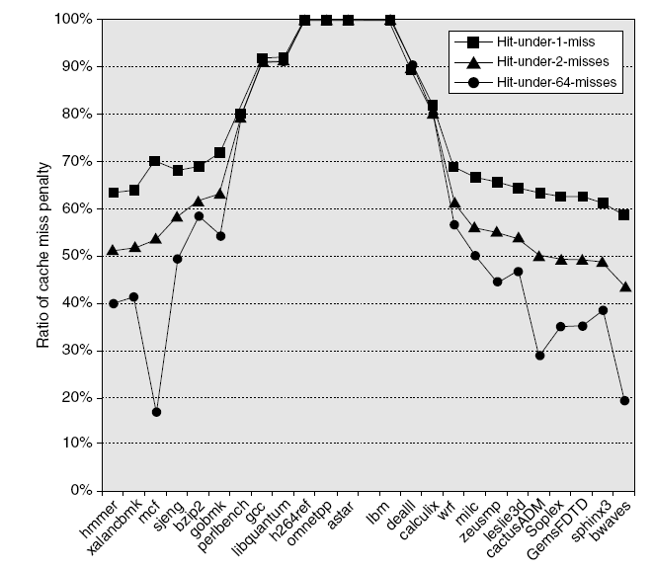
Nonblocking Caches
Allow hits before previous misses complete
  “Hit under miss”
  “Hit under multiple miss”
L2 must support this
In general, processors can hide L1 miss penalty but not L2 miss penalty
Advanced Optimizations

Slide 43
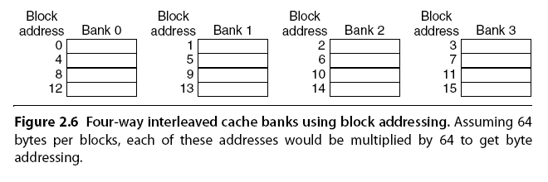
Multibanked Caches
Organize cache as independent banks to support simultaneous access
  ARM Cortex-A8 supports 1-4 banks for L2
  Intel i7 supports 4 banks for L1 and 8 banks for L2
Interleave banks according to block address
Advanced Optimizations

Slide 44
Critical Word First, Early Restart
Critical word first
  Request missed word from memory first
  Send it to the processor as soon as it arrives
Early restart
  Request words in normal order
  Send missed work to the processor as soon as it arrives
Effectiveness of these strategies depends on block size and likelihood of another access to the portion of the block that has not yet been fetched
Advanced Optimizations

Slide 45
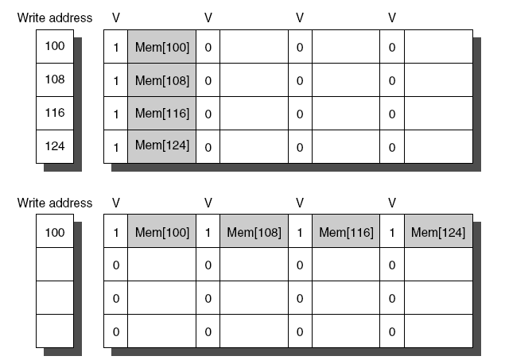
Merging Write Buffer
When storing to a block that is already pending in the write buffer, update write buffer
Reduces stalls due to full write buffer
Do not apply to I/O addresses
Advanced Optimizations
No write buffering
Write buffering

Slide 46
Compiler Optimizations
Loop Interchange
  Swap nested loops to access memory in sequential order
Blocking
  Instead of accessing entire rows or columns, subdivide matrices into blocks
  Requires more memory accesses but improves locality of accesses
Advanced Optimizations

Slide 47
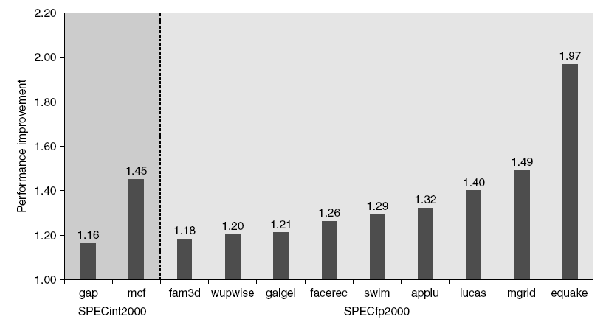
Hardware Prefetching
Fetch two blocks on miss (include next sequential block)
Advanced Optimizations
Pentium 4 Pre-fetching

Slide 48
Compiler Prefetching
Insert prefetch instructions before data is needed
Non-faulting: prefetch doesn’t cause exceptions
Register prefetch
  Loads data into register
Cache prefetch
  Loads data into cache
Combine with loop unrolling and software pipelining
Advanced Optimizations

Slide 49
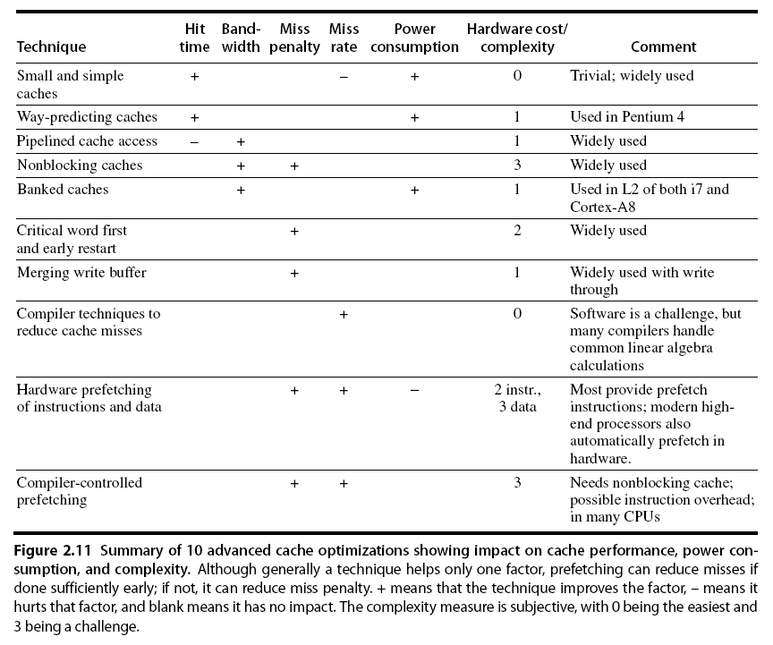
Summary
Advanced Optimizations

Slide 50
Memory Technology
Memory Technology
Performance metrics
  Latency is concern of cache
  Bandwidth is concern of multiprocessors and I/O
  Access time
    Time between read request and when desired word arrives
  Cycle time
    Minimum time between unrelated requests to memory
DRAM used for main memory, SRAM used for cache

Slide 51
Memory Technology
Memory Technology
SRAM
  Requires low power to retain bit
  Requires 6 transistors/bit
DRAM
  Must be re-written after being read
  Must also be periodically refeshed
    Every ~ 8 ms
    Each row can be refreshed simultaneously
  One transistor/bit
  Address lines are multiplexed:
    Upper half of address: row access strobe (RAS)
    Lower half of address: column access strobe (CAS)

Slide 52
Memory Technology
Memory Technology
Amdahl:
  Memory capacity should grow linearly with processor speed
  Unfortunately, memory capacity and speed has not kept pace with processors
Some optimizations:
  Multiple accesses to same row
  Synchronous DRAM
    Added clock to DRAM interface
    Burst mode with critical word first
  Wider interfaces
  Double data rate (DDR)
  Multiple banks on each DRAM device

Slide 53
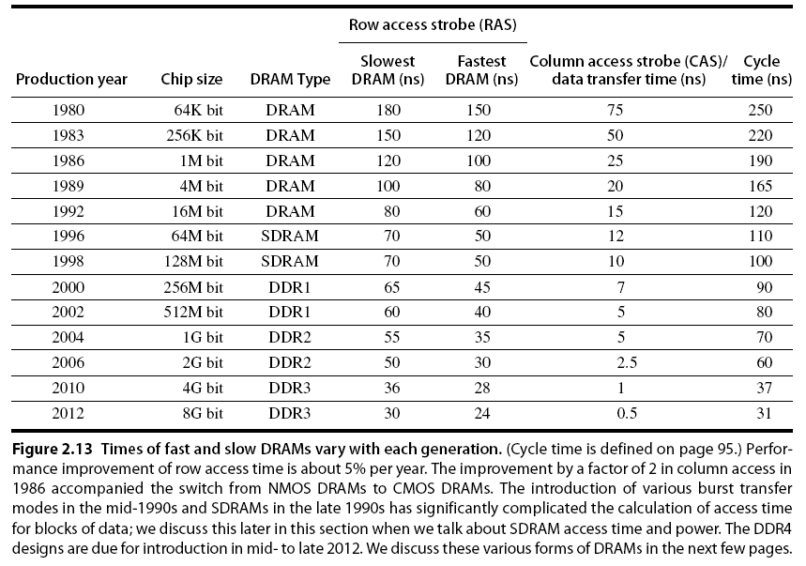
Memory Optimizations
Memory Technology

Slide 54
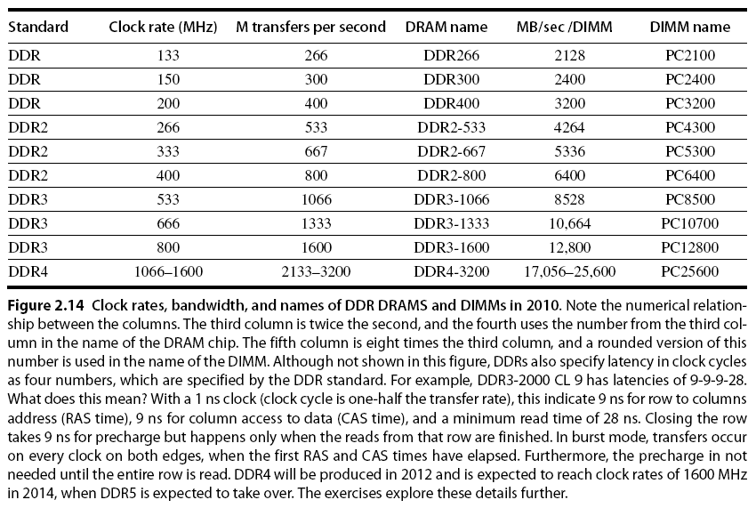
Memory Optimizations
Memory Technology

Slide 55
Memory Optimizations
Memory Technology
DDR:
  DDR2
    Lower power (2.5 V -> 1.8 V)
    Higher clock rates (266 MHz, 333 MHz, 400 MHz)
  DDR3
    1.5 V
    800 MHz
  DDR4
    1-1.2 V
    1600 MHz
GDDR5 is graphics memory based on DDR3

Slide 56
DDR4 SDRAM
DDR4 SDRAM, an abbreviation for double data rate fourth generation synchronous dynamic random-access memory, is a type of synchronous dynamic random-access memory (SDRAM) with a high bandwidth ("double data rate") interface. It was released to the market in 2014
Benefits include
  higher module density and lower voltage requirements,
  coupled with higher data rate transfer speeds.
  DDR4 operates at a voltage of 1.2V with frequency between 1600 and 3200 MHz, compared to frequency between 800 and 2133 MHz and voltage requirement of 1.5 or 1.65V of DDR3.
  DDR4 modules can also be manufactured at twice the density of DDR3.
http://en.wikipedia.org/wiki/DDR4_SDRAM

Slide 57
Memory Optimizations
Memory Technology
Graphics memory:
  Achieve 2-5 X bandwidth per DRAM vs. DDR3
    Wider interfaces (32 vs. 16 bit)
    Higher clock rate
      Possible because they are attached via soldering instead of socketted DIMM modules
Reducing power in SDRAMs:
  Lower voltage
  Low power mode (ignores clock, continues to refresh)

Slide 58
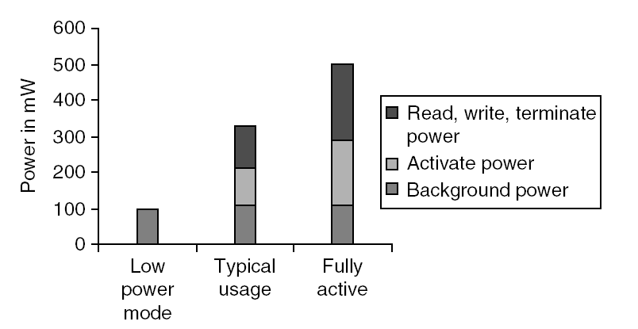
Memory Power Consumption
Memory Technology

Slide 59
Flash Memory
Memory Technology
Type of EEPROM
Must be erased (in blocks) before being overwritten
Non volatile
Limited number of write cycles
Cheaper than SDRAM, more expensive than disk
Slower than SRAM, faster than disk

Slide 60
Understand ReadyBoost and whether it will Speed Up your System
Windows 7 supports Windows ReadyBoost.
  This feature uses external USB flash drives as a hard disk cache to improve disk read performance.
  Supported external storage types include USB thumb drives, SD cards, and CF cards.
  Since ReadyBoost will not provide a performance gain when the primary disk is an SSD, Windows 7 disables ReadyBoost when reading from an SSD drive.
External storage must meet the following requirements:
  Capacity of at least 256 MB, with at least 64 kilobytes (KB) of free space. The 4-GB limit of Windows Vista has been removed.
  At least a 2.5 MB/sec throughput for 4-KB random reads
  At least a 1.75 MB/sec throughput for 1-MB random writes
http://technet.microsoft.com/en-us/magazine/ff356869.aspx

Slide 61
Memory Dependability
Memory Technology
Memory is susceptible to cosmic rays
Soft errors: dynamic errors
  Detected and fixed by error correcting codes (ECC)
Hard errors: permanent errors
  Use sparse rows to replace defective rows
Chipkill: a RAID-like error recovery technique

Slide 62
Solid State Drives
http://en.wikipedia.org/wiki/Solid-state_drive
http://www.tomshardware.com/charts/hard-drives-and-ssds,3.html
  Hard Drives 34 dimensions: eg Desktop performance
  SSD -

Slide 63
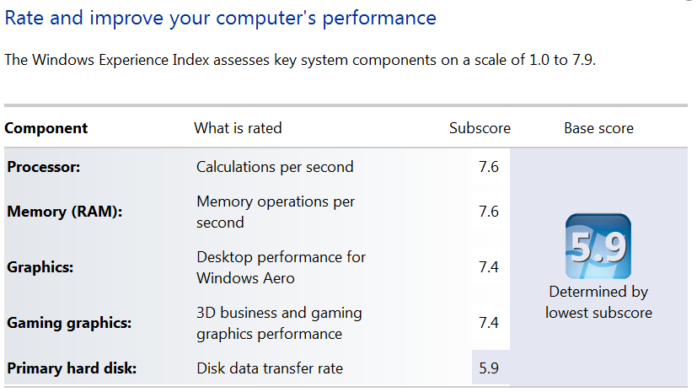
Windows Experience Index
Control Panel\All Control Panel Items\Performance Information and Tools
Control Panel\All Control Panel Items\Performance Information and Tools

Slide 64
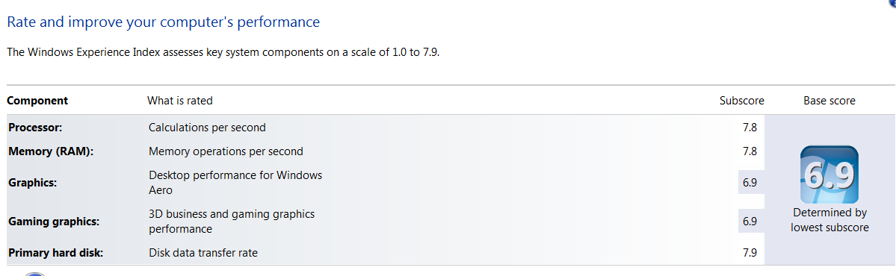
Windows Experience Index with Solid State Disk Drive

