Slide 1
Lecture 6
Memory Hierarchy
CSCE 513 Computer Architecture
Topics
  Cache overview
Readings: Appendix B
September 20, 2017

Slide 2
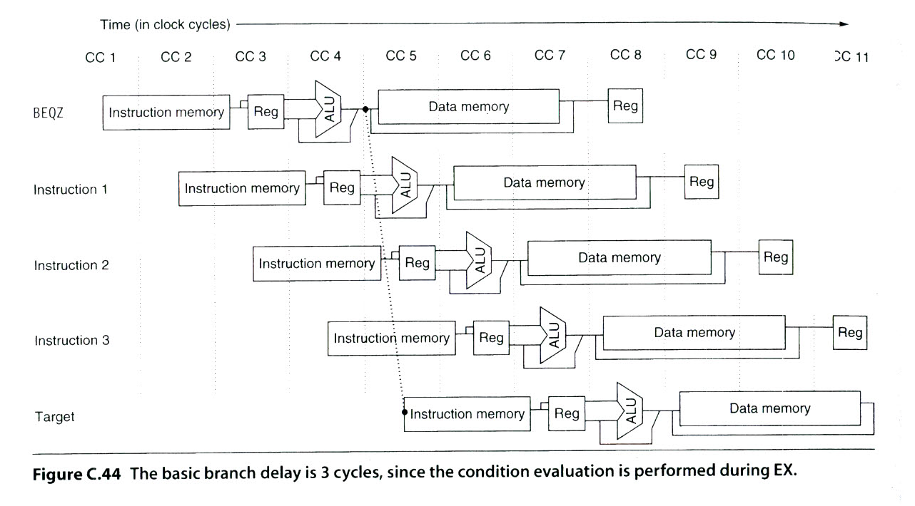
Figure C.44 - 5 stage ➔ 8 stage

Slide 3
Von Neumann Architecture
“Changing the program of a fixed-program machine requires re-wiring, re-structuring, or re-designing the machine. The earliest computers were not so much "programmed" as they were "designed". "Reprogramming", when it was possible at all, was a laborious process, starting with flowcharts and paper notes, followed by detailed engineering designs, and then the often-arduous process of physically re-wiring and re-building the machine. It could take three weeks to set up a program on ENIAC and get it working.^{[3]}
The idea of the stored-program computer changed all that:”
Princeton (Eniac) vs Harvard (Edvac)
http://en.wikipedia.org/wiki/Von_Neumann_architecture

Slide 4
Designing an Instruction Set
Balancing conflicting goals
To have as many registers as possible
To have many address modes
To have a short average instruction length
To have short programs
To have instruction length to support pipelining

Slide 5
The Memory Hierarchy Chapter B
Memory Types
Static RAM
Dynamic RAM
Disk
What we want is a very large very fast memory.
But of course the best generally costs more.
Others not of concern here: Flash RAM, ROM, PROM, FPGA
References: Chapter 2 of text

Slide 6
Quote on Memory for ENIAC
Ideally one would desire an infinitely large memory capacity such that any particular … word would be immediately available …
We are … forced to recognize the possibility of constructing a hierarchy of memories, each of which has greater capacity than the preceding but which is less quickly accessible.
A. W. Burks, H. H. Goldstine and John von Neumann (1946 - Preliminary discussion of the logical design of an electronic computing
  http://www.cs.unc.edu/~adyilie/comp265/vonNeumann.html instrument)

Slide 7
Accessing Memory
CPU chip
register file
ALU
system bus
memory bus
main
memory
bus interface
I/O
bridge
I/O bus
Expansion slots for
other devices such
as network adapters.
USB
controller
graphics
adapter
disk
controller
mouse
keyboard
monitor
disk
Comp.Systems:APP2e. Randal E. Bryant and David R. O'Hallaron

Slide 8
Since 1980, CPU has outpaced DRAM ...
Q. How do architects address this gap?
A. Put smaller, faster “cache” memories between CPU and DRAM.
Create a “memory hierarchy”.
Performance
(1/latency)
CPU
60% per yr
2X in 1.5 yrs
1000
CPU
100
Gap grew 50% per year
10
DRAM
9% per yr
2X in 10 yrs
DRAM
1980
1990
2000
Year
UCB cs252-S07, Lecture 4

Slide 9

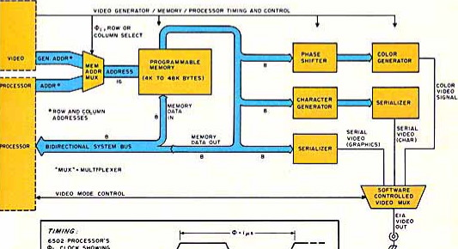
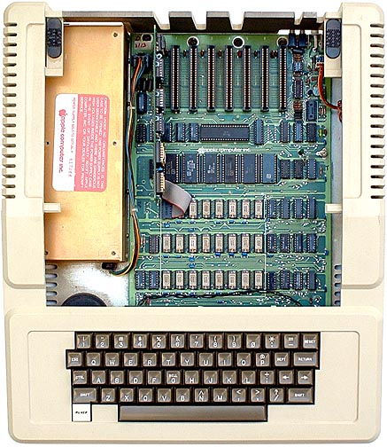


1977: DRAM faster than microprocessors
Apple ][ (1977)
CPU: 1000 ns
DRAM: 400 ns
Steve
Wozniak
Steve Jobs
UCB cs252-S07, Lecture 4

Slide 10
Disk Access Time
Average time to access some target sector approximated by :
  Taccess = Tavg seek + Tavg rotation + Tavg transfer
Seek time (Tavg seek)
  Time to position heads over cylinder containing target sector.
  Typical Tavg seek is 3—9 ms
Rotational latency (Tavg rotation)
  Time waiting for first bit of target sector to pass under r/w head.
  Tavg rotation = 1/2 x 1/RPMs x 60 sec/1 min
  Typical Tavg rotation = 7200 RPMs
Transfer time (Tavg transfer)
  Time to read the bits in the target sector.
  Tavg transfer = 1/RPM x 1/(avg # sectors/track) x 60 secs/1 min.
CSAPP – Computer Systems: a Programmer’s Perspective 3rd ed. Bryant and O’Hallaron

Slide 11
Disk Access Time Example
Given:
  Rotational rate = 7,200 RPM
  Average seek time = 9 ms.
  Avg # sectors/track = 400.
Derived:
  Tavg rotation = 1/2 x (60 secs/7200 RPM) x 1000 ms/sec = 4 ms.
  Tavg transfer = 60/7200 RPM x 1/400 secs/track x 1000 ms/sec = 0.02 ms
  Taccess = 9 ms + 4 ms + 0.02 ms
Important points:
  Access time dominated by seek time and rotational latency.
  First bit in a sector is the most expensive, the rest are free.
  SRAM access time is about 4 ns/doubleword, DRAM about 60 ns
    Disk is about 40,000 times slower than SRAM,
    2,500 times slower then DRAM.
CSAPP – Computer Systems: a Programmer’s Perspective 3rd ed. Bryant and O’Hallaron

Slide 12
Solid State Disks (SSDs)
I/O bus
Requests to read and
write logical disk blocks
Solid State Disk (SSD)
Flash
translation layer
Flash memory
Block 0
Block B-1
…
…
…
Page 0
Page 1
Page P-1
Page 0
Page 1
Page P-1
Pages: 512KB to 4KB, Blocks: 32 to 128 pages
Data read/written in units of pages.
Page can be written only after its block has been erased
A block wears out after about 100,000 repeated writes.
CSAPP – Computer Systems: a Programmer’s Perspective 3rd ed. Bryant and O’Hallaron

Slide 13
SSD Performance Characteristics
Sequential read tput 550 MB/s Sequential write tput 470 MB/s
Random read tput 365 MB/s Random write tput 303 MB/s
Avg seq read time 50 us Avg seq write time 60 us
Sequential access faster than random access
  Common theme in the memory hierarchy
Random writes are somewhat slower
  Erasing a block takes a long time (~1 ms)
  Modifying a block page requires all other pages to be copied to new block
  In earlier SSDs, the read/write gap was much larger.
Source: Intel SSD 730 product specification.

Slide 14
SSD Tradeoffs vs Rotating Disks
Advantages
  No moving parts → faster, less power, more rugged
Disadvantages
  Have the potential to wear out
    Mitigated by “wear leveling logic” in flash translation layer
    E.g. Intel SSD 730 guarantees 128 petabyte (128 x 10¹⁵ bytes) of writes before they wear out
  In 2015, about 30 times more expensive per byte
Applications
  MP3 players, smart phones, laptops
  Beginning to appear in desktops and servers
CSAPP – Computer Systems: a Programmer’s Perspective 3rd ed. Bryant and O’Hallaron

Slide 15
The CPU-Memory Gap
The gap widens between DRAM, disk, and CPU speeds.
Disk
SSD
DRAM
CPU
CSAPP – Computer Systems: a Programmer’s Perspective 3rd ed. Bryant and O’Hallaron

Slide 16
Locality to the Rescue!
The key to bridging this CPU-Memory gap is a fundamental property of computer programs known as locality
CSAPP – Computer Systems: a Programmer’s Perspective 3rd ed. Bryant and O’Hallaron

Slide 17
Locality
Principle of Locality: Programs tend to use data and instructions with addresses near or equal to those they have used recently
Temporal locality:
  Recently referenced items are likely
  to be referenced again in the near future
Spatial locality:
  Items with nearby addresses tend
  to be referenced close together in time
CSAPP – Computer Systems: a Programmer’s Perspective 3rd ed. Bryant and O’Hallaron

Slide 18
Memory Hierarchies
Some fundamental and enduring properties of hardware and software:
  Fast storage technologies cost more per byte, have less capacity, and require more power (heat!).
  The gap between CPU and main memory speed is widening.
  Well-written programs tend to exhibit good locality.
These fundamental properties complement each other beautifully.
They suggest an approach for organizing memory and storage systems known as a memory hierarchy.
CSAPP – Computer Systems: a Programmer’s Perspective 3rd ed. Bryant and O’Hallaron

Slide 19
Memory Hierarchy
L0:
CPU registers hold words retrieved from the L1 cache.
Regs
Smaller,
faster,
and
costlier
(per byte)
storage
devices
L1 cache holds cache lines retrieved from the L2 cache.
L1:
L1 cache
(SRAM)
L2:
L2 cache
(SRAM)
L2 cache holds cache lines
retrieved from L3 cache
L3:
L3 cache
(SRAM)
L3 cache holds cache lines
retrieved from main memory.
Larger,
slower,
and
cheaper
(per byte)
storage
devices
L4:
Main memory
(DRAM)
Main memory holds disk blocks retrieved from local disks.
L5:
Local secondary storage
(local disks)
Local disks hold files retrieved from disks
on remote servers
L6:
Remote secondary storage
(e.g., Web servers)
CSAPP – Computer Systems: a Programmer’s Perspective 3rd ed. Bryant and O’Hallaron

Slide 20
Caches
Cache: A smaller, faster storage device that acts as a staging area for a subset of the data in a larger, slower device.
Fundamental idea of a memory hierarchy:
  For each k, the faster, smaller device at level k serves as a cache for the larger, slower device at level k+1.
Why do memory hierarchies work?
  Because of locality, programs tend to access the data at level k more often than they access the data at level k+1.
  Thus, the storage at level k+1 can be slower, and thus larger and cheaper per bit.
Big Idea: The memory hierarchy creates a large pool of storage that costs as much as the cheap storage near the bottom, but that serves data to programs at the rate of the fast storage near the top.
CSAPP – Computer Systems: a Programmer’s Perspective 3rd ed. Bryant and O’Hallaron

Slide 21
Intel Core i7 Cache Hierarchy
Processor package
Core 0
Core 3
L1 i-cache and d-cache:
  32 KB, 8-way,
  Access: 4 cycles
L2 unified cache:
  256 KB, 8-way,
  Access: 10 cycles
L3 unified cache:
  8 MB, 16-way,
  Access: 40-75 cycles
Block size: 64 bytes for all caches.
Regs
Regs
L1
d-cache
L1
i-cache
L1
d-cache
L1
i-cache
…
L2 unified cache
L2 unified cache
L3 unified cache
(shared by all cores)
Main memory

Slide 22
Memory Hierarchy Questions
Where can a block be placed?
  Block placement
How is a block found?
  Block identification
Which block should be replaced on a miss?
  Block replacement:
What happens on a write?
  Write strategy: write-through or write-back
How do you partition up the cache?
  L1/L2, Data-Instruction-Unified

Slide 23
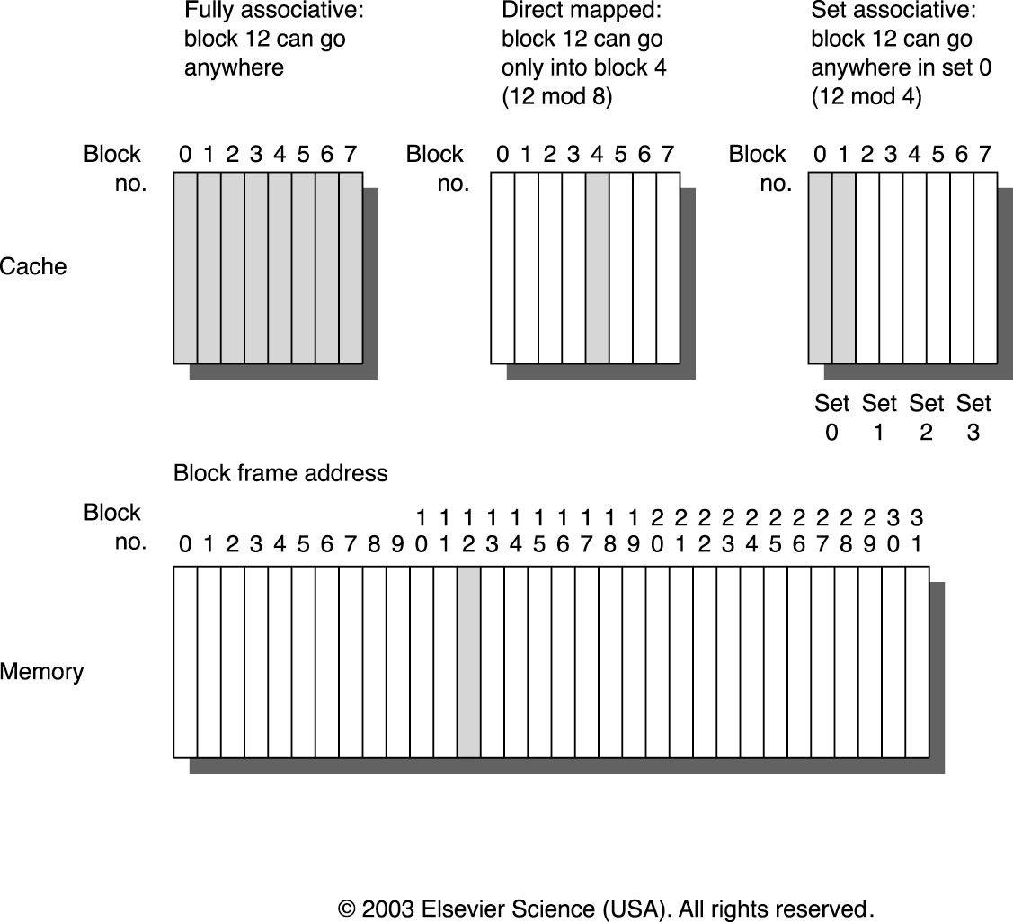
Cache Mapping Concepts
How do we map blocks from the higher level memory to the cache?
Direct Mapped
Fully Associative
Set Assciative
Comp.Systems:APP2e. Randal E. Bryant and David R. O'Hallaron

Slide 24
Addressing Caches
Address A:
t bits
s bits
b bits
m-1
0
v
tag
0
1
• • •
B–1
set 0:
• • •
<tag>
<set index>
<block offset>
v
tag
0
1
• • •
B–1
v
tag
0
1
• • •
B–1
set 1:
• • •
v
tag
0
1
• • •
B–1
The word at address A is in the cache if
the tag bits in one of the <valid> lines in
set <set index> match <tag>.
The word contents begin at offset
<block offset> bytes from the beginning
of the block.
• • •
v
tag
0
1
• • •
B–1
set S-1:
• • •
v
tag
0
1
• • •
B–1
Comp.Systems:APP2e. Randal E. Bryant and David R. O'Hallaron

Slide 25
Cache Performance Metrics
Miss Rate
  Fraction of memory references not found in cache (misses/references)
  Typical numbers:
    3-10% for L1
    can be quite small (e.g., < 1%) for L2, depending on size, etc.
Hit Time
  Time to deliver a line in the cache to the processor (includes time to determine whether the line is in the cache)
  Typical numbers:
    1 clock cycle for L1
    3-8 clock cycles for L2
Miss Penalty
  Additional time required because of a miss
    Typically 25-100 cycles for main memory

Slide 26
CPU Performance Revisited
CPU_{execution time} = CPU clock cycles * Clock Cycle Time
But when we consider the memory hierarchy
CPU_{execution time} = (CPU-clock-cycles + Memory Stall Cycles)* CCTime
Memory-Stall-Cycles = Number-of-misses * Miss-Penalty
= IC * Misses/Instruction * Miss-Penalty
= IC*Memory-Accesses/Instruction* Miss-rate*Miss-Penalty

Slide 27
Example
Assumptions
  No misses ➔ CPI=1.0
  Only data access loads and stores
  50% instructions are memory reference instruct.
  Miss-Penalty = 25 cycles
  Miss-Rate = 2%
How much faster would the computer be if there were no misses?
Perfect all references hit
CPU_{execution time} =
Now for the machine described
CPU_{execution time} =

Slide 28
Four Memory Hierarchy Questions
Where can a block be placed?
  Block placement
How is a block found?
  Block identification
Which block should be replaced on a miss?
  Block replacement:
What happens on a write?
  Write strategy: write-through or write-back

Slide 29
Which block should be replaced on a miss?
Direct-Mapped ➔ no choice to make
For Set associative or fully associative how do we select which block is removed from the cache
Three strategies
Random
  Randomly or pseudo-randomly select the block to swap out
Least Recently Used (LRU)
  Temporal locality ➔ more recently used blocks are more likely to be used again sooner
  LRU – the least recently used block is the one selected to go
First In First Out (FIFO)
  Least Recently Used block difficult to compute easier to keep track of oldest block

Slide 30
What happens on a write?
Write through
Write back
Write allocate
No-write allocate

Slide 31
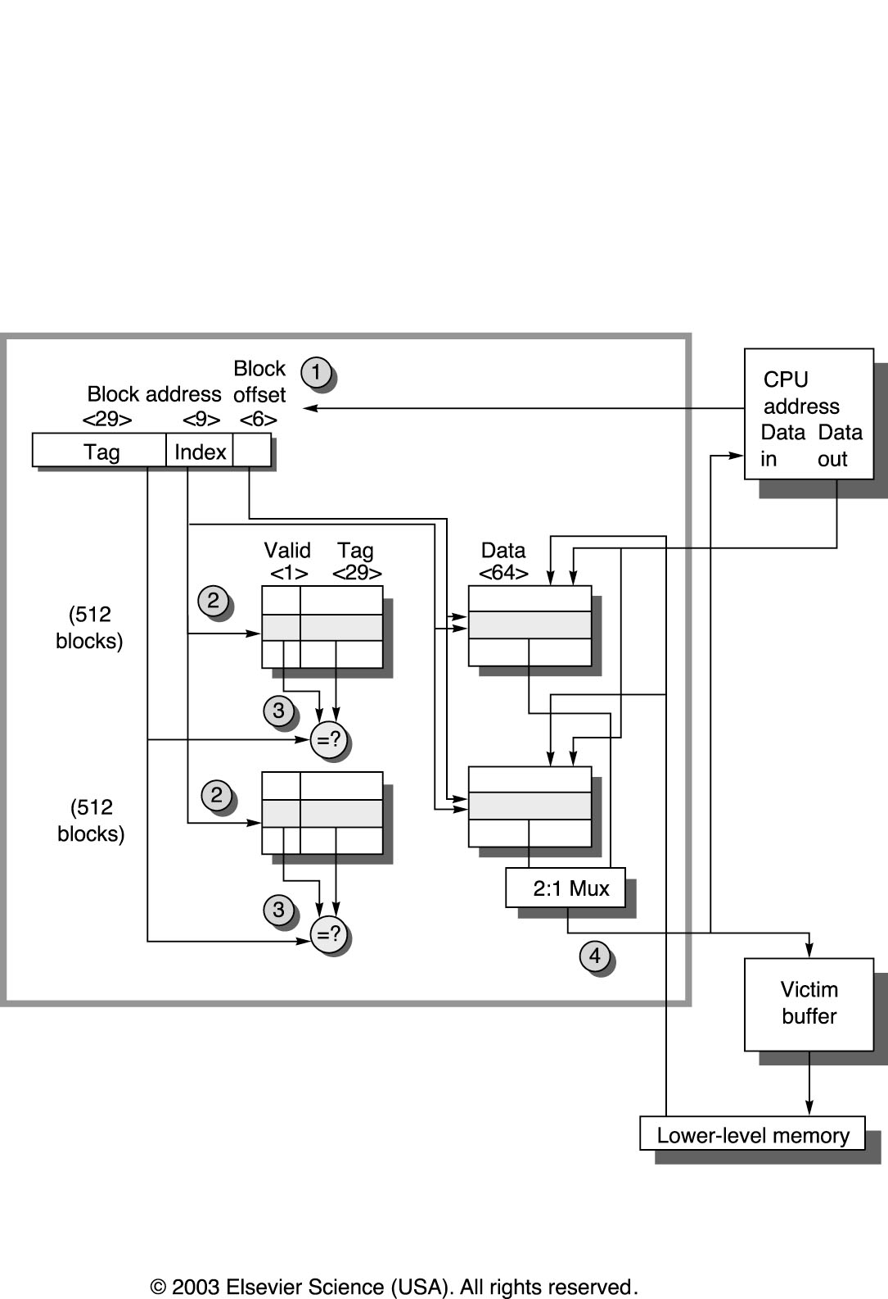
Example the Alpha 21264 Data Cache
Address Fields
Tag 29 bits
Index 9 bits ➔ 29 sets
Block Offset 6 bits ➔

Slide 32
Intel Core i7 Cache Hierarchy
Processor package
Core 0
Core 3
L1 i-cache and d-cache:
  32 KB, 8-way,
  Access: 4 cycles
L2 unified cache:
  256 KB, 8-way,
  Access: 10 cycles
L3 unified cache:
  8 MB, 16-way,
  Access: 40-75 cycles
Block size: 64 bytes for all caches.
Regs
Regs
L1
d-cache
L1
i-cache
L1
d-cache
L1
i-cache
…
L2 unified cache
L2 unified cache
L3 unified cache
(shared by all cores)
Main memory

Slide 33
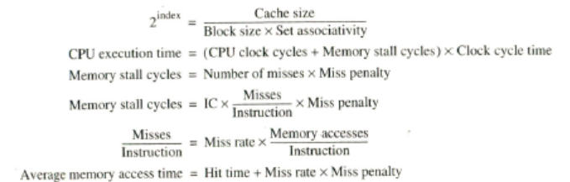
Fig B.7 Memory Hierarchy Equations

Slide 34
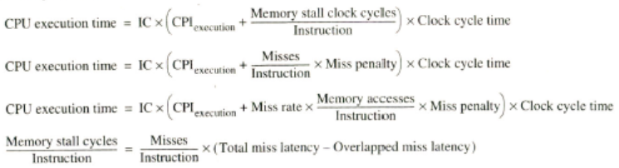
Fig B.7 Memory Hier. Equations II

Slide 35
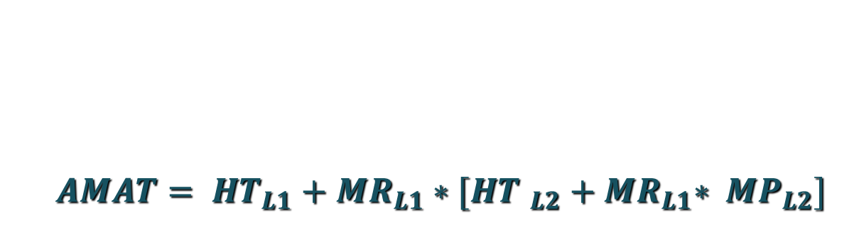
Two Level cache AMAT equation

Slide 36
Average Memory Access Time (AMAT) Example: page B-31
Suppose that in 1000 memory references there are 40 misses in first level and 20 in second level cache.
Assume the miss penalty for L2 is 200 clock cycles, hit time for L2 is 10 cycles and the HitTime of L1 is 1 cycle.
If there are 1.5 memory references per instruction
What is the AMAT and
What is the average number of stall cycles per instruction ?

Slide 37
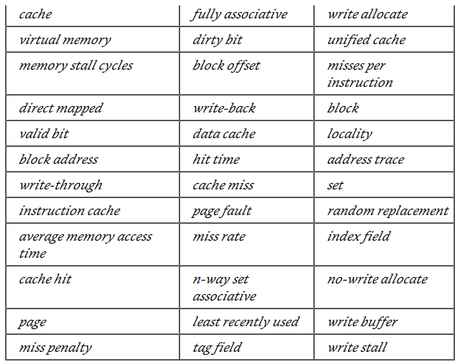
Cache terminology review

