Slide 1
Lecture 4
Pipelines II
CSCE 513 Computer Architecture
Topics
  IEEE754
  ISA and frequency counts
  Pipelining
  Data Hazards
  Forwarding
  Load-Use Hazard
  Control Hazards
Readings: Appendix C
September 13, 2017

Slide 2
Overview
Last Time
  Review of Single cycle design
  5 stage Pipeline
  Lecture 3 slides 1-20
New
  Slides 20-51 of Lecture 3
  IEEE 754 Floating Point
  Normal Pipeline Operations – the Ideal World
  Hazards
  Data Hazards: RAW, WAR, WAW, forwarding, load-use
  Control hazards
  Performance with Stalls
References
  Appendix C

Slide 3
gcc –S matmul.c ➔ matmul.s
matmul.c
232 lines
Inner loop
C[i][j] = 0.0;
for(x=0;x<k;++x){
C[i][j] = C[i][j] + A[i][x] * B[x][j];
}
%st - floating point on stack
%st(1) – one below it
matmul.s
690 lines
Part of Inner loop
.....
…..
movl 48(%esp), %ecx
sall $3, %ecx
addl %ecx, %eax
fldl (%eax)
fmulp %st, %st(1)
faddp %st, %st(1)
fstpl (%edx)
addl $1, 52(%esp)

Slide 4
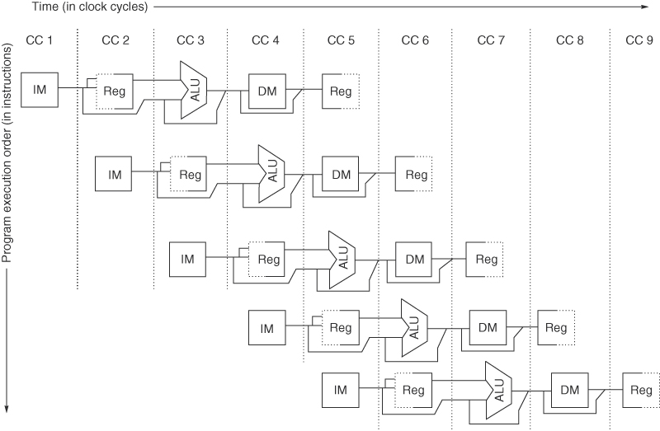
Figure C.2 The pipeline can be thought of as a series of data paths shifted in time. This shows the overlap among the parts of the data path, with clock cycle 5 (CC 5) showing the steady-state situation. Because the register file is used as a source in the ID stage and as a destination in the WB stage, it appears twice. We show that it is read in one part of the stage and written in another by using a solid line, on the right or left, respectively, and a dashed line on the other side. The abbreviation IM is used for instruction memory, DM for data memory, and CC for clock cycle.

Slide 5
Appendix A – Instruction Set Architecture(ISA)
Memory Addressing
  Big Endian vs Little Endian
  alignment
Address Modes – fig A.6 (next slide)
Frequency of 80x86 Instruction Execution – fig A.7, A.13
Role of Compilers –
  Optimization
  Register allocation
MIPS review: Appendix A.9
  Registers: 32 integer reg. R0-R31(R0=0), float/double regs F0-F31

Slide 6
Address Modes – fig A.6
Register
Immediate
Displacement
Register Indirect
Indexed
Direct
Memory Indirect
Autoincrement
scaled

Slide 7
Frequency of Address Modes A.7
.

Slide 8
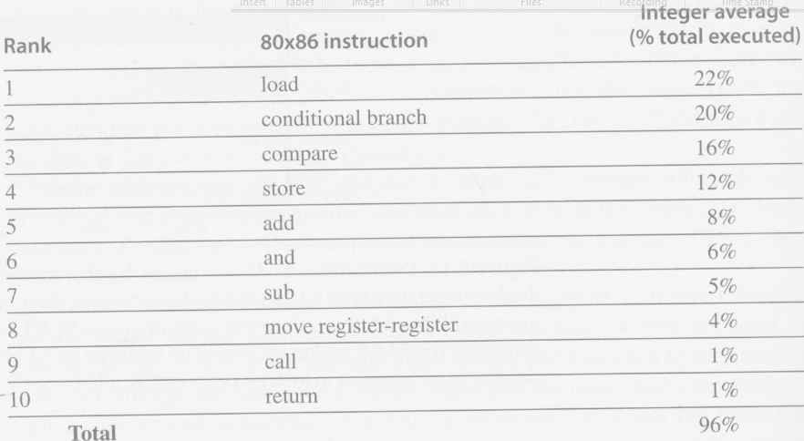
Frequency of 80x86 Instructions A.13
.

Slide 9
Compiler Optimizations figure A.20

Slide 10
Figure C.22 Inserting Pipeline Registers into Data Path

Slide 11
Figure C.22 Inserting Pipeline Registers into Data Path
Fields in pipeline registers
  IF/ID.IR ➔ ID/EX.IR ➔ EX/MEM.IR ; Instruction copied
  ID/EX.A, ID/EX.B EX/MEM.ALUoutput …

Slide 12
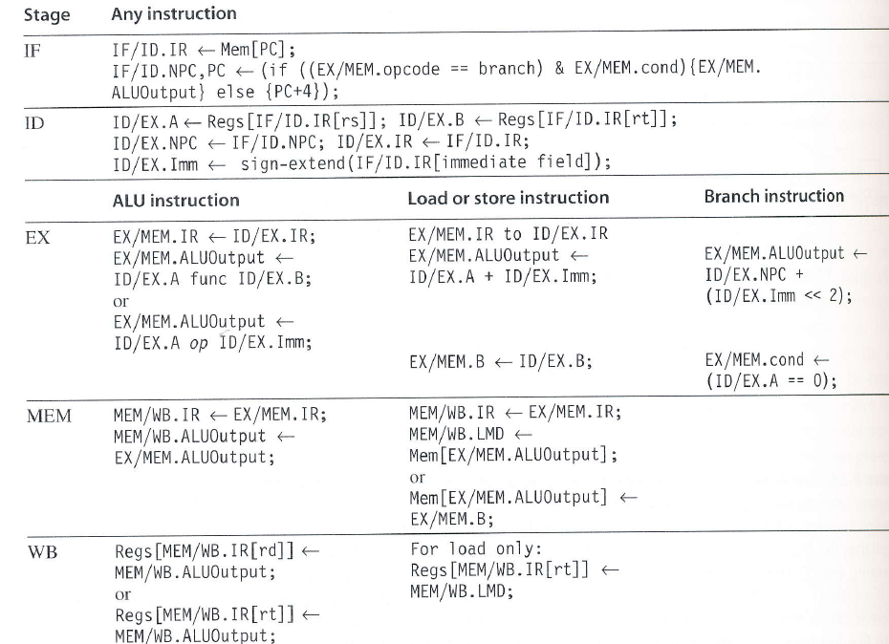
Figure C.23

Slide 13
Figure C.21 Examples of Data Hazards
No Dependencies with Accesses in order
Instruction |  | 1 | 2 | 3 | 4 | 5 | 6 | 7 | 8
LD R1, 44(R2)
DADD R5, R6, R7
DSUB R8, R6, R7
OR R9, R4, R7

Slide 14
Examples of Data Hazards
Dependency requiring a stall
Note
  Instr₁ = Load, … and Instr₂ = DADD, DSUB, OR, AND, …
  rt in Instr₁ == rs in Instr₂
What type of circuit implements the == ?
Instruction |  | 1 | 2 | 3 | 4 | 5 | 6 | 7 | 8
LD R1, 44(R2)
DADD R5, R1, R7
DSUB R8, R6, R7
OR R9, R1, R7

Slide 15
Examples of Data Hazards
Dependence
Instruction |  | 1 | 2 | 3 | 4 | 5 | 6 | 7 | 8
LD R1, 44(R2)
DADD R5, R6, R7
DSUB R8, R6, R1
OR R9, R4, R7

Slide 16
Figure C.21 Examples of Data Hazards
Forwarding through the registers
Instruction |  | 1 | 2 | 3 | 4 | 5 | 6 | 7 | 8
LD R1, 44(R2)
DADD R5, R6, R7
DSUB R8, R6, R7
OR R9, R1, R7

Slide 17
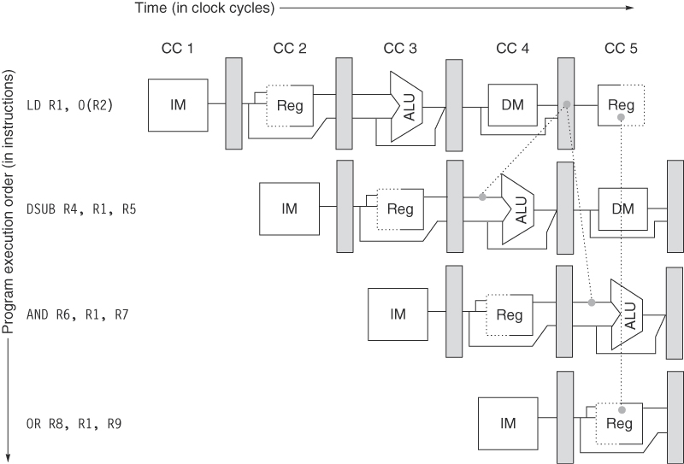
Figure C.9 (new slide) Data Forwarding
Figure C.9 The load instruction can bypass its results to the AND and OR instructions, but not to the DSUB, since that would mean forwarding the result in “negative time.”
Copyright © 2011, Elsevier Inc. All rights Reserved.

Slide 18
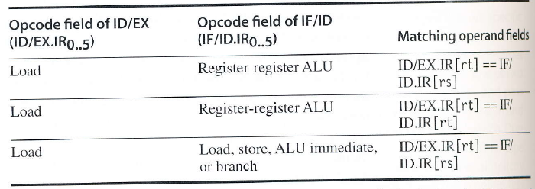
Logic to detect Hazards

Slide 19
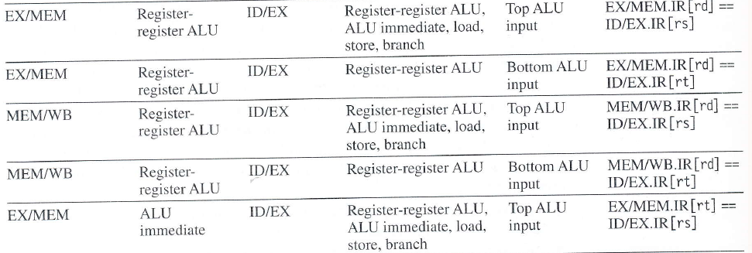
Forwarding Figure C.26
Pipeline Reg. Source | Opcode of Source | Pipeline Reg. Destination | Opcode of Destination | Destination of forwarding | Comparison (if equal then forward )

Slide 20
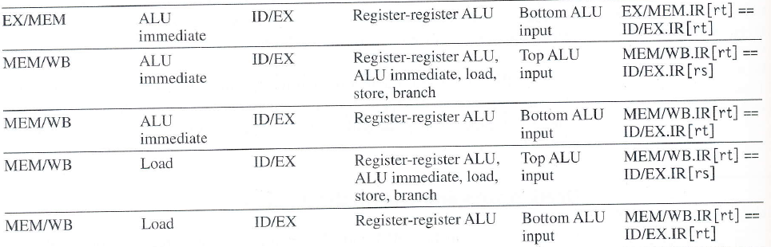
Pipeline Reg. Source | Opcode of Source | Pipeline Reg. Destination | Opcode of Destination | Destination of forwarding | Comparison (if equal then forward )

Slide 21
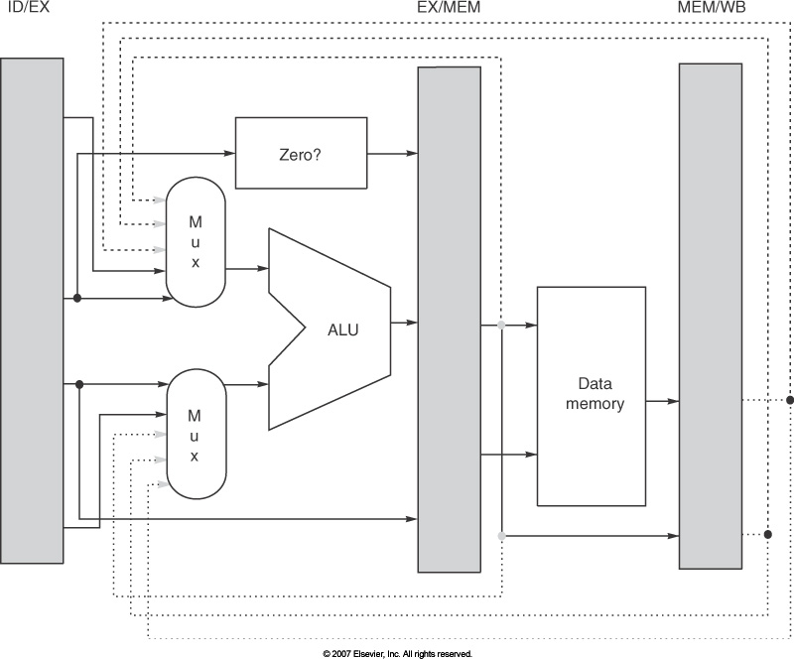
Figure C.23 Forwarding Paths

Slide 22
Load/Use Hazard

Slide 23
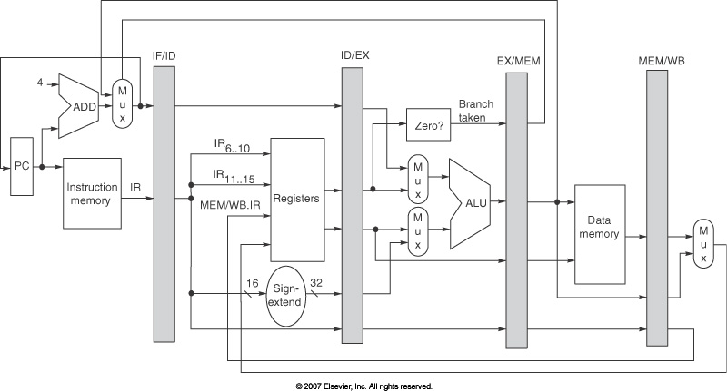
Delays for Mis-predicted Branches
.

Slide 24
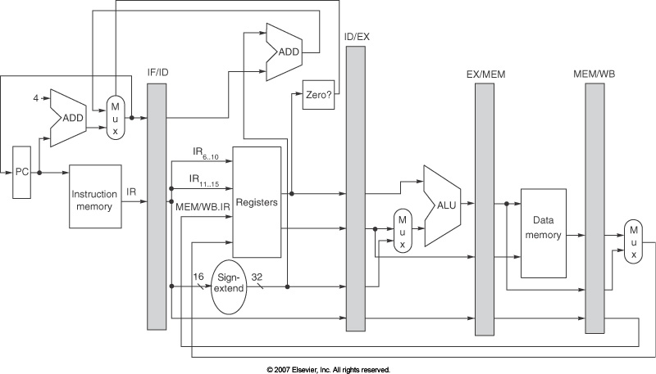
Figure C.24 Avoiding some Branch Stalls

Slide 25
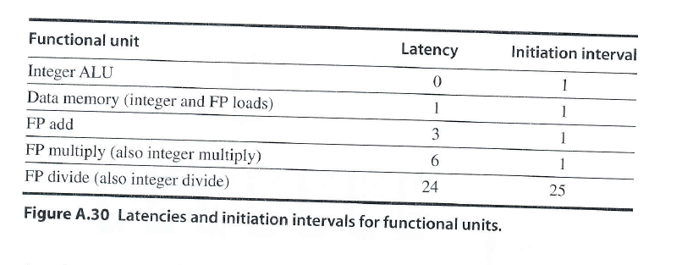
Figure FP Latencies

Slide 26
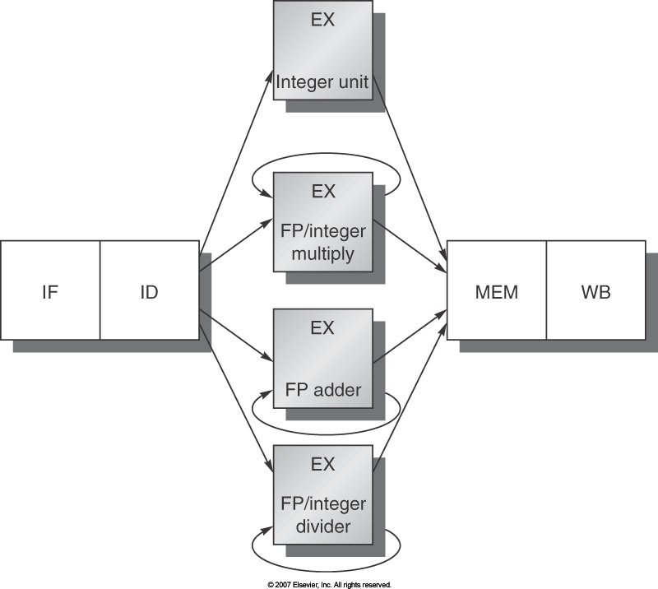
Figure C.29 MIPS Pipeline +FP Units
.

Slide 27
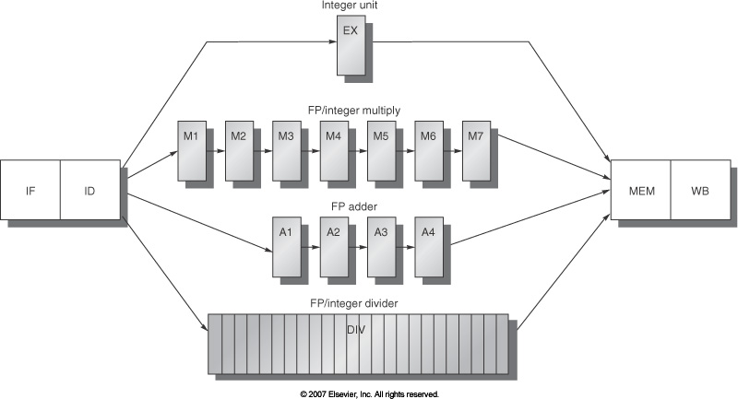
Figure C.31 Supporting multiple outstanding FP operations

Slide 28
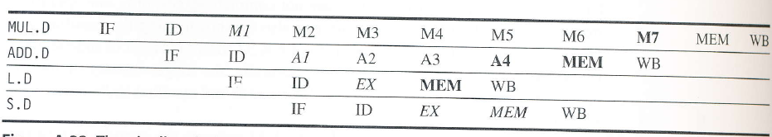
Figure C.32 Timings of Independent FP operations
.

Slide 29
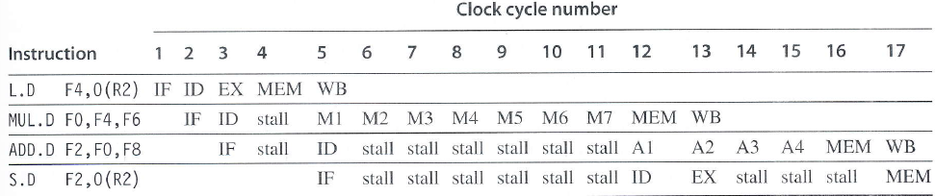
Figure C.33 Stalls due to RAW hazards
.

Slide 30
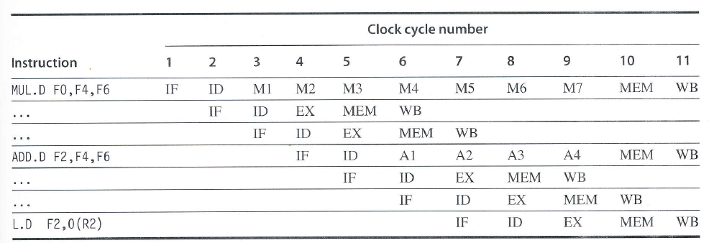
Figure C.34 Simultaneous write-back
.

Slide 31
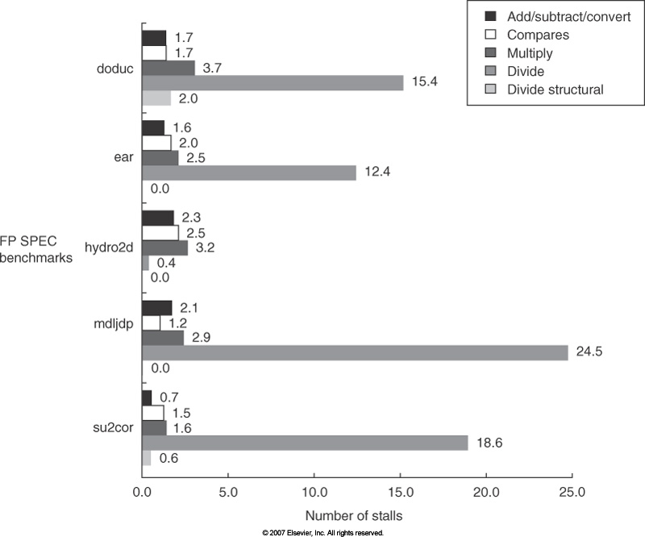

Slide 32
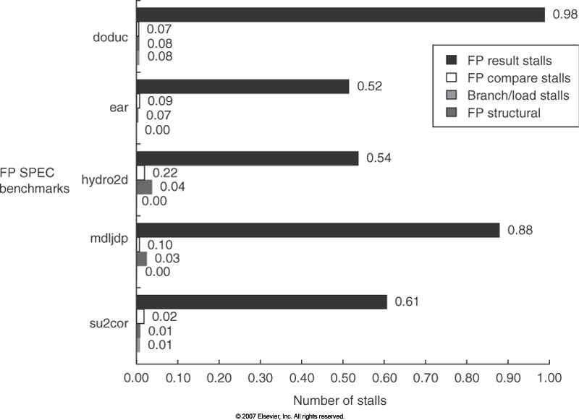

Slide 33
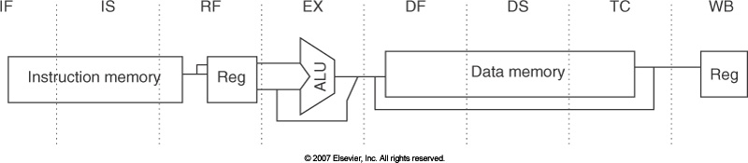

Slide 34
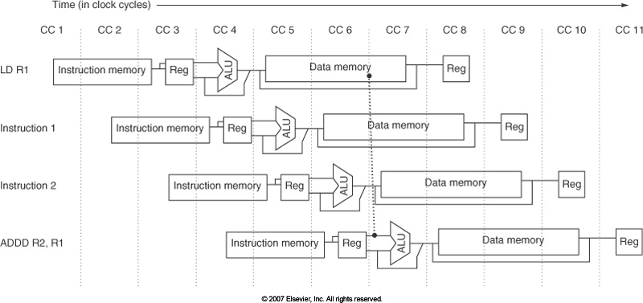

Slide 35
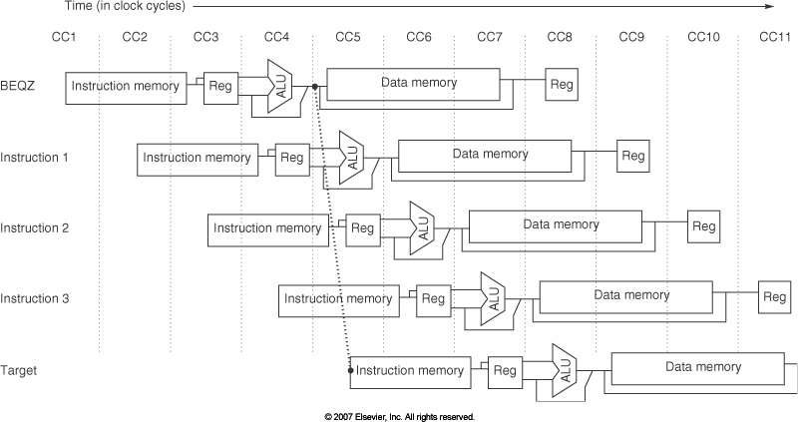
Figure C.40

Slide 36
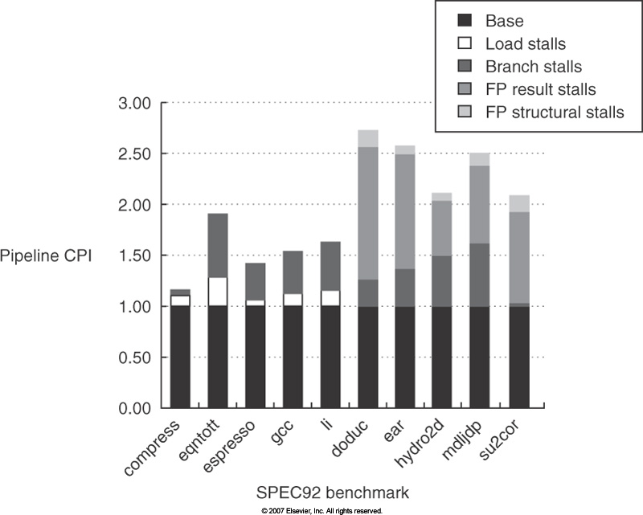

Slide 37
Dynamic Scheduling

Slide 38
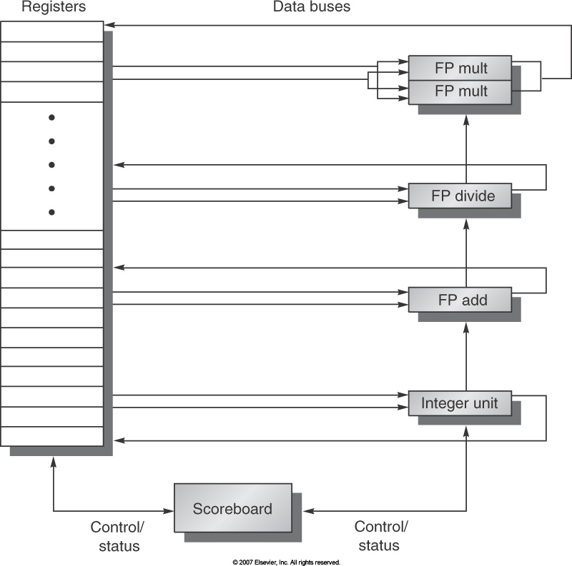

Slide 39
Homework
…

Slide 40
Figure C.2 The pipeline can be thought of as a series of data paths shifted in time. This shows the overlap among the parts of the data path, with clock cycle 5 (CC 5) showing the steady-state situation. Because the register file is used as a source in the ID stage and as a destination in the WB stage, it appears twice. We show that it is read in one part of the stage and written in another by using a solid line, on the right or left, respectively, and a dashed line on the other side. The abbreviation IM is used for instruction memory, DM for data memory, and CC for clock cycle.

Slide 41
Figure C.9 (new slide) Data Forwarding
Figure C.9 The load instruction can bypass its results to the AND and OR instructions, but not to the DSUB, since that would mean forwarding the result in “negative time.”
Copyright © 2011, Elsevier Inc. All rights Reserved.

Slide 42
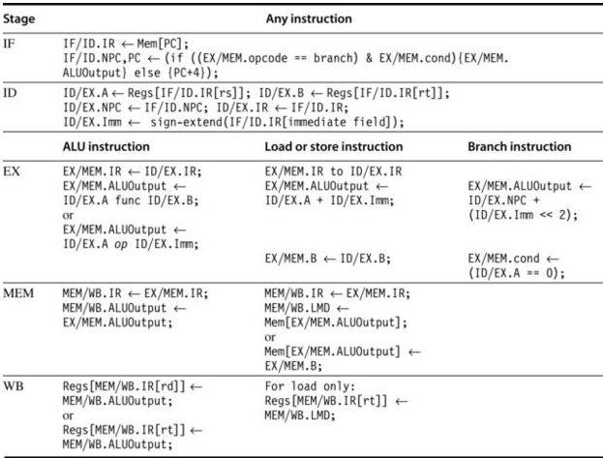
Figure C-23 Events on Pipeline

Slide 43
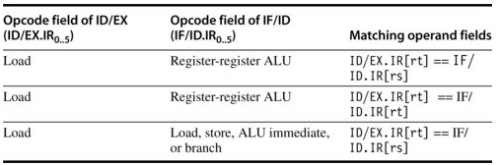

Slide 44
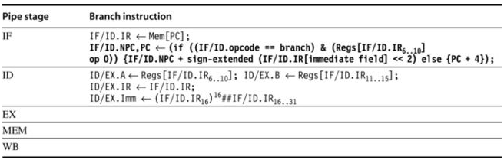
.

Slide 45
terms interrupt, fault, and exception
The terms interrupt, fault, and exception are used, although not in a consistent fashion. We use the term exception to cover all these mechanisms, including the following:
  I/ O device request Invoking an operating system service from a user program
  Tracing instruction execution
  Breakpoint (programmer-requested interrupt)
  Integer arithmetic overflow FP arithmetic anomaly
  Page fault (not in main memory)
  Misaligned memory accesses (if alignment is required)
  Memory protection violation
  Using an undefined or unimplemented instruction
  Hardware malfunctions
  Power failure

Slide 46
Linux
File System Hierarchy
Basic Commands
  ls
  cd
  mv
  cp
  rm
  pwd
  gcc
  ./a.out
Editors: emacs, vim, nano, pico, gedit, kate, …

Slide 47
Linux - lscpu
cocsce-l1d39-16> lscpu
Architecture: x86_64
CPU op-mode(s): 32-bit, 64-bit
Byte Order: Little Endian
CPU(s): 8
On-line CPU(s) list: 0-7
Thread(s) per core: 2
Core(s) per socket: 4
Socket(s): 1
NUMA node(s): 1
Vendor ID: GenuineIntel
CPU family: 6
Model: 60
Stepping: 3
CPU MHz: 800.156
BogoMIPS: 7184.02
Virtualization: VT-x
L1d cache: 32K
L1i cache: 32K
L2 cache: 256K
L3 cache: 8192K
NUMA node0 CPU(s): 0-7

Slide 48
Man –k ls | grep “^ls”
cocsce-l1d39-16> man -k ls | grep "^ls"
lsattr (1) - list file attributes on a Linux second extended file sy...
lsb (8) - Linux Standard Base support for Debian
lsb_release (1) - print distribution-specific information
lsblk (8) - list block devices
lscpu (1) - display information on CPU architecture
lsdiff (1) - show which files are modified by a patch
lsearch (3) - linear search of an array
lseek (2) - reposition read/write file offset
lshw (1) - list hardware
lsinitramfs (8) - list content of an initramfs image
lsmod (8) - Show the status of modules in the Linux Kernel
lsof (8) - list open files
lspci (8) - list all PCI devices
lspcmcia (8) - display extended PCMCIA debugging information
lspgpot (1) - extracts the ownertrust values from PGP keyrings and li...
lstopo (1) - Show the topology of the system
lstopo-no-graphics (1) - Show the topology of the system
lsusb (8) - list USB devices

