Slide 1
Lec09
Memory Hierarchy yet again
CSCE 513 Computer Architecture
Topics
  Memory Hierarchy Review
    Terminology review
    Basic Equations
    6 Basic Optimizations
  Memory Hierarchy – Chapter 2
Readings: Appendix B, Chapter 2
September 21, 2016

Slide 2
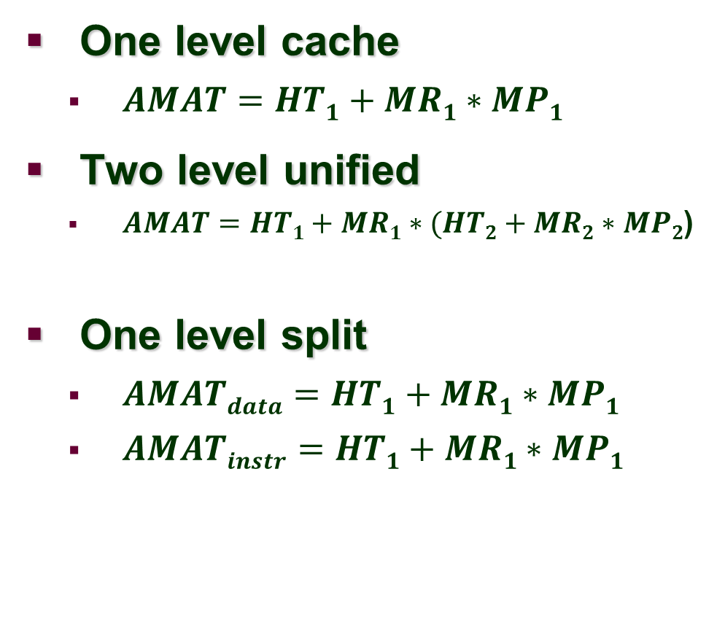
AMAT Equations
Terminology (abbreviations)
AMAT
HT – HitTime
MR miss Rate
MP miss Penalty

Slide 3
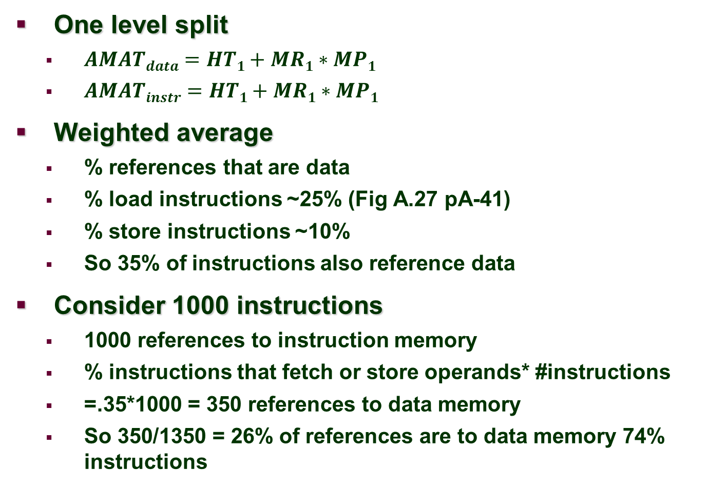
AMAT – weighted average

Slide 4
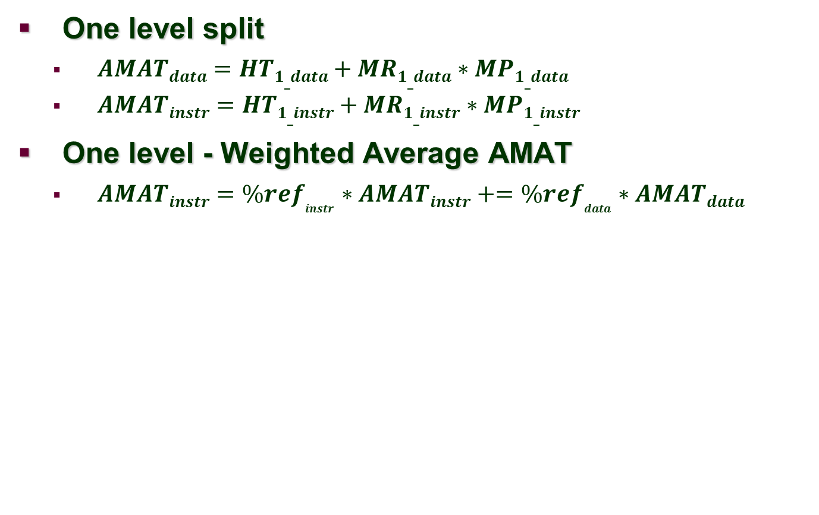
AMAT – weighted average (continued)

Slide 5
2.2 - 10 Advanced Cache Optimizations
Five Categories
Reducing Hit Time-Small and simple first-level caches and way-prediction. Both techniques also generally decrease power consumption.
Increasing cache bandwidth— Pipelined caches, multibanked caches, and nonblocking caches. These techniques have varying impacts on power consumption.
Reducing the miss penalty— Critical word first and merging write buffers. These optimizations have little impact on power.
Reducing the miss rate— Compiler optimizations
Reducing the miss penalty or miss rate via parallelism— Hardware prefetching and compiler prefetching.

Slide 6
Way Prediction
To improve hit time, predict the way to pre-set mux
  Mis-prediction gives longer hit time
  Prediction accuracy
    > 90% for two-way
    > 80% for four-way
    I-cache has better accuracy than D-cache
  First used on MIPS R10000 in mid-90s
  Used on ARM Cortex-A8
Extend to predict block as well
  “Way selection”
  Increases mis-prediction penalty
Advanced Optimizations

Slide 7
Pipelining Cache
Pipeline cache access to improve bandwidth
  Examples:
    Pentium: 1 cycle
    Pentium Pro – Pentium III: 2 cycles
    Pentium 4 – Core i7: 4 cycles
Increases branch mis-prediction penalty
Makes it easier to increase associativity
Advanced Optimizations

Slide 8
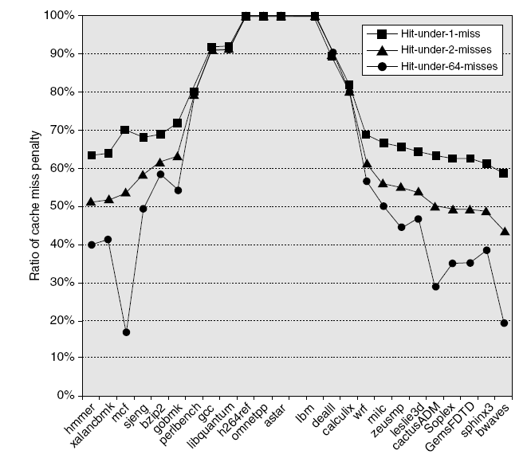
Nonblocking Caches
Allow hits before previous misses complete
  “Hit under miss”
  “Hit under multiple miss”
L2 must support this
In general, processors can hide L1 miss penalty but not L2 miss penalty
Advanced Optimizations

Slide 9
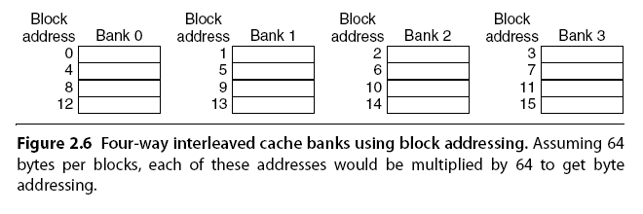
Multibanked Caches
Organize cache as independent banks to support simultaneous access
  ARM Cortex-A8 supports 1-4 banks for L2
  Intel i7 supports 4 banks for L1 and 8 banks for L2
Interleave banks according to block address
Advanced Optimizations

Slide 10
Critical Word First, Early Restart
Critical word first
  Request missed word from memory first
  Send it to the processor as soon as it arrives
Early restart
  Request words in normal order
  Send missed work to the processor as soon as it arrives
Effectiveness of these strategies depends on block size and likelihood of another access to the portion of the block that has not yet been fetched
Advanced Optimizations

Slide 11
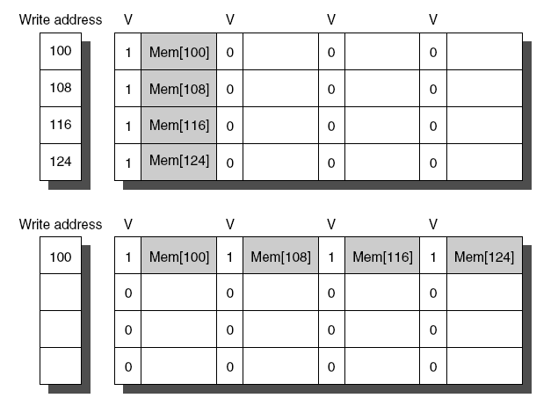
Merging Write Buffer
When storing to a block that is already pending in the write buffer, update write buffer
Reduces stalls due to full write buffer
Do not apply to I/O addresses
Advanced Optimizations
No write buffering
Write buffering

Slide 12
Compiler Optimizations
Loop Interchange
  Swap nested loops to access memory in sequential order
Blocking
  Instead of accessing entire rows or columns, subdivide matrices into blocks
  Requires more memory accesses but improves locality of accesses
Advanced Optimizations

Slide 13
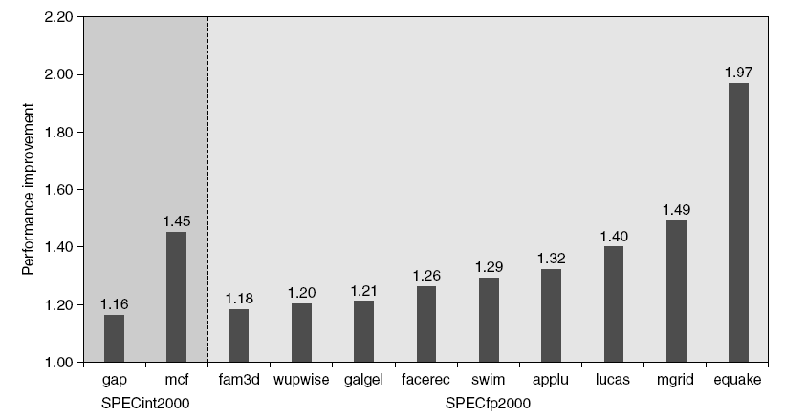
Hardware Prefetching
Fetch two blocks on miss (include next sequential block)
Advanced Optimizations
Pentium 4 Pre-fetching

Slide 14
Compiler Prefetching
Insert prefetch instructions before data is needed
Non-faulting: prefetch doesn’t cause exceptions
Register prefetch
  Loads data into register
Cache prefetch
  Loads data into cache
Combine with loop unrolling and software pipelining
Advanced Optimizations

Slide 15
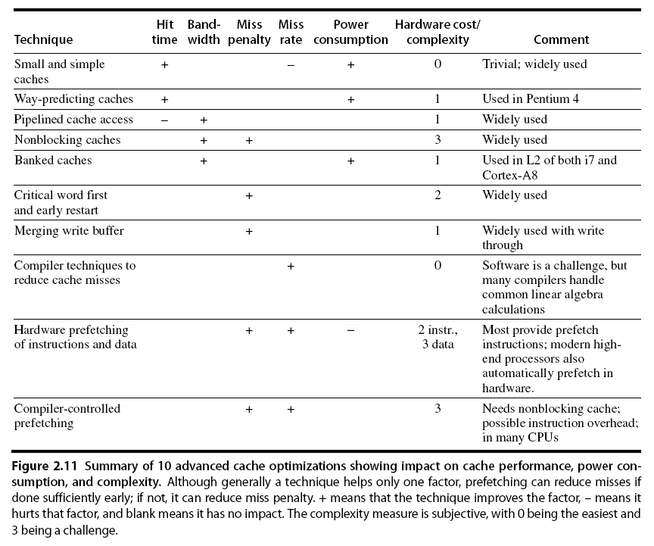
Summary
Advanced Optimizations

Slide 16
Memory Technology
Memory Technology
Performance metrics
  Latency is concern of cache
  Bandwidth is concern of multiprocessors and I/O
  Access time
    Time between read request and when desired word arrives
  Cycle time
    Minimum time between unrelated requests to memory
DRAM used for main memory, SRAM used for cache

Slide 17
Memory Technology
Memory Technology
SRAM
  Requires low power to retain bit
  Requires 6 transistors/bit
DRAM
  Must be re-written after being read
  Must also be periodically refeshed
    Every ~ 8 ms
    Each row can be refreshed simultaneously
  One transistor/bit
  Address lines are multiplexed:
    Upper half of address: row access strobe (RAS)
    Lower half of address: column access strobe (CAS)

Slide 18
Memory Technology
Memory Technology
Amdahl:
  Memory capacity should grow linearly with processor speed
  Unfortunately, memory capacity and speed has not kept pace with processors
Some optimizations:
  Multiple accesses to same row
  Synchronous DRAM
    Added clock to DRAM interface
    Burst mode with critical word first
  Wider interfaces
  Double data rate (DDR)
  Multiple banks on each DRAM device

Slide 19
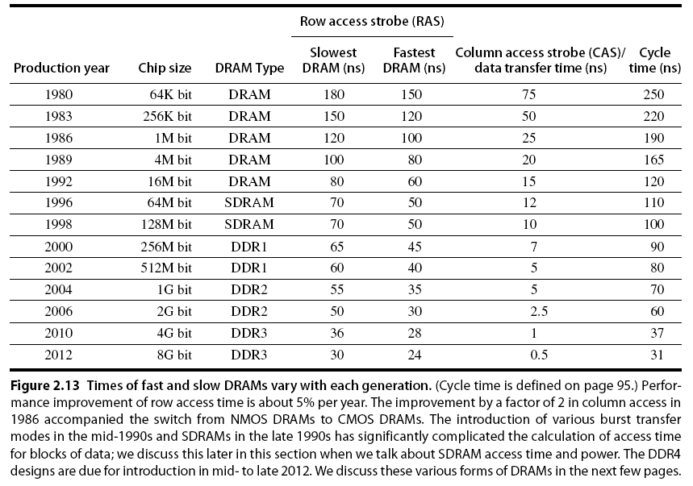
Memory Optimizations
Memory Technology

Slide 20
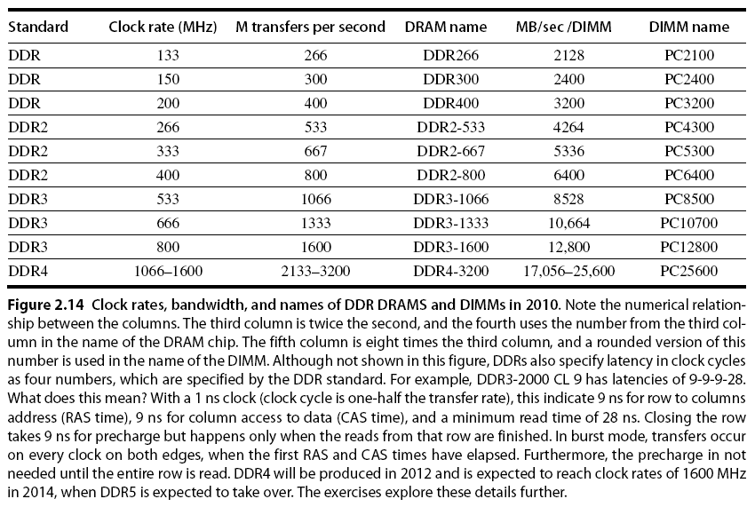
Memory Optimizations
Memory Technology

Slide 21
Memory Optimizations
Memory Technology
DDR:
  DDR2
    Lower power (2.5 V -> 1.8 V)
    Higher clock rates (266 MHz, 333 MHz, 400 MHz)
  DDR3
    1.5 V
    800 MHz
  DDR4
    1-1.2 V
    1600 MHz
GDDR5 is graphics memory based on DDR3

Slide 22
Memory Optimizations
Memory Technology
Graphics memory:
  Achieve 2-5 X bandwidth per DRAM vs. DDR3
    Wider interfaces (32 vs. 16 bit)
    Higher clock rate
      Possible because they are attached via soldering instead of socketted DIMM modules
Reducing power in SDRAMs:
  Lower voltage
  Low power mode (ignores clock, continues to refresh)

Slide 23
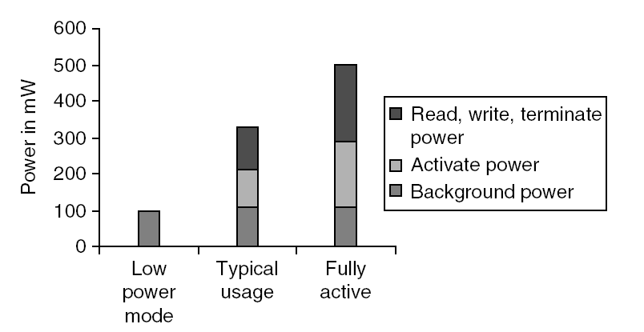
Memory Power Consumption
Memory Technology

Slide 24
Flash Memory
Memory Technology
Type of EEPROM
Must be erased (in blocks) before being overwritten
Non volatile
Limited number of write cycles
Cheaper than SDRAM, more expensive than disk
Slower than SRAM, faster than disk

Slide 25
Understand ReadyBoost and whether it will Speed Up your System
Windows 7 supports Windows ReadyBoost.
  This feature uses external USB flash drives as a hard disk cache to improve disk read performance.
  Supported external storage types include USB thumb drives, SD cards, and CF cards.
  Since ReadyBoost will not provide a performance gain when the primary disk is an SSD, Windows 7 disables ReadyBoost when reading from an SSD drive.
External storage must meet the following requirements:
  Capacity of at least 256 MB, with at least 64 kilobytes (KB) of free space. The 4-GB limit of Windows Vista has been removed.
  At least a 2.5 MB/sec throughput for 4-KB random reads
  At least a 1.75 MB/sec throughput for 1-MB random writes
http://technet.microsoft.com/en-us/magazine/ff356869.aspx

Slide 26
Memory Dependability
Memory Technology
Memory is susceptible to cosmic rays
Soft errors: dynamic errors
  Detected and fixed by error correcting codes (ECC)
Hard errors: permanent errors
  Use sparse rows to replace defective rows
Chipkill: a RAID-like error recovery technique

Slide 27
Solid State Drives
http://en.wikipedia.org/wiki/Solid-state_drive
http://www.tomshardware.com/charts/hard-drives-and-ssds,3.html
  Hard Drives 34 dimensions: eg Desktop performance
  SSD -

Slide 28
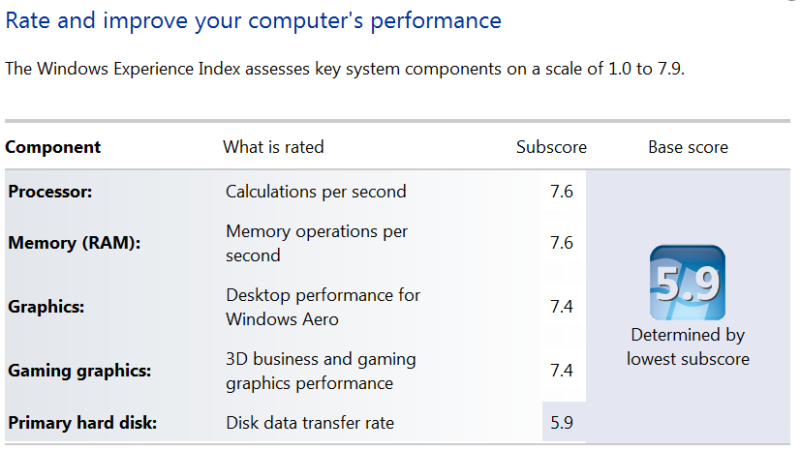
Windows Experience Index
Control Panel\All Control Panel Items\Performance Information and Tools
Control Panel\All Control Panel Items\Performance Information and Tools

