Slide 1
Lecture 3
Instruction Level Parallelism
(Pipelining)
CSCE 513 Computer Architecture
Topics
  Execution time
  ILP
Readings: Appendix C
September 6, 2017

Slide 2
Overview
Last Time
  Overview:
  Speed-up
  Power wall, ILP wall, ➔ to multicore
  Def Computer Architecture
  Lecture 1 slides 1-29?
New
  Syllabus and other course pragmatics
    Website (not shown)
    Dates
  Figure 1.9 Trends: CPUs, Memory, Network, Disk
  Why geometric mean?
  Speed-up again
  Amdahl’s Law

Slide 3
Finish up Slides from Lecture 2
Slides 18 ➔
CPU Performance Equation
Fallacies and Pitfalls
List of Appendices

Slide 4
Patterson’s 5 steps to design a processor
Analyze instruction set => datapath requirements
Select set of data-path components & establish clock methodology
Assemble data-path meeting the requirements
Analyze implementation of each instruction to determine setting of control points that effects the register transfer.
Assemble the control logic

Slide 5
Components we are assuming you know
Basic Gates
  Ands, ors, xors, nands, nors
Combinational components
  Adders
  ALU
  Multiplexers (MUXs)
  Decoders
  Not going to need: PLAs, PALs, FPGAs …
Sequential Components
  Registers
  Register file: banks of registers, pair of Mux, decoder for load lines
  Memories
Register Transfer Language
  NonBranch: PC ⬅ PC + 4 (control signal: register transfer)

Slide 6
MIPS Simplifies Processor Design
Instructions same size
Source registers always in same place
Immediates are always same size, same location
Operations always on registers or immediates
Single cycle data path means …
CPI is …
CCT is …
Reference http://en.wikipedia.org/wiki/MIPS_architecture
Ref: http://en.wikipedia.org/wiki/MIPS_architecture

Slide 7
Register File
Data in
R0
R31
Notes
How big are the lines ?
  Some 5
  Some 32
  Some 1
Data-In goes to every register
R0 = 0
Rd
5x32
decoder
32:1 Mux
32:1 Mux
Rt
Rs
Bus A
Bus B

Slide 8
Instruction Fetch (non-branch)

Slide 9
High Level for Register-Register Instruct.

Slide 10
Stores: Store Rs, disp(Rb)
Notes
    Sign extend for 16bit immediates
    Write trace
    Read trace

Slide 11
Loads LD rd, disp(Rr)
Notes
  Sign extend for 16bit (disp) to calculate address = disp + Rr

Slide 12
Branches
Notes
  Sign extend for backwards branches
  Note Shift left 2 = Multiply by 4 ➔ which means displacement is in words
  Register Transfer Language
  Cond⬅ R[rs] == R[rt]
  if (COND eq 0)
    PC ⬅ PC + 4 + (SE(imm16) x 4 )
  else
    PC ⬅ PC + 4

Slide 13
Branch Hardware
Inst Address
nPC_sel
4
Adder
Mux
PC
Adder
imm16
PC Ext
Clk

Slide 14
Adding Instruction Fetch / PC Increment

Slide 15
Simple Data Path for All Instructions

Slide 16
Pulling it All Together
Notes
  Note PC=PC+4 (all MIPS instructions are 4 bytes)

Slide 17
Adding Control

Slide 18
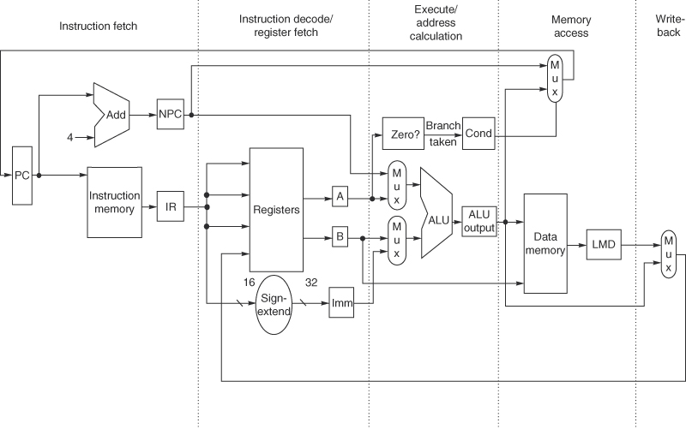
Non-pipelined RISC operations Fig C.21
Store 4 cycles (10%) CPI ?
Branches 2 cycles (12%)
Others 5 cycles (78%)

Slide 19
Multicycle Data Path (appendix C)
Multicycle Data Path
  Execute instructions in stages
  Shorter Clock Cycle Time (CCT)
  Executing an instruction takes a few cycles
    (how many stages we have)
  We can execute different things in each stage at the same time; precursor to the pipelined version
Stages
  Fetch
  Decode
  Execute
  Memory
  Write Back

Slide 20
Stages of Classical 5-stage pipeline
Instruction Fetch Cycle
  IR ← Mem[PC]
  NPC ← PC + 4
Decode
  A ← Regs[rs]
  B ←
  Imm ← sign-extend of
Execute
  .
Memory
  .
Write Back
  .

Slide 21
Execute
Based on type of intsruction
Memory Reference – calculate effective address d(rb)
  ALUOutput ← A + Imm
Register-Register ALU instruction
  ALUOutput ← A func B
Register-Immediate ALU instruction
  ALUOutput ← A op Imm
Branch
  ALUOutput ← NPC + (Imm <<2)
  Cond ← (A==0)

Slide 22
Memory
  PC ← NPC
Memory
  LMD ← Mem[ALUOutput], or
  Mem[ALUOutput] ← B
Branch
  If (cond) PC ← ALUOutput

Slide 23
Write-back (WB) cycle
Register-Register ALU instruction
  Regs[rd] ← ALUOutput
Register-Immediate ALU instruction
  Regs[rt] ← ALUOutput
Load Instruction
  Regs[rt] ← LMD

Slide 24
Simple RISC Pipeline
Clock cycle number (time ➔)
Instruction
Instruction n
Instruction n+1
Instruction n+2
Instruction n+3
Instruction n+4
1 | 2 | 3 | 4 | 5 | 6 | 7 | 8 | 9
IF | ID | EX | MEM | WB
 | IF | ID | EX | MEM | WB
 |  | IF | ID | EX | MEM | WB
 |  |  | IF | ID | EX | MEM | WB
 |  |  |  | IF | ID | EX | MEM | WB

Slide 25
Performance Analysis in Perfect World
Assuming S stages in the pipeline.
At each cycle a new instruction is initiated.
To execute N instructions takes:
N cycles to start-up instructions
(S-1) cycles to flush the pipeline
TotalTime = N + (S-1)
Example for S=5 from previous slide N=100 instructions
Time to execute in non-pipelined = 100 * 5 = 500 cycles
Time to execute in pipelined version = 100 + (5-1) = 104 cycles
SpeedUp = …

Slide 26
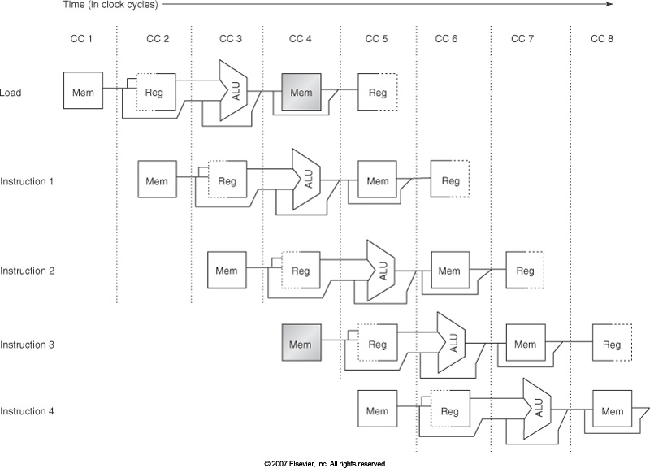
Implement Pipelines Supp. Fig C.4

Slide 27
Pipeline Example with a problem (A.5 like)
DADD
DSUB
AND
OR
XOR
Instruction
R1, R2, R3
R4, R1, R5
R6, R1, R7
R8, R1, R9
R10, R1, R11
1 | 2 | 3 | 4 | 5 | 6 | 7 | 8 | 9
IM | ID | EX | DM | WB
 | IM | ID | EX | DM | WB
 |  | IM | ID | EX | DM | WB
 |  |  | IM | ID | EX | DM | WB
 |  |  |  | IM | ID | EX | DM | WB

Slide 28
Inserting Pipeline Registers into Data Path fig A’.18

Slide 29
Major Hurdle of Pipelining
Consider executing the code below
DADD R1, R2, R3 /* R1⬅ R2 + R3 */
DSUB R4, R1, R5 /* R4⬅ R1 + R5 */
AND R6, R1, R7 /* R6⬅ R1 + R7 */
OR R8, R1, R9 /* R8⬅ R1 | R9 */
XOR R10, R1, R11 /* R10 ⬅ R1 ^ R11 */

Slide 30
RISC Pipeline Problems
Clock cycle number (time ➔)
DADD
DSUB
AND
OR
XOR
Instruction
R1, R2, R3
R4, R1, R5
R6, R1, R7
R8, R1, R9
R10, R1, R11
1 | 2 | 3 | 4 | 5 | 6 | 7 | 8 | 9
IM | ID | EX | DM | WB
 | IM | ID | EX | DM | WB
 |  | IM | ID | EX | DM | WB
 |  |  | IM | ID | EX | DM | WB
 |  |  |  | IM | ID | EX | DM | WB
So what’s the problem?

Slide 31
Hazards
Data Hazards – a data value computed in one stage is not ready when it is needed in another stage of the pipeline
Simple Solution: stall until it is ready but we can do better
Control or Branch Hazards
Structural Hazards – arise when resources are not sufficient to completely overlap instruction sequence e.g. two floating point add units then having to do three simultaneously

Slide 32
Performance of Pipelines with Stalls
Thus Pipelining can be thought of as improving CPI or improving CCT.
Relationships
Equations

Slide 33
Performance Equations with Stalls
If we ignore overhead of pipelining
Special Case: If we assume every instruction takes same number of cycles, i.e., CPI = constant and assume this constant is the depth of the pipeline then

Slide 34
Performance Equations with Stalls
Alternatively focusing on improvement in CCT
Then simplifying using formulas for CCTpipelined

Slide 35
Performance Equations with Stalls
Then simplifying using formulas for _{CCTpipelined} and
We obtain

Slide 36
Structural Hazards
If a combination of instructions cannot be accommodated because of resource conflicts is called a structural hazard.
Examples
Single port memory (what is a dual port memory anyway?)
One write port on register file
Single floating point adder
…
A stall in pipeline frequently called a pipeline bubble or just bubble.
A bubble floats through the pipeline occupying space

Slide 37
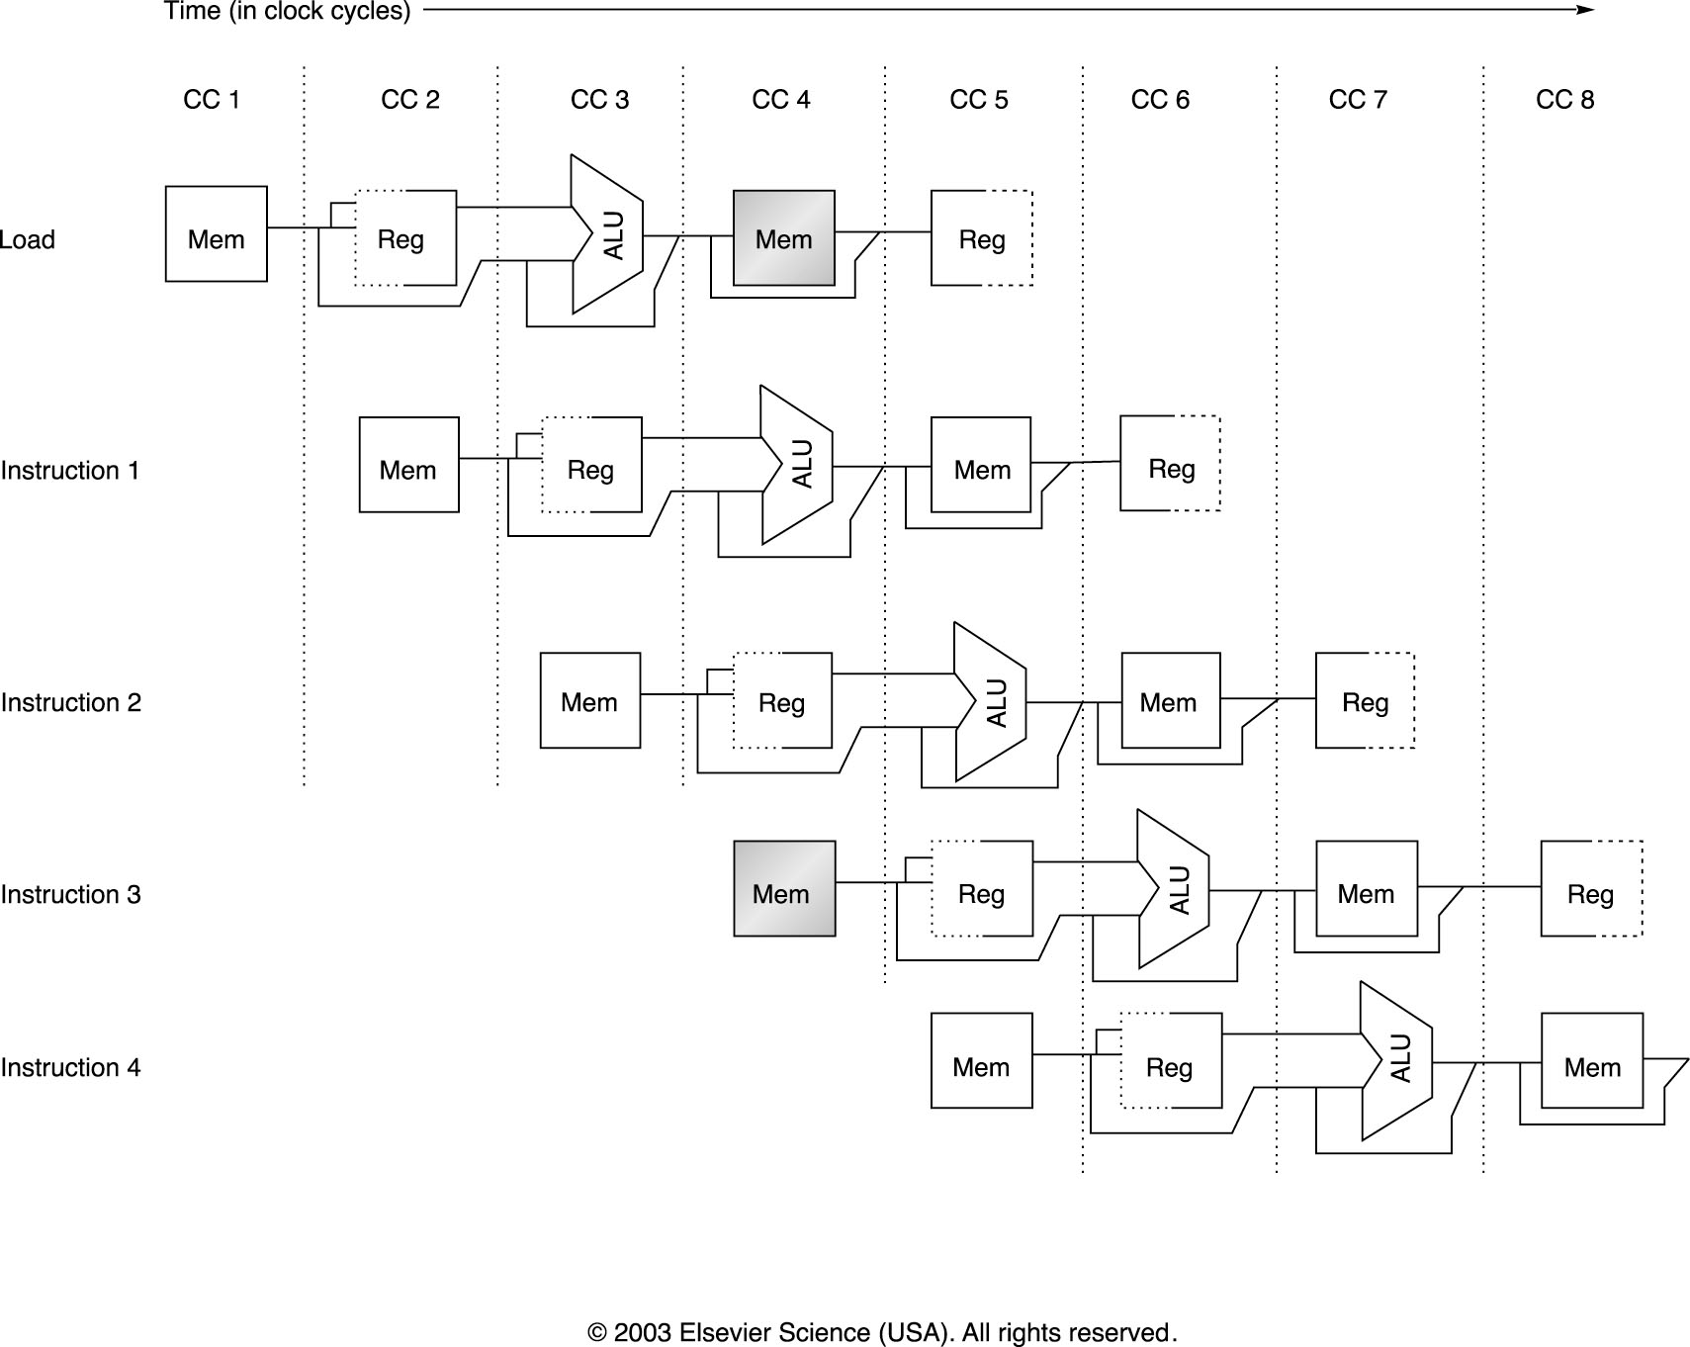
Example Structural Hazard Fig C.4

Slide 38
Pipeline Stalled for Structural Hazard
Clock cycle number (time ➔)
Instruction
Instruction n
Instruction n+1
Instruction n+2
Instruction n+3
Instruction n+4
1 | 2 | 3 | 4 | 5 | 6 | 7 | 8 | 9
IF | ID | EX | MEM | WB
 | IF | ID | EX | MEM* | WB
 |  | IF | ID | EX | MEM | WB
 |  |  | stall | IF | ID | EX | MEM | WB
 |  |  |  |  | stall | IF | ID | EX
MEM – a Memory cycle that is a load or Store
MEM* – a Memory cycle that is not a load or Store

Slide 39
Data Hazards

Slide 40
Data Hazard
Clock cycle number (time ➔)
DADD
DSUB
AND
OR
XOR
Instruction
R1, R2, R3
R4, R1, R5
R6, R1, R7
R8, R1, R9
R10, R1, R11
1 | 2 | 3 | 4 | 5 | 6 | 7 | 8 | 9
IM | ID | EX | DM | WB
 | IM | ID | EX | DM | WB
 |  | IM | ID | EX | DM | WB
 |  |  | IM | ID | EX | DM | WB
 |  |  |  | IM | ID | EX | DM | WB
IM – instruction Memory, DM – data memory

Slide 41
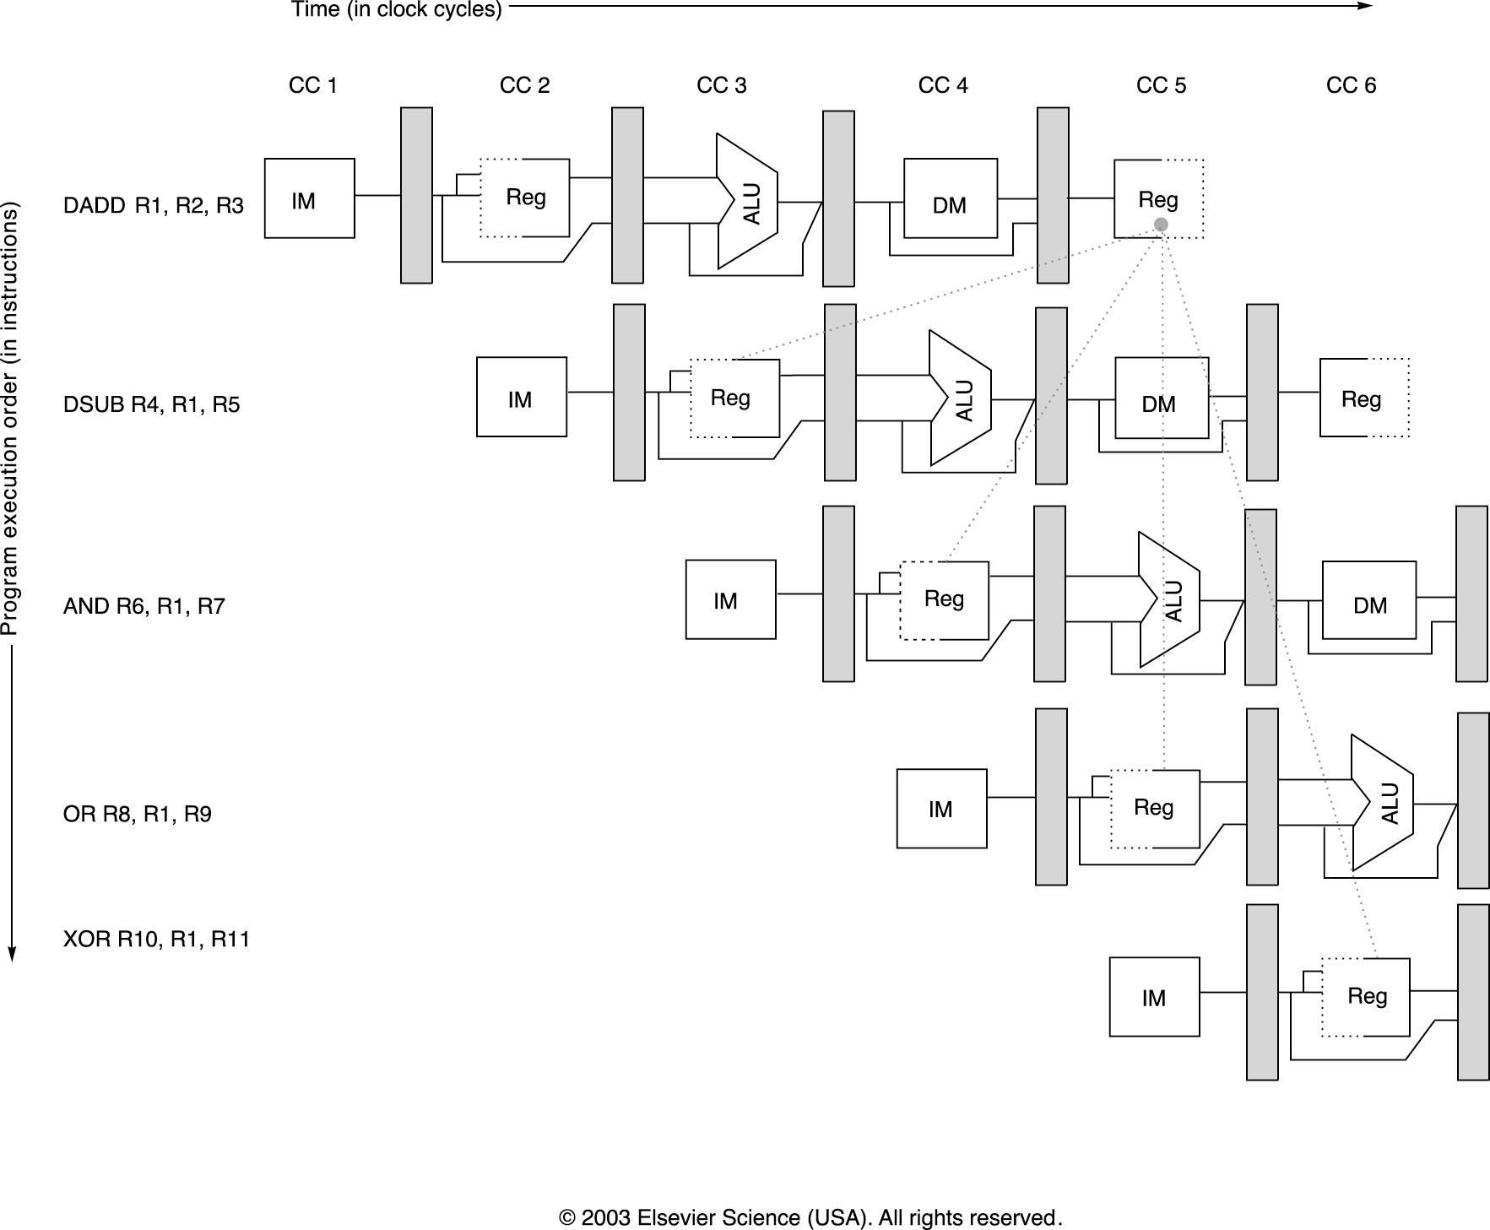
Figure C.6

Slide 42
Minimizing Data Hazard Stalls by Forwarding

Slide 43
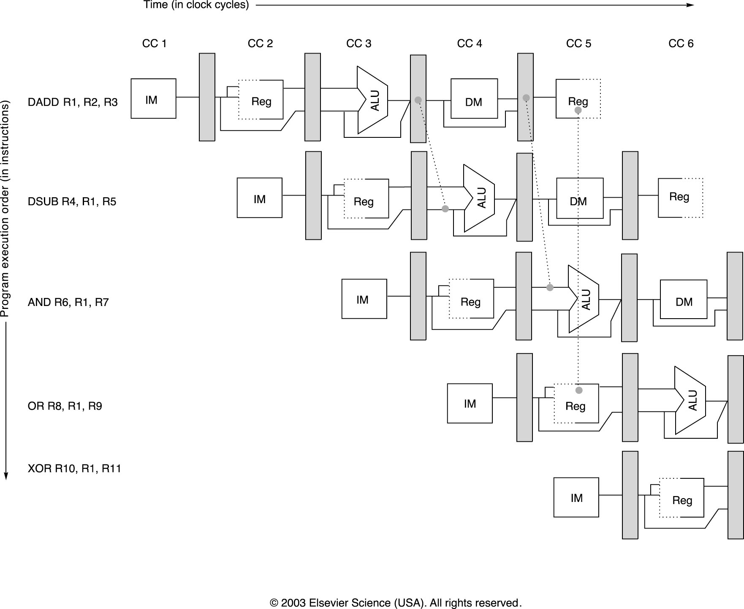
Fig C.7 Forwarding

Slide 44
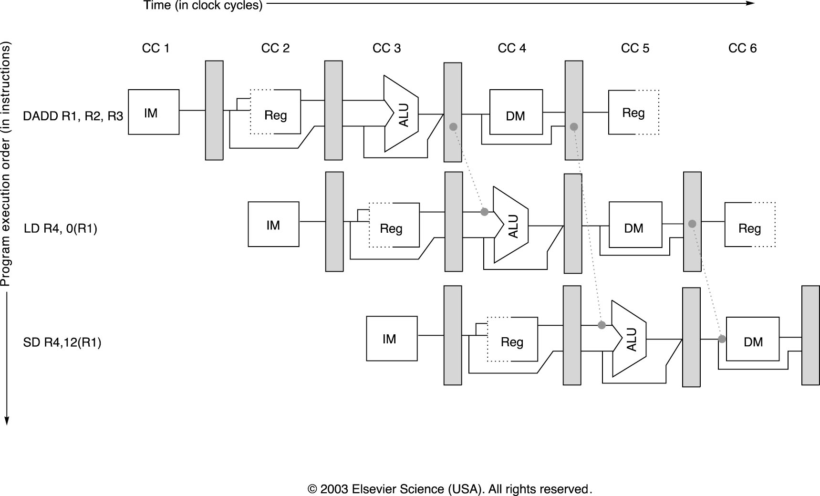
Forward of operands for Stores C.8

Slide 45
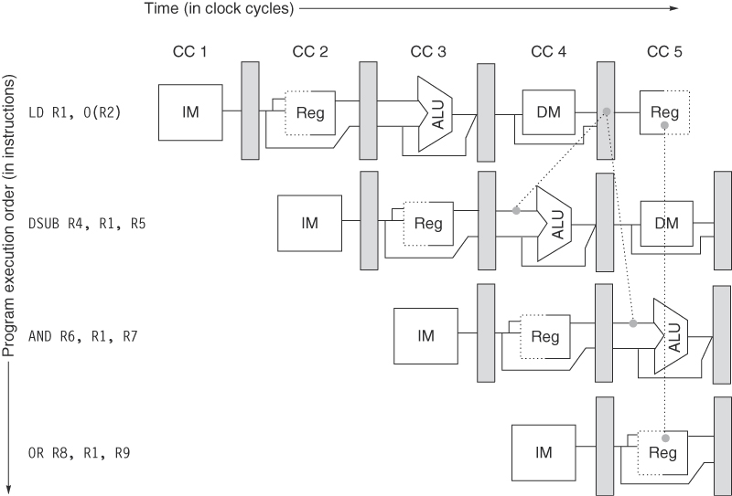
Figure C.9 (new slide) Data Forwarding
Figure C.9 The load instruction can bypass its results to the AND and OR instructions, but not to the DSUB, since that would mean forwarding the result in “negative time.”
Copyright © 2011, Elsevier Inc. All rights Reserved.

Slide 46
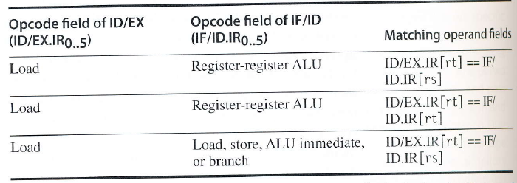
Logic to detect Hazards

Slide 47
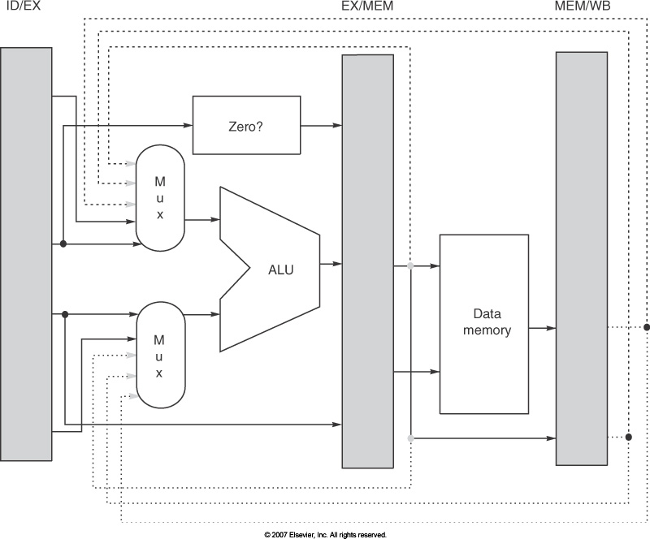
Figure C.23 Forwarding Paths

Slide 48
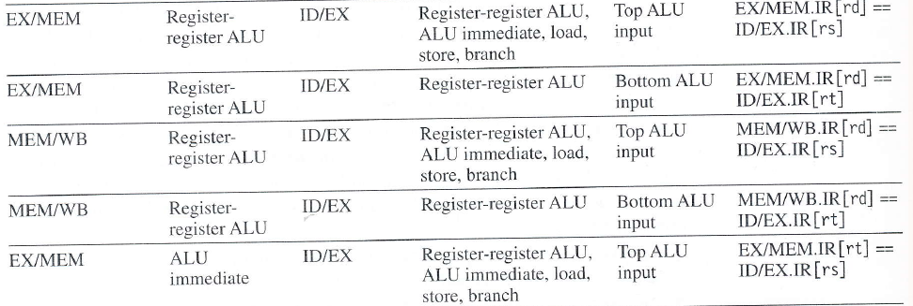
Forwarding Figure C.26
Pipeline Reg. Source | Opcode of Source | Pipeline Reg. Destination | Opcode of Destination | Destination of forwarding | Comparison (if equal then forward )

Slide 49
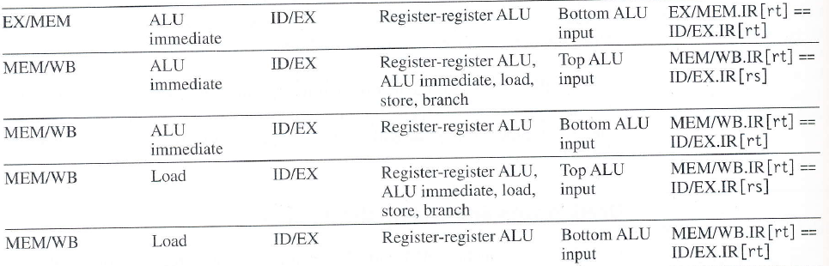
Pipeline Reg. Source | Opcode of Source | Pipeline Reg. Destination | Opcode of Destination | Destination of forwarding | Comparison (if equal then forward )

Slide 50
Figure C.23 Forwarding Paths

Slide 51
Load/Use Hazard

Slide 52
Control Hazrds

Slide 53
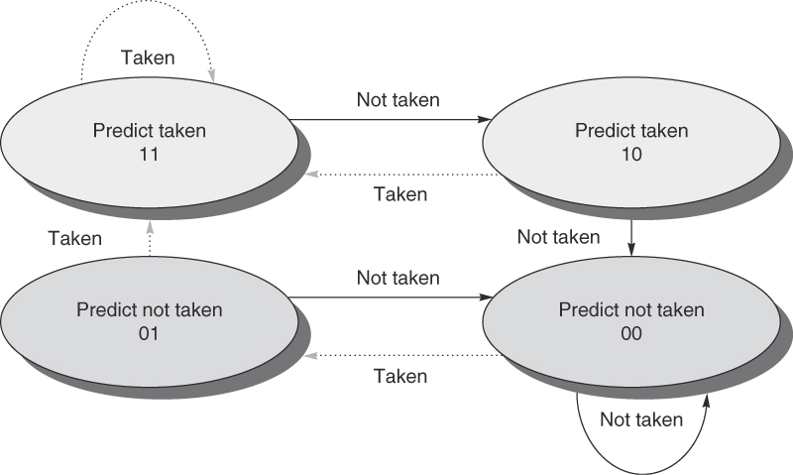
Figure C.18 The states in a 2-bit prediction scheme. By using 2 bits rather than 1, a branch that strongly favors taken or not taken—as many branches do—will be mispredicted less often than with a 1-bit predictor. The 2 bits are used to encode the four states in the system. The 2-bit scheme is actually a specialization of a more general scheme that has an n-bit saturating counter for each entry in the prediction buffer. With an n-bit counter, the counter can take on values between 0 and 2n – 1: When the counter is greater than or equal to one-half of its maximum value (2n – 1), the branch is predicted as taken; otherwise, it is predicted as untaken. Studies of n-bit predictors have shown that the 2-bit predictors do almost as well, thus most systems rely on 2-bit branch predictors rather than the more general n-bit predictors.

Slide 54
Pop Quiz
Suppose that your application is 60% parallelizable what is the overall Speedup in going from 1 core to 2?
Assuming Power and Frequency are linearly related how is the Dynamic Power affected by the improvement?

Slide 55
Plan of attack
Chapter reading plan
1➔
Appendix C(pipeline review)➔
Appendix B (Cache review)➔
Chapter 2 (Memory Hierarchy)➔
Appendix A (ISA review not really)
Chapter 3 (Instruction Level Parallelism ILP)➔
Chapter 4 (Data level parallelism➔
Chapter 5 (Thread level parallelism)
Chapter 6 (Warehouse-scale computing)
Sprinkle in other appendices
Website
Lectures
HW
Links
Errata ??
moodle
https://dropbox.cse.sc.edu/
CEC login/password
Systems
Simplescalar - pipeline
Beowulf cluster - MPI
GTX - multithreaded

