Slide 1
Lecture 2
Quantifying Performance
CSCE 513 Computer Architecture
Topics
  Speedup
  Amdahl’s law
  Execution time
Readings: Chapter 1
August 30, 2017

Slide 2
Overview
Last Time
  Overview:
  Speed-up
  Power wall, ILP wall, ➔ to multicore
  Def Computer Architecture
  Lecture 1 slides 1-29?
New
  Syllabus and other course pragmatics
    Website (not shown)
    Dates
  Figure 1.9 Trends: CPUs, Memory, Network, Disk
  Why geometric mean?
  Speed-up again
  Amdahl’s Law

Slide 3
Instruction Set Architecture (ISA)
“Myopic view of computer architecture”
ISAs – appendices A and K
  80x86
  ARM
  MIPS

Slide 4
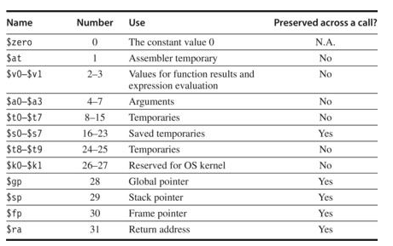
MIPS Register Usage Figure 1.4
Ref. CAAQA

Slide 5
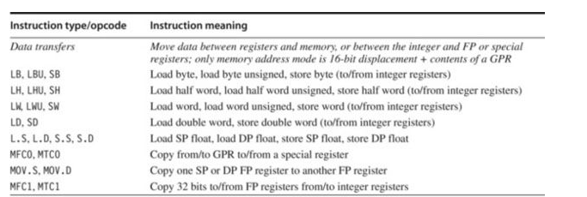
MIPS Instructions Fig 1.5 Data Transfers
Ref. CAAQA

Slide 6
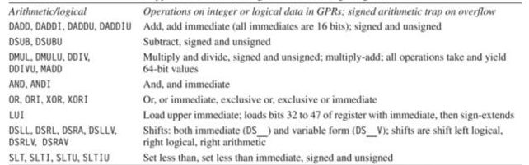
MIPS Instructions Fig 1.5 Arithmetic/Logical
Most significant bit is bit zero; lsb #63
Ref. CAAQA

Slide 7
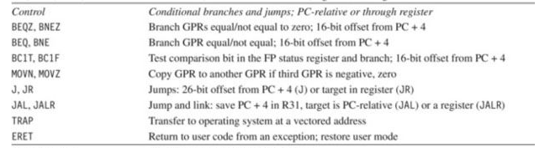
MIPS Instructions Fig 1.5 Control
Condition Codes set by ALU operations
PC Relative branches
Jumps
JumpAndLink
Return address on function call?
Return Address
Ref. CAAQA

Slide 8
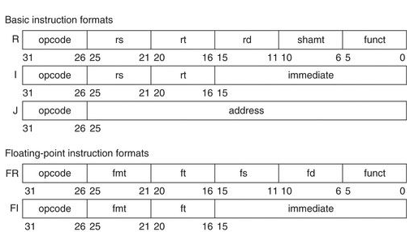
MIPS Instruction Format (RISC)
Ref. CAAQA

Slide 9
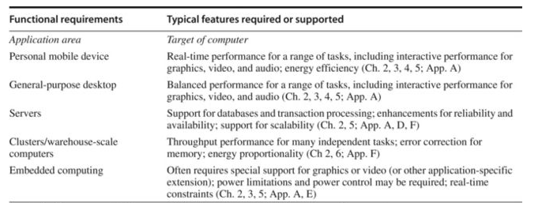
Fig 1.7 Requirement Challenges for Computer Architects
Level of software compatibility
Operating system requirements
Standards
Ref. CAAQA

Slide 10
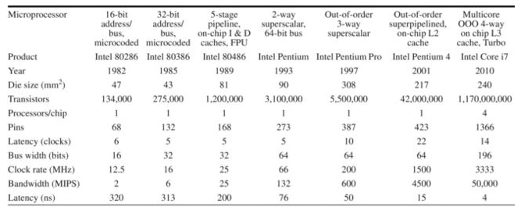
Fig 1.10 Performance over last 25-40 years
Processors
Ref. CAAQA

Slide 11
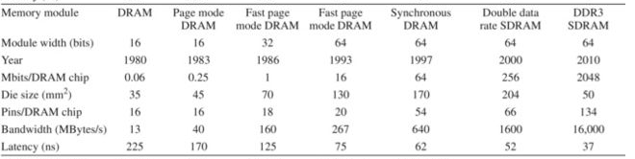
Fig 1.10 Performance over last 25-40 years
Memory
Ref. CAAQA

Slide 12
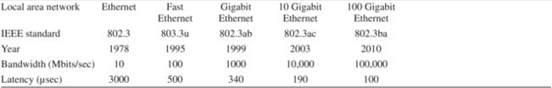
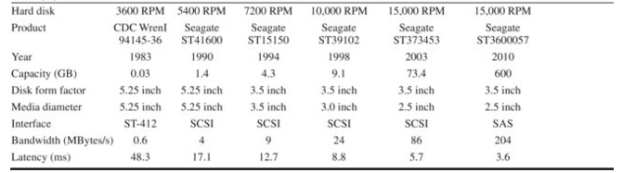
Fig 1.10 Performance over last 25-40 years
Networks
Disk
Ref. CAAQA

Slide 13
Fig 1.10 Performance over last 25-40 years
Processors
Ref. CAAQA

Slide 14
Quantitative Principles of Design
Take advantage of Parallelism
Principle of locality
  Temporal locality
  Spatial locality
Focus on the common case
Amdahl’s Law
Ref. CAAQA

Slide 15
Taking Advantage of Parallelism
Logic parallelism – carry lookahead adder
Word parallelism – SIMD
Instruction pipelining – overlap fetch and execute
Multithreads – executing independent instructions at the same time
Speculative execution -
Ref. CAAQA

Slide 16
Principle of Locality
Rule of thumb – (Zipf’s law?? Not really)
A program spends 90% of its execution time in only 10% of the code.
So what do you try to optimize?
Locality of memory references
Temporal locality
Spatial locality

Slide 17
Execution Time of enhanced systems
Suppose you have an enhancement or improvement in a design component.
The improvement in the performance of the system is limited by the % of the time the enhancement can be used

Slide 18
Amdahl’s Law
Suppose you have an enhancement or improvement in a design component.
The improvement in the performance of the system is limited by the % of the time the enhancement can be used
Ref. CAAQA

Slide 19
Amdahl’s with Fractional Use Factor
Example: Suppose we are considering an enhancement to a web server. The enhanced CPU is 10 times faster on computation but the same speed on I/O. Suppose also that 60% of the time is waiting on I/O
Ref. CAAQA

Slide 20
Amdahl’s Law revisited
Speedup = (execution time without enhance.) / (execution time with enhance.)
= (time without) / (time with) = T_{wo} / T_{with}
Notes
The enhancement will be used only a portion of the time.
If it will be rarely used then why bother trying to improve it
Focus on the improvements that have the highest fraction of use time denoted Fraction_{enhanced}.
Note Fraction_{enhanced} is always less than 1.
Then
Ref. CAAQA

Slide 21
Amdahl’s with Fractional Use Factor
Ref. CAAQA

Slide 22
Amdahl’s with Fractional Use Factor
Example: Suppose we are considering an enhancement to a web server. The enhanced CPU is 10 times faster on computation but the same speed on I/O. Suppose also that 60% of the time is waiting on I/O
Ref. CAAQA

Slide 23
Graphics Square Root Enhancement p 40
NewDesign1 FPSQRT
20% speed up FPSQR 10 times
NewDesign2 FP
improve all FP by 1.6; FP=50% of exec time
Ref. CAAQA

Slide 24
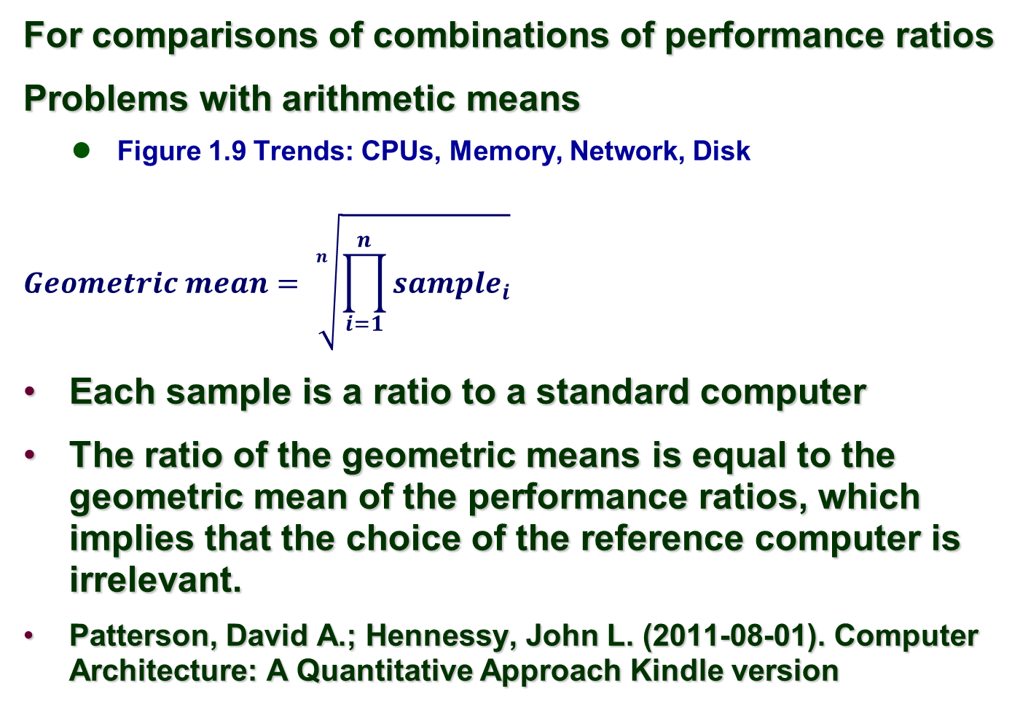
Geometric Means vs Arithmetic Means
Ref. CAAQA

Slide 25
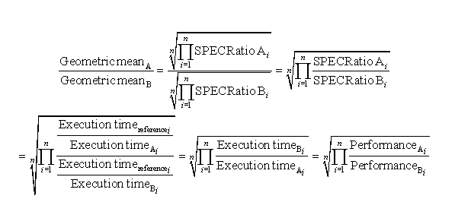
Comparing 2 computers Spec_Ratios
Ref. CAAQA

Slide 26
Performance Measures
Response time (latency) -- time between start and completion
Throughput (bandwidth) -- rate -- work done per unit time
Processor Speed – e.g. 1GHz
When does it matter?
When does it not?
Ref. CAAQA

Slide 27
Availability
Ref. CAAQA

Slide 28
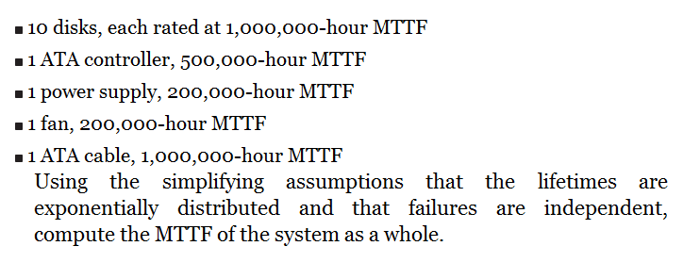
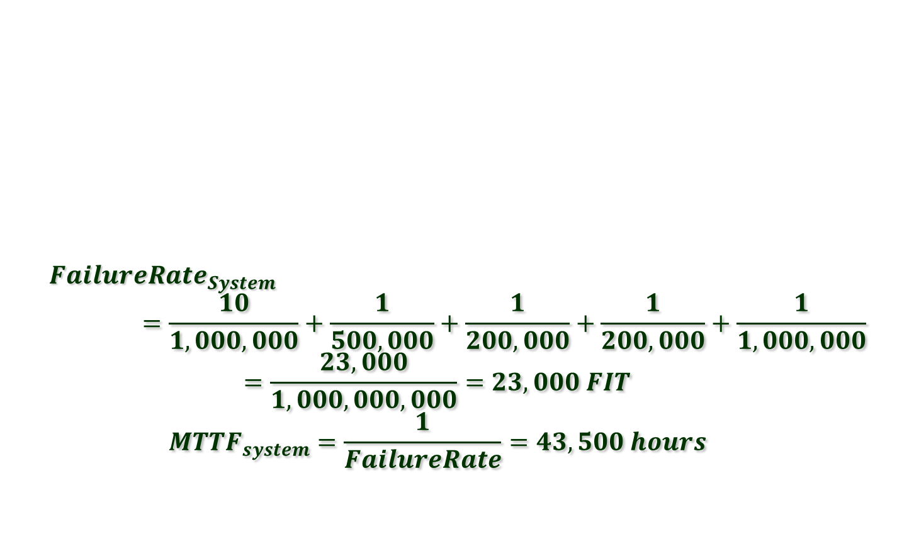
MTTF Example
Ref. CAAQA

Slide 29
Comparing Performance fig 1.15
Comparing three program executing on three machines
 | Computer A | Computer B | Computer C
Program P1 | 1 | 10 | 20
Program P2 | 1000 | 100 | 20
Total Times | 1001 | 110 | 40
Faster than relationships
A is 10 times faster than B on program 1
B is 10 times faster than A on program 2
C is 50 times faster than A on program 2
… 3 * 2 comparisons (3 choose 2 computers * 2 programs)
So what is the relative performance of these machines???
Ref. CAAQA

Slide 30
fig 1.15 Total Execution times
Comparing three program executing on three machines
 | Computer A | Computer B | Computer C
Program P1 | 1 | 10 | 20
Program P2 | 1000 | 100 | 20
Total times | 1001 | 110 | 40
So now what is the relative performance of these machines???
B is 1001/110 = 9.1 times as fast as A
Arithmetic mean execution time =
Ref. CAAQA

Slide 31
Weighted Execution Times fig 1.15
 | Computer A | Computer B | Computer C
Program P1 | 1 | 10 | 20
Program P2 | 1000 | 100 | 20
Program P3 | 1001 | 110 | 40
Now assume that we know that P1 will run 90%, and P2 10% of the time.
So now what is the relative performance of these machines???
timeA = .9*1 + .1*1000 = 100.9
timeB = .9*10 +.1*100 = 19
Relative performance A to B = 100.9/19 = 5.31
Ref. CAAQA

Slide 32
Geometric Means
Compare ratios of performance to a standard
Using A as the standard
program 1 B ratio = 10/1 = 10 C ratio = 20/1 = 20
program 2 Br = 100/1000 = .1 Cr = 20/1000 = .02
B is “twice as fast” as C using A as the standard
Using B as the standard
program 1 Ar = 1/10 = .1 Cr =
program 2 Br = 1000/100 = 10 Cr =
So now compare A and B ratios to each other you get the same 10 and .1, so what? Same ?
Ref. CAAQA

Slide 33
Geometric Means fig 1.17
Measure performance ratios to a standard machine
 | Normalized to A |  |  | Normalized to B |  |  | Normalized to C
 | A | B | C | A | B | C | A | B | C
P1 | 1.0 | 10.0 | 20.0 | .1 | 1.0 | 2.0 | .05 | .5 | 1.0
P2 | 1.0 | .1 | .02 | 10 | 1.0 | .2 | 50. | 5.0 | 1.0
Arithmetic mean | 1.0 | 5.05 | 10.01 | 5.05 | 1.0 | 1.1 | 25.03 | 2.75 | 1.0
Geometric Mean | 1.0 | 1.0 | .63 | 1.0 | 1.0 | .63 | 1.58 | 1.58 | 1.0
Total Time | 1.0 | .11 | .4 | 9.1 | 1.0 | .36 | 25.03 | 2.75 | 1.0
Ref. CAAQA

Slide 34
CPU Performance Equation
Almost all computers use a clock running at a fixed rate.
Clock period e.g. 1GHz
Instruction Count (IC) –
CPI = CPUclockCyclesForProgram / InstructionCount
CPUtime = IC * ClockCycleTime * CyclesPerInstruction
Ref. CAAQA

Slide 35
CPU Performance Equation
CPUtime =
Instruction Count
CPI
Clock cycle time
Ref. CAAQA

Slide 36
Fallacies and Pitfalls
Pitfall: Falling prey to Amdahl’s law.
Pitfall: A single point of failure.
Fallacy: the cost of the processor dominates the cost of the system.
Fallacy: Benchmarks remain valid indefinitely.
The rated mean time to failure of disks is 1,2000,000 hours or almost 140 years, so disks practically never fail.
Fallacy Peak performance tracks observed performance.
Pitfall: Fault detection can lower availability.
Ref. CAAQA

Slide 37
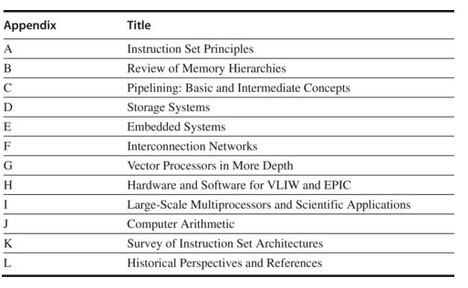
List of Appendices
Ref. CAAQA

Slide 38
Homework Set #1
Due Friday Sept 6 (Dropbox )
1.5
1.8 a-d (Change 2015 throughout the question ➔ 2017)
1.9
1.18
George K. Zipf (1949) Human Behavior and the Principle of Least Effort. Addison-Wesley

Slide 39
1.8 [10/ 15/ 15/ 10/ 10] < 1.4, 1.5 > One challenge for architects is that the design created today will require several years of implementation, verification, and testing before appearing on the market. This means that the architect must project what the technology will be like several years in advance. Sometimes, this is difficult to do.
[10] < 1.4 > According to the trend in device scaling observed by Moore’s law, the number of transistors on a chip in 2015 should be how many times the number in 2005?
b. [15] < 1.5 > The increase in clock rates once mirrored this trend. Had clock rates continued to climb at the same rate as in the 1990s, approximately how fast would clock rates be in 2015?
c. [15] < 1.5 > At the current rate of increase, what are the clock rates now projected to be in 2015?
d. [10] < 1.4 > What has limited the rate of growth of the clock rate, and what are architects doing with the extra transistors now to increase performance?
Patterson, David A.; Hennessy, John L. (2011-08-01). Computer Architecture: A Quantitative Approach (The Morgan Kaufmann Series in Computer Architecture and Design) (Kindle Locations 2203-2217). Elsevier Science (reference). Kindle Edition.

Slide 40
Zipf's law
Zipf's law states that given some corpus of natural language utterances, the frequency of any word is inversely proportional to its rank in the frequency table.
Thus the most frequent word will occur approximately twice as often as the second most frequent word, three times as often as the third most frequent word, etc.: the rank-frequency distribution is an inverse relation.
in the Brown Corpus of American English text,
  "the" is the most frequently occurring word, and by itself accounts for nearly 7% of all word occurrences
  True to Zipf's Law, the second-place word "of" accounts for slightly over 3.5% of words (36,411 occurrences),
  followed by "and" (28,852). Only 135 vocabulary items are needed to account for half the Brown Corpus.^{[4]}

Slide 42
Stages of Classical 5-stage pipeline
Instruction Fetch Cycle
  IR ← Mem[PC]
  NPC ← PC + 4
Decode
  A ← Regs[rs]
  B ←
  Imm ← sign-extend of
Execute
  .
Memory
  .
Write Back
  .

Slide 43
Simple RISC Pipeline
Clock cycle number (time ➔)
Instruction
Instruction n
Instruction n+1
Instruction n+2
Instruction n+3
Instruction n+4
1 | 2 | 3 | 4 | 5 | 6 | 7 | 8 | 9
IF | ID | EX | MEM | WB
 | IF | ID | EX | MEM | WB
 |  | IF | ID | EX | MEM | WB
 |  |  | IF | ID | EX | MEM | WB
 |  |  |  | IF | ID | EX | MEM | WB

Slide 44
Performance Analysis in Perfect World
Assuming S stages in the pipeline.
At each cycle a new instruction is initiated.
To execute N instructions takes:
N cycles to start-up instructions
(S-1) cycles to flush the pipeline
TotalTime = N + (S-1)
Example for S=5 from previous slide N=100 instructions
Time to execute in non-pipelined = 100 * 5 = 500 cycles
Time to execute in pipelined version = 100 + (5-1) = 104 cycles
SpeedUp = …

Slide 45
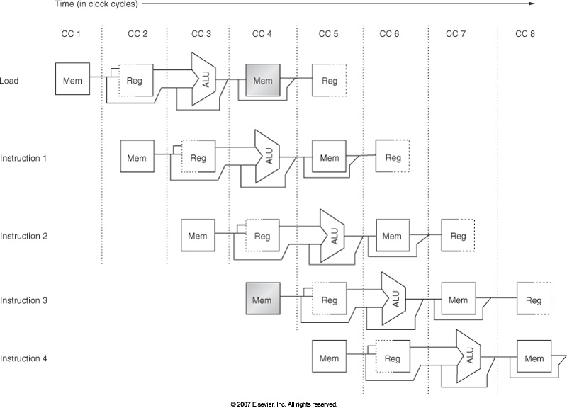
Implement Pipelines Supp. Fig C.4

Slide 46
Pipeline Example with a problem (A.5 like)
DADD
DSUB
AND
OR
XOR
Instruction
R1, R2, R3
R4, R1, R5
R6, R1, R7
R8, R1, R9
R10, R1, R11
1 | 2 | 3 | 4 | 5 | 6 | 7 | 8 | 9
IM | ID | EX | DM | WB
 | IM | ID | EX | DM | WB
 |  | IM | ID | EX | DM | WB
 |  |  | IM | ID | EX | DM | WB
 |  |  |  | IM | ID | EX | DM | WB

Slide 47
Inserting Pipeline Registers into Data Path fig A’.18

Slide 48
Major Hurdle of Pipelining
Consider executing the code below
DADD R1, R2, R3 /* R1⬅ R2 + R3 */
DSUB R4, R1, R5 /* R4⬅ R1 + R5 */
AND R6, R1, R7 /* R6⬅ R1 + R7 */
OR R8, R1, R9 /* R8⬅ R1 | R9 */
XOR R10, R1, R11 /* R10 ⬅ R1 ^ R11 */

Slide 49
RISC Pipeline Problems
Clock cycle number (time ➔)
DADD
DSUB
AND
OR
XOR
Instruction
R1, R2, R3
R4, R1, R5
R6, R1, R7
R8, R1, R9
R10, R1, R11
1 | 2 | 3 | 4 | 5 | 6 | 7 | 8 | 9
IM | ID | EX | DM | WB
 | IM | ID | EX | DM | WB
 |  | IM | ID | EX | DM | WB
 |  |  | IM | ID | EX | DM | WB
 |  |  |  | IM | ID | EX | DM | WB
So what’s the problem?

Slide 50
Hazards
Data Hazards – a data value computed in one stage is not ready when it is needed in another stage of the pipeline
Simple Solution: stall until it is ready but we can do better
Control or Branch Hazards
Structural Hazards – arise when resources are not sufficient to completely overlap instruction sequence e.g. two floating point add units then having to do three simultaneously

