Slide 1
Lecture 1
Overview of Computer Architecture
CSCE 513 Computer Architecture
Topics
Overview
Readings: Chapter 1
August 28, 2017

Slide 2
Course Pragmatics
Syllabus
  Instructor: Manton Matthews
  Teaching Assistant: Xiaopeng Li (xl4@email.sc.edu) Website: http://www.cse.sc.edu/~matthews/Courses/513/index.html
  Text
    Computer Architecture: A Quantitative Approach, 5th ed.," John L. Hennessey and David A. Patterson, Morgan Kaufman, 2011
  Important Dates
    http://registrar.sc.edu/html/calendar5yr/5YrCalendar3.stm
  Academic Integrity

Slide 3
Overview
New
  Syllabus
  What you should know!
  What you will learn (Course Overview)
    Instruction Set Design
    Pipelining (Appendix A)
    Instruction level parallelism
    Memory Hierarchy
    Multiprocessors
  Why you should learn this

Slide 4
What is Computer Architecture?
Computer Architecture is those aspects of the instruction set available to programmers, independent of the hardware on which the instruction set was implemented.
The term computer architecture was first used in 1964 by Gene Amdahl, G. Anne Blaauw, and Frederick Brooks, Jr., the designers of the IBM System/360.
The IBM/360 was a family of computers all with the same architecture, but with a variety of organizations(implementations).

Slide 5
Genuine Computer Architecture
Designing the Organization and Hardware to Meet Goals and Functional Requirements
two processors with the same instruction set architectures but different organizations are the AMD Opteron and the Intel Core i7.

Slide 6
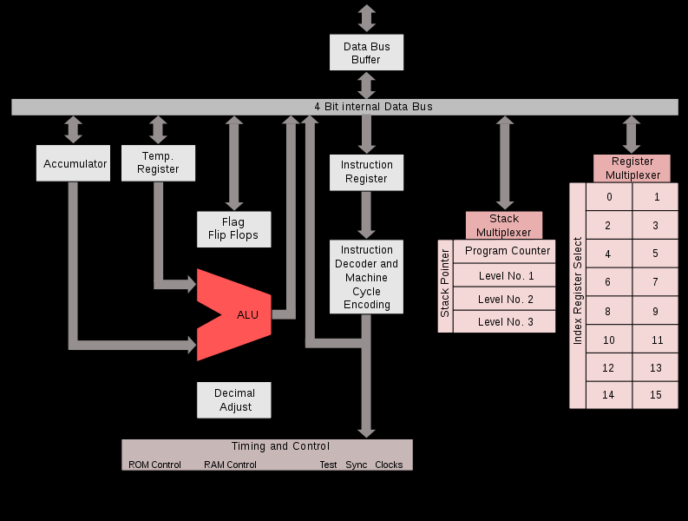
What you should know
http://en.wikipedia.org/wiki/Intel_4004 (1971)
Steps in Execution
Load Instruction
Decode
.
.
.
.

Slide 7
Crossroads: Conventional Wisdom in Comp. Arch
Old Conventional Wisdom: Power is free, Transistors expensive
New Conventional Wisdom: “Power wall” Power expensive, Xtors free
(Can put more on chip than can afford to turn on)
Old CW: Sufficiently increasing Instruction Level Parallelism via compilers, innovation (Out-of-order, speculation, VLIW, …)
New CW: “ILP wall” law of diminishing returns on more HW for ILP
Old CW: Multiplies are slow, Memory access is fast
New CW: “Memory wall” Memory slow, multiplies fast
(200 clock cycles to DRAM memory, 4 clocks for multiply)
Old CW: Uniprocessor performance 2X / 1.5 yrs
New CW: Power Wall + ILP Wall + Memory Wall = Brick Wall
  Uniprocessor performance now 2X / 5(?) yrs
⇒ Sea change in chip design: multiple “cores”
(2X processors per chip / ~ 2 years)
    More simpler processors are more power efficient

Slide 8
Computer Arch. a Quantitative Approach
Hennessy and Patterson
  Patterson UC Berkeley
  Hennessy – Stanford
  Preface – Bill Joy of Sun Micro Systems
Evolution of Editions
  Almost universally used for graduate courses in architecture
  Pipelines moved to appendix A ??
  Path through 1➔ appendix A ➔2…

Slide 9
Want a Supercomputer?
Today, less than $ 500 will purchase a mobile computer that has more performance, more main memory, and more disk storage than a computer bought in 1985 for $ 1 million.
Patterson, David A.; Hennessy, John L. (2011-08-01). Computer Architecture: A Quantitative Approach (The Morgan Kaufmann Series in Computer Architecture and Design) (Kindle Locations 609-610). Elsevier Science (reference). Kindle Edition.

Slide 10
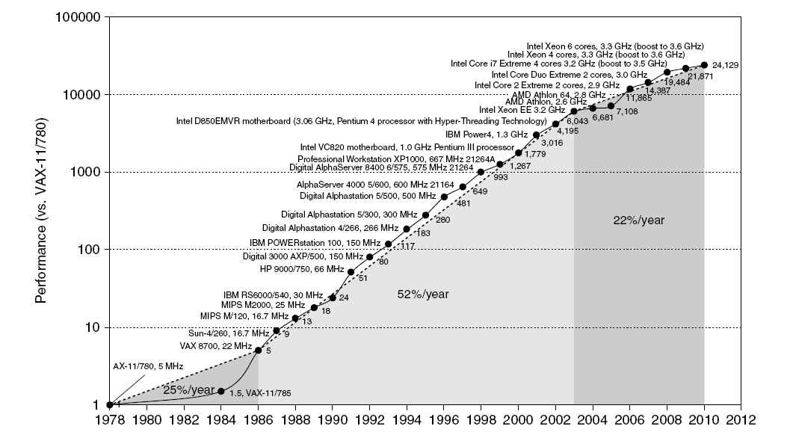
Single Processor Performance
Introduction
Move to multi-processor
RISC

Slide 11
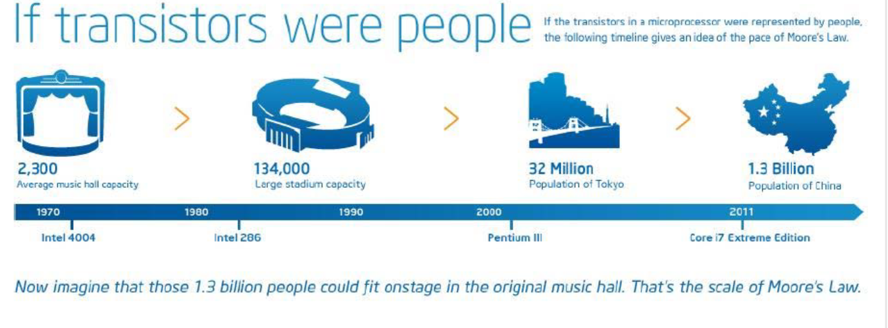
Moore’s Law
Gordon Moore, one of the founders of Intel
  In 1965 he predicted the doubling of the number of transistors per chip every couple of years for the next ten years
  http://www.intel.com/research/silicon/mooreslaw.htm
  http://www.intel.com/research/silicon/mooreslaw.htm

Slide 12
Transistors and Wires
Trends in Technology
Feature size
  Minimum size of transistor or wire in x or y dimension
  10 microns in 1971 to .032 microns in 2011
  10 *10⁻⁶ = 10⁻⁵➔ .032 *10⁻⁶ = 3*10⁻⁸➔
  Transistor performance scales linearly
    Wire delay does not improve with feature size!
  Integration density scales quadratically

Slide 13
Current Trends in Architecture
Introduction
Cannot continue to leverage Instruction-Level parallelism (ILP)
  Single processor performance improvement ended in 2003
New models for performance:
  Data-level parallelism (DLP)
  Thread-level parallelism (TLP)
  Request-level parallelism (RLP)
These require explicit restructuring of the application

Slide 14
Classes of Computers
Personal Mobile Device (PMD)
  e.g. start phones, tablet computers
  Emphasis on energy efficiency and real-time
Desktop Computing
  Emphasis on price-performance
Servers
  Emphasis on availability, scalability, throughput
Clusters / Warehouse Scale Computers
  Used for “Software as a Service (SaaS)”
  Emphasis on availability and price-performance
  Sub-class: Supercomputers, emphasis: floating-point performance and fast internal networks
Embedded Computers
  Emphasis: price
Classes of Computers

Slide 15
Parallelism
Classes of Computers
Classes of parallelism in applications:
  Data-Level Parallelism (DLP)
  Task-Level Parallelism (TLP)
Classes of architectural parallelism:
  Instruction-Level Parallelism (ILP)
  Vector architectures/Graphic Processor Units (GPUs)
  Thread-Level Parallelism
  Request-Level Parallelism

Slide 16
Main Memory
DRAM – dynamic RAM – one transistor/capacitor per bit
SRAM – static RAM – four to 6 transistors per bit
DRAM density increases approx. 50% per year
DRAM cycle time decreases slowly (DRAMs have destructive read-out, like old core memories, and data row must be rewritten after each read)
DRAM must be refreshed every 2-8 ms
Memory bandwidth improves about twice the rate that cycle time does due to improvements in signaling conventions and bus width

Slide 17
Trends in Technology
Trends in Technology
Integrated circuit technology
  Transistor density: 35%/year
  Die size: 10-20%/year
  Integration overall: 40-55%/year
DRAM capacity: 25-40%/year (slowing)
Flash capacity: 50-60%/year
  15-20X cheaper/bit than DRAM
Magnetic disk technology: 40%/year
  15-25X cheaper/bit then Flash
  300-500X cheaper/bit than DRAM

Slide 18
Power and Energy
Problem: Get power in, get power out
Thermal Design Power (TDP)
  Characterizes sustained power consumption
  Used as target for power supply and cooling system
  Lower than peak power, higher than average power consumption
Clock rate can be reduced dynamically to limit power consumption
Energy per task is often a better measurement
Trends in Power and Energy

Slide 19
Dynamic Energy and Power
Dynamic energy
  Transistor switch from 0 -> 1 or 1 -> 0
  ½ x Capacitive load x Voltage²
Dynamic power
  ½ x Capacitive load x Voltage² x Frequency switched
Reducing clock rate reduces power, not energy
Trends in Power and Energy

Slide 20

Energy Power example
Example Some microprocessors today are designed to have adjustable voltage, so a 15% reduction in voltage may result in a 15% reduction in frequency. What would be the impact on dynamic energy and on dynamic power?
Answer Since the capacitance is unchanged, the answer for energy is the ratio of the voltages since the capacitance is unchanged:
CAAQA

Slide 21
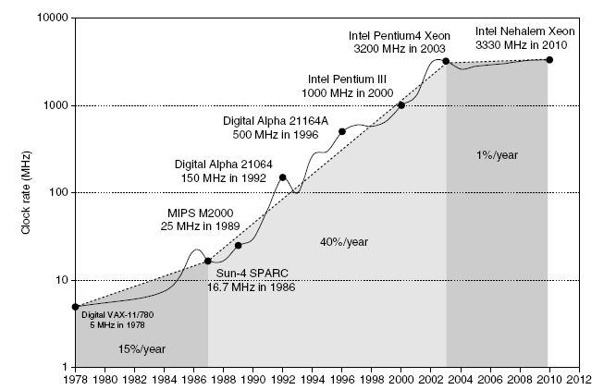
Power
Intel 80386 consumed ~ 2 W
3.3 GHz Intel Core i7 consumes 130 W
Heat must be dissipated from 1.5 x 1.5 cm chip
This is the limit of what can be cooled by air
Trends in Power and Energy

Slide 22
Reducing Power
Techniques for reducing power:
  Do nothing well
  Dynamic Voltage-Frequency Scaling
  Low power state for DRAM, disks
  Overclocking, turning off cores
Trends in Power and Energy

Slide 23
Static Power
Static power consumption
  Current_{static} x Voltage
  Scales with number of transistors
  To reduce: power gating
Trends in Power and Energy

Slide 24
Intel Multi-core processors I-7 980
Frequently Asked Questions: Intel® Multi-Core Processor Architecture
Essential Concepts
The Move to Multi-Core Architecture Explained
How to Benefit from Multi-Core Architecture
Challenges in Multithreaded Programming
How Intel Can Help
Additional Resources
.
https://software.intel.com/en-us/articles/frequently-asked-questions-intel-multi-core-processor-architecture/

Slide 25
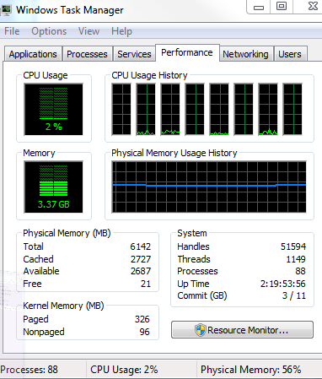
Quad Core Intel I7

Slide 26
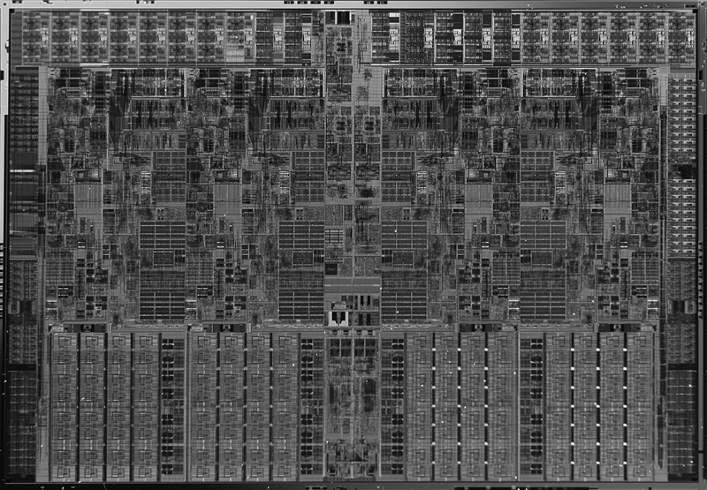
Figure 1.13 Photograph of an Intel Core i7 microprocessor die, which is evaluated in Chapters 2 through 5. The dimensions are 18.9 mm by 13.6 mm (257 mm2) in a 45 nm process. (Courtesy Intel.)

Slide 27
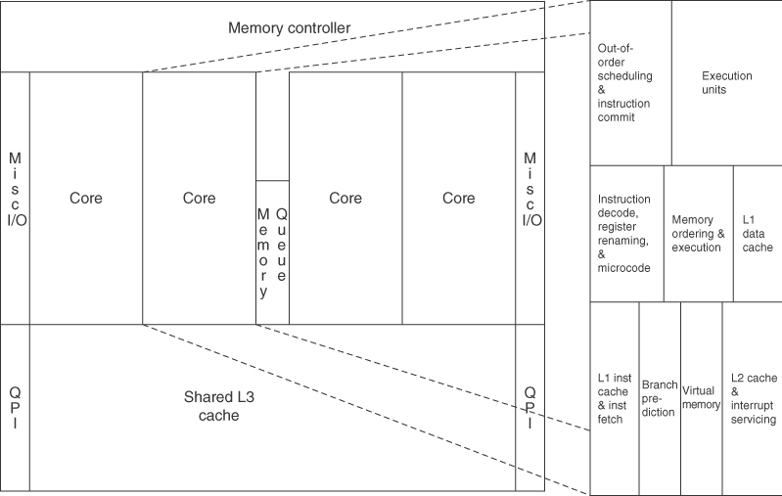
Figure 1.14 Floorplan of Core i7 die in Figure 1.13 on left with close-up of floorplan of second core on right.

Slide 28
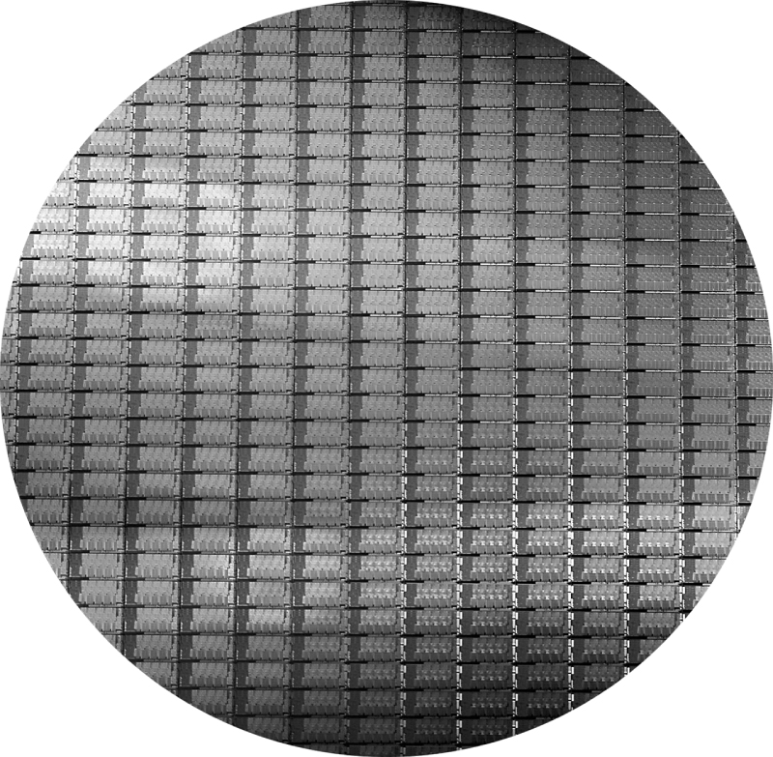
Figure 1.15 This 300 mm wafer contains 280 full Sandy Bridge dies, each 20.7 by 10.5 mm in a 32 nm process. (Sandy Bridge is Intel’s successor to Nehalem used in the Core i7.) At 216 mm2, the formula for dies per wafer estimates 282. (Courtesy Intel.)

Slide 29
Cost of IC’s
Cost of IC = (Cost of die + cost of testing die + cost of packaging and final test) / (Final test yield)
Cost of die = Cost of wafer / (Dies per wafer * die yield)
Dies per wafer is wafer area divided by die area, less dies along the edge
= (wafer area) / (die area) - (wafer circumference) / (die diagonal)
Die yield = (Wafer yield) * ( 1 + (defects per unit area * die area/alpha) ) ** (-alpha)

Slide 30
Classes of Computers
Personal Mobile Device (PMD)
  e.g. start phones, tablet computers
  Emphasis on energy efficiency and real-time
Desktop Computing
  Emphasis on price-performance
Servers
  Emphasis on availability, scalability, throughput
Clusters / Warehouse Scale Computers
  Used for “Software as a Service (SaaS)”
  Emphasis on availability and price-performance
  Sub-class: Supercomputers, emphasis: floating-point performance and fast internal networks
Embedded Computers
  Emphasis: price
Classes of Computers

Slide 31
Performance Measures
Response time (latency) -- time between start and completion
Throughput (bandwidth) -- rate -- work done per unit time
Speedup -- B is n times faster than A
  Means exec_time_A/exec_time_B == rate_B/rate_A
Other important measures
power (impacts battery life, cooling, packaging)
RAS (reliability, availability, and serviceability)
scalability (ability to scale up processors, memories, and I/O)

Slide 32
Bandwidth and Latency
Trends in Technology
Bandwidth or throughput
  Total work done in a given time
  10,000-25,000X improvement for processors
  300-1200X improvement for memory and disks
Latency or response time
  Time between start and completion of an event
  30-80X improvement for processors
  6-8X improvement for memory and disks

Slide 33
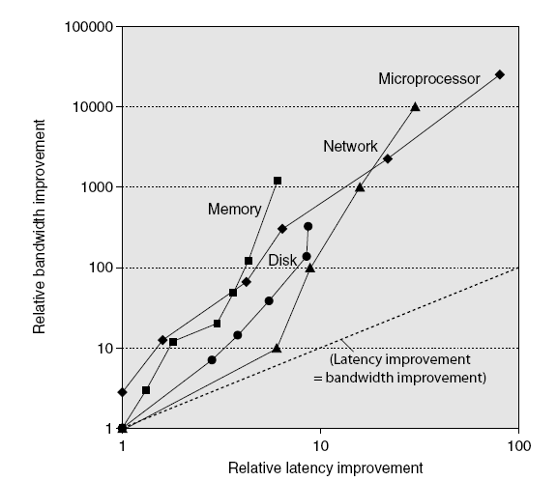
Bandwidth and Latency
Trends in Technology
Log-log plot of bandwidth and latency milestones

Slide 34
Measuring Performance
Time is the measure of computer performance
Elapsed time = program execution + I/O + wait -- important to user
Execution time = user time + system time (but OS self measurement may be inaccurate)
CPU performance = user time on unloaded system -- important to architect

Slide 35
Real Performance
Benchmark suites
Performance is the result of executing a workload on a configuration
Workload = program + input
Configuration = CPU + cache + memory + I/O + OS + compiler + optimizations
compiler optimizations can make a huge difference!

Slide 36
Benchmark Suites
Whetstone (1976) -- designed to simulate arithmetic-intensive scientific programs.
Dhrystone (1984) -- designed to simulate systems programming applications. Structure, pointer, and string operations are based on observed frequencies, as well as types of operand access (global, local, parameter, and constant).
PC Benchmarks – aimed at simulating real environments
  Business Winstone – navigator + Office Apps
  CC Winstone –
  Winbench -

Slide 37
Comparing Performance
Total execution time (implies equal mix in workload)
  Just add up the times
Arithmetic average of execution time
  To get more accurate picture, compute the average of several runs of a program
Weighted execution time (weighted arithmetic mean)
  Program p1 makes up 25% of workload (estimated), P2 75% then use weighted average

Slide 38
Comparing Performance cont.
Normalized execution time or speedup (normalize relative to reference machine and take average)
SPEC benchmarks (base time a SPARCstation)
Arithmetic mean sensitive to reference machine choice
Geometric mean consistent but cannot predict execution time
  Nth root of the product of execution time ratios
  Combining samples

Slide 39
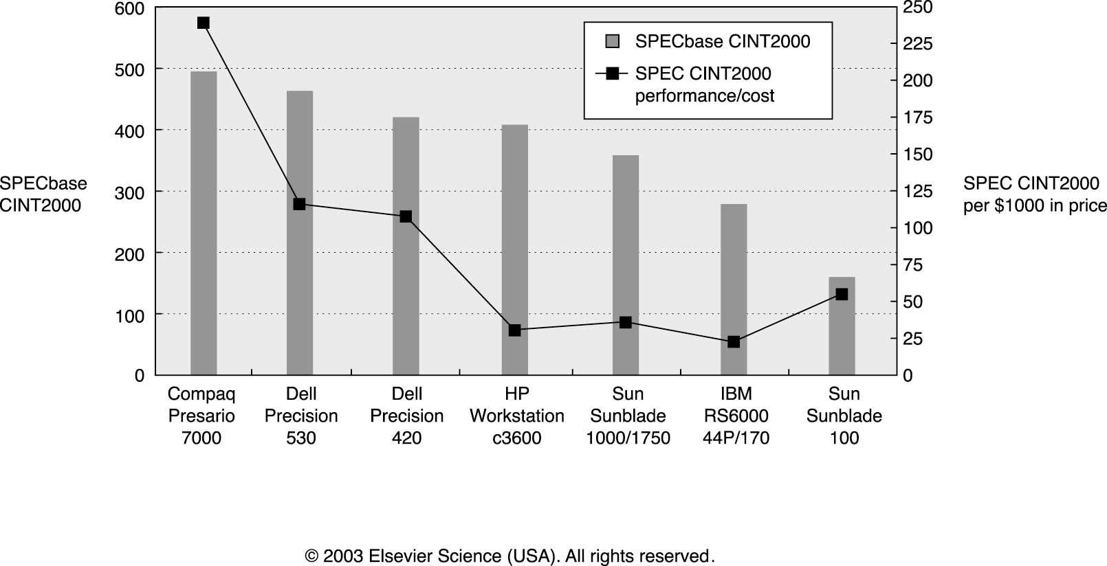

Slide 40
Improve Performance by
changing the
  algorithm
  data structures
  programming language
  compiler
  compiler optimization flags
  OS parameters
improving locality of memory or I/O accesses
overlapping I/O
on multiprocessors, you can improve performance by avoiding cache coherency problems (e.g., false sharing) and synchronization problems

Slide 41
Amdahl’s Law
Speedup =
(performance of entire task not using enhancement)
(performance of entire task using enhancement)
Alternatively
Speedup =
(execution time without enhancement) / (execution time with enhancement)

Slide 43
Performance Measures
Response time (latency) -- time between start and completion
Throughput (bandwidth) -- rate -- work done per unit time
Speedup =
(execution time without enhance.) / (execution time with enhance.)
= time_{wo enhancement}) / (time_{with enhancement})
Processor Speed – e.g. 1GHz
When does it matter?
When does it not?

Slide 44
MIPS and MFLOPS
MIPS (Millions of Instructions per second)
= (instruction count) / (execution time * 10⁶)
  Problem1 depends on the instruction set (ISA)
  Problem2 varies with different programs on the same machine
MFLOPS (mega-flops where a flop is a floating point operation)
= (floating point instruction count) / (execution time * 10⁶)
  Problem1 depends on the instruction set (ISA)
  Problem2 varies with different programs on the same machine

Slide 45
Amdahl’s Law revisited
Speedup =
(execution time without enhance.) / (execution time with enhance.)
= (time without) / (time with) = T_{wo} / T_{with}
Notes
The enhancement will be used only a portion of the time.
If it will be rarely used then why bother trying to improve it
Focus on the improvements that have the highest fraction of use time denoted Fraction_{enhanced}.
Note Fraction_{enhanced} is always less than 1.
Then

Slide 46
Amdahl’s with Fractional Use Factor
ExecTime_{new} =
ExecTime_{old} * [( 1- Frac_{enhanced}) + (Frac_{enhanced})/(Speedup_{enhanced})]
Speedup_{overall} = (ExecTime_{old}) / (ExecTime_{new})
= 1 / [( 1- Frac_{enhanced}) + (Frac_{enhanced})/(Speedup_{enhanced})]

Slide 47
Amdahl’s with Fractional Use Factor
Example: Suppose we are considering an enhancement to a web server. The enhanced CPU is 10 times faster on computation but the same speed on I/O. Suppose also that 60% of the time is waiting on I/O
Frac_{enhanced} = .4
Speedup_{enhanced} = 10
Speedup_{overall} =
= 1 / [( 1- Frac_{enhanced}) + (Frac_{enhanced})/(Speedup_{enhanced})]
=

Slide 48
Graphics Square Root Enhancement p 42

Slide 49
CPU Performance Equation
Almost all computers use a clock running at a fixed rate.
Clock period e.g. 1GHz
CPUtime = CPUclockCyclesForProgram * ClockCycleTime
= CPUclockCyclesForProgram / ClockRate
Instruction Count (IC) –
CPI = CPUclockCyclesForProgram / InstructionCount
CPUtime = IC * ClockCycleTime * CyclesPerInstruction

Slide 50
CPU Performance Equation
CPUtime = IC * ClockCycleTime * CyclesPerInstruction
CPUtime

Slide 51
Principle of Locality
Rule of thumb –
A program spends 90% of its execution time in only 10% of the code.
So what do you try to optimize?
Locality of memory references
Temporal locality
Spatial locality

Slide 52
Taking Advantage of Parallelism
Logic parallelism – carry lookahead adder
Word parallelism – SIMD
Instruction pipelining – overlap fetch and execute
Multithreads – executing independent instructions at the same time
Speculative execution -

Slide 53
Homework Set #1

Slide 54
ISA – Example MIPs/ IA32

Slide 55
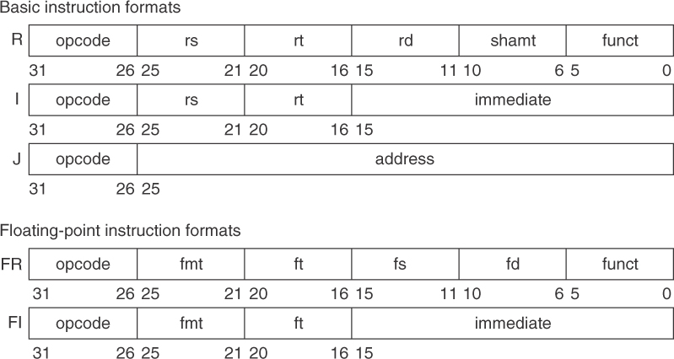
Figure 1.6 MIPS64 instruction set architecture formats. All instructions are 32 bits long. The R format is for integer register-to-register operations, such as DADDU, DSUBU, and so on. The I format is for data transfers, branches, and immediate instructions, such as LD, SD, BEQZ, and DADDIs. The J format is for jumps, the FR format for floating-point operations, and the FI format for floating-point branches.

