Slide 1
CSCE 510 - Systems Programming
Lecture 30 Exam Review

Slide 2
Overview of Course
Overview
System Calls
Stat System Call
AR & File I/O again
ProcessesMemory
Crefs & memory allocation & time
make & stdio & buf.
Buffering & Shells
Shells
Signals
Longjmps
Adv Shell Implementation
Test 1
Shell 2 & Filesystems
Adv. Signals
Sigaction2
Daemons
Sockets
Sockets II
Webservers
Webservers & CGI
POSIX threads
FinallyPOSIX threads
FinallyPOSIX threads II
Threads III
Unit Testing
Shared Libraries
Finale
Exam Review

Slide 3
Short Answer -
shells
commands
manual sections
file systems – size of pointers in blocks

Slide 4
Programs – Anything is fair game
But especially:
pthreads
matrix sum – blocks (no synchronization required)
Sum of entries of matrix (synchronization required)
Client server
pipe/fork/exec
login/sleep - alarm

Slide 5
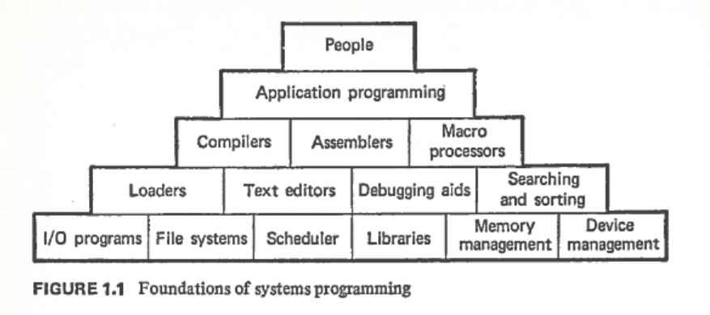
Lec 1 - Overview
What are systems programs?
History of Unix
Ken Thompson
Dennis Ritchie
Bill Joy
Richard Stallman
Andrew Tanenbaum
Linus Torvalds
System V vs BSD
POSIX
Why Python and not perl?

Slide 6
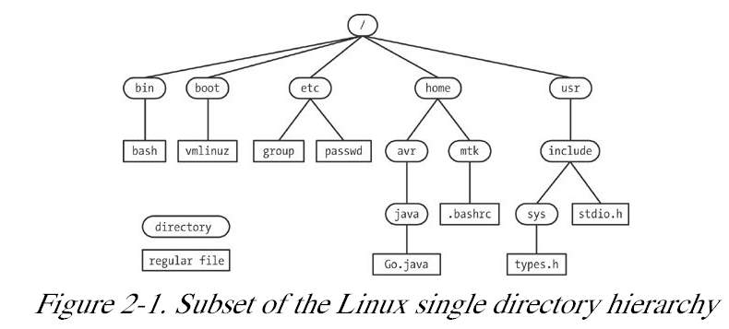
Lec 1 – slide 26 Fig 2.1

Slide 7
Lec 1 slide 32 Man – the Online Manual
The sections of the manual
Commands
System Calls
Library functions
Special files (usually found in /dev)
File formats and conventions eg /etc/passwd
Games
Miscellaneous (including macro packages and conventions), e.g. man(7), groff(7)
System administration commands (usually only for root)
Kernel routines [Non standard]

Slide 8
Lec 1 – Questions
How to you find the man page for the system call chmod?
What are the sections of the manual? 1,2,5,7,8,
What is the relationship between the unix Hierarchy and filesystems?

Slide 9
Lec 2 -System Calls
Chapter 2, 3, 18.8, 15.1
/class/csce510-001/Code/TLPI
File I/O model
open, close, read, write
file descriptors, per-process open file table
stdio library: fopen, fprintf, fscanf
processes: fork, exit(), ps, scheduler
Memory layout of process
Fig 3.1 Execution of System Call
18.8 Reading Directories

Slide 10
errno = 0;
direntp = readdir( dirp);
if (direntp = = NULL) {
if (errno != 0) {
/* Handle error */
} else {
/* We reached end-of-directory */
}
}

Slide 11
Stat structure
Macros
S_ISREG(m) is it a regular file?
S_ISDIR(m) directory?
S_ISCHR(m) character device?
S_ISBLK(m) block device?
S_ISFIFO(m) FIFO (named pipe)?
S_ISLNK(m) symbolic link? S_ISSOCK(m) socket?
less /usr/include/sys/stat.h
struct stat {
dev_t st_dev;
ino_t st_ino;
mode_t st_mode;
nlink_t st_nlink;
uid_t st_uid;
gid_t st_gid;
dev_t st_rdev;
off_t st_size;
blksize_t st_blksize;
blkcnt_t st_blocks;
time_t st_atime;
time_t st_mtime;
time_t st_ctime;
};

Slide 12
Lec 2 - Questions
What distinguishes between a system call and a library function?
Write code to open and print the names and inode numbers of the contents a a directory.
Describe what the unlink system call does.

Slide 13
Lec 4 - AR

Slide 14
Lec 4 – File I/O calls

Slide 15
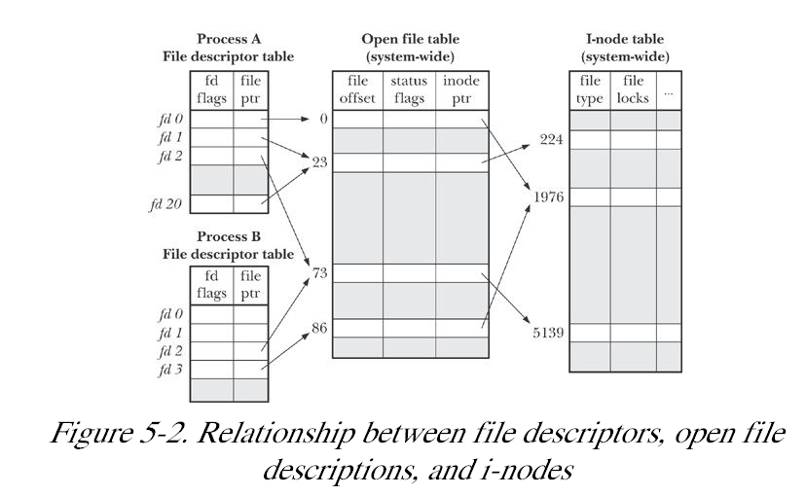
Lec 4 Figure 5.2
.
Kerrisk, TLPI 2011, O”Reilly (Kindle)

Slide 16
Chapter 6 Processes
6.1 Processes and Programs
6.2 Process ID and Parent Process ID
6.3 Memory Layout of a Process
6.4 Virtual Memory Management
6.5 The Stack and Stack Frames
6.6 Command-Line Arguments (argc, argv)
6.7 Environment List
6.8 Performing a Nonlocal Goto: setjmp() and longjmp()
6.9 Summary

Slide 17
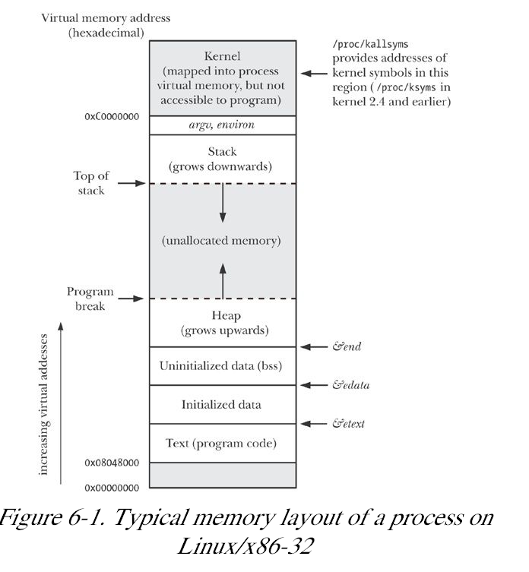
Memory Layout of a Process
Fig 6-1

Slide 18
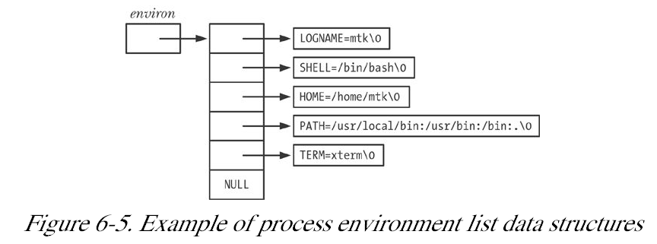
Accessing environment from C
char **environ; // global variable
less TLPI/proc/display_env.c
Alternatively int main( int argc, char *argv[], char *envp[])

Slide 19
Allocating on the Heap
malloc, free, etc.
#include <stdlib.h>
void *calloc(size_t nmemb, size_t size);
void *malloc(size_t size);
void free(void *ptr);
void *realloc(void *ptr, size_t size);
TLPI/memalloc/free_and_sbrk.c

Slide 20
Lec 8 slide 3 - Fork revisited
rv=fork()
Properties inherited (shorter list last time)
Open files, uids, cwd, root directory, umask,
signal mask and table,
environment, shared ,memory
Properties not inherited
Return value of fork, pid ppid, times,
file locks,
pending signals

Slide 21
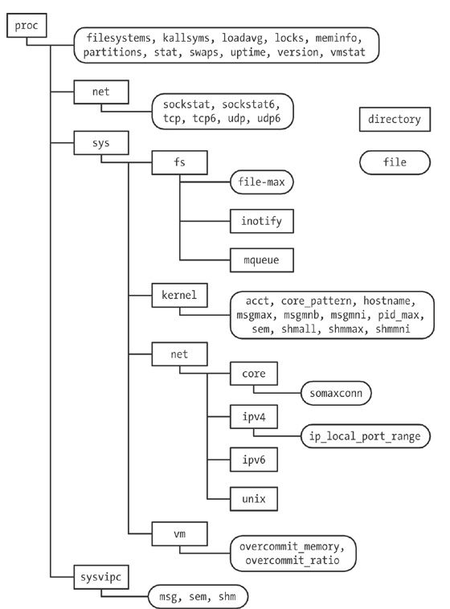
Figure 12-1 /proc hierarchy

Slide 22
Lec 9 Shell basics
History
Thompson, Bourne Sh(V7)
csh, tcsh, Korne
Bash
Substitutions
History (last time) (!str:0)
Filename expanison (ls *.c)
Filename completion
str<TAB>
Variable expansion (ls $c5)
Alias, …
Standard Bash variables
PATH, HOME etc
Builtin functions
cd

Slide 23
CD – Why must it be built-in?
cd path
cd
cd p1 p2 ??
Directory stack
pushd path
popd
Dirs – dump stack
CDPATH
Like PATH except for cd
Related commands: pwd, chdir(2)

Slide 24
I/O redirections

Slide 25
Pipeorder ls | grep | wc

Slide 26
Exec family of functions
EXEC(3) Linux Programmer's Manual EXEC(3)
NAME - execl, execlp, execle, execv, execvp - execute a file
SYNOPSIS
#include <unistd.h>
extern char **environ;
int execl (const char *path, const char *arg, ...);
int execlp (const char *file, const char *arg, ...);
int execle (const char *path, const char *arg, ..., char * const envp[]);
int execv (const char *path, char *const argv[]);
int execvp(const char *file, char *const argv[]);
DESCRIPTION
The exec() family of functions replaces the current process image with a new process image. The functions described in this manual page are front-ends for execve(2). The functions execlp() and execvp() will search for an executable

Slide 27
Examples/execExamples.c
/* Simple execv */
myargv[0] = "ls";
myargv[1] = "-l";
myargv[2] = "sh.pipe.pseudo";
myargv[3] = "execExamples.c";
myargv[4] = NULL;
execv("/bin/ls", myargv);
/* Simple execvp */
myargv[0] = "ls";
myargv[1] = "-l";
myargv[2] = "sh.pipe.pseudo";
myargv[3] = "execExamples.c";
myargv[4] = NULL;
execvp("ls", myargv);
execlp("ls", "ls", " ", NULL);
execlp("ls", "ls", "-l", NULL);
execlp("ls", "ls", " ", NULL);
execlp("ls", "ls", "-l", NULL);
/* note PATH is used to find cmd */
}
/* Examples of exec's of course, only first will be executed */
main(){
char *myargv[24]; /*max of 24 args */
char **envp; /*env ptr */
char **tmp; /*temp for env*/
/* Simple execve */
myargv[0] = "env";
myargv[1] = NULL;
envp = (char **)malloc(15 * sizeof (char *));
tmp = envp;
*(tmp++) = strdup("TERM=vt101");
*(tmp++) = strdup("SHELL=/mysh");
*(tmp++) = NULL;
execve("/usr/bin/env", myargv, envp);
fatal("Exec Failed");

Slide 28
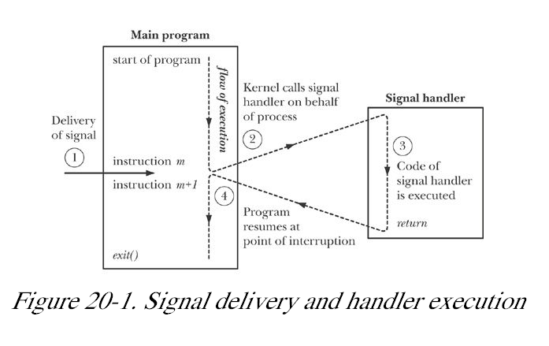
20-1 Signal delivery and handling
When do you interrupt?
mid instruction?
mid system call?

Slide 29
Set_jmp revisited
proc/setjmp_vars.c

Slide 30
Multipipes pseudo code sheet
ls | grep “^d” | wc // after substitutions
lastPipe=NULL
for(p=cmd; p != NULL; p = p->next){
if ( strcmp(p->word, “|”) == 0){
lastPipe = p;
}
Now break into two cmds; one without any pipes (cmd1)
cmd
word
next
word
next
word
next
word
next
word
next
word
next
λ
“ls”
“|”
“grep”
“^d”
“|”
“wc”

Slide 31
cmd
lastPipe
word
next
word
next
word
next
word
next
word
next
word
next
λ
“ls”
“|”
“grep”
“^d”
“|”
“wc”
then
What if lastPipe == NULL?
cmd1 = lastPipe->next
End cmd; lastPipe-> previous ->
pipe and fork
in parent remap stdin; execute cmd1
in child remap stdout; recursively exec_cmd_with_pipes(cmd)

Slide 32
Lec 11
zombie.c

Slide 33
Examples/sigmask1.c
…
sigemptyset(&sigset);
sigaddset(&sigset, SIGINT);
if(sigprocmask(SIG_SETMASK, &sigset, &oldset) < 0) fatal("sigprocmask");
if((pid = fork()) < 0) fatal("Fork failed");
else if (pid == 0) {
sleep(3);
if(sigpending(&newset)< 0) fatal("SIGpending");
if(sigismember(&newset,SIGINT))
printf("SIGINT signal is pending\n");
}else{
if(kill(pid, SIGINT)< 0) fatal("Fork failed");
}
}

Slide 34
Examples/popen.c
#include <stdio.h>
main(){
FILE *fp;
FILE *my_popen(char *cmd, char *mode);
char str[1024];
fp = my_popen("date","r");
fgets(str, 1024, fp);
fprintf(stdout, "%s", str);
}
FILE *my_popen(char *cmd, char *mode){
FILE *fp, *fdopen();
int pfd[2];
int pid;
if(pipe(pfd) < 0) fatal("Pipe failed");
if(*mode == 'r'){
if((pid = fork()) < 0){ fatal("Fork failed");
}else if (pid == 0){
close(pfd[0]);
close(1);
if(dup(pfd[1]) != 1) fatal("Dup returned non STDOUT");
execlp(cmd, cmd, NULL);
fatal("Exec failed");
}else{
if((fp = fdopen(pfd[0],"r")) == NULL) fatal("Fdopen failed");
return(fp);
}
}else if(*mode == 'w'){
}else{
fatal("popen mode must be 'r' or 'w'");
}
}

Slide 35
proc/longjmp.c
main(int argc, char *argv[])
{
switch (setjmp(env)) {
case 0: /* return after the initial setjmp() */
printf("Calling f1() after initial setjmp()\n");
f1(argc); /* Never returns... */
break; /* ... but this is good form */
case 1:
printf("We jumped back from f1()\n");
break;
case 2:
printf("We jumped back from f2()\n");
break;
}
exit(EXIT_SUCCESS);
}
#include <setjmp.h>
#include "tlpi_hdr.h"
static jmp_buf env;
static void
f2(void)
{
longjmp(env, 2);
}
static void
f1(int argc)
{
if (argc == 1)
longjmp(env, 1);
f2();
}

Slide 36
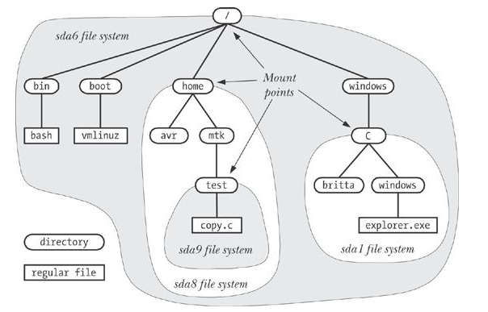
Filesystems and the hierarchy
mounting a filesystem
mount
shows what is mounted
mount dev path
umount
fsck
/proc/mounts
The Linux Programming Interface: Kerrisk, Michael (2011-02-11).

Slide 37
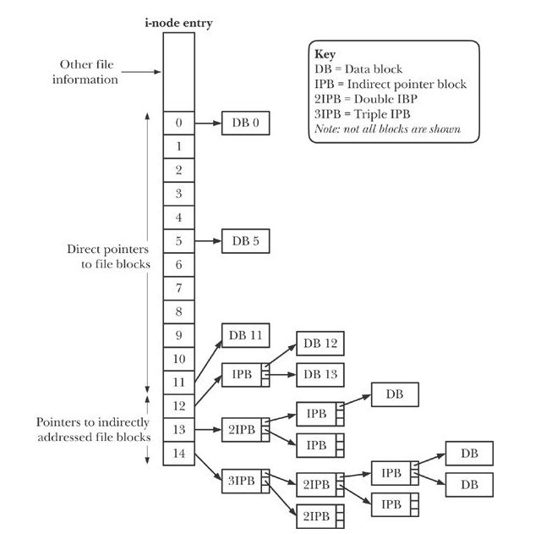
Figure 14-2 Structure of file blocks for a file in an ext2 filesys
The Linux Programming Interface: Kerrisk, Michael (2011-02-11).

Slide 38
Set_jmp revisited
proc/setjmp_vars.c

Slide 39
Lec 15 AdvSignals
Filesystems
Ext2 in text; ext4 similar
14.5 Virtual File System (VFS)
Journaling file systems
links hard and symbolic again
link, unlink, symlink
mkfs
/dev - device drivers
nfs
Behavior Driven design

Slide 40
Lec 15 - Questions

Slide 41
Lec 16 - Sigaction
slide 3 Virtual memory filesys : tmpfs
slide 7 Set_jmp revisited
Slide 8Volatile variables and why?
slide 10 StackOverflow why sigaction instead of signal ?
unreliable signals
Classifying Programs by signal usage
Job control

Slide 42
Graceful Exit with sigaction
#include <stdio.h>
#include <stdlib.h>
#include <signal.h>
void onint(int );/* SIGINT handler */
main(){
int i;
int rv; /* should be checked everytime */
struct sigaction act, *oldact;
sigset_t signal_mask;
rv=sigfillset(&signal_mask);
act.sa_handler = onint;
act.sa_mask = signal_mask;
act.sa_flags = 0;
act.sa_restorer = NULL;
sigaction(SIGINT, &act, oldact);
sigaction(SIGQUIT, &act, oldact);
for(i=0; ;i++)
fprintf(stdout,"%d\n",i);
}
void
onint(int sig){
fprintf(stderr,"STDERR:Recieved SIGNAL NUMBER =%d\n", sig);
fprintf(stdout,"STDOUT:Recieved SIGNAL NUMBER =%d\n", sig);
/*
* Graceful exit type things removing temporary files etc.
*
*/
exit(0)

Slide 43
Examples/Sigaction/restart.c
void onint(int );/* SIGINT handler */
struct sigaction act, oldact;
jmp_buf jbuf;
__sigset_t signal_mask; /* sigset_t should work here but doesn't */
int save_mask;
typedef struct cnode{
struct cnode *prev;
char *word;
struct cnode *next;
} CMD_NODE, *CMD_PTR;
CMD_PTR buildCmd();
main(){
int i;
int rv; /* should be checked everytime */
CMD_PTR c;
rv=sigfillset((int *) &signal_mask);
act.sa_handler = onint;
act.sa_mask = signal_mask;
act.sa_flags = 0;
act.sa_restorer = NULL;
rv=sigaction(SIGINT, &act, &oldact);
// rv=sigaction(SIGQUIT, &act, &oldact); leave unset so that can use SIGQUIT
to terminate
rv=sigprocmask(SIG_UNBLOCK, NULL, &save_mask); // find sigmask for restoring

Slide 44
Lec 17 - Daemons
Classes of signal handling
Job Control
Terminal input char by char (not line)
cbreak, raw, canonical
APUE.2e/tty_cbreak
Shell2 – Program
Daemons

Slide 45
Lec 17 slide 5 Code/apue.2e/fig18.20.c - cbreak
…
static struct termios save_termios;
static int ttysavefd = -1;
static enum { RESET, RAW, CBREAK } ttystate = RESET;
int
tty_cbreak(int fd) /* put terminal into a cbreak mode */
{
int err;
struct termios buf;
if (ttystate != RESET) {
errno = EINVAL;
return(-1);
}
if (tcgetattr(fd, &buf) < 0)
return(-1);
save_termios = buf; /* structure copy */
/* Echo off, canonical mode off. */
buf.c_lflag &= ~(ECHO | ICANON);
/* Case B: 1 byte at a time, no timer. */
buf.c_cc[VMIN] = 1;
buf.c_cc[VTIME] = 0;
if (tcsetattr(fd, TCSAFLUSH, &buf) < 0)
return(-1);
/* Verify that the changes stuck. */
if (tcgetattr(fd, &buf) < 0) {
err = errno;
tcsetattr(fd, TCSAFLUSH, &save_termios);
errno = err;
return(-1);
}
if ((buf.c_lflag & (ECHO | ICANON)) || buf.c_cc[VMIN] != 1 ||
buf.c_cc[VTIME] != 0) {
/*Only some of the changes were made. Restore the originals*/
tcsetattr(fd, TCSAFLUSH, &save_termios);
errno = EINVAL;
return(-1);
}
ttystate = CBREAK;
ttysavefd = fd;
return(0);
}

Slide 46
Topics revisted
pipes, fifos
SIGPIPE signal
Links and symbolic links again
GDB
Daemons, chron

Slide 47
Lec 18 Sockets

Slide 48
Creating a daemon
fork
parent exits
child lives on (adopted by ______)
Why
child continues on in background
child not process-group leader
child calls setsid – start new session –free from terminal
if daemon opens terminal later it might reaquire a controlling terminal O_NOCTTY on open
Clear process umask
change cwd typically to root “/” Why?
close all open file descriptors
open /dev/null, dup2(fd, 0,1,2)

Slide 49
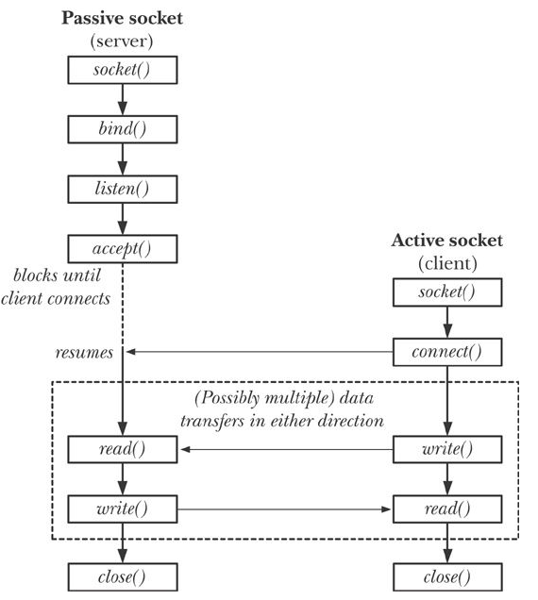
Lec 18 slide 11 Figure 56-1 overview of system calls used with stream

Slide 50
Lec 18 Sockets - Questions
Which is reliable Stream or datagram?
What does that mean anyway?

Slide 51
Lec 21 slide 8 DNS: nslookup(1)
ares> nslookup howstuffworks.com
Server: 129.252.11.15
Address: 129.252.11.15#53
Non-authoritative answer:
Name: howstuffworks.com
Address: 107.21.49.125
host(1) gives similar results

Slide 52
Lec 21 slide 19 Process Query String
#include <stdio.h>
#include <stdlib.h>
int main()
{
printf("Content-type: text/html\n\n");
printf("<html>\n");
printf("<body>\n");
printf("<h1>The value entered was: ")
printf("%s</h1>\n", getenv("QUERY_STRING"));
printf("</body>\n");
printf("</html>\n");
return 0;
}
http://computer.howstuffworks.com/cgi.htm

Slide 53
Lec 22 - POSIX Threads Pacheko
TLPI/sockets
TLPI/sockets/readline
TLPI/sockets/inet.c
TLPI/sockets/gethostbyname
deprecated ➔ getaddrinfo
readline
inet_sockets.[ch]

Slide 54
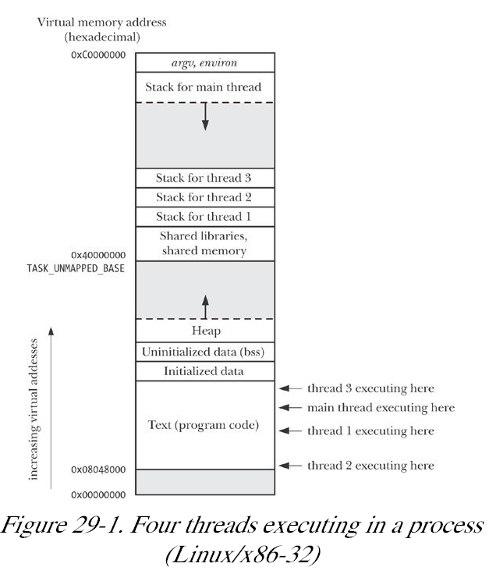
Fig 29-1
4 threads➔ 4 stacks
threads share the same global space
Kerrisk, Michael (2011-02-11). The Linux Programming Interface

Slide 55
Mutexes

Slide 56
Lec 22 - Questions
Explain why you need mutexes.
What happens if a thread does a mutex_lock then returns?

Slide 57
Lec 24 - POSIX Threads again; Unit Testing
Autotools
Threads topics from TLPI
Chap 29 Threads Introduction Chap 30 Symchornization
Chap 31 Safety and Performance
Chap 32 Thread cancellation
Chap 33 Thread further details

Slide 58
TLPI/threads Example Programs
simple_thread.c (Example 29-1) very simple one thread hello-world
thread_incr.c (30-1)
thread_incr_mutex.c ( )
thread_multijoin.c ( )
pthread_create
pthread_join
need for mutual exclusion fig 30-1
mutexes

Slide 59
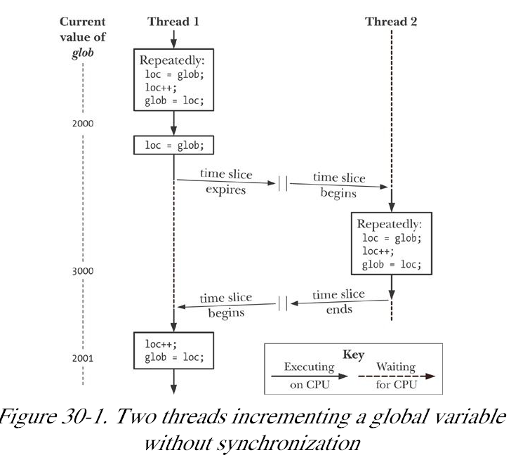

Slide 60
Lec 24 - POSIX Threads Questions

Slide 61
Getrusage
struct rusage {
struct timeval ru_utime; /* user time used */
struct timeval ru_stime; /* system time used */
long ru_maxrss; /* maximum resident set size */
long ru_ixrss; /* integral shared memory size */
long ru_idrss; /* integral unshared data size */
long ru_isrss; /* integral unshared stack size */
long ru_minflt; /* page reclaims */
long ru_majflt; /* page faults */
long ru_nswap; /* swaps */
long ru_inblock; /* block input operations */
long ru_oublock; /* block output operations */
long ru_msgsnd; /* messages sent */
long ru_msgrcv; /* messages received */
long ru_nsignals; /* signals received */
long ru_nvcsw; /* voluntary context switches */
long ru_nivcsw; /* involuntary context switches */
};

Slide 62
Lec 26 - Questions
What does getrusage give you access to?
Which core is my process running on?
what does top show you?

Slide 63
Lec 26 - POSIX Threads again; Unit Testing
POSIX threads from Lec22
Autotools: dataflow
Threads topics from TLPI
Chap 31 Safety and Performance
Chap 32 Thread cancellation
Chap 33 Thread further details
POSIX semaphores
Getrusage
Time revisited fig 10-1
time structures
Which core is my process running on?

Slide 64
POSIX semaphores

Slide 65
Getrusage
struct rusage {
struct timeval ru_utime; /* user time used */
struct timeval ru_stime; /* system time used */
long ru_maxrss; /* maximum resident set size */
long ru_ixrss; /* integral shared memory size */
long ru_idrss; /* integral unshared data size */
long ru_isrss; /* integral unshared stack size */
long ru_minflt; /* page reclaims */
long ru_majflt; /* page faults */
long ru_nswap; /* swaps */
long ru_inblock; /* block input operations */
long ru_oublock; /* block output operations */
long ru_msgsnd; /* messages sent */
long ru_msgrcv; /* messages received */
long ru_nsignals; /* signals received */
long ru_nvcsw; /* voluntary context switches */
long ru_nivcsw; /* involuntary context switches */
};

Slide 66
Lec 26 - Questions
What does getrusage give you access to?
Which core is my process running on?
what does top show you?

Slide 67
Lec 27 -
IPC (Interprocess Communication)
System V IPC (just enough to bash=criticize)
POSIX IPC
Shared Libraries
Program Educational Objectives
Course Outcomes
Exam
Exam Review

Slide 68
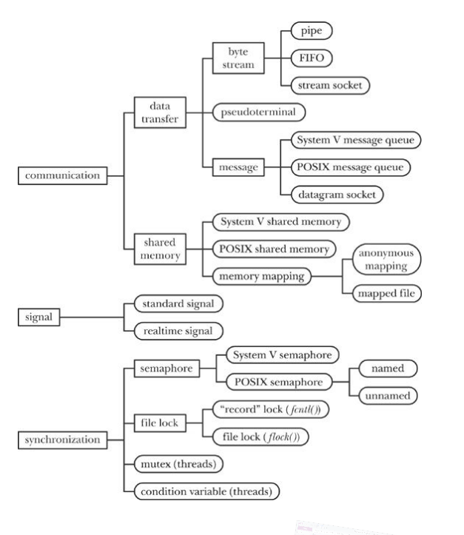
IPC
traditional
signals
pipes, fifos
sockets
System V IPC
msgqueues
semaphore sets
shared memory
POSIX
msgqueues,
shared memory,
semaphores,

Slide 69
Table 51-1 POSIX IPC Summary

Slide 70
Lec 27 - Questions
What is the main advantage of a shared library?
Describe how the linking of a dynamic linked library works.

