Slide 1

CSCE 510 - Systems Programming
Lecture 22 POSIX Threads

Slide 2
Overview
Last Time
  Tools Survey
  Web Servers again
  Web Server Skeleton – Pop Quiz
  Git slides
    creating, adding, committing
  CGI Common Gateway Interface
    QUERY_STRING env variable
Email ?? method missing
Today
  Webserver Assignment
  TLPI/sockets/readline
  TLPI/sockets/inet.c
  TLPI/sockets/gethostbyname
    deprecated ➔ getaddrinfo
  x

Slide 3
cat ares/TLPI/sockets/README
Many of the programs in this directory are named according to the
conventions described below.
A prefix identifies the socket domain in which the program operates, and the socket type employed. The socket domain is indicated by one or two letters:
u UNIX
i Internet (both v4 and v6)
i6 Internet v6 only
The socket type is one of the following:
d datagram
s stream
A suffix indicates whether the program is a client or server:
cl client
sv server
Thus, id_echo_sv.c is a server program that uses datagram sockets in the Internet domain.

Slide 4
TLPI/sockets/ other examples
i6d_ucase_sv.c
i6d_ucase_cl.c
id_echo_sv.c
is_echo_sv.c
is_echo_sv2.c
is_seqnum_sv.c
is_seqnum_v2_sv.c
socknames.c
ud_ucase_sv.c
us… don’t care

Slide 5
Readline from socket
data is received in packets
long lines might be broken up to several packets
Read might return what data is there
Not like the terminal handler waiting for ‘\n’
/* Read characters from 'fd' until a newline is encountered. If a newline character is not encountered in the first (n - 1) bytes, then the excess characters are discarded. …
  from header
GNU standards ???

Slide 6
TLPI/sockets/read_line.c
ssize_t
readLine(int fd, void *buffer, size_t n)
{
ssize_t numRead; /* # of bytes last read() */
size_t totRead; /* Total bytes read so far */
char *buf;
char ch;
if (n <= 0 || buffer == NULL) {
errno = EINVAL;
return -1;}
buf = buffer; /* No pointer arith on "void *" */
totRead = 0;
for (;;) {
numRead = read(fd, &ch, 1);
if (numRead == -1) {
if (errno == EINTR) // Int. --> restart read()
continue;
else
return -1; /* Some other error */
} else if (numRead == 0) { /* EOF */
if (totRead == 0) // No bytes read; return 0
return 0;
else /* Some bytes read; add '\0' */
break;
} else { // 'numRead' must be 1 if we get here
if (totRead < n - 1) { // Discard > (n - 1) bytes
totRead++;
*buf++ = ch;
}
if (ch == '\n')
break;
}
}
*buf = '\0';
return totRead;
}

Slide 7
TLPI/sockets/inet_sockets.[ch]
TLPI TCP support library
  int inetConnect(const char *host, const char *service, int type);
  int inetListen(const char *service, int backlog, socklen_t *addrlen);
  int inetBind(const char *service, int type, socklen_t *addrlen);
  char *inetAddressStr(const struct sockaddr *addr, socklen_t addrlen, char *addrStr, int addrStrLen);
  #define IS_ADDR_STR_LEN 4096
  #ifndef INET_SOCKETS_H
  #define INET_SOCKETS_H
Isolate/hide the getaddrinfo
CANNOT BE USED FOR WEBSERVER PROGRAM!!!
  can and should be used as example
  Server
  socket
  bind
  listen
  accept
  fork
You must use these calls!!
inetlisten: socket,bind,listen

Slide 8
TLPI/sockets/inet_sockets.c -header
A package of useful routines for Internet domain sockets.
*/
#define _BSD_SOURCE /* To get NI_MAXHOST and NI_MAXSERV
definitions from <netdb.h>
*/
#include <sys/socket.h>
#include <netinet/in.h>
#include <arpa/inet.h>
#include <netdb.h>
#include "inet_sockets.h"
/* Declares functions defined here */
#include "tlpi_hdr.h"
/* The following arguments are common to several of the routines below:
'host': NULL for loopback IP add, or
a host name or numeric IP addr
'service':either a name or a port number
'type‘: either SOCK_STREAM or SOCK_DGRAM
*/
/* Create socket and connect it to the address specified by
'host' + 'service'/'type'.
Return socket descriptor on success,
or -1 on error
*/

Slide 9
inetPassiveSocket
static int /* Public interfaces: inetBind() and inetListen() */
inetPassiveSocket(const char *service, int type, socklen_t *addrlen,
Boolean doListen, int backlog)
{
struct addrinfo hints;
struct addrinfo *result, *rp;
int sfd, optval, s;
memset(&hints, 0, sizeof(struct addrinfo));
hints.ai_canonname = NULL;
hints.ai_addr = NULL;
hints.ai_next = NULL;
hints.ai_socktype = type;
hints.ai_family = AF_UNSPEC; // Allows IPv4 or v6
hints.ai_flags = AI_PASSIVE; // Use wildcard IP addr
s = getaddrinfo(NULL, service, &hints, &result);
if (s != 0)
return -1;
/* Create an Internet domain socket and bind it to the address
{ wildcard-IP-address +'service'/'type' }.
If 'doListen' is TRUE, then make this a listening socket (by calling listen() with 'backlog'), with the SO_REUSEADDR option set.
If 'addrLen' is not NULL, then use it to return the size of the address structure for the address family for this socket.
Return the socket descriptor on success, or -1 on error. */

Slide 10
inetPassiveSocket p2
if (rp != NULL && doListen) {
if (listen(sfd, backlog) == -1) {
freeaddrinfo(result);
return -1;
}
}
if (rp != NULL && addrlen != NULL)
*addrlen = rp->ai_addrlen;
/* Return address structure size */
freeaddrinfo(result);
return (rp == NULL) ? -1 : sfd;
}
/* Walk through returned list until we find an address structure that can be used to successfully create and bind a socket */
optval = 1;
for (rp = result; rp != NULL; rp = rp->ai_next) {
sfd = socket(rp->ai_family, rp->ai_socktype,
rp->ai_protocol);
if (sfd == -1) continue; // On error, try next address
if (doListen) {
if (setsockopt(sfd, SOL_SOCKET,
SO_REUSEADDR, &optval,
sizeof(optval)) == -1) {
close(sfd);
freeaddrinfo(result);
return -1;
}
}
if (bind(sfd, rp->ai_addr, rp->ai_addrlen) == 0)
break; /* Success */
/* bind() failed: close this socket and try next addr */
close(sfd);
}

Slide 11
Listen,bind,…
/* Given a socket address in 'addr', whose length is specified in 'addrlen', return a null-terminated string containing the host and service names in the form "(hostname, port#)". The string is returned in the buffer pointed to by 'addrStr', and this value is also returned as the function result. The caller must specify the size of the 'addrStr' buffer in 'addrStrLen'. */
char *
inetAddressStr(const struct sockaddr *addr,
socklen_t addrlen,
char *addrStr, int addrStrLen)
{
char host[NI_MAXHOST], service[NI_MAXSERV];
if (getnameinfo(addr, addrlen, host, NI_MAXHOST,service, NI_MAXSERV, NI_NUMERICSERV) == 0)
snprintf(addrStr, addrStrLen, "(%s, %s)", host, service);
else
snprintf(addrStr, addrStrLen, "(?UNKN?)");
return addrStr;
}
int
inetListen(const char *service, int backlog, socklen_t *addrlen){
return inetPassiveSocket(service, SOCK_STREAM,
addrlen, TRUE, backlog);
}
/* Create socket bound to wildcard IP address + port given in 'service'. Return socket descriptor on success, or -1 on error. */
int
inetBind(const char *service, int type, socklen_t *addrlen){
return inetPassiveSocket(service, type, addrlen,
FALSE,
0);
}

Slide 12
inetConnect
s = getaddrinfo(host, service, &hints, &result);
if (s != 0) {
errno = ENOSYS;
return -1;
}
/* Walk through returned list until we find an address structure that can be used to successfully connect a socket */
for (rp = result; rp != NULL; rp = rp->ai_next) {
sfd = socket(rp->ai_family, rp->ai_socktype,
rp->ai_protocol);
if (sfd == -1)
continue; /* On error, try next address */
if (connect(sfd, rp->ai_addr, rp->ai_addrlen) != -1)
break; /* Success */
/* Connect failed: close this socket and try next addr */
close(sfd);
}
freeaddrinfo(result);
return (rp == NULL) ? -1 : sfd;
}
/* Create socket and connect it to the address specified by 'host' + 'service'/'type'. Return socket descriptor on success, or -1 on error */
int
inetConnect(const char *host, const char *service, int type)
{
struct addrinfo hints;
struct addrinfo *result, *rp;
int sfd, s;
memset(&hints, 0, sizeof(struct addrinfo));
hints.ai_canonname = NULL;
hints.ai_addr = NULL;
hints.ai_next = NULL;
hints.ai_family = AF_UNSPEC; //Allows IPv4 v6
hints.ai_socktype = type;
cat
cat

Slide 14
TLPI POSIX threads
Threads: Introduction
  Pthreads library: gcc prog.c –l pthread
  Stack map for 4 threads
Threads: Thread Synchronization
Threads: Thread Safety and per thread Storage
Threads: Thread Cancellation
Threads: Further details
Kerrisk, Michael (2011-02-11). The Linux Programming Interface

Slide 15
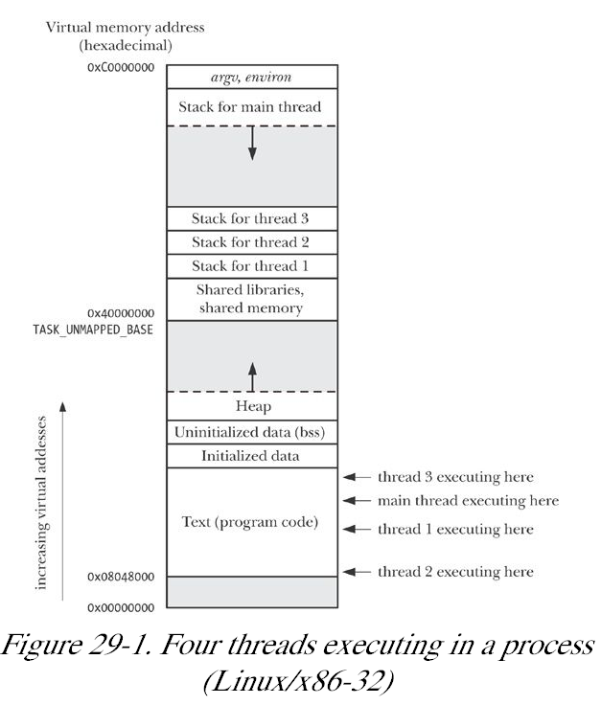
Fig 29-1
4 threads➔ 4 stacks
threads share the same global space
Kerrisk, Michael (2011-02-11). The Linux Programming Interface

Slide 16
threads share a lot
process ID and parent process ID;
process group ID and session ID;
controlling terminal;
process credentials (user and group IDs);
open file descriptors;
record locks created using fcntl();
signal dispositions;
file system-related information: umask, current working directory, and root directory;
interval timers (setitimer()) and POSIX timers (timer_create());
System V semaphore undo (semadj) values (Semaphore Undo Values);
resource limits;
CPU time consumed (as returned by times());
resources consumed (as returned by getrusage()); and
nice value (set by setpriority() and nice()).
Kerrisk, Michael (2011-02-11). The Linux Programming Interface

Slide 17
But threads don’t share everything
thread ID (Thread IDs);
signal mask;
thread-specific data (Thread-Specific Data);
alternate signal stack (sigaltstack());
the errno variable;
floating-point environment (see fenv( 3));
realtime scheduling policy and priority (Overview of Realtime Process Scheduling and Realtime Process Scheduling API);
CPU affinity (Linux-specific, described in CPU Affinity);
capabilities (Linux-specific, described in Chapter 39);
and stack (local variables and function call linkage information).
Kerrisk, Michael (2011-02-11). The Linux Programming Interface

Slide 18

Pthreads tutorial from llnl
https://computing.llnl.gov/tutorials/pthreads/
http://www.yolinux.com/TUTORIALS/LinuxTutorialPosixThreads.html
Pacheco – text
Table of Contents
Abstract
Pthreads Overview
  What is a Thread?
  What are Pthreads?
  Why Pthreads?
  Designing Threaded Programs
The Pthreads API
Compiling Threaded Programs
Thread Management
  Creating and Terminating Threads
  Passing Arguments to Threads
  Joining and Detaching Threads
  Stack Management
  Miscellaneous Routines
Exercise 1
Mutex Variables Mutex Variables Overview
Creating and Destroying Mutexes
Locking and Unlocking Mutexes
Condition Variables Condition Variables Overview
Creating and Destroying Condition Variables
Waiting and Signaling on Condition Variables
Monitoring, Debugging and Performance Analysis Tools for Pthreads
LLNL Specific Information and Recommendations
Topics Not Covered
Exercise 2
References and More Information

Slide 19
An Introduction to Parallel Programming
Peter Pacheco
Chapter 4
Shared Memory Programming with Pthreads

Slide 20
Roadmap
# Chapter Subtitle
Problems programming shared memory systems.
Controlling access to a critical section.
Thread synchronization.
Programming with POSIX threads.
Mutexes.
Producer-consumer synchronization and semaphores.
Barriers and condition variables.
Read-write locks.
Thread safety.
Pacheko Parallel Programming Ch 04 - Threads

Slide 21
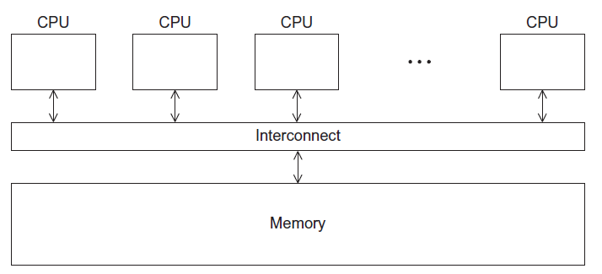
A Shared Memory System
Pacheko Parallel Programming Ch 04 - Threads

Slide 22
Processes and Threads
A process is an instance of a running (or suspended) program.
Threads are analogous to a “light-weight” process.
In a shared memory program a single process may have multiple threads of control.
Pacheko Parallel Programming Ch 04 - Threads

Slide 23
POSIX® Threads
Also known as Pthreads.
A standard for Unix-like operating systems.
A library that can be linked with C programs.
Specifies an application programming interface (API) for multi-threaded programming.
Pacheko Parallel Programming Ch 04 - Threads

Slide 24

Caveat
The Pthreads API is only available on POSIXR systems — Linux, MacOS X, Solaris, HPUX, …
Pacheko Parallel Programming Ch 04 - Threads

Slide 25
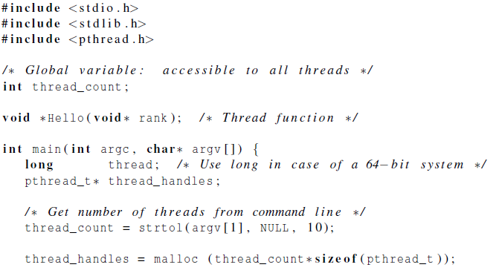
Hello World! (1)
declares the various Pthreads
functions, constants, types, etc.
Pacheko Parallel Programming Ch 04 - Threads

Slide 26
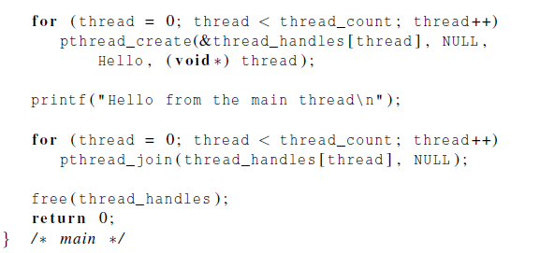
Hello World! (2)
Pacheko Parallel Programming Ch 04 - Threads

Slide 27
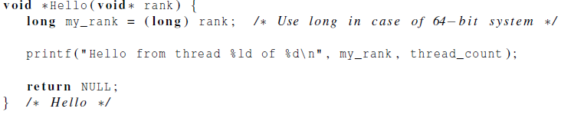
Hello World! (3)
Pacheko Parallel Programming Ch 04 - Threads

Slide 28
Compiling a Pthread program
gcc −g −Wall −o pth_hello pth_hello.c −lpthread
link in the Pthreads library
Pacheko Parallel Programming Ch 04 - Threads

Slide 29
Running a Pthreads program
. / pth_hello <number of threads>
. / pth_hello 1
Hello from the main thread
Hello from thread 0 of 1
. / pth_hello 4
Hello from the main thread
Hello from thread 0 of 4
Hello from thread 1 of 4
Hello from thread 2 of 4
Hello from thread 3 of 4
Pacheko Parallel Programming Ch 04 - Threads

Slide 30

Global variables
Can introduce subtle and confusing bugs!
Limit use of global variables to situations in which they’re really needed.
  Shared variables.
Pacheko Parallel Programming Ch 04 - Threads

Slide 31
Starting the Threads
Processes in MPI are usually started by a script.
In Pthreads the threads are started by the program executable.
Pacheko Parallel Programming Ch 04 - Threads

Slide 32
Starting the Threads
pthread.h
One object for each thread.
pthread_t
int pthread_create (
pthread_t* thread_p /* out */ ,
const pthread_attr_t* attr_p /* in */ ,
void* (*start_routine ) ( void ) /* in */ ,
void* arg_p /* in */ ) ;
Pacheko Parallel Programming Ch 04 - Threads

Slide 33
pthread_t objects
Opaque
The actual data that they store is system-specific.
Their data members aren’t directly accessible to user code.
However, the Pthreads standard guarantees that a pthread_t object does store enough information to uniquely identify the thread with which it’s associated.
Pacheko Parallel Programming Ch 04 - Threads

Slide 34
A closer look (1)
int pthread_create (
pthread_t* thread_p /* out */ ,
const pthread_attr_t* attr_p /* in */ ,
void* (*start_routine ) ( void ) /* in */ ,
void* arg_p /* in */ ) ;
We won’t be using, so we just pass NULL.
Allocate before calling.
Pacheko Parallel Programming Ch 04 - Threads

Slide 35
A closer look (2)
int pthread_create (
pthread_t* thread_p /* out */ ,
const pthread_attr_t* attr_p /* in */ ,
void* (*start_routine ) ( void ) /* in */ ,
void* arg_p /* in */ ) ;
Pointer to the argument that should
be passed to the function start_routine.
The function that the thread is to run.
Pacheko Parallel Programming Ch 04 - Threads

Slide 36
Function started by pthread_create
Prototype:
void* thread_function ( void* args_p ) ;
Void* can be cast to any pointer type in C.
So args_p can point to a list containing one or more values needed by thread_function.
Similarly, the return value of thread_function can point to a list of one or more values.
Pacheko Parallel Programming Ch 04 - Threads

Slide 37
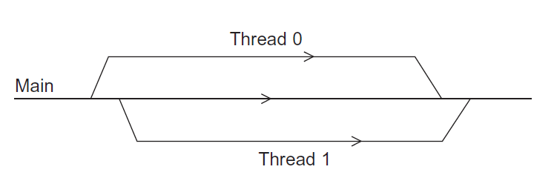
Running the Threads
Main thread forks and joins two threads.
Pacheko Parallel Programming Ch 04 - Threads

Slide 38
Stopping the Threads
We call the function pthread_join once for each thread.
A single call to pthread_join will wait for the thread associated with the pthread_t object to complete.
Pacheko Parallel Programming Ch 04 - Threads

Slide 39
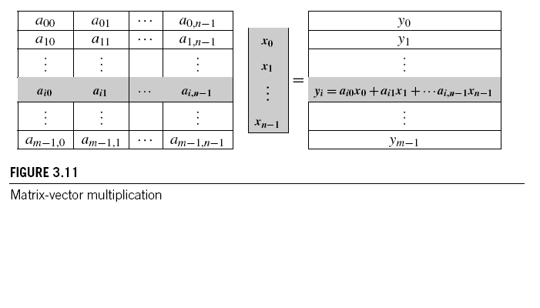
Matrix-Vector Multiplication in pthreads
Pacheko Parallel Programming Ch 04 - Threads

Slide 40
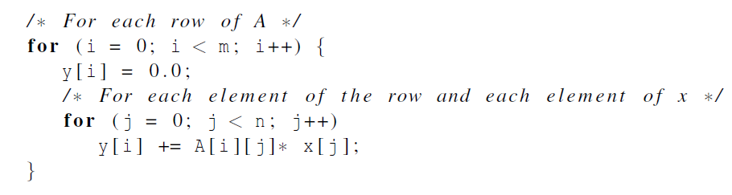
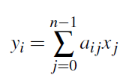
Serial pseudo-code
Pacheko Parallel Programming Ch 04 - Threads

Slide 41
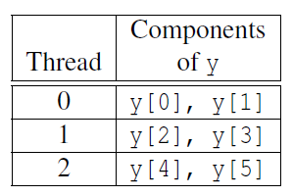
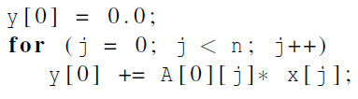
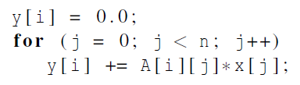
Using 3 Pthreads
thread 0
general case
Pacheko Parallel Programming Ch 04 - Threads

Slide 42
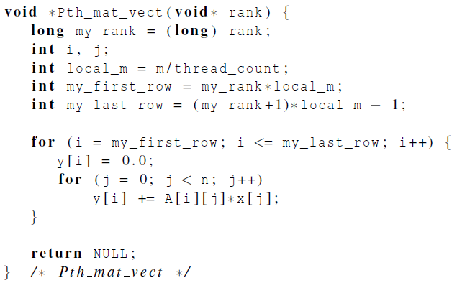
Pthreads matrix-vector multiplication
Pacheko Parallel Programming Ch 04 - Threads

Slide 43

Critical sections
Pacheko Parallel Programming Ch 04 - Threads

Slide 44
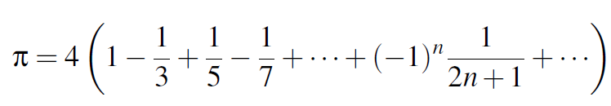
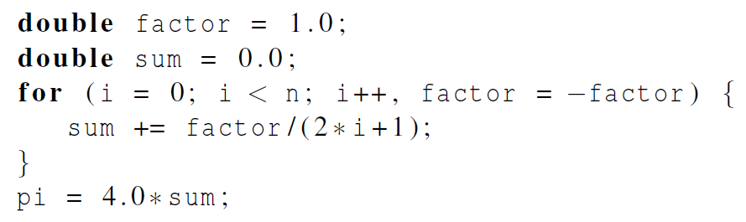
Estimating π
Pacheko Parallel Programming Ch 04 - Threads

Slide 45
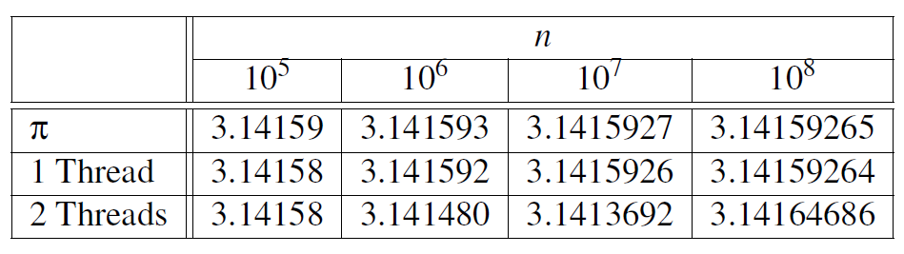
Using a dual core processor
Note that as we increase n, the estimate with one thread gets better and better.
Pacheko Parallel Programming Ch 04 - Threads

Slide 46
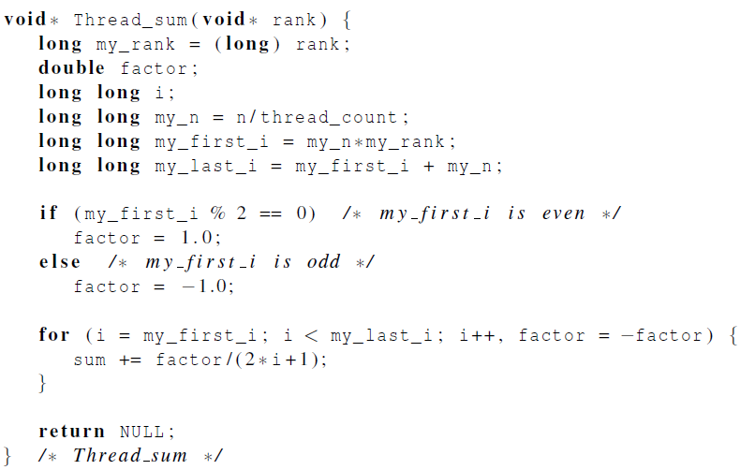
A thread function for computing π
Pacheko Parallel Programming Ch 04 - Threads

Slide 47
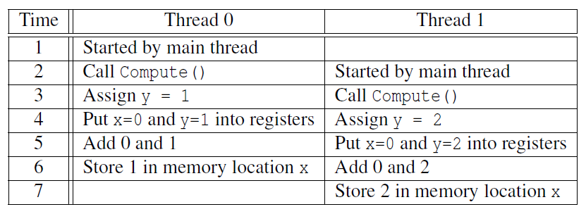

Possible race condition
Pacheko Parallel Programming Ch 04 - Threads

Slide 48
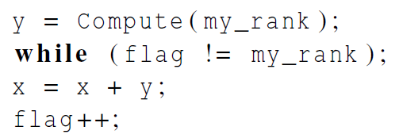
Busy-Waiting
A thread repeatedly tests a condition, but, effectively, does no useful work until the condition has the appropriate value.
Beware of optimizing compilers, though!
flag initialized to 0 by main thread
Pacheko Parallel Programming Ch 04 - Threads

Slide 49
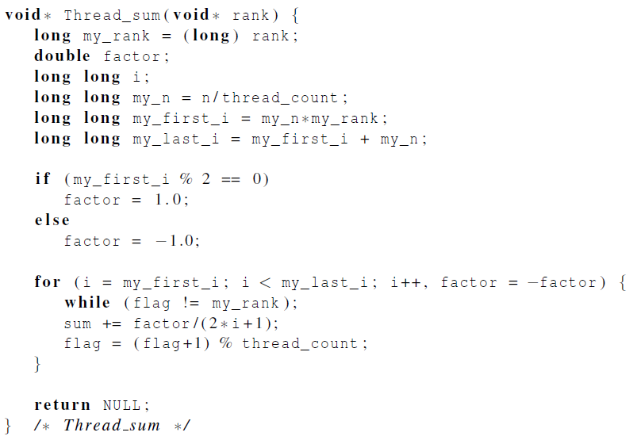
Pthreads global sum with busy-waiting
Pacheko Parallel Programming Ch 04 - Threads

Slide 50
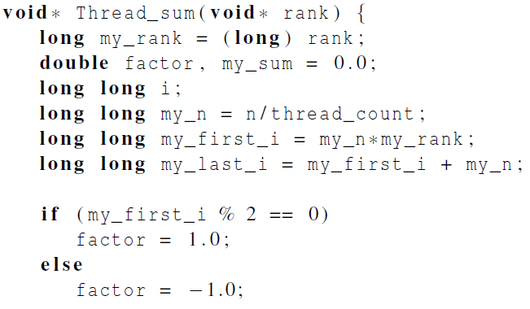
Global sum function with critical section after loop (1)
Pacheko Parallel Programming Ch 04 - Threads

Slide 51
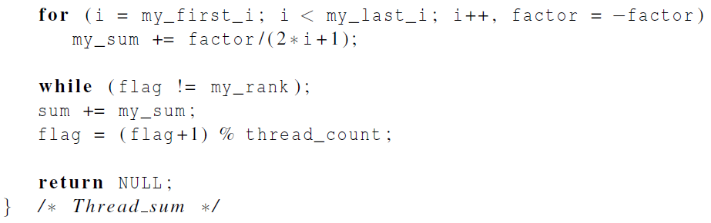
Global sum function with critical section after loop (2)
Pacheko Parallel Programming Ch 04 - Threads

Slide 52
Mutexes
A thread that is busy-waiting may continually use the CPU accomplishing nothing.
Mutex (mutual exclusion) is a special type of variable that can be used to restrict access to a critical section to a single thread at a time.
Pacheko Parallel Programming Ch 04 - Threads

Slide 53

Mutexes
Used to guarantee that one thread “excludes” all other threads while it executes the critical section.
The Pthreads standard includes a special type for mutexes: pthread_mutex_t.
Pacheko Parallel Programming Ch 04 - Threads

Slide 54
Mutexes
When a Pthreads program finishes using a mutex, it should call
In order to gain access to a critical section a thread calls
Pacheko Parallel Programming Ch 04 - Threads

Slide 55
Mutexes
When a thread is finished executing the code in a critical section, it should call
Pacheko Parallel Programming Ch 04 - Threads

Slide 56
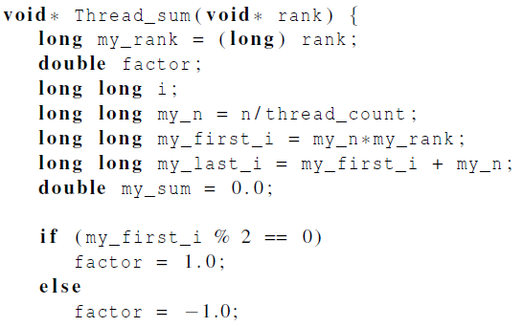
Global sum function that uses a mutex (1)
Pacheko Parallel Programming Ch 04 - Threads

Slide 57
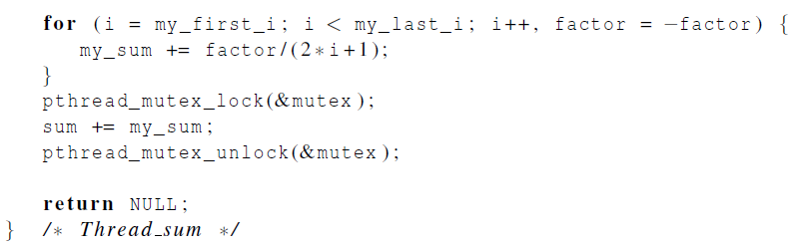
Global sum function that uses a mutex (2)
Pacheko Parallel Programming Ch 04 - Threads

Slide 58
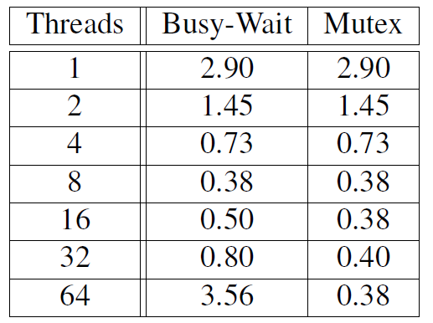
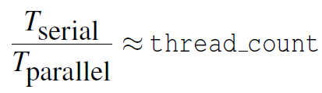
Run-times (in seconds) of π programs using n = 108 terms on a system with two four-core processors.
Pacheko Parallel Programming Ch 04 - Threads

Slide 59
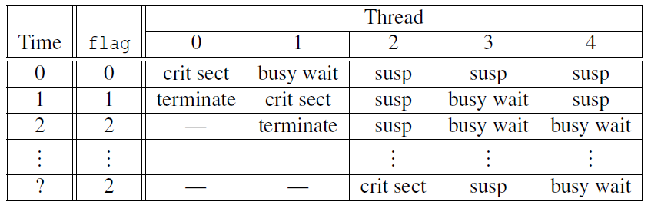
Possible sequence of events with busy-waiting and more threads than cores.
Pacheko Parallel Programming Ch 04 - Threads

Slide 60
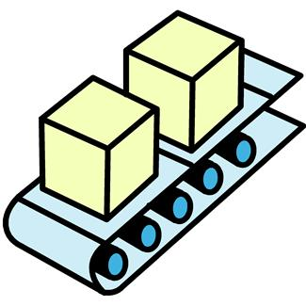
Producer-Consumer Synchronization and Semaphores
Pacheko Parallel Programming Ch 04 - Threads

Slide 61
Issues
Busy-waiting enforces the order threads access a critical section.
Using mutexes, the order is left to chance and the system.
There are applications where we need to control the order threads access the critical section.
Pacheko Parallel Programming Ch 04 - Threads

Slide 62
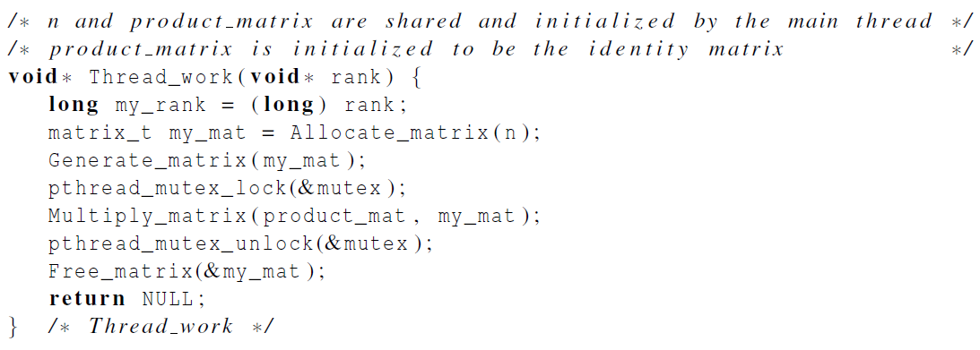
Problems with a mutex solution
Pacheko Parallel Programming Ch 04 - Threads

Slide 63
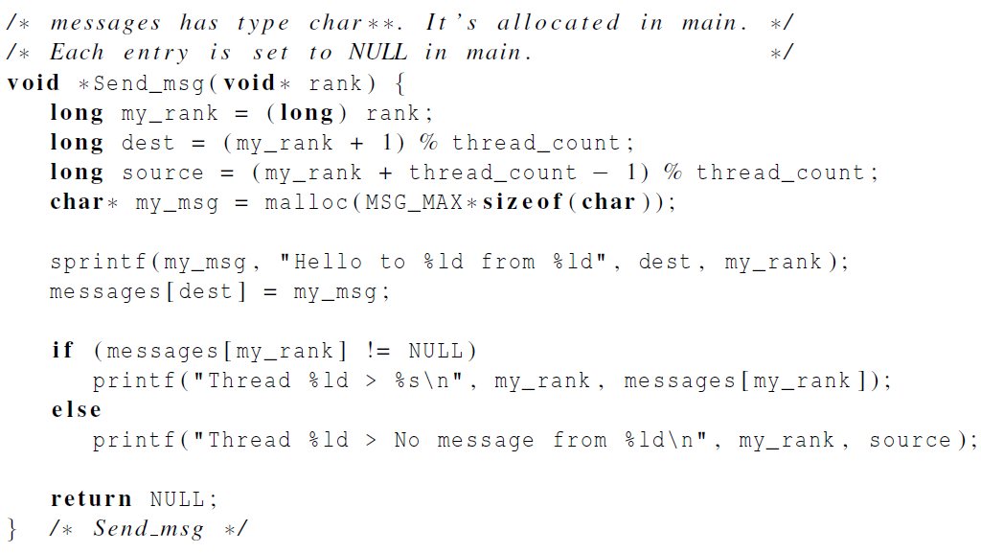
A first attempt at sending messages using pthreads
Pacheko Parallel Programming Ch 04 - Threads

Slide 64

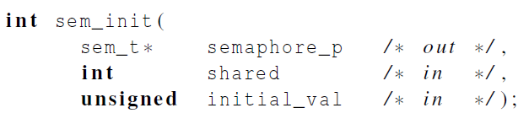
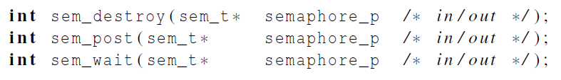
Syntax of the various semaphore functions
Semaphores are not part of Pthreads;
you need to add this.
Pacheko Parallel Programming Ch 04 - Threads

