Slide 1
CSCE 510 - Systems Programming
Lecture 19 Sockets, really this time

Slide 2
Overview
Last Time
Email
Shell 2 specs
Shell2 base code
become_daemon
Overview of webserver
socket/bind/listen/accept
fork process in child; listen in parent
Sockets
Overview of calls for stream (web server)
socket, bind, listen, accept
getaddrinfo
Chapters 56,58
Email
x
Today
Last times slides 22-36
Stream Server skeleton
Web server Assignment

Slide 3
daemons everywhere
hermes> ps -e | grep "d$"
2 ? 00:00:00 kthreadd
23 ? 00:00:00 kacpid
29 ? 00:00:00 ksuspend_usbd
30 ? 00:00:00 khubd
31 ? 00:00:00 kseriod
32 ? 00:00:00 kmmcd
35 ? 00:00:00 khungtaskd
37 ? 00:00:00 ksmd
49 ? 00:00:00 kstriped
52 ? 00:00:00 kmpath_handlerd
53 ? 00:00:00 ksnapd
292 ? 00:00:00 udevd
522 ? 00:00:00 kpsmoused
733 ? 00:00:00 rpc.statd
876 ? 00:00:02 nfsiod

Slide 4
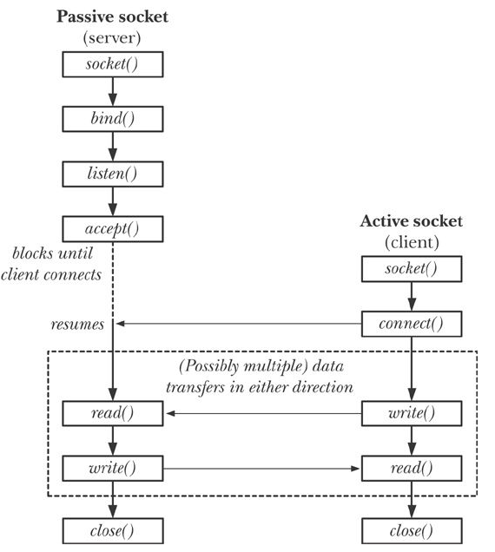
Review Figure 56-1 overview of system calls used with stream

Slide 5
Other Socket System Calls
Other Socket System Calls
accept4 (2) - accept a connection on a socket
getpeername (2) - get name of connected peer socket
getsockopt (2) - get and set options on sockets
socketcall (2) - socket system calls (Linux lumpall??)
socketpair (2) - create a pair of connected sockets
accept4 (2) - accept a connection on a socket
I/O in addition to read and write
recv (2) - receive a message from a socket
recvfrom (2) - receive a message from a socket
recvmsg (2) - receive a message from a socket
send (2) - send a message on a socket
sendmsg (2) - send a message on a socket
sendto (2) - send a message on a socket

Slide 6
Section 7 - format entries
AF_UNIX (7) - Sockets for local interprocess communication
SOCK_RAW (7) - Linux IPv4 raw sockets
socket (7) - Linux socket interface
rtnetlink (7) - Linux IPv4 routing socket
NETLINK_ROUTE (7) - Linux IPv4 routing socket
PF_LOCAL (7) - Sockets for local interprocess communication
PF_UNIX (7) - Sockets for local interprocess communication
raw (7) - Linux IPv4 raw sockets
unix (7) - Sockets for local interprocess communication
Socket Commands
byobu-reconnect-sockets (1) - Sourcable script that updates GPG_AGENT_INFO an...
dbus-cleanup-sockets (1) - clean up leftover sockets in a directory
fuser (1) - identify processes using files or sockets
ncat (1) - Concatenate and redirect sockets
ss (8) - another utility to investigate sockets

Slide 7
TLPI/sockets
ls
ares> ls *.c
i6d_ucase_cl.c is_echo_v2_sv.c scm_cred_recv.c ud_ucase_cl.c
i6d_ucase_sv.c is_seqnum_cl.c scm_cred_send.c ud_ucase_sv.c
id_echo_cl.c is_seqnum_sv.c scm_rights_recv.c unix_sockets.c
id_echo_sv.c is_seqnum_v2_cl.c scm_rights_send.c us_abstract_bind.c
inet_sockets.c is_seqnum_v2_sv.c sendfile.c us_xfr_cl.c
is_echo_cl.c rdwrn.c socknames.c us_xfr_sv.c
is_echo_inetd_sv.c read_line_buf.c t_gethostbyname.c us_xfr_v2_cl.c
is_echo_sv.c read_line.c t_getservbyname.c us_xfr_v2_sv.c

Slide 8
apue.2e/sockets
ares> ls /class/csce510-001/Code/apue.2e/sockets/
bindunix.c
findsvc.c
servlisten.c
bo.c
servaccept.c
initsrv1.c initsrv2.c
clconn.c cliconn.c
sendfd2.c sendfd.c spipe.c recvfd.c recvfd2.c ruptimed-fd.c
ruptime.c ruptime-dg.c ruptimed.c
linux.mk solaris.mk freebsd.mk macos.mk

Slide 9
fgrep apue.2e/socket fig*
fgrep socket fig*
fig16.8:#include <sys/socket.h> - print info returned from getaddrinfo
fig16.9:#include <sys/socket.h>
fig16.10:#include <sys/socket.h>
fig16.10: if ((fd = socket(addr->sa_family, type, 0)) < 0)
fig16.14:#include <sys/socket.h>
fig16.14: if ((sockfd = socket(aip->ai_family, SOCK_STREAM, 0)) < 0)
fig16.15:#include <sys/socket.h>
fig16.16:#include <sys/socket.h>
fig16.17:#include <sys/socket.h>
fig16.18:#include <sys/socket.h>
fig16.18: if ((sockfd = socket(aip->ai_family, SOCK_DGRAM, 0)) < 0) {
fig16.20:#include <sys/socket.h>
fig16.20: if ((fd = socket(addr->sa_family, type, 0)) < 0)
fig 17.13 :#include <sys/socket.h>

Slide 10
I/O on stream sockets
bidirectional
reliable -

Slide 11
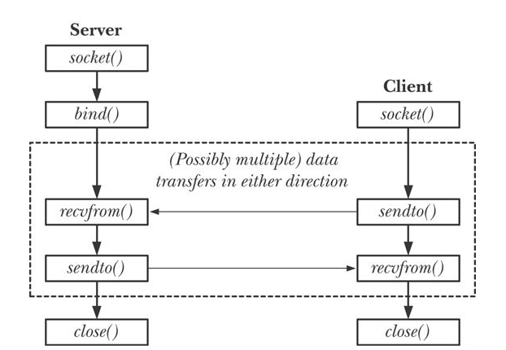
Fig 56-4 Datagram sockets

Slide 12
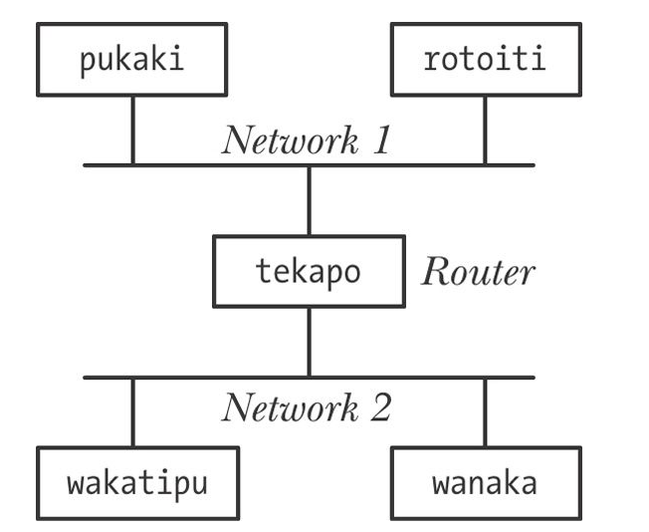
fig 58-1 router

Slide 13
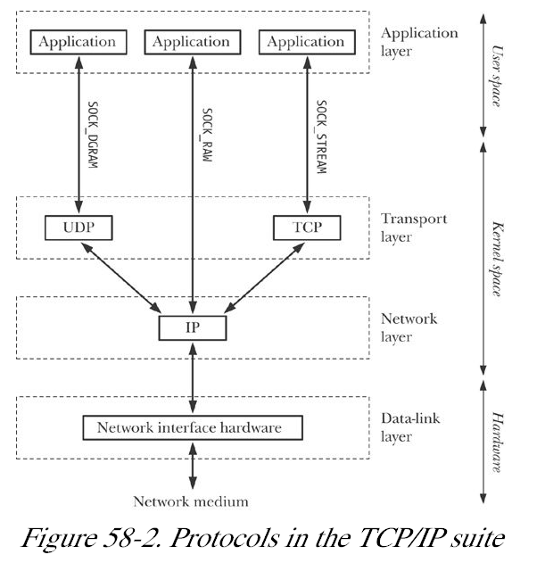
Fig 58-2 TCP/IP

Slide 14
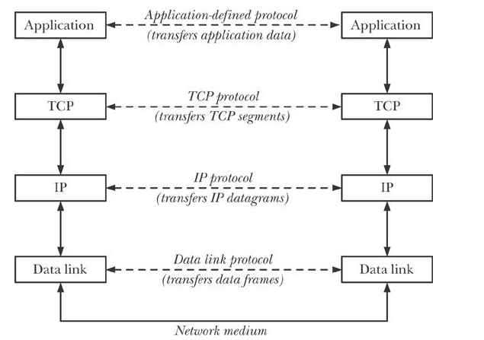
Fig 58-3 Layered Implementation

Slide 15
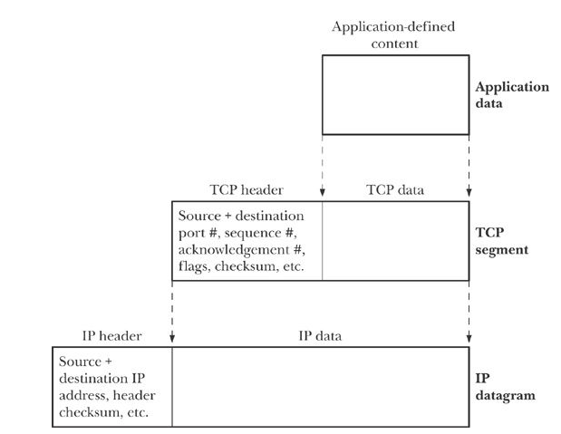
fig 58-4 Encapsulation of packets

Slide 16
IPv4 addresses
IPv4 addresses
32 bits (4G distinct addresses)
dotted decimal notation
w.x.y.z/n – left n bits =networkID
network address/ network mask
networkid. subnetid.hostid
129.252 – class B address
129.252.11
ifconfig (ipconfig /all in Windows)
loopback 127.0.0.1
host id = 0, hostid=255 not allowed
subnet broadcast 129.252.11.255
INADDR_ANY 0.0.0.0 usually
Kerrisk, TLPI 2011, O”Reilly (Kindle)

Slide 17
IPv6 addresses
128 bits (2¹²⁸ addresses)
IPv6 addresses are typically written as a series of eight 16-bit hexadecimal numbers separated by colons
e.g. F000: 0: 0: 0: 0: 0: A: 1
double colon represents string of zeroes (only one allowed)
F000: : A: 1
loopback 127 zeroes followed by a 1; ::1
wildcard address 0::0 or ::
Kerrisk, TLPI 2011, O”Reilly (Kindle)

Slide 18
More IPv6 addresses or atoms in Universe?
Number IP addresses (ignoring loopbacks, widcards etc.) = 2¹²⁸ addresses ~= 3.40 e+38
Number of atoms in universe – 10 e+78
Number of atoms on earth 9.0 e+49
Number of oxygen atoms on earth 6.02 e+49
Number of water molecules on earth 5.07 e+48
Number of atoms in human body 7 e+27
Number of grains of sand on earth 7 e+20
People on earth 6.6 e+9 (5.1 e+26 IPv6 addresses per person)
Atoms in all people on earth 6.6e9 * 7e27= 4.62 e+37
so less than 10 IPv6
All lies, I mean estimates
http://rednectar.net/2012/05/24/just-how-many-ipv6-addresses-are-there-really/
http://rednectar.net/2012/05/24/just-how-many-ipv6-addresses-are-there-really/

Slide 19
Mapping IPv4 to IPv6
Kerrisk, TLPI 2011, O”Reilly (Kindle)

Slide 20
IP layer
network layer, which is concerned with delivering packets (data) from the source host to the destination host.
Network layer (IP) performs:
breaking data into fragments small enough for transmission via the data-link layer (if necessary);
routing data across the internet; and
providing services to the transport layer.
IP transmits datagrams
header 20-60 bytes (address of target, and the sender)
upper bound on size of datagrams:
IPv4 > 576 bytes; IPv6 > 1500 bytes
IP is connectionless and unreliable
packets with header errors are silently discarded
IP may fragment datgrams
packet > MTU(maximum transmission Unit) ➔ break into chunks, send; reassemle
Kerrisk, TLPI 2011, O”Reilly (Kindle)

Slide 21
Transport Layer
port numbers
16 bit number
well-known, registered and privileged ports
well-known – range port 0 to port 1023 (reserved)
ssh port 22, http port 80
http:// www.iana.org/ assignments/ port-numbers
ephemeral ports – transient assignment usually for client
Transport layer protocols: UDP or TCP

Slide 22
http:// www.iana.org/ assignments/ port-numbers
.

Slide 23
/etc
emacs23
gai.conf
gconf
gdb
group
hostname
hosts
hosts.allow
hosts.deny
idmapd.conf
ifplugd
init
init.d
iproute2
nanorc
netbeans.conf
passwd.orig
services
sudoers.d
sysctl.conf
bash.bashrc
bash_completion
bash_completion.d
bindresvport.blacklist
checkbox.d
computer-janitor.d
cron.d
cron.daily
cron.hourly
cron.monthly
crontab
cron.weekly
eclipse.ini
bash_completion.d
bindresvport.blacklist
checkbox.d
computer-janitor.d
cron.d

Slide 24
More /etc/hosts and services
More /etc/hosts
ares> more /etc/hosts
127.0.0.1 ares localhost.localdomain localhost
127.0.1.1 ares
129.252.130.15 garnet garnet.cse.sc.edu
# The following lines are desirable for IPv6 capable hosts
::1 localhost ip6-localhost ip6-loopback
fe00::0 ip6-localnet
ff00::0 ip6-mcastprefix
ff02::1 ip6-allnodes
ff02::2 ip6-allrouters
More /etc/services
echo 7/tcp
echo 7/udp
systat 11/tcp users
daytime 13/tcp
netstat 15/tcp
ftp-data 20/tcp
ftp 21/tcpssh 22/tcp
ssh 22/udp
telnet 23/tcp
smtp 25/tcp mail
finger 79/tcp
www 80/tcp
www 80/udp
imap2 143/udp
tcpfatserv 347/udp
rpc2portmap 369/tcp

Slide 25
UDP
Adds to IP
port numbers
data checksum for transmission error detection
Selecting UDP datagram size to avoid fragmentation
MTU (maximum transmission unit)
max datagram 576 bytes = likely minimum
8 for UDP header
20 bytes for IP header
548 - data

Slide 26
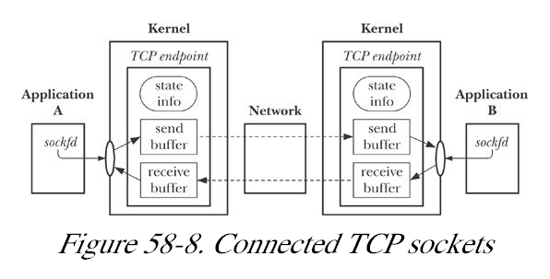
TCP connection
connection-oriented, reliable,
Kerrisk, TLPI 2011, O”Reilly (Kindle)

Slide 27
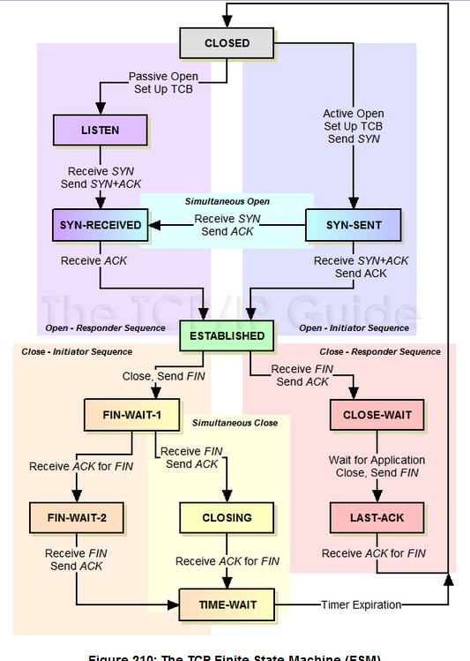
TCP state Machine
Finite state machines really get used.
RFC - TCP
http://www.tcpipguide.com/free/t_TCPOperationalOverviewandtheTCPFiniteStateMachineF-2.htm

Slide 28
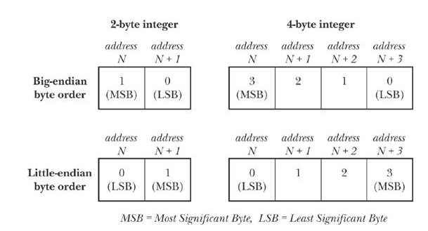
fig 59-1 Big Endian
htons(), htonl(), ntohs(), and ntohl() functions
Kerrisk, TLPI 2011, O”Reilly (Kindle)

Slide 29
apue.2e/bo.c (bo = byte-order)
#include <inttypes.h>int
main(void){
uint32_t i;
unsigned char *cp;
i = 0x04030201;
cp = (unsigned char *)&i;
if (*cp == 1)
printf("little-endian\n");
else if (*cp == 4)
printf("big-endian\n");
else
printf("who knows?\n");
exit(0);}

Slide 30
IPv4 Addresses
struct in_addr { /* IPv4 4-byte address */
in_addr_t s_addr; /* Unsigned 32-bit integer */
};
struct sockaddr_in { /* IPv4 socket address */
sa_family_t sin_family; /* Address family (AF_INET) */
in_port_t sin_port; /* Port number */
struct in_addr sin_addr; /* IPv4 address */
unsigned char __pad[ X]; /* Pad to size of 'sockaddr' structure (16 bytes) */
};
Kerrisk, Michael (2011-02-11). The Linux Programming Interface: A Linux and UNIX System Programming Handbook (Kindle Locations 51438-51444). O'Reilly Distribution. Kindle Edition.
Kerrisk, TLPI 2011, O”Reilly (Kindle)

Slide 31
TCP Server connection Establishment
sfd=socket – create socket
bind – associate sfd with address(host/port)
listen(sfd, backlog) – backlog how many incoming calls to maintain (max)
cfd=accept(sfd, *sockaddr, *addrlen)
sfd – “listening socket”
cfd – socket just for processing this connection
sockaddr – ptr to address of client
addrlen
Accept4 – allows passing in of some flags

Slide 32
TCP Client side connection Estab.
sockfd=socket(AF_INET, SOCK_STREAM, 0)
connect(int sockfd, const struct sockaddr *serv_addr,
socklen_t serv_addrlen);
Kerrisk, TLPI 2011, O”Reilly (Kindle)

Slide 33
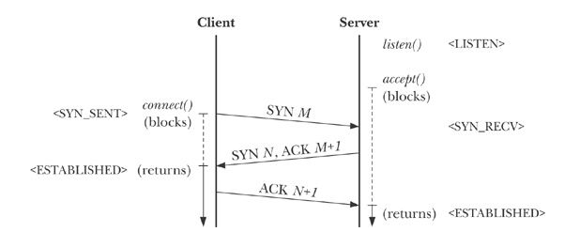
TCP – Three Way Handshake
client’s connect send TCP – SYN (synchronize) packet
server (accepts) send back AKN(acknowledgement) and SYN packet of its own (AKN/SYN combined)
client send back AKN (returns from connect; server receives and returns from accept)
Kerrisk, TLPI 2011, O”Reilly (Kindle)

Slide 34
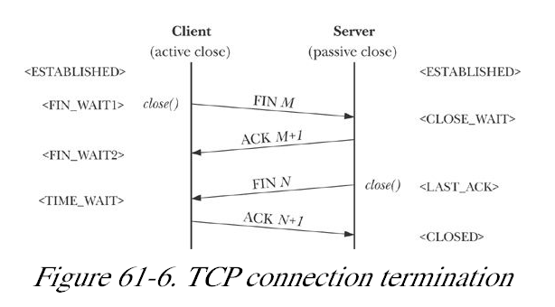
Fig 61-6 TCP connection termination
.

Slide 35
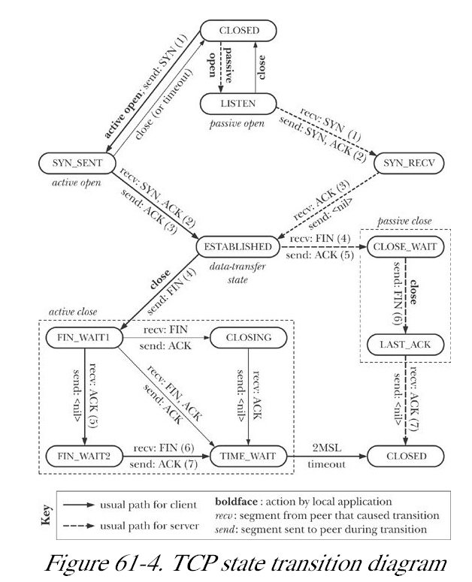
Fig 61-4
Kerrisk, TLPI 2011, OReilly (Kindle)

Slide 36
Review Figure 56-1 overview of system calls used with stream

Slide 37
Overview of Host and Service Conversion Functions
A hostname is the symbolic identifier for a system that is connected to a network (possibly with multiple IP addresses).
A service name is the symbolic representation of a port number.
Kerrisk, TLPI 2011, OReilly (Kindle)

Slide 38
Converting Internet addresses between binary and human readable
inet_aton(): dotted-decimal ➔ binary
inet_neta(): binary ➔ dotted.decimal
IPv6 functions
inet_pton(), inet_ntop()

Slide 39
Converting host and service names to and from binary
Obsolete
gethostbyname()
getservbyname()
gethostbyaddr()
getservbyport()
Should use these since they handle both IPv4 and IPv6
getaddrinfo()
getnameinfo()

Slide 40
INET_PTON(3) Linux Programmer's Manual INET_PTON(3)
NAME
inet_pton - convert IPv4 and IPv6 addresses from text to binary form
SYNOPSIS
#include <arpa/inet.h>
int inet_pton(int af, const char *src, void *dst);
DESCRIPTION
This function converts the character string src into a network address
structure in the af address family, then copies the network address
structure to dst.

Slide 41
INET_NTOP(3) Linux Programmer's Manual INET_NTOP(3)
NAME
inet_ntop - convert IPv4 and IPv6 addresses from binary to text form
SYNOPSIS
#include <arpa/inet.h>
const char *inet_ntop(int af, const void *src,
char *dst, socklen_t size);
DESCRIPTION
This function converts the network address structure src in the af
address family into a character string. The resulting string is copied
to the buffer pointed to by dst, which must be a non-NULL pointer. The
caller specifies the number of bytes available in this buffer in the
argument size.

Slide 42
ifconfig
ares> ifconfig
eth1 Link encap:Ethernet HWaddr 00:13:72:28:95:ba
inet addr:129.252.130.150 Bcast:129.252.130.255 Mask:255.255.255.0
inet6 addr: fe80::213:72ff:fe28:95ba/64 Scope:Link
UP BROADCAST RUNNING MULTICAST MTU:1500 Metric:1
RX packets:281293 errors:0 dropped:0 overruns:0 frame:0
TX packets:455400 errors:0 dropped:0 overruns:0 carrier:0
collisions:0 txqueuelen:1000
RX bytes:151525825 (151.5 MB) TX bytes:420750529 (420.7 MB)
Interrupt:17
lo Link encap:Local Loopback
inet addr:127.0.0.1 Mask:255.0.0.0
inet6 addr: ::1/128 Scope:Host
UP LOOPBACK RUNNING MTU:16436 Metric:1
RX packets:152 errors:0 dropped:0 overruns:0 frame:0
TX packets:152 errors:0 dropped:0 overruns:0 carrier:0
collisions:0 txqueuelen:0
RX bytes:10348 (10.3 KB) TX bytes:10348 (10.3 KB)

Slide 43
IPv6 illustrated – i6d_ucase
TLPI/sockets
i6d_ucase_sv & -server run in background
ares> ./i6d_ucase_sv &
[1] 11834
hermes> i6d_ucase_cl fe80::213:72ff:fe28:95ba "hello world"
Server received 10 bytes from (fe80::213:72ff:fe28:95ba, 52560)
Response 1: HELLO WORL

Slide 44
TLPI/sockets
ares> ls *.c > listing
i6d_ucase_cl.c IPv6 datagram convert to upper case client-server
i6d_ucase_sv.c
id_echo_cl.c
id_echo_sv.c -implements a daemon that provides the UDP "echo" service
inet_sockets.c – library of support routines for IPv4 sockets
is_echo_cl.c - An implementation of the TCP "echo" service.
is_echo_inetd_sv.c
is_echo_sv.c- An implementation of the TCP "echo" service.
is_echo_v2_sv.c
is_seqnum_cl.c
is_seqnum_sv.c
is_seqnum_v2_cl.c
is_seqnum_v2_sv.c

Slide 45
rdwrn.c
read_line_buf.c
read_line.c
scm_cred_recv.c
scm_cred_send.c
scm_rights_recv.c
scm_rights_send.c
sendfile.c – any ideas? but just support routine
socknames.c -Demonstrate the use of getsockname() and getpeername() to retrieve the local and peer socket addresses.
t_gethostbyname.c – convert hostname (argv[1])➔ address
t_getservbyname.c

Slide 46
TLPI/i6D_ucase_sv.c
memset(&svaddr, 0, sizeof(struct sockaddr_in6));
svaddr.sin6_family = AF_INET6;
svaddr.sin6_addr = in6addr_any; /* Wildcard addr*/
svaddr.sin6_port = htons(PORT_NUM);
if (bind(sfd, (struct sockaddr *) &svaddr,
sizeof(struct sockaddr_in6)) == -1)
errExit("bind");
for (;;) {
len = sizeof(struct sockaddr_in6);
numBytes = recvfrom(sfd, buf, BUF_SIZE, 0,
(struct sockaddr *) &claddr, &len);
if (numBytes == -1)
errExit("recvfrom");
if (inet_ntop(AF_INET6, &claddr.sin6_addr, claddrStr,
INET6_ADDRSTRLEN) == NULL)
if (sendto(sfd, buf, numBytes, 0, (struct sockaddr *) &claddr, len) != numBytes)
fatal("sendto");
#include "i6d_ucase.h"
int
main(int argc, char *argv[])
{
struct sockaddr_in6 svaddr, claddr;
int sfd, j;
ssize_t numBytes;
socklen_t len;
char buf[BUF_SIZE];
char claddrStr[INET6_ADDRSTRLEN];
/* Create a datagram socket bound to an address in the IPv6 somain */
sfd = socket(AF_INET6, SOCK_DGRAM, 0);
if (sfd == -1)
errExit("socket");

Slide 47
TLPI/i6D_ucase_cl.c
memset(&svaddr, 0, sizeof(struct sockaddr_in6));
svaddr.sin6_family = AF_INET6;
svaddr.sin6_port = htons(PORT_NUM);
if (inet_pton(AF_INET6, argv[1], &svaddr.sin6_addr) <= 0)
fatal("inet_pton failed for address '%s'", argv[1]);
/* Send messages to server; echo responses on stdout */
for (j = 2; j < argc; j++) {
msgLen = strlen(argv[j]);
if (sendto(sfd, argv[j], msgLen, 0, (struct sockaddr *) svaddr, sizeof(struct sockaddr_in6)) != msgLen)
fatal("sendto");
numBytes = recvfrom(sfd, resp, BUF_SIZE, 0,NULL,NULL);
if (numBytes == -1)
errExit("recvfrom");
printf("Response %d: %.*s\n", j - 1, (int) numBytes, resp);
}
exit(EXIT_SUCCESS);
}
#include "i6d_ucase.h"
int
main(int argc, char *argv[])
{
struct sockaddr_in6 svaddr;
int sfd, j;
size_t msgLen;
ssize_t numBytes;
char resp[BUF_SIZE];
if (argc < 3 || strcmp(argv[1], "--help") == 0)
usageErr("%s host-address msg...\n", argv[0]);
/* Create a datagram socket; send to an address in the IPv6 somain */
sfd = socket(AF_INET6, SOCK_DGRAM, 0); /* Create client socket */
if (sfd == -1)
errExit("socket");

Slide 48
APUE.2e/sockets

Slide 49
More code: Examples/ClientServer
http://stackoverflow.com/questions/9198608/simple-socket-programming-code-working
TCP server, client
server.c -47 lines of code
client.c – 66 lines of code
http://www.linuxhowtos.org/C_C++/socket.htm
server2.c, client2.c
reads port from command line arguments

Slide 50
Examples/server.c (stackOverflow)
//TCP SERVER
#include<sys/socket.h>
#include<netinet/in.h>
#include<stdio.h>
#include<string.h>
#include<stdlib.h>
#include <arpa/inet.h>
//#include <fcntl.h>
#include <unistd.h>
main() {
char buf[100];
socklen_t len;
int k,sock_desc,temp_sock_desc;
struct sockaddr_in client,server;
memset(&client,0,sizeof(client));
memset(&server,0,sizeof(server)); sock_desc =
socket(AF_INET,SOCK_STREAM,0);
server.sin_family = AF_INET;
server.sin_addr.s_addr = inet_addr("127.0.0.1");
server.sin_port = 7777; k = bind(sock_desc, (struct sockaddr*)&server,sizeof(server));
k = bind(sock_desc,(struct sockaddr*)&server, sizeof(server));
k = listen(sock_desc,20);
len = sizeof(client); temp_sock_desc =accept( sock_desc,( struct sockaddr*)&client, &len);
while(1) {
k = recv(temp_sock_desc,buf,100,0); if(strcmp(buf,"exit")==0) break; if(k>0) printf("%s",buf);
}
close(sock_desc);
close(temp_sock_desc);
return 0;
}
http://stackoverflow.com/questions/9198608/simple-socket-programming-code-working

Slide 51
Examples/client.c (stackOverflow)
//TCP Client
… same includes
main() {
char buf[100];
struct sockaddr_in client;
int sock_desc,k;
sock_desc = socket(AF_INET, SOCK_STREAM,0); memset(&client,0,sizeof(client));
client.sin_family = AF_INET;
client.sin_addr.s_addr =
inet_addr("127.0.0.1");
client.sin_port = 7777;
k = connect(sock_desc,
(struct sockaddr*)&client, sizeof(client));
while(1) {
gets(buf);
k = send(sock_desc,buf,100,0);
if(strcmp(buf,"exit")==0) break;
}
close(sock_desc);
return 0;
}
http://stackoverflow.com/questions/9198608/simple-socket-programming-code-working

Slide 52
Examples/server2.c
portno = atoi(argv[1]);
serv_addr.sin_family = AF_INET;
serv_addr.sin_addr.s_addr = INADDR_ANY;
serv_addr.sin_port = htons(portno);
if (bind(sockfd, (struct sockaddr *) &serv_addr,
sizeof(serv_addr)) < 0)
error("ERROR on binding");
listen(sockfd,5);
clilen = sizeof(cli_addr);
newsockfd = accept(sockfd,
(struct sockaddr *) &cli_addr,
&clilen);
if (newsockfd < 0)
error("ERROR on accept");
bzero(buffer,256);
n = read(newsockfd,buffer,255);
if (n < 0) error("ERROR reading from socket");
printf("Here is the message: %s\n",buffer);
n = write(newsockfd,"I got your message",18);
if (n < 0) error("ERROR writing to socket");
close(newsockfd);
close(sockfd);
return 0;
}
#include …
void error(const char *msg){
perror(msg);
exit(1);
}
int main(int argc, char *argv[]){
int sockfd, newsockfd, portno;
socklen_t clilen;
char buffer[256];
struct sockaddr_in serv_addr, cli_addr;
int n;
if (argc < 2) {
fprintf(stderr,"ERROR, no port provided\n");
exit(1);
}
sockfd = socket(AF_INET, SOCK_STREAM, 0);
if (sockfd < 0)
error("ERROR opening socket");
bzero((char *) &serv_addr, sizeof(serv_addr));

Slide 53
Examples/client2.c
portno = atoi(argv[1]);
serv_addr.sin_family = AF_INET;
serv_addr.sin_addr.s_addr = INADDR_ANY;
serv_addr.sin_port = htons(portno);
if (bind(sockfd, (struct sockaddr *) &serv_addr,
sizeof(serv_addr)) < 0)
error("ERROR on binding");
listen(sockfd,5);
clilen = sizeof(cli_addr);
newsockfd = accept(sockfd,
(struct sockaddr *) &cli_addr,
&clilen);
if (newsockfd < 0)
error("ERROR on accept");
bzero(buffer,256);
n = read(newsockfd,buffer,255);
if (n < 0) error("ERROR reading from socket");
printf("Here is the message: %s\n",buffer);
n = write(newsockfd,"I got your message",18);
if (n < 0) error("ERROR writing to socket");
close(newsockfd);
close(sockfd);
return 0;
}
#include …
void error(const char *msg){
perror(msg);
exit(1);
}
int main(int argc, char *argv[]){
int sockfd, newsockfd, portno;
socklen_t clilen;
char buffer[256];
struct sockaddr_in serv_addr, cli_addr;
int n;
if (argc < 2) {
fprintf(stderr,"ERROR, no port provided\n");
exit(1);
}
sockfd = socket(AF_INET, SOCK_STREAM, 0);
if (sockfd < 0)
error("ERROR opening socket");
bzero((char *) &serv_addr, sizeof(serv_addr));

Slide 54
Commands man –k network pruned
hermes> man -k network
interfaces (5) - network interface configuration for ifup and …
aseqnet (1) - ALSA sequencer connectors over network
avahi-autoipd (8) - IPv4LL network address configuration daemon
byteorder(3)- convert values between host and network byte order
ctstat (8) - unified linux network statistics
dhclient-script (8) - DHCP client network configuration script
dumpcap (1) - Dump network traffic
endhostent (3) - get network host entry
endnetent (3) - get network entry
endnetgrent (3) - handle network group entries
freeaddrinfo (3) - network address and service translation
freehostent (3) - get network hostnames and addresses
gai_strerror (3) - network address and service translation
getaddrinfo (3) - network address and service translation
gethostbyaddr (3) - get network host entry
netstat (8) - Print network connections, routing tables, interface s...
NetworkManager (8) - network management daemon
networks (5) - network name information
nm-ppp-starter (1) - PPP connection helper for NetworkManager
nm-tool (1) - utility to report NetworkManager state and devices
nm-vpn-properties (1) - Network management framework
nstat (8) - network statistics tools.
ntohl (3) - convert values between host and network byte order
ntohs (3) - convert values between host and network byte order
pabrowse (1) - List PulseAudio sound servers on the network
ping (8) - send ICMP ECHO_REQUEST to network hosts
ping6 (8) - send ICMP ECHO_REQUEST to network hosts
png (5) - Portable Network Graphics (PNG) format
pngtopnm (1) - convert a Portable Network Graphics file into portable...
pnmtopng (1) - convert a portable anymap into a Portable Network Grap...
rtacct (8) - network statistics tools.
rtstat (8) - unified linux network statistics
services (5) - Internet network services list
sethostent (3) - get network host entry
setnetent (3) - get network entry
setnetgrent (3) - handle network group entries
slattach (8) - attach a network interface to a serial line
smbtree (1) - A text based smb network browser
tcpdump (8) - dump traffic on a network
tcptraceroute (8) - print the route packets trace to network host
tcptraceroute.db (8) - print the route packets trace to network host
tracepath (8) - traces path to a network host discovering MTU along th...
tracepath6 (8) - traces path to a network host discovering MTU along th...
traceproto (1) - print the route packets trace to network host
traceproto.db (1) - print the route packets trace to network host
traceroute (1) - print the route packets trace to network host
traceroute-nanog (1) - print the route packets trace to network host
traceroute-nanog.db (1) - print the route packets trace to network host
traceroute.db (1) - print the route packets trace to network host
traceroute6 (1) - print the route packets trace to network host
traceroute6 (8) - traces path to a network host
traceroute6.db (1) - print the route packets trace to network host
traceroute6.iputils (8) - traces path to a network host
umount.nfs (8) - unmount a Network File System
wget (1) - The non-interactive network downloader.
wireshark (1) - Interactively dump and analyze network traffic
X (7) - a portable, network-transparent window system

