Slide 1

CSCE 510 - Systems Programming
Lect. 10 –Longjmps; File Systems

Slide 2
Overview
Last Time
  Rehits: ls | wc (Examples/pipe.c)
  Signals Introduction
  GNU Coding Standards / Unit testing overview
Readings for today
  Sigaction again
  Setsets, sigmasks
  Blocking signals
  Inheriting signal masks
  File Systems – Chap 18

Slide 3
Review for test – old test emailed
Class | Date | Day | Topic | System Calls | Reading | Labs/Case Studies
1 | 14-Jan | Mon | Overview: history, uid/gid,permissions | chmod |  | printargs.c
2 | 16-Jan | Wed | System Calls: /proc, I/O, stat struct | open, read,write,close, fork, opendir, readdir
 | 21-Jan | Mon | Martin Luther King Day
3 | 23-Jan | Wed | StatSysCall: reentrant, inode table, | stat, fstat, lstat, I/O, lseek | Chap 4
4 | 28-Jan | Mon | Ar, File I/O again, holes | dup, dup2, fcntl, truncate, tmpfile(3) | Chap 5
5 | 30-Jan | Wed | Processes, Memory Layout, Environment | getpid, getenv(3), Setjmp / longjmp, malloc | Chap 6,7,8,9
6 | 4-Feb | Mon | Java2C, Memory, Time: gdb, printf | string(3), brk, malloc impl, time |  | tree.c, gdb
7 | 6-Feb | Wed | Make, Stdio, I/O Buffering | vfork, wait, execve, getconf | Chap 24, 12
8 | 11-Feb | Mon | I/O buffering, Shells: /proc, stdio | Exec family, ps(1), stdio(3), setvbuf(3) | Chap 12,13
9 | 13-Feb | Wed | Shells, pipes | truncate again, strtok(3),pipe | Chap 3, 44 | 2-Shell Prog
10 | 18-Feb | Mon | Signals, GNU Coding Standards: | hsearch(3), pipe, exec(3), signal, sigaction | Chap 20, 21, GNU
11 | 20-Feb | Wed | Longjmps; File Systems | setjmp, longjmp | Chap 21,22,18

Slide 4
Zombies, orphans and such

Slide 5
Examples/zombie
/* Attempt to create a zombie */
#include <stdio.h>
#include <sys/wait.h>
main(){
int pid, pid2, status;
if ((pid = fork()) < 0)
fatal("Cannot fork");
else if (pid == 0){ /*Child code */
printf("Child code%d\n", getpid());
if ((pid = fork()) < 0) fatal("Cannot fork");
else if (pid == 0){ /* CofC code */
printf("Child of Child code %d\n", getpid());
sleep(1);
exit(30);
}else { /* Parent of Child code */
printf(“Child code%d\n", getpid());
sleep(30);
exit(31);
}

Slide 6
Examples/zombie continued
}else{ /* Parent Code */
while( pid2 = wait(&status) > 0){
printf("\n pid=%d \n return value pid %d \n", pid, pid2);
printf("status = %4x, status shifted=%d\n", status, status>>8);
}
}
}
hermes> ps -l
F S UID PID PPID C PRI NI ADDR SZ WCHAN TTY TIME CMD
0 S 20213 2137 2136 0 80 0 - 1159 wait pts/0 00:00:00 bash
0 S 20213 2163 2137 0 80 0 - 408 wait pts/0 00:00:00 a.out
1 S 20213 2164 2163 0 80 0 - 409 hrtime pts/0 00:00:00 a.out
1 Z 20213 2165 2164 0 80 0 - 0 exit pts/0 00:00:00 a.ou <defunct>
0 R 20213 2167 2137 0 80 0 - 630 - pts/0 00:00:00 ps
hermes>
pid=2164
return value pid 1
status = 1f00, status shifted=31

Slide 7
Output of Zombie2: init inherits orphans
Child code pid = 2347.
Child of Child code pid = 2348, my ambition is to be an orphan.
Child exiting, my parent's ID is = 2346.
Parent code pid = 2346.
F S UID PID PPID C PRI NI ADDR SZ WCHAN TTY TIME CMD
0 S 20213 2326 2325 0 80 0 - 1158 wait pts/0 00:00:00 bash
0 S 20213 2346 2326 0 80 0 - 409 wait pts/0 00:00:00 zombie2
1 Z 20213 2347 2346 0 80 0 - 0 exit pts/0 00:00:00 zomb <defunct>
1 S 20213 2348 1 0 80 0 - 409 hrtime pts/0 00:00:00 zombie2
0 S 20213 2349 2346 0 80 0 - 462 wait pts/0 00:00:00 sh
0 R 20213 2350 2349 0 80 0 - 630 - pts/0 00:00:00 ps
Now the parent will wait
pid=2347
return value 1
status = 1f00, status shifted=31
Orphan Anne, my parent's ID is = 1.

Slide 8
Examples/sigmask0.c

Slide 9
Examples/sigmask0.c

Slide 10
Examples/sigmask0.c
#include <signal.h>
#include <stdio.h>
main() {
sigset_t sigset, oldset;
sigemptyset(&sigset);
sigaddset(&sigset, SIGINT);
if(sigprocmask(SIG_SETMASK, &sigset, &oldset) < 0) {
fprintf(stderr, "sigprocmask ERROR\n");
exit(1);
}
if(sigismember(&sigset, SIGINT)) printf("SIGINT MASKED\n");
else printf("SIGINT NOT MASKED\n");
}

Slide 11
Examples/sigmask1.c
…
sigemptyset(&sigset);
sigaddset(&sigset, SIGINT);
if(sigprocmask(SIG_SETMASK, &sigset, &oldset) < 0) fatal("sigprocmask");
if((pid = fork()) < 0) fatal("Fork failed");
else if (pid == 0) {
sleep(3);
if(sigpending(&newset)< 0) fatal("SIGpending");
if(sigismember(&newset,SIGINT))
printf("SIGINT signal is pending\n");
}else{
if(kill(pid, SIGINT)< 0) fatal("Fork failed");
}
}

Slide 12
Examples/sigmask2.c

Slide 13
Examples/popen.c
#include <stdio.h>
main(){
FILE *fp;
FILE *my_popen(char *cmd, char *mode);
char str[1024];
fp = my_popen("date","r");
fgets(str, 1024, fp);
fprintf(stdout, "%s", str);
}
FILE *my_popen(char *cmd, char *mode){
FILE *fp, *fdopen();
int pfd[2];
int pid;
if(pipe(pfd) < 0) fatal("Pipe failed");
if(*mode == 'r'){
if((pid = fork()) < 0){ fatal("Fork failed");
}else if (pid == 0){
close(pfd[0]);
close(1);
if(dup(pfd[1]) != 1) fatal("Dup returned non STDOUT");
execlp(cmd, cmd, NULL);
fatal("Exec failed");
}else{
if((fp = fdopen(pfd[0],"r")) == NULL) fatal("Fdopen failed");
return(fp);
}
}else if(*mode == 'w'){
}else{
fatal("popen mode must be 'r' or 'w'");
}
}

Slide 14
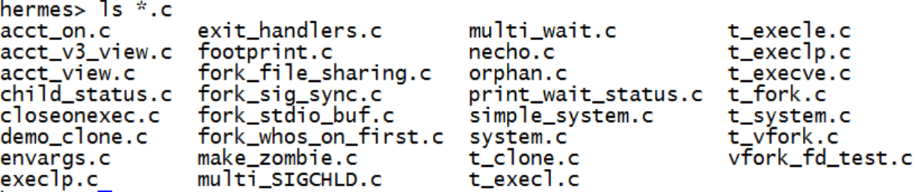
TLPI/procexec

Slide 15
procexec/fork_whos_on_first.c
main(int argc, char *argv[])
{
int numChildren, j;
pid_t childPid;
if (argc > 1 &&
strcmp(argv[1], "--help") == 0)
usageErr("%s [num-children]\n", argv[0]);
numChildren = (argc > 1) ? getInt(argv[1], GN_GT_0, "num-children") : 1;
setbuf(stdout, NULL); /*unbufrd */
for (j = 0; j < numChildren; j++) {
switch (childPid = fork()) {
case -1:
errExit("fork");
case 0:
printf("%d child\n", j);
_exit(EXIT_SUCCESS);
default:
printf("%d parent\n", j);
wait(NULL); /* Wait for child to terminate */
break;
}
}

Slide 16
multi_wait.c
switch (fork()) {
case -1:
errExit("fork");
case 0: /* Child sleeps then exits */
printf("[%s] child %d started with PID %ld, sleeping %s "
"seconds\n", currTime("%T"), j, (long) getpid(), argv[j]);
sleep(getInt(argv[j], GN_NONNEG, "sleep"));
_exit(EXIT_SUCCESS);
default: /* Parent just continues */
break;
}
}
numDead = 0;
main(int argc, char *argv[])
{
int numDead; /* Number of children so far waited for */
pid_t childPid; /* PID of waited for child */
int j;
if (argc < 2 || strcmp(argv[1], "--help") == 0)
usageErr("%s sleep-time...\n", argv[0]);
setbuf(stdout, NULL); /* Disable buffering of stdout */
for (j = 1; j < argc; j++) {

Slide 17
numDead = 0;
for (;;) { /* Parent waits for each child to exit */
childPid = wait(NULL);
if (childPid == -1) {
if (errno == ECHILD) {
printf("No more children - bye!\n");
exit(EXIT_SUCCESS);
} else { /* Some other (unexpected) error */
errExit("wait");
}
}
numDead++;
printf("[%s] wait() returned child PID %ld (numDead=%d)\n",
currTime("%T"), (long) childPid, numDead);
}
}

Slide 18
System.c
#include <sys/wait.h>
#include <sys/types.h>
#include <errno.h>
int
system(const char *command)
{
sigset_t blockMask, origMask;
struct sigaction saIgnore, saOrigQuit, saOrigInt, saDefault;
pid_t childPid;
int status, savedErrno;
if (command == NULL) /* Is a shell available? */
return system(":") == 0;
/* The parent process (the caller of system()) blocks SIGCHLD
and ignore SIGINT and SIGQUIT while the child is executing.
We must change the signal settings prior to forking, to avoid
possible race conditions. This means that we must undo the
effects of the following in the child after fork(). */

Slide 19
System.c
sigemptyset(&blockMask); /* Block SIGCHLD */
sigaddset(&blockMask, SIGCHLD);
sigprocmask(SIG_BLOCK, &blockMask, &origMask);
saIgnore.sa_handler = SIG_IGN; /* Ignore SIGINT and SIGQUIT */
saIgnore.sa_flags = 0;
sigemptyset(&saIgnore.sa_mask);
sigaction(SIGINT, &saIgnore, &saOrigInt);
sigaction(SIGQUIT, &saIgnore, &saOrigQuit);
switch (childPid = fork()) {
case -1: /* fork() failed */
status = -1;
break; /* Carry on to reset signal attributes */

Slide 20
System.c
case 0: /* Child: exec command */
/* We ignore possible error returns because the only specified error
is for a failed exec(), and because errors in these calls can't
affect the caller of system() (which is a separate process) */
saDefault.sa_handler = SIG_DFL;
saDefault.sa_flags = 0;
sigemptyset(&saDefault.sa_mask);
if (saOrigInt.sa_handler != SIG_IGN)
sigaction(SIGINT, &saDefault, NULL);
if (saOrigQuit.sa_handler != SIG_IGN)
sigaction(SIGQUIT, &saDefault, NULL);
sigprocmask(SIG_SETMASK, &origMask, NULL);

Slide 21
System.c
case 0: /* Child: exec command */
/* We ignore possible error returns because the only specified error
is for a failed exec(), and because errors in these calls can't
affect the caller of system() (which is a separate process) */
saDefault.sa_handler = SIG_DFL;
saDefault.sa_flags = 0;
sigemptyset(&saDefault.sa_mask);
if (saOrigInt.sa_handler != SIG_IGN)
sigaction(SIGINT, &saDefault, NULL);
if (saOrigQuit.sa_handler != SIG_IGN)
sigaction(SIGQUIT, &saDefault, NULL);
sigprocmask(SIG_SETMASK, &origMask, NULL);

Slide 22
System.c
execl("/bin/sh", "sh", "-c", command, (char *) NULL);
_exit(127); /* We could not exec the shell */
default: /* Parent: wait for our child to terminate */
/* We must use waitpid() for this task; using wait() could inadvertently
collect the status of one of the caller's other children */
while (waitpid(childPid, &status, 0) == -1) {
if (errno != EINTR) { /* Error other than EINTR */
status = -1;
break; /* So exit loop */
}
}
break;
});

Slide 23
System.c
/* Unblock SIGCHLD, restore dispositions of SIGINT and SIGQUIT */
savedErrno = errno; /* The following may change 'errno' */
sigprocmask(SIG_SETMASK, &origMask, NULL);
sigaction(SIGINT, &saOrigInt, NULL);
sigaction(SIGQUIT, &saOrigQuit, NULL);
errno = savedErrno;
return status;
}

Slide 24
proc/longjmp.c
#include <setjmp.h>
#include "tlpi_hdr.h"
static jmp_buf env;
static void
f2(void)
{
longjmp(env, 2);
}
static void
f1(int argc)
{
if (argc == 1)
longjmp(env, 1);
f2();
}
main(int argc, char *argv[])
{
switch (setjmp(env)) {
case 0: /* This is the return after the initial setjmp() */
printf("Calling f1() after initial setjmp()\n");
f1(argc); /* Never returns... */
break; /* ... but this is good form */
case 1:
printf("We jumped back from f1()\n");
break;
case 2:
printf("We jumped back from f2()\n");
break;
}
exit(EXIT_SUCCESS);
}

Slide 25
main(int argc, char *argv[])
{
switch (setjmp(env)) {
case 0: /* This is the return after the initial setjmp() */
printf("Calling f1() after initial setjmp()\n");
f1(argc); /* Never returns... */
break; /* ... but this is good form */
case 1:
printf("We jumped back from f1()\n");
break;
case 2:
printf("We jumped back from f2()\n");
break;
}
exit(EXIT_SUCCESS);
}
if (setjmp(env) == 0) { /* Code executed after setjmp() */
nvar = 777;
rvar = 888;
vvar = 999;
doJump(nvar, rvar, vvar);
} else { /* Code executed after longjmp() */
printf("After longjmp(): nvar=%d rvar=%d vvar=%d\n", nvar, rvar, vvar);
}
exit(EXIT_SUCCESS);
}

Slide 26
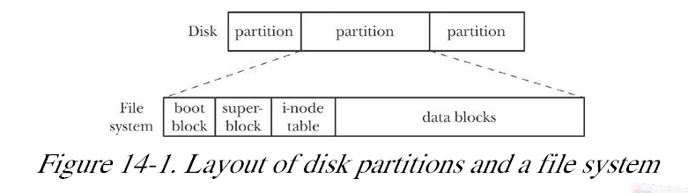
Filesystems and the hierarchy

Slide 27
Filesystems
boot block – one boot block, the first block of partition
Superblock
  size of inode table
  size of logical blocks in filesystem
  size of filesystem in logical blocks
Inode table
Data blocks
Documentation/ filesystems/ ext2. txt,
Kerrisk, Michael (2011-02-11). The Linux Programming Interface: A Linux and UNIX System Programming Handbook (Kindle Location 12504). O'Reilly Distribution. Kindle Edition.

Slide 28
Inodes – everything returned by stat

Slide 29
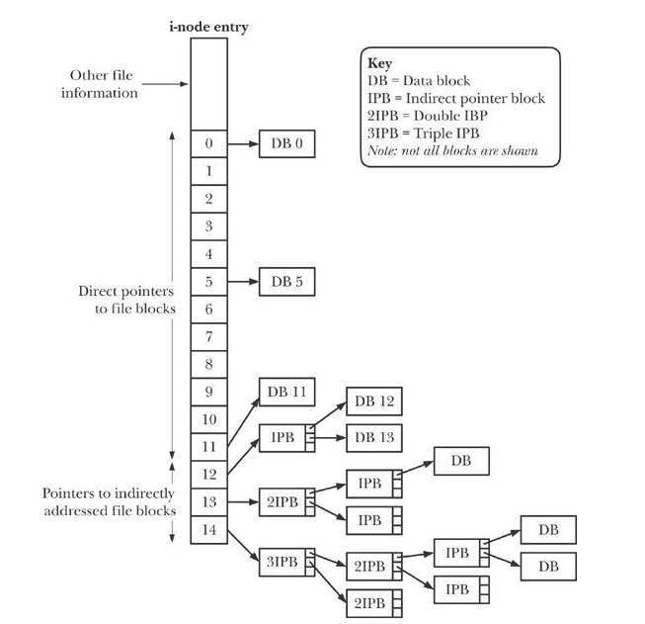
Figure 14-2 Structure of file blocks for a file in an ext2 filesys

Slide 30
Filesizes
Note As an example, the author measured one system containing somewhat more than 150,000 files. Just over 30% of the files were less than 1000 bytes in size, and 80% occupied 10,000 bytes or less. Assuming a 1024-byte block size, all of the latter files could be referenced using just the 12 direct pointers, which can refer to blocks
Kerrisk, Michael (2011-02-11). The Linux Programming Interface: A Linux and UNIX System Programming Handbook (Kindle Locations 12569-12572). O'Reilly Distribution. Kindle Edition.

