Slide 1
CSCE 510 - Systems Programming
Lec 28 Finale – Wrap-Up

Slide 2
Overview
Last Time
IPC (Interprocess Communication)
System V IPC (just enough to bash=criticize)
POSIX IPC
Shared Libraries
Today
Shared Libraries Again
Program Educational Objectives
Course Outcomes
Exam
Exam Review

Slide 3
Awareness of Topics yet Uncovered
IPC in general
POSIX IPC (Ch 51-54)
message queues
semaphores
shared memory
Shared Libraries
syslog Daemons (Ch 37)
Access Control Lists (Ch17)
va_list argList;
TLPI/procexec
pseudoterminals (Ch 64)
secure privileged programs (Ch 38)
mmap (Ch 49)
Virtual Memory operations (Ch 50)

Slide 4
Overview of Shared Libraries
save disk
executable smaller
only one copy instead of separate copies
save loading
bug or security fixes to static library require …?

Slide 5
Creating a Shared Library
“In order to build a shared version of the static library we created earlier, we perform the following steps:
$ gcc -g -c -fPIC -Wall mod1. c mod2. c mod3. c
$ gcc -g -shared -o libfoo.so mod1. o mod2. o mod3. o
$ objdump --all-headers libfoo.so | grep TEXTREL
$ readelf -d libfoo.so | grep TEXTREL
Kerrisk, Michael (2011-02-11). The Linux Programming Interface: A Linux and UNIX System Programming Handbook (Kindle Locations 37769-37771). O'Reilly Distribution. Kindle Edition.

Slide 6
Using a Shared library
$ gcc -g -Wall -o prog prog.c libfoo.so
Kerrisk, Michael (2011-02-11). The Linux Programming Interface: A Linux and UNIX System Programming Handbook (Kindle Locations 37789-37790). O'Reilly Distribution. Kindle Edition.

Slide 7
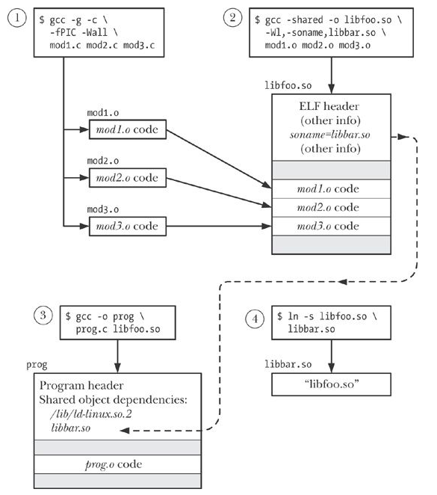
Fig 41-1
Shared libraries
Creating
Linking

Slide 8
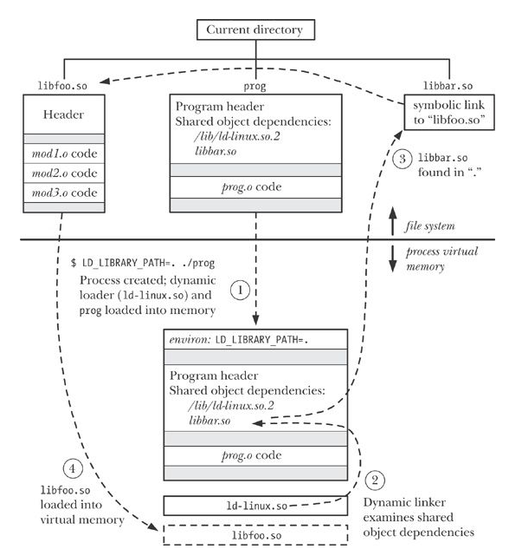
SharedLibrary Execution Fig 41-2

Slide 9
Shared Libraries – relevant commands
ldd(1) - print shared library dependencies
objdump(1) - - display information from object files
readelf(1) - Displays information about ELF files
nm(1) - list symbols from object files

Slide 10
Creating A shared Library - Conventions
$ gcc -g -c -fPIC -Wall mod1. c mod2. c mod3. c
Then we create the shared library with the real name libdemo.so. 1.0.1 and the soname libdemo.so. 1.
$ gcc -g -shared -Wl,-soname, libdemo.so. 1 -o libdemo.so. 1.0.1 \ mod1. o mod2. o mod3. o
Next, we create appropriate symbolic links for the soname and linker name:
$ ln -s libdemo.so. 1.0.1 libdemo.so. 1
$ ln -s libdemo.so. 1 libdemo.so
We can employ ls to verify the setup (with awk used to select the fields of interest):
$ ls -l libdemo.so* | awk '{ print $ 1, $ 9, $ 10, $ 11}' lrwxrwxrwx libdemo.so -> libdemo.so. 1 lrwxrwxrwx libdemo.so. 1 -> libdemo.so. 1.0.1 -rwxr-xr-x libdemo.so. 1.0.1
Kerrisk, Michael (2011-02-11). The Linux Programming Interface: A Linux and UNIX System Programming Handbook (Kindle Locations 38074-38090). O'Reilly Distribution. Kindle Edition.

Slide 11
Webserver Architecture
multi-process server
threaded server
hybrid
front end - distributor

Slide 12
Learning Outcomes for 510
Specific goals for the course
Specific outcomes of instruction are that students will be able to:
Demonstrate mastery of the internal operation of Unix system software including assemblers, loaders, macro-processors, command language interpreters, inter-process communication. {tests}
Develop medium to large C/C++ programs in a Unix Environment utilizing the C preprocessor, the debugger (gdb), make, source code revision systems (sccs), etc. {programming assignments, tests}

Slide 13
Program Educational Objectives
The mission of the Computer Science degree program is to prepare graduates with the knowledge and skills needed for successful practice in the field of computing and for post-baccalaureate education. The program educational objectives are that five years after graduation Computer Science graduates will be:
Contributing to economic development and society through the development and management of computer systems for industry and research.
Continuing their professional development through professional study and research.
Advancing in their careers through knowledge of computer science, communication skills and understanding of computer systems and contemporary technological issues.

Slide 14
PEOs – Computer Engr & CIS
… Computer Engineering
Contributing to their communities and society with innovations in computer technology and applications and an understanding of contemporary technological issues.
Continuing their professional development through professional study and research.
Advancing in their careers through their knowledge of computer engineering, by communicating and working effectively as team members and by interacting responsibly with colleagues, customers, employers, and others in society.

Slide 15
PEOs – Computer Information Systems
… CIS
Contributing to economic development and society through the development and management of computer information systems.
Advancing in their careers through knowledge of computer information systems, communications skills and understanding of business and contemporary technological issues.
Continuing their professional development through professional study and research.

Slide 16
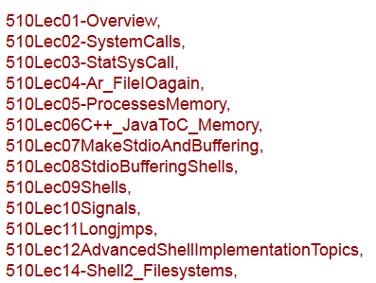
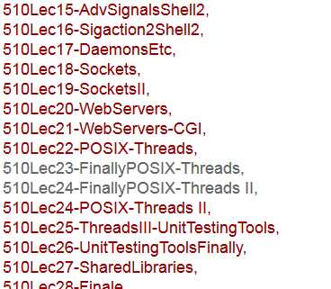
Exam Review Lectures by title

Slide 17
Exam
Test 1
Test 2
Test 2 – in-class
Since Test 2
POSIX threads
IPC
Shared libraries

Slide 18
Test 1 - remember
1. AR - lseek, magic, header
2. Shell - subst, linked lists, exec
3. Remapping stdio - popen
4. make
5. Memory layout; malloc/free
6. signals
7. setjmp/longjmp

Slide 19
Test 2 – Lecture 25 slides 3-5
Signals
Explain in detail what happens when the system call “rv = signal(SIGINT, intr);” is executed.
Write a section of code that will temporarily block the SIGINT signal.
Write a section of code to check if there is a SIGINT signal pending.
Are signals queued up?
pipes and fifos
What are the major differences between a pipe and a fifo?
How do you know if a file in the hierarchy is a fifo?
Longjmps/setjmps
What is the problem with global variables?
When are acceptable times to use longjmp?
Is the environment stored when you do a setjmp?

Slide 20
3b - Write a program “p3b.c” that will create two children A and B.
The parent should write ( a line) to A;
A should read then write (a line) to B,
B should … and then the parent should read (a line) from B.
What are the essential steps in a process becoming a daemon?
Filesystems
Explain triple indirect blocks
How many new blocks are required when adding a character to a file necessitates the first use of the triple indirect pointer?
How big in terms of blocks is the file at that point?

Slide 21
Sockets
write code to set up a datagram socket on port 5777 and start accepting packets on it and sending back responses
How do you find the IPv6 address of a machine?
What is the IPv4, IPv6, ethernet address of one of the machines in 3D??
Webservers - Modify your accept-fork-process to a multithreaded webserver using pthreads
POSIX threads/semaphores
in using a named semaphore how do you get started and then what commands do you do to signal and wait?
in using a non-named semaphore how do you get started and then what commands do you do to signal and wait?

Slide 22
Since Test 2
Sockets
POSIX threads
mutex,
IPC
System V IPC major components; main flaws
POSIX IPC
Shared Libraries
figure 41-2: main advantages
Etc.
file locks: lockf, fcntl
POSIX Semaphores
Shared memory segments: main +, main –

Slide 23
Exclusions
Check – Unit Testing
Extra credit
github
msgqueues

Slide 24
Short Answer -
shells
commands
manual sections
file systems – size of pointers in blocks

Slide 25
Programs – Anything is fair game
But especially:
pthreads
matrix sum – blocks (no synchronization required)
Sum of entries of matrix (synchronization required)
Client server
limitations
pipe/fork/exec
login/sleep - alarm

