Slide 1
CSCE 510 - Systems Programming
Lec 27 Shared Libraries Et cetera

Slide 2
Overview
Last Time
Webserver Assignment due date delayed because of network/server problems!
POSIX threads from Lec22
Autotools: dataflow
Threads topics from TLPI
Chap 31 Safety and Performance
Chap 32 Thread cancellation
Chap 33 Thread further details
POSIX semaphores
Getrusage
Tools-Check for Unit Testing
Test 2 Dropbox up and open
Today
IPC (Interprocess Communication)
System V IPC (just enough to bash=criticize)
POSIX IPC
Shared Libraries
Program Educational Objectives
Course Outcomes
Exam
Exam Review

Slide 3
Awareness of Topics yet Uncovered
IPC in general
POSIX IPC (Ch 51-54)
message queues
semaphores
shared memory
Shared Libraries
syslog Daemons (Ch 37)
Access Control Lists (Ch17)
va_list argList;
TLPI/procexec
pseudoterminals (Ch 64)
secure privileged programs (Ch 38)
mmap (Ch 49)
Virtual Memory operations (Ch 50)

Slide 4
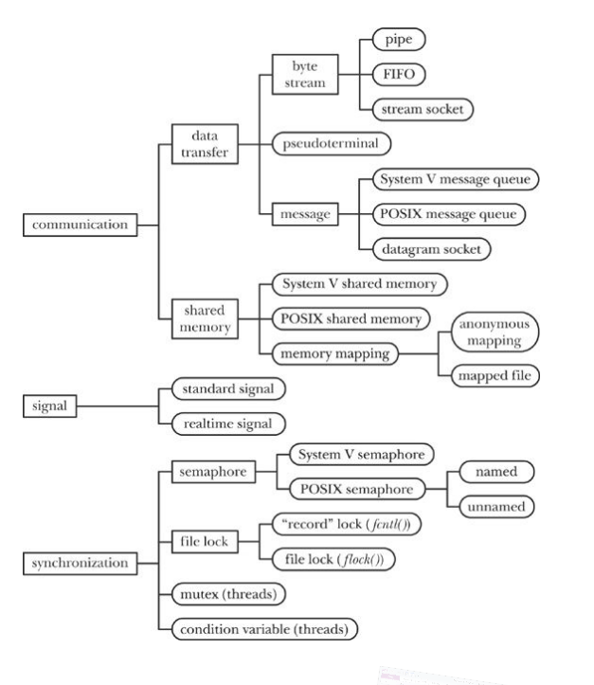
IPC
traditional
signals
pipes, fifos
sockets
System V IPC
msgqueues
semaphore sets
shared memory
POSIX
msgqueues,
shared memory,
semaphores,

Slide 5
FCNTL(2) Linux Programmer's Manual FCNTL(2)
NAME
fcntl - manipulate file descriptor
SYNOPSIS
#include <unistd.h>
#include <fcntl.h>
int fcntl(int fd, int cmd, ... /* arg */ );
DESCRIPTION - fcntl() performs one of the operations described below on the open file descriptor fd. The operation is determined by cmd.
cmd = … F_DUPFD_CLOEXEC, … , Advisory locking
F_GETLK, F_SETLK and F_SETLKW (acquire, set and test)
LOCKF(3) implemented in terms of fcntl ???

Slide 6
FLOCK(1) H. Peter Anvin FLOCK(1)
NAME
flock - Manage locks from shell scripts
SYNOPSIS
flock [-sxon] [-w timeout] lockfile [-c] command...
flock [-sxon] [-w timeout] lockdir [-c] command...
flock [-sxun] [-w timeout] fd
DESCRIPTION
This utility manages flock(2) locks from within shell scripts or the command line.

Slide 7
System V IPC objects (Ch 45-48)
msgqueues - priority queue for atomic messages
atomic writes – what does this mean???
priority queue
shared memory segments
two running processes “share” the same memory segment
shmat – shared memory attach
void *shmat(int shmid, const void *shmaddr, int shmflg);
shared segment does not start at the same address in each process?!!
why?
➔ use offsets
semaphore sets arrays of semaphores ???
front
M1/3 | M2/ | M3 | M4 | M5 | … | Mi/priority of Mi |  |  | Mn

Slide 8
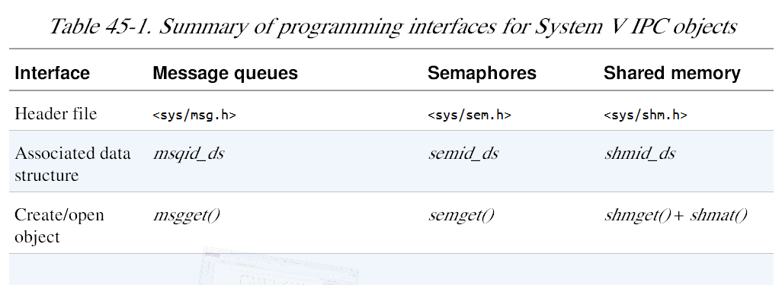
API for System V IPC objects

Slide 9
System V IPC identifies IPC objects with keys
ftok
key_t ftok(const char *pathname, int proj_id);
key_t plays the role of “filename”; Note not fd.
Given an integer key (analogous to a filename), the get call either:
creates a new IPC object with the given key and returns a unique identifier for that object; or
returns the identifier of an existing IPC object with the given key.
Kerrisk, Michael (2011-02-11). The Linux Programming Interface:

Slide 10
hermes> man -k "System V"
ftok (3) - convert a pathname and a project identifier to a ...
ipc (2) - System V IPC system calls
ipc (5) - System V interprocess communication mechanisms
service (8) - run a System V init script
sighold (3) - System V signal API
sigignore (3) - System V signal API
sigrelse (3) - System V signal API
sigset (3) - System V signal API
svipc (7) - System V interprocess communication mechanisms
sysv_signal (3) - signal handling with System V semantics
termio (7) - the System V terminal driver interface

Slide 11
Excerpts from TLPI/svipc/mix of svmsg_server/client.c
#include <sys/msg.h>
#include <sys/stat.h>
#include "tlpi_hdr.h"
#define KEY_FILE "/some-path/some-file“ /* Should exist or be created*/
int
main(int argc, char *argv[])
{
int msqid;
key_t key;
const int MQ_PERMS = S_IRUSR | S_IWUSR | S_IWGRP;
key = ftok(KEY_FILE, 1);
…
msqid = msgget(key, IPC_CREAT | IPC_EXCL | MQ_PERMS)
… one side client writes … msgsnd(msqid, &msg, len, 0)
}
In the sever program after ftok’ing and msgget’ing uses
msgrec(rec_qid, &entry, MAXOBN, (-1*MAXPRIOR, MSG_NOERROR)
to read message

Slide 12
POSIX IPC (Chapter 51)
As in System V IPC
msgqueues
semaphores
shared memory
API
use pathnames directly; none of this ftok stuff
i.e. “The System V shared memory model, which uses keys and identifiers, is not consistent with the standard UNIX I/ O model, which uses filenames and descriptors.”
Kerrisk, Michael (2011-02-11). The Linux Programming Interface:

Slide 13
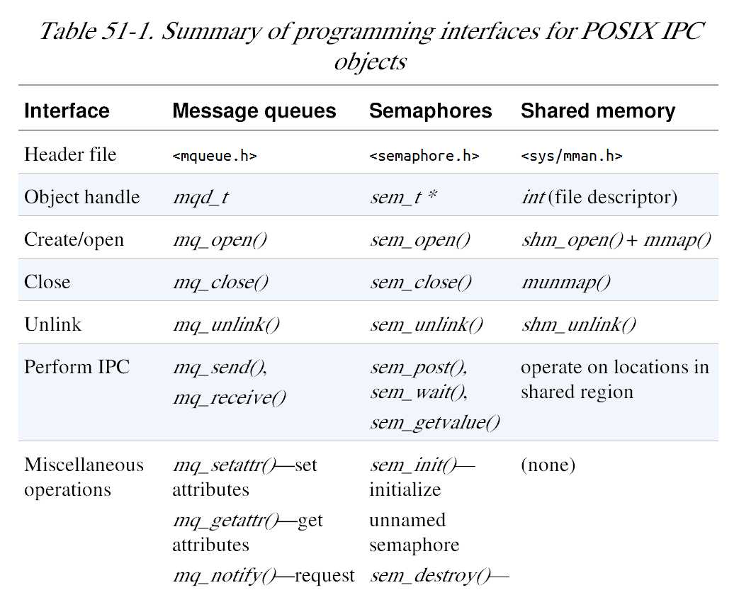
Table 51-1 POSIX IPC Summary

Slide 14
TLPI/pmsg/
hermes> pwd
/class/csce510-001/Code/tlpi-dist/pmsg
hermes> ls *.c
mq_notify_sig.c
mq_notify_thread.c ⬅ ?? next few slides msgqueues+pthreads
pmsg_getattr.c
mq_notify_sigwaitinfo.c
pmsg_create.c ⬅ create queue, send, receive. remove
pmsg_send.c
pmsg_receive.c
pmsg_unlink.c

Slide 15
TLPI/pmsg/mq_notify_thread.c
/* mq_notify_thread.c -- Demonstrate message notification via threads on a POSIX message queue.
Linux supports POSIX message queues since kernel 2.6.6. */
#include <pthread.h>
#include <mqueue.h>
#include <fcntl.h> /* For definition of O_NONBLOCK */
#include "tlpi_hdr.h"
static void notifySetup(mqd_t *mqdp);
static void /* Thread notification function */
threadFunc(union sigval sv)
{
ssize_t numRead;
mqd_t *mqdp;
void *buffer;
struct mq_attr attr;
mqdp = sv.sival_ptr;
???

Slide 16
if (mq_getattr(*mqdp, &attr) == -1)
errExit("mq_getattr");
buffer = malloc(attr.mq_msgsize);
if (buffer == NULL)
errExit("malloc");
/* Reregister for message notification */
notifySetup(mqdp);
while ((numRead = mq_receive(*mqdp, buffer, attr.mq_msgsize, NULL)) >= 0)
printf("Read %ld bytes\n", (long) numRead);
if (errno != EAGAIN) /* Unexpected error */
errExit("mq_receive");
free(buffer);
pthread_exit(NULL);
}

Slide 17
static void
notifySetup(mqd_t *mqdp)
{
struct sigevent sev;
sev.sigev_notify = SIGEV_THREAD; /* Notify via thread */
sev.sigev_notify_function = threadFunc;
sev.sigev_notify_attributes = NULL;
/* Could be pointer to pthread_attr_t structure */
sev.sigev_value.sival_ptr = mqdp; /* Arg to threadFunc() */
if (mq_notify(*mqdp, &sev) == -1)
errExit("mq_notify");
}
static void
notifySetup(mqd_t *mqdp)
{
struct sigevent sev;
sev.sigev_notify = SIGEV_THREAD; /* Notify via thread */
sev.sigev_notify_function = threadFunc;
sev.sigev_notify_attributes = NULL;
/* Could be pointer to pthread_attr_t structure */
sev.sigev_value.sival_ptr = mqdp; /* Argument to threadFunc() */
if (mq_notify(*mqdp, &sev) == -1)
errExit("mq_notify");
}

Slide 18
int
main(int argc, char *argv[])
{
mqd_t mqd;
if (argc != 2 || strcmp(argv[1], "--help") == 0)
usageErr("%s mq-name\n", argv[0]);
mqd = mq_open(argv[1], O_RDONLY | O_NONBLOCK);
if (mqd == (mqd_t) -1)
errExit("mq_open");
notifySetup(&mqd);
pause(); /* Wait for notifications via thread function */
}

Slide 19
POSIX Shared Memory (Ch 54)
cleaner API more inline with Standard Unix I/O interface
“POSIX talks about shared memory objects, while System V talks about shared memory segments.”

Slide 20
SHM_OPEN(3) Linux Programmer's Manual SHM_OPEN(3)
NAME
shm_open, shm_unlink - Create/open or unlink POSIX shared memory
objects
SYNOPSIS
#include <sys/mman.h>
#include <sys/stat.h> /* For mode constants */
#include <fcntl.h> /* For O_* constants */
int shm_open(const char *name, int oflag, mode_t mode);
int shm_unlink(const char *name);
Link with -lrt.
DESCRIPTION - shm_open() creates and opens a new, or opens an existing, POSIX shared memory object.
…
SEE ALSO - close(2), fchmod(2), fchown(2), fcntl(2), fstat(2), ftruncate(2), mmap(2), open(2), umask(2), shm_overview(7)
???

Slide 21
POSIX Shared Memory Examples
hermes> pwd
/class/csce510-001/Code/tlpi-dist/pshm
hermes> ls *
Makefile
pshm_create.c
pshm_read.c
pshm_unlink.c
pshm_write.c

Slide 22
TLPI/pshm/pshm_create.c
main(int argc, char *argv[])
{
int flags, opt, fd;
mode_t perms;
size_t size;
void *addr;
flags = O_RDWR;
while ((opt = getopt(argc, argv, "cx")) != -1) {
switch (opt) {
case 'c': flags |= O_CREAT; break;
case 'x': flags |= O_EXCL; break;
default: usageError(argv[0]);
}
}
if (optind + 1 >= argc)
usageError(argv[0]);
size = getLong(argv[optind + 1], GN_ANY_BASE, "size");
perms = (argc <= optind + 2) ? (S_IRUSR | S_IWUSR) :
getLong(argv[optind + 2], GN_BASE_8, "octal-perms");

Slide 23
/* Create shared memory object and set its size */
fd = shm_open(argv[optind], flags, perms);
if (fd == -1)
errExit("shm_open");
if (ftruncate(fd, size) == -1)
errExit("ftruncate");
/* Map shared memory object */
addr = mmap(NULL, size, PROT_READ | PROT_WRITE, MAP_SHARED, fd, 0);
if (addr == MAP_FAILED)
errExit("mmap");
exit(EXIT_SUCCESS);
}

Slide 24
MMAP(2) Linux Programmer's Manual MMAP(2)
NAME
mmap, munmap - map or unmap files or devices into memory
SYNOPSIS
#include <sys/mman.h>
void *mmap(void *addr, size_t length, int prot, int flags,
int fd, off_t offset);
int munmap(void *addr, size_t length);
DESCRIPTION
mmap() creates a new mapping in the virtual address space of the calling process. The starting address for the new mapping is specified in addr. The length argument specifies the length of the mapping.

Slide 25
TLPI/pshm/pshm_write.c
//pshm_write.c--Usage: pshm_write shm-name string
…
fd = shm_open(argv[1], O_RDWR, 0); /*Open exist. obj */
…
len = strlen(argv[2]);
if (ftruncate(fd, len) == -1) /* Resize object to hold string */
errExit("ftruncate");
printf("Resized to %ld bytes\n", (long) len);
addr = mmap(NULL, len, PROT_READ | PROT_WRITE, MAP_SHARED, fd, 0);
if (addr == MAP_FAILED)
errExit("mmap");
if (close(fd) == -1) /* 'fd' is mo longer needed */
errExit("close");

Slide 26
Ch 41 Fundamentals of Shared Libraries
first Object libaries
$ cc -g -c prog.c mod1. c mod2. c mod3. c
$ cc -g -o prog_nolib prog.o mod1. o mod2. o mod3. o
hermes> ls /usr/lib/libc*
…
/usr/lib/libcrypto.a
…
/usr/lib/libc.so // What is that .so??
shared vs static

Slide 27
hermes> ar tl /usr/lib/libcrypto.a | more
cryptlib.o
dyn_lck.o
mem.o
mem_clr.o
tmdiff.o
cpt_err.o
…
hermes> ar tv /usr/lib/libc.so
ar: /usr/lib/libc.so: File format not recognized
l should be v

Slide 28
man -k shared
curl_share_cleanup (3) - Clean up a shared object
curl_share_init (3) - Create a shared object
curl_share_setopt (3) - Set options for a shared object
deb-shlibs (5) - Debian shared library information file
deb-symbols (5) - Debian's extended shared library information file
dh_shlibdeps (1) - calculate shared library dependencies
dh_strip (1) - strip executables, shared libraries, and some static l...
dl_iterate_phdr (3) - walk through list of shared objects
dpkg-gensymbols (1) - generate symbols files (shared library dependency info...
dpkg-shlibdeps (1) - generate shared library substvar dependencies
ibv_create_srq (3) - create or destroy a shared receive queue (SRQ)
ibv_destroy_srq (3) - create or destroy a shared receive queue (SRQ)
ibv_modify_srq (3) - modify attributes of a shared receive queue (SRQ)
ibv_post_srq_recv (3) - post a list of work requests (WRs) to a shared receiv...
ibv_query_srq (3) - get the attributes of a shared receive queue (SRQ)
ipcrm (1) - remove a message queue, semaphore set or shared memory id
ldd (1) - print shared library dependencies
mpool (3) - shared memory buffer pool
…

Slide 29
man -k libraries | grep 7
hermes> man -k libraries | grep 7
glibc (7) - Overview of standard C libraries on Linux
kdeoptions (7) - Common commandline options for all applications based ...
libc (7) - Overview of standard C libraries on Linux
hermes> man –s 7 glibc
…
The pathname /lib/libc.so.6 (or something similar) is normally a symbolic link that points to the location of the glibc library

Slide 30
Creating your own lib review
$ cc -g -c mod1. c mod2. c mod3. c
$ ar r libdemo.a mod1. o mod2. o mod3. o
$ rm mod1. o mod2. o mod3. o
$ cc -g -c prog.c
$ cc -g -o prog prog.o libdemo.a
$ cc -g -o prog prog.o –ldemo
$ cc -g -o prog prog.o -Lmylibdir -ldemo

Slide 31
Overview of Shared Libraries
save disk
executable smaller
only one copy instead of separate copies
save loading
bug or security fixes to static library require …?

Slide 32
Creating a Shared Library
“In order to build a shared version of the static library we created earlier, we perform the following steps:
$ gcc -g -c -fPIC -Wall mod1. c mod2. c mod3. c
$ gcc -g -shared -o libfoo.so mod1. o mod2. o mod3. o
$ objdump --all-headers libfoo.so | grep TEXTREL
$ readelf -d libfoo.so | grep TEXTREL
Kerrisk, Michael (2011-02-11). The Linux Programming Interface: A Linux and UNIX System Programming Handbook (Kindle Locations 37769-37771). O'Reilly Distribution. Kindle Edition.

Slide 33
Using a Shared library
$ gcc -g -Wall -o prog prog.c libfoo.so
Kerrisk, Michael (2011-02-11). The Linux Programming Interface: A Linux and UNIX System Programming Handbook (Kindle Locations 37789-37790). O'Reilly Distribution. Kindle Edition.

Slide 34
More to come

Slide 35
Quote’s for the goal of the rest of the course
Awareness is the first step to knowledge.
"Order and simplification are the first steps toward mastery of a subject - the actual enemy is the unknown”
Thomas Mann
He who knows nothing is closer to the truth than he whose mind is filled with falsehoods and errors.
Ritu Ghatourey

Slide 36
Socrates
“understanding a question is half an answer”
“The beginning of wisdom is the definition of terms.”
True knowledge exists in knowing that you know nothing.”
“The Only Thing I Know For Sure Is That I Know Nothing At All, For Sure”
“By all means marry; if you get a good wife, you’ll become happy; if you get a bad one, you’ll become a philosopher.”
“Children nowadays are tyrants. They contradict their parents, gobble their food, and tyrannise their teachers.”

Slide 37
Awareness of Topics yet Uncovered
POSIX IPC
message queues
semaphores
shared memory
Shared Libraries
syslog
Access Control Lists
va_list argList;
TLPI/procexec
pseudoterminals
secure privileged programs

Slide 38
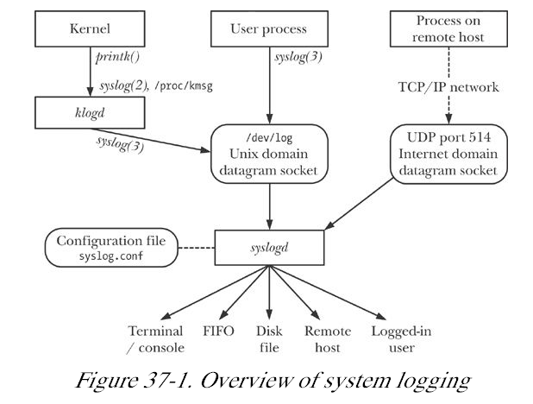
syslog -- TLPI/t_syslog.c

Slide 39
Access Control Lists (ACL)
“File permissions in Unix: rwx for owner, group and others
some applications need finer control over the permissions granted to specific users and groups.
ACLs allow file permissions to be specified per user or per group, for an arbitrary number of users and groups.”
Kerrisk, Michael (2011-02-11). The Linux Programming Interface:

Slide 40
printf(format-str, v1, v2, …)
va_list argList;

Slide 41
STDARG(3) Linux Programmer's Manual STDARG(3)
NAME
stdarg, va_start, va_arg, va_end, va_copy - variable argument lists
SYNOPSIS
#include <stdarg.h>
void va_start(va_list ap, last);
type va_arg(va_list ap, type);
void va_end(va_list ap);
void va_copy(va_list dest, va_list src);
DESCRIPTION
A function may be called with a varying number of arguments of varying types.

Slide 42
#include <stdio.h>
#include <stdarg.h>
void
foo(char *fmt, ...)
{
va_list ap;
int d;
char c, *s;
va_start(ap, fmt);
while (*fmt)
switch (*fmt++) {
case 's': /* string */
s = va_arg(ap, char *);
printf("string %s\n", s);
break;
case 'd': /* int */
d = va_arg(ap, int);

Slide 44
TLPI/procexec
orphan.c
vfork_fd_test.c
child_status.c
fork_file_sharing.c
closeonexec.c
fork_sig_sync.c
demo_clone.c
fork_stdio_buf.c print_wait_status.c
t_execl.c
t_execle.c
t_execlp.c
t_execve.c
t_system.c
t_clone.c
t_vfork.c
t_fork.c
fork_whos_on_first.c
acct_on.c
execlp.c
make_zombie.c
system.c
envargs.c
simple_system.c
acct_v3_view.c
exit_handlers.c
acct_view.c
multi_SIGCHLD.c
necho.c
footprint.c
multi_wait.c

Slide 45
Pseudoterminals
script command

Slide 46
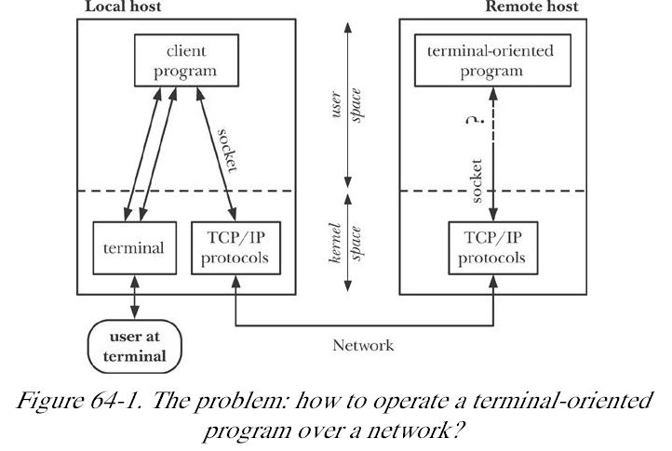

Slide 47
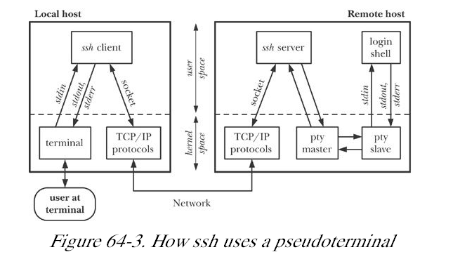
ssh using pseudoterminal

Slide 48
Applications of pseudoterminals
expect( 1) --uses a pseudoterminal to allow an interactive terminal-oriented program to be driven from a script file.
xterm employs pseudoterminals to provide the terminal-related functionality that goes with a terminal window.
screen( 1) -- uses pseudoterminals to multiplex a single physical terminal
script( 1) -- uses pseudoterminals to record all of the input and output that occurs during a shell session.
Kerrisk, Michael (2011-02-11). The Linux Programming Interface

Slide 49
REPLAY(1) User Contributed Perl Documentation REPLAY(1)
NAME
scriptreplay - play back typescripts, using timing information
SYNOPSIS
scriptreplay timingfile [typescript [divisor]]
DESCRIPTION
This program replays a typescript, using timing information to ensure that output happens at the same speed as it originally appeared when the script was recorded.

Slide 50
expect(1) - Linux man page
expect -programmed dialogue with interactive programs
expect [ -dDinN ] [ -c cmds ] [ [ -[f|b] ] cmdfile ] [ args ]
Introduction
Expect is a program that "talks" to other interactive programs according to a script. Following the script, Expect knows what can be expected from a program and what the correct response should be. An interpreted language provides branching and high-level control structures to direct the dialogue.

Slide 51
man autoexpect
autoexpect - generate an Expect script from watching a session
Synopsis
autoexpect [ args ] [ program args... ]
Introduction
autoexpect watches you interacting with another program and creates an Expect script that reproduces your interactions.

Slide 52
secure privileged programs
privileged programs ?
privileged commands?

