Slide 1
CSCE 510 - Systems Programming
Lecture 26 POSIX Threads again; Unit Testing

Slide 2
Overview
Last Time
POSIX threads from last times slides
Autotools
Threads topics from TLPI
Chap 29 Threads Introduction
Chap 30 Synchronization
Chap 31 Safety and Performance
Chap 32 Thread cancellation
Chap 33 Thread further details
How far did we go???
Email (none recently)
Today
Webserver Assignment due date delayed because of network/server problems!
POSIX threads from Lec22
Autotools: dataflow
Threads topics from TLPI
Chap 31 Safety and Performance
Chap 32 Thread cancellation
Chap 33 Thread further details
POSIX semaphores
Getrusage
Tools-Check for Unit Testing
Test 2

Slide 3
Test 2 – Due Monday 11:55PM
Signals
Explain in detail what happens when the system call “rv = signal(SIGINT, intr);” is executed.
Write a section of code that will temporarily block the SIGINT signal.
Write a section of code to check if there is a SIGINT signal pending.
Are signals queued up?
pipes and fifos
What are the major differences between a pipe and a fifo?
How do you know if a file in the hierarchy is a fifo?
Longjmps/setjmps
What is the problem with global variables?
When are acceptable times to use longjmp?
Is the environment stored when you do a setjmp?

Slide 4
Write a program “p2b.c” that will create two children A and B.
The parent should write ( a line) to A;
A should read then write (a line) to B,
B should … and then the parent should read (a line) from B.
What are the essential steps in a process becoming a daemon?
Filesystems
Explain triple indirect blocks
How many new blocks are required when adding a character to a file necessitates the first use of the triple indirect pointer?
How big in terms of blocks is the file at that point?

Slide 5
Sockets
write code to set up a datagram socket on port 5777 and start accepting packets on it and sending back responses
How do you find the IPv6 address of a machine?
What is the IPv4, IPv6, ethernet address of one of the machines in 3D??
Webservers - Modify your accept-fork-process to a multithreaded webserver using pthreads
POSIX threads/semaphores
in using a named semaphore how do you get started and then what commands do you do to signal and wait?
in using a non-named semaphore how do you get started and then what commands do you do to signal and wait?

Slide 6
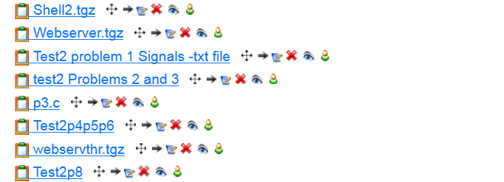
.

Slide 7
TLPI/threads Example Programs
simple_thread.c (Example 29-1) very simple one thread hello-world
detached_attrib.c (29-2) pthread_attr – detached attr
thread_incr.c (30-1)
thread_incr_mutex.c ( )
prod_no_condvar.c ( )
prod_condvar.c ( ) - condition variable in a producer/consumer
thread_multijoin.c ( )
strerror.c ( ); strerror_test.c ( ) - non-thread safe version
strerror_tsd.c ( ) (31-3) – thread safe using thread specific data
strerror_tls.c ( ) (31-4) – thread safe using thread local data
thread_cleanup.c ( )
thread_cancel.c ( )
one_time_init.c ( )

Slide 8
POSIX semaphores

Slide 9
Getrusage
get-Resource-usage
for self, children and threads

Slide 10
GETRUSAGE(2) Linux Programmer's Manual GETRUSAGE(2)
NAME
getrusage - get resource usage
SYNOPSIS
#include <sys/time.h>
#include <sys/resource.h>
int getrusage(int who, struct rusage *usage);
DESCRIPTION
getrusage() returns resource usage measures for who, which can be one
of the following: RUSAGE_SELF, RUSAGE_CHILDREN, RUSAGE_THREAD

Slide 11
struct rusage from man page
struct rusage {
struct timeval ru_utime; /* user time used */
struct timeval ru_stime; /* system time used */
long ru_maxrss; /* maximum resident set size */
long ru_ixrss; /* integral shared memory size */
long ru_idrss; /* integral unshared data size */
long ru_isrss; /* integral unshared stack size */
long ru_minflt; /* page reclaims */
long ru_majflt; /* page faults */
long ru_nswap; /* swaps */
long ru_inblock; /* block input operations */
long ru_oublock; /* block output operations */
long ru_msgsnd; /* messages sent */
long ru_msgrcv; /* messages received */
long ru_nsignals; /* signals received */
long ru_nvcsw; /* voluntary context switches */
long ru_nivcsw; /* involuntary context switches */
};
q

Slide 13
TLPI/procres/rusage.c
switch (childPid = fork()) {
case -1:
errExit("fork");
case 0:
execvp(argv[1], &argv[1]);
errExit("execvp");
default:
printf("Command PID: %ld\n", (long) childPid);
if (wait(NULL) == -1)
errExit("wait");
if (getrusage(RUSAGE_CHILDREN, &ru) == -1)
errExit("getrusage");
printf("\n");
printRusage("\t", &ru);
exit(EXIT_SUCCESS);
}
}
/* Note /procres/print_rusage.c contains function*/
/* rusage.c - Execute a command and then print a summary of the resources (as retrieved by getrusage()) that it used. */
#include <sys/resource.h>
#include <sys/wait.h>
#include "print_rusage.h"
#include "tlpi_hdr.h"
int
main(int argc, char *argv[])
{
pid_t childPid;
struct rusage ru;
if (argc < 2 || strcmp(argv[1], "--help") == 0)
usageErr("%s command arg...\n", argv[0]);

Slide 14
hermes> ./rusage ls .
Command PID: 19862
Makefile print_rusage.c rlimit_nproc.c rusage_wait
print_rlimit.c print_rusage.h rusage rusage_wait.c
print_rlimit.h rlimit_nproc rusage.c
CPU time (secs): user=0.000; system=0.004
Max resident set size: 920
Integral shared memory: 0
Integral unshared data: 0
Integral unshared stack: 0
Page reclaims: 296
Page faults: 0
Swaps: 0
Block I/Os: input=0; output=0
Signals received: 0
IPC messages: sent=0; received=0
Context switches: voluntary=9; involuntary=2

Slide 15
Time Again – Chapter 10
Lecture 6 Slides 25 – 32
file times, process times (handwaving)
Gettimeofday(2)
TIME(2) – file times, seconds since epoch
Time Conversion Functions Fig 10-1 repeated next slide
printing time
ctime
Examples
Strftime() - format date and time
Time Structures (from the figure)
time_t, struct tm, struct timeval

Slide 16
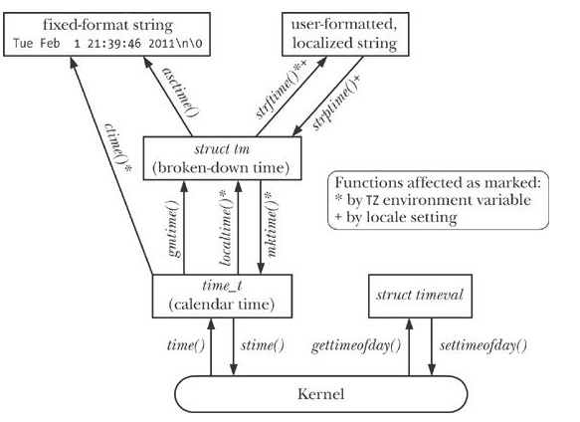
Time Conversion Functions Fig 10-1
.

Slide 17
Time structures from time.h
struct tm {
int tm_sec; /* seconds */
int tm_min; /* minutes */
int tm_hour; /* hours */
int tm_mday; /* day of mon
int tm_mon; /* month */
int tm_year; /* year */
int tm_wday; /* day of week
int tm_yday; /* day in year */
int tm_isdst; /* daylight saving time */
};
struct timeval {
time_t tv_sec; /* seconds */
suseconds_t tv_usec; /* microsecs */
};
time_t = calendar time. When interpreted as an absolute time value, it represents the number of seconds elapsed since Jan 1, 1970
/* POSIX.1b structure for a time value. This is like a `struct timeval' but has nanoseconds instead of microseconds. */
struct timespec
{
__time_t tv_sec; /* Seconds. */
long int tv_nsec; /* Nanoseconds*/
};

Slide 18
How can I see which CPU core a thread is running in?
Question (on StackOverflow)
n Linux, supposing a thread's pid is [pid], from the directory /proc/[pid] we can get many useful information. For example, these proc files, /proc/[pid]/status,/proc/[pid]/stat and /proc/[pid]/schedstat are all useful. But how can I get the CPU core number that a thread is running in? If a thread is in sleep state, how can I know which core it will run after it is scheduled again?
BTW, is there a way to dump the process(thread) list of running and sleeping tasks for each CPU core?

Slide 19
Answer: look at /proc//task//status
31466 (bc) R 31348 31466 31348 34819 31466 4202496 2557 0 0 0 3818 12 0 0 20 0 1 0 10196934 121827328 1091 18446744073709551615 4194304 4271839 140737264235072 140737264231824 4235516 0 0 0 2 0 0 0 17 2 0 0 0 0 0
Currently running on core 2.
To see what the rest of the fields mean, have a look at the Linux kernel source -- specifically the do_task_stat function in fs/proc/array.c or Documentation/filesystems/stat.txt
Note that all of this information may be obsolete by the time you get it. It was true at some point between when you made the open call on the file in proc and when that call returned
???? This make sense but ???
To get the information you want, look in /proc//task//status. The third field will be an 'R' if the thread is running. The sixth from the last field will be the core the thread is currently running on, or the core it last ran on (or was migrated to) if it's not currently running.
31466 (bc) S 31348 31466 31348 34819 31466 4202496 2557 0 0 0 5006 16 0 0 20 0 1 0 10196934 121827328 1091 18446744073709551615 4194304 4271839 140737264235072 140737264232056 217976807456 0 0 0 137912326 18446744071581662243 0 0 17 3 0 0 0 0 0
Not currently running. Last ran on core 3.

Slide 20
From the command line
top -H -p {PROC_ID}
top -H -p 20212

