Slide 1

CSCE 510 - Systems Programming
Lecture 21 Web Server: CGI -Dynamic Pages

Slide 2
Overview
Last Time
Last times slides 22-36
Stream Server skeleton
Web server Assignment
Software as a Service (SaaS)
Email ??
Today
  Tools Survey
  Web Servers again
  Web Server Skeleton – Pop Quiz
  Git
  CGI Common Gateway Interface

Slide 3
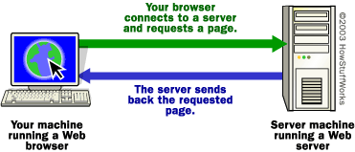
How Web Servers Work
HowStuffWorks –
  http://www.howstuffworks.com/web-server1.htm
  by Marshall Brain
http://computer.howstuffworks.com/web-server1.htm

Slide 4
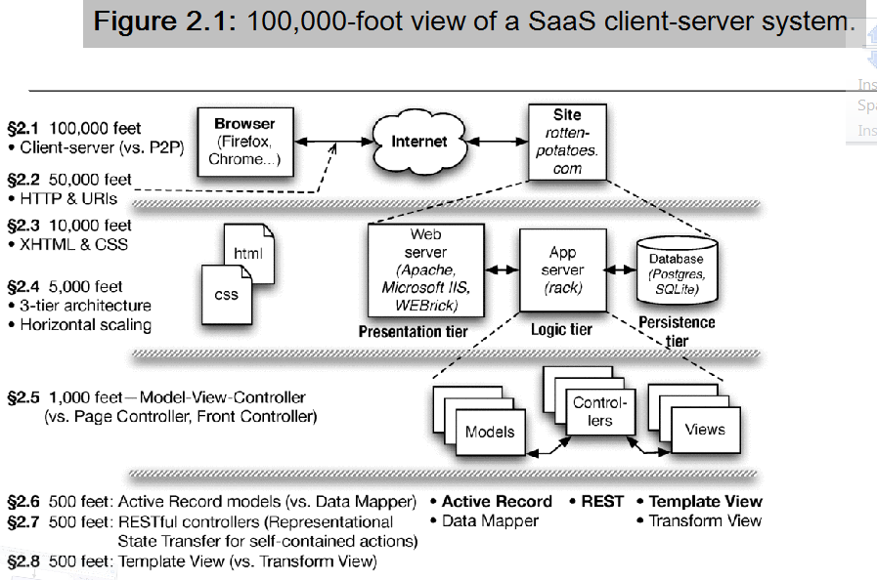
Saas Book Figure 2.1 (Last Time slide 18 repeat)
Engineering Long-Lasting Software: An Agile Approach Using SaaS and Cloud Computing (Beta Edition)

Slide 5
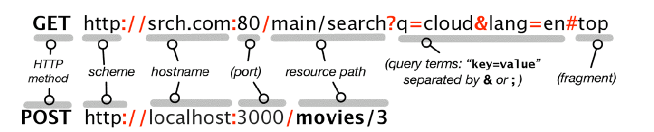
Behind the Scenes – Browser Initiates
Decompose URL/URI
  The protocol ("http")
  The server name ("www.howstuffworks.com")
  optional :port
  The path name ("web-server.htm")
Name to IP address translation
gethostbyname – now obsolete; use getaddrinfo(3) and getnameinfo(3)
int getaddrinfo(const char *node ← www.howstuffworks.com
Ref
Saas Book

Slide 6
Domain Name Service (DNS)
man –k dns
host(1) … no section 3 entries except for pm
Name servers

Slide 7
vim /etc/resolv.conf
nameserver 129.252.11.15
nameserver 129.252.21.12
nameserver 129.252.21.13
domain cse.sc.edu
search cse.sc.edu
Command Anyone Know????

Slide 8
DNS: nslookup(1)
ares> nslookup howstuffworks.com
Server: 129.252.11.15
Address: 129.252.11.15#53
Non-authoritative answer:
Name: howstuffworks.com
Address: 107.21.49.125
host(1) gives similar results

Slide 9
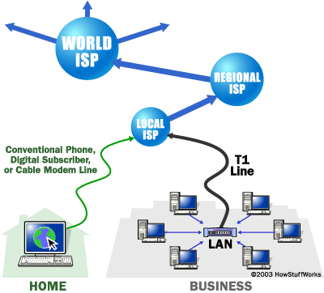
How does nslookup does its thing?
Or how does getaddrinfo do its thing?
DNS packets
  header
  question
  answer
  Authority
look up in local table
if not found send DNS (UDP) packet to nameserver
At each nameserver:
  if it does not know knows somebody else to ask
http://computer.howstuffworks.com/web-server1.htm

Slide 10
Get request + cookies sometimes
Static Pages – just return HTML in file
  get means – give me the file
Stateless
  connect to sever
  Send “Get page.html”
  Server: return page.html in HTML packet
  Server close connection
session info / logins etc
  how does the server remember?
  It doesn’t it send a cookie to the browser
  the browser returns it with later requests

Slide 11
Domain Names
.com, .org, .net, .edu
top of the food chain for nameservers

Slide 12
Dynamic Pages
Web 2.0 ?
Dynamic pages – html pages generated on server and then sent to the browser
Access Database
process form
…
java servlets
cgi

Slide 13
CGI – Common Gateway Interface
chroot for static pages “webroot”
cgi-bin – place for executables cgi scripts
  typically perl or C or ….

Slide 14
A simple CGI script
cgi program to generate
#include <stdio.h>
int main()
{
printf("Content-type: text/html\n\n");
printf("<html>\n");
printf("<body>\n");
printf("<h1>Hello there!</h1>\n");
printf("</body>\n");
printf("</html>\n");
return 0;
}
A simple HTMl page
<html>
<body>
<h1>Hello there!</h1>
</body>
</html>
compile with
gcc simplest.c -o simplest.cgi
http://computer.howstuffworks.com/cgi.htm

Slide 15
Perl version
#! /usr/bin/perl
print "Content-type: text/html\n\n";
print "<html><body><h1>Hello World!";
print "</h1></body></html>\n";
http://computer.howstuffworks.com/cgi.htm

Slide 16
Counter
fscanf(f, "%d", &i);
i++;
fseek(f,0,SEEK_SET);
fprintf(f, "%d", i);
fclose(f);
return i;
}
int main()
{
printf("Content-type: text/html\n\n");
printf("<html>\n");
printf("<body>\n");
printf("<h1>The current count is: ")
printf("%d</h1>\n", incrementcount());
printf("</body>\n");
printf("</html>\n");
return 0;
}
#include <stdio.h>
int incrementcount()
{
FILE *f;
int i;
f=fopen("count.txt", "r+");
if (!f)
{
sleep(1);
f=fopen("count.txt", "r+");
if (!f)
return -1;
}
http://computer.howstuffworks.com/cgi.htm

Slide 17
Forms: Sending Input
lycos search:
  http://www.lycos.com/cgi-bin/pursuit?matchmode=and
  &cat=lycos&query=test&x=10&y=9
http://computer.howstuffworks.com/cgi.htm

Slide 18
HTML form
<html>
<body>
<h1>A super-simple form<h1>
<FORM METHOD=GET ACTION="http://www.howstuffworks.com/
cgi-bin/simpleform.cgi">
Enter Your Name:
<input name="Name" size=20 maxlength=50>
<P>
<INPUT TYPE=submit value="Submit">
<INPUT TYPE=reset value="Reset">
</FORM>
</body>
</html>
http://computer.howstuffworks.com/cgi.htm

Slide 19
Process Query String
#include <stdio.h>
#include <stdlib.h>
int main()
{
printf("Content-type: text/html\n\n");
printf("<html>\n");
printf("<body>\n");
printf("<h1>The value entered was: ")
printf("%s</h1>\n", getenv("QUERY_STRING"));
printf("</body>\n");
printf("</html>\n");
return 0;
}
http://computer.howstuffworks.com/cgi.htm

Slide 20
Environment passed to scripts
AUTH_TYPE
CONTENT_LENGTH
CONTENT_TYPE
GATEWAY_INTERFACE
HTTP_ACCEPT
HTTP_USER_AGENT
PATH_INFO
PATH_TRANSLATED
QUERY_STRING
REMOTE_ADDR
REMOTE_HOST
REMOTE_IDENT
REMOTE_USER
REQUEST_METHOD
SCRIPT_NAME
SERVER_NAME
SERVER_PORT
SERVER_PROTOCOL
SERVER_SOFTWARE
http://computer.howstuffworks.com/cgi.htm

Slide 21
A real Form
<html>
<body>
<h1>HSW Survey Form<h1>
<FORM METHOD=POST ACTION="http:
//www.howstuffworks.com/cgi-bin/survey.cgi">
Enter Your Name:
<input name="Name" size=20 maxlength=50>
<P>Enter your sex:
<input type=radio CHECKED name=sex value=MALE>Male
<input type=radio name=sex value=FEMALE>Female
<P>Select your age<br>
</SELECT>
<SELECT size=2 NAME=age>
<OPTION> 1-10
<OPTION> 11-20
<OPTION> 21-30
<OPTION> 31-40
<OPTION> 41-50
<OPTION> 51-60
<OPTION> 61 and up
</SELECT>
<P>Enter Your Comment:
<input name="Name" size=40 maxlength=100>

