Slide 1

CSCE 510 - Systems Programming
Lecture 20 Web Server

Slide 2
Overview
Last Time
  Overview of TCP server
    socket
    bind
    listen
    accept
    fork process in child; listen in parent
Chapters 56-59
Email
Today
  Last times slides 22-36
  Stream Server skeleton
  Web server Assignment
  Software as a Service (SaaS)
  CGI Common Gateway Interface

Slide 3
Commands man –k network pruned
hermes> man -k network
interfaces (5) - network interface configuration for ifup and …
aseqnet (1) - ALSA sequencer connectors over network
avahi-autoipd (8) - IPv4LL network address configuration daemon
byteorder(3)- convert values between host and network byte order
ctstat (8) - unified linux network statistics
dhclient-script (8) - DHCP client network configuration script
dumpcap (1) - Dump network traffic
endhostent (3) - get network host entry
endnetent (3) - get network entry
endnetgrent (3) - handle network group entries
freeaddrinfo (3) - network address and service translation
freehostent (3) - get network hostnames and addresses
gai_strerror (3) - network address and service translation
getaddrinfo (3) - network address and service translation
gethostbyaddr (3) - get network host entry
netstat (8) - Print network connections, routing tables, interface s...
NetworkManager (8) - network management daemon
networks (5) - network name information
nm-ppp-starter (1) - PPP connection helper for NetworkManager
nm-tool (1) - utility to report NetworkManager state and devices
nm-vpn-properties (1) - Network management framework
nstat (8) - network statistics tools.
ntohl (3) - convert values between host and network byte order
ntohs (3) - convert values between host and network byte order
pabrowse (1) - List PulseAudio sound servers on the network
ping (8) - send ICMP ECHO_REQUEST to network hosts
ping6 (8) - send ICMP ECHO_REQUEST to network hosts
png (5) - Portable Network Graphics (PNG) format
pngtopnm (1) - convert a Portable Network Graphics file into portable...
pnmtopng (1) - convert a portable anymap into a Portable Network Grap...
rtacct (8) - network statistics tools.
rtstat (8) - unified linux network statistics
services (5) - Internet network services list
sethostent (3) - get network host entry
setnetent (3) - get network entry
setnetgrent (3) - handle network group entries
slattach (8) - attach a network interface to a serial line
smbtree (1) - A text based smb network browser
tcpdump (8) - dump traffic on a network
tcptraceroute (8) - print the route packets trace to network host
tcptraceroute.db (8) - print the route packets trace to network host
tracepath (8) - traces path to a network host discovering MTU along th...
tracepath6 (8) - traces path to a network host discovering MTU along th...
traceproto (1) - print the route packets trace to network host
traceproto.db (1) - print the route packets trace to network host
traceroute (1) - print the route packets trace to network host
traceroute-nanog (1) - print the route packets trace to network host
traceroute-nanog.db (1) - print the route packets trace to network host
traceroute.db (1) - print the route packets trace to network host
traceroute6 (1) - print the route packets trace to network host
traceroute6 (8) - traces path to a network host
traceroute6.db (1) - print the route packets trace to network host
traceroute6.iputils (8) - traces path to a network host
umount.nfs (8) - unmount a Network File System
wget (1) - The non-interactive network downloader.
wireshark (1) - Interactively dump and analyze network traffic
X (7) - a portable, network-transparent window system

Slide 4
Web Server Skeleton

Slide 5
HTTP Protocol
Packets
Get
Post
Put
HEAD
HTTP application layer
built on top of TCP
Man –k http
http://en.wikipedia.org/wiki/Hypertext_Transfer_Protocol

Slide 6
Get – response Example
Client request
GET /index.html HTTP/1.1
Host: www.example.com
Server response
HTTP/1.1 200 OK
Date: Mon, 23 May 2005 22:38:34 GMT
Server: Apache/1.3.3.7 (Unix) (Red-Hat/Linux)
Last-Modified: Wed, 08 Jan 2003 23:11:55 GMT
Etag: "3f80f-1b6-3e1cb03b"
Content-Type: text/html; charset=UTF-8
Content-Length: 131
Connection: close
<html>
<head> <title>An Example Page</title> </head> <body>
Hello World, this is a very simple HTML document.
</body> </html>

Slide 7
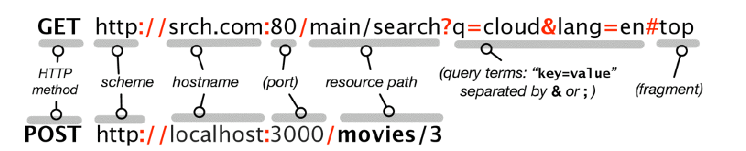
Breaking Down Get and Post requests
Browser Requests (Client)
Engineering Long-Lasting Software: An Agile Approach Using SaaS and Cloud Computing (Beta Edition)

Slide 8
HTTP packets
The initial line is different for the request than for the response. A request line has three parts, separated by spaces:
An HTTP Method Name
The local path of the requested resource.
The version of HTTP being used.
GET /path/to/file/index.html HTTP/1.0
Format of Request and Response
An initial line CRLF
Zero or more header lines CRLF
A blank line ie. a CRLF
An optional message body like file, query data or query output.
Header
URI Uniform Resource Indicator

Slide 9
Packet Sniffers
man –k sniffer
  Failure
man –k packet
pcap (3) - Packet Capture library
rpp (3) - reliable packet protocol
PF_PACKET (7) - packet interface on device level.
gpgsplit (1) - Split an OpenPGP message into packets
ip6tables (8) - IPv6 packet filter administration
iptables (8) - administration tool for IPv4 packet filtering and NAT
…
tcptraceroute (8) - print the route packets trace to network host
tcptraceroute.db (8) - print the route packets trace to network host
text2pcap (1) - Generate a capture file from an ASCII hexdump of packets

Slide 10
man –k http
ares> man -k http
CGI::Carp (3pm) - CGI routines for writing to the HTTPD (or other) error...
CGI::Cookie (3pm) - Interface to HTTP Cookies
HTTP::Server::Simple (3pm) - Lightweight HTTP server
HTTP::Server::Simple::CGI (3pm) - CGI.pm-style version of HTTP::Server::Simple
HTTP::Server::Simple::CGI::Environment (3pm) - a HTTP::Server::Simple mixin t...
HTTP::Server::Simple::Mason (3pm) - An abstract baseclass for a standalone ma...
Net::Server::HTTP (3pm) - very basic Net::Server based HTTP server class
Net::Server::PSGI (3pm) - basic Net::Server based PSGI HTTP server class
ab (8) - Apache HTTP server benchmarking tool
curl_formadd (3) - add a section to a multipart/formdata HTTP POST
curl_formfree (3) - free a previously build multipart/formdata HTTP POST c...
git-http-backend (1) - Server side implementation of Git over HTTP
git-http-fetch (1) - Download from a remote git repository via HTTP
git-http-push (1) - Push objects over HTTP/DAV to another repository
HTTP::Config (3pm) - Configuration for request and response objects
HTTP::Cookies (3pm) - HTTP cookie jars

Slide 11
Man –k http (continued)
HTTP::Cookies::Microsoft (3pm) - access to Microsoft cookies files
HTTP::Cookies::Netscape (3pm) - access to Netscape cookies files
HTTP::Daemon (3pm) - a simple http server class
HTTP::Date (3pm) - date conversion routines
HTTP::Headers (3pm) - Class encapsulating HTTP Message headers
HTTP::Headers::Util (3pm) - Header value parsing utility functions
HTTP::Message (3pm) - HTTP style message (base class)
HTTP::Negotiate (3pm) - choose a variant to serve
HTTP::Request (3pm) - HTTP style request message
HTTP::Request::Common (3pm) - Construct common HTTP::Request objects
HTTP::Response (3pm) - HTTP style response message
HTTP::Status (3pm) - HTTP Status code processing
kcookiejar (1) - HTTP Cookie Daemon
kcookiejar4 (8) - KDE HTTP cookie daemon
kio_http_cache_cleaner (1) - KDE HTTP cache maintenance tool
Net::HTTP (3pm) - Low-level HTTP connection (client)
Net::HTTP::NB (3pm) - Non-blocking HTTP client

Slide 12
HTTP::Request(3pm) User Contributed Perl Documentation HTTP::Request(3pm)
NAME
HTTP::Request - HTTP style request message
SYNOPSIS
require HTTP::Request;
$request = HTTP::Request->new(GET => 'http://www.example.com/');
and usually used like this:
$ua = LWP::UserAgent->new;
$response = $ua->request($request);
DESCRIPTION
"HTTP::Request" is a class encapsulating HTTP style requests,
consisting of a request line, some headers, and a content body. Note
that the LWP library uses HTTP style requests even for non-HTTP
protocols. Instances of this class are usually passed to the request()
method of an "LWP::UserAgent" object.

Slide 13
CGI – Common Gateway Interface
Server Side programming
See Also
FastCGI
Rack (web server interface)
Web Server Gateway Interface
Perl Web Server Gateway Interface
#!/usr/bin/perl
=head1 DESCRIPTION
printenv—demo CGI program which just prints its environment
=cut
print "Content-type:text/plain\n\n";
for my $var ( sort keys %ENV ) {
my $value = $ENV{$var};
$value =~ s/\n/\\n/g;
$value =~ s/"/\\"/g;
print qq[$var="$value"\n];
}
http://en.wikipedia.org/wiki/Common_Gateway_Interface

Slide 14
Supporting CGI without Library help

Slide 15
http://www.citycat.ru/doc/CGI/overview/primer.html
How do I send my document back to the client?
For example, to send back HTML to the client, your output should read:
Content-type: text/html
<HTML><HEAD>
<TITLE>output of HTML from CGI script</TITLE>
</HEAD><BODY>
<H1>Sample output</H1>
What do you think of <STRONG>this?</STRONG>
</BODY></HTML>
Reference another doc
<HTML><HEAD>
<TITLE>Sorry...it moved</TITLE>
</HEAD><BODY>
<H1>Go to gopher instead</H1>
Now available at
<A HREF="gopher://httprules.foobar.org/0">a new location
</A> on our gopher server. </BODY></HTML>

Slide 16
CGI(3pm) User Contributed Perl Documentation CGI(3pm)
NAME - CGI - Handle Common Gateway Interface requests and responses
SYNOPSIS
use CGI;
my $q = CGI->new;
# Process an HTTP request
@values = $q->param('form_field');
$fh = $q->upload('file_field');
$riddle = $query->cookie('riddle_name');
%answers = $query->cookie('answers');
# Prepare various HTTP responses
print $q->header();
print $q->header('application/json');
“JSON or JavaScript Object Notation, is a text-based open standard designed for human-readable data interchange.” Wikipedia

Slide 17

Service Oriented Architecture SOA
SOA
SAAS Software as a Service

Slide 18
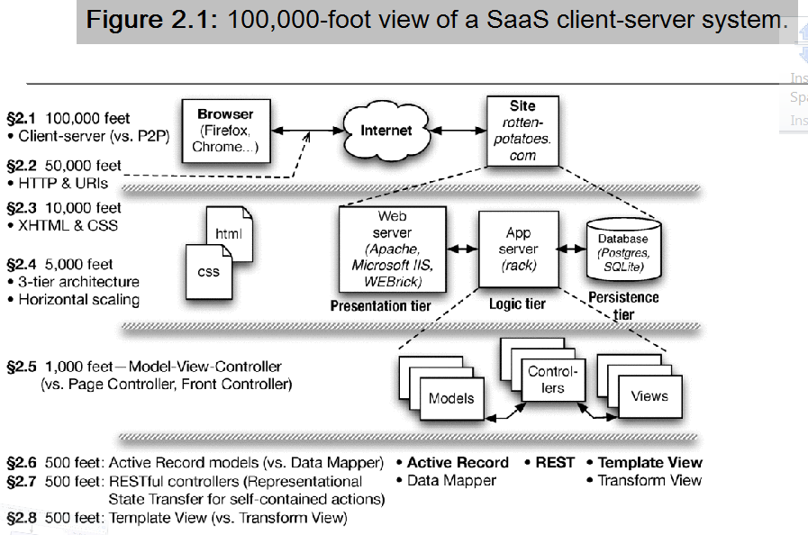
Saas Book Figure 2.1
Engineering Long-Lasting Software: An Agile Approach Using SaaS and Cloud Computing (Beta Edition)

Slide 19
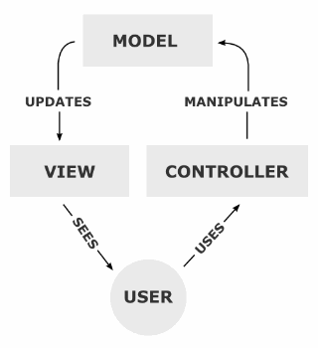
Model View Controller (MVC) Pattern
Design Patterns
Gang of Four (GoF)
abstraction of well tested “patterns” for software solutions
MVC (later pattern)
Interview question :
What is your favorite pattern?

Slide 20
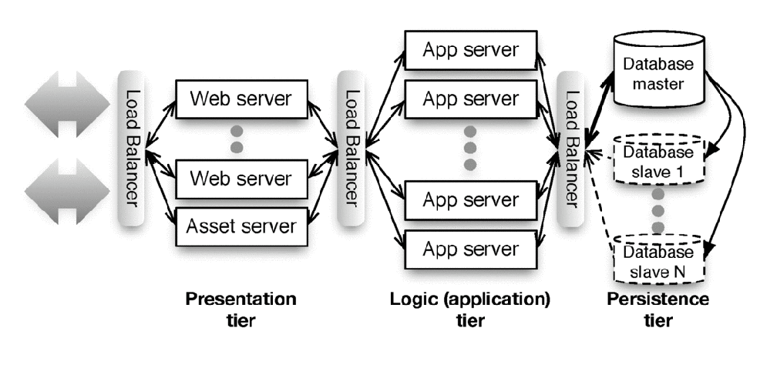
Replication for performance
Load Balancing
Relational DB don’t scale well
NoSql -
Engineering Long-Lasting Software: An Agile Approach Using SaaS and Cloud Computing (Beta Edition)

Slide 21
NoSql – from StackOverflow
At its most basic form NoSQL is really no more than a way of storing objects using some sort of key/value pairing system. You use this all the time already I assume. For instance. in javascript you can create an object named foo and then do foo['myobj'] = myobj to store stuff in the object.
All NoSQL servers really do is give you a way to add/delete/query massive arrays and still allow for persistence and fault tolerance. You can create a NoSQL in memory server in about 100 lines of code.
So let's do it this way...in CouchDB you use map/reduce...so let's create a map function do to the same as a bit of SQL code:
SELECT * FROM users WHERE age > 10
In CouchDB you provide the server with a Javascript function that gets run against every item in the database...
function (doc) {
  if (doc.objType == "users") {
  if (doc.age > 10) {
  emit(doc._id, null)
  } } }
http://stackoverflow.com/questions/2328169/nosql-crash-course-tutorial#

Slide 22
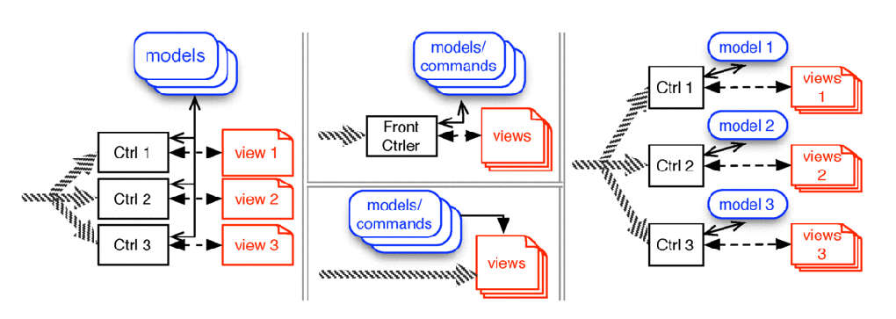
Fig 2.9 Web app Architectural Patterns
Page Controller – Sinatra
  (on left below)
J2EE servlets (top center)
PHP (bottom center)
MVC (on right)
Engineering Long-Lasting Software: An Agile Approach Using SaaS and Cloud Computing (Beta Edition)

Slide 24
Program: Simple Server -
Write/modify a TCP server
setup port > reserved port numbers
listen/accept
fork and process cfd
read get-request
send response
close connection

