Slide 1

CSCE 510 - Systems Programming
Lecture 18 Sockets, really this time

Slide 2
Overview
Last Time
  signals one more thing
  APUE.2e/tty_cbreak
  Shell2 – Program
  Pipes revisited (SIGPIPE)
  mkfifo – named pipes
  Links revisited
  GDB
  daemons
Email
  Shell 2 specs
  Shell2 base code
Today
  Classes of signal handling
  Job Control
  Terminal input char by char (not line)
  APUE.2e/tty_cbreak
  Shell2 - Program

Slide 3
Overview
Last Time
  signals one more thing
  APUE.2e/tty_cbreak
  Shell2 – Program
  Pipes revisited (SIGPIPE)
  mkfifo – named pipes
  Links revisited
  GDB
  daemons
Email
  Shell 2 specs
  Shell2 base code
Today
  Shell2 – Program due Tuesday

Slide 4
Daemons
A daemon is a process that
is long-lived; runs from system start-up till shut-down
runs in background with no controlling terminal ➔ no signals from terminal
typically a “server”
Examples
  cron
  sshd
  httpd
  inetd – listens for incoming connections

Slide 5
CRON(8) CRON(8)
NAME
cron - daemon to execute scheduled commands (Vixie Cron)
SYNOPSIS
cron [-f] [-l] [-L loglevel]
DESCRIPTION
cron is started automatically from /etc/init.d on entering multi-user runlevels.
/etc/con.d file

Slide 6
Creating a daemon
fork
  parent exits
  child lives on (adopted by ______)
  Why
  child continues on in background
  child not process-group leader
child calls setsid – start new session –free from terminal
if daemon opens terminal later it might reaquire a controlling terminal O_NOCTTY on open
Clear process umask
change cwd typically to root “/” Why?
close all open file descriptors
open /dev/null, dup2(fd, 0,1,2)

Slide 7
TLPI/daemon
ls
become_daemon.c
daemon_SIGHUP.c
test_become_daemon.c
become_daemon.h
Makefile
t_syslog.c

Slide 8
TLPI/become_daemon.c
if (!(flags & BD_NO_UMASK0))
umask(0); /* Clear file mode creation mask */
if (!(flags & BD_NO_CHDIR))
chdir("/"); /* Change to root directory */
if (!(flags & BD_NO_CLOSE_FILES)) {
/* Close all open files */
maxfd = sysconf(_SC_OPEN_MAX);
if (maxfd == -1) /* Limit is indeterminate... */
maxfd = BD_MAX_CLOSE; /* so take a guess */
for (fd = 0; fd < maxfd; fd++)
close(fd);
}
if (!(flags & BD_NO_REOPEN_STD_FDS)) {
close(STDIN_FILENO); /* Reopen standard fd's to /dev/null */
fd = open("/dev/null", O_RDWR);
if (fd != STDIN_FILENO) /* 'fd' should be 0 */
return -1;
if (dup2(STDIN_FILENO, STDOUT_FILENO) != STDOUT_FILENO)
return -1;
if (dup2(STDIN_FILENO, STDERR_FILENO) != STDERR_FILENO)
return -1;
}
int /* Returns 0 on success, -1 on error */
becomeDaemon(int flags)
{
int maxfd, fd;
switch (fork()) { /* Become background process */
case -1: return -1;
case 0: break; /* Child falls through... */
default: _exit(EXIT_SUCCESS); /* while parent terminates */
}
if (setsid() == -1) /* Become leader of new session */
return -1;
switch (fork()) { /* Ensure we are not session leader */
case -1: return -1;
case 0: break;
default: _exit(EXIT_SUCCESS);
}

Slide 9
Web Server overview

Slide 10
Sockets
TCP/IP
RCFs
http://www.internetsociety.org/internet/what-internet/history-internet/brief-history-internet
  J.C.R. Licklider of MIT in August 1962 discussing his "Galactic Network" concept
  DARPA – ARPAnet (plan 1967)
  1969 4 computers on ARPAnet
http://www.tcpipguide.com/free/t_TCPIPOverviewandHistory.htm

Slide 11
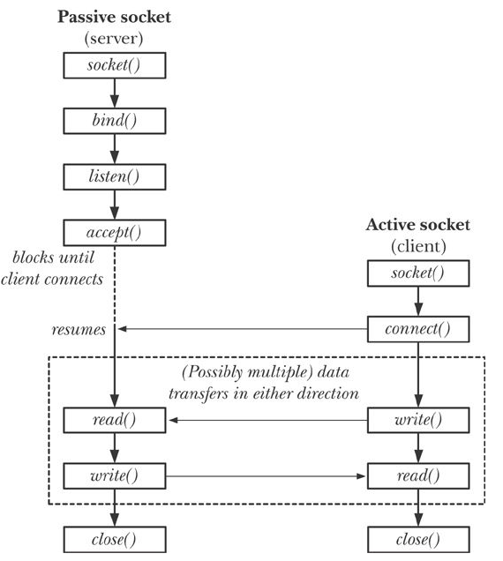
Figure 56-1 overview of system calls used with stream

Slide 12
Sockets in TheLinuxProgInterface text
Chap 56 – Sockets: Introduction
Chap 57 – Sockets: Unix domain sockets
Chap 58 – Sockets: Features of TCP/IP
Chap 59 – Sockets: internet domain sockets
Chap 60 – Sockets: design of servers
Chap 61 – Sockets: Advanced Topics

Slide 13
man –k socket (System Calls)
Main Socket System Calls
socket (2) - create an endpoint for communication
getaddrinfo, freeaddrinfo, gai_strerror - network address and service
translation
bind (2) - bind an address (machine/port) to a socket
listen (2) - listen for connections on a socket
(in coming calls)
accept (2) - accept a connection on a socket
connect (2) - initiate a connection on a socket
I/O by read, write and more
getsockname (2) - get socket name

Slide 14
man - prototypes
#include <sys/types.h> /* See NOTES */
#include <sys/socket.h>
int socket(int domain, int type, int protocol);
domain
  usually AF_INET, AF_UNIX, AF_INET6
type:
  SOCK_STREAM – reliable two-way byte streams (reliable)
  SOCK_DGRAM – datagrams; connectionless unreliable messages
  SOCK_SEQPACKET – sequenced, reliable two-way datagrams not implemented for AF_INET
  SOCK_RAW, SOCK_RDM, SOCK_PACKET
protocol – 0 in our examples

Slide 15
Socket options also specified by type parameter
bitwise or with the following flags
SOCK_NONBLOCK
SOCK_CLOEXEC
Errors – return value = -1 errno=
  EACCES
  EAFNOSUPPORT,
  EINVAL
  EMFILE, ENFILE
  ENOBUFS, ENOMEM
  EPROTONOSUPPORT

Slide 16
Getting Socket addresses
Deprecated functions: The gethostbyname*() and gethostbyaddr*() functions are obsolete.
Applications should use getaddrinfo(3) and getnameinfo(3) instead.
GETADDRINFO(3) Linux Programmer's Manual GETADDRINFO(3)
NAME
getaddrinfo, freeaddrinfo, gai_strerror - network address and service translation
SYNOPSIS
#include <sys/types.h>
#include <sys/socket.h>
#include <netdb.h>
int getaddrinfo(const char *node, const char *service,
const struct addrinfo *hints,
struct addrinfo **res);
getaddrinfo() function combines the functionality
provided by the getservbyname(3) and getservbyport(3) functions

Slide 17
getaddrinfo parameters
const char *node,
  node specifies either a numerical network address (dotted-quad) or
  a network hostname
const char *service,
  service sets the port in each returned address structure
  see services(5):
  one of node and service may be null (but not both)
const struct addrinfo *hints,
struct addrinfo **res

Slide 18
man getaddrinfo code excerpt: Server
main(int argc, char *argv[])
{
struct addrinfo hints;
struct addrinfo *result, *rp;
int sfd, s;
struct sockaddr_storage peer_addr;
socklen_t peer_addr_len;
ssize_t nread;
char buf[BUF_SIZE];
if (argc != 2) {
fprintf(stderr, "Usage: %s port\n", argv[0]);
exit(EXIT_FAILURE);
}
memset(&hints, 0, sizeof(struct addrinfo));
hints.ai_family = AF_UNSPEC; /* Allow IPv4 or IPv6 */
hints.ai_socktype = SOCK_DGRAM;
hints.ai_flags = AI_PASSIVE; /* For wildcard IP address */
hints.ai_protocol = 0; /*Any protocol */
hints.ai_canonname = NULL;
hints.ai_addr = NULL;
hints.ai_next = NULL;
s = getaddrinfo(NULL, argv[1], &hints, &result);

Slide 19
if (s != 0) {
fprintf(stderr, "getaddrinfo: %s\n", gai_strerror(s));
exit(EXIT_FAILURE);
}
/* getaddrinfo() returns a list of address structures.
Try each address until we successfully bind(2).
If socket(2) (or bind(2)) fails, we (close the socket
and) try the next address. */
for (rp = result; rp != NULL; rp = rp->ai_next) {
sfd = socket(rp->ai_family, rp->ai_socktype,
rp->ai_protocol);
if (sfd == -1)
continue;
if (bind(sfd, rp->ai_addr, rp->ai_addrlen) == 0)
break; /* Success */
close(sfd);
}
if (rp == NULL) { /* No address succeeded */
fprintf(stderr, "Could not bind\n");
exit(EXIT_FAILURE);
}

Slide 20
Server receives datagram and echoes
for (;;) {
peer_addr_len = sizeof(struct sockaddr_storage);
nread = recvfrom(sfd, buf, BUF_SIZE, 0, (struct sockaddr *) &peer_addr, &peer_addr_len);
if (nread == -1) continue; /* Ignore failed request */
char host[NI_MAXHOST], service[NI_MAXSERV];
s = getnameinfo((struct sockaddr *) &peer_addr, peer_addr_len, host, NI_MAXHOST,
service, NI_MAXSERV, NI_NUMERICSERV);
if (s == 0) printf("Received %ld bytes from %s:%s\n", (long) nread, host, service);
else
fprintf(stderr, "getnameinfo: %s\n", gai_strerror(s));
if (sendto(sfd, buf, nread, 0,
(struct sockaddr *) &peer_addr,
peer_addr_len) != nread)
fprintf(stderr, "Error sending response\n");
}

Slide 21
Addrinfo structure
struct addrinfo {
int ai_flags;
int ai_family;
int ai_socktype;
int ai_protocol;
size_t ai_addrlen;
struct sockaddr *ai_addr;
char *ai_canonname;
struct addrinfo *ai_next;
};

Slide 22
Other Socket System Calls
Other Socket System Calls
accept4 (2) - accept a connection on a socket
getpeername (2) - get name of connected peer socket
getsockopt (2) - get and set options on sockets
socketcall (2) - socket system calls (Linux lumpall??)
socketpair (2) - create a pair of connected sockets
accept4 (2) - accept a connection on a socket
I/O in addition to read and write
recv (2) - receive a message from a socket
recvfrom (2) - receive a message from a socket
recvmsg (2) - receive a message from a socket
send (2) - send a message on a socket
sendmsg (2) - send a message on a socket
sendto (2) - send a message on a socket

Slide 23
Section 7 - format entries
AF_UNIX (7) - Sockets for local interprocess communication
SOCK_RAW (7) - Linux IPv4 raw sockets
socket (7) - Linux socket interface
rtnetlink (7) - Linux IPv4 routing socket
NETLINK_ROUTE (7) - Linux IPv4 routing socket
PF_LOCAL (7) - Sockets for local interprocess communication
PF_UNIX (7) - Sockets for local interprocess communication
raw (7) - Linux IPv4 raw sockets
unix (7) - Sockets for local interprocess communication
Socket Commands
byobu-reconnect-sockets (1) - Sourcable script that updates GPG_AGENT_INFO an...
dbus-cleanup-sockets (1) - clean up leftover sockets in a directory
fuser (1) - identify processes using files or sockets
ncat (1) - Concatenate and redirect sockets
ss (8) - another utility to investigate sockets

Slide 24
TLPI/sockets
ls
ares> ls *.c
i6d_ucase_cl.c is_echo_v2_sv.c scm_cred_recv.c ud_ucase_cl.c
i6d_ucase_sv.c is_seqnum_cl.c scm_cred_send.c ud_ucase_sv.c
id_echo_cl.c is_seqnum_sv.c scm_rights_recv.c unix_sockets.c
id_echo_sv.c is_seqnum_v2_cl.c scm_rights_send.c us_abstract_bind.c
inet_sockets.c is_seqnum_v2_sv.c sendfile.c us_xfr_cl.c
is_echo_cl.c rdwrn.c socknames.c us_xfr_sv.c
is_echo_inetd_sv.c read_line_buf.c t_gethostbyname.c us_xfr_v2_cl.c
is_echo_sv.c read_line.c t_getservbyname.c us_xfr_v2_sv.c

Slide 25
apue.2e/sockets
ares> ls /class/csce510-001/Code/apue.2e/sockets/
bindunix.c
findsvc.c
servlisten.c
bo.c
servaccept.c
initsrv1.c initsrv2.c
clconn.c cliconn.c
sendfd2.c sendfd.c spipe.c recvfd.c recvfd2.c ruptimed-fd.c
ruptime.c ruptime-dg.c ruptimed.c
linux.mk solaris.mk freebsd.mk macos.mk

Slide 26
fgrep socket fig*
fgrep socket fig*
fig16.8:#include <sys/socket.h> - print info returned from getaddrinfo
fig16.9:#include <sys/socket.h>
fig16.10:#include <sys/socket.h>
fig16.10: if ((fd = socket(addr->sa_family, type, 0)) < 0)
fig16.14:#include <sys/socket.h>
fig16.14: if ((sockfd = socket(aip->ai_family, SOCK_STREAM, 0)) < 0)
fig16.15:#include <sys/socket.h>
fig16.16:#include <sys/socket.h>
fig16.17:#include <sys/socket.h>
fig16.18:#include <sys/socket.h>
fig16.18: if ((sockfd = socket(aip->ai_family, SOCK_DGRAM, 0)) < 0) {
fig16.20:#include <sys/socket.h>
fig16.20: if ((fd = socket(addr->sa_family, type, 0)) < 0)
fig 17.13 :#include <sys/socket.h>

Slide 27
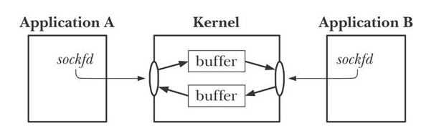
I/O on stream sockets
bidirectional
reliable -

Slide 28
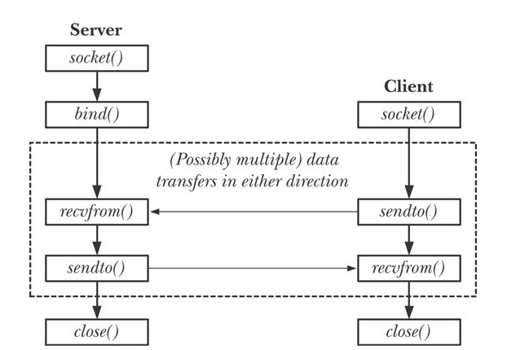
Fig 56-4 Datagram sockets

Slide 29
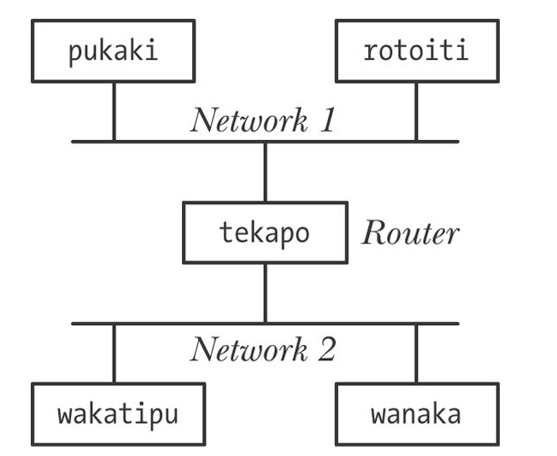
fig 58-1 router

Slide 30
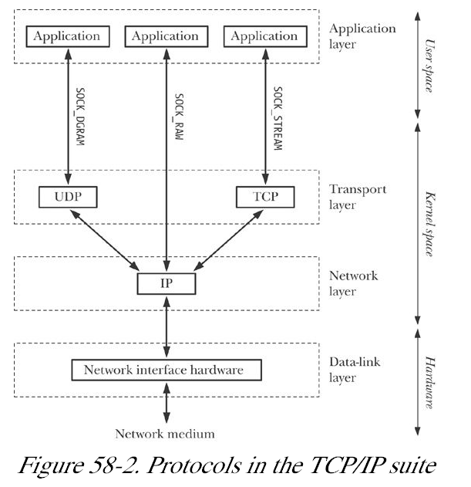
Fig 58-2 TCP/IP

Slide 31
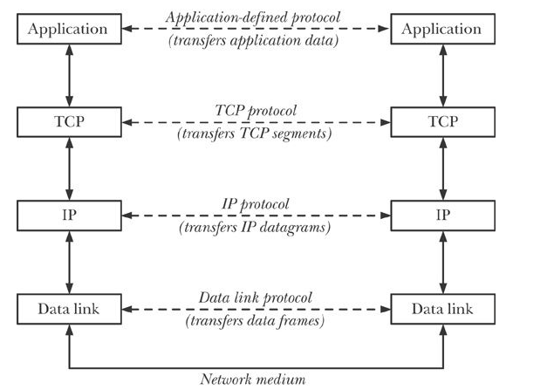
Fig 58-3 Layered Implementation

Slide 32
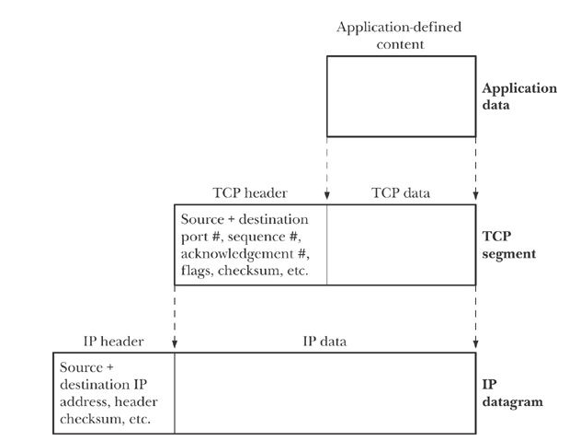
fig 58-4 Encapsulation of packets

Slide 33
IPv4 addresses
32 bits
dotted decimal notation
network address/ network mask
networkid. subnetid.hostid
129.252 – class B address
  129.252.11
ifconfig (ipconfig /all in Windows)
loopback 127.0.0.1
host id = 0, hostid=255 not allowed
subnet broadcast 129.252.11.255
INADDR_ANY 0.0.0.0 usually

Slide 34
Transport Layer
port numbers
well-known, registered and privileged ports

Slide 35
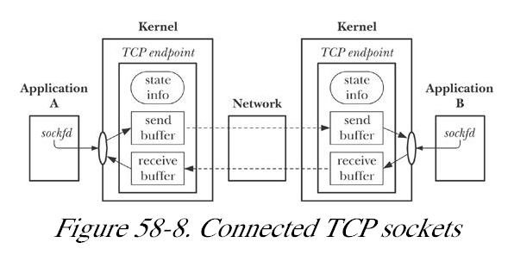

Slide 36
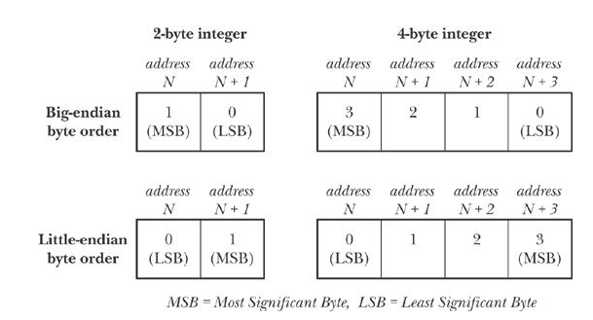
fig 59-1 Big Endian

