Slide 1

CSCE 510 - Systems Programming
Lecture 15 Shell 2 Finally-Filesystems again (note no Lecture 13 – test 1)

Slide 2
Overview
Last Time
  File Systems
  ext2 diagram
  Multiple Pipes
Test
  Distribution
  Average 22.5 off
  Take-home made mistake on dropbox ➔ discuss Test Wednesday
Today
  Ext4 comments
  Advanced Signals
  More signals:
    graceful exit
    “restart” as in shell
  Job Control
  Terminal input char by char (not line)
  Configure
  Automake
  Shell2 - Program

Slide 3
What filesystem are we running?
ares> mount
/dev/sda1 on / type ext4 (rw,errors=remount-ro)
proc on /proc type proc (rw)
none on /sys type sysfs (rw,noexec,nosuid,nodev)
…
/dev/sda6 on /work type ext4 (rw,noatime)
saratoga:/usr/local on /usr/local type nfs (rw,addr=129.252.138.40)
neptune:/acct on /acct type nfs (rw,addr=129.252.138.8)
garnet:/class on /class type nfs (rw,addr=129.252.130.15)
garnet:/work/ftproot on /ftproot type nfs (rw,addr=129.252.130.15)
binfmt_misc on /proc/sys/fs/binfmt_misc type binfmt_misc (rw,noexec,nosuid,nodev

Slide 4
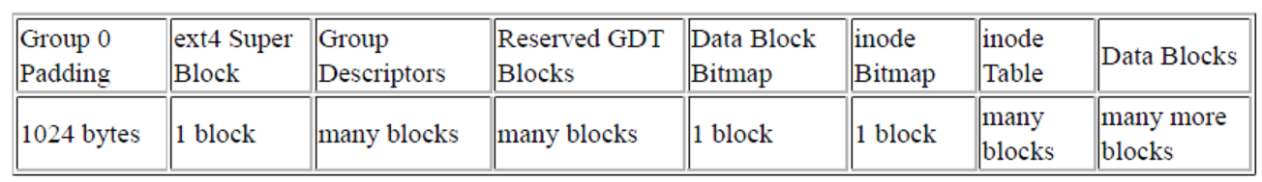
Ext4 Comments
References:
  https://ext4.wiki.kernel.org/index.php/Main_Page
  https://ext4.wiki.kernel.org/index.php/Ext4_Disk_Layout
Layout of standard block group
Direct/Indirect Block Addressing
  Indirect block: (file blocks 12 to ($block_size / 4) + 11, or 12 to 1035 if 4KiB blocks)

Slide 5
NFS – on one slide (the Book)
Assuming a Unix-style scenario in which one machine (the client) requires access to data stored on another machine (the NFS server):
The server implements NFS daemon processes (running by default as nfsd) in order to make its data generically available to clients.
The server administrator determines what to make available, exporting the names and parameters of directories (typically using the /etc/exports configuration file and the exportfs command).
The server security-administration ensures that it can recognize and approve validated clients.
The server network configuration ensures that appropriate clients can negotiate with it through any firewall system.
The client machine requests access to exported data, typically by issuing a mount command. (The client asks the server (rpcbind) which port the NFS server is using, the client connects to the NFS server (nfsd), nfsd passes the request to mountd)
If all goes well, users on the client machine can then view and interact with mounted filesystems on the server within the parameters permitted.
http://en.wikipedia.org/wiki/Network_File_System

Slide 6
NFS – the Movie

Slide 7
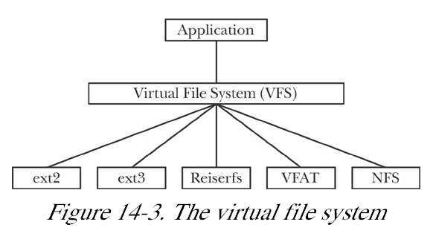
14.5 Virtual File System (VFS)
Umbrella(API), generic interface for filesystem operations facilitating support for multiple file systems
Operations provided:
  open(), read(), write(), lseek(), close(), truncate(), stat(), mount(), umount(), mmap(), mkdir(), link(), unlink(), symlink(), and rename()
Kerrisk, Michael (2011-02-11). The Linux Programming Interface

Slide 8
Journaling Filesystems
crash ➔ fsck to ensure integrity of the filesystem
“A journaling file system logs (journals) all metadata updates to a special on-disk journal file”
Reiserfs first journaling fs for Linux
Kerrisk, Michael (2011-02-11). The Linux Programming Interface

Slide 9
Links – Hard and symbolic
Links Commands (1)
  link existFile linkName - make a new name for a file (2nd link)
  unlink - call the unlink function to remove the specified file
    check number of hard links – decrement and if 0 remove inode and DBs
  ln – many more options version of link
  ln –s target link_name – create symbolic link
  lndir - create a shadow directory of symbolic links
System calls (2) : link, unlink, symlink(2,7)
mkfs – make a file system required before mounting

Slide 10
Virtual Memory File System: tmpfs
virtual file systems reside in memory (can you say fast)
usual suspects: (open(), read(), write(), link(), mkdir(), …
tmpfs – uses ram and the swap space
mount -a [-fFnrsvw] [-t vfstype] [-O optlist]

Slide 11
Devices – device drivers
/dev – directory to hold device drivers
  fd0u1040 –
  sda1
  ram0
  tty24
  usbmon1
  /dev/null – place where bytes go to die
  stdin, stdout, stderr, nvidia0, console,
  ? snapshot, mapper, mem, net, cpu_dma_latency
Character devices
Block devices
Device IDs – major number (class) minor number (specific)
mknod command - make block or character special files

Slide 12
Homework: Filesystems
Assuming 4K byte blocks what is the Maximum Size File in ext4?
Write a program or programs to find out/verify at what point does adding one character on our system adds three ( or maybe just more than 1) blocks?
  You can use TLPI/t_statvfs “/” to find the block size.

Slide 13
Intermission
Test 1 Post Mortem
slides on website
Testing
Agile User Stories – shell 1 examples
Shell 2 – pipes, sigaction, jobs, terminals

Slide 14
Agile
Agile
  http://www.agiledevelopment.org/
User stories
  http://en.wikipedia.org/wiki/User_story
  A team at Connextra developed the traditional user-story template in 2001^{[2]}:
  "As a <role>, I want <goal/desire> so that <benefit>"
Behavior driven development (BDD)
  Cucumber http://cukes.info/ - runs user stories
Test Driven Development (TDD)
  Rspec (ruby) http://rspec.info/

Slide 15
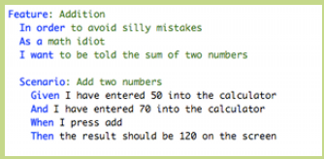
User Stories – Behavior Driven Development (BDD)

Slide 16
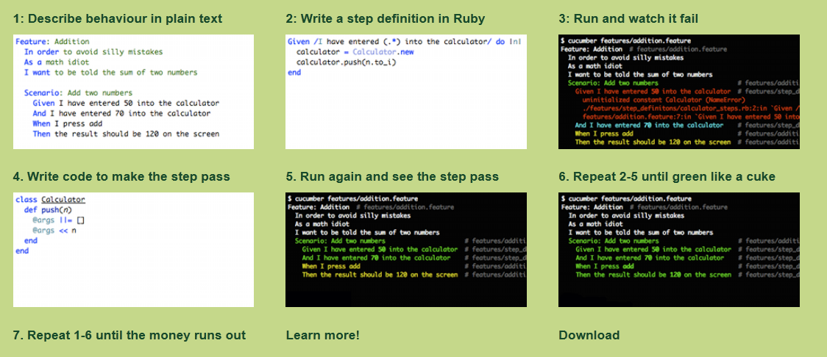
Cucumber – Behavior Driven Dev. BDD
http://cukes.info/

Slide 17
Rspec – Ruby Test Driven Development (TDD)
# bowling_spec.rb
require 'bowling'
describe Bowling, "#score" do
it "returns 0 for all gutter game" do
bowling = Bowling.new
20.times { bowling.hit(0) }
bowling.score.should eq(0)
end
end
Run and watch fail (comes up red)
write minimal code to make pass
Run and watch(hope) it pass (comes up green)

Slide 18
Test target in Makefile
TESTS=test1 test2
…
test: mysh $(TESTS)
./mysh < test1 > output-test1
./mysh < test2 > output-test2

Slide 19
And if you should mimic bash
BashTestResults: $(TESTS)
bash < test1 > bash-output-test1
## create goldStd-output-test2
##by hand since not comp with bash
touch BashTestResults
test: mysh $(TESTS) BashTestResults
mv test-report Old-test-report
echo date > test-report
./mysh < test1 > output-test1
diff output-test1 bash-output-test1 >> test-report
./mysh < test2 > output-test2
diff output-test2 goldStd-output-test2 >> test-report
touch test

Slide 20
Configure / Automake
download
unpack
  gunzip make*
  tar xvf make.tar
configure
make
Configure sh script
for as_dir in /bin$PATH_SEPARATOR/usr/bin$PATH_SEPARATOR$PATH
do
IFS=$as_save_IFS
test -z "$as_dir" && as_dir=.
as_found=:
case $as_dir in #(
/*)
for as_base in sh bash ksh sh5; do
# Try only shells that exist,
# to save several forks.
as_shell=$as_dir/$as_base

Slide 21
SETJMP(3) Linux Programmer's Manual SETJMP(3)
NAME
setjmp, sigsetjmp - save stack context for non-local goto
SYNOPSIS
#include <setjmp.h>
int setjmp(jmp_buf env);
int sigsetjmp(sigjmp_buf env, int savesigs);
DESCRIPTION
setjmp() and longjmp(3) are useful for dealing with errors and interrupts encountered in a low-level subroutine of a program. setjmp() saves the stack context/environment in env for later use by longjmp(3).
The stack context will be invalidated if the function which called setjmp() returns.
sigsetjmp() is similar to setjmp(). If, and only if, savesigs is non-zero, the process's current signal

Slide 22
Examples/Test1/setjmp0.c
#include <stdio.h>
#include <stdlib.h>
#include <setjmp.h>
static jmp_buf jbuf;
void
dumpMem(void* start, int length){
int *ip, i;
ip = (int *) start;
for(i=0; i < length; ++i){
printf("addr %p\tval=%x\n", ip, *ip++);
}
}
int
main(int argc, char *argv[])
{
printf("Sizeof jmp_buf=%d\n", sizeof(jmp_buf));
setjmp(jbuf);
dumpMem((void *)&jbuf, sizeof(jmp_buf));
}

Slide 23
Examples/Test1/setjmp1.c
#include <stdio.h>
#include <stdlib.h>
#include <setjmp.h>
static jmp_buf jbuf;
void
dumpMem(void* start, int length){
int *ip, i;
ip = (int *) start;
for(i=0; i < length; ++i){
printf("addr %p\tval=%x\n", ip, *ip++);
}
}
int
main(int argc, char *argv[])
{
printf("Sizeof jmp_buf=%d\n", sizeof(jmp_buf));
if( setjmp(jbuf) == 0){ /* first call */
dumpMem((void *)&jbuf, sizeof(jmp_buf));
putenv("XXX=YYYY");
longjmp(jbuf, 1);
}else{ /* return from longjmp; */
dumpMem((void *)&jbuf, sizeof(jmp_buf));
printf("env value of XXX=%s\n", getenv("XXX"));
}

Slide 24
Set_jmp revisited: proc/setjmp_vars.c
int
main(int argc, char *argv[])
{
int nvar;
register int rvar; /* Allocated in register if possible */
volatile int vvar; /* See text */
nvar = 111;
rvar = 222;
vvar = 333;
if (setjmp(env) == 0) { /*Code executed after setjmp()*/
nvar = 777;
rvar = 888;
vvar = 999;
doJump(nvar, rvar, vvar);
} else { /* Code executed after longjmp() */
printf("After longjmp(): nvar=%d rvar=%d vvar=%d\n", nvar, rvar, vvar);
}
exit(EXIT_SUCCESS);
}
#include <stdlib.h>
#include <setjmp.h>
static jmp_buf env;
static void
doJump(int nvar, int rvar, int vvar)
{
printf("Inside doJump(): nvar=%d rvar=%d vvar=%d\n", nvar, rvar, vvar);
longjmp(env, 1);
}

Slide 25
Volatile in C
In C, and consequently C++, the volatile keyword was intended to:
allow access to memory mapped devices
allow uses of variables between setjmp and longjmp
allow uses of sig_atomic_t variables in signal handlers.
Operations on volatile variables are not atomic, nor do they establish a proper happens-before relationship for threading. This is according to the relevant standards (C, C++, POSIX, WIN32),^{[2]} and this is the matter of fact for the vast majority of current implementations. Thus, the usage of volatile keyword as a portable synchronization mechanism is discouraged by many C/C++ groups
http://en.wikipedia.org/wiki/Volatile_variable

Slide 26
Example of memory-mapped I/O in C
static int foo;
void bar(void) {
foo = 0;
while (foo != 255)
;
}
Optimizing compiler’s view
void bar_optimized(void) {
foo = 0;
while (true)
;
}
http://en.wikipedia.org/wiki/Volatile_variable

Slide 27
StackOverflow why sigaction instead of signal ?
Use sigaction() unless you've got very compelling reasons not to do so.
The signal() interface has antiquity (and hence availability) in its favour, and it is defined in the C standard. Nevertheless, …
The signal() function does not block other signals from arriving while the current handler is executing; sigaction() can block other signals until the current handler returns.
The signal() function resets the signal action back to SIG_DFL (default) for almost all signals. (not on our Linux)
  This means that the signal() handler must reinstall itself as its first action.
  It also opens up a window of vulnerability between the time when the signal is detected and the handler is reinstalled during which if a second instance of the signal arrives, the default behaviour (usually terminate, sometimes with prejudice - aka core dump) occurs.
http://stackoverflow.com/questions/231912/what-is-the-difference-between-sigaction-and-signal

Slide 28
Unreliable signals: (old Man Signals) Examples/Unreliable.c
#include <stdio.h>
#include <signal.h>
main(){
int onint(); /* SIGINT handler */
int i;
signal(SIGINT, onint);
signal(SIGQUIT, onint);
for(i=0; ;i++)
fprintf(stdout,"%d\n",i);
}
int
onint(int sig){
fprintf(stderr,"Rec SIG NUM=%d\n", sig);
fprintf(stdout,"Rec SIG NUM=%d\n", sig);
if(sig == SIGQUIT) exit(1);
sleep(2);
signal(SIGINT, onint);
}

Slide 29
Unreliable Signals delivery picture
signal(SIGINT, onintr)
rv=sigtab[SIGINT]
sigtab[SIGINT]=onintr
signal pending
signal received
transfer to onintr
restore table to default
sigtab[SIGINT]=SIGDFL
sleep(2) // time to get killed
signal(SIGINT, onintr)
rv=signal(SIGINT, onint);
…
infinite loop

Slide 30
Sigaction structure
struct sigaction {
void (*sa_handler)(int);
void (*sa_sigaction)(int, siginfo_t *, void *);
sigset_t sa_mask;
int sa_flags;
void (*sa_restorer)(void);
};
On some architectures a union is involved: do not assign to both sa_handler and sa_sigaction.

Slide 31
Classifying Programs by signal usage
Simple (programmer ignore) take default actions
  gcc,
graceful exit : Catch signal ➔ graceful exit
  catch signal longjmp to spot to remove temporary files, sync DB, etc., close open fd
Catch signal and restart - consider a shell; what should it do when a SIGINT is received?
  vim, emacs, bash, …
Full-metal Jacket – block all signals that one can for a server or other daemon.

Slide 32
Examples/graceful.c (note old sigs)
Should be updated to sigaction!!!
#include <stdio.h>
#include <signal.h>
void onint(int ); /* SIGINT handler */
main(){
int i;
signal(SIGINT, (void *) onint);
signal(SIGQUIT, (void *) onint);
for(i=0; ;i++)
fprintf(stdout,"%d\n",i);
}
void
onint(int sig){
fprintf(stderr,”Received SIG=%d\n”, sig);
fprintf(stdout,”Received SIG=%d\n”, sig);
/*
* Graceful exit type things removing temporary files, flushing buffers etc.
*
*/
}

Slide 34
Graceful Exit with sigaction
#include <stdio.h>
#include <stdlib.h>
#include <signal.h>
void onint(int );/* SIGINT handler */
main(){
int i;
int rv; /* should be checked everytime */
struct sigaction act, *oldact;
sigset_t signal_mask;
rv=sigfillset(&signal_mask);
act.sa_handler = onint;
act.sa_mask = signal_mask;
act.sa_flags = 0;
act.sa_restorer = NULL;
sigaction(SIGINT, &act, oldact);
sigaction(SIGQUIT, &act, oldact);
for(i=0; ;i++)
fprintf(stdout,"%d\n",i);
}
void
onint(int sig){
fprintf(stderr,"STDERR:Recieved SIGNAL NUMBER =%d\n", sig);
fprintf(stdout,"STDOUT:Recieved SIGNAL NUMBER =%d\n", sig);
/*
* Graceful exit type things removing temporary files etc.
*
*/
exit(0)

Slide 35
Catch Signals and Start Over

Slide 36
TLPI/signals/*.c
catch_rtsigs.c
sigmask_longjmp.c cond compilation sigsetjmp
t_kill.c - kill implemnation
demo_SIGFPE.c –div by 0
signal.c
t_sigaltstack.c
ignore_pending_sig.c
signalfd_sigval.c
t_sigqueue.c
intquit.c
signal_functions.c
t_sigsuspend.c
nonreentrant.c
sig_receiver.c
t_sigwaitinfo.c
ouch.c
sig_sender.c
siginterrupt.c
sig_speed_sigsuspend.c

Slide 37
First pipe remapping review ls|wc
Pipes system maintained buffer for communication between processes
  int pipe (int fd[2]);
  pipesize = buffer size in limits.h
  remember kernel automatically does synchronization
    pipe-full ➔ writer has to wait
    pipe-empty ➔ reader has to wait
  ls | wc
  pipe(pfd)
  fork
  read side
  write side

Slide 38
Job Control
^Z sends SIGSTOP

Slide 39
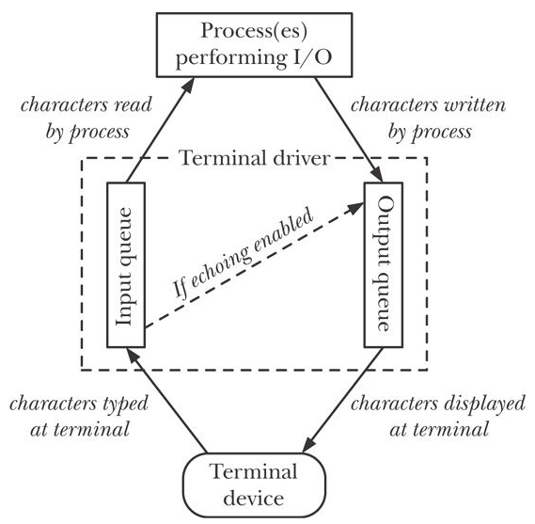
Terminal I/O
Fig 62-1
stty
stty noecho

Slide 40
Terminal I/O
Typical input from keyboard is line buffered by terminal handler
  nothing input buffered till you type ‘\n’
Vi, less, Shells - character by character processing
  allowing up arrow and other arrows
Chapter 62
  stty: canonical mode
  cbreak and raw mode (table 62-3)

Slide 41
Canonical Mode
input line-buffered
  if read requests less bytes remaining data saved for next read
^D (EOT ) causes read to return EOF
line editing is enabled
  ERASE backspace/delete
  KILL ^U

Slide 42
Noncanonical Mode
MIN=0, TIME==0 (polling read)
MIN > 0, TIME==0 (blocking read)
MIN == 0, TIME>0 (read with timeout)
MIN > 0, TIME>0 (read with interbyte timeout)

Slide 43
Cooked, Raw, Cbreak
Table 62-3
Feature | Cooked | Cbreak | Raw
Input available | line by line | char by char | char by char
Line editing? | Yes | No | No
Signal generating chars interpreted? | Yes | Yes | No
START/STOP interpreted? | Yes | Yes | No
Other special chars interpreted? | Yes | No | No
Other input processing? | Yes | Yes | No
Other output processing? | Yes | Yes | No
Input echoed? | Yes | maybe | No

Slide 44
TERMIOS(3) Linux Programmer's Manual TERMIOS(3)
NAME
termios, tcgetattr, tcsetattr, tcsendbreak, tcdrain, tcflush, tcflow, cfmakeraw, cfgetospeed, cfgetispeed, cfsetispeed, cfsetospeed, cfsetspeed - get and set terminal attributes, line control, get and set baud rate
SYNOPSIS
#include <termios.h>
#include <unistd.h>
int tcgetattr(int fd, struct termios *termios_p);
int tcsetattr(int fd, int optional_actions,
const struct termios *termios_p);

Slide 45
TLPI/tty
ls tty/*.c
demo_SIGWINCH.c
no_echo.c
tty_functions.c
new_intr.c
test_tty_functions.c
ttyname.c

Slide 46
Configure / Automake
download
unpack
  gunzip make*
  tar xvf make.tar
configure
make
Git anyone?
GitHub?
Configure sh script
for as_dir in /bin$PATH_SEPARATOR/usr/bin$PATH_SEPARATOR$PATH
do
IFS=$as_save_IFS
test -z "$as_dir" && as_dir=.
as_found=:
case $as_dir in #(
/*)
for as_base in sh bash ksh sh5; do
# Try only shells that exist,
# to save several forks.
as_shell=$as_dir/$as_base

Slide 47
Shell 2 – write up in the mail tonight
Due Saturday of the week after we are back from Spring break. This is March 23.
multiple pipes
character by character input for filename/command completion
Job control ? (let me think about this one.)

