Slide 1

CSCE 510 - Systems Programming
Lecture 14 Shell 2 – Filesystems Finally
(note no Lecture 13 – test 1)

Slide 2
Overview
Last Time
  Test1
Test
  Closed Book
    Function signatures,
    DS: stat, sigact, ???
    Notes sheet – 1 side 8.5x11 handwritting pencil or blue ink
  Take-home % ?
  Old Tests: CPP, UFS,
Today
  File Systems – Chap 18
  Shell1 - Program
  More signals:
    graceful exit
    “restart” as in shell
  Multiple Pipes
  Job Control
  Terminal input char by char (not line)
  Configure
  Automake

Slide 3

Filesystems Finally
.

Slide 4
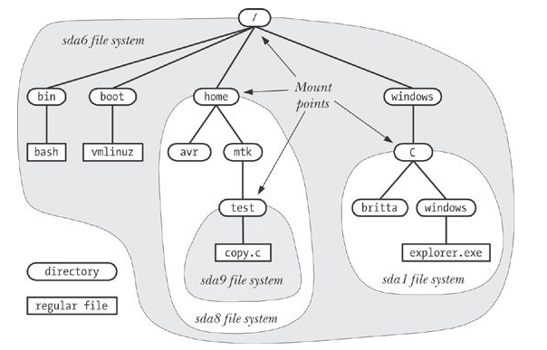
Filesystems and the hierarchy
mounting a filesystem
mount
  shows what is mounted
mount dev path
umount
fsck
/proc/mounts
The Linux Programming Interface: Kerrisk, Michael (2011-02-11).

Slide 5
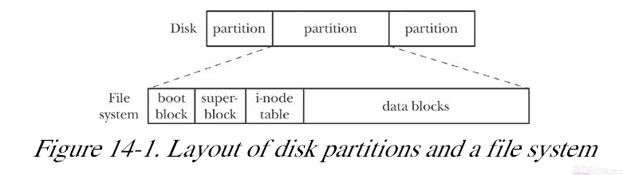
.
The Linux Programming Interface: Kerrisk, Michael (2011-02-11).

Slide 6
Filesystems
boot block – one boot block, the first block of partition
Superblock
  size of inode table
  size of logical blocks in filesystem
  size of filesystem in logical blocks
Inode table
Data blocks
Documentation/ filesystems/ ext2. txt,
Kerrisk, Michael (2011-02-11). The Linux Programming Interface: A Linux and UNIX System Programming Handbook (Kindle Location 12504). O'Reilly Distribution. Kindle Edition.

Slide 7
Inodes – everything returned by stat
The Linux Programming Interface:

Slide 8
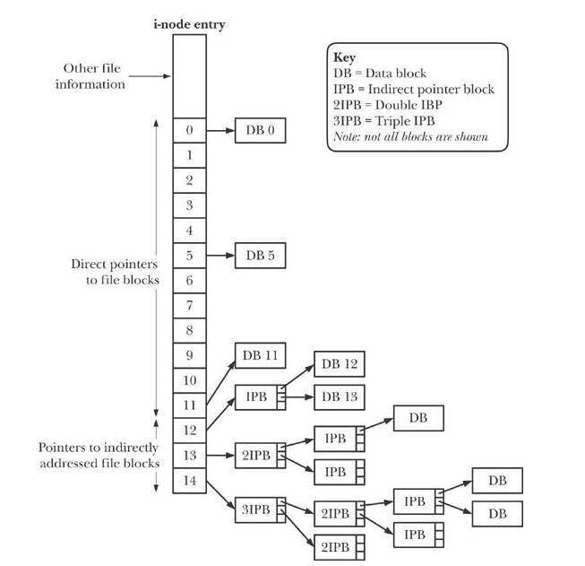
Figure 14-2 Structure of file blocks for a file in an ext2 filesys
The Linux Programming Interface: Kerrisk, Michael (2011-02-11).

Slide 9
What is the Maximum Size File?
assuming 1024 byte blocks
12 direct blocks
indirect
double indirect
triple indirect
Total

Slide 10
Adding one byte requires two additional blocks, sometimes?

Slide 11
Filesizes
Note As an example, the author measured one system containing somewhat more than 150,000 files. Just over 30% of the files were less than 1000 bytes in size, and 80% occupied 10,000 bytes or less. Assuming a 1024-byte block size, all of the latter files could be referenced using just the 12 direct pointers, which can refer to blocks
Kerrisk, Michael (2011-02-11). The Linux Programming Interface: A Linux and UNIX System Programming Handbook (Kindle Locations 12569-12572). O'Reilly Distribution. Kindle Edition.

Slide 12
MOUNT(8) Linux Programmer's Manual MOUNT(8)
NAME
mount - mount a filesystem
SYNOPSIS
…
mount [-fnrsvw] [-t vfstype] [-o options] device dir
DESCRIPTION
All files accessible in a Unix system are arranged in one big tree, the file hierarchy, rooted at /. These files can be spread out over several devices. The mount command serves to attach the filesystem found on some device to the big file tree. Conversely, the umount(8) command will detach it again.
What the heck is in section 8?
man –s 8 intro ➔ privileged commands

Slide 13
STATVFS(2) Linux Programmer's Manual STATVFS(2)
NAME
statvfs, fstatvfs - get file system statistics
SYNOPSIS
#include <sys/statvfs.h>
int statvfs(const char *path, struct statvfs *buf);
int fstatvfs(int fd, struct statvfs *buf);
DESCRIPTION
The function statvfs() returns information about a mounted file system. path is the pathname of any file within the mounted file system. buf is a pointer to a statvfs structure defined approximately as follows:

Slide 14
the statvfs structure
struct statvfs {
unsigned long f_bsize; /* file system block size */
unsigned long f_frsize; /* fragment size */
fsblkcnt_t f_blocks; /* size of fs in f_frsize units */
fsblkcnt_t f_bfree; /* # free blocks */
fsblkcnt_t f_bavail; /* # free blocks for non-root */
fsfilcnt_t f_files; /* # inodes */
fsfilcnt_t f_ffree; /* # free inodes */
fsfilcnt_t f_favail; /* # free inodes for non-root */
unsigned long f_fsid; /* file system ID */
unsigned long f_flag; /* mount flags */
unsigned long f_namemax; /* maximum filename length */
};

Slide 15
TLPI/filesys
hermes> cd filesys
hermes> ls *.c
t_statfs.c
  use of statfs() to retrieve filesys info
t_mount.c -
  Demonstrate the use of mount(2) to create a mount point.
  example of getopt
t_statvfs.c
t_umount.c

Slide 16
t_statvfs.c
#include <sys/statvfs.h>
#include "tlpi_hdr.h"
int
main(int argc, char *argv[])
{
struct statvfs sb;
if (argc != 2 || strcmp(argv[1], "--help") == 0)
usageErr("%s path\n", argv[0]);
if (statvfs(argv[1], &sb) == -1)
errExit("statvfs");
printf("Block size %lu\n", sb.f_bsize);
printf("Fundamental block size %lu\n", sb.f_frsize);
printf("Total blocks (in above units) %lu\n", (unsigned long) sb.f_blocks);
printf("Free blocks for priv. proc. %lu\n", (unsigned long) sb.f_bfree);
…

Slide 17
More in the manual
umount
fsck
/proc/mounts
/etc/mtab
/etc/fstab

Slide 18
http://www.tldp.org/HOWTO/Filesystems-HOWTO.html
1. Introduction
2. Volumes
3. Dos, FAT 12/16/32, VFAT, HPFS
5. New Technology FileSystem (NTFS)
6. Extended filesystems (Ext, Ext2, Ext3)
Mac, CDROM, other
11. Appendix
11.1 Network filesystems
11.2 Encrypted filesystems
11.3 Filesystem benchmarking utilities
11.4 Writing your own filesystem driver
11.5 Related documents

Slide 19
http://en.wikipedia.org/wiki/File_system
This article may be too technical for most readers to understand. Please help improve this article to make it understandable to non-experts, without removing the technical details. The talk page may contain suggestions. (October 2012)
Looks like good overview
“Linux supports many different file systems, but common choices for the system disk on a block device include the ext* family (such as ext2, ext3 and ext4), XFS, JFS, ReiserFS and btrfs. For raw flash without a flash translation layer (FTL) or Memory Technology Device (MTD), there is UBIFS, JFFS2, and YAFFS, among others. SquashFS is a common compressed read-only file system.”
http://en.wikipedia.org/wiki/File_system

Slide 20
Intermission
Test 1 Post Mortem
slides on website
Testing
Agile User Stories – shell 1 examples
Shell 2 – pipes, sigaction, jobs, terminals

Slide 21
Test 1
Each question worth 15 points
Grade on test is points-off
Take-home problems not graded yet
Solutions
Rank in class (out of 20)
1.0
5.0
11.3
11.5
12.0
12.5
14.5
19.0
19.5
19.8
22.3
24.0
25.0
27.0
31.0
31.5
39.0
39.5
49.0
62.5

Slide 22
1 |  |  |  |  |  |  |  |  |  |  |  |  |  | TH |  |  |  |  |  |  |  |  | TH |  |  |  |  |  |  |  | 1
5 | TH |  |  |  |  |  |  |  |  |  |  |  |  | TH |  |  |  |  |  |  |  |  |  | 3 | 3
11.25 |  | 1 |  |  |  | 1 |  |  |  |  |  |  | 3 |  |  | 3 | 1 | 3 |  |  |  |  | TH
11.5 |  | 3 |  |  | 2 |  |  |  |  |  | TH |  |  | TH |  |  |  |  |  | 1 |  |  | 1 |  | 3 |  |  | 3
12 |  |  |  | 2 |  |  |  |  | 1 | 1 |  | 3 |  | TH |  |  |  |  |  |  | 1 |  | TH |  |  |  |  |  |  |  | 5
12.5 |  |  |  |  |  | 1 |  |  | 1 |  | TH |  |  | TH |  |  |  |  |  |  |  |  |  |  | 3 |  |  |  | 3 |  | 5
14.5 |  |  |  |  |  | 1 |  | 1 |  |  |  | 2 | 3 |  |  |  |  |  |  |  |  |  |  |  |  |  |  |  | 3 |  | 5
19 |  |  |  |  | 1 | 1 |  |  | 1 |  | TH |  |  | TH |  |  |  |  |  | 1 | 4 |  |  | 3 | 3 |  |  |  | 2 |  | 4
19.5 |  | 1 |  |  |  | 3 |  | 2 | 2 |  | TH |  |  | TH |  |  |  |  |  |  | 4 |  | 1 |  | 1 |  |  | 3 | 3
19.75 |  |  | 3 | 1 | 3 | TH |  |  |  |  |  |  | 4 | TH |  |  |  |  |  |  | 4 |  |  | 3 | 1 |  |  |  | 1
22.25 |  | 1 | 3 |  | 3 | 2 |  |  | 1 |  | TH |  |  | 1 |  | 3 |  |  |  | 1 | 4 |  |  |  | 3 |  |  | 2 | 1
24 |  | 3 |  |  | 3 | 2 |  |  | 1 |  |  | 3 | 3 | TH |  |  |  |  |  |  |  |  | 3 | 3 | 3 | 2
25 | TH |  |  |  |  | 1 |  | 3 |  |  | TH |  |  |  |  |  |  |  |  |  |  |  | 1 |  | 3 |  |  | 3 | 5 | 5 | 5
27 |  |  |  | 3 | 3 |  |  |  | 3 |  |  | 1 | 5 | TH |  |  |  |  |  | 1 | 4 |  | TH |  |  |  |  |  | 2 |  | 5
31 |  | 1 |  | 2 |  | 2 |  |  | 1 | 1 |  | 3 | 4 | TH |  |  |  |  |  |  | 4 | 4 | TH |  |  |  |  |  | 5 | 5
31.5 |  | 2 | 2 | 3 | 3 | 2 |  |  | 1 |  | 2 | 3 | 5 | TH |  |  |  |  |  |  | 4 |  | TH |  |  |  |  |  |  |  | 5
39 |  |  | 2 | 3 |  | 2 | 3 | 1 | 1 |  | TH |  |  | 2 |  | 3 |  | 3 |  | 2 |  |  | 3 | 3 | 3 |  | 3 | 3 |  | 1 | 5
39.5 |  |  |  | 2 | 2 | 2 | 1 | 2 | 3 | 2 | TH |  |  | TH |  |  |  |  |  | 1 | 4 |  |  | 3 | 3 | 3 | 3 | 3 | 5 |  | 5
49 |  |  |  | 2 | 3 | 1 |  | 2 |  | 1 |  | 5 | 5 | TH |  |  |  |  |  |  | 4 | 4 | 3 | 3 | 3 | 3 |  | 3 | 5 | 5
62.5 | TH |  |  |  |  | 1 | 3 | 2 | 3 |  | 4 | 4 | 5 | 2 |  | 3 |  |  |  | 5 | 5 | 5 | 2 | 3 | 3 | 3 | 1 |  | 4 | 3 | 4
 | P1a | P1b | 1c | 1d | 1e | 2a | 2b | 2c | 2d | 2e | 3a | 3b | 3c | 4a | 4b | 4c | 4d | 4e | 4f | 5a | 5b | 5c | 6a | 6b | 6c | 6d | 6e | 6f | 7a | 7b | 7c

Slide 23
Test target in Makefile
TESTS=test1 test2
…
test: mysh $(TESTS)
./mysh < test1 > output-test1
./mysh < test2 > output-test2

Slide 24
And if you should mimic bash
BashTestResults: $(TESTS)
bash < test1 > bash-output-test1
## create goldStd-output-test2
##by hand since not comp with bash
touch BashTestResults
test: mysh $(TESTS) BashTestResults
mv test-report Old-test-report
echo date > test-report
./mysh < test1 > output-test1
diff output-test1 bash-output-test1 >> test-report
./mysh < test2 > output-test2
diff output-test2 goldStd-output-test2 >> test-report
touch test

Slide 25
Set_jmp revisited
proc/setjmp_vars.c

Slide 26
Why sigaction not signal?
Unreliable signals

Slide 27
Sigaction structure
struct sigaction {
void (*sa_handler)(int);
void (*sa_sigaction)(int, siginfo_t *, void *);
sigset_t sa_mask;
int sa_flags;
void (*sa_restorer)(void);
};
On some architectures a union is involved: do not assign to both sa_handler and sa_sigaction.

Slide 28
SA_NOCLDSTOP
  If signum is SIGCHLD, do not receive notification when child processes stop
SA_NOCLDWAIT (Since Linux 2.6)
  If signum is SIGCHLD, do not transform children into zombies when they terminate.
SA_NODEFER
  Do not prevent the signal from being received from within its own signal handler.
SA_ONSTACK
  Call the signal handler on an alternate signal stack provided by sigaltstack(2).

Slide 29
Advanced Shell Implementation
  Multiple Pipes
    ls –lrt | grep “^d” | wc
  Job Control
    background
    Cntl-Z to terminal handler sends SIGSTOP to foreground process
    bg – moves stopped job to background
  Terminal input char by char (not line)

Slide 30
More signals
Catch signal ➔ graceful exit
  catch signal longjmp to spot to flush buffer, close open fd
Catch signal and restart - consider a shell; what should it do when a SIGINT is received?

Slide 31
Examples/graceful.c (note old sigs)
Should be updated to sigaction!!!
#include <stdio.h>
#include <signal.h>
main(){
int onint(int); /* SIGINT handler */
int i;
signal(SIGINT, (void *) onint);
signal(SIGQUIT, (void *) onint);
for(i=0; ;i++)
fprintf(stdout,"%d\n",i);
}
int
onint(int sig){
fprintf(stderr,"Received SIG=%d\n", sig);
fprintf(stdout,"Received SIG=%d\n", sig);
/*
* Graceful exit type things removing temporary files, flushing buffers etc.
*
*/

Slide 32
Graceful Exit with sigaction
onintr as before

Slide 33
Catch Signals and Start Over

Slide 34
TLPI/*.c
catch_rtsigs.c
sigmask_longjmp.c cond compilation sigsetjmp
t_kill.c - kill implemnation
demo_SIGFPE.c –div by 0
signal.c
t_sigaltstack.c
ignore_pending_sig.c
signalfd_sigval.c
t_sigqueue.c
intquit.c
signal_functions.c
t_sigsuspend.c
nonreentrant.c
sig_receiver.c
t_sigwaitinfo.c
ouch.c
sig_sender.c
siginterrupt.c
sig_speed_sigsuspend.c

Slide 35
First pipe remapping review ls|wc
Pipes system maintained buffer for communication between processes
  int pipe (int fd[2]);
  pipesize = buffer size in limits.h
  remember kernel automatically does synchronization
    pipe-full ➔ writer has to wait
    pipe-empty ➔ reader has to wait
  ls | wc
  pipe(pfd)
  fork
  read side
  write side

Slide 36
Multipipes implementation
ls –l –r –t | grep “^d” | wc
How many processes? (include shell)
How many forks?
Who should quit first?
Who is the child of the shell?

Slide 38
Multipipes Pop Quiz: Find Last Pipe
ls | grep “^d” | wc // after substitutions
Finish off the skeleton below to find the “rightmost” pipe and then break the command into two cmds; one without any pipes (cmd1)
lastPipe=NULL
for(p=cmd ; ; ){
  }
cmd
word
next
word
next
word
next
word
next
word
next
word
next
λ
“ls”
“|”
“grep”
“^d”
“|”
“wc”

Slide 39
Now assuming lastpipe break into 2 cmds cmd – that possibly contains more pipes cmd1 – that has no pipes
set cmd1; fix pointers
fix end of cmd
free extra node and “|” string

Slide 40
cmd
lastPipe
word
next
word
next
word
next
word
next
word
next
word
next
λ
“ls”
“|”
“grep”
“^d”
“|”
“wc”
then
What if lastPipe == NULL?
cmd1 = lastPipe->next
End cmd; lastPipe-> previous ->
pipe and fork
in parent remap stdin; execute cmd1
in child remap stdout; recursively exec_cmd_with_pipes(cmd)

Slide 41
MultiplePipes: The Process Picture
cmd – original command truncated at lastPipe
cmd – cmd from lastPipe->next on (no pipes in this)
pipe(pfd)
fork()
exec(cmd1)
exec_cmd_with_pipes(cmd)

Slide 42
MultiplePipes: fill in the code
cmd – original truncated at lastPipe
cmd – cmd from lastPipe->next on
} else { /*Pipe joining cmd and cmd1 */
if(pipe(pfd) < 0)
fatal("Mysh can't create pipe");
if((pid = fork()) < 0)
fatal("Mysh Can't fork");
if (pid == 0){ /* P2 code */
- close stdout
- map stdout to the pipe
- close extra fd
- recursive call
cmd – original command truncated at lastPipe
} else { /* P1 Code */
- close stdin
- map stdin to the pipe (dup pfd[0])
- close extra fd
- exec cmd1 after putting in argv form
}

Slide 43
Job Control
^Z sends SIGSTOP

Slide 44
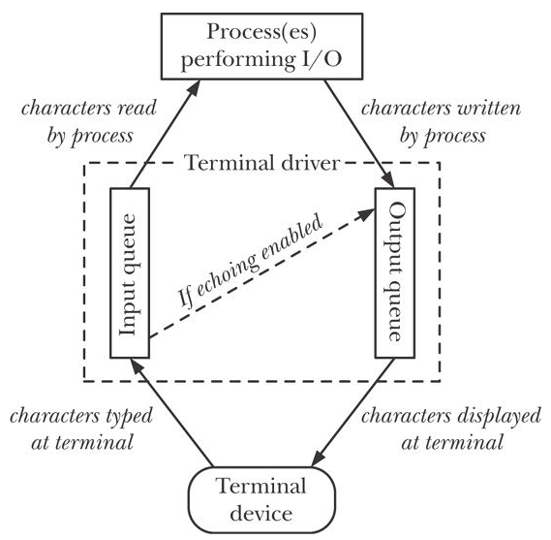
Terminal I/O
Fig 62-1
stty
stty noecho

Slide 45
Terminal I/O
Typical input from keyboard is line buffered by terminal handler
  nothing input buffered till you type ‘\n’
Vi, less, Shells - character by character processing
  allowing up arrow and other arrows
Chapter 62
  stty: canonical mode
  cbreak and raw mode (table 62-3)

Slide 46
Canonical Mode
input line-buffered
  if read requests less bytes remaining data saved for next read
^D (EOT ) causes read to return EOF
line editing is enabled
  ERASE backspace/delete
  KILL ^U

Slide 47
Noncanonical Mode
MIN=0, TIME==0 (polling read)
MIN > 0, TIME==0 (blocking read)
MIN == 0, TIME>0 (read with timeout)
MIN > 0, TIME>0 (read with interbyte timeout)

Slide 48
Cooked, Raw, Cbreak
Table 62-3
Feature | Cooked | Cbreak | Raw
Input available | line by line | char by char | char by char
Line editing? | Yes | No | No
Signal generating chars interpreted? | Yes | Yes | No
START/STOP interpreted? | Yes | Yes | No
Other special chars interpreted? | Yes | No | No
Other input processing? | Yes | Yes | No
Other output processing? | Yes | Yes | No
Input echoed? | Yes | maybe | No

Slide 49
TERMIOS(3) Linux Programmer's Manual TERMIOS(3)
NAME
termios, tcgetattr, tcsetattr, tcsendbreak, tcdrain, tcflush, tcflow, cfmakeraw, cfgetospeed, cfgetispeed, cfsetispeed, cfsetospeed, cfsetspeed - get and set terminal attributes, line control, get and set baud rate
SYNOPSIS
#include <termios.h>
#include <unistd.h>
int tcgetattr(int fd, struct termios *termios_p);
int tcsetattr(int fd, int optional_actions,
const struct termios *termios_p);

Slide 50
TLPI/tty
ls tty/*.c
demo_SIGWINCH.c
no_echo.c
tty_functions.c
new_intr.c
test_tty_functions.c
ttyname.c

Slide 51
Configure / Automake
download
unpack
  gunzip make*
  tar xvf make.tar
configure
make
Configure sh script
for as_dir in /bin$PATH_SEPARATOR/usr/bin$PATH_SEPARATOR$PATH
do
IFS=$as_save_IFS
test -z "$as_dir" && as_dir=.
as_found=:
case $as_dir in #(
/*)
for as_base in sh bash ksh sh5; do
# Try only shells that exist,
# to save several forks.
as_shell=$as_dir/$as_base

Slide 52
Test

