Slide 1

CSCE 510 - Systems Programming
Lect. 10 –Signals, GNU Coding Standards

Slide 2
Overview
Last Time
  Shells: GNU bash manual
Readings for today
  Class website improved a little
  Rehits:
    ls | wc (Examples/pipe.c)
    Exec family
  Loose Topics: Spirit of C from Stackoverflow, umask; Set-uid bit, sticky-bit, hsearch
  Signals Introduction
  GNU Coding Standards

Slide 3
Adding node to linked list
neword = getword()
newnode = malloc()
Then your program should add neword to the newnode
  newnode→word = strdup(newword);
Set the pointers for the newnode
  newnode→previous = last;
  newnode→next=NULL;
Change the next pointer of the last node to point to the new node
  last→ next = newnode;
Change last to point to the newnode
  last = newnode;
cmd
lastword
X
prev
word
next
prev
word
next
“ls”
“|”
newword
“ls”
newnode
prev
word
next
λ
“ls”

Slide 4
From stackoverflow.com – Spirit of C
Keep the spirit of C. The Committee kept as a major goal to preserve the traditional spirit of C. There are many facets of the spirit of C, but the essence is a community sentiment of the underlying principles upon which the C language is based. Some of the facets of the spirit of C can be summarized in phrases like
Trust the programmer.
Don't prevent the programmer from doing what needs to be done.
Keep the language small and simple.
Provide only one way to do an operation.
Make it fast, even if it is not guaranteed to be portable.
http://stackoverflow.com/questions/6118539/hashtable-as-part-of-standard-c-library

Slide 5
HSEARCH(3) Linux Programmer's Manual HSEARCH(3)
NAME - hcreate, hdestroy, hsearch, hcreate_r, hdestroy_r, hsearch_r - hash table management
SYNOPSIS
#include <search.h>
int hcreate(size_t nel);
ENTRY *hsearch(ENTRY item, ACTION action);
void hdestroy(void);
DESCRIPTION - The three functions hcreate(), hsearch(), and hdestroy() allow the caller to create and manage a hash search table containing entries consisting of a key (a string) and associated data. Using these functions, only one hash table can be used at a time.
…
The argument item is of type ENTRY, which is defined in <search.h> as follows:
typedef struct entry {
char *key;
void *data;
} ENTRY;

Slide 6
Hsearch example from man pages
#include <stdio.h>
#include <stdlib.h>
#include <search.h>
char *data[] = { "alpha", … "zulu" };
int main(void) {
ENTRY e, *ep;
int i;
hcreate(30);
for (i = 0; i < 24; i++) {
e.key = data[i];
e.data = (void *) i;
ep = hsearch(e, ENTER);
if (ep == NULL) {…}
for (i = 22; i < 26; i++) {
/* print .. entries */
e.key = data[i];
ep = hsearch(e, FIND);
printf("%9.9s -> %9.9s:%d \n", e.key,
ep ? ep->key : "NULL",
ep ? (int)(ep->data)
: 0);
}
hdestroy();
exit(EXIT_SUCCESS);
}

Slide 7
Bash executing ls | wc

Slide 8
Examples/pipe.c
/* * A simple pipe example to illustrate ls | wc */
/#include <sys/types.h>
main(){
int pfd[2];
pid_t p;
if(pipe(pfd) < 0)
fatal("Pipe failed");
if((p = fork()) < 0)
fatal("Fork failed");

Slide 9
Examples/pipe.c continued
if(p == 0){ /*Child wc */
close(0); dup(pfd[0]); close(pfd[1]);
close(pfd[0]); execlp("wc","wc",(char*)0);
} else{ /* Child of Child ls */
close(1); dup(pfd[1]); close(pfd[0]); close(pfd[1]); execlp("ls","ls",(char*)0);
}

Slide 10
Pipeorder ls | grep | wc

Slide 11
Exec family of functions
EXEC(3) Linux Programmer's Manual EXEC(3)
NAME - execl, execlp, execle, execv, execvp - execute a file
SYNOPSIS
#include <unistd.h>
extern char **environ;
int execl (const char *path, const char *arg, ...);
int execlp (const char *file, const char *arg, ...);
int execle (const char *path, const char *arg, ..., char * const envp[]);
int execv (const char *path, char *const argv[]);
int execvp(const char *file, char *const argv[]);
DESCRIPTION
The exec() family of functions replaces the current process image with a new process image. The functions described in this manual page are front-ends for execve(2). The functions execlp() and execvp() will search for an executable

Slide 12
Examples/execExamples.c
/* Simple execv */
myargv[0] = "ls";
myargv[1] = "-l";
myargv[2] = "sh.pipe.pseudo";
myargv[3] = "execExamples.c";
myargv[4] = NULL;
execv("/bin/ls", myargv);
/* Simple execvp */
myargv[0] = "ls";
myargv[1] = "-l";
myargv[2] = "sh.pipe.pseudo";
myargv[3] = "execExamples.c";
myargv[4] = NULL;
execvp("ls", myargv);
execlp("ls", "ls", " ", NULL);
execlp("ls", "ls", "-l", NULL);
execlp("ls", "ls", " ", NULL);
execlp("ls", "ls", "-l", NULL);
/* note PATH is used to find cmd */
}
/* Examples of exec's of course, only first will be executed */
main(){
char *myargv[24]; /*max of 24 args */
char **envp; /*env ptr */
char **tmp; /*temp for env*/
/* Simple execve */
myargv[0] = "env";
myargv[1] = NULL;
envp = (char **)malloc(15 * sizeof (char *));
tmp = envp;
*(tmp++) = strdup("TERM=vt101");
*(tmp++) = strdup("SHELL=/mysh");
*(tmp++) = NULL;
execve("/usr/bin/env", myargv, envp);
fatal("Exec Failed");

Slide 13
Examples/Exit_status.c
#include <stdio.h>
#include <sys/wait.h>
main(){
int pid, pid2, status;
if ((pid = fork()) < 0)
fatal("Cannot fork");
else if (pid == 0){ /* Child code */
exit(31);
}else{ /* Parent Code */
pid2 = wait(&status);
printf("\n pid=%d \n return value %d \n status = %4x, status shifted=%d\n", pid, pid2, status, status>>8);
}}

Slide 14
Examples/forkstdio.c
}else if (pid == 0) {
fprintf(fp, "child after fork");
sleep(1);
}else{
fprintf(fp, "PARENT AFTER FORK");
sleep(1);
}
sleep(1);
fprintf(fp, "Common Code after fork, pid val=%u\n",(unsigned short) pid);
}
hermes> more junk
Before the forkPARENT AFTER THE FORKCommon Code after the fork, pid val=er the forkCommon Code after the fork, pid val=
main(){
FILE *fp;
pid_t pid; /*ret val from fork*/
char buf[150]; /* the buffer */
if((fp= fopen("junk","w+")) == NULL)
fatal("Open of junk Failed");
setvbuf(fp, buf, _IOFBF, 20);
fprintf(fp, "Before the fork");
if((pid = fork()) < 0){
fatal("ForkStdio Test fork failed");

Slide 15
Programming assignment 2 -Shell
Simple I/O redirection; single pipes
Builtin functions: set, cd, exit
Startup file ~/.mybashrc
Filename expansion
Shell variable(parameter) expansion
  Standard ones
    PATH, CDPATH
Environ passed

Slide 16
Signals
One process can send a signal and interrupt another process
signal is a small int typically < 32
The process receiving the signal has to set up ahead of time (using sigaction system call)
  when this signal is received do this action(function)
Can you name programs that you use that catch signals?

Slide 17
SIGNAL(2) Linux Programmer's Manual SIGNAL(2)
NAME signal - ANSI C signal handling
SYNOPSIS
#include <signal.h>
typedef void (*sighandler_t)(int);
sighandler_t signal(int signum, sighandler_t handler);
DESCRIPTION
The behavior of signal() varies across Unix versions, and has also varied historically across different versions of Linux.
Avoid its use: use sigaction(2) instead.
SEE ALSO
kill(1), alarm(2), kill(2), killpg(2), pause(2), sigaction(2), signalfd(2), sigpending(2), sigprocmask(2), sigqueue(2), sigsuspend(2), bsd_signal(3), raise(3), siginterrupt(3), sigsetops(3), sigvec(3), sysv_signal(3), feature_test_macros(7), signal(7)

Slide 18
The Signals – man –s 7 signal also Tab 20-1
Signal Value Action Comment
SIGHUP 1 Term Hangup detected on controlling terminal or death of controlling process
SIGINT 2 Term Interrupt from keyboard
SIGQUIT 3 Core Quit from keyboard
SIGILL 4 Core Illegal Instruction
SIGABRT 6 Core Abort signal from abort(3)
SIGFPE 8 Core Floating point exception
SIGKILL 9 Term Kill signal
SIGSEGV 11 Core Invalid memory reference
SIGPIPE 13 Term Broken pipe: write to pipe with no readers
TERM=terminate, CORE=terminate and dump, Ignore, Stop

Slide 19
The Signals continued
SIGALRM 14 Term Timer signal from alarm(2)
SIGTERM 15 Term Termination signal
SIGUSR1 30,10,16 Term User-defined signal 1
SIGUSR2 31,12,17 Term User-defined signal 2
SIGCHLD 20,17,18 Ign Child stopped or terminated
SIGCONT 19,18,25 Cont Continue if stopped
SIGSTOP 17,19,23 Stop Stop process
SIGTSTP 18,20,24 Stop Stop typed at tty
SIGTTIN 21,21,26 Stop tty input for background process
SIGTTOU 22,22,27 Stop tty output for background process
The signals SIGKILL and SIGSTOP cannot be caught, blocked, or ignored.

Slide 20
SUSv2 and POSIX.1-2001 Signals
SIGBUS 10,7,10 Core Bus error (bad memory access)
SIGPOLL Term Pollable event (Sys V).
Synonym for SIGIO
SIGPROF 27,27,29 Term Profiling timer expired
SIGSYS 12,-,12 Core Bad argument to routine (SVr4)
SIGTRAP 5 Core Trace/breakpoint trap
SIGURG 16,23,21 Ign Urgent condition on socket (4.2BSD)
SIGVTALRM 26,26,28 Term Virtual alarm clock (4.2BSD)
SIGXCPU 24,24,30 Core CPU time limit exceeded (4.2BSD)
SIGXFSZ 25,25,31 Core File size limit exceeded (4.2BSD)

Slide 21
Signal handler / signal table
rv = signal(SIGINT, onintr)
void
onintr(int sig){
/*process signal somehow*/
}
Sig | Ptr to Handler
2 | SIG_DFL
. | …

Slide 22
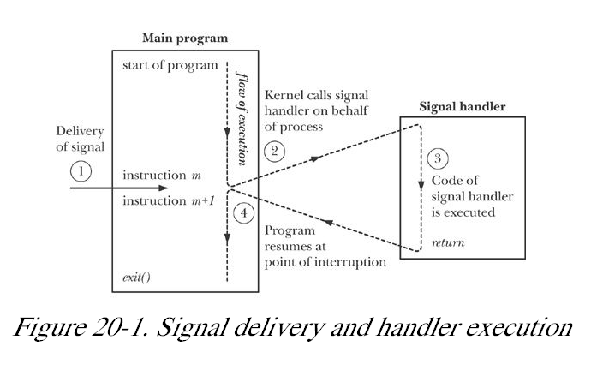
20-1 Signal delivery and handling
When do you interrupt?
mid instruction?
mid system call?

Slide 23
TLPI/signals
hermes> ls *.c
catch_rtsigs.c
nonreentrant.c
signal.c
sig_sender.c
t_sigqueue.c
demo_SIGFPE.c
ouch.c
signalfd_sigval.c
sig_speed_sigsuspend.c
t_sigsuspend.c
ignore_pending_sig.c
siginterrupt.c
signal_functions.c
t_kill.c
t_sigwaitinfo.c
intquit.c
sigmask_longjmp.c
sig_receiver.c
t_sigaltstack.c

Slide 24
TLPI/ouch.c
#include <signal.h>
#include "tlpi_hdr.h"
static void
sigHandler(int sig)
{
printf("Ouch!\n"); /* UNSAFE (see Section 21.1.2) */
}
int
main(int argc, char *argv[])
{
int j;
/* Establish handler for SIGINT */
if (signal(SIGINT, sigHandler) == SIG_ERR) errExit("signal");
for (j = 0; ; j++) {
printf("%d\n", j);
sleep(3); /* Loop slowly... */
}
}

Slide 25
SIGACTION(2) Linux Programmer's Manual - struct and call
NAME - sigaction - examine and change a signal action
SYNOPSIS
#include <signal.h>
int sigaction(int signum,
const struct sigaction *act,
struct sigaction *oldact);
…
struct sigaction {
void (*sa_handler)(int);
void (*sa_sigaction)(int, siginfo_t *, void *);
sigset_t sa_mask;
int sa_flags;
void (*sa_restorer)(void);
};

Slide 26
TLPI/demo_SIGFPE.c
printf("Catching SIGFPE\n");
sigemptyset(&sa.sa_mask);
sa.sa_flags = SA_RESTART;
sa.sa_handler = sigfpeCatcher;
if (sigaction(SIGFPE, &sa, NULL) == -1)
errExit("sigaction");
}
blocking = argc > 1 && strchr(argv[1], 'b') != NULL;
if (blocking) {
printf("Blocking SIGFPE\n");
sigemptyset(&blockSet);
sigaddset(&blockSet, SIGFPE);
if (sigprocmask(SIG_BLOCK, &blockSet, &prevMask) == -1)
errExit("sigprocmask");
}
printf("About to generate SIGFPE\n");
y = 0; x = 1 / y;
if (blocking) {
if (sigprocmask(SIG_SETMASK, &prevMask, NULL) == -1)…h
#define _GNU_SOURCE /* Get strsignal() declaration */
#include <string.h>
#include <signal.h>
static void
sigfpeCatcher(int sig){
printf("Caught signal %d (%s)\n", sig, strsignal(sig));
… /*UNSAFE (see Sec 21.1.2) */
}
int main(int argc, char *argv[]) {
int x, y;
sigset_t blockSet, prevMask;
Boolean blocking;
struct sigaction sa;
if (argc > 1 && strchr(argv[1], 'i') != NULL) {
if (signal(SIGFPE, SIG_IGN) == SIG_ERR) errExit("signal");
} else {

Slide 27
Just in case too small: Ignore and Catch
IGNORE
if (signal(SIGFPE, SIG_IGN) == SIG_ERR) // should be SIG_DFL errExit("signal");
Catch SIGFPE
sigemptyset(&sa.sa_mask);
sa.sa_flags = SA_RESTART;
sa.sa_handler = sigfpeCatcher;
if (sigaction(SIGFPE, &sa, NULL) == -1)
errExit("sigaction");

Slide 28
if too small continued Blocking
blocking = argc > 1 && strchr(argv[1], 'b') != NULL;
if (blocking) {
printf("Blocking SIGFPE\n");
sigemptyset(&blockSet);
sigaddset(&blockSet, SIGFPE);
if (sigprocmask(SIG_BLOCK,
&blockSet, &prevMask) == -1)
errExit("sigprocmask");
}
printf("generate SIGFPE\n");
y = 0;
x = 1 / y;
if (blocking) {
printf("Sleep before unblocking");
sleep(2);
printf("Unblocking SIGFPE\n");
if (sigprocmask(SIG_SETMASK, &prevMask, NULL) == -1)
errExit("sigprocmask");
}
printf("Shouldn't get here!\n");
exit(EXIT_FAILURE);
}

Slide 29
Re-entrant ➔ no globals
If we set up the same handler function to deal with several different signals or use the SA_NODEFER flag to sigaction(), then a handler may interrupt itself. As a consequence, the handler may be nonreentrant if it updates global (or static) variables, even if they are not used by the main program.
Kerrisk, Michael (2011-02-11). The Linux Programming Interface: A Linux and UNIX System Programming Handbook (Kindle Locations 20500-20503). O'Reilly Distribution. Kindle Edition.

Slide 30
Quiz: Pointers
1. Which of the following is the proper declaration of a pointer?
A. int x;
B. int &x;
C. ptr x;
D. int *x;
2. Which of the following gives the memory address of integer variable a?
A. *a;
B. a;
C. &a;
D. address(a);
3. Which of the following gives the memory address of a variable pointed to by pointer a?
A. a;
B. *a;
C. &a;
D. address(a);
4. Which of the following gives the value stored at the address pointed to by pointer a?
A. a;
B. val(a);
C. *a;
D. &a;
5. Which of the following is the proper keyword or function to allocate memory in C?
A. new
B. malloc
C. create
D. value
6. Which of the following is the proper keyword or function to deallocate memory?
A. free
B. delete
C. clear
http://www.cprogramming.com/tutorial/c/quiz/quiz6.html

Slide 31
Pop Quiz page 2 - printCmd
Given the structure below finish the printCmd function on the right.
struct node{
char *word;
struct node *previous;
struct node *next;
} *cmd;
void
printCmd(struct node *p)
{
while(p != NULL){
}
}

Slide 32
Coding Conventions/Standards
“Coding conventions are a set of guidelines for a specific programming language that recommend programming style, practices and methods for each aspect of a piece program written in this language.”
Formatting
  indentation, comments, declarations, whitespace, statements
Programming practices
  naming conventions – Camel case, snake case
  programming best principles
  architectural practices
http://en.wikipedia.org/wiki/Coding_conventions

Slide 33
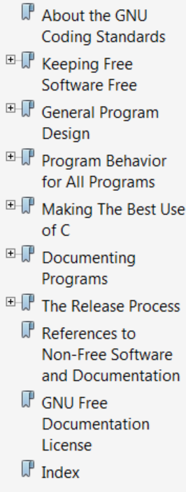
Gnu Coding Standards
Why coding standards?
Gnu Coding Standards
  http://www.gnu.org/prep/standards/standards.html

Slide 34
4 Program Behavior for All Programs
4.1 Non-GNU Standards
  Standard C - check with –pedantic to gcc
  POSIX.2 “df” “du” specify blocks as 512b
4.2 Writing Robust Programs
  Avoid arbitrary limits on length of data structure
    allocate dynamically; reallocate
    most Unix utilities “long lines are silently truncated” Unacceptable GNU
  do not drop Nul or other non-printable chars
  Check return value of every system call
  If you use temp files check the TMPDIR environment variable; use that or /tmp

Slide 35
4.3 Library Behavior
  make reentrant avoid malloc and other global data structs
  choose prefix for library; externals start with this prefix
  external symbols that are not documented entry points should start with ‘_’ underscore
4.4 Formatting Error Messages
  sourcefile: lineno: message
4.5 Standards for Interfaces Generally
  don’t make behavior based on name (as in vi/ex)

Slide 36
4.6 Standards for Graphical Interfaces
  works with X window and GTK+ toolkit
4.7 Standards for Command Line Interfaces
  4.7.1 --version
  4.7.2 –help
4.8 Standards for Dynamic Plug-in Interfaces
  “Another aspect of keeping free programs free is encouraging free plug-ins”
  4.9 Table of Long Options getopt_long – table pages 14-30
4.10 OID Allocations
4.11 Memory Usage free if not in use; except right before end
4.12 File Usage

Slide 37
5 Making The Best Use of C
5.1 Formatting Your Source Code
5.2 Commenting Your Work
5.3 Clean Use of C Constructs
5.4 Naming Variables, Functions, and Files
5.5 Portability between System Types
5.6 Portability between CPUs
5.7 Calling System Functions
5.8 Internationalization
5.9 Character Set
5.10 Quote Characters
5.11 Mmap

Slide 38
5.1 Formatting Your Source Code
function declarations
  char *
  concat(char *str1, char *str2)
  {
  …
  }
structures same shape
GNU recommendat

Slide 39
Body of functions
GNU recommendations vetoed
Use K&R style – note also deviation from GNU function style; Use GNU!!
int main(int argc, char *argv[])
{
...
while (x == y) {
something();
somethingelse();
if (some_error) { /* curly braces optional */
do_correct();
} else
continue_as_usual();
}
finalthing();
...
}
http://en.wikipedia.org/wiki/Indent_style

Slide 40
6 Documenting Programs
6.1 GNU Manuals
6.2 Doc Strings and Manuals
6.3 Manual Structure Details
6.4 License for Manuals
6.5 Manual Credits
6.6 Printed Manuals
6.7 The NEWS File
6.8 Change Logs
  6.8.1 Change Log Concepts
  6.8.2 Style of Change Logs
  6.8.3 Simple Changes
  6.8.4 Conditional Changes
  6.8.5 Indicating the Part Changed
6.9 Man Pages
6.10 Reading other Manuals

Slide 41
indent – GNU formatter
more options than you can shake a stick at
indent prog.c -o prog_form.c
Styles
  GNU
  K&R
  Berkeley indent -orig or –original
  Linux style – used in kernel code
http://www.gnu.org/software/indent/manual/indent.pdf

Slide 42
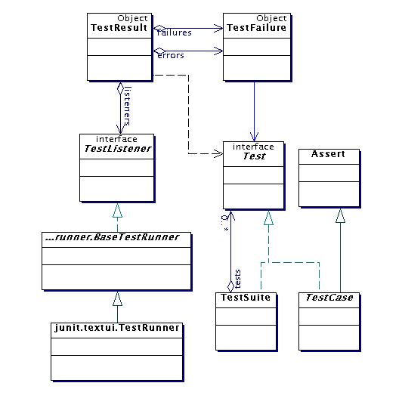
Unit Testing programs
JUnit
http://junit.sourceforge.net/doc/testinfected/testing.htm

Slide 43
Unit Testing C programs
#include "myimplementationfile.c"
#include <gtest/gtest.h>
// Mock out external dependency on mylogger.o
void Logger_log(...){}
TEST(FactorialTest, Zero) {
EXPECT_EQ(1, Factorial(0));
}
http://stackoverflow.com/questions/148576/how-to-test-c-code

Slide 44
Basic Unit Testing with Check
How to write a Test using Check
#include <check.h>
then a unit test looks like
START_TEST(test_name)
{
unit test source code
}
END_TEST
http://check.sourceforge.net/doc/check_html/check_3.html

Slide 45
Check
relies on GNU AutoTools:
  Autoconf
  Automake
  Libtool
http://check.sourceforge.net/doc/check_html/index.html

Slide 46
END of HANDOUT

Slide 47
Program 2 Questions

Slide 48
--verbose

Slide 49
Startup

Slide 50
Substitutions

Slide 51
History

Slide 52
Shell variable

Slide 53
filename expansion

Slide 54
filename completion

Slide 55
Builtin functions

Slide 56
Simple I/O redirection

Slide 57
No zombies

Slide 58
Coding standards
check result of every system call

Slide 59
logistics

