Slide 1
CSCE 510 - Systems Programming
Lecture 08 –Stdio, I/O Buffering, Shells

Slide 2
Overview
Last Time
Agile –
Make – implementation
Process creation –
Fork
execve
Systems limits – not really
Readings for today
Stdio
Chapter 13 – I/O buffering
Shells:
Basics: read command into doubly linked list
Shell variables, set command
background,
Substitutions: variable substitutions, pseudo filename completion, history substitution,
Simple I/O redirection
Shell version 2: signals, pipes, command substitution

Slide 3
Fork revisited
rv=fork()
Properties inherited (shorter list last time)
Open files, uids, cwd, root directory, umask,
signal mask and table,
environment, shared ,memory
Properties not inherited
Return value of fork, pid ppid, times,
file locks,
pending signals

Slide 4
vfork

Slide 5
Exec family of functions
int execle( const char *pathname, const char *arg, ... /* , (char *) NULL, char *const envp[] */ );
int execlp( const char *filename, const char *arg, ... /* , (char *) NULL */);
int execvp( const char *filename, char *const argv[]);
int execv( const char *pathname, char *const argv[]);
int execl( const char *pathname, const char *arg, ...

Slide 6
Chapter 12. System and Process Info.
12.1 The /proc File System
12.1.1 Obtaining Information About a Process: /proc/PID
12.1.2 System Information Under /proc
12.1.3 Accessing /proc Files
12.2 System Identification: uname()
ps -e

Slide 7
PS EXAMPLES
To see every process on the system using standard syntax:
ps -e
ps -ef
ps -eF
ps -ely
To see every process using BSD syntax:
ps ax
ps axu
To print a process tree:
ps -ejH
ps axjf
To get info about threads:
ps -eLf
ps axms
To get security info:
ps –eo euser, ruser, suser, fuser, f, comm, label
ps axZ
ps –eM
To see every process running as root (real & effective ID) in user format:
ps -U root -u root u
Print only the process IDs of syslogd:
ps -C syslogd -o pid=

Slide 8
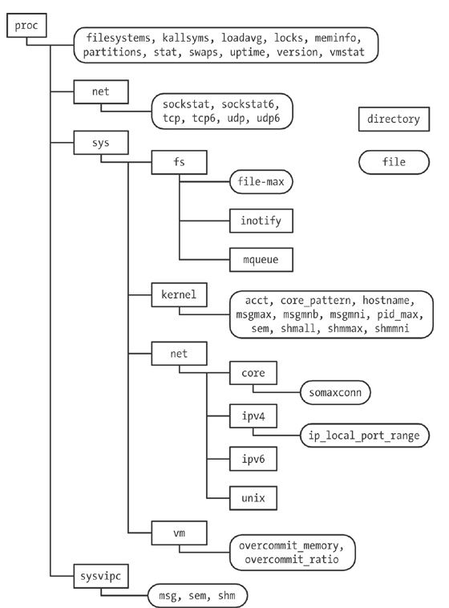
Figure 12-1 /proc hierarchy

Slide 9
hermes> cd sysinfo
hermes> ls
Makefile
procfs_pidmax.c
procfs_user_exe.c
t_uname.c
procfs_pidmax
procfs_user_exe
t_uname

Slide 10
FILE I/O Buffering
13.1 Kernel Buffering of File I/O: The Buffer Cache
13.2 Buffering in the stdio Library
13.3 Controlling Kernel Buffering of File I/O
13.4 Summary of I/O Buffering
13.5 Giving the Kernel Hints About I/O Patterns: posix_fadvise()
13.6 Bypassing the Buffer Cache: Direct I/O
13.7 Mixing Library Functions and System Calls for File I/O
13.8 Summary
13.9 Exercises

Slide 11
Stat structure revisted
struct stat {
dev_t st_dev; /* ID of device containing file */
ino_t st_ino; /* inode number */
mode_t st_mode; /* protection */
nlink_t st_nlink; /* number of hard links */
uid_t st_uid; /* user ID of owner */
gid_t st_gid; /* group ID of owner */
dev_t st_rdev; /* device ID (if special file) */
off_t st_size; /* total size, in bytes */
blksize_t st_blksize; /* blocksize for file system I/O */
blkcnt_t st_blocks; /* number of 512B blocks allocated */
time_t st_atime; /* time of last access */
time_t st_mtime; /* time of last modification */
time_t st_ctime; /* time of last status change */
};

Slide 12
Stdio - library
IO/syscalls
FILE structure
FILE * functions
fopen(path, “r | w | …” [, mode] )
int fscanf(FILE *stream, const char *format, ...);
int fprintf(FILE *stream, const char *format, ...);
Scanf, sscanf, printf, sprintf versions
fclose(), fread, fwrite,
fgetc, fputc, fgets, fputs, fflush
Fdopen, freopen
Ungetc
mktemp

Slide 13
FILE structure
Use to be in /usr/include/stdio.h
int _fileno;
int _blksize;
int _flags2;
int _cnt;
_IO_off_t _old_offset; /* This used to be _offset but…*/
Now, cleverly /usr/include/stdio.h contains
typedef struct _IO_FILE FILE;

Slide 14
FILE structure
struct _IO_FILE {
int _flags; /* High-order word is _IO_MAGIC; rest is flags. */
#define _IO_file_flags _flags
/* The following pointers correspond to the C++ streambuf protocol. */
/* Note: Tk uses the _IO_read_ptr and _IO_read_end fields directly. */
char* _IO_read_ptr; /* Current read pointer */
char* _IO_read_end; /* End of get area. */
char* _IO_read_base; /*Start of putback+get area. */
char* _IO_write_base; /* Start of put area. */
char* _IO_write_ptr; /* Current put pointer. */
char* _IO_write_end; /* End of put area. */
char* _IO_buf_base; /* Start of reserve area. */
char* _IO_buf_end; /* End of reserve area. */
/* The following fields are used to support backing up and undo. */
char *_IO_save_base; /* Pointer to start of non-current get area. */
char *_IO_backup_base; /* Pointer to first valid character of backup area */
char *_IO_save_end; /* Pointer to end of non-current get area. */

Slide 15
FILE structure
struct _IO_FILE *_chain;
int _fileno;
#if 0
int _blksize;
#else
int _flags2;
#endif
struct _IO_marker *_markers;
_IO_off_t _old_offset; /* This used …
#define __HAVE_COLUMN /* temporary */
/* 1+column number of pbase(); 0 is unknown. */
unsigned short _cur_column;
signed char _vtable_offset;
char _shortbuf[1];
/* char* _save_gptr; char* _save_egptr; */
_IO_lock_t *_lock;
#ifdef _IO_USE_OLD_IO_FILE
};

Slide 16
Stdin, stdout, stderr
extern FILE *stdin;
extern FILE *stdout;
extern FILE *stderr;

Slide 17
Examples/FILE.c
gcc –E FILE.c > FILE.cpp_out
getc() is equivalent to fgetc() except that it may be implemented as a macro which evaluates stream more than once.
What I expected!
#define getchar() getc(stdin)
#define getc(p) ((--(p)->_cnt < 0 ? _fillbuf(p): (int)*(p)->_ptr++)
NOTE!!! Rescanning of macro expansions

Slide 18
Getc macro
#define getc(p) ((--(p)->_cnt < 0 ? _fillbuf(p): (int)*(p)->_ptr++)
FILE *p;

Slide 19
Which is faster read() or getc()?
readoneAtTime.c
getc_version.c
getchar_version.i
getchar and getc are supposed to be macros!!!

Slide 20
Table 13-1. Time required to copy
Table 13-1. Time required to duplicate a file of 100 million bytes
BUF_SIZE Time CPU-total User Sys
1 107.43 107.32 8.20 99.12
2 54.16 53.89 4.13 49.76
4 31.72 30.96 2.30 28.66
…
1024 2.05 0.65 0.02 0.63
4096 2.05 0.38 0.01 0.38
16384 2.05 0.34 0.00 0.33
65536 2.06 0.32 0.00 0.32

Slide 21
TLPI/filebuff/write_bytes.c
Table 13-2

Slide 22
SETBUF(3) Linux Programmer's Manual SETBUF(3)
NAME
setbuf, setbuffer, setlinebuf, setvbuf - stream buffering operations
SYNOPSIS
#include <stdio.h>
void setbuf(FILE *stream, char *buf);
void setbuffer(FILE *stream, char *buf, size_t size);
void setlinebuf(FILE *stream);
int setvbuf(FILE *stream, char *buf, int mode, size_t size);
DESCRIPTION The three types of buffering available are unbuffered, block buffered, and line buffered.

Slide 23
Flags
_IONBF unbuffered
_IOLBF line buffered
_IOFBF fully buffered
setvbuf(stream, buf, buf ? _IOFBF : _IONBF, BUFSIZ);

Slide 24
Flushing a stdio buffer, etc
fflush()
Fsync()

Slide 25
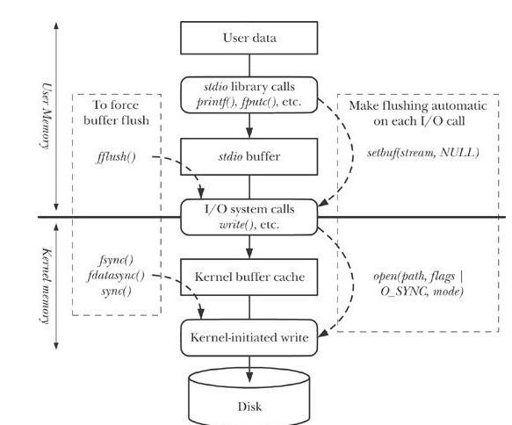
Fig 13-1 Summary of I/O buffering

Slide 26
Shell Implementation
What does the shell do?

Slide 27
Shell Substitutions

Slide 28
Shell variables / Environment

Slide 29
History Mechanism

