Slide 1

CSCE 510 - Systems Programming
Lecture 07 – Make, Stdio, I/O Buffering

Slide 2
Overview
Last Time
  Chapter 7 – Memory
  Chapter 8 – User and groups
  Back to C from Java and C++
Readings for today
  Agile –
  Make - implementation
  Chapter 13 – I/O buffering
  Shells:
    Basics: read command into doubly linked list
    Shell variables, set command
    background,
    Substitutions: variable substitutions, pseudo filename completion, history substitution,
    Simple I/O redirection
  Shell version 2: signals, pipes, command substitution

Slide 3
Agile Software Development
What is Agile?
Agile Manifesto for Agile Software Development –
We are uncovering better ways of developing
software by doing it and helping others do it.
Through this work we have come to value:
Individuals and interactions over processes and tools
Working software over comprehensive documentation
Customer collaboration over contract negotiation
Responding to change over following a plan
That is, while there is value in the items on
the right, we value the items on the left more.
http://agilemanifesto.org/

Slide 4
Iterative Development/Testing
Iterations
Small initial system – read archive and step through
Process arg t as in “myar t archive”
Add functionality for other arguments with stub functions maybe
Add replace for new file as in “myar r arch f1” when f1 is not in the archive so just plcace it on the end
Add extract as in “myar x archive f1”
Add delete as in “myar d archive f1” – happy/sad cases
Finish functionality for replace

Slide 5

Unix for 100
Univ Michigan ugrad
MS UC-Berkeley 1979
Wrote TCP/IP for UNIX
co-founder status at Sun Microsystems
1986 Grace Murray Hopper Award
Inspired NFS, Java
"Why the future doesn't need us“
Vi, BSD, paging Unix, …

Slide 6
MAKE(1) LOCAL USER COMMANDS MAKE(1)
NAME
make - GNU make utility to maintain groups of programs
SYNOPSIS
make [ -f makefile ] [ options ] ... [ targets ] ...
WARNING
This man page is an extract of the documentation of GNU make. It is
updated only occasionally, because the GNU project does not use nroff.
For complete, current documentation, refer to the Info file make.info
which is made from the Texinfo source file make.texi.
DESCRIPTION - The purpose of the make utility is to:
1) determine automatically which pieces of a large program need to be recompiled, and
2) issue the commands to recompile them.

Slide 7
Make Advantages
Make saves time - both typing and recompilation
The Makefile documents the dependencies and how to build the software.
For distribution of software one can `make' and `make install' a package with knowing anything about it.

Slide 8
Makefiles - Make Specification Files
Definitions of the form
name=value
Target Groups of the form
target_1 : dependency list_1
<TAB> cmdlist_1
target_2 : dependencylist_2
<TAB> cmdlist_2
...

Slide 9
A Simple Makefile
# Makefile Example
prog: main.o routines.o
cc -o prog main.o routines.o
# Each command line starts with a \tab
main.o: main.c defs.h
cc -c main.c
routines.o: routines.c defs.h
cc -c routines.c

Slide 10
Make Tree actually forest
To determine if we make a target we check the modification time of all its dependencies (things/files it depends on); if any is newer rebuild the target
Macros –
Built-in Rules –
make –n
make -p

Slide 11
# Another Makefile Example
FILES = Makefile defs.h main.c routines.c
OBJS = main.o routines.o
LIBES = -lm
CFLAGS = -g
LP = /fac/matthews/bin/p2c
INSTALL_DIR = /fac/matthews/bin
prog: main.o routines.o
$(CC) $(CFLAGS) $(OBJS) $(LIBES) -o prog
$(OBJS): defs.h
cleanup:
-rm *.o
-du
install: prog
mv prog $(INSTALL_DIR)
print: $(FILES)
pr $? > /tmp/manton
$(LP) /tmp/manton
touch print
-rm /tmp/manton

Slide 12
Make Implementation Algorithm
Procedure newest(target)
If target is not in the target tree then
If file exists return(modification_time)
Else return(FAIL)
Else
min = modification_time of target
Foreach child in the dependency list Do
child_time = newest(child)
If child_time < min Then min = child_time
End
If min < modification_time of target Then
build(target)
min = now
EndIf
End
End
Begin {Main}
Parse Specification File
Build Dependency Tree
newest(target)
End
Build(target)?

Slide 13
GNU Make
http://www.gnu.org/software/make/
``Makefile conventions'' (147 k characters) of the GNU Coding Standards (147 k characters).
Downloading GNU ftp server:
  http://ftp.gnu.org/gnu/make/
Documentation for Make
  http://www.gnu.org/software/make/manual/

Slide 14
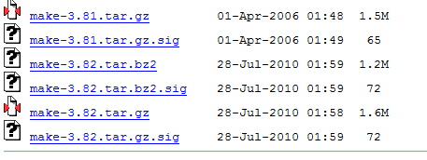
Downloading
http://ftp.gnu.org/gnu/make/
mv make-3.82.tar.gz GNU
cd GNU
tar xcfz make-3.82.tar.gz
more INSTALL README
./configure -- takes a while

Slide 15
Do we want to look at the source?

Slide 16
Make –p shows Rules/Macro defs
Variables …
COMPILE.cpp = $(COMPILE.cc)
LINUX_LIBCRYPT = -lcrypt
# default
CC = cc
CPP = $(CC) -E
… hundreds of lines
%: %.cpp
# commands to execute (built-in):
$(LINK.cpp) $^ $(LOADLIBES) $(LDLIBS) -o $@
%.o: %.cpp
# commands to execute (built-in):
$(COMPILE.cpp) $(OUTPUT_OPTION) $<

Slide 17
Make builtin Macros
$@ - the name of the file to be ``made'‘
$? - the set of dependent names that are younger than the target
$< - the name of the related file that caused the action (the precursor to the target) - this is only for suffix rules
$* - the shared prefix of the target and dependent - only for suffix rules
$$ quote the ‘$’
http://owen.sj.ca.us/~rk/howto/slides/make/slides/makemacro.html

Slide 18
Chapter 24 PROCESS CREATION
24.1 Overview of fork(), exit(), wait(), and execve()
24.2 Creating a New Process: fork()
24.2.1 File Sharing Between Parent and Child
24.2.2 Memory Semantics of fork()
24.3 The vfork() System Call
24.4 Race Conditions After fork()
24.5 Avoiding Race Conditions by Synchronizing with Signals
24.6 Summary

Slide 19
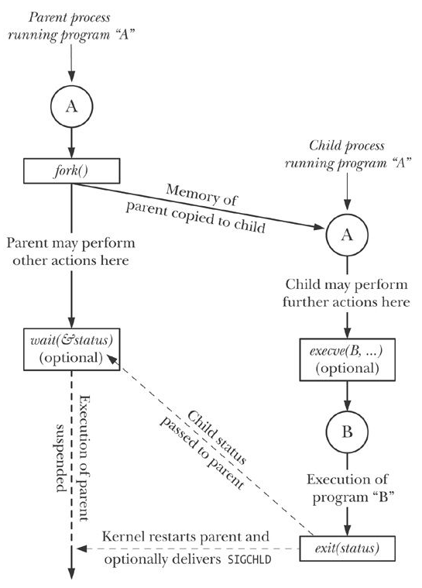
Fork/exec Fig24-1
Fork()
Wait(&status)
Execve(B,…)

Slide 20
fork
#include < unistd.h >
pid_t fork( void);
rv=fork()
Returns pid of child in parent
Returns 0 in child
Returns -1 on error
“the two processes are executing the same program text, but they have separate copies of the stack, data, and heap segments.”

Slide 21
Other things that are the same
Per process open files and File descriptors
Some signals
Some are not the same
Pid, ppid of course
locks

Slide 22
Procexec/t_fork.c
/* t_fork.c - Demonstrate the use of fork(), showing that parent and child get separate copies of stack and data segments. */
#include "tlpi_hdr.h"
static int idata = 111; /* Allocated in data segment */
int
main(int argc, char *argv[])
{
int istack = 222; /* Allocated in stack segment */
pid_t childPid;

Slide 23
t_execve.c
int
main(int argc, char *argv[])
{
char *argVec[10]; /* Larger than required */
char *envVec[] = { "GREET=salut", "BYE=adieu", NULL };
if (argc != 2 || strcmp(argv[1], "--help") == 0)
usageErr("%s pathname\n", argv[0]);
/* Create argument list for the new program */
argVec[0] = strrchr(argv[1], '/'); /* Get basename from argv[1] */
if (argVec[0] != NULL)
argVec[0]++;
else
argVec[0] = argv[1];
argVec[1] = "hello world";
argVec[2] = "goodbye";
argVec[3] = NULL; /* List must be NULL-terminated */
/* Execute the program specified in argv[1] */
execve(argv[1], argVec, envVec);
errExit("execve"); /* If we get here, something went wrong */
}

Slide 24
switch (childPid = fork()) {
case -1:
errExit("fork");
case 0:
idata *= 3;
istack *= 3;
break;
default:
sleep(3); /* Give child a chance to execute */
break;
}
/* Both parent and child come here */
printf("PID=%ld %s idata=%d istack=%d\n", (long) getpid(),
(childPid == 0) ? "(child) " : "(parent)", idata, istack);
exit(EXIT_SUCCESS);
}

Slide 26
Examples
Date command
TLPI/time/calendar_time.c

Slide 27
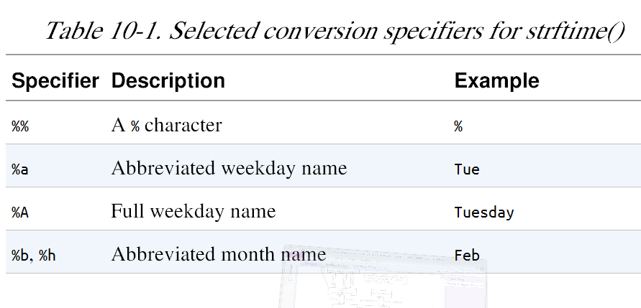
Strftime() - format date and time
… many more

Slide 28
Chapter 11 - SYSTEM LIMITS AND OPTIONS
11.1 System Limits
11.2 Retrieving System Limits (and Options) at Run Time
11.3 Retrieving File-Related Limits (and Options) at Run Time
11.4 Indeterminate Limits
11.5 System Options
11.6 Summary
11.7 Exercises

Slide 29
System Limits
How many files can a process hold open at one time?
Does the system support realtime signals?
What is the largest value that can be stored in a variable of type int?
How big an argument list can a program have?
What is the maximum length of a pathname?
Kerrisk, Michael (2011-02-11). The Linux Programming Interface: A Linux and UNIX System Programming Handbook (Kindle Locations 10186-10190). O'Reilly Distribution. Kindle Edition.

Slide 30
Why worry?
Across UNIX implementations:
At run time on a particular implementation:
From one file system to another:
SUSv3 defines three functions— sysconf(), pathconf(), and fpathconf()—
Kerrisk, Michael (2011-02-11). The Linux Programming Interface: A Linux and UNIX System Programming Handbook (Kindle Locations 10197-10198). O'Reilly Distribution. Kindle Edition.

Slide 31
SYSCONF(3) Linux Programmer's Manual SYSCONF(3)
NAME
sysconf - Get configuration information at runtime
SYNOPSIS
#include <unistd.h>
long sysconf(int name);
DESCRIPTION
POSIX allows an application to test at compile or run time whether certain options are supported, or what the value is of certain configurable constants or limits.
At compile time this is done by including <unistd.h> and/or <limits.h>
and testing the value of certain macros.
At run time, one can ask for numerical values using the present function sysconf(). On can ask for numerical values that may depend on the file system a file is in using the calls fpathconf(3) and pathconf(3). One can ask for string values using confstr(3).

Slide 32
Table 11-1. Selected SUSv3 limits
Name of Limit <limits.h> | Min Value | Sysconf() Name | Description
ARG_MAX | 4096 | _SC_ARG_MAX | Maximum bytes for arguments (argv) plus environment (environ) that can be supplied to an exec() (Environment List and Passing the Caller’s Environment to the New Program)
- | - | _SC_CLK_TCK | Unit of measurement for times()
LOGIN_NAME_MAX | 9 | _SC_LOGIN_NAME_MAX | Maximum size of a login name (including terminating null byte)
OPEN_MAX | 20 | _SC_OPEN_MAX | Maximum number of file descriptors that a process can have open at one time, and one greater than maximum usable descriptor number (Process Resource Lim.)
NGROUPS_MAX | 8 | _SC_NGROUPS_MAX | Maximum number of supplementary groups of process can have open at one time, and one greater than maximum usable descriptor number (Process Res.Lim

Slide 33
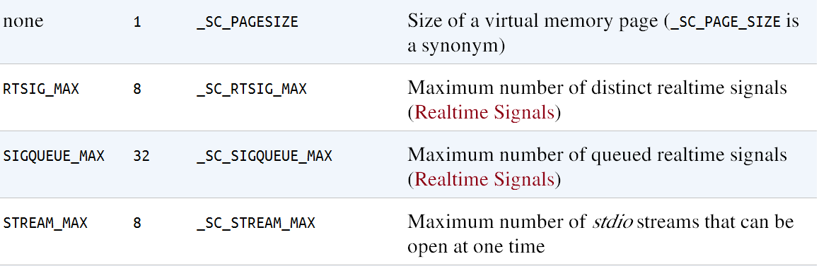

Slide 34
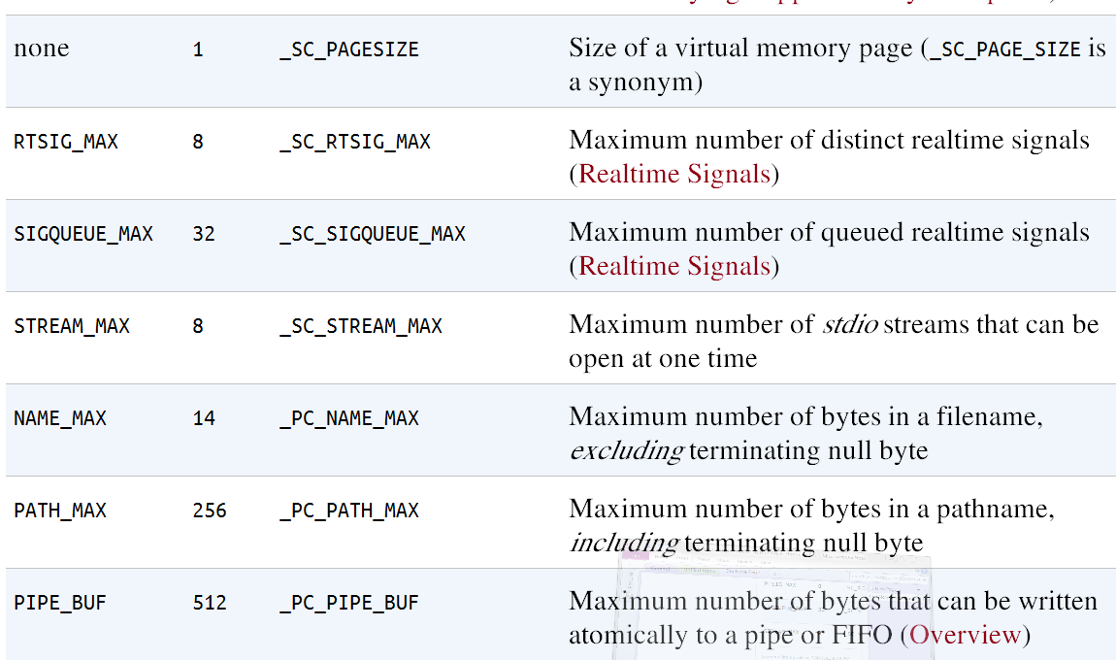

Slide 35
Determining limits and options from the shell: getconf
The constant FOPEN_MAX, defined in < stdio.h >, is synonymous with STREAM_MAX.
NAME_MAX excludes the terminating null byte, while PATH_MAX includes it.
Kerrisk, Michael (2011-02-11). The Linux Programming Interface: A Linux and UNIX System Programming Handbook (Kindle Locations 10435-10436). O'Reilly Distribution. Kindle Edition.

Slide 36
Example 11-1. Using sysconf()
TLPI/syslim/t_sysconf.c
#include "tlpi_hdr.h"
static void /* Print 'msg' plus sysconf() value for 'name' */
sysconfPrint(const char *msg, int name)
{
long lim;
errno = 0;
lim = sysconf(name);
if (lim != -1) { /* Call succeeded, limit determinate */
printf("%s %ld\n", msg, lim);
} else {
if (errno == 0) /* Call succeeded, limit indeterminate */
printf("%s (indeterminate)\n", msg);
else /* Call failed */
errExit("sysconf %s", msg);
}
}

Slide 37
int
main(int argc, char *argv[])
{
sysconfPrint("_SC_ARG_MAX: ", _SC_ARG_MAX);
sysconfPrint("_SC_LOGIN_NAME_MAX: ",_SC_LOGIN_NAME_MAX);
sysconfPrint("_SC_OPEN_MAX: ", _SC_OPEN_MAX);
sysconfPrint("_SC_NGROUPS_MAX: ", _SC_NGROUPS_MAX);
sysconfPrint("_SC_PAGESIZE: ", _SC_PAGESIZE);
sysconfPrint("_SC_RTSIG_MAX: ", _SC_RTSIG_MAX);
exit(EXIT_SUCCESS);
}

Slide 38
FPATHCONF(3) Linux Programmer's Manual FPATHCONF(3)
NAME
fpathconf, pathconf - get configuration values for files
SYNOPSIS
#include <unistd.h>
long fpathconf(int fd, int name);
long pathconf(char *path, int name);
DESCRIPTION
fpathconf() gets a value for the configuration option name for the open
file descriptor fd.
pathconf() gets a value for configuration option name for the filename
path.

Slide 39
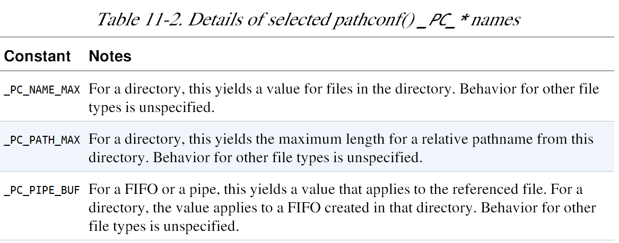

Slide 40
TLPI/syslim/t_fpathconf.c
static void /* Print 'msg' plus value of fpathconf(fd, name) */
fpathconfPrint(const char *msg, int fd, int name)
{
long lim;
errno = 0;
lim = fpathconf(fd, name);
if (lim != -1) { /* Call succeeded, limit determinate */
printf("%s %ld\n", msg, lim);
} else {
if (errno == 0) /* Call succeeded, limit indeterminate */
printf("%s (indeterminate)\n", msg);
else /* Call failed */
errExit("fpathconf %s", msg);
}
}

Slide 41
TLPI/syslim/t_fpathconf.c - main
int
main(int argc, char *argv[])
{
fpathconfPrint("_PC_NAME_MAX: ", STDIN_FILENO, _PC_NAME_MAX);
fpathconfPrint("_PC_PATH_MAX: ", STDIN_FILENO, _PC_PATH_MAX);
fpathconfPrint("_PC_PIPE_BUF: ", STDIN_FILENO, _PC_PIPE_BUF);
exit(EXIT_SUCCESS);
}

Slide 42
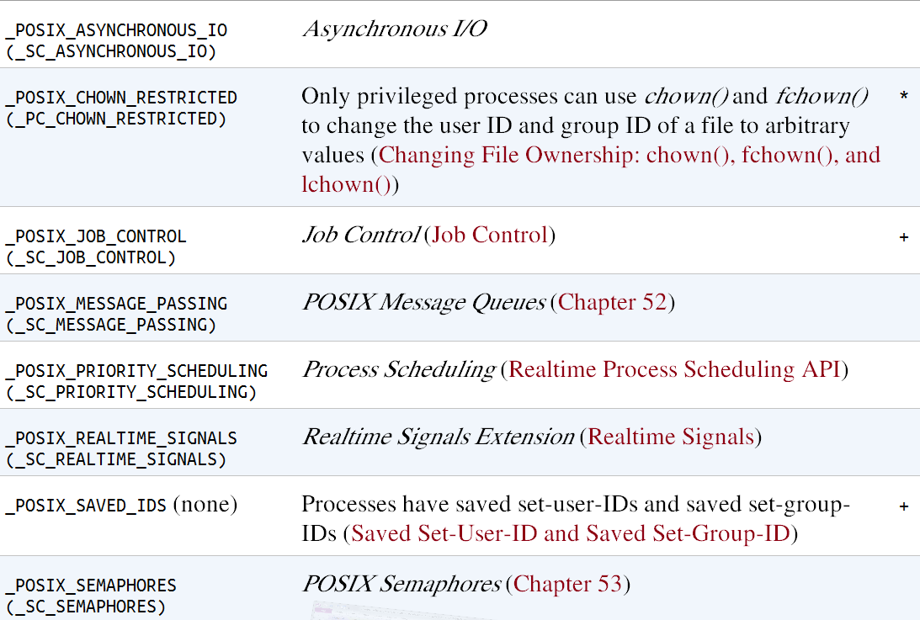
System Options
… (more not shown here) inlcuding _POSIX_THREADS

Slide 43
Chapter 12. System and Process Info.
12.1 The /proc File System
12.1.1 Obtaining Information About a Process: /proc/PID
12.1.2 System Information Under /proc
12.1.3 Accessing /proc Files
12.2 System Identification: uname()
12.3 Summary
12.4 Exercises

Slide 44
Process info: ps -
X
hermes> ps -e
PID TTY TIME CMD
1 ? 00:00:01 init
2 ? 00:00:00 kthreadd
3 ? 00:00:00 migration/0
4 ? 00:00:00 ksoftirqd/0
5 ? 00:00:00 watchdog/0
6 ? 00:00:00 migration/1
7 ? 00:00:00 ksoftirqd/1
8 ? 00:00:00 watchdog/1
9 ? 00:00:00 events/0
10 ? 00:00:00 events/1
11 ? 00:00:00 cpuset
12 ? 00:00:00 khelper
13 ? 00:00:00 netns
14 ? 00:00:00 async/mgr
15 ? 00:00:00 pm
17 ? 00:00:00 sync_supers
1786 pts/0 00:00:00 bash
1807 ? 00:00:00 oosplash
1820 ? 00:00:00 notification-da
1895 ? 00:00:44 soffice.bin
1978 ? 00:00:00 flush-8:0
2005 ? 00:00:00 flush-0:22
2010 ? 00:00:02 plugin-containe
2013 ? 00:00:05 acroread
2087 pts/0 00:00:00 vi
2092 ? 00:00:00 sshd
2181 ? 00:00:00 sshd
2182 pts/1 00:00:00 bash
2207 ? 00:00:00 evolution-data-
2211 ? 00:00:00 evolution-excha
2253 pts/1 00:00:00 ps
2254 pts/1 00:00:00 less

Slide 45
PS EXAMPLES
To see every process on the system using standard syntax:
ps -e
ps -ef
ps -eF
ps -ely
To see every process using BSD syntax:
ps ax
ps axu
To print a process tree:
ps -ejH
ps axjf
To get info about threads:
ps -eLf
ps axms
To get security info:
ps –eo euser, ruser, suser, fuser, f, comm, label
ps axZ
ps –eM
To see every process running as root (real & effective ID) in user format:
ps -U root -u root u
Print only the process IDs of syslogd:
ps -C syslogd -o pid=

Slide 46
/proc file system revisited
How many processes are running on the system and who owns them?
What files does a process have open?
What files are currently locked, and which processes hold the locks?
What sockets are being used on the system?
Kerrisk, Michael (2011-02-11). The Linux Programming Interface: A Linux and UNIX System Programming Handbook (Kindle Locations 10801-10804). O'Reilly Distribution. Kindle Edition.

Slide 47
/proc/PID/status
hermes> cat /proc/2/status
Name: kthreadd
State: S (sleeping)
Tgid: 2
Pid: 2
PPid: 0
TracerPid: 0
Uid: 0 0 0 0
Gid: 0 0 0 0
FDSize: 32
Groups:
Threads: 1
SigQ: 0/16023
SigPnd: 0000000000000000
ShdPnd: 0000000000000000
SigBlk: 0000000000000000
SigIgn: ffffffffffffffff
SigCgt: 0000000000000000
CapInh: 0000000000000000
CapPrm: ffffffffffffffff
CapEff: fffffffffffffeff
CapBnd: ffffffffffffffff
Cpus_allowed: ff
Cpus_allowed_list: 0-7
Mems_allowed: 1
Mems_allowed_list: 0
voluntary_ctxt_switches: 107
nonvoluntary_ctxt_switches: 0

Slide 48
Table 12-1. Selected files in each /proc/ PID directory
File | Description (process attribute)
cmdline | Command-line arguments delimited by \0
Cmd | Symbolic link to current working directory
environ | Environment list NAME = value pairs, delimited by \0
exe | Symbolic link to file being executed
fd | Directory containing symbolic links to files opened by this process
maps | Memory mappings
mem | Process virtual memory (must lseek() to valid offset before I/ O)
mounts | Mount points for this process
root | Symbolic link to root directory

Slide 49
More /proc/PID
/proc/PID/fd – symbolic link for every file descriptor that a process has open
/proc/PID/task/TID – thread ID

Slide 50
Table 12-2 Selected /proc subdirectories
Directory | Information exposed by files in this directory
/proc | Various system information
/proc/net | Status information about networking and sockets
/proc/sys/fs | Settings related to file systems
/proc/sys/kernel | Various general kernel settings
/proc/sys/net | Networking and sockets settings
/proc/sys/vm | Memory-management settings
/proc/sysvipc | Information about System V IPC objects

Slide 51
FILE I/O Buffering
13.1 Kernel Buffering of File I/O: The Buffer Cache
13.2 Buffering in the stdio Library
13.3 Controlling Kernel Buffering of File I/O
13.4 Summary of I/O Buffering
13.5 Giving the Kernel Hints About I/O Patterns: posix_fadvise()
13.6 Bypassing the Buffer Cache: Direct I/O
13.7 Mixing Library Functions and System Calls for File I/O
13.8 Summary
13.9 Exercises

Slide 52
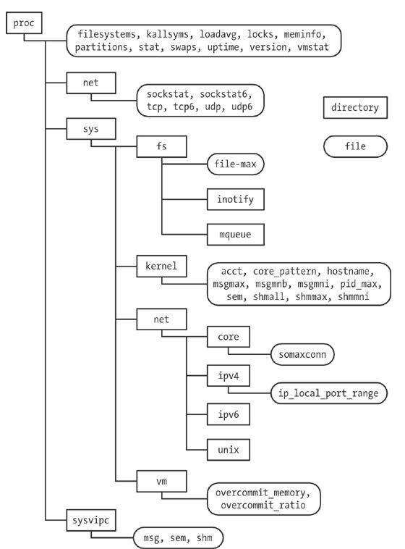
Figure 12-1 /proc hierarchy

Slide 53
hermes> cd sysinfo
hermes> ls
Makefile
procfs_pidmax.c
procfs_user_exe.c
t_uname.c
procfs_pidmax
procfs_user_exe
t_uname

