Slide 1

CSCE 510 - Systems Programming
Lecture 06 - C++/Java ➔ C, Memory

Slide 2
Overview
Last Time
  Chapter 6 – Processes
  Threatened to do Chap 7 Memory and Chap 8 users and groups
Readings for today
  Chapter 7 – Memory
  Chapter 8 – User and groups
  Back to C from Java and C++
Prologue
  Processes and memory
Interlude - Course Pragmatics, CS man of the day, Quiz
Epilogue
  Users and groups

Slide 3
C from Java and C++
Emailed links and things
  Ar program –
  Slides up - Slides are up on the website http://www.cse.sc.edu/~matthews/Courses/510/Lectures.html
  Some handouts
Printf from Guy Steele’s “C reference Manual”
CMU Guide Java ➔ C

Slide 4
Email 1 – ar program Due Feb 8
510ers,
For the ar program you should implement the following commands:
1) r as in "ar r arch1 f1" should replace/add f1 to the archive arch1. If the archive ddoes not exist then this should create the archive and put r in it
2) x as in "ar x arch1 f1" extract f1 from the archive and set the modification time to the time in the archive. (see utimes system call.)
3) d as in "ar d arch1 f1" - delete f1 from the archive
4) t print the table of contents
Due next Friday Feb 8.
Kerrisk, TLPI 2011, O”Reilly (Kindle)

Slide 5

Emailed today 1:57PM
Some repeats I hope
C Quick reference card
Gdb Quick reference card
C primer from CMU
Printf form “Steele”
Getword, tree from K&R

Slide 6
Gdb Quick reference card
Essential Commands
Essential Commands
gdb program [core] debug program using coredump core
b[file:] function set breakpoint at function file
run [arglist] start your program 􀀀with arglist
bt backtrace: display program stack
p expr display the value of an expression
c continue running your program
n next line stepping over function calls
s next line stepping into function calls

Slide 7
Printf excerpts from “Steele”
Table 15-2 output conversion specifiers
Conversion flags
Table 15-1 input conversions
Examples of the d conversions on output
% | -#0+ flags | Field Width | .4 precision | H size modifier | Conversion letter

Slide 8
C-PrimerCMU

Slide 9
C strings / String library
man string
STRING(3) Linux Programmer's Manual STRING(3)
NAME
strcasecmp, strcat, strchr, strcmp, strcoll, strcpy, strcspn, strdup,
strfry, strlen, strncat, strncmp, strncpy, strncasecmp, strpbrk,
strrchr, strsep, strspn, strstr, strtok, strxfrm, index, rindex
- string operations
SYNOPSIS
#include <strings.h>

Slide 10
Kernighan and Ritchie (K&R)
Pointers to structures email
/class/csce510/Examples
  getword.c
  tree.c

Slide 11
Getword function – read a word
int getword(FILE *fp, char *word,
int lim)
{
int c, t;
char *w = word;
while(isspace(c = getc(fp)))
;
if (c != EOF)
*w++ = c;
if (!isalpha(c)){
*w = EOS;
return c;
}
for( ; --lim > 0; ++w){
if(!isalpha(*w = getc(fp))){
ungetc(*w, fp);
break;
}
}
*w = EOS;
return(LETTER);
}

Slide 12
Getword.c – main program
#include <stdio.h>
#define EOS '\0'
#define LETTER 'a'
#define DIGIT '0'
#define WORDSIZE 1000
main(){
char word[WORDSIZE];
int getword();
int x;
FILE *fp;
FILE *fp;
fp = fopen("test","r");
if (fp == NULL){
perror("getword test");
fp = stdin;
}
while((x = getword(fp, word, WORDSIZE)) != EOF)
printf("\n%s\t Getw %o ",word, x);
}

Slide 13
Tree.c
struct tnode{/* the basic node */
char *word; /*ptr to text */
int count; /*number …*/
struct tnode *left; /*left child*/
struct tnode *right; /*rght chld*/
};
/* Picture to be added here in class !!!!! */
main(){ /* word frequency count */
struct tnode *root, *addtree();
char word[MAXWORD];
int t;
root = NULL;
while((t=getword(word, MAXWORD)) != EOF)
if (t == LETTER)
root = addtree(root,word);
treeprint(root);
}

Slide 14
struct tnode *addtree(struct tnode *p, char *w){ /* install w at or below p */
struct tnode *talloc();
char *strdup();
int cond;
if(p == NULL){ /* a new word … */
p = talloc(); /* make a new node */
p->word = strdup(w);
p->count = 1;
p->left = p->right = NULL;
}else if ((cond = strcmp(w, p->word)) == 0)
p->count++; /* repeated word */
else if (cond < 0) /* lower goes left*/
p->left = addtree(p->left, w);
else /*greater goes to right subtree */
p->right = addtree(p->right, w);
return(p);
}
treeprint(struct tnode *p){
if(p != NULL){
treeprint(p->left);
printf("%4d %s\n",p->count,
p->word);
treeprint(p->right);
}
}
/*
* Revised to use malloc instead of alloc.
*/
struct tnode*talloc(){
void *malloc();
return((struct tnode *)
malloc(sizeof (struct tnode)));
}

Slide 15
More from TLPI/proc

Slide 16
Chapter 7 MEMORY ALLOCATION
7.1 Allocating Memory on the Heap
7.1.1 Adjusting the Program Break: brk() and sbrk()
7.1.2 Allocating Memory on the Heap: malloc() and free()
7.1.3 Implementation of malloc() and free()
7.1.4 Other Methods of Allocating Memory on the Heap
7.2 Allocating Memory on the Stack: alloca()
7.3 Summary
7.4 Exercises

Slide 17
NAME -- brk, sbrk - change data segment size
SYNOPSIS
#include <unistd.h>
int brk(void *addr);
void *sbrk(intptr_t increment);
brk(), sbrk(): _BSD_SOURCE || _SVID_SOURCE || _XOPEN_SOURCE >= 500
DESCRIPTION - brk() and sbrk() change the location of the program break, which defines the end of the process's data segment. Increasing the program break has the effect of allocating memory to the process; decreasing the break deallocates memory.
brk() sets the end of the data segment to the value specified by addr,
when that value is reasonable, the system has enough memory, and the process does not exceed its maximum data size (see setrlimit(2)).
sbrk() increments the program's data space by increment bytes.

Slide 18
Allocating on the Heap
malloc, free, etc.
#include <stdlib.h>
void *calloc(size_t nmemb, size_t size);
void *malloc(size_t size);
void free(void *ptr);
void *realloc(void *ptr, size_t size);
TLPI/memalloc/free_and_sbrk.c

Slide 19
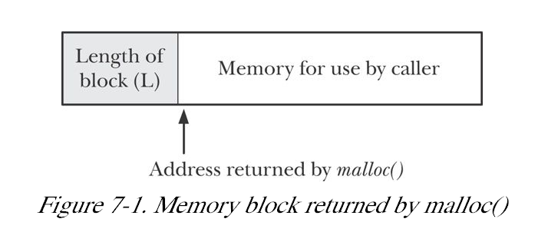
Implementation of malloc and free

Slide 20
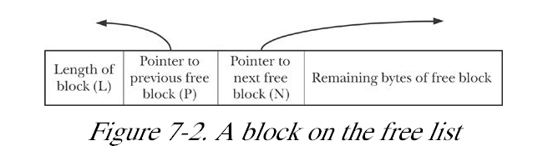

Slide 21
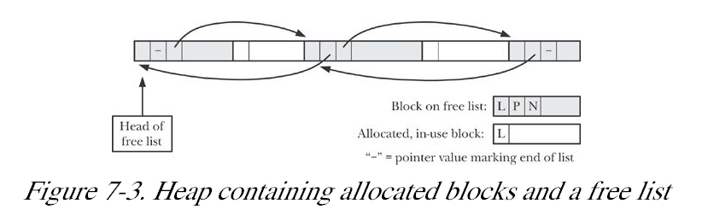
Fig 7.3
Memory leaks
Checking for memory leaks?

Slide 22

Unix for 100
Univ Michigan ugrad
MS UC-Berkeley 1979
Wrote TCP/IP for UNIX
co-founder status at Sun Microsystems
1986 Grace Murray Hopper Award
Inspired NFS, Java
"Why the future doesn't need us“
Vi, BSD, paging Unix, …

Slide 23
Chapter 8 USERS AND GROUPS
8.1 The Password File: /etc/passwd
8.2 The Shadow Password File: /etc/shadow
8.3 The Group File: /etc/group
8.4 Retrieving User and Group Information
8.5 Password Encryption and User Authentication
8.6 Summary
8.7 Exercises

Slide 24
Chapter 9 PROCESS CREDENTIALS
9.1 Real User ID and Real Group ID
9.2 Effective User ID and Effective Group ID
9.3 Set-User-ID and Set-Group-ID Programs
9.4 Saved Set-User-ID and Saved Set-Group-ID
9.5 File-System User ID and File-System Group ID
9.6 Supplementary Group IDs
9.7 Retrieving and Modifying Process Credentials
9.7.1 Retrieving and Modifying Real, Effective, and Saved Set IDs
9.7.2 Retrieving and Modifying File-System IDs
9.7.3 Retrieving and Modifying Supplementary Group IDs
9.7.4 Summary of Calls for Modifying Process Credentials
9.7.5 Example: Displaying Process Credentials
9.8 Summary
9.9 man –k uid | less

Slide 25
Time – Chap 10
Calendar time – seconds since epoch
File times
  Modification
  Access
  Creation !? I-node change time
ls sorts by any?(I think)
Process times – later
time command
hermes> time gcc tree.c
real 0m0.070s
user 0m0.036s
sys 0m0.024s

Slide 26
Gettimeofday(2)
SYNOPSIS
#include <sys/time.h>
int gettimeofday(struct timeval *tv, struct timezone *tz);
int settimeofday(const struct timeval *tv, const struct timezone *tz);
…
DESCRIPTION
The functions gettimeofday() and settimeofday() can get and set the
time as well as a timezone. The tv argument is a struct timeval (as
specified in <sys/time.h>):
struct timeval {
time_t tv_sec; /* seconds */
suseconds_t tv_usec; /* microseconds */
};

Slide 27
Time
TIME(2) Linux Programmer's Manual TIME(2)
NAME
time - get time in seconds
SYNOPSIS
#include <time.h>
time_t time(time_t *t);
DESCRIPTION
time() returns the time since the Epoch (00:00:00 UTC, January 1, 1970), measured in seconds.

Slide 28
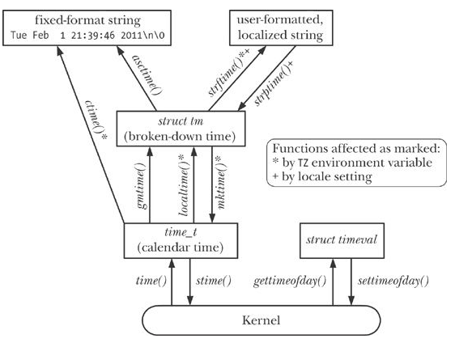
Time Conversion Functions Fig 10-1
.

Slide 29
Printing time
#include < time.h > char *ctime( const time_t *timep);
Kerrisk, Michael (2011-02-11). The Linux Programming Interface: A Linux and UNIX System Programming Handbook (Kindle Locations 9098-9100). O'Reilly Distribution. Kindle Edition.

Slide 30
CTIME(3) Linux Programmer's Manual CTIME(3)
NAME - asctime, ctime, gmtime, localtime, mktime, asctime_r, ctime_r, gmtime_r, localtime_r
- transform date and time to broken-down time or ASCII
SYNOPSIS
#include <time.h>
char *asctime(const struct tm *tm);
char *ctime(const time_t *timep);
struct tm *gmtime(const time_t *timep);
struct tm *localtime(const time_t *timep);
struct tm *localtime_r(const time_t *timep, struct tm *result);
time_t mktime(struct tm *tm);

Slide 31
Examples
Date command
TLPI/time/calendar_time.c

Slide 32
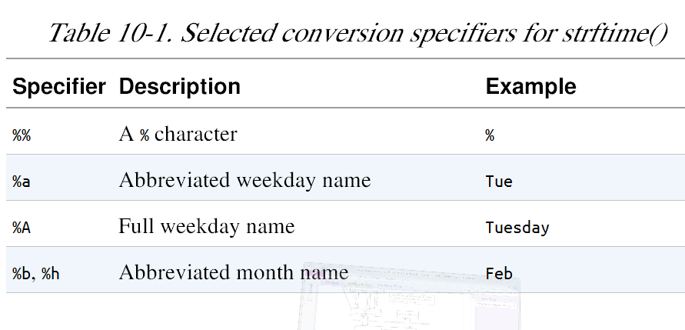
Strftime() - format date and time
… many more

