Slide 1
CSCE 510 - Systems Programming
Lecture 05 - Processors, Memory

Slide 2
Overview
Last Time
Ar –archiver
Ch 05 more on File I/0
Readings for today
Chapter 6 – Processes
Chapter 7 – Memory
Chapter 8 – User and groups
Prologue
Processes and memory
Interlude - Course Pragmatics, CS man of the day, Quiz
Epilogue
Users and groups

Slide 3
Chapter 6 Processes
6.1 Processes and Programs
6.2 Process ID and Parent Process ID
6.3 Memory Layout of a Process
6.4 Virtual Memory Management
6.5 The Stack and Stack Frames
6.6 Command-Line Arguments (argc, argv)
6.7 Environment List
6.8 Performing a Nonlocal Goto: setjmp() and longjmp()
6.9 Summary

Slide 4
6.1 Processes and Programs
A process is an instance of an executing program. In this section, we elaborate on this definition and clarify the distinction between a program and a process.
A program is a file containing a range of information that describes how to construct a process at run time.
Kerrisk, TLPI 2011, O”Reilly (Kindle)

Slide 5
Binary format identification:
a.out – “assembler output”
COFF common Object File Format
ELF Executable and linkable Format
Machine language
od –c
od –d
Program entry point
Data
Symbol and relocatable tables
Shared-libraries

Slide 6
Process ID and Parent Process ID
What does the kill() system call do?
SYNOPSIS
#include <sys/types.h>
#include <unistd.h>
pid_t getpid(void);
pid_t getppid(void);
DESCRIPTION
getpid() returns the process ID of the calling process. (often used to generate unique temp filenames
getppid() returns the process ID of the parent of the calling process.

Slide 7
Pid_t
pid_t limits to 32,767
on 64-bit platforms, it can be adjusted to any value up to 2²²
ID counter resets to 300, Why?
/proc/PID/status_file

Slide 8
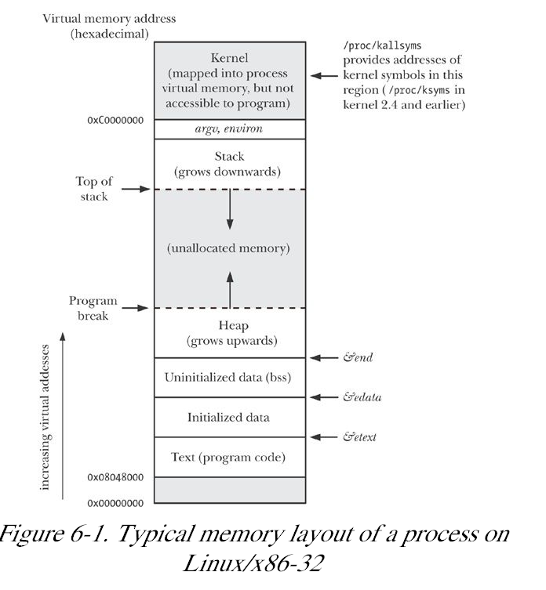
Memory Layout of a Process
Fig 6-1

Slide 9
%p, size and other things

Slide 10
Example 6.1 = proc/mem_segments.c

Slide 11
Global symbols etext, edata, and end

Slide 12
Virtual memory
Fork()
Shared memory, pipes
Swap area
Page fault
On x86-32, pages are 4096 bytes in size.
sysconf(_SC_PAGESIZE),

Slide 13
Stack and Stack Frames

Slide 14
Command line arguments
“gzip( 1), gunzip( 1), and zcat( 1) commands, all of which are links to the same executable file”
argv[ argc] is NULL

Slide 15
Csce510-001/TPLI/proc
hermes> pwd
/class/csce510-001/TLPI/proc
hermes> ls *.c
bad_longjmp.c
longjmp.c
modify_env.c
setenv.c
t_getenv.c
display_env.c
mem_segments.c
necho.c
setjmp_vars.c

Slide 16
necho.c – look familiar
#include "tlpi_hdr.h"
int
main(int argc, char *argv[])
{
int j;
for (j = 0; j < argc; j++)
printf("argv[%d] = %s\n", j, argv[j]);
exit(EXIT_SUCCESS);
}

Slide 17
Pointers –argv again
char **p; /* example 6.? */
for (p = argv; *p != NULL; p++)
puts(*p);
/proc/PID/cmdline
ARG_MAX
/usr/include/limits.h
“the limit on the total space used for argv and environ can be controlled via the RLIMIT_STACK”

Slide 18
Getopt – Appendix B

Slide 19
The Envirnoment
env – list of name=value strings
Environment variables
env | fgrep SHELL
HOME, PATH
Create a shell variable
c5=/class.csce510-001
export c5 -- puts it into the environment
What is a shell variable?
Set, unset

Slide 20
env vs printenv
man env
man printenv
man –s7 environ
man –k environ // = apropos?

Slide 21
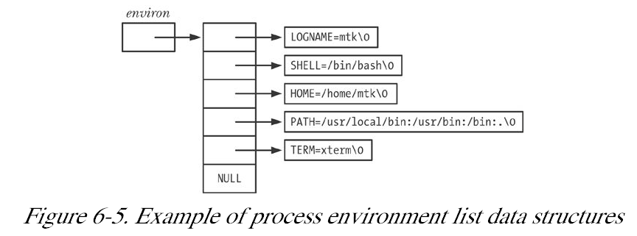
Accessing environment from C
char **environ; // global variable
less TLPI/proc/display_env.c
Alternatively int main( int argc, char *argv[], char *envp[])

Slide 22
Accessing environment from C part 2
char *getenv(const char *name);
DESCRIPTION - The getenv() function searches the environment list to find the environment variable name, and returns a pointer to the corresponding value string.

Slide 23
PUTENV(3) Linux Programmer's Manual PUTENV(3)
NAME
putenv - change or add an environment variable
SYNOPSIS
#include <stdlib.h>
int putenv(char *string);
Feature Test Macro Requirements for glibc (see feature_test_macros(7)):
putenv(): _SVID_SOURCE || _XOPEN_SOURCE
DESCRIPTION The putenv() function adds or changes the value of environment variables. The argument string is of the form name=value.

Slide 24
NAME
setenv - change or add an environment variable
SYNOPSIS
#include <stdlib.h>
int setenv(const char *name, const char *value, int overwrite);
int unsetenv(const char *name);

Slide 25
More from TLPI/proc

Slide 26
“On occasion, it is useful to erase the entire environment, and then rebuild it with selected values. For example, we might do this in order to execute set-user-ID programs in a secure manner (Don't Trust Inputs or the Environment). We can erase the environment by assigning NULL to environ”
environ = NULL;
#define _BSD_SOURCE
#include <stdlib.h>
int clearenv( void)

Slide 27
Setjmp / longjmp
NAME
setjmp, sigsetjmp - save stack context for non-local goto
SYNOPSIS
#include <setjmp.h>
int setjmp(jmp_buf env);
int sigsetjmp(sigjmp_buf env, int savesigs);

Slide 28
LONGJMP(3) Linux Programmer's Manual LONGJMP(3)
NAME
longjmp, siglongjmp - non-local jump to a saved stack context
SYNOPSIS
#include <setjmp.h>
void longjmp(jmp_buf env, int val);
void siglongjmp(sigjmp_buf env, int val);

Slide 29
Unix for 100
Texas A&M faculty
1993: The ACM Grace Murray Hopper award.
2004: Elected member of The National Academy of Engineering
"How to test?" "When?
“C makes it easy to shoot yourself in the foot;
C++ makes it harder, but when you do it blows your whole leg off.”

Slide 30
Chapter 7 MEMORY ALLOCATION
7.1 Allocating Memory on the Heap
7.1.1 Adjusting the Program Break: brk() and sbrk()
7.1.2 Allocating Memory on the Heap: malloc() and free()
7.1.3 Implementation of malloc() and free()
7.1.4 Other Methods of Allocating Memory on the Heap
7.2 Allocating Memory on the Stack: alloca()
7.3 Summary
7.4 Exercises

Slide 31
NAME -- brk, sbrk - change data segment size
SYNOPSIS
#include <unistd.h>
int brk(void *addr);
void *sbrk(intptr_t increment);
brk(), sbrk(): _BSD_SOURCE || _SVID_SOURCE || _XOPEN_SOURCE >= 500
DESCRIPTION - brk() and sbrk() change the location of the program break, which defines the end of the process's data segment. Increasing the program break has the effect of allocating memory to the process; decreasing the break deallocates memory.
brk() sets the end of the data segment to the value specified by addr,
when that value is reasonable, the system has enough memory, and the process does not exceed its maximum data size (see setrlimit(2)).
sbrk() increments the program's data space by increment bytes.

Slide 32
Allocating on the Heap
malloc, free, etc.
#include <stdlib.h>
void *calloc(size_t nmemb, size_t size);
void *malloc(size_t size);
void free(void *ptr);
void *realloc(void *ptr, size_t size);
TLPI/memalloc/free_and_sbrk.c

Slide 33
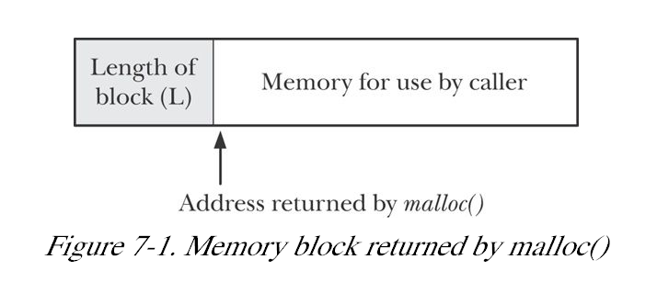
Implementation of malloc and free

Slide 35
Fig 7.3
Memory leaks
Checking for memory leaks?

Slide 36
Chapter 8 USERS AND GROUPS
8.1 The Password File: /etc/passwd
8.2 The Shadow Password File: /etc/shadow
8.3 The Group File: /etc/group
8.4 Retrieving User and Group Information
8.5 Password Encryption and User Authentication
8.6 Summary
8.7 Exercises

Slide 37
Chapter 9 PROCESS CREDENTIALS
9.1 Real User ID and Real Group ID
9.2 Effective User ID and Effective Group ID
9.3 Set-User-ID and Set-Group-ID Programs
9.4 Saved Set-User-ID and Saved Set-Group-ID
9.5 File-System User ID and File-System Group ID
9.6 Supplementary Group IDs
9.7 Retrieving and Modifying Process Credentials
9.7.1 Retrieving and Modifying Real, Effective, and Saved Set IDs
9.7.2 Retrieving and Modifying File-System IDs
9.7.3 Retrieving and Modifying Supplementary Group IDs
9.7.4 Summary of Calls for Modifying Process Credentials
9.7.5 Example: Displaying Process Credentials
9.8 Summary
9.9 Exercises

