Slide 1
CSCE 510 - Systems Programming
Lecture 04 - ar Libraries

Slide 2
Overview
Last Time
Text: 18.8, 15.1, /class/csce510-001/Code/TLPI
Ch 04 File I/0
Readings for today
Ar: man, wikipedia, http://man7.org/linux/man-pages/index.html
/class/csce510-001/Code/TLPI
Prologue
Directories
Stat system call for information on files
Interlude - Course Pragmatics, CS man of the day, Quiz
Epilogue
File I/0

Slide 3
Ar – library archiver
AR(1) GNU Development Tools AR(1)
NAME
ar - create, modify, and extract from archives
SYNOPSIS
ar [--plugin name] [-X32_64] [-]p[mod [relpos] [count]] archive
[member...]
DESCRIPTION - The GNU ar program creates, modifies, and extracts from archives. …
Options:

Slide 4
Ar - options
d – delete
m – move
p - print
q – quickly append
r - replace
t – table of contents
x – extract file from archive
c – create the archive
Position modifiers
SEE ALSO
nm(1), ranlib(1), and the Info entries for binutils.

Slide 5
ar --- Archive (File) format
Global header – magic string “!<arch>”
File Header – 60 bytes
File contents
Offset | Length | Name | Format
0 | 16 | File name | ASCII
16 | 12 | File modification timestamp | Decimal
28 | 6 | Owner ID | Decimal
34 | 6 | Group ID | Decimal
40 | 8 | File mode | Octal
48 | 10 | File size in bytes | Decimal
58 | 2 | File magic | 0x60 0x0A
Offset | Length | Name | Format
0 | 16 | File name | ASCII
16 | 12 | File modification timestamp | Decimal
28 | 6 | Owner ID | Decimal
34 | 6 | Group ID | Decimal
40 | 8 | File mode | Octal
48 | 10 | File size in bytes | Decimal
58 | 2 | File magic | 0x60 0x0A
http://en.wikipedia.org/wiki/Ar_%28Unix%29

Slide 6
Calendar time
Time in seconds since Jan 1 1970
TLPI/time
ls *.c
calendar_time.c
curr_time.c
process_time.c
show_time.c
strtime.c
t_stime.c

Slide 7
More calendar_time.c
#include <locale.h>
#include <time.h>
#include <sys/time.h>
#include "tlpi_hdr.h"
#define SECONDS_IN_TROPICAL_YEAR (365.24219 * 24 * 60 * 60)
int
main(int argc, char *argv[])
{
time_t t;
struct tm *gmp, *locp;
struct tm gm, loc;
struct timeval tv;
/* Retrieve time, convert and display it in various forms */
t = time(NULL);
printf("Seconds since the Epoch (1 Jan 1970): %ld", (long) t);
printf(" (about %6.3f years)\n", t / SECONDS_IN_TROPICAL_YEAR);
if (gettimeofday(&tv, NULL) == -1)
errExit("gettimeofday");

Slide 8
if (gettimeofday(&tv, NULL) == -1)
errExit("gettimeofday");
printf(" gettimeofday() returned %ld secs, %ld microsecs\n", (long) tv.tv_sec, (long) tv.tv_usec);
gmp = gmtime(&t);
if (gmp == NULL)
errExit("gmtime");
gm = *gmp; /* Save local copy, since *gmp may be modified
by asctime() or gmtime() */
printf("Broken down by gmtime():\n");
printf(" year=%d mon=%d mday=%d hour=%d min=%d sec=%d ", gm.tm_year, gm.tm_mon, gm.tm_mday, gm.tm_hour, gm.tm_min, gm.tm_sec);
printf("wday=%d yday=%d isdst=%d\n", gm.tm_wday, gm.tm_yday, gm.tm_isdst);
… Modifying by setting TZ environment variable

Slide 9
Year 2038 problem?
2^32 seconds woops!
http://en.wikipedia.org/wiki/Year_2038_problem

Slide 10
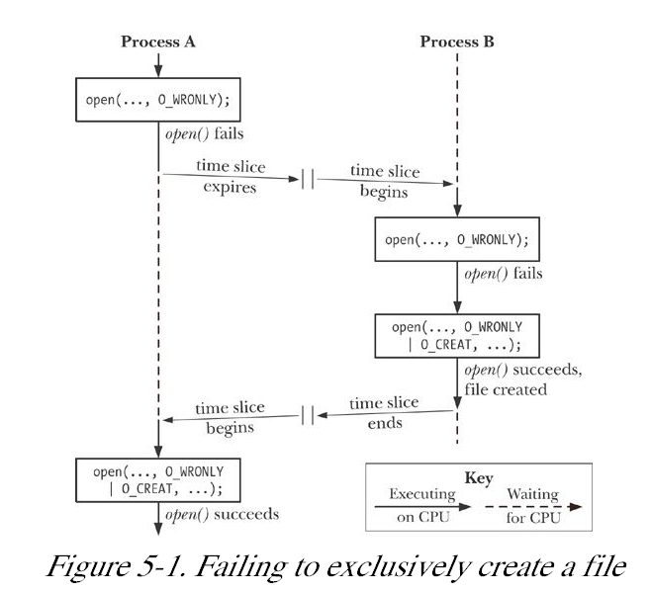
Chapter 5. File I/ O: Further Details
Example 5-1. Incorrect code to exclusively open a file
Kerrisk, TLPI 2011, O”Reilly (Kindle)

Slide 11
File Descriptors / Open Files
To understand what is going on, we need to examine three data structures maintained by the kernel:
the per-process file descriptor table;
the system-wide table of open file descriptions; and
the file system i-node table.
Kerrisk, TLPI 2011, O”Reilly (Kindle)

Slide 12
Appending data to a file
lseek(fd, 0, SEEK_END); write(fd, …) to end?
Interrupt between
Another process could move again overwriting
O_APPEND – the right way
Kerrisk, TLPI 2011, O”Reilly (Kindle)

Slide 13
FCNTL(2) Linux Programmer's Manual FCNTL(2)
NAME
fcntl - manipulate file descriptor
SYNOPSIS
#include <unistd.h>
#include <fcntl.h>
int fcntl(int fd, int cmd, ... /* arg */ );
DESCRIPTION
fcntl() performs one of the operations described below on the open file
descriptor fd. The operation is determined by cmd.

Slide 14
DUP(2) - Linux Programmer's Manual
NAME
dup, dup2, dup3 - duplicate a file descriptor
SYNOPSIS
#include <unistd.h>
int dup(int oldfd);
int dup2(int oldfd, int newfd);
#define _GNU_SOURCE
#include <unistd.h>
int dup3(int oldfd, int newfd, int flags);
DESCRIPTION - These system calls create a copy of the file descriptor oldfd.

Slide 15
Dup flags / Errors
FD_CLOEXEC
O_CLOEXEC
ERRORS
EBADF
EBUSY
EINTR
EINVAL – invalid value in dup3
EMFILE – max open fd

Slide 16
ls > listing
Who does the work? (remapping stdio)
ls? the shell?
The work
fork()
fd = open(“listing”, flags)
close(1)
dup2(fd, 1)
Execute ls – (execve)
The picture

Slide 17
Fcntl - commands
F_DUPFD (long)
Find the lowest numbered available file descriptor greater than or equal to arg and make it be a copy of fd
F_GETFD (void)
Read the file descriptor flags; arg is ignored.
F_SETFD (long)
Set the file descriptor flags to the value specified by arg.
F_GETFL (void)
Read the file status flags; arg is ignored.
F_SETFL (long)
Set the file status flags to the value specified by arg.
Advisory locking – lock sections of file (later)
Kerrisk, TLPI 2011, O”Reilly (Kindle)

Slide 18
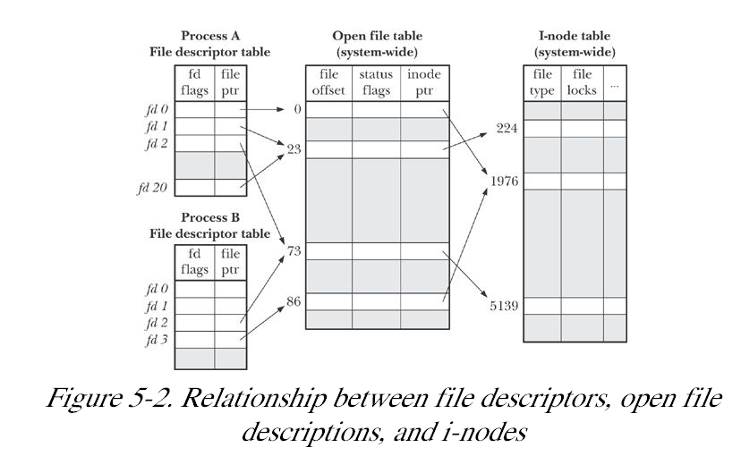
Figure 5.2
.
Kerrisk, TLPI 2011, O”Reilly (Kindle)

Slide 19
Pread, pwrite
PREAD(2) Linux Programmer's Manual PREAD(2)
NAME
pread, pwrite - read from or write to a file descriptor at a given offâ[m
set
SYNOPSIS
#define _XOPEN_SOURCE 500
#include <unistd.h>
ssize_t pread(int fd, void *buf, size_t count, off_t offset);
ssize_t pwrite(int fd, const void *buf, size_t count, off_t offset);

Slide 20
pread() is equivalent to atomically equiv.
off_t orig;
orig = lseek( fd, 0, SEEK_CUR); /* Save current offset */
lseek( fd, offset, SEEK_SET);
s = read( fd, buf, len);
lseek( fd, orig, SEEK_SET); /* Restore offset */
Kerrisk, TLPI 2011, O”Reilly (Kindle)

Slide 21
Unix for 100
Not really Unix
Harvard Grad Applied Math PhD
Howard Aiken advisor
"Adding manpower to a late software project makes it later.“
Mythical Man Month
IBM 360, OS/360
Research on virtual environments

Slide 22
READV(2) Linux Programmer's Manual READV(2)
NAME
readv, writev - read or write data into multiple buffers
SYNOPSIS
#include <sys/uio.h>
ssize_t readv(int fd, const struct iovec *iov, int iovcnt);
ssize_t writev(int fd, const struct iovec *iov, int iovcnt);
….
struct iovec {
void *iov_base; /* Starting address */
size_t iov_len; /* Number of bytes to transfer */
};

Slide 23
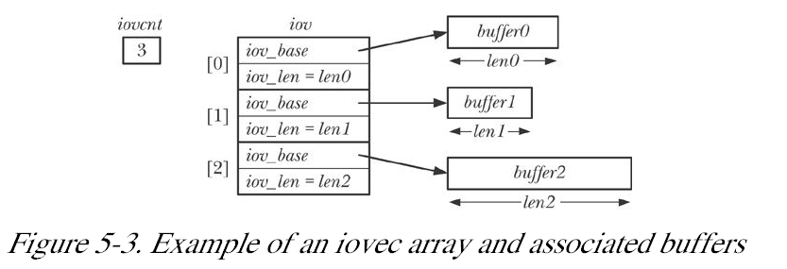
struct iovec {
void *iov_base; /* Starting address */
size_t iov_len; /* Number of bytes to transfer
};

Slide 24
fileio/t_readv.c

Slide 25
truncate()
man truncate – woops section 1
TRUNCATE(2) Linux Programmer's Manual TRUNCATE(2)
NAME
truncate, ftruncate - truncate a file to a specified length
SYNOPSIS
#include <unistd.h>
#include <sys/types.h>
int truncate(const char *path, off_t length);
int ftruncate(int fd, off_t length);

Slide 27
I/O on large files
off_t where is it defined?
32 bit integer ➔ file size limited to 2³² – 1
2GB actual limit
open64 = O_LARGEFILE

Slide 28
~/.bash_profile
PATH=$HOME/bin:${PATH}:-/usr/bin:. # list of directories separated by colons
PATH=${PATH}:/acct/f1/matthews/ToAndFromWindows/ResearchUW/GraphsUW/nauty24
LD_LIBRARY_PATH=/usr/local/ssl/lib:/usr/local/lib:/usr/local/3rdparty/lib:.
export LD_LIBRARY_PATH
tset -I -Q
PS1="`hostname`> “
c5=/class/csce510-001/

Slide 29
I/O files with holes revisited :
more $c5/Examples/hole.c
/* derived from APUE with chains broken */
…
char buf1[] = "abcdefghij";
…
main(void){
int fd;
if ((fd = creat("file.hole", FILE_MODE)) < 0)
err_sys("creat error");
if (write(fd, buf1, 10) != 10) /* offset now = 10 */
err_sys("buf1 write error");
if (lseek(fd, 16384, SEEK_SET) == -1) /* offset now = 16384 */
if (write(fd, buf2, 10) != 10)
err_sys("buf2 write error");
…

Slide 30
The /dev/fd directory
fd = open("/ dev/ fd/ 1", O_WRONLY);
fd = dup( 1); /* Duplicate standard output*/
sleep(30)
/dev/stdin
/dev/stdout
/dev/stderr

Slide 31
Creating temporaries
hermes> cat > /tmp/mmmjunk
Lkjklsfjkljsafkl
^D
hermes> ls -l !$
ls -l /tmp/mmmjunk
-rw-r--r-- 1 matthews faculty 17 2013-01-28 15:01 /tmp/mmmjunk
hermes>
x

Slide 32
MKSTEMP(3) Linux Programmer's Manual MKSTEMP(3)
NAME
mkstemp, mkostemp - create a unique temporary file
SYNOPSIS
#include <stdlib.h>
int mkstemp(char *template);
int mkostemp (char *template, int flags);

Slide 33
TMPFILE(3) Linux Programmer's Manual TMPFILE(3)
NAME
tmpfile - create a temporary file
SYNOPSIS
#include <stdio.h>
FILE *tmpfile(void);
DESCRIPTION
The tmpfile() function opens a unique temporary file in binary
read/write (w+b) mode. The file will be automatically deleted when
it is closed or the program terminates.

