Slide 1

CSCE 510 - Systems Programming
Lecture 02 - System Calls

Slide 2
Overview
Last Time
  Outback
Readings for today
  Text Chapter 2, 3, 18.8, 15.1
  /class/csce510-001/Code/TLPI
Prologue
  Fundamental Unix/systems programming (Chap 2) continued
Interlude - Course Pragmatics, CS man of the day, Quiz
Epilogue
  System Calls
  Directories
  Stat system call for information on files

Slide 3
Overview Continued – Chapter 2
Shell revisited
2.6 Programs
2.7 Processes
2.8 Memory Mappings
2.9 Static and Shared Libraries
2.10 Interprocess Communication and Synchronization
2.11 Signals
2.12 Threads
2.13 - 2.19 Other Topics

Slide 4
Shell revisited
Print prompt
→ Read command
→ Substitutions
→ Fork/Exec
→Wait - get return (exit) status
Repeat
Substitutions
  Wildcards, Filename completion, alias subs., history, cmd substitution
I/O redirection
  Filter a program that reads stdin writes stdout
  ls –l > listing
  grep Unix | wc

Slide 5
File I/O Model
  One of the distinguishing features of the I/O model on UNIX systems is the concept of universality of I/O.
  This means that the same system calls:
    open(), read(), write(), close(),
    used to perform I/ O on all types of files, including devices.
    File descriptors 0 – stdin, 1 – stdout, 2 – stderr unless remapped
  Stdio Library
    FILE *fp = fopen(“filename, “w+”)
The Linux Programming Interface - Kerrisk

Slide 6
Programs
Source files
.c, .cpp, .y, .py, .rb …
Object modules
Executables
Ar archives
Scripts
  Shell scripts, perl, python, ruby,
gcc –c prog.c -lm
gcc –S prog.c
gcc prog.c

Slide 7
Processes
fork()- creates processes
Parent, Child
_exit(), exit(), wait()
init, scheduler
ps, kill
Memory Layout
Memory Layout of a Unix Process
Environment, command line args
Stack
Heap
Shared Libraries
Heap
Bss: Global Data
Text Segment

Slide 8
Memory Mappings

Slide 9
Static and Shared Libraries
Static Libraries
  gcc –O2 -Wall prog.c –lm
  ar t /usr/lib/libm.a | less
Shared Libraries
.so

Slide 10
Interprocess Communication and Synchronization
Signals
Pipes
Sockets
File locks
IPC: semaphores, shared memory, msgqueues

Slide 11
Signals

Slide 12
Threads

Slide 13
/proc
“an interface to kernel data structures in a form that looks like files and directories”
/proc/pid - directory of info about running process
  /proc/1 – information on init
/proc/cpuinfo

Slide 14
Other Topics from Chapter 2
2.13 Process Groups and Shell Job Control
2.14 Sessions, Controlling Terminals, and Controlling Processes
2.15 Pseudoterminals
2.16 Date and Time
2.17 Client-Server Architecture
2.18 Realtime
2.19 The /proc File System

Slide 15
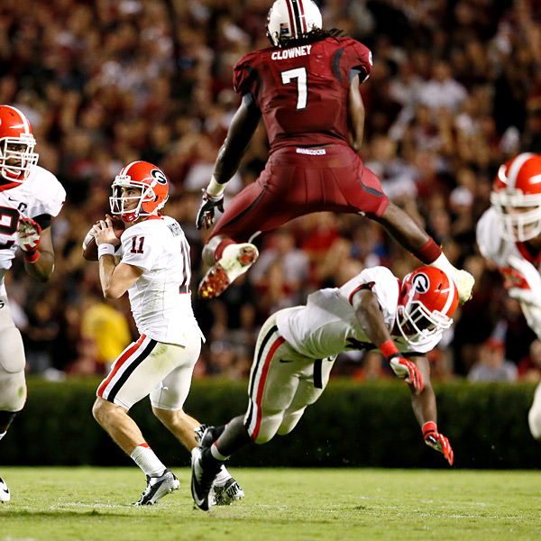
Intermission
Unix Jeopardy
System Calls
Directories 18.8
HW 1
Program 1

Slide 16
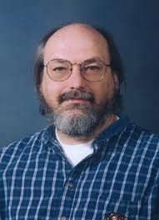
Unix for 100
UC Berkeley Grad
“You can't trust code that you did not totally create yourself.”
“I wanted to avoid, special IO for terminals.”
B
the chess machine Belle
Turing Award
ken@google.com
Unix

Slide 17
Lions Book
http://www.lemis.com/grog/Documentation/Lions/index.php
Commentary on the 6th Edition of Unix

Slide 18
HW -1
More than a hint http://computer.howstuffworks.com/c38.htm
  Name the program args.c
  Args.py
No hints

Slide 19
Args.py
#!/usr/bin/python
import sys
print sys.argv[1:]

Slide 20
2nd Half
3.1 System Calls
3.2 Library Functions
3.3 The Standard C Library; The GNU C Library (glibc)
3.4 Handling Errors from System Calls and Library Functions
3.5 Notes on the Example Programs in This Book
3.5.1 Command-Line Options and Arguments
3.5.2 Common Functions and Header Files
3.6 Portability Issues
18.8 Directories
15.1 Stat system call to retrieve file information

Slide 21
3.1 System Calls
A controlled entry point into the kernel
Allows process to request the kernel to do something
Switches from user mode to kernel mode

Slide 22
Errors on System Calls
fd = open( pathname, flags, mode); /* system call to open a file */
if (fd = = -1) {
/* Code to handle the error */
}
...
if (close( fd) = = -1) {
/* Code to handle the error */
}
-1, NULL, errno, perror()

Slide 23
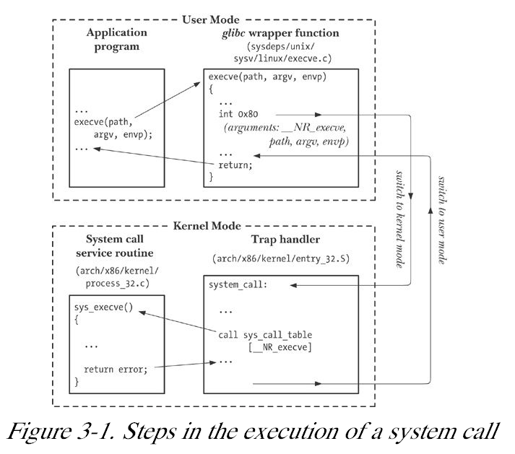
Fig 3.1 Execution of System Call
.

Slide 24
3.2 Library Functions

Slide 25
3.3 The Standard C Library

Slide 26
The GNU C Library (glibc)
http:// www.gnu.org/ software/ libc/
Determining the version of glibc on the system
/lib/ libc.so. 6
lld - list dynamic dependencies
#include < gnu/ libc-version.h >
const char *gnu_get_libc_version( void);

Slide 27
Example 3-1. Header file for TLPI programs
lib/ tlpi_hdr.h
#ifndef TLPI_HDR_H
#define TLPI_HDR_H /* Prevent accidental double inclusion */ #include < sys/ types.h > /*Type defs used by many programs*/ #include < stdio.h > /* Standard I/ O functions */
#include < stdlib.h > /* Prototypes of commonly used library functions, plus EXIT_SUCCESS and EXIT_FAILURE constants */ #include < unistd.h > /* Prototypes for many system calls */ #include < errno.h > /* Declares errno and defines err constnts*/
Kerrisk, Michael (2011-02-11). The Linux Programming Interface: A Linux and UNIX System Programming Handbook (Kindle Locations 3610-3617). O'Reilly Distribution. Kindle Edition.

Slide 28
#include < string.h > /*Common string-handling functions */
#include "get_num.h" /* Declares our functions for handling numeric arguments (getInt(), getLong()) */
#include "error_functions.h" /* Declares our error-handling functions */
typedef enum { FALSE, TRUE } Boolean;
#define min( m, n) (( m) < (n) ? (m) : (n))
#define max( m, n) (( m) > (n) ? (m) : (n))
#endif lib/ tlpi_hdr.h
Kerrisk, Michael (2011-02-11). The Linux Programming Interface: A Linux and UNIX System Programming Handbook (Kindle Locations 3617-3622). O'Reilly Distribution. Kindle Edition.

Slide 29
3.5.1 Error-diagnostic functions
Example 3-2. Decl for common error-handling funcs
lib/ error_functions.h
#ifndef ERROR_FUNCTIONS_H
#define ERROR_FUNCTIONS_H
void errMsg( const char *format, ...);
#ifdef __GNUC__ /* This macro stops 'gcc -Wall' complaining that "control reaches... */
#define NORETURN __attribute__ ((__noreturn__))
#else
#define NORETURN
#endif void errExit( const char *format, ...) NORETURN ;
void err_exit( const char *format, ...) NORETURN ;
void errExitEN( int errnum, const char *format, ...) NORETURN ;
void fatal( const char *format, ...) NORETURN ;
void usageErr( const char *format, ...) NORETURN ;
void cmdLineErr( const char *format, ...) NORETURN ;

Slide 30
3.5 Notes on the Example Programs from Text

Slide 31
18.8 Reading Directories
opendir(), readdir()
#include < dirent.h >
DIR *fdopendir( int fd);
struct dirent *readdir( DIR *dirp);
struct dirent {
ino_t d_ino; /* File i-node number */
char d_name[]; /* name of file */
};

Slide 32
errno = 0;
direntp = readdir( dirp);
if (direntp = = NULL) {
if (errno != 0) {
/* Handle error */
} else {
/* We reached end-of-directory */
}
}

Slide 33
/class/csce510-001/Code/TLPI
tar xvfz tlpi-121015-dist.tar.gz // the code from text
hermes> ls
tlpi-121015-dist.tar.gz tlpi-dist
cd tl<TAB>
Ls
hermes> ls
acl getopt pmsg svmsg
…
daemons Makefile.inc.MacOSX pshm tty
dirs_links Makefile.inc.Solaris pty users_groups
…
files pgsjc sockets
filesys pipes svipc

Slide 34
TLPI/dirs_links
cd dir_links
ls
bad_symlink.c
list_files_readdir_r.c
t_dirbasename.c
file_type_stats.c
Makefile
t_unlink.c
list_files.c
nftw_dir_tree.c
view_symlink.c

Slide 35
more list_files_readdir_r.c

Slide 36
Example 18-2. Scanning a directory

Slide 37
Stat structure
struct stat {
dev_t st_dev; /* ID of device containing file */
ino_t st_ino; /* inode number */
mode_t st_mode; /* protection */
nlink_t st_nlink; /* number of hard links */
uid_t st_uid; /* user ID of owner */
gid_t st_gid; /* group ID of owner */
dev_t st_rdev; /* device ID (if special file) */
off_t st_size; /* total size, in bytes */
blksize_t st_blksize; /* blocksize for file system I/O */
blkcnt_t st_blocks; /* number of 512B blocks allocated */
time_t st_atime; /* time of last access */
time_t st_mtime; /* time of last modification */
time_t st_ctime; /* time of last status change */
};

Slide 38
st_mode macros
S_ISREG(m) is it a regular file?
S_ISDIR(m) directory?
S_ISCHR(m) character device?
S_ISBLK(m) block device?
S_ISFIFO(m) FIFO (named pipe)?
S_ISLNK(m) symbolic link? (Not in POSIX.1-1996.)
S_ISSOCK(m) socket? (Not in POSIX.1-1996.)

Slide 39
st_mode Flags
ls /usr/include/sys
…
less /usr/include/sys/stat.h
… pages of stuff
#define S_IRUSR __S_IREAD /* Read by owner. */
#define S_IWUSR __S_IWRITE /* Write by owner. */
#define S_IXUSR __S_IEXEC /* Execute by owner. */
…
#define S_IRGRP (S_IRUSR >> 3) /* Read by group. */

